Slide 1

Song Topic Presentation
Exercise Motivation
Through
Strong Warning Messages
Lee Insung and Friends
Lee Minjae · Lee Yeongu · Lee Insung · Lee Hayul
Notes:
Good morning everyone. Today, our team — Lee Insung and Friends — will introduce our project: a song about exercise motivation, built around a strong warning message. The members are Lee Minjae, Lee Yeongu, Lee Insung, and Lee Hayul. Let's get started.

Slide 2

Listen to the Song
“Kids Who Exercise” (운동하는 아이들) · Music & Lyrics by insung20402 · Created with Suno AI
▶ Click to Play the Song
VERSE 1
Wake up early in the morning light
I should eat some veggies, make it right
No breakfast, no success,
study's struggle nothing less
CHORUS
Let's go take a walk outside
Exercise every day, feel the pride
Healthy habits make me strong
Singing this happy morning song!
VERSE 2
I should move my body every day
Eating a good breakfast is the way
Let's jump and run under the sun
Healthy life is so much fun!
BRIDGE
Sometimes it is hard to do
But it is good for me and you
Step by step and day by day
We can chase the lazy away!
Notes:
Before we explain the idea behind our project, let's listen to the song itself. This song is called "Kids Who Exercise," written and composed by our team using Suno AI. Notice how the song moves from a warning about not exercising to an energetic, positive message about moving every day. (Play the song now.)

Slide 3
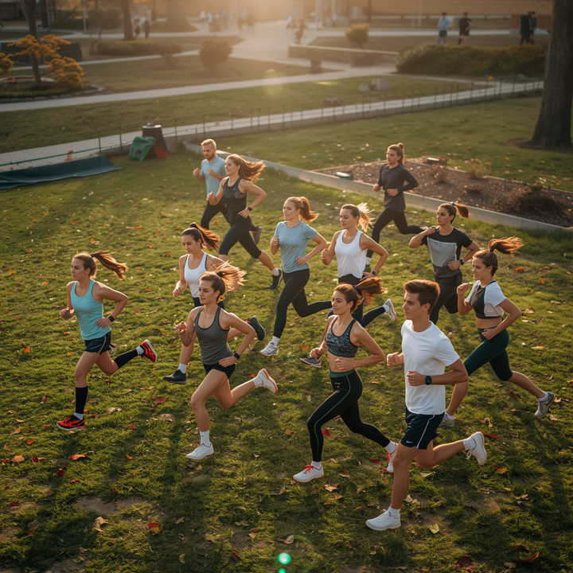
Lee Insung and Friends
Song Introduction
It gives motivation for exercise through a strong warning message.
🎵
This song is about exercise. It uses a strong warning message to make people move. The message is, 'If you do not move, tomorrow will be worse.' It shows why exercise is important.
Exercise helps our body and mind. It improves fitness, mental health, and daily life. Please think about the importance of exercise with this song.
"If you do not move, tomorrow will be worse."
Notes:
So, what is this song about? This song is about exercise. It uses a strong warning message to make people want to move. The core message is: "If you do not move, tomorrow will be worse." Through this idea, the song shows why exercise is so important. Exercise helps both our body and our mind — it improves fitness, mental health, and our daily life. We hope this song makes you think about the importance of exercise, and gives you motivation to move through a strong, honest warning.

Slide 4
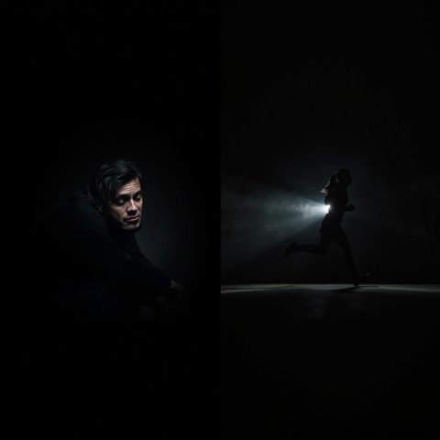
Meaning and Examples of Strong Warning Messages
"If you do not move, tomorrow will be worse" — A message that leads people to act
⚠️
What happens without exercise: low fitness, low energy, and poor health
"Move now, or your future will be worse."
No Exercise vs Exercise — A clear contrast that gives motivation
A strong warning message can make people act by showing a real problem. The message, 'Move now or your future will be worse,' shows why exercise is needed.
Notes:
Now let's look more closely at what we mean by a "strong warning message." Our key phrase is: "If you do not move, tomorrow will be worse." This is a message designed to lead people to action. We also looked at what happens when people don't exercise — low fitness, low energy, and poor health. By placing "No Exercise" next to "Exercise," we create a clear contrast that motivates people to choose the healthier path. A strong warning message works because it shows a real problem. Saying "Move now, or your future will be worse" makes the need for exercise feel urgent and personal.

Slide 5

Song Topic Presentation - Lee Insung and Friends
Negative Effects
Lack of exercise has serious effects on health and daily life.
Low Fitness and Disease Risk
Worse Mental Health
Lower Quality of Life
Lack of exercise makes muscles and heart health weaker. It also increases the risk of obesity, diabetes, and heart disease.
Not being active can increase stress, anxiety, and sadness. It can also reduce sleep quality.
People may feel tired, lose focus, and enjoy daily life less.
Notes:
Let's talk about the negative effects of not exercising. First, low fitness and disease risk: lack of exercise weakens our muscles and heart health, and increases the risk of obesity, diabetes, and heart disease. Second, worse mental health: being inactive can increase stress, anxiety, and sadness, and it can reduce our sleep quality. Third, lower quality of life: without exercise, people may feel tired, lose focus, and enjoy daily life less. In short, a lack of exercise has serious effects on both our health and our daily life — and that's exactly the warning our song is sending.

Slide 6
Lee Insung and Friends
Team Members
📝
🎨
🎤
🎵
Lee Minjae
Script Writer
Lee Yeongu
PPT & Design Lead
Lee Insung
Presenter & Design
Lee Hayul
Team Leader & Composer
Wrote the full presentation script.
Built the slides and led the visual design.
Delivered the presentation and supported the design.
Led the team and composed the song with Suno AI.
Notes:
Here is our team. Lee Minjae wrote the full presentation script. Lee Yeongu built the slides and led the visual design. Lee Insung delivered the presentation and supported the design work. And Lee Hayul, our team leader, composed the song using Suno AI. Together, we combined writing, design, presentation, and music to bring this project to life.

Slide 7

Lee Insung and Friends
Key Message Summary
Warning is the start. Exercise is the first step to change.
🏃
"Move today for a better tomorrow."
Change starts when we face reality. If we do not exercise, our health can get worse. But one small step today can change tomorrow.
Start moving now. Small actions make a healthy life!
"Move today for a better tomorrow."
Notes:
So here is our key message: "Move today for a better tomorrow." Change starts when we face reality. If we don't exercise, our health can get worse over time. But one small step today can change tomorrow. We want everyone to start moving now — small actions can build a healthy life. Remember: the warning is the start, but exercise is the first step to real change.

Slide 8

Lee Insung and Friends
The end
Let us move together and make a healthy tomorrow!
Lee Minjae · Lee Yeongu · Lee Insung · Lee Hayul
Song Topic Presentation
Warning is the Start, Exercise is Change
Notes:
Thank you for listening. Let's move together and make a healthy tomorrow! Once again, our team is Lee Minjae, Lee Yeongu, Lee Insung, and Lee Hayul. Remember our message: warning is the start, exercise is the change. Thank you!

