Slide 1
Cybersecurity Compliance and Reporting Platform
Interim Report Presentation
June 2025

Slide 2
Agenda
Project Overview Recap
Interim Report
Progress to Date
Challenges and Solutions
Next Steps
Notes:
This is the agenda for today's interim report presentation.

Slide 3


Project Overview Recap
This project aims to create a centralized platform to assist and streamline cybersecurity incident reporting and compliance.
The main objectives include the following:
Facilitate users to submit information on cyber security incidents.
Generate standardized incident reports
Store the submitted reports securely
Enable objective severity evaluation of the incident
Assess the requirement for notifying the regulator and send notification if necessary.
Provide mitigation and prevention advice by aligning the submitted report with relevant guidelines.
Notes:
Let's start with a quick recap of the project.
Our project aims to develop a centralized platform for assisting organizations in Hong Kong to streamline incident reporting and compliance.
The main objectives include:
Simplifying the reporting process to allow users to quickly submit information about cybersecurity incidents
Enabling automatic generation of standardized reports for submission to various regulatory bodies
Ensuring secure data storage to protect the confidentiality of the submitted information
Implementing an objective severity evaluation model to eliminate inconsistencies
Assessing whether an incident necessitates regulatory notification and deciding the regulatory body to notify
And finally, matching the submitted information with the latest guidelines and standards to provide customized mitigation and prevention advice

Slide 4
Progress to Date - Summary
Background Research (95% complete)
Compliance and Reporting Review (completed)
Severity Classification and Reporting Path Recommendation Designs (80% complete)
Development Methodology Enhancement (completed)
Platform Development (60% complete)
Core Component | Status | Progress | Breakdown
Input | On Schedule | 80% complete | Development tools survey and selection (completed) Online form development and input field selection (completed) Severity Classification Model development (completed)
Frontend | On Schedule | 70% complete | Development tools survey and selection (completed) UI/UX design and development (90% complete) Web development: Settings and administration page (completed) Textual guide page (completed) Report creator page (60% complete) Report viewer/editor page (60% complete) LLM advisor page (0% complete)
Backend | On Schedule | 80% complete | Development tools survey and selection (completed) Architecture design (completed) Backend development: Settings and administration (completed) Incident report database (90% complete) Knowledge graph (0% complete)
Report | On Schedule | 60% complete | Development tools survey and selection (completed) Report viewer/editor development (90% complete) Reporting Path Recommendation Model (50% complete) Regulator notification function development (30% complete)
Advice | On Schedule | 20% complete | Development tools survey and selection (completed) LLM advisor development (0%)
Notes:
We are pleased to report that the project is progressing smoothly, with all tasks currently on schedule.
The background research is nearly complete and has resulted in three key accomplishments:
We conducted an in-depth review of relevant literature to ensure our development aligns with latest regulatory guidelines, reporting requirements, and industry standards.
Leveraging insights from our literature review, we have nearly finalized designing the rules for severity classification and reporting path recommendation.
We refined our development methodology by focusing more on delivering value to the user.
The platform development is approximately 60% complete and the progress overview is shown in this table.
In the slides that follow, we will present a more in-depth analysis of the progress across each part of the project.

Slide 5
Progress to Date – Background Research
Compliance and Reporting Review
Surveyed over 40 references including cybersecurity regulations and guidelines in Hong Kong, as well as international industry standards.
Highlighted 8 critical industries including Energy, Information Technology, Banking and Financial Services, Air Transport, Land Transport, Maritime Transport, Healthcare Services, and Telecommunications and Broadcasting Services.
Reviewed compliance and reporting requirements across industries, identifying gaps in the current processes, including those below.
Reporting: Lack of clarity on how to define “material”, “serious” or “significant” which might have led to underreporting.
Compliance: Misinterpretation of incidents and authority of different regulators hinders effective regulatory compliance.
Fragmentation: The absence of a centralized platform for incident reporting and compliance guidance results in opacity and inefficiencies
Our insights into the cybersecurity compliance and reporting landscape justify the importance of developing the Cybersecurity Compliance and Reporting Platform.
Formulated severity classification model to assist users in evaluating the incidents and to decide whether an incident is of a “material”, “serious” or “significant” nature in a standardised way with Reporting Path Recommendation Model to identify the governing parties to be notified.
Notes:
We performed a comprehensive review of literature related to cybersecurity compliance and reporting, and we surveyed over 40 references, including HK cybersecurity guidelines and regulations, as well as international standards
We identified 8 critical industries to focus on, including Energy, IT, Banking, Air Transport, Land Transport, Maritime Transport, Healthcare, and Telecommunications.
Through our review, we uncovered several gaps in the current processes:
These included Reporting gaps such as Ambiguities in definitions like “material” and “significant”, which can lead to underreporting of incidents.
Compliance gaps such as misinterpretations of incidents and the varying authority of regulators hinder effective compliance.
Fragmentation gaps such as the absence of a centralized platform that results in inefficiencies in incident reporting and compliance.
These findings highlight the need for the Cybersecurity Compliance and Reporting Platform.
Additionally, based on our insights, we developed a severity classification model to assist users in evaluating incidents and a reporting path recommendation model to identify the relevant authorities to notify.

Slide 6
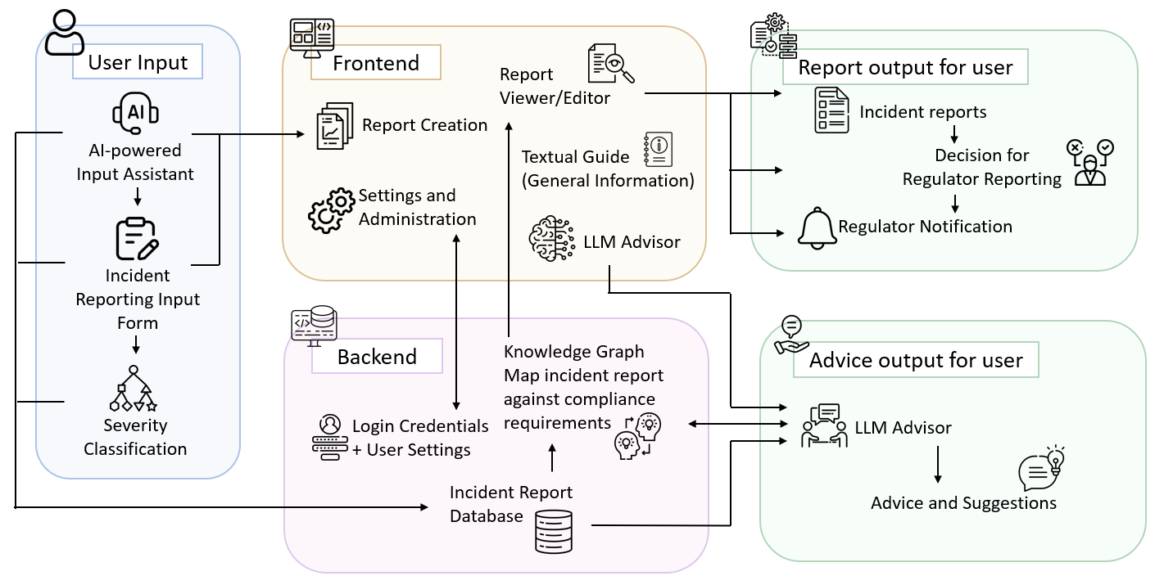
Progress to Date – Background Research
Development Methodology Enhancement
We refined the development framework by conducting a comprehensive feasibility review, allowing us to clearly define the core components, functionalities, inputs,and outputs.
Inputs
Consultant Reports
Incident Descriptions
Form Data
Output 2
Incident Report
Output 3
Regulator Notification
Output 4
Match Incident with Guideline
Output 5
Advice on Mitigation and Prevention
Output 1
Incident Severity
Notes:
We have conducted a comprehensive feasibility study of the development framework, which helped us clearly define the core components, functionalities, inputs and outputs of the platform.
The platform consists of five core components: Frontend, Backend, User Input, Report, and Advice.
The Frontend is the user's initial point of interaction. After logging in, users are directed to the homepage, where they can access five functionalities which are Report Creation, Report Viewer/Editor, Textual Guide, LLM Advisor, and Settings and Administration.
The Backend component manages server-side processes, including user credentials, settings, and data management.
The User Input allows users to input information about a cybersecurity incident. After selecting Report Creation, they have three options for inputting the information:
First, If a user has a cybersecurity consultant's report that doesn't meet the required format, they can upload it.
Secondly, If a user doesn't have cybersecurity consultant or expertise, they can draft a description of the incident and upload it.
In both cases, the AI-powered input assistant extracts key information and maps it to the relevant fields, pre-filling the input form where possible.
For the third option, users can input data directly into the form.
Once the input form is completed, a classification model outputs the severity classification of the incident, and the report is saved.
The Report component allows users to review and finalize their saved reports. After finalization, a decision model determines whether regulatory notification is necessary. If the user decides to notify the regulator a notification, it is automatically generated and sent to the appropriate regulator.
A more detailed explanation of the User Input and Report logic will be provided in the Incident Analysis Flow slide later.
The Advice component analyses the incident reports created by the users and provides tailored advice based on the government guidelines and industry standards. The advice includes matching the incident with relevant guidelines and standards, and recommendations for mitigation and prevention.

Slide 7
Progress to Date – Background Research
Development Methodology Enhancement
We incorporated the feedback from past progress updates and ensured each function delivers user value.
Component | Functions | Value
Frontend | User-centric UI that is both highly responsive and intuitive. | Enhanced usability
Backend | Backend architecture that supports multiple systems (Windows, Linux, Mac). Robust security to protect confidential incident report information. | Flexible access and high data security
User Input | Data input form for collection of essential information for severity analysis and regulator matching. Rule-based severity classification model that is aligned with the government guidelines and international standards. AI-powered input assistant that helps input information by extracting relevant information from consultant reports and incident descriptions. | Accurate incident input Speedy and consistent classification
Report | Standardized incident reports for different HK regulatory bodies. Rule-based reporting path recommendation model that is aligned with the reporting requirements of different regulatory bodies. | Simplified reporting and notification Reduced non-notification risk
Advice | LLM-based advisor that matches submitted incident with relevant government guidelines and provides advice on mitigation and prevention. Guardrails to prevent inappropriate output. | Matching guidelines Safe and reliable advice
Notes:
We have also incorporated the feedback from past progress updates to ensure each function in our platform delivers value to the user.
The Frontend component is designed to be an user-centric interface that is both highly responsive and intuitive, enhancing usability for all users.
The Backend component supports access from the multiple systems, including Windows, Linux and Mac, and provides robust security to protect confidential data, ensuring flexible access and strong data security.
The User Input component allows accurate and speedy input of incident information for regulatory reporting and severity analysis. Moreover, the rule-based severity classification model aligns with government guidelines to generate consistent classifications.
The Report component standardizes the reporting format to meet the requirements of various HK regulatory bodies, simplifying the reporting process and ensuring compliance.
The Advice component implements a LLM-based advisor that matches incident reports with relevant guidelines and provides actionable advice on mitigation and prevention.
In summary, our enhanced development methodology improves user experience and assists users to comply with the regulatory guidelines and standards.

Slide 8




Progress to Date – Platform Development
Development Tool Survey and Selection
We surveyed different development tools and selected the most effective option to optimize performance.
Frontend
Runtime Environment: Node.js enables fast, responsive web application development.
Dependency Manager: NPM (Node Package Manager) simplifies dependency management.
Framework: React.js allows building of user interfaces with a modular architecture that facilitates complex application management.
Backend
Framework: Django was selected based on below:
Easy to Learn: Built on Python, it is straightforward to pick up and code with.
Community Support: As the most popular backend framework, it has a large, active development community.
Database Integration: It's built-in ORM (Object-Relational Mapping) tool simplifies database integration.
Notes:
We evaluated various development tools to identify the most effective options for optimizing the platform's performance.
To develop the Frontend, we chose Node.js as the runtime environment because it enables fast and responsive web applications, which is essential for user experience. We are using NPM as our dependency manager as it simplifies the management of libraries and packages, making it easier to build modular applications. React is chosen as it allows creation of dynamic user interfaces with a modular architecture.
To develop the Backend, we selected Django based on its advantages including easy to learn, large community support and database integration. Django is built on Python, making it straightforward to learn and implement. Django also has large active development community, which helped us when we encountered difficulties during the development process. Additionally, the built-in ORM (Object-Relational Mapping) funcitonality simplifies database integration and management.

Slide 9



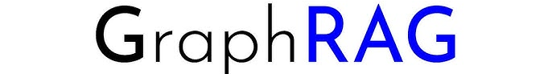


Progress to Date – Platform Development
User Input - AI-based Input Assistant
AI: DeepSeek-R1 can perform advanced language processing with less computational cost.
Platform: Ollama enables local deployment of LLMs and vector embedding models.
Framework: Langchain facilitates building applications with LLMs
Database: Chromadb enables efficient similarity searches and embedding vector storage
Advice – LLM Advisor
AI: DeepSeek-R1 provides powerful reasoning capabilities and low computational costs..
Platform: Ollama enables local deployment of LLMs and vector embedding models.
Framework and Knowledge Graph: GraphRAG enables effective multi-hop reasoning to connect incident reports to guidelines and standards.
Guardrails: NeMo enables implementation of rules to prevent inappropriate outputs to ensure the safety and reliability of the advice.
Notes:
To develop the AI-based Input Assistant, we selected DeepSeek R1 as our AI model due to its advanced language processing capabilities and low computational costs. For deployment, we will utilize Ollama, Langchain, and ChromaDB. These tools facilitate the efficient deployment of large language models and context vector embeddings.
The LLM Advisor operates similarly to the AI-based Input Assistant but analyses broader context. It must analyse extensive information, including incident reports, regulatory guidelines and industry standards. To effectively connect and analyse these information, the LLM Advisor will implement GraphRAG, which generates knowledge graphs to organize and link related data based on their relationships. This approach enables more accurate and context-aware analysis.
In addition to providing relevant advice, ensuring the safety and reliability of the advice is also very important. To achieve this, we will use NeMo, which offers pre-built tools to implement guardrails that prevent inappropriate or harmful outputs by establishing rules and constraints.

Slide 10
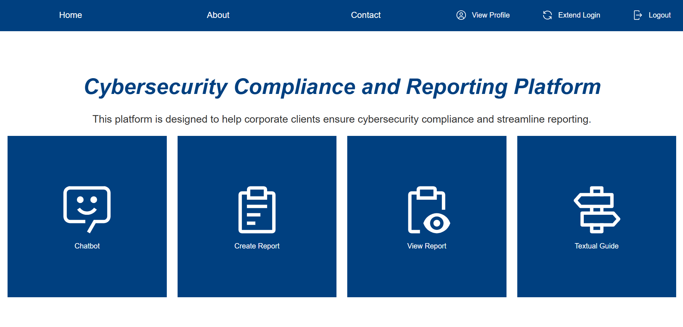
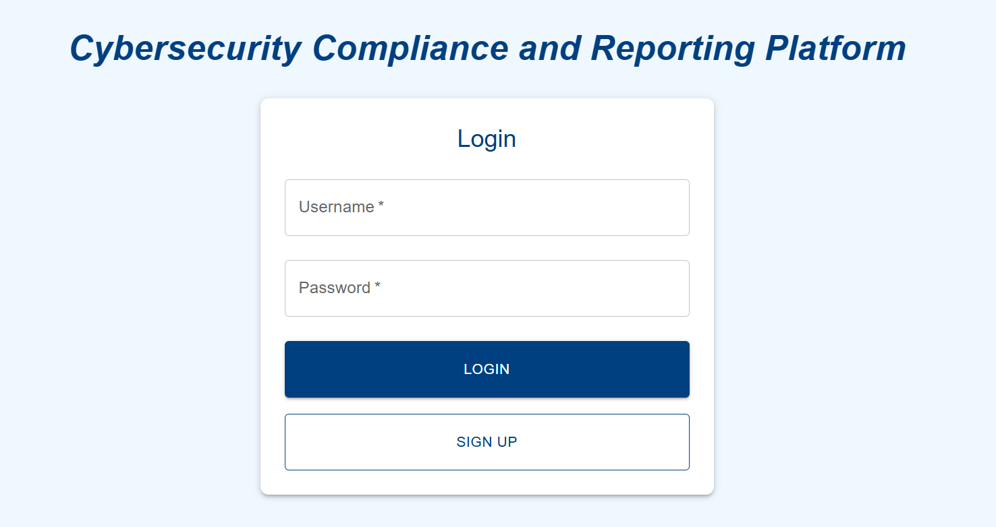
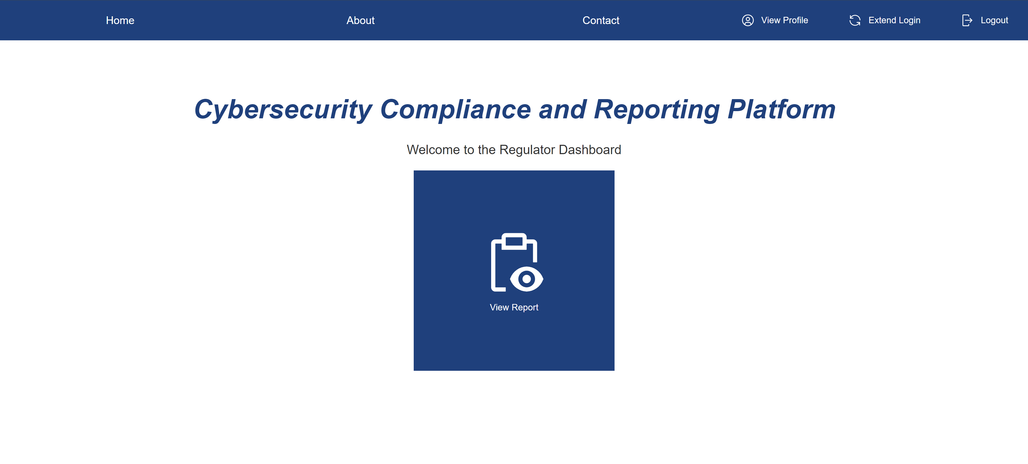
Progress to Date – Platform Development
Platform Development Showcase
Login Page
Home Page
Notes:
This section showcases the platfrom development progress.
The Login Page is the entry point to the platform where users authenticate their credentials by inputting their username and password. There are two different entry points, one for the normal users and another for the different regulators.
The Home Page is the landing point after the user logs into the platform. It serves as the central hub for quick navigation and access to the key functionalities.

Slide 11
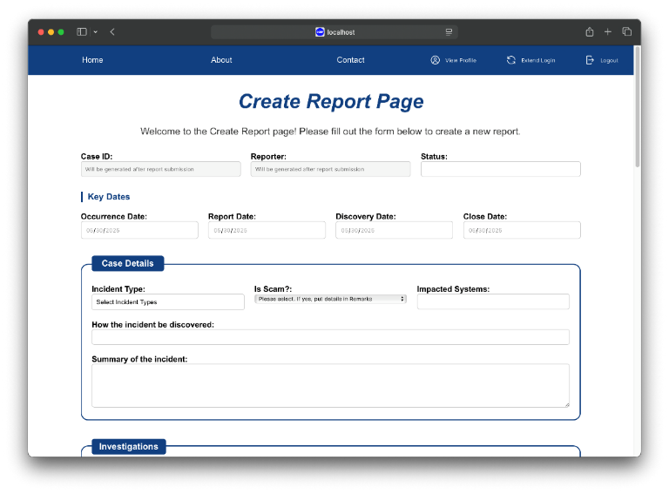
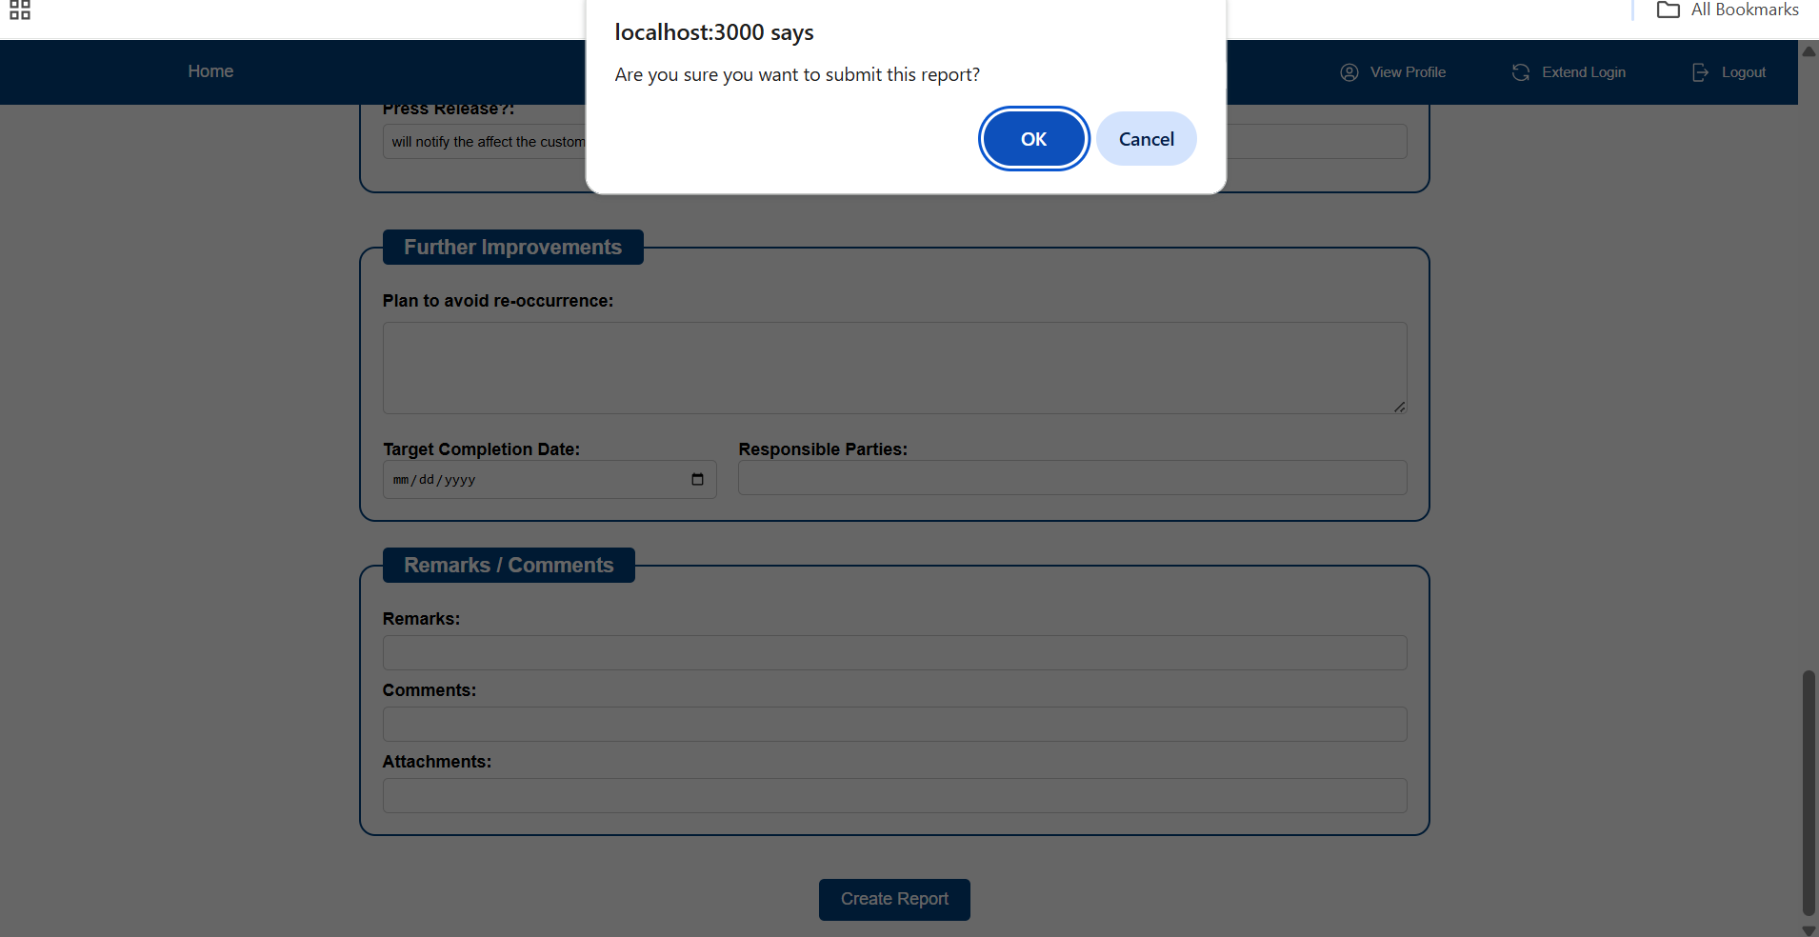
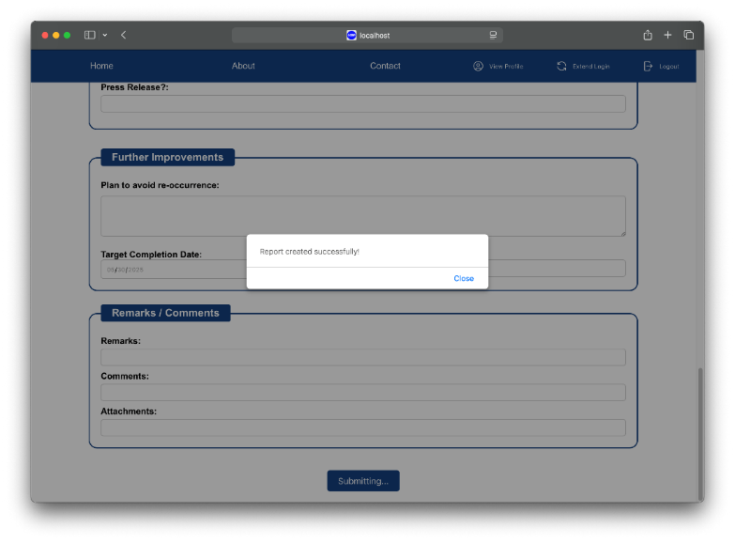
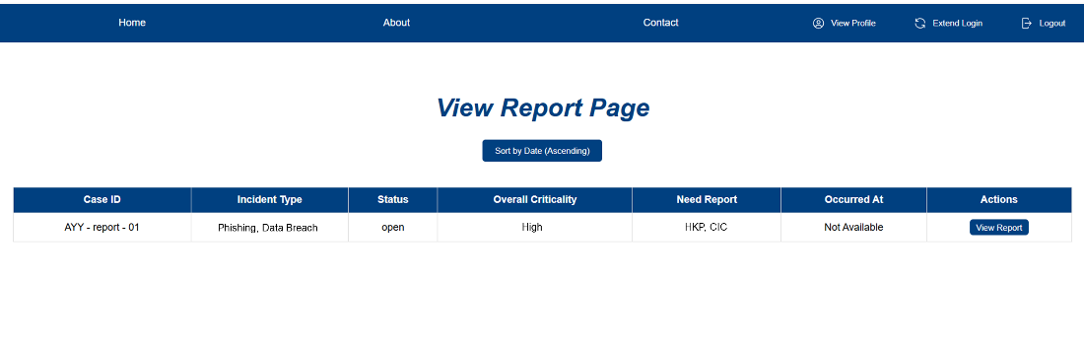
Progress to Date – Platform Development
Platform Development Showcase
Online Form
1
3
1. Online Form
2. Submit Report
3. Creation Success
4. List View
2
4
Notes:
The Online Form allows users to input detailed information about a cybersecurity incident. The input information will be stored in the incident report database and used by the severity classification and notification decision models.

Slide 12
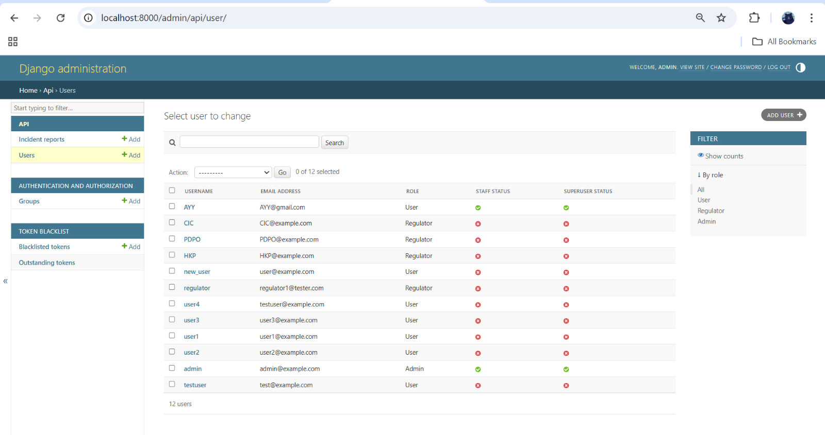
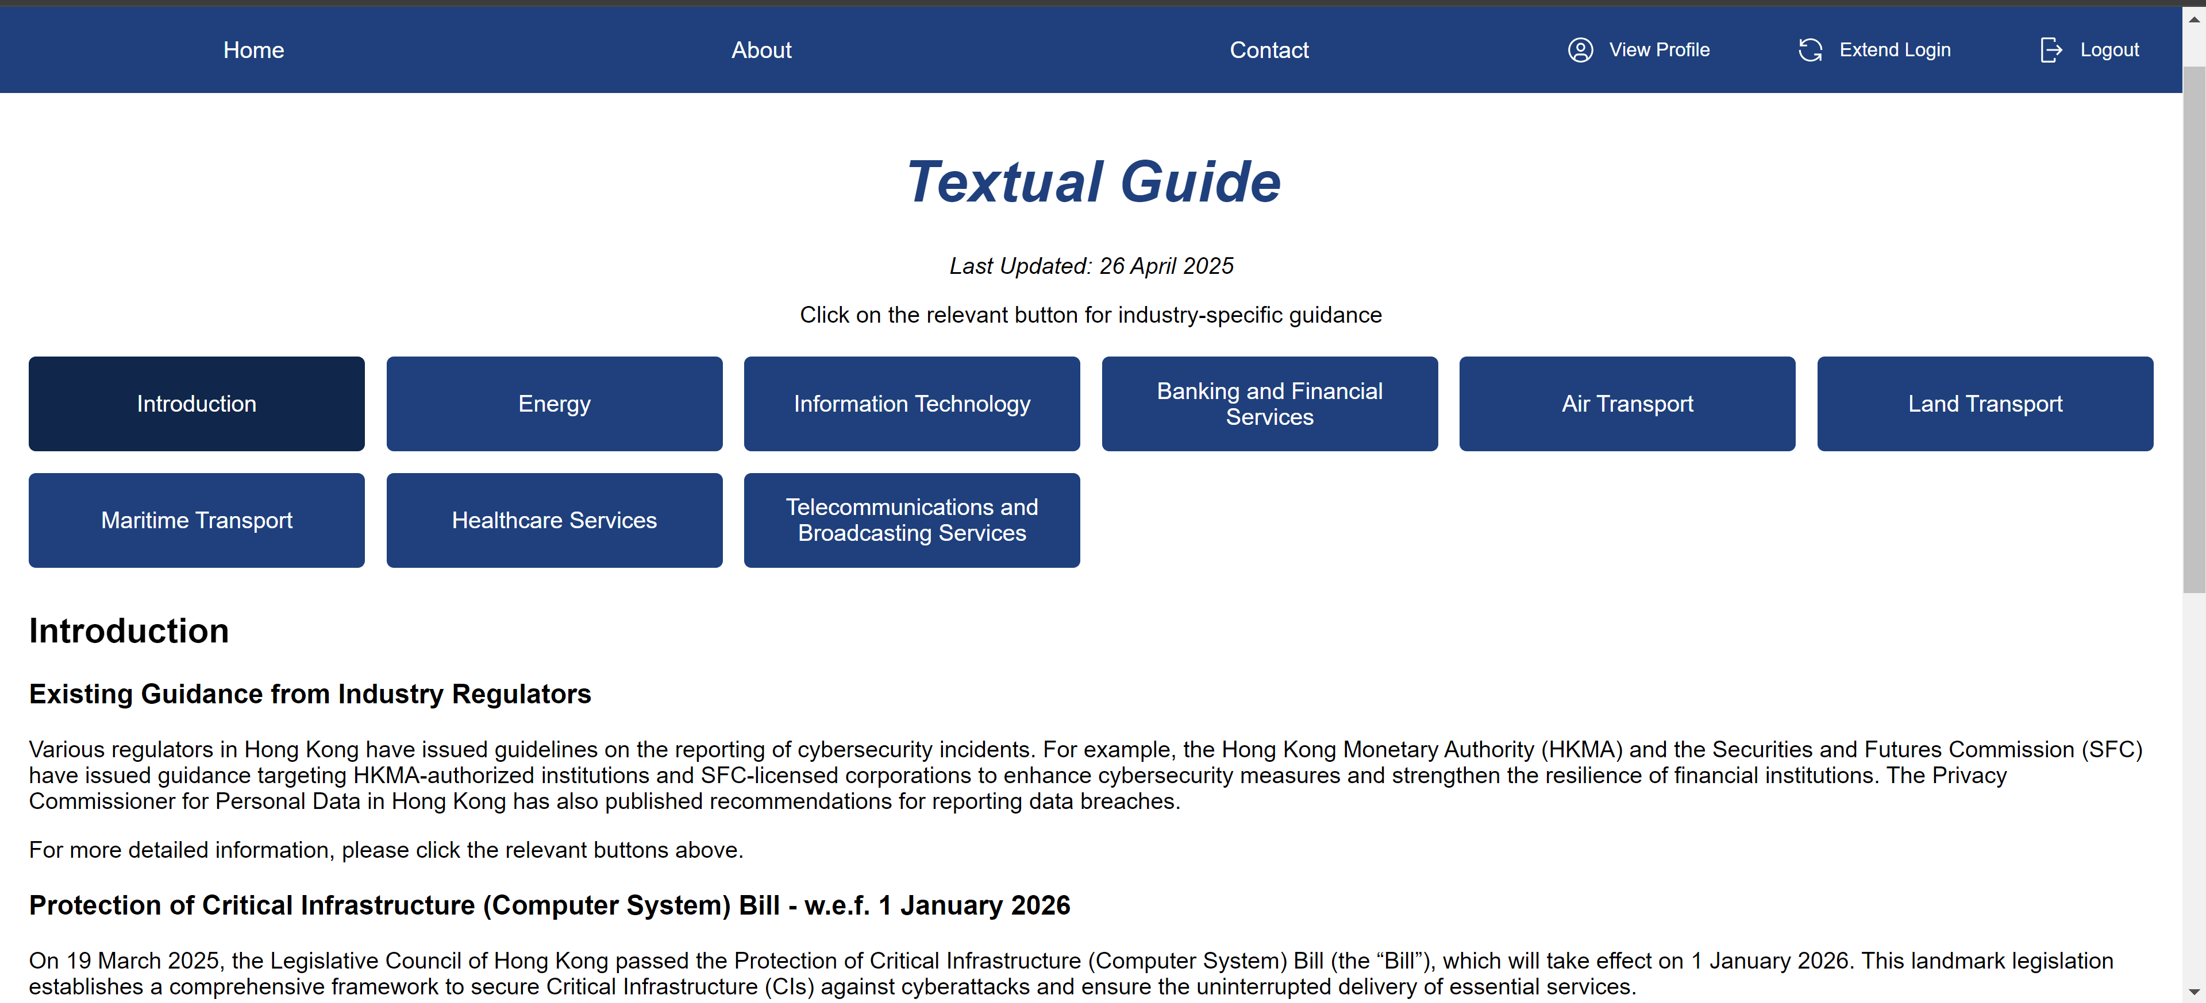
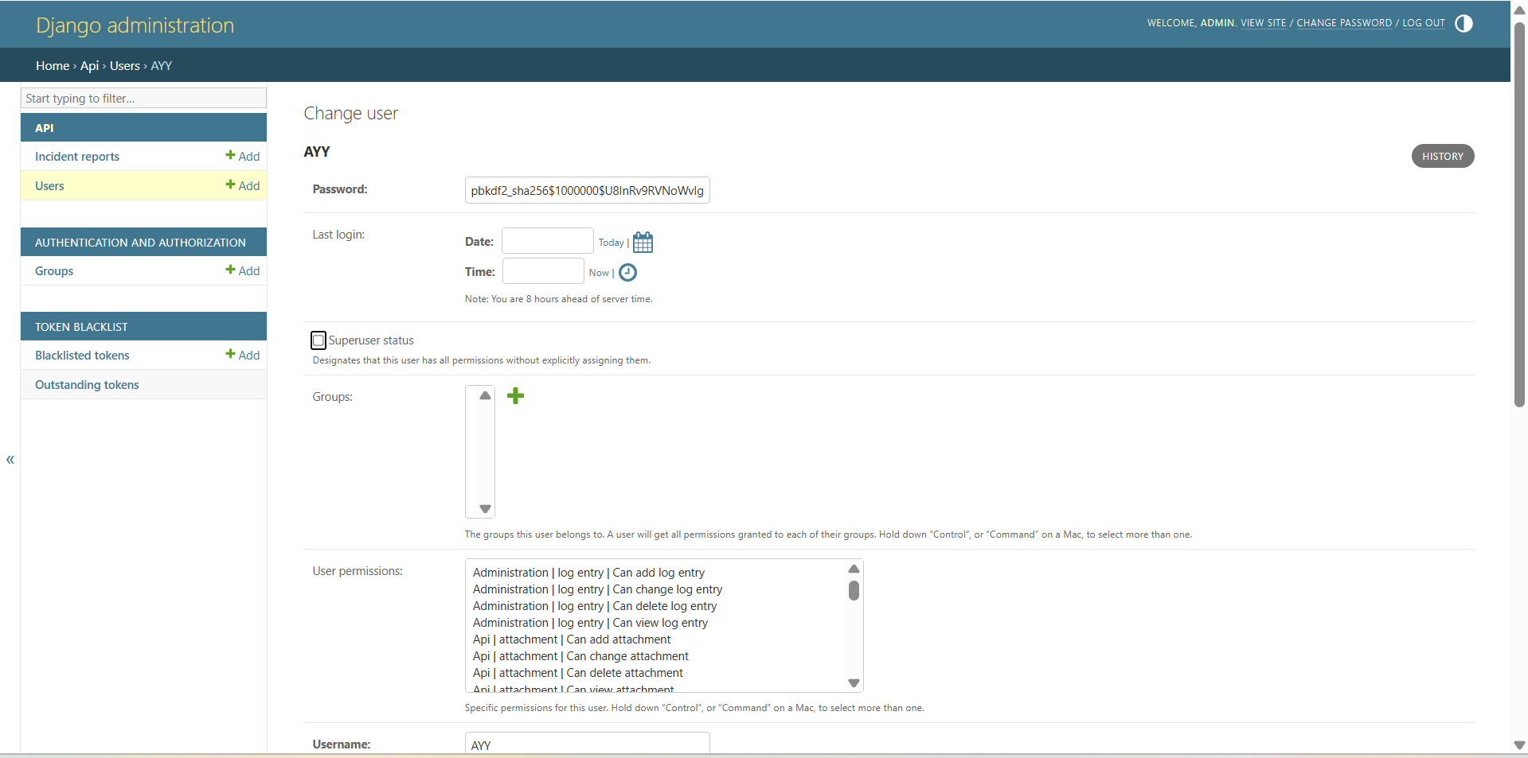
Progress to Date – Platform Development
Platform Development Showcase
Textual Guide
Administration
Notes:
The Textual Guide provides industry-specific cybersecurity guidance in a user-friendly manner.
The Administration page allows admin users to modify settings and login credentials.

Slide 13
Progress to Date – Incident Analysis Flow (tentative)
Start
User Inputs Data to the Form
Severity Classification
Is the Incident Severe Enough?
Yes
No
Report Created
Exit, Report remains on the Platform until deleted by User
Reporting Path Recommendation (on Regulator, Content and Timeline)
User Reviews Report and Recommendation
Report or Not?
No
Yes
User Notifies Selected Regulator
Exit, Report remains on the Platform until deleted by User
End, Report accessible by Selected Regulator
Notes:
The Incident Analysis Flow is shown on this slide.
The process begins when a user inputs data into the incident reporting form.
The system then evaluates the severity of the incident. If the incident is not severe enough, the process exits here. If it is severe enough, the process proceeds.
Once the incident is deemed severe, a report is created.
The system provides recommendations tailored to the incident. These include guidance on the appropriate regulatory body, the content of the report, and submission timelines.
Next, the user reviews the report and the system's recommendations. At this stage, the user decides whether or not to proceed with reporting.
If the user opts to report, the platform notifies the selected regulator, and the report is accessible to them.
If the user decides not to report, the process exits, but the report remains on the platform for future reference or until the user deletes it.

Slide 14
Challenges and Solutions
Severity Classification and Reporting Related Challenges and Solutions
Subjectivity of Severity Classification:
A key challenge we encountered was the subjectivity in classifying cybersecurity incident severity. Reliance on individual interpretation can lead to inconsistencies, hindering decision-making and effective incident response.
Solution: We researched and aligned our framework with Hong Kong government guidelines and global standards. We created a structured severity classification model that considers operational disruption, the number of affected individuals, financial impact, and data leakage. This standardization ensures consistent and transparent severity ratings across different incidents and user groups.
Diverse Reporting Requirements Across Regulators
Hong Kong’s different regulators have different cybersecurity reporting rules and regulations, making it impractical to cover all sectors in this project.
Solution: We decided to focus on eight key industries: Energy, IT, Banking and Financial Services, Air, Land, and Maritime Transport, Healthcare, and Telecommunications/Broadcasting. This targeted approach ensures effective solutions aligned with the specific expectations of the relevant regulatory bodies.
Notes:
When developing our platform, we encountered various challenges and proposed solutions to address them.
This slide outlines the challenges and solutions related Severity Classification and Reporting.
The first challenge relates to the subjectivity of severity classification.
Cybersecurity incidents can be interpreted differently depending on individual judgment, which can lead to inconsistent severity ratings. This inconsistency affects both decision-making and the efficiency of incident response.
To address this, we conducted in-depth research and aligned our framework with the cybersecurity reporting guidelines of the Hong Kong government, as well as recognized global standards.
We designed a structured severity classification model that takes into account of factors such as the level of operational disruption, the number of individuals impacted, financial consequences, and the extent of data leakage."
This model can help organizations apply consistent severity classifications across various incidents and user groups.
The second challenge relates to the diverse reporting requirements across different regulators in Hong Kong.
Each regulatory body has its own reporting rules, making it difficult to design an unified solution.
To address this, we selected eight critical industries to focus on, namely Energy, IT, Banking and Financial Services, Air, Land, and Maritime Transport, Healthcare, and Telecommunications/Broadcasting."
By concentrating on these sectors, we were able to develop targeted approaches that align closely with the specific expectations and requirements of the relevant regulators.

Slide 15
Challenges and Solutions
Technical Related Challenges and Solutions
Handling Multiple Selection as Input
The incident reporting form requires multiple selection fields such as Incident Type and Report To, which are list-type fields. This presented compatibility issues with our database (SQLite), as it doesn’t support list-type fields. Additionally, Django’s ManyToManyField necessitates a list of model IDs instead of plain strings, leading to further backend compatibility issues.
Solution: We replaced ManyToManyField with a CharField to store concatenated string values. The frontend now joins selected options into a delimiter-separated string before sending data, ensuring compatibility with SQLite while preserving multi-selection functionality.
LLM Safety and Reliability
Ensuring the safety and reliability of LLM is challenging. Key risks include the generation of unsafe content that could offend users, and the potential for producing factually incorrect information, which undermines trust.
Solution: We will implement guardrail tools like NeMo. NeMo enables developers to establish rules that constrain LLM outputs to reduce the likelihood of generating inappropriate content. This approach enhances both the safety and reliability of the LLM.
Notes:
We also encountered several technical challenges, which are detailed in this slide.
The first challenge relates to handling multiple selection fields in the incident reporting form.
Fields such as "Incident Type" and "Report To" allow users to select multiple options, but this caused compatibility issues with our database, SQLite, as it does not support list-type fields. Additionally, Django’s ManyToManyField requires a list of model IDs, which led to further backend challenges.
To address this, we replaced the ManyToManyField with a CharField to store concatenated string values. On the frontend, selected options are joined into a delimiter-separated string before being sent to the database. This approach ensures compatibility with SQLite while preserving the functionality for multi-selection inputs.
The second challenge involves ensuring the safety and reliability of LLMs.
Key risks include the generation of unsafe content, which may offend users, and the potential for factually incorrect outputs, which could undermine trust in the system.
To mitigate these risks, we will implement guardrail tools like NeMo. NeMo allows users to define rules that constrain the outputs of the LLM, reducing the likelihood of inappropriate or unsafe content.

Slide 16
Next Steps - Milestones
Month
 | 3 | 4 | 5 | 6 | 7
Detailed Project Proposal (10 March)
1st Milestone (7 April) - Develop a website with role-based access control (sign-up, login, logout, etc.). - Implement functionality for submitting incident response reports.
Project Progress Update 1 (7 April) - Presentation on the 1st Milestone
Project Progress Update 2 (10 May) - Working towards the 2nd Milestone in relation to further enhancing functionality of the platform and report generation functions, and evaluation of pre-reporting evaluation framework.
2nd Milestone (1 June) Further enhancing functionality of website and report generation functions. Evaluation of pre-reporting evaluation framework. Explore enhancing the platform and outstanding functionalities.
Interim Report and Presentation (1 June)
Project Progress Update 3 (16 June)
3rd Milestone (7 July) - Transition from Proof of Concept (POC) to Production. - Finalize platform deployment and conduct user acceptance testing (UAT)
Project Progress Update 4 (7 July)
Project Report (18 July)
Oral Examination (End of July)
Notes:
The updated project schedule with the milestones is shown in this table. The project is progressing smoothly, with the planned tasks completed within their designated timeframes. Moving forward, we will continue to enhance the platform while exploring the outstanding functionalities, including the AI-based Input Assistant and the LLM advisor.

Slide 17
Next Steps – Testing and Evaluating
Upon completion of the platform, we intend to evaluate its performance using the following performance metrics and evaluation data.
Rule-based Severity Classification Model
The rule-based severity classification model may be evaluated using F1 score.
We may use the EuRepoC global cyber incident dataset that contains 3,416 annotated global cyber incidents spanning between January 1, 2000, to December 31, 2024 [1].
AI-powered Input Assistant and LLM Advisor
The AI-powered Input Assistant and LLM Advisor may be evaluated using the RAGA framework, which assesses context precision/recall and answer faithfulness/relevancy [2].
The evaluation dataset may include real-world cybersecurity incident scenarios from PCPD, HKCERT, HKMA, and media reports, as well as simulated incidents from international repositories.
[1] European Repository of Cyber Incidents, “EuRepoC Database”. [Online]. Avaliable: https://eurepoc.eu/database/
[2] Es, S., James, J., Anke, L. E., & Schockaert, S. (2024, March). Ragas: Automated evaluation of retrieval augmented generation. In Proceedings of the 18th Conference of the European Chapter of the Association for Computational Linguistics: System Demonstrations (pp. 150-158).
Notes:
Upon completion of the platform, we intend to evaluate its performance using the following performance metrics and evaluation data.
For the Rule-based Severity Classification Model, we may evaluate it using the F1 score and utilize the EuRepoC global cyber incident dataset.
For the AI-powered Input Assistant and LLM Advisor, we may evaluate it using the RAGA framework. This framework facilitates developers to effectively measure a LLM RAG model's context precision and relevance, as well as answer faithfulness and relevancy. The evaluation dataset may include real-world cybersecurity incident scenarios from PCPD, HKCERT, HKMA, and media reports, as well as simulated incidents from international repositories.

Slide 18
Thank You
Notes:
In this interim report, we detailed our progress to date, identified challenges, proposed solutions, and outlined the next steps for the developing the Cybersecurity Compliance and Reporting Platform.
We welcome any questions you may have and look forward to your feedback. Thank You.

