Slide 1
Development of Cov19 life cycle model: documentation
Oleg Demin
demin@insysbio.com
2020-05-12

Slide 2
Commit date: 12.05.12 Commit name: 2 steady states in HCV model
Aim: To demonstrate that reproduced HCV model has 2 stable steady states and it can attend them depending on initial value of HCV

Slide 3
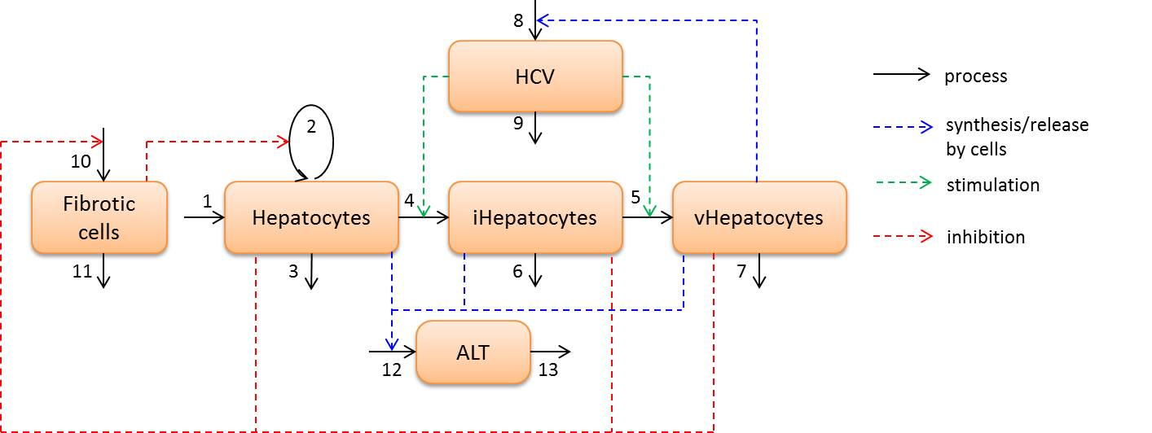
Model scheme and simulation design
Simulation design:
Family of 5 curves with different initial value of HCV: 1000, 200, 40, 8, 1.6

Slide 4
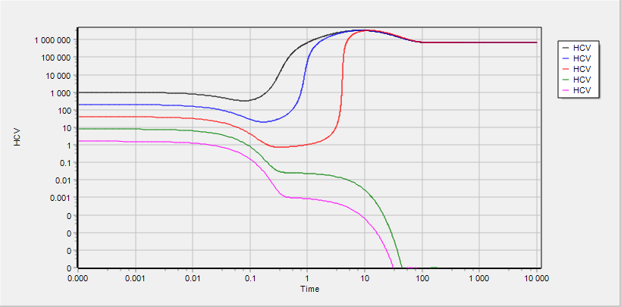
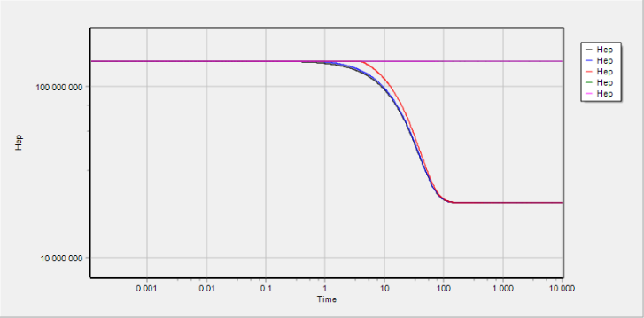
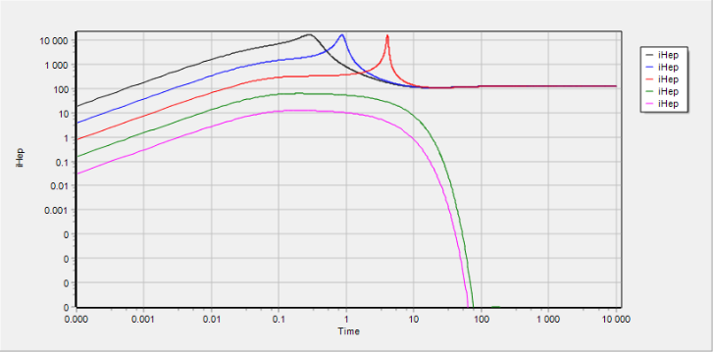
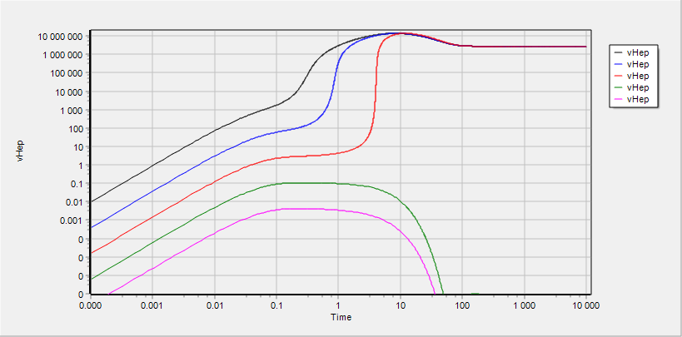
HCV, Hep, iHep and vHep
All variables demonstrate 2 stable steady state

Slide 5
Commit date: 21.05.12 Commit name: initial version (VL_v0.1.0) of SARS-CoV-2 viral dynamics model
Aim: To develop a structure and to perform initial calibration of viral dynamics model for SARS-CoV-2

Slide 6
Model scheme: simple
shedding
shedding
shedding
ACE2
ACE2
ACE2
COV
COV
COV
synthesis
synthesis
synthesis
binding
binding
binding
COV°ACE2
COV°ACE2
COV°ACE2
influx
transition
entry
transition
entry
COV_{ipc}
COV_{ipc}
uncoating
assembling
release
COV_{RNA}
PC
iPC
vPC
replication
COV
death
death
death
degradation
PC - Pneumocytes free of virus
iPC - Pneumocyte with entered but not yet replicated virus
vPC - Pneumocyte with actively replicated virus

Slide 7
Model scheme: detailed
degradation with cell death
degradation with cell death
degradation with cell death
shedding
shedding
shedding
ACE2
ACE2
ACE2
COV
transition with cells
COV
transition with cells
COV
synthesis
synthesis
synthesis
binding
binding
binding
COV°ACE2
COV°ACE2
COV°ACE2
transition with cells
transition with cells
influx
transition
entry
transition
entry
COV_{ipc}
COV_{ipc}
transition with cells
uncoating
COV
release with cell death
COV
assembling
release
COV_{RNA}
PC
iPC
vPC
replication
COV
death
death
death
degradation
COV
PC - Pneumocytes free of virus
iPC - Pneumocyte with entered but not yet replicated virus
vPC - Pneumocyte with actively replicated virus
release with cell death

Slide 8

Model scheme: regulations
degradation with cell death
degradation with cell death
degradation with cell death
shedding
shedding
shedding
ACE2
ACE2
ACE2
COV
transition with cells
COV
transition with cells
COV
synthesis
synthesis
synthesis
binding
binding
binding
COV°ACE2
COV°ACE2
COV°ACE2
transition with cells
transition with cells
influx
transition
entry
transition
entry
COV_{ipc}
COV_{ipc}
transition with cells
uncoating
COV
release with cell death
COV
assembling
release
COV_{RNA}
PC
iPC
vPC
replication
COV
death
death
death
degradation
COV
PC - Pneumocytes free of virus
iPC - Pneumocyte with entered but not yet replicated virus
vPC - Pneumocyte with actively replicated virus
release with cell death

Slide 9
Simulation design

Slide 10
Cells and virus in bulk phase

Slide 11
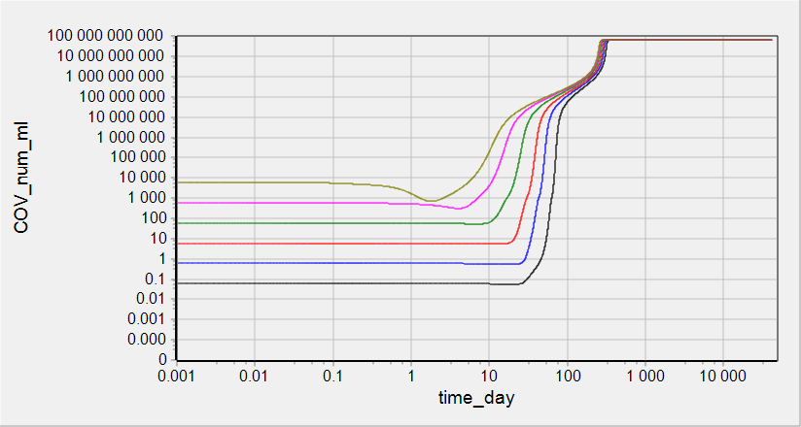
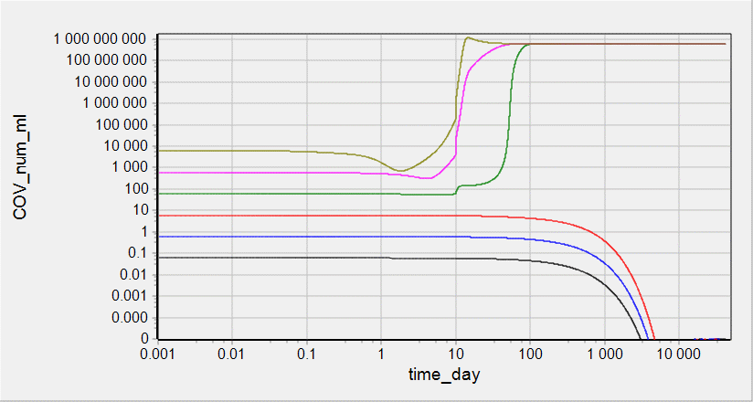
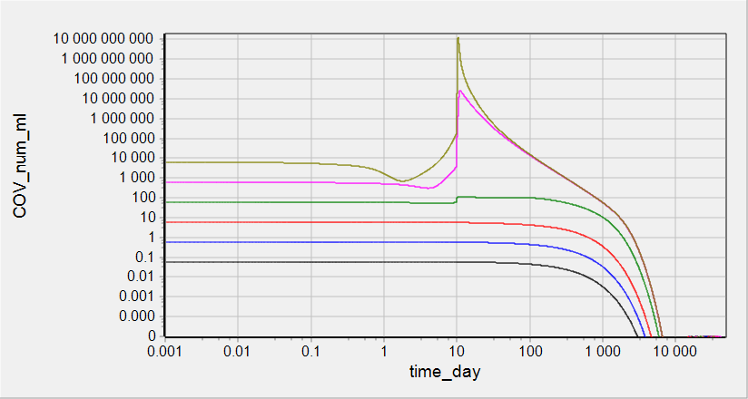
Simulations: COV in surfactant
IR factor = 1
IR factor = 100
IR factor = 1000

Slide 12
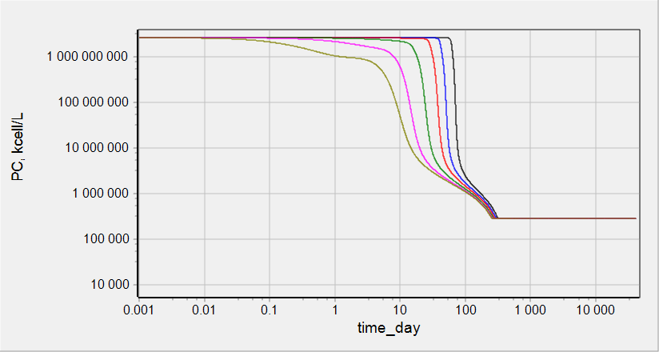
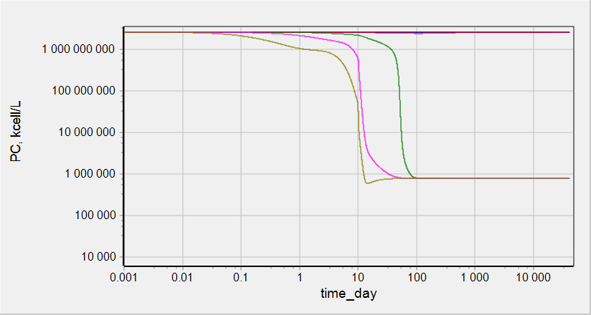
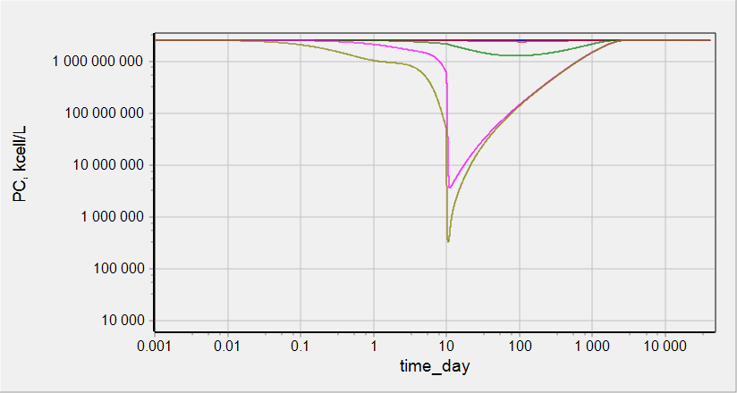
Simulations: PC count
IR factor = 1
IR factor = 100
IR factor = 1000

Slide 13
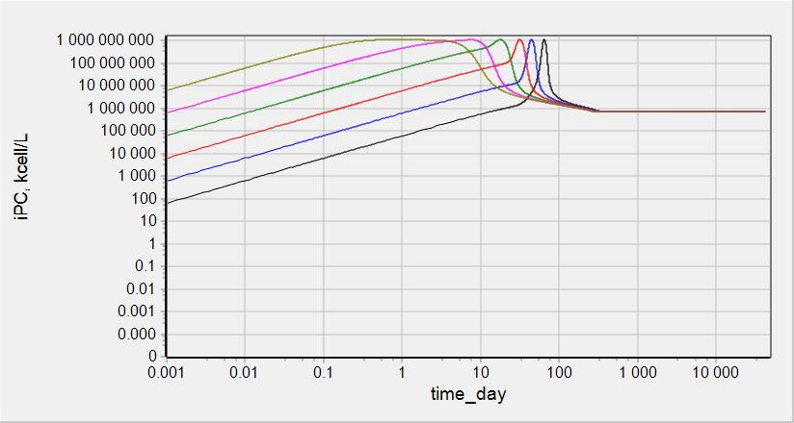
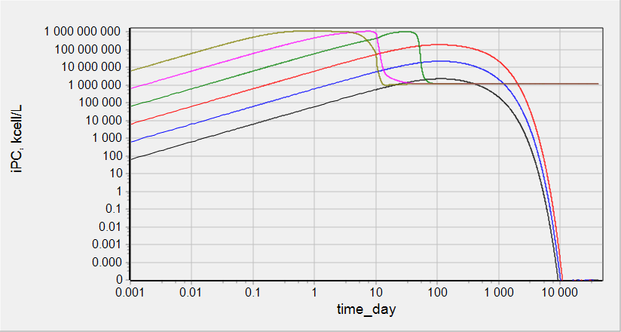
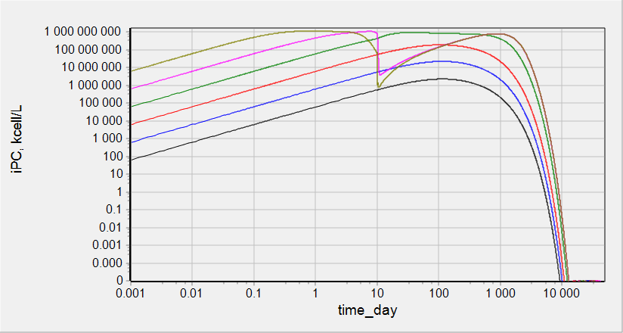
Simulations: iPC count
IR factor = 1
IR factor = 100
IR factor = 1000

Slide 14
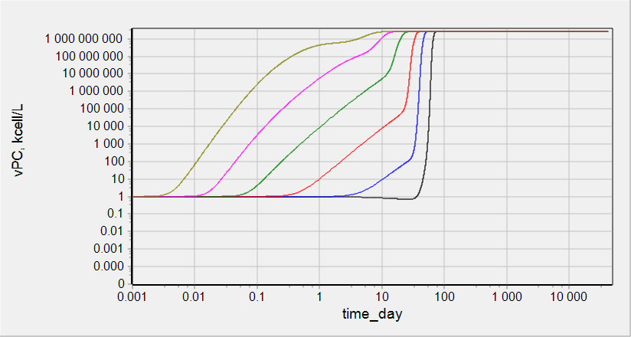
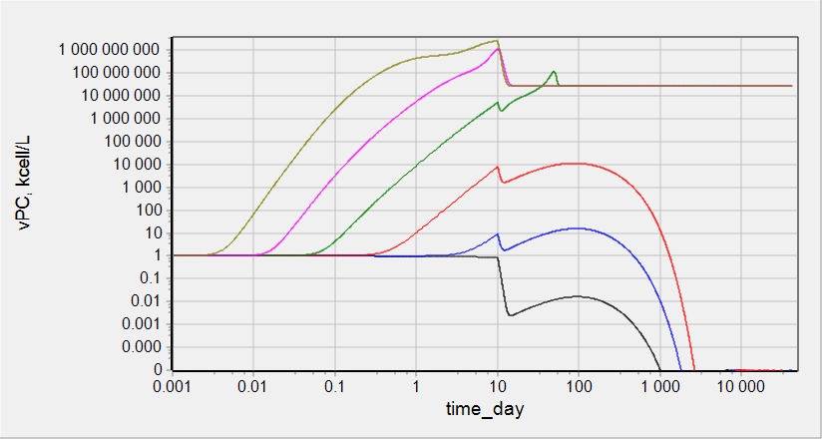
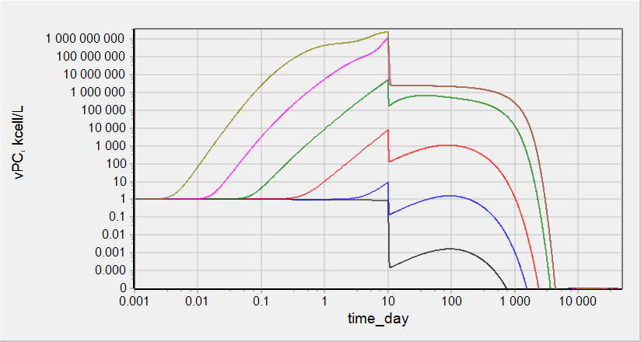
Simulations: vPC count
IR factor = 1
IR factor = 100
IR factor = 1000

Slide 15
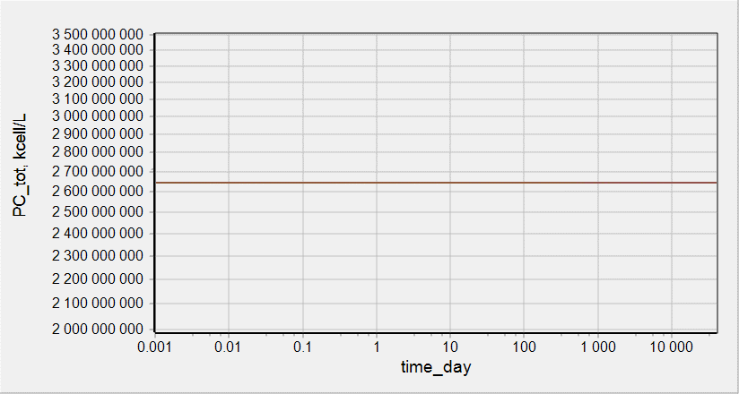
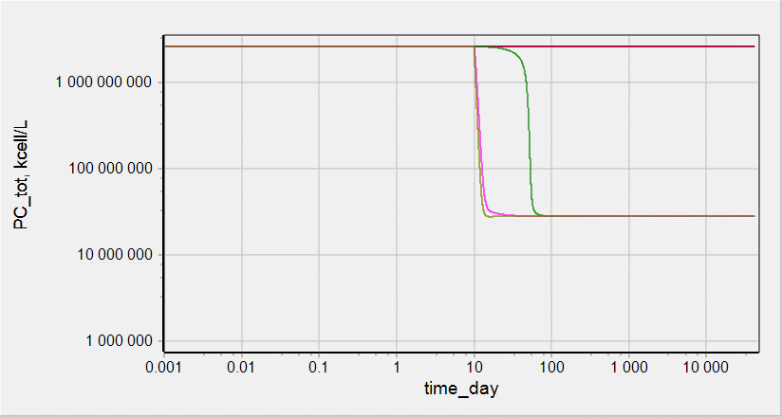
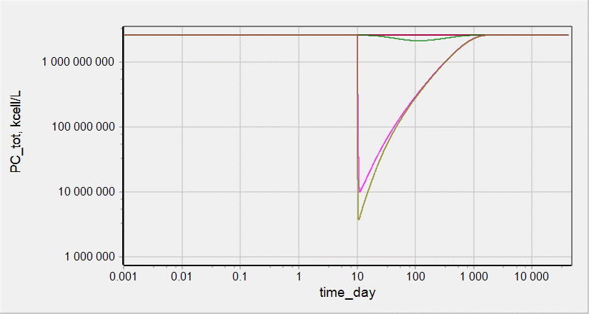
Simulations: total PC count
IR factor = 1
IR factor = 100
IR factor = 1000

Slide 16
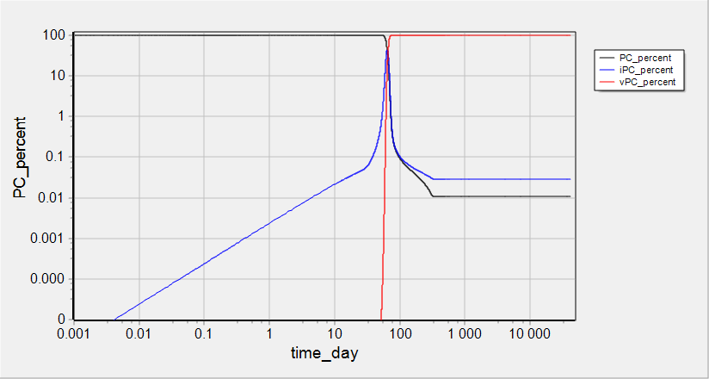
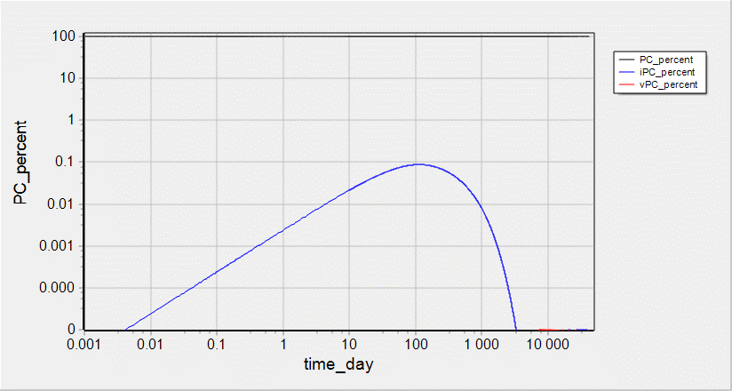
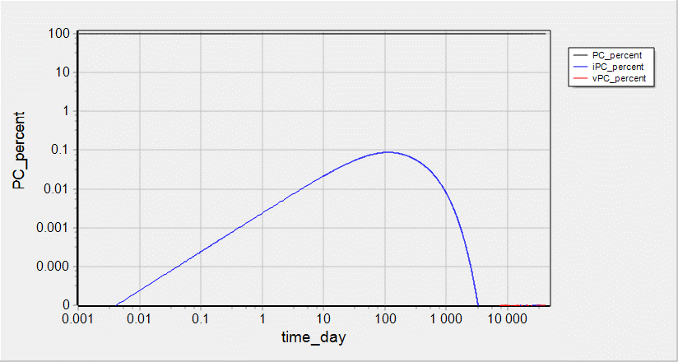
Simulations: % of PC, iPC, vPC at COV=1e-1 item/mL
IR factor = 1
IR factor = 100
IR factor = 1000

Slide 17
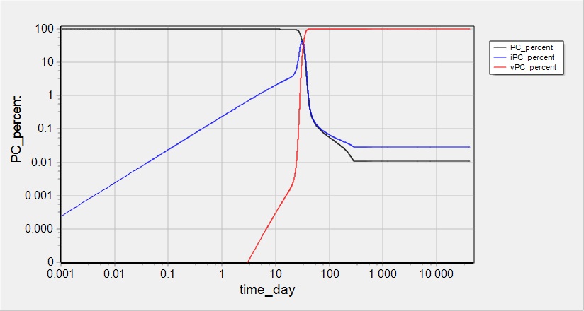
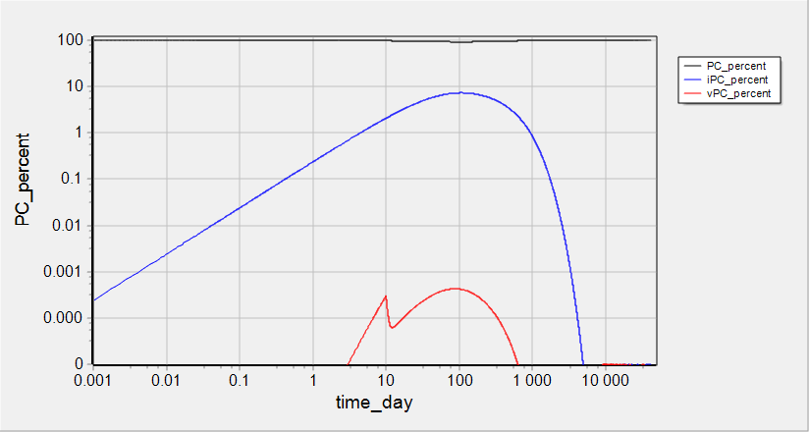
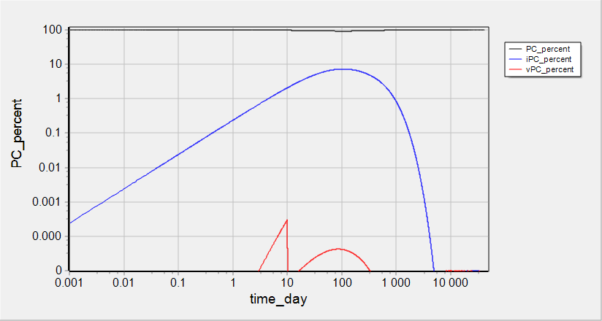
Simulations: % of PC, iPC, vPC at COV=1e1 item/mL
IR factor = 1
IR factor = 100
IR factor = 1000

Slide 18
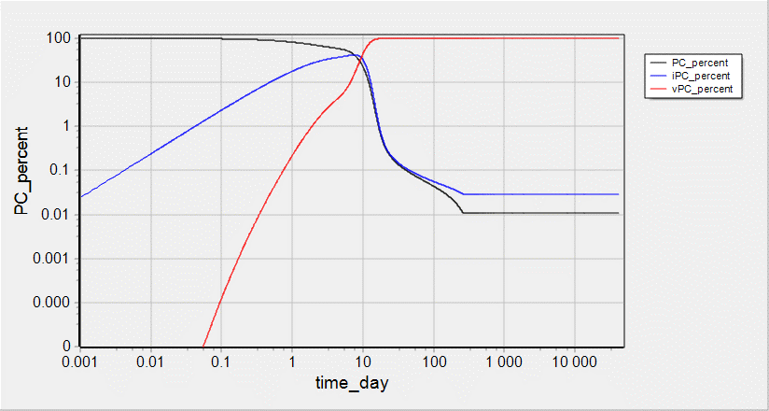
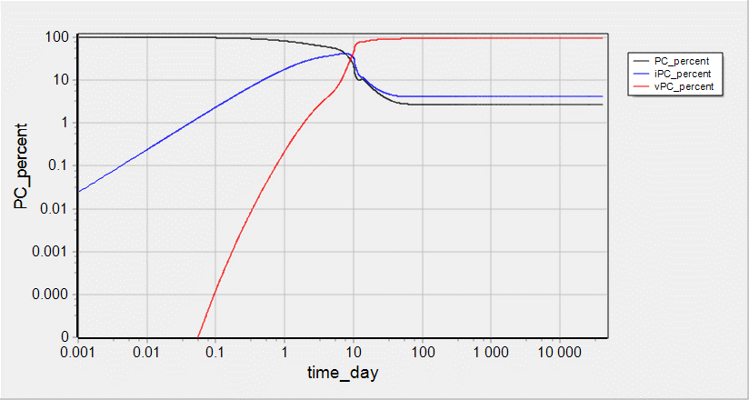
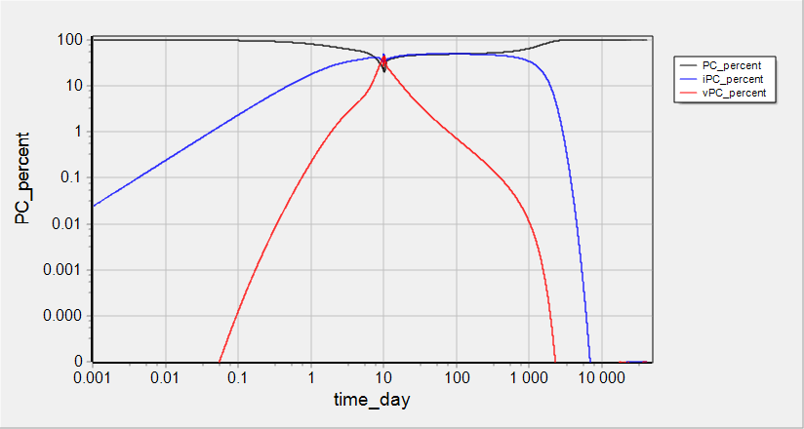
Simulations: % of PC, iPC, vPC at COV=1e3 item/mL
IR factor = 1
IR factor = 100
IR factor = 1000

Slide 19
ACE2 on cell surface

Slide 20
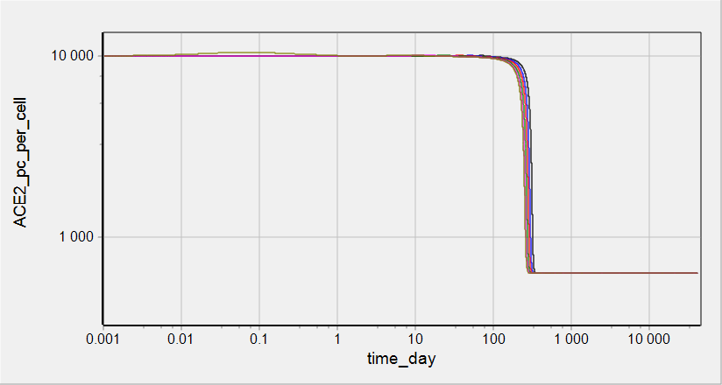
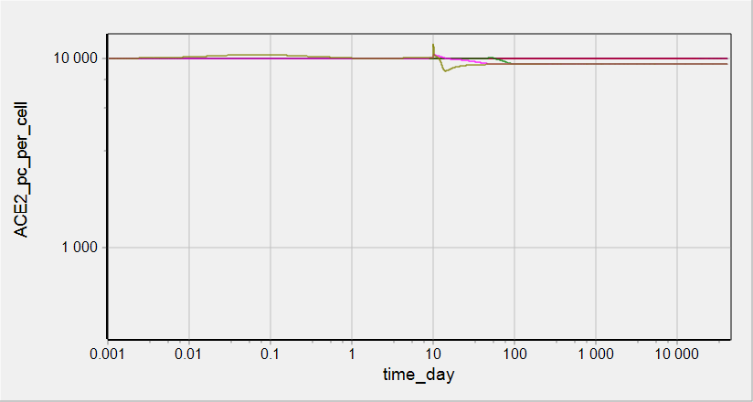
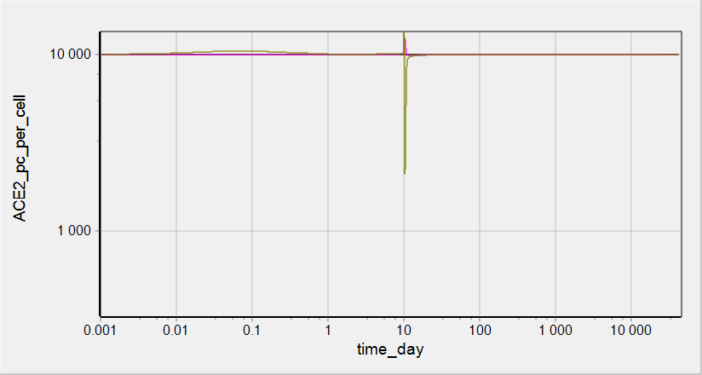
Simulations: ACE2 on PC surface
IR factor = 1
IR factor = 100
IR factor = 1000

Slide 21
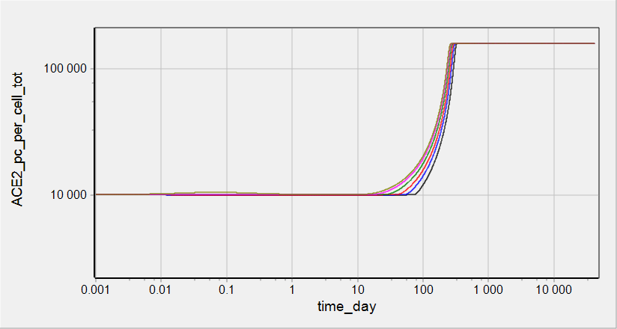
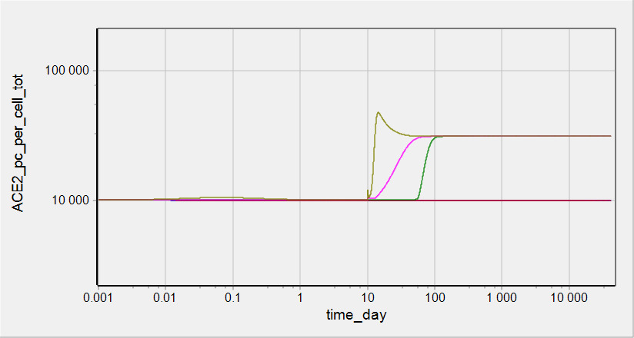
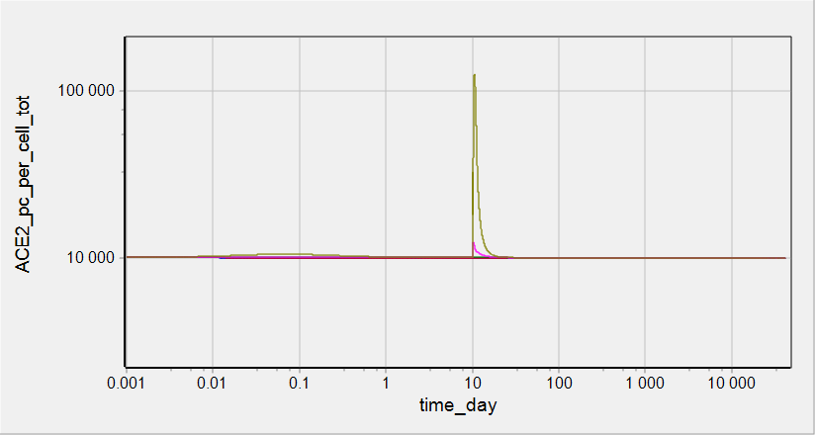
Simulations: total ACE2 on PC surface
IR factor = 1
IR factor = 100
IR factor = 1000

Slide 22
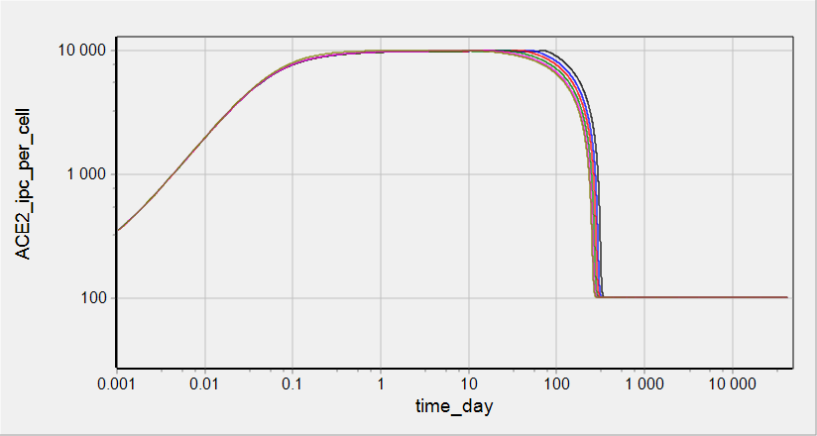
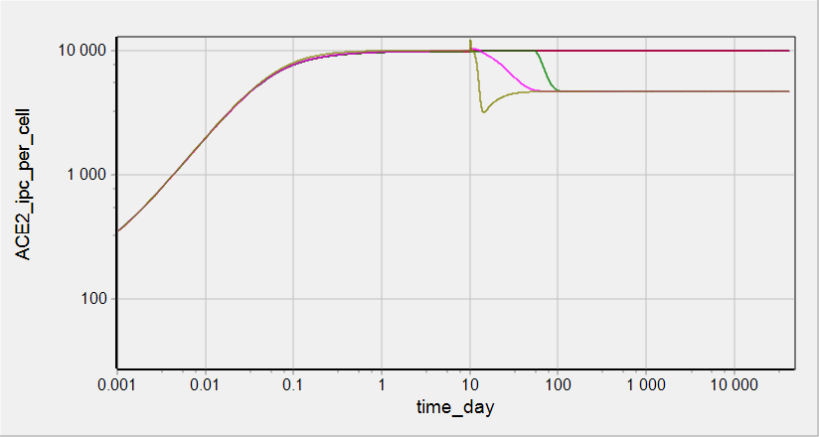
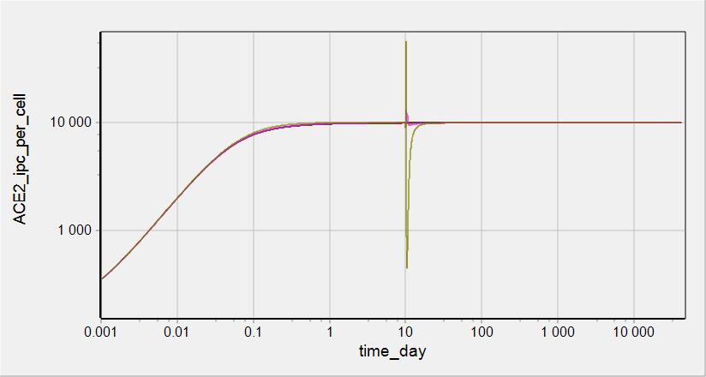
Simulations: ACE2 on iPC surface
IR factor = 1
IR factor = 100
IR factor = 1000

Slide 23
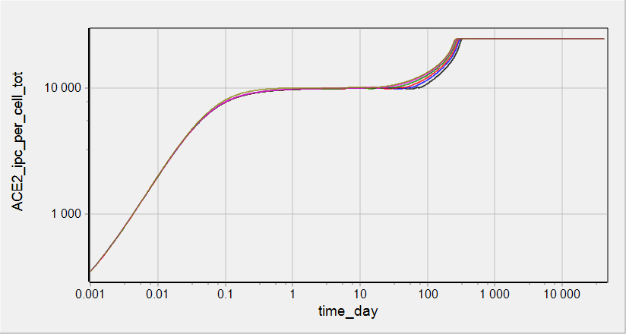
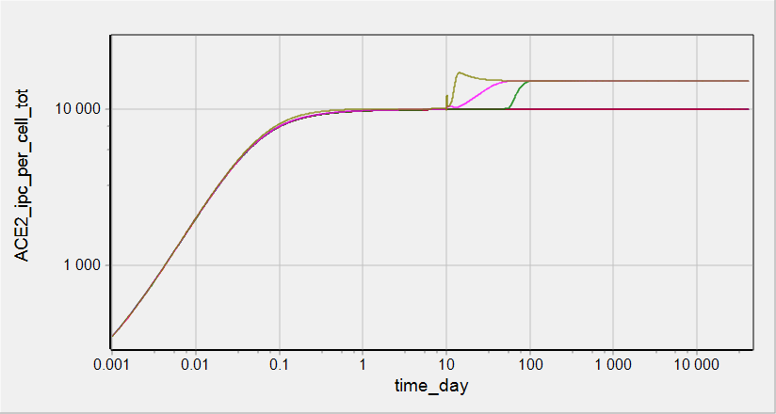
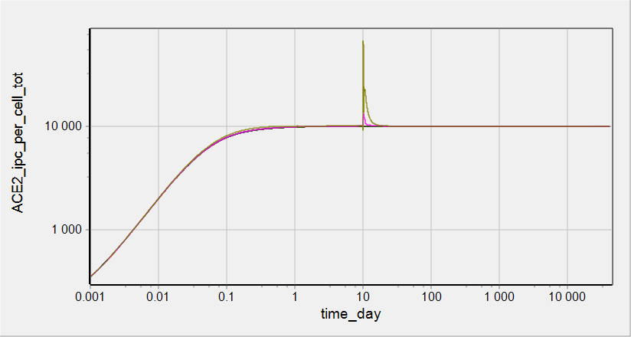
Simulations: total ACE2 on iPC surface
IR factor = 1
IR factor = 100
IR factor = 1000

Slide 24
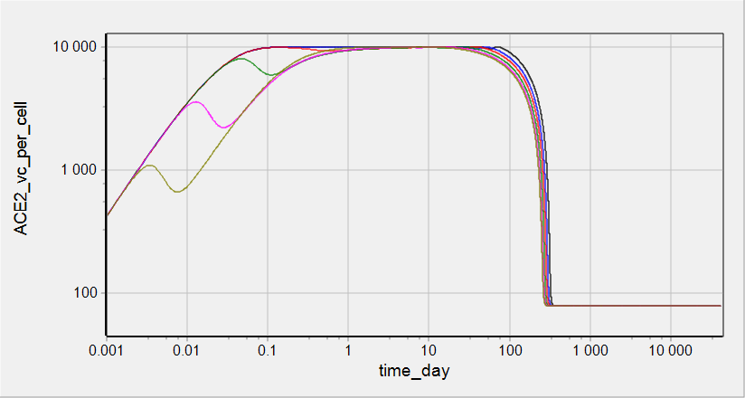
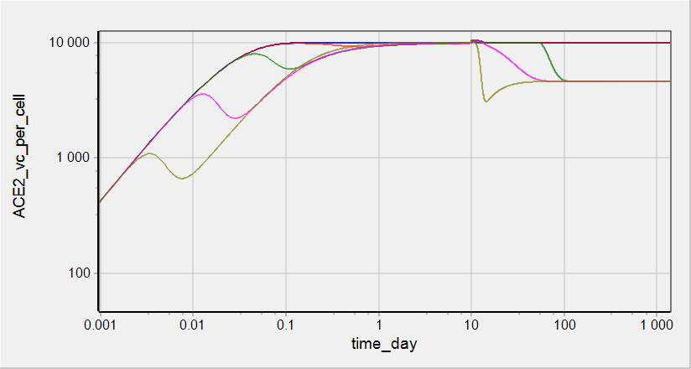
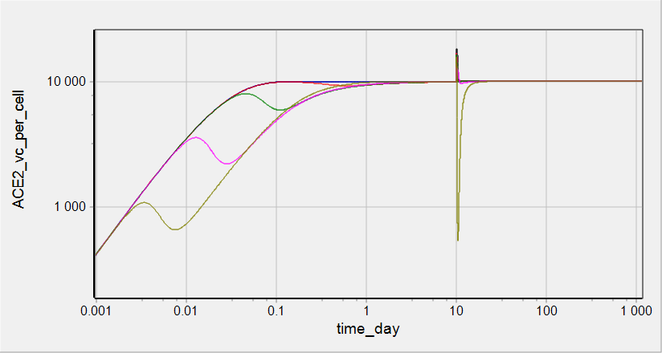
Simulations: ACE2 on vPC surface
IR factor = 1
IR factor = 100
IR factor = 1000

Slide 25
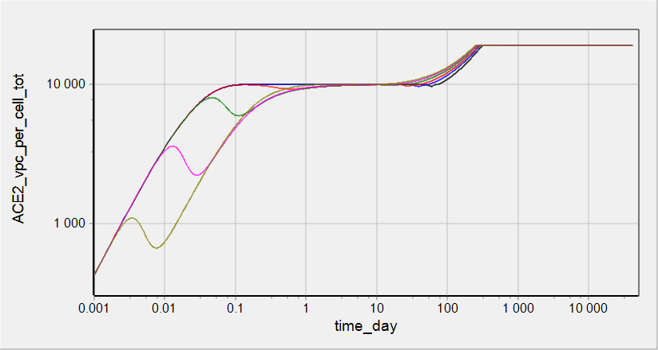
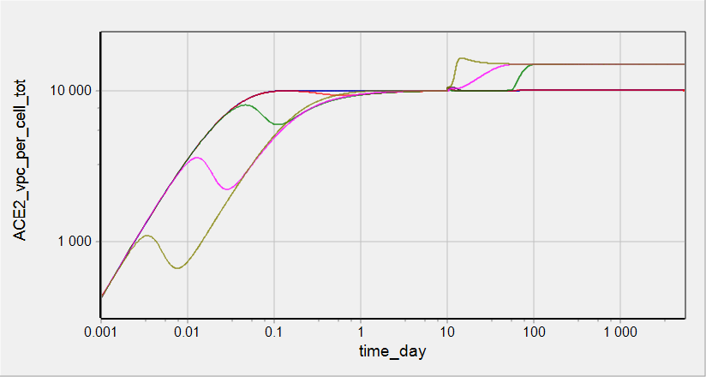
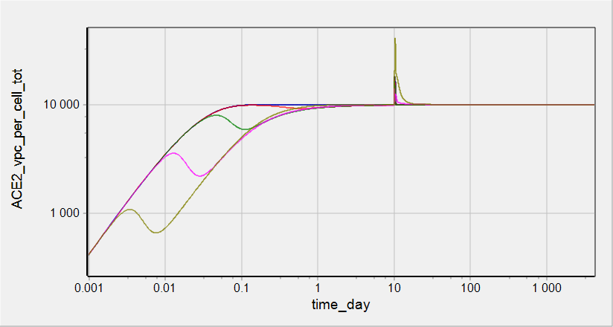
Simulations: total ACE2 on vPC surface
IR factor = 1
IR factor = 100
IR factor = 1000

Slide 26
Virus on cell surface and inside cells

Slide 27
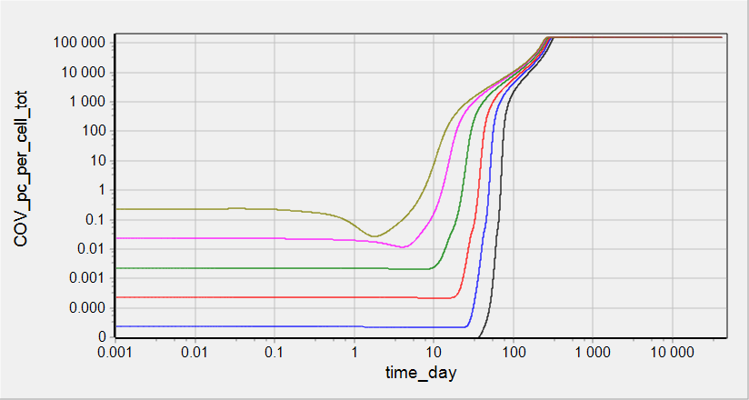
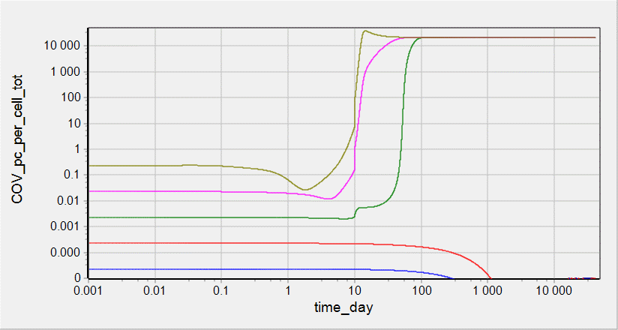
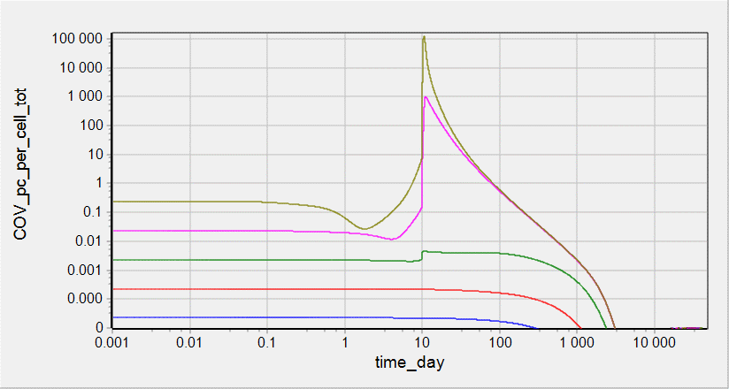
Simulations: total COV on PC
IR factor = 1
IR factor = 100
IR factor = 1000

Slide 28



Simulations: COV_ACE2 on PC surface
IR factor = 1
IR factor = 100
IR factor = 1000

Slide 29



Simulations: total COV on/inside iPC
IR factor = 1
IR factor = 100
IR factor = 1000

Slide 30



Simulations: COV_ACE2 on iPC surface
IR factor = 1
IR factor = 100
IR factor = 1000

Slide 31



Simulations: COV inside iPC
IR factor = 1
IR factor = 100
IR factor = 1000

Slide 32



Simulations: total COV on/inside vPC
IR factor = 1
IR factor = 100
IR factor = 1000

Slide 33



Simulations: COV_ACE2 on vPC surface
IR factor = 1
IR factor = 100
IR factor = 1000

Slide 34



Simulations: COV inside vPC
IR factor = 1
IR factor = 100
IR factor = 1000

Slide 35



Simulations: COV_RNA inside vPC
IR factor = 1
IR factor = 100
IR factor = 1000

Slide 36
Commit date: 26.05.12 Commit name: updated version (VL_v0.1.1) of SARS-CoV-2 viral dynamics model
Aims:
To introduce limitation in number of virions able to bind to PCII cell to avoid non-physiological accumulation of (i) the virions on the cell surface and (ii) virus RNA in nucleus
Reproduction of clinical data on virus load dynamics

Slide 37
Model scheme: simple
Changes in the version in comparison with VL_v0.1.0 is selected by red circles
shedding
shedding
shedding
ACE2
ACE2
ACE2
COV
COV
COV
synthesis
synthesis
synthesis
binding
binding
binding
COV°ACE2
COV°ACE2
COV°ACE2
influx
transition
entry
transition
entry
COV_{ipc}
COV_{ipc}
uncoating
assembling
release
COV_{RNA}
PC
iPC
vPC
replication
COV
death
death
death
degradation
PC - Pneumocytes free of virus
iPC - Pneumocyte with entered but not yet replicated virus
vPC - Pneumocyte with actively replicated virus

Slide 38
Model scheme: detailed
Changes in the version in comparison with VL_v0.1.0 is selected by red circles
degradation with cell death
degradation with cell death
degradation with cell death
shedding
shedding
shedding
ACE2
ACE2
ACE2
COV
transition with cells
COV
transition with cells
COV
synthesis
synthesis
synthesis
binding
binding
binding
COV°ACE2
COV°ACE2
COV°ACE2
transition with cells
transition with cells
influx
transition
entry
transition
entry
COV_{ipc}
COV_{ipc}
transition with cells
uncoating
COV
degradation with cell death
COV
assembling
release
COV_{RNA}
PC
iPC
vPC
replication
COV
death
death
death
degradation
COV
PC - Pneumocytes free of virus
iPC - Pneumocyte with entered but not yet replicated virus
vPC - Pneumocyte with actively replicated virus
degradation with cell death

Slide 39

Model scheme: regulations
Changes in the version in comparison with VL_v0.1.0 is selected by red circles
degradation with cell death
degradation with cell death
degradation with cell death
shedding
shedding
shedding
ACE2
ACE2
ACE2
COV
transition with cells
COV
transition with cells
COV
synthesis
COV°ACE2 per cell
synthesis
COV°ACE2 per cell
synthesis
COV°ACE2 per cell
binding
binding
binding
COV°ACE2
COV°ACE2
COV°ACE2
transition with cells
transition with cells
influx
transition
entry
transition
entry
COV_{ipc}
COV_{ipc}
transition with cells
uncoating
COV
degradation with cell death
COV
assembling
release
COV_{RNA}
PC
iPC
vPC
-
replication
COV
death
death
death
degradation
COV
PC - Pneumocytes free of virus
iPC - Pneumocyte with entered but not yet replicated virus
vPC - Pneumocyte with actively replicated virus
degradation with cell death

Slide 40



Reproduction of clinical data on viral load dynamics
Data taken from Wolfer et al
doi.org/10.1101/2020.03.05.20030502
Sputum viral load was measured for 9 patients
Individual data were averaged and presented as median and range
Activation of Immune Response was modeled as increase in rate constant of cell death. It was implemented via events
Initial value of COV = 16850 copies/mL was chosen to describe clinically measured dynamics of viral load and roughly corresponds to minimal infection dose equal to 1000 (for MERS/SARS-CoV)

Slide 41
Commit date: 20.06.01/20.06.07 Commit name: updated version (VL_v0.1.2) of SARS-CoV-2 viral dynamics model
Aims:
To introduce new variable COVass_vpc designating assembled virus amount in vPC and implement release of COV from vPC from the variable. Delete release of the virus from COV_vpc.
Cell death leads to release of the virus bound with ACE2 at the cell surface. ACE2 is degraded.
To introduce 2 modes of immune response in empiric way: (i) Spike specific antibodies ( IgG/IgM) interfere binding of virus ACE2 (ii) stimulation of death of infected cells
Introduction of sputum dilution coefficient
Change in parameters k_rep_cov_rna_vpc , k_ass_cov_vpc , kbase_tran_pc_ipc , kbase_tran_ipc_vpc to describe clinically measured data on viral load and percent of subgenomic viral mRNA in sputum

Slide 42
Model scheme: simple
shedding
shedding
shedding
ACE2
ACE2
ACE2
COV
COV
COV
synthesis
synthesis
synthesis
binding
binding
binding
COV°ACE2
COV°ACE2
COV°ACE2
influx
transition
entry
transition
entry
PC
iPC
vPC
COV_{ipc}
COV_{vpc}
uncoating
replication
COVass_{vpc}
assembling
COV_{RNA}
release
COV
release with cell death
death
death
death
degradation
COV_RNA
PC - Pneumocytes free of virus
iPC - Pneumocyte with entered but not yet replicated virus
vPC - Pneumocyte with actively replicated virus
degradation

Slide 43
Model scheme: detailed
degradation with cell death
degradation with cell death
degradation with cell death
shedding
shedding
shedding
ACE2
ACE2
ACE2
COV
transition with cells
COV
transition with cells
COV
synthesis
synthesis
synthesis
binding
binding
binding
release with cell death
COV°ACE2
COV°ACE2
COV°ACE2
transition with cells
transition with cells
influx
transition
entry
transition
entry
PC
iPC
vPC
COV_{ipc}
COV_{vpc}
transition with cells
uncoating
degradation with cell death
degradation with cell death
replication
COVass_{vpc}
assembling
COV_{RNA}
release
COV
release with cell death
release with cell death
death
death
death
degradation
COV_RNA
PC - Pneumocytes free of virus
iPC - Pneumocyte with entered but not yet replicated virus
vPC - Pneumocyte with actively replicated virus
degradation

Slide 44
Model scheme: regulations
degradation with cell death
degradation with cell death
degradation with cell death
shedding
shedding
shedding
ACE2
ACE2
ACE2
COV
transition with cells
COV
transition with cells
COV
synthesis
COV°ACE2 per cell
synthesis
COV°ACE2 per cell
synthesis
COV°ACE2 per cell
binding
binding
binding
release with cell death
COV°ACE2
COV°ACE2
COV°ACE2
transition with cells
transition with cells
influx
transition
entry
transition
entry
PC
iPC
vPC
COV_{ipc}
COV_{vpc}
transition with cells
uncoating
degradation with cell death
degradation with cell death
replication
COVass_{vpc}
assembling
COV_{RNA}
release
COV
release with cell death
release with cell death
death
death
death
degradation
COV_RNA
PC - Pneumocytes free of virus
iPC - Pneumocyte with entered but not yet replicated virus
vPC - Pneumocyte with actively replicated virus
degradation

Slide 45



Implementation of Immune Response
To describe effect of Immune Response (IR) on viral load dynamics we take into account:
Increase in vPC death
Decrease in virus binding to the host cell due to increase in anti-Spike antibodies concentration
These 2 modes of IR were implemented empirically in following manner:
- IR mediated vPC death
V_apo_vpc = Vol_alv*k_apo_vpc*vPC
k_apo_vpc = kbase_apo_vpc*IR_apo
IR_apo = $1+\frac{\text{switch}\text{_}\text{ir}\text{∗}\text{Emax}\text{_}\text{ir}\text{_}\text{apo}\text{∗}{\text{(}\text{t}\text{ − }\text{T}\text{_}\text{sw}\text{_}\text{ir}\text{)}}^{\text{n}\text{_}\text{ir}}}{{\text{(}\text{T}\text{_}\text{sw}\text{_}\text{ir}\text{ + }\text{ET}\text{50_}\text{ir}\text{)}}^{\text{n}\text{_}\text{ir}}\text{ +}{\text{(}\text{t}\text{ − }\text{T}\text{_}\text{sw}\text{_}\text{ir}\text{)}}^{\text{n}\text{_}\text{ir}}}$
where IR_apo is explicit function of time after infection
- Effect of anti-S Ab on COV to ACE2 binding
V_bind_cov_ace2_pc = k_off_cov_ace2*(steric_factor_pc*COV*ACE2_pc/Kd_cov_ace2 - COV_ACE2_pc)
steric_factor_pc = 1 - COV_ACE2_pc_per_cell/Nmax_cov_per_cell
COV_ACE2_pc_per_cell = NA_pmole*COV_ACE2_pc/PC/Vol_alv/kcell_to_cell
Kd_cov_ace2 = Kd_spike_ace2/Num_sp_per_cov/(1 - VO)
VO = anti_Ab/(Kd_anti_Ab + anti_Ab)
anti_Ab = $\frac{\text{switch}\text{_}\text{ir}\text{∗}\text{anti}\text{_}\text{Ab}\text{_}\text{max}\text{∗}{\text{(}\text{t}\text{ − }\text{T}\text{_}\text{sw}\text{_}\text{ir}\text{)}}^{\text{n}\text{_}\text{ir}}}{{\text{(}\text{T}\text{_}\text{sw}\text{_}\text{ir}\text{ + }\text{ET}\text{50_}\text{ir}\text{)}}^{\text{n}\text{_}\text{ir}}\text{ +}{\text{(}\text{t}\text{ − }\text{T}\text{_}\text{sw}\text{_}\text{ir}\text{)}}^{\text{n}\text{_}\text{ir}}}$
We have introduced virus occupancy level with anti-S Ab and taken into account
elevation of apparent Kd responsible for COV ACE2 binding with increase in VO

Slide 46


Reproduction of clinical data on viral load dynamics
Viral load and % of viral subgenomic mRNA in sputum were simulated
IR was implemented in empiric way as described earlier with following parameters:
T_sw_ir = 50 {units: h};
ET50_ir = 190 {units: h};
Emax_ir_apo = 800 {units: UL};
n_ir = 5 {units: UL};
Kd_anti_Ab = 14300 {units: pM};
anti_Ab_max = 941000 {units: pM};
Wolfer et al, doi.org/10.1101/
2020.03.05.20030502
Wolfer et al, doi.org/10.1101/
2020.03.05.20030502
Time/value of peak viral load and range of viral shedding [PMID 32315724]
Wolfer et al, doi.org/10.1101/
2020.03.05.20030502
Virus initial concentration: 3370 copies/mL
6740 copies/mL
Virus initial concentration: 3370 copies/mL

Slide 47

Simulations: Viral load dynamics
Virus initial concentration:
843 copies/mL
1685 copies/mL
3370 copies/mL
6740 copies/mL
Limit of detection
There is a threshold in virus initial concentration.
The values above the threshold lead to substantial and transient virus load in sputum.
The values below the threshold do not allow detect virus in sputum at any time.
Increase in virus initial concentration results in higher peak of viral load which is faster achieved.

Slide 48
Functions for diagnostic simulations
COV_num_sputum_ml = sputum_dilution_coef * (COV + COV_RNA) * Vol_alv * NA_pmole / 1000; // 'number of virus copies in 1 mL of sputum' {units: item/mL}
PC_tot = PC + iPC + vPC; // {units: kcell/L} PC_percent = 100 * PC / PC_tot; // {units: UL} iPC_percent = 100 * iPC / PC_tot; // {units: UL}
vPC_percent = 100 * vPC / PC_tot; // {units: UL}
ACE2_pc_per_cell = NA_pmole * ACE2_pc / PC / Vol_alv / kcell_to_cell; // @Record 'number of ACE2 per PC cell' {units: item/cell}
COV_ACE2_pc_per_cell = NA_pmole * COV_ACE2_pc / PC / Vol_alv / kcell_to_cell; // @Record 'number of COV_ACE2 per PC cell' {units: item/cell}
ACE2_pc_per_cell_tot = ACE2_pc_per_cell + COV_ACE2_pc_per_cell; // @Record 'total number of ACE2 molecules per PC cell' {units: item/cell}
ACE2_ipc_per_cell = NA_pmole * ACE2_ipc / iPC / Vol_alv / kcell_to_cell; // @Record 'number of ACE2 per iPC cell' {units: item/cell}
COV_ACE2_ipc_per_cell = NA_pmole * COV_ACE2_ipc / iPC / Vol_alv / kcell_to_cell; // @Record 'number of COV_ACE2 per iPC cell' {units: item/cell}
ACE2_ipc_per_cell_tot = ACE2_ipc_per_cell + COV_ACE2_ipc_per_cell; // @Record 'total number of ACE2 molecules per iPC cell' {units: item/cell}
ACE2_vpc_per_cell = NA_pmole * ACE2_vpc / vPC / Vol_alv / kcell_to_cell; // @Record 'number of ACE2 per vPC cell' {units: item/cell}
COV_ACE2_vpc_per_cell = NA_pmole * COV_ACE2_vpc / vPC / Vol_alv / kcell_to_cell; // @Record 'number of COV_ACE2 per vPC cell' {units: item/cell}
ACE2_vpc_per_cell_tot = ACE2_vpc_per_cell + COV_ACE2_vpc_per_cell; // @Record 'total number of ACE2 molecules per vPC cell' {units: item/cell}
COV_pc_per_cell_tot = COV_ACE2_pc_per_cell; // @Record 'total number of COV genomes per PC cell' {units: item/cell}
COV_ipc_per_cell = NA_pmole * COV_ipc / iPC / Vol_alv / kcell_to_cell; // @Record 'number of COV per iPC cell' {units: item/cell}
COV_ipc_per_cell_tot = COV_ACE2_ipc_per_cell + COV_ipc_per_cell; // @Record 'total number of COV genomes per iPC cell' {units: item/cell}
COV_vpc_per_cell = NA_pmole * COV_vpc / vPC / Vol_alv / kcell_to_cell; // @Record 'number of COV per vPC cell' {units: item/cell}
COV_RNA_vpc_per_cell = NA_pmole * COV_RNA_vpc / vPC / Vol_alv / kcell_to_cell; // @Record 'number of COV_RNA per vPC cell' {units: item/cell}
COVass_vpc_per_cell = NA_pmole * COVass_vpc / vPC / Vol_alv / kcell_to_cell; // @Record 'number of COVass per vPC cell' {units: item/cell}
COV_vpc_per_cell_tot = COV_ACE2_vpc_per_cell + COV_vpc_per_cell + COV_RNA_vpc_per_cell + COVass_vpc_per_cell; // @Record 'total number of COV genomes per vPC cell' {units: item/cell}
COV_sgRNA_perc = 100 * COV_RNA / (COV + COV_RNA); // @Record 'percent of actively transcribed subgenomic RNA of total (packed + unpacked) RNA in sputum samples taken from the patients' {units: UL

Slide 49
Cells and virus in bulk phase
Diagnostic simulations of key model species and characteristics

Slide 50


Simulations: COV in surfactant
Virus initial concentration:
843 copies/mL
1685 copies/mL
3370 copies/mL
6740 copies/mL
Initial COV is very rapidly consumed from the bulk phase: 1e-5 day = 0.86 sec
It took about 5 days to start to observe increase in bulk phase COV
Virus initial concentration:
843 copies/mL
1685 copies/mL
3370 copies/mL
6740 copies/mL

Slide 51




Simulations: PC count
Virus initial concentration:
843 copies/mL
1685 copies/mL
3370 copies/mL
6740 copies/mL
Total PC declines more than 100 folds when initial virus concentration is above threshold. Looks strange if we consider that virus affect whole lung!
Total PC declines slightly if initial virus concentration is below threshold
Replenishment of PC cells takes about 80-90 days

Slide 52




Simulations: % of PC, iPC, vPC of PC_tot
COVinit=843 copies/mL
COVinit=1685 copies/mL
below threshold
below threshold
COVinit=3370 copies/mL
COVinit=6740 copies/mL
above threshold
above threshold
At day 10 or nearby almost all 100% of PC are in vPC state when initial virus concentration is above threshold.

Slide 53
ACE2 on cell surface
Diagnostic simulations of key model species and characteristics

Slide 54






Simulations: free and total ACE2 on PC surface
Virus initial concentration:
843 copies/mL
1685 copies/mL
3370 copies/mL
6740 copies/mL
Total ACE2 concentration increases before day 10 if “inoculum” is above threshold
The increase is higher in PC than in iPC and vPC

Slide 55
Virus on cell surface and inside cells
Diagnostic simulations of key model species and characteristics

Slide 56



Simulations: total COV on/inside of PC states
Virus initial concentration:
843 copies/mL
1685 copies/mL
3370 copies/mL
6740 copies/mL

Slide 57


Simulations: COV on/inside of iPC
Virus initial concentration:
843 copies/mL
1685 copies/mL
3370 copies/mL
6740 copies/mL

Slide 58




Simulations: COV on/inside of vPC
Virus initial concentration:
843 copies/mL
1685 copies/mL
3370 copies/mL
6740 copies/mL

Slide 59
Commit date: 20.06.16/20.06.21/20.06.28 Commit name: Mph life cycle - updated version (Mph_v0.1.0)
Aims:
To upgrade right hand sides of Mph life cycle sub-model downloaded from IRT
Estimation of values of static cytokines (GMCSF_ts, GMCSF_pl, IFNg_ts, IL4_ts, IL4_ln, CCL22_ts, CCL22_ln, IL13_ts) on the basis of Cytocon DB and implementation them into the model
Initial estimation of values of cell components of Mph sub-model (PBM_ts, iMph_ts, M1_ts, M2_ts) for HC, COVID19 and NSCLC patients on the basis of Cytocon DB and implementation them into the model; preparation of data file for DBSolve
Initial fitting of cell components of Mph sub-model (PBM_ts, iMph_ts, M1_ts, M2_ts)

Slide 60

Mph sub-model scheme: IRT version
Updates to be implemented:
Merging M2a, M2b and M2c into one specie M2. Rational: (1) no data to characterize cell dynamics of the species separately, (2) simplification of the model
Introduction of PBM_ts and regulations of PBM migration separate from PBM differentiation. Rational: there is data on regulation of PBM migration
Implementation of regulations of PBM to iMph and iMph to M1/M2 differentiation described in literature
Implementation of Il10, TGFb and CCL2 synthesis by M2 in TISSUE. Rational: these synthesis were no implemented in IRT

Slide 61
Mph sub-model scheme: updated version
Lymph node
Tissue
M1
M2
cell death
cell death
differentiation
differentiation
Ag_ts, IFNg_ts
proliferation
Il4_ts, IL13_ts,
IL10_ts, TGFb_ts
IL10_ts, TGFb_ts
iMph
cell death
GMCSF_ts
differentiation
PBM
CCL2_ts, CXCL10_ts,
TGFb_ts
cell death
migration to TISSUE
Bone marrow
Plasma
PBM
cell death
GMCSF_pl
Migration to OTHER TISSUES
Synthesis of Il10, TGFb and CCL2 by M2 in TISSUE was also implemented (not shown in the scheme)
All changes in xlsx file are selected in red font or highlighted with yellow

Slide 62

Preliminary calibration of updated Mph submodel
M2_ts
M1_ts
iMph_ts
PBM_pl
Changes in model parameters providing quality of fitting presented above
kbase_rec_pbm_pl = 2e4;//8000; // @Const {units: kcell/litre/h};
kbase_act_imph_m1_ts = 9e-2;//0.003; // @Const {units: 1/h};
kbase_act_imph_m2_ts = 2e-1;//9e-2;//0.003; // @Const {units: 1/h};

