Slide 1
Calibration, validation and key model simulations
Oleg Demin
demin@insysbio.com
2020-05-12

Slide 2
Commit date: 26.05.12 Commit name: updated version (VL_v0.1.1) of SARS-CoV-2 viral dynamics model
Aims:
To introduce limitation in number of virions able to bind to PCII cell to avoid non-physiological accumulation of (i) the virions on the cell surface and (ii) virus RNA in nucleus
Reproduction of clinical data on virus load dynamics

Slide 3
Model scheme: simple
Changes in the version in comparison with VL_v0.1.0 is selected by red circles
shedding
shedding
shedding
ACE2
ACE2
ACE2
COV
COV
COV
synthesis
synthesis
synthesis
binding
binding
binding
COV°ACE2
COV°ACE2
COV°ACE2
influx
transition
entry
transition
entry
COV_{ipc}
COV_{ipc}
uncoating
assembling
release
COV_{RNA}
PC
iPC
vPC
replication
COV
death
death
death
degradation
PC - Pneumocytes free of virus
iPC - Pneumocyte with entered but not yet replicated virus
vPC - Pneumocyte with actively replicated virus

Slide 4
Model scheme: detailed
Changes in the version in comparison with VL_v0.1.0 is selected by red circles
degradation with cell death
degradation with cell death
degradation with cell death
shedding
shedding
shedding
ACE2
ACE2
ACE2
COV
transition with cells
COV
transition with cells
COV
synthesis
synthesis
synthesis
binding
binding
binding
COV°ACE2
COV°ACE2
COV°ACE2
transition with cells
transition with cells
influx
transition
entry
transition
entry
COV_{ipc}
COV_{ipc}
transition with cells
uncoating
COV
degradation with cell death
COV
assembling
release
COV_{RNA}
PC
iPC
vPC
replication
COV
death
death
death
degradation
COV
PC - Pneumocytes free of virus
iPC - Pneumocyte with entered but not yet replicated virus
vPC - Pneumocyte with actively replicated virus
degradation with cell death

Slide 5


Model scheme: regulations
Changes in the version in comparison with VL_v0.1.0 is selected by red circles
degradation with cell death
degradation with cell death
degradation with cell death
shedding
shedding
shedding
ACE2
ACE2
ACE2
COV
transition with cells
COV
transition with cells
COV
synthesis
COV°ACE2 per cell
synthesis
COV°ACE2 per cell
synthesis
COV°ACE2 per cell
binding
binding
binding
COV°ACE2
COV°ACE2
COV°ACE2
transition with cells
transition with cells
influx
transition
entry
transition
entry
COV_{ipc}
COV_{ipc}
transition with cells
uncoating
COV
degradation with cell death
COV
assembling
release
COV_{RNA}
PC
iPC
vPC
-
replication
COV
death
death
death
degradation
COV
PC - Pneumocytes free of virus
iPC - Pneumocyte with entered but not yet replicated virus
vPC - Pneumocyte with actively replicated virus
degradation with cell death

Slide 6
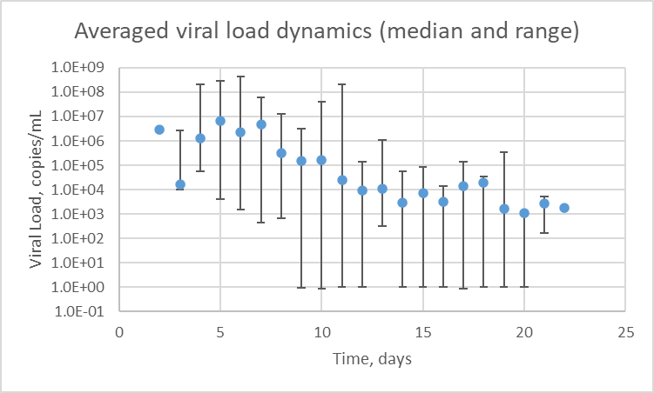
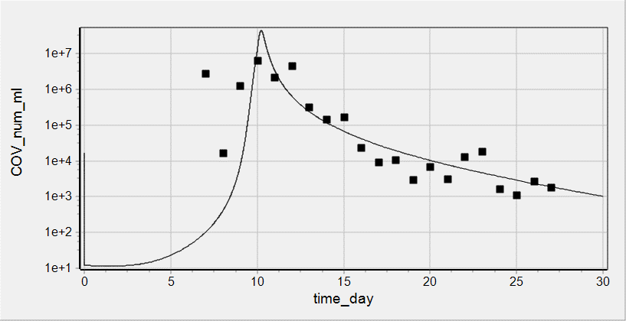
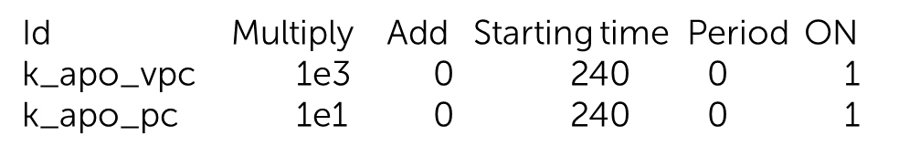
Reproduction of clinical data on viral load dynamics
Data taken from Wolfer et al
doi.org/10.1101/2020.03.05.20030502
Sputum viral load was measured for 9 patients
Individual data were averaged and presented as median and range
Activation of Immune Response was modeled as increase in rate constant of cell death. It was implemented via events
Initial value of COV = 16850 copies/mL was chosen to describe clinically measured dynamics of viral load and roughly corresponds to minimal infection dose equal to 1000 (for MERS/SARS-CoV)

Slide 7
Commit date: 20.06.01 Commit name: updated version (VL_v0.1.2) of SARS-CoV-2 viral dynamics model
Aims:
To introduce new variable COVass_vpc designating assembled virus amount in vPC and implement release of COV from vPC from the variable. Delete release of the virus from COV_vpc.
Cell death leads to release of the virus bound with ACE2 at the cell surface. ACE2 is degraded.
To introduce 2 modes of immune response in empiric way: (i) Spike specific antibodies ( IgG/IgM) interfere binding of virus ACE2 (ii) stimulation of death of infected cells
Introduction of sputum dilution coefficient
Change in parameters k_rep_cov_rna_vpc , k_ass_cov_vpc , kbase_tran_pc_ipc , kbase_tran_ipc_vpc to describe clinically measured data on viral load and percent of subgenomic viral mRNA in sputum

Slide 8
Model scheme: simple
shedding
shedding
shedding
ACE2
ACE2
ACE2
COV
COV
COV
synthesis
synthesis
synthesis
binding
binding
binding
COV°ACE2
COV°ACE2
COV°ACE2
influx
transition
entry
transition
entry
PC
iPC
vPC
COV_{ipc}
COV_{vpc}
uncoating
replication
COVass_{vpc}
assembling
COV_{RNA}
release
COV
release with cell death
death
death
death
degradation
COV_RNA
PC - Pneumocytes free of virus
iPC - Pneumocyte with entered but not yet replicated virus
vPC - Pneumocyte with actively replicated virus
degradation

Slide 9
Model scheme: detailed
degradation with cell death
degradation with cell death
degradation with cell death
shedding
shedding
shedding
ACE2
ACE2
ACE2
COV
transition with cells
COV
transition with cells
COV
synthesis
synthesis
synthesis
binding
binding
binding
release with cell death
COV°ACE2
COV°ACE2
COV°ACE2
transition with cells
transition with cells
influx
transition
entry
transition
entry
PC
iPC
vPC
COV_{ipc}
COV_{vpc}
transition with cells
uncoating
degradation with cell death
degradation with cell death
replication
COVass_{vpc}
assembling
COV_{RNA}
release
COV
release with cell death
release with cell death
death
death
death
degradation
COV_RNA
PC - Pneumocytes free of virus
iPC - Pneumocyte with entered but not yet replicated virus
vPC - Pneumocyte with actively replicated virus
degradation

Slide 10
Model scheme: regulations
degradation with cell death
degradation with cell death
degradation with cell death
shedding
shedding
shedding
ACE2
ACE2
ACE2
COV
transition with cells
COV
transition with cells
COV
synthesis
COV°ACE2 per cell
synthesis
COV°ACE2 per cell
synthesis
COV°ACE2 per cell
binding
binding
binding
release with cell death
COV°ACE2
COV°ACE2
COV°ACE2
transition with cells
transition with cells
influx
transition
entry
transition
entry
PC
iPC
vPC
COV_{ipc}
COV_{vpc}
transition with cells
uncoating
degradation with cell death
degradation with cell death
replication
COVass_{vpc}
assembling
COV_{RNA}
release
COV
release with cell death
release with cell death
death
death
death
degradation
COV_RNA
PC - Pneumocytes free of virus
iPC - Pneumocyte with entered but not yet replicated virus
vPC - Pneumocyte with actively replicated virus
degradation

Slide 11
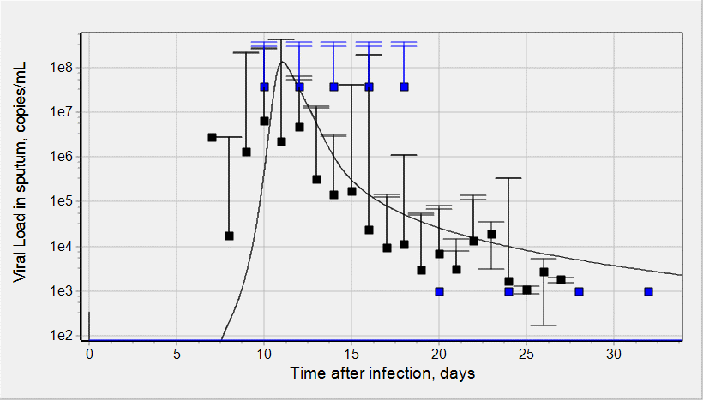
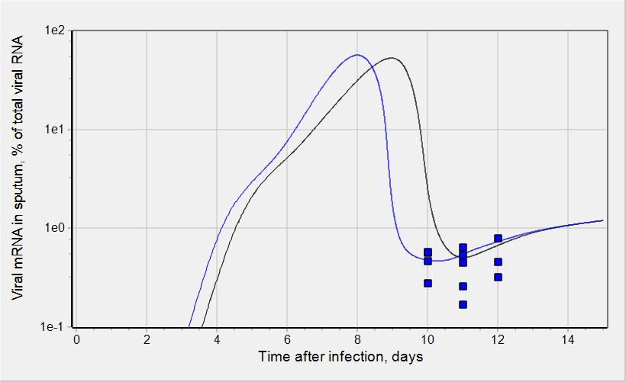
Reproduction of clinical data on viral load dynamics
Viral load and % of viral subgenomic mRNA in sputum were simulated
IR was implemented in empiric way as described earlier with following parameters:
T_sw_ir = 50 {units: h};
ET50_ir = 190 {units: h};
Emax_ir_apo = 800 {units: UL};
n_ir = 5 {units: UL};
Kd_anti_Ab = 14300 {units: pM};
anti_Ab_max = 941000 {units: pM};
Wolfer et al, doi.org/10.1101/
2020.03.05.20030502
Wolfer et al, doi.org/10.1101/
2020.03.05.20030502
Time/value of peak viral load and range of viral shedding [PMID 32315724]
Wolfer et al, doi.org/10.1101/
2020.03.05.20030502
Virus initial concentration: 3370 copies/mL
6740 copies/mL
Virus initial concentration: 3370 copies/mL

Slide 12
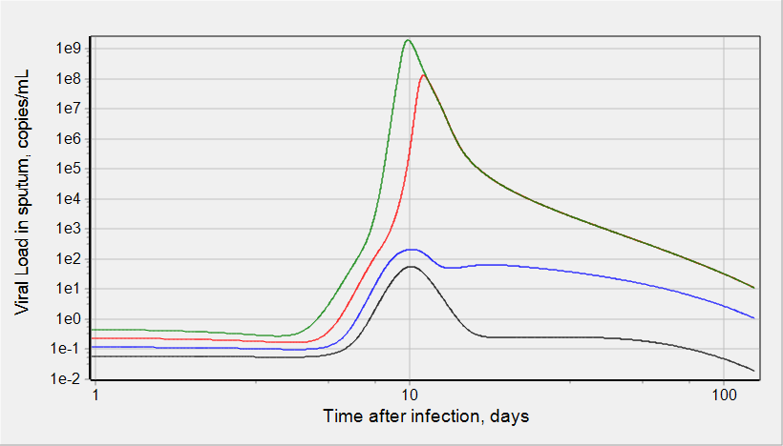
Simulations: Viral load dynamics
Virus initial concentration:
843 copies/mL
1685 copies/mL
3370 copies/mL
6740 copies/mL
Limit of detection
There is a threshold in virus initial concentration.
The values above the threshold lead to substantial and transient virus load in sputum.
The values below the threshold do not allow detect virus in sputum at any time.
Increase in virus initial concentration results in higher peak of viral load which is faster achieved.

Slide 13
Dots are experimental data
Solid lines are model simulations

Slide 14
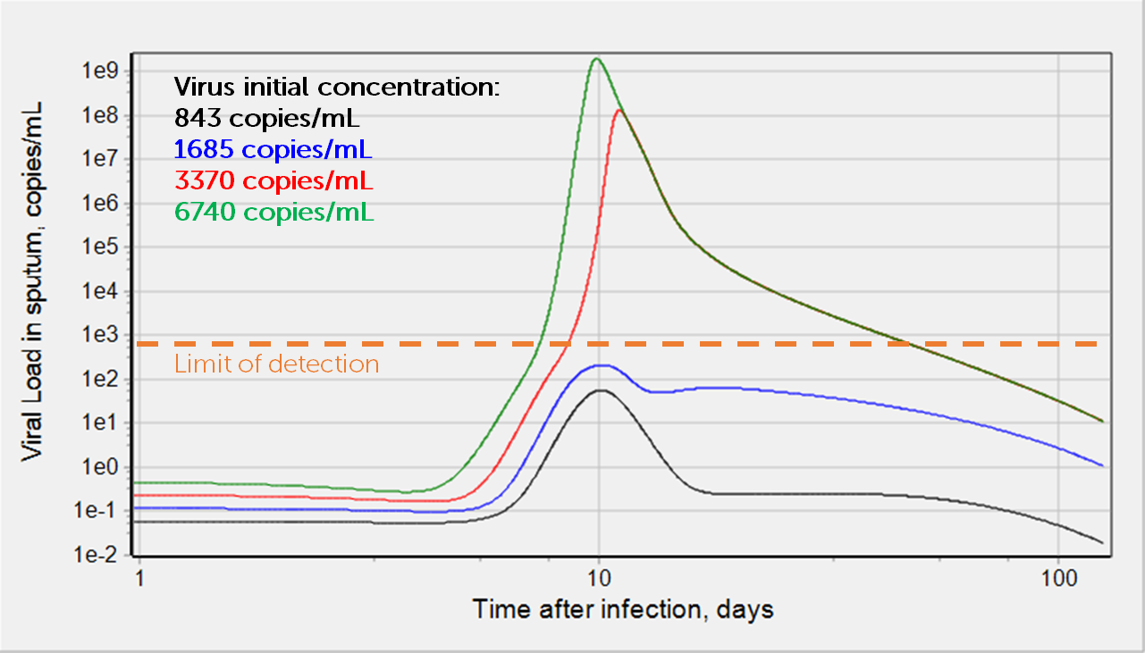
Model simulations and experimental data
Wolfer et al, doi.org/10.1101/
2020.03.05.20030502
Time/value of peak viral load and range of viral shedding [PMID 32315724]
Wolfer et al, doi.org/10.1101/
2020.03.05.20030502
Virus initial concentration: 3370 copies/mL
6740 copies/mL
Virus initial concentration: 3370 copies/mL
Dots are experimental data
Solid lines are model simulations
There is a threshold in virus initial concentration.
The values above the threshold lead to substantial and transient virus load in sputum.
The values below the threshold do not allow detect virus in sputum at any time.
Increase in virus initial concentration results in higher peak of viral load which is faster achieved.

