Slide 1
Exploration of role of immune response in treatment efficacy of HCV patients with combinations of direct antiviral agents
Oleg Demin Jr
Laboratory α [Alpha]

Slide 2
Introduction
Clinical data indicates [PLoS One. 2012;7(9):e45698, Aliment Pharmacol Ther. 2012 Jul;36(2):104-14] that depending on individual patient characteristics and initial viral load there are two possible outcomes of the HCV infection. Indeed, virus concentration initially introduced to the blood either can be eliminated by immune system of a subject without any treatment [J Med Virol. 2003 Sep;71(1):56-61] or starts to grow leading to chronic hepatitis C (CHC).
Significant number of patients with CHC develops liver cirrhosis (is 15–30% within 20 years) and subsequent complications such as hepatocellular carcinoma (HCC) [The New England Journal of Medicine 364 (25): 2429–38]. So fibrotic change of liver tissues is one of the key components of the disease pathogenesis.
There are many indirect facts [J Viral Hepat. 2002 Jan;9(1):18-28; J Acquir Immune Defic Syndr. 2014 Nov 1;67(3):295-303; Mol Cells. 2014 Jan;37(1):66-73; J Virol. 2001 Jun;75(12):5550-8; Eur J Immunol. 2008 Oct;38(10):2665-77; J Hepatol. 2005 Nov;43(5):776-82] demonstrating that HCV could suppress immune response
correlation of IFNg positive CD4 T cells and MDSC levels with HCV level
increase of CD4 and CD8 levels and decrease MDSC level in during treatment, etc
CHC treatments includes
Interferon + ribavirin (PI2a + RBV): long period of treatments, about 50% non-responders
Direct antiviral agents (DAA) and their combinations: very effective and expensive challenges: (i) decrease in treatment period, (ii) prediction of success rate of different combinations
Nivolumab is PD-1 inhibitor approved for cancer treatment. PD-1 is expressed on CD8 T cells and its binding with PD-L1 on target cell (cancer cell, infected hepatocyte) inhibits specific lysis of target cell by CD8 T cell. Thus, PD-1 inhibitor stimulates immune cells to kill target cells. Potentially, immunotherapy (PD-1, PD-L1, CTLA-4 inhibitors etc) could be used in treatment of viral infections (HCV, HBV, HIV etc).

Slide 3
Questions to address
Aims of the study
To develop model of HCV Progression and Liver Fibrosis (HPLF) which can describe:
Dynamics of HCV and ALT in plasma during disease progression
Hepatocytes infection and proliferation
Fibrosis development during disease progression
Death of infected hepatocytes driven by Immune Response
Immune Response suppression with HCV
To implement in HPLF model
the therapy of CHC patients with GT1 virus with 17 DAAs and their combinations and predict the treatment outcomes observed in clinical trials
primary endpoint of clinical trials (SVR12) and predict the DAA combinations treatment outcomes of ongoing clinical trials
the therapy of CHC patients with PD-1 inhibitor Nivolumab and to predict treatment outcome observed in clinical trials
3) To explore mode of “efficacy drug-drug” interactions in combo treatments with DAAs
4) To explore contribution of immune response to efficacy of treatment of CHC patients with
DAAs.
5) To predict differences in response of CHC patients treated with DAAs and PD-1 inhibitor.

Slide 4
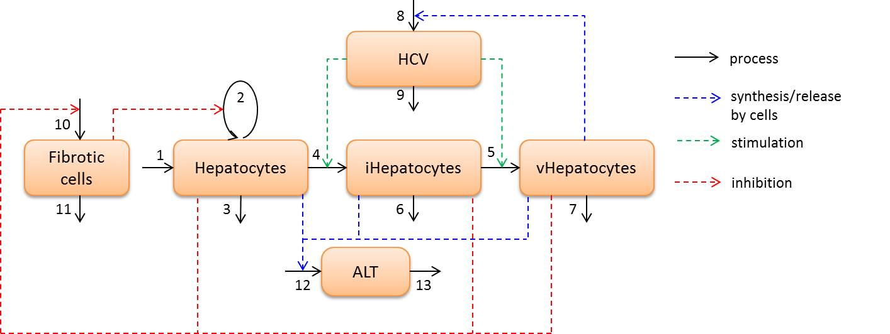
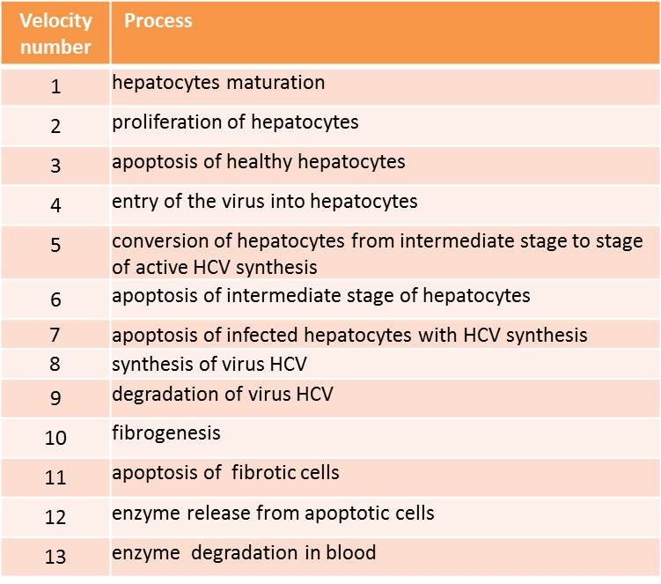
HCV model scheme
Hepatocytes - healthy hepatocytes with the ability to proliferate
iHepatocytes - an intermediate stage where the virus has entered
the cell, but they still do not produce new copies.
vHepatocytes - infected hepatocytes able to produce HCV
HCV – plasma concentration of virus
ALT – activity of ALT in plasma
Fibrotic cells – concentration of fibrotic cells
Key experimental facts and assumptions:
We assume that transition of infected cells to the cells, which a able to produce HCV, depends on the intracellular viral concentration.
In case of damage or destruction of cells rich in ALT (liver, heart muscle, skeletal muscle, kidney), this enzyme is released into the bloodstream, which leads to an increase of its activity in blood [Lancet. 2000, 355:1463-4; Hepatology. 2008 ,47:1363-70]
Fibrosis develops gradually, reducing the ability of the liver to proliferate as hepatocytes are replaced by fibrous tissue [Hepatology. 2005, 42:1373-81; Hepatology. 1993, 18:79-85]
Model describes:
Hepatocytes proliferation for healthy subjects and HCV patients
Liver regeneration after partial hepatectomy for healthy subjects and HCV patients
HCV and ALT dynamics and fibrosis during disease progression
HPLF model was calibrated against the data on viral dynamics, fibrosis development, hepatocytes proliferation and level of infected hepatocytes during disease progression.

Slide 5
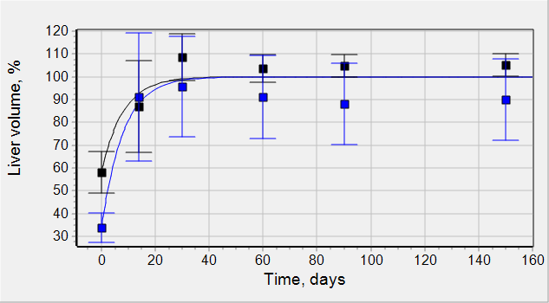
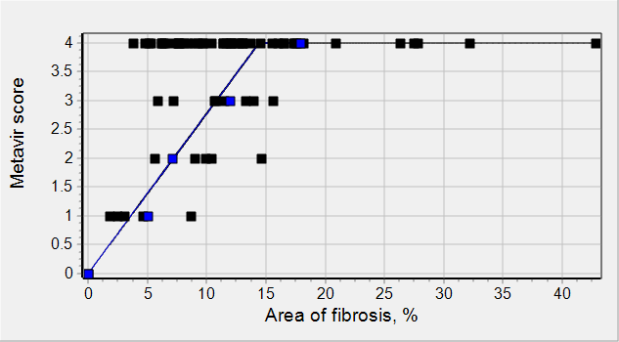
Hepatocytes proliferation and fibrosis description
Model calibration against healthy subjects data
Liver regeneration after resection
The parameters of liver proliferation were fitted against the experimental data on liver resection for normal patients with middle resection (30-50% of resection) and normal patients with large resection (≥50% resection)
fitting
[Hepatology. 1993 Jul;18(1):79-85]
Normal patients with middle resection (30-50% of resection), n=6
Normal patients with large resection (≥50% resection), n=7
Clinically, the level of fibrosis is characterized be metavir score [Lancet. 1997 Mar 22;349(9055):825-32, Hepatology. 2005 Dec;42(6):1373-81]. To express metavir score in terms of hepatocyte and fibrotic cell numbers we have used clinically measured dependence of metavir score on area of fibrosis.
fitting
[Liver Int. 2010 Oct;30(9):1346-54]
[Hepatology. 2005 Dec;42(6):1373-81]
Patients with NAFLD [Liver Int. 2010 Oct;30(9):1346-54]
Patients with HCV or HBV [Hepatology. 2005 Dec;42(6):1373-81]
If Area of fibrosis < 14.5% =>
Metavir = k_metavir * Area_of_fibrosis
If Area of fibrosis > 14.5% =>
Metavir = 4
We have assumed that area of fibrosis is a fraction of fibrotic cells in liver:
Area of fibrosis (%) = 100*Fibrotic cells number / (Fibrotic cells number + Hepatocyte number)

Slide 6
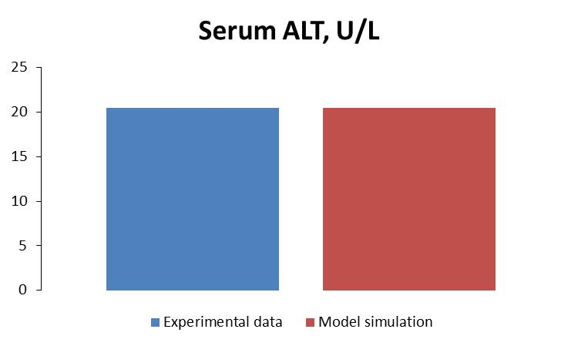
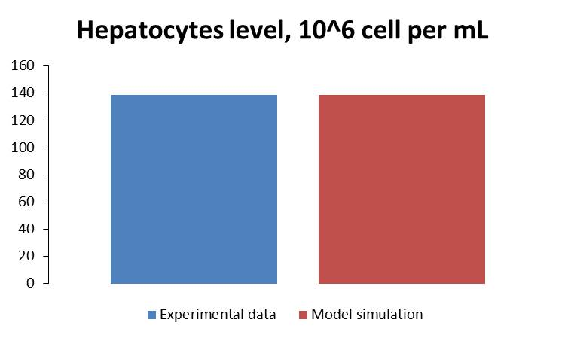
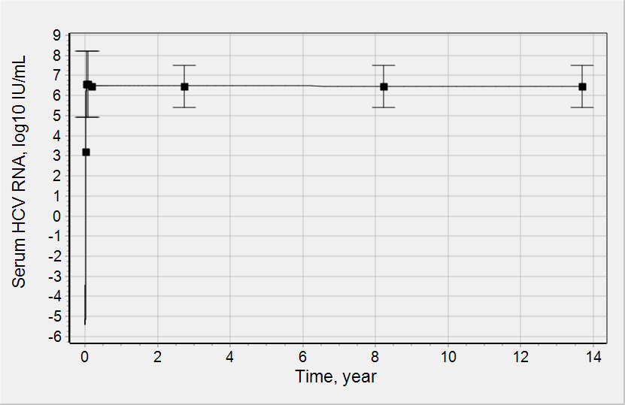
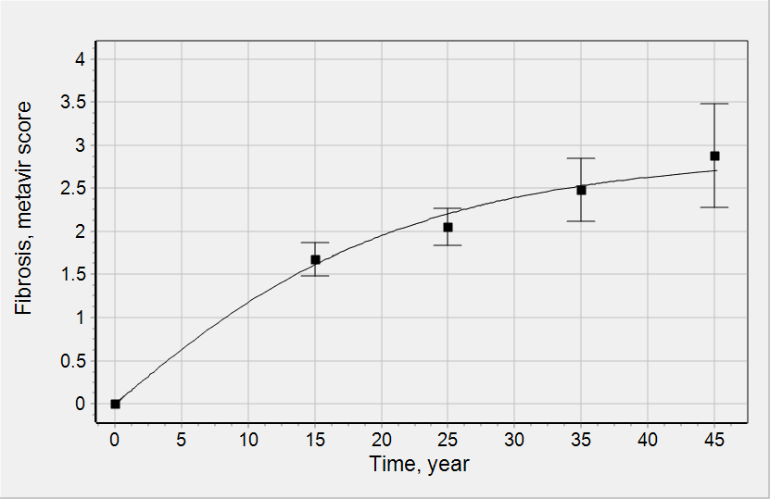
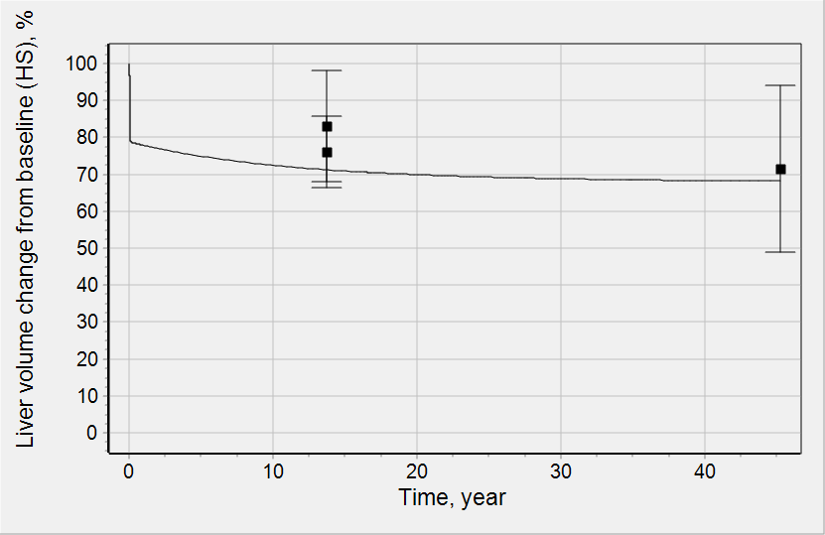
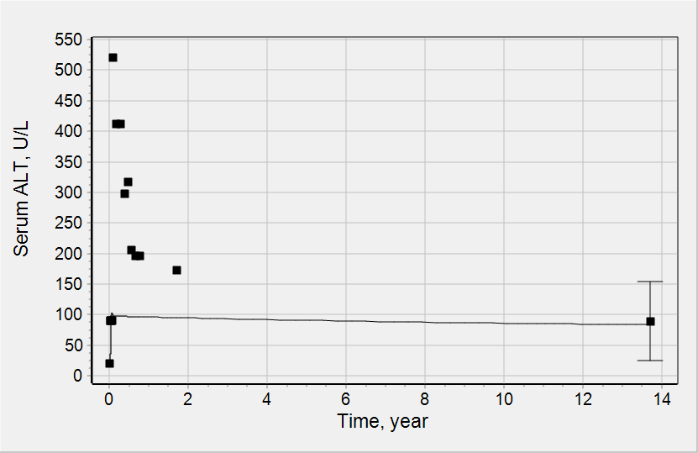
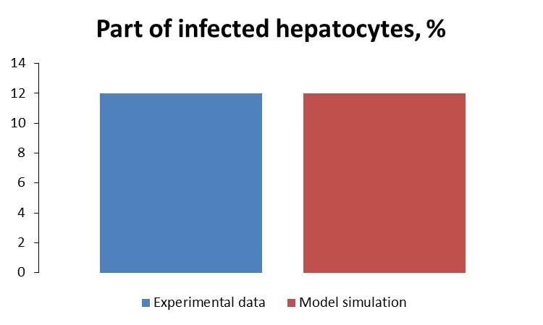
HCV progression description
Model calibration against healthy subjects and CHC data
Healthy subject steady state:
fitting
fitting
J Gastroenterol Hepatol. 2013 Mar;28(3):522-9.
Toxicol In Vitro. 2006 Dec;20(8):1582-6.
HCV progression and chronic HCV steady state:
Limitation: current version of model do not describes ALT dynamics of acute HCV
Lancet. 1997 Mar 22;349(9055):825-32.
HEPATOLOGY, Vol. 36, No. 5, Suppl. 1, 2002
Transfusion. 2005 Jun;45(6):994-1002.
fitting
fitting
Hepatology. 2005 Jul;42(1):86-92.
fitting
Hepatology. 2004 Jun;39(6):1721-31.
Hepatology. 1993 Jul;18(1):79-85.
fitting
fitting
J Mol Diagn. 2005 Oct;7(4):535-43.

Slide 7
Implementation of immune response in model
Modulation in Immune Response (IR_function)
Immune Response (IR) contribute to infected cell death
IR was implemented in the model in empiric way, i.e. no variables describing dynamics of key components of Immune Systems were not introduced
Rate constants of infected cell death reflect basal IR specific for CHC patients
Increase in IR due to HCV decline was taken into account
Rate equations of infected hepatocytes death (apoptosis) were multiplied by IR_function :
V_apo_vhep = k_apo * vHep * IR_function
IR_function = f(HCV, number of infected hepatocytes)
IR_function is dimensionless function describing dependence of fold increase in immune response (immune cells – CD4, CD8) on HCV decrease (CHC patient as a baseline) and infected hepatocytes level (antigen)
We assumed that decrease in HCV will lead to stimulation of immune response, i.e. increase of infected hepatocytes death. This effect is independent from the type of treatment.

Slide 8
Calibration of immune response
To fit parameters of IR_function we utilized available data on treatment of CHC patients with PI2a + ribavirin.
Different subpopulations of CHC patients (responders vs non-responders) with respect to response to PI2a + ribavirin treatment were considered
Following characteristics were measured in the studies
HCV RNA change in serum
Changes in count of CD8 T cell in blood
Changes in count of CD8 T cell in blood
Changes in count of MDSC (myeloid derived suppressor cells) cell in blood
For each clinical study IC50s responsible for PI2a effect were fitted against “HCV RNA change” data
HCV dynamics (specific for each study) were used as forcing function
Dynamics of fold changes in CD8 T cell measured in study with fast responders were used to fit parameters of IR_function
Dynamics of fold changes in CD4 T cell and MDSC measured in study with both slow and fast responders were used to validate model of Immune Response
RBV
PI2a
IR_function

Slide 9
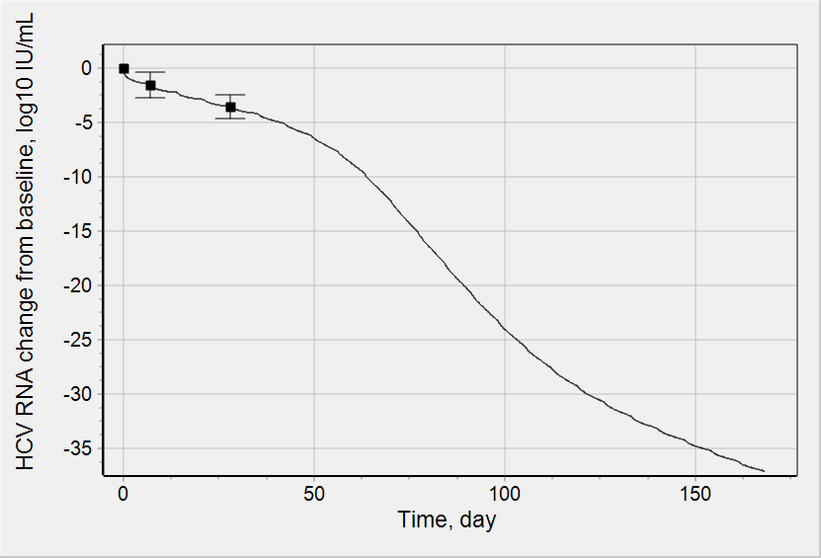
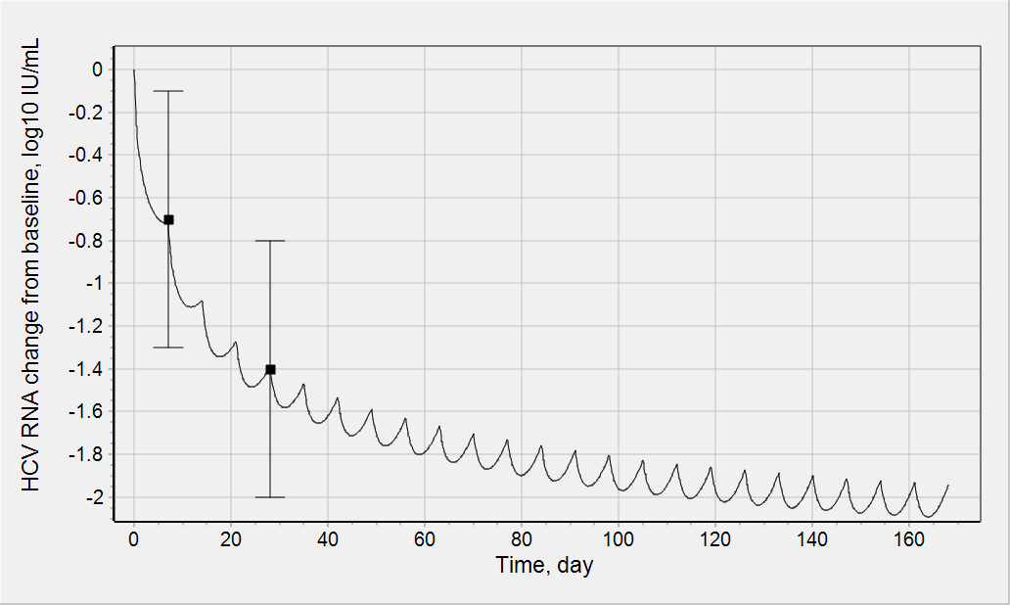
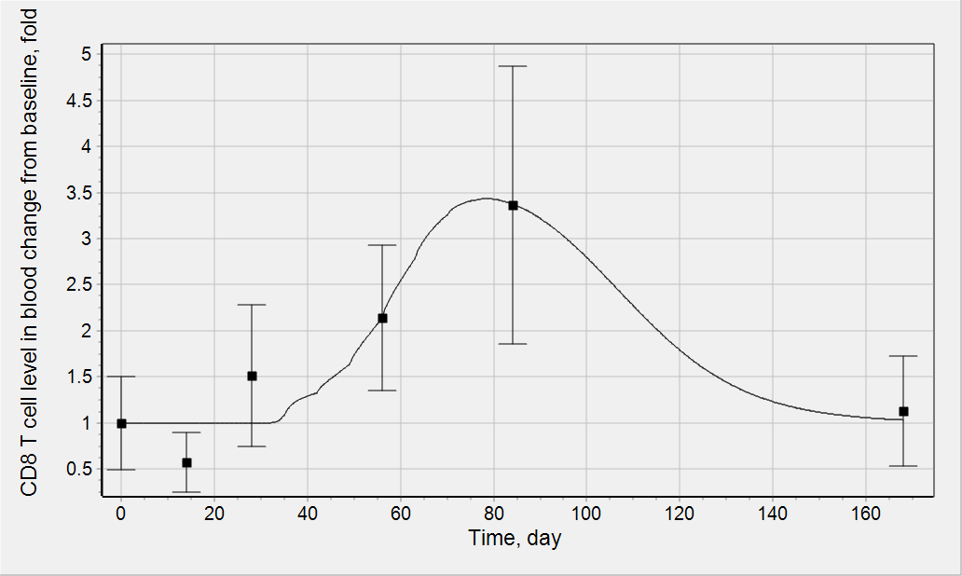
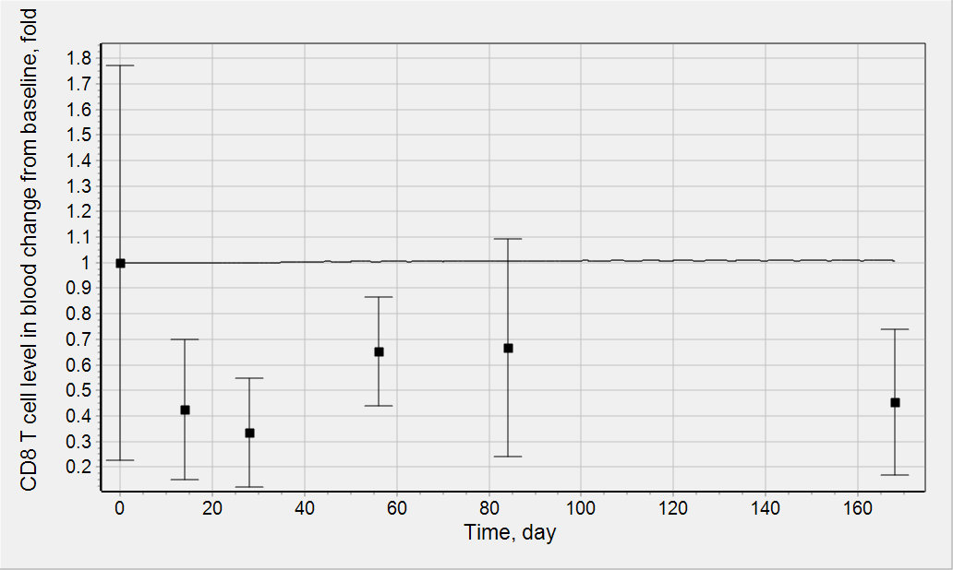
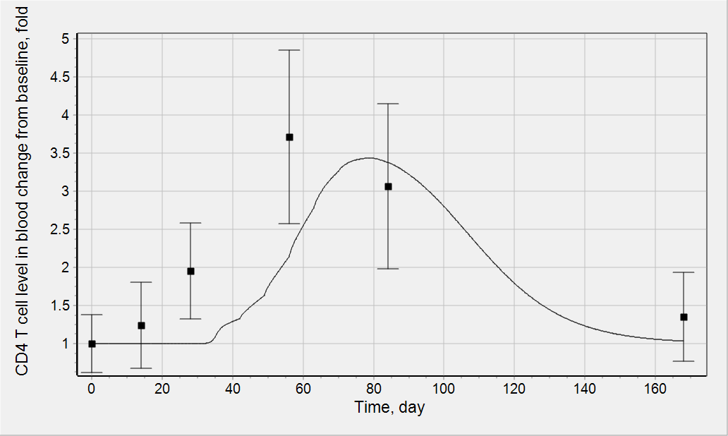
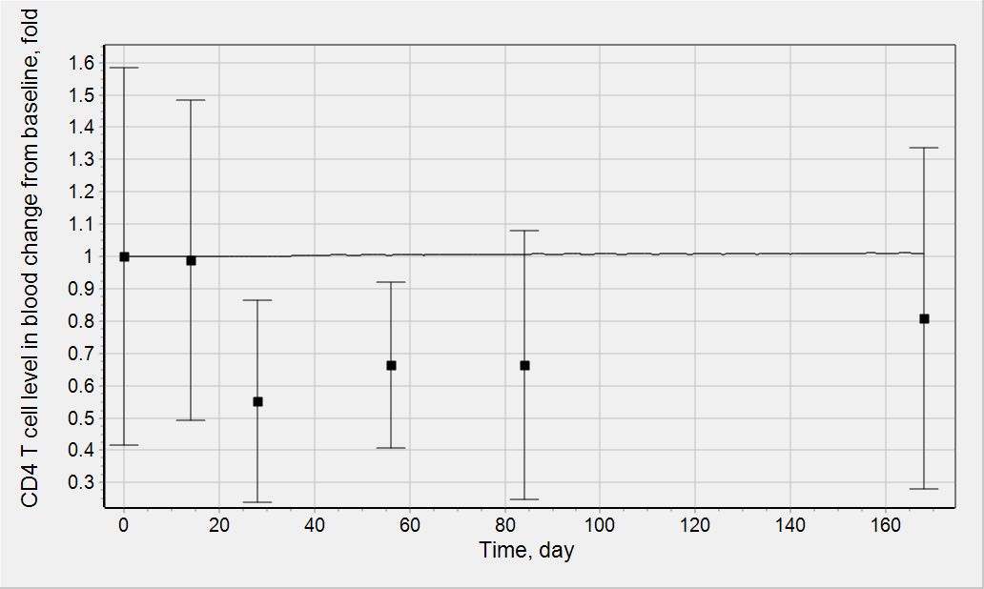
Calibration and validation of immune response
The data of change in CD8 T cells (CD8 T cells induce specific lysis of infected hepatocytes) was used for fitting of IR_function parameters.
Data on CD4 T cell change and one curve with CD8 T cell change was used for validation. Data: J Hepatol. 2005 Nov;43(5):776-82.
CD8_fold_increase = CD4_fold_increase = IR_function
Fast Responders
Slow Responders
Treatment:
PI2a + ribavirin
fitting
fitting
To describe data the delay in immune response activation was introduced. The parameters of delay were fitted against data on CD8 T cells. That is why there is lag in CD4 T cell increase simulation, because CD4 T cells activated before CD8 T cells.
fitting
validation
validation
validation

Slide 10
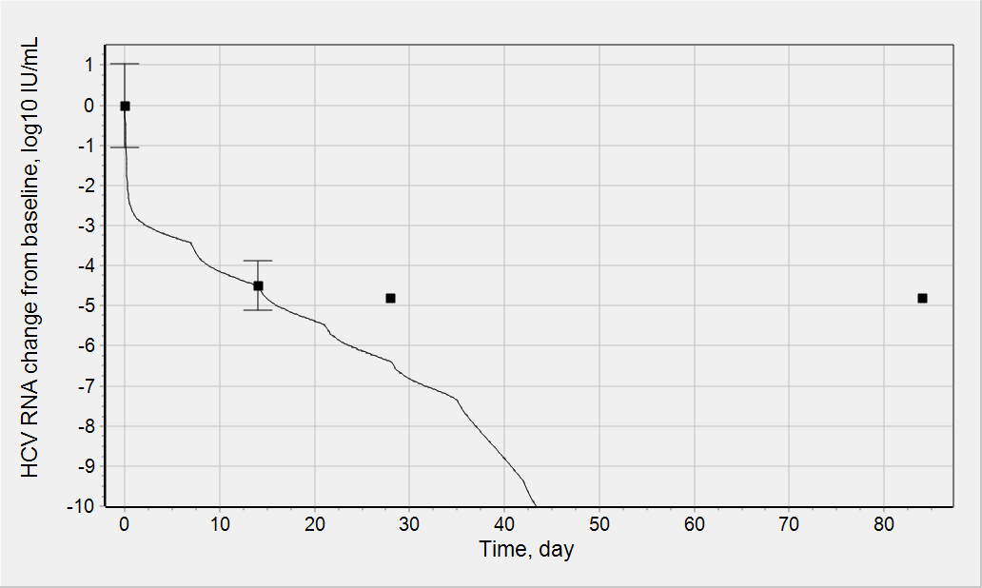
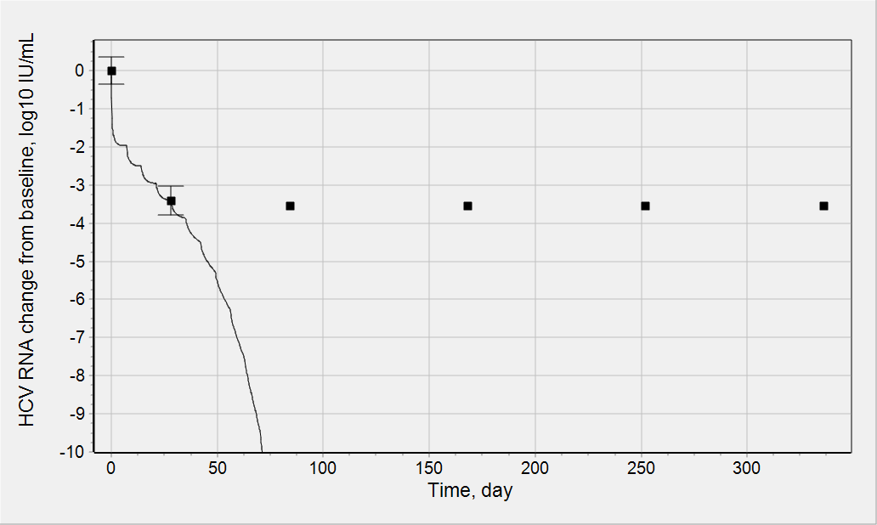
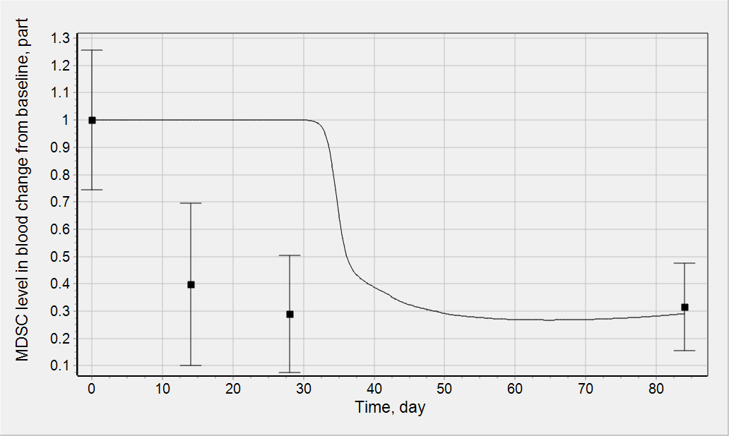
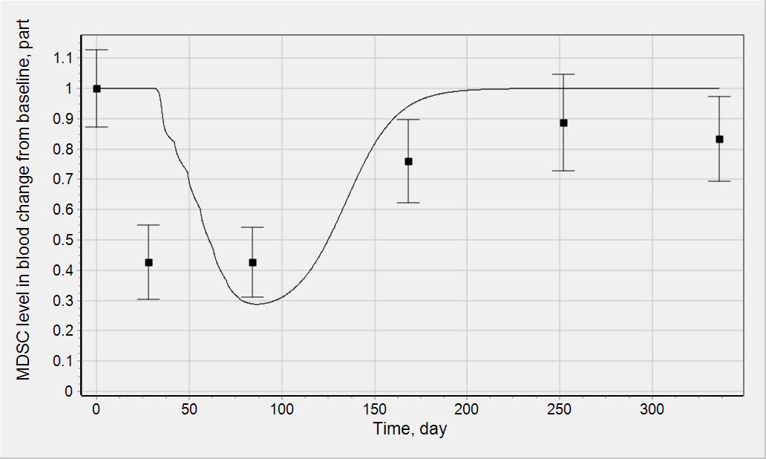
Validation of immune response
The data of change in MDSC (myeloid derived suppressor cells) was used for validation.
MDSC_change = 1/IR_function.
MDSC is CD4 and CD8 suppressor cells, that is why their change is opposite to CD8 and CD4 T cells.
Treatment:
PI2a + ribavirin
Mol Cells. 2014 Jan;37(1):66-73.
fitting
fitting
LLOQ
LLOQ
To describe data the delay in immune response activation was introduced. The parameters of delay were fitted against data on CD8 T cells. That is why there is lag in MDSC decrease simulation.
J Clin Immunol. 2013 May;33(4):798-808.
Mol Cells. 2014 Jan;37(1):66-73.
validation
validation
J Clin Immunol. 2013 May;33(4):798-808.
Conclusions:
HPLF model was developed, calibrated and validated
It can be applied to describe DAAs and PD-1 effect and to address questions of the project

Slide 11
Implementation of DAAs in model
DAA
IR_function
17 DAAs were included in the model: sofosbuvir, ledipasvir, asunapervir, daclatasvir, beclabuvir, grazoprevir, elbasvir, MK-3682, velpatasvir (GS-5816), GS-9669, GS-9857, vedroprevir, ACH-3102, ACH-3422, sovaprevir, ABT-493, ABT-530.
Depending on DAA type their effect on HCV production is described by either Emax model or Emax model with additional variable/compartment responsible for complex PK/PD relationships

Slide 12
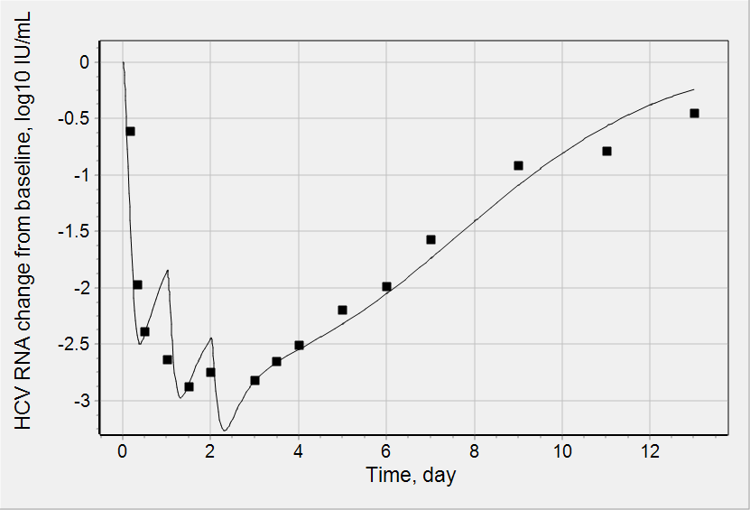
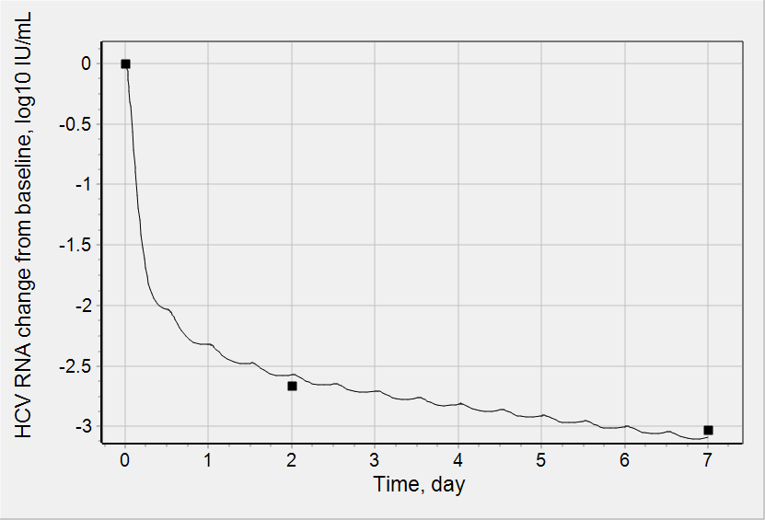
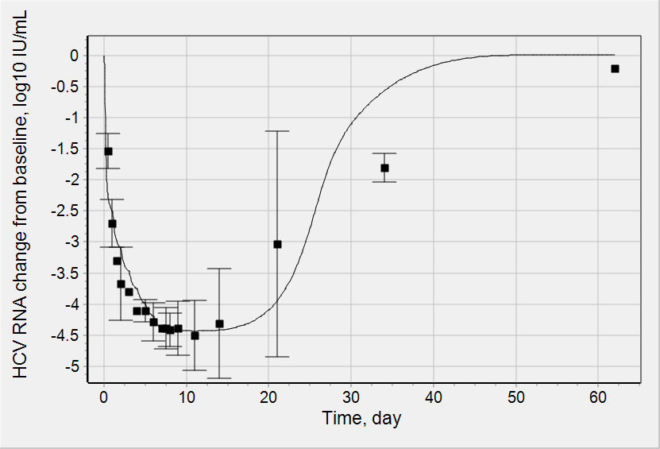
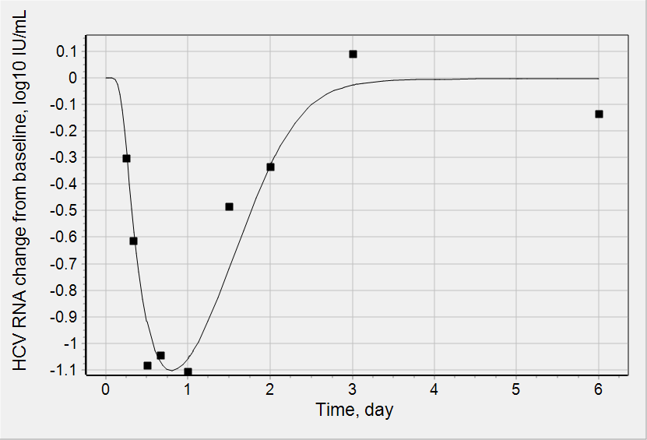
Calibration of DAAs PK and PD
DAA PK and available data on “PK drug-drug interactions” were reproduced in the model.
The efficacy parameters of each DAA were fitted against data on HCV decline during monotherapy.
Only GT1 data was used.
EXAMPLES only. In total about 80 fitting curves with the same quality is available
60 mg QD (during 3 days) ledipasvir
30 mg BID (during 7 days) daclatasvir
fitting
Hepatology. 2011 Dec;54(6):1956-65.
fitting
J Hepatol. 2012 Jul;57(1):24-31.
100 mg QD (during 7 days) grazoprevir
100 mg SD beclabuvir
fitting
Safety and Antiviral Activity of MK-5172, a Next Generation HCV NS3/4A Protease Inhibitor with a Broad HCV Genotypic Activity Spectrum and Potent Activity Against Known Resistance Mutants, in genotype-1 and -3 HCV-Infected Patients. HepDART 2011
fitting
Antimicrob Agents Chemother. 2014 Jun;58(6):3496-503.
Conclusions:
DAAs were implemented in HPLF model
PK/PD parameters of DAAs were identified on the basis of data on monotherapies

Slide 13
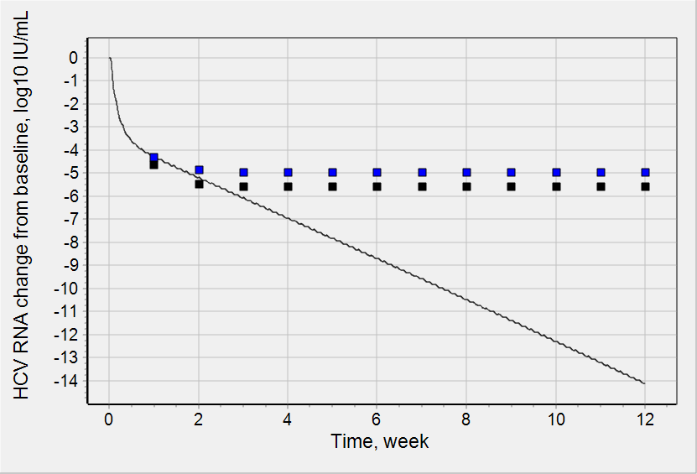
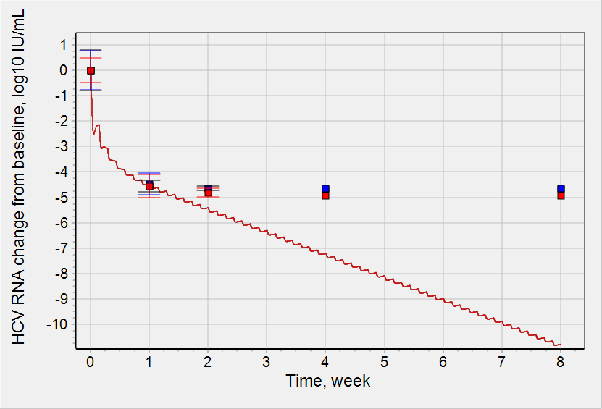
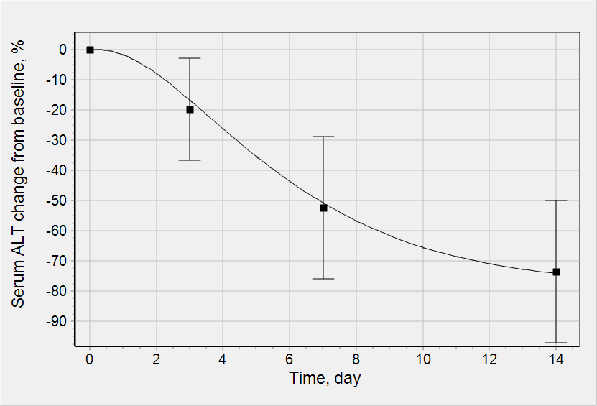
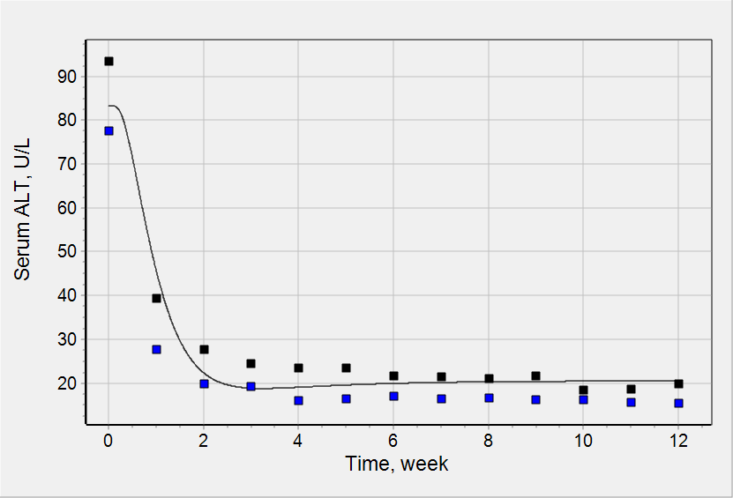
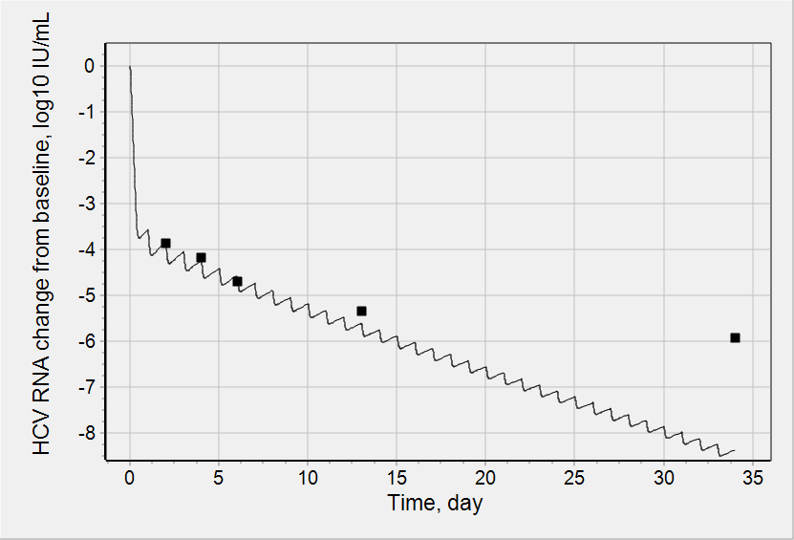
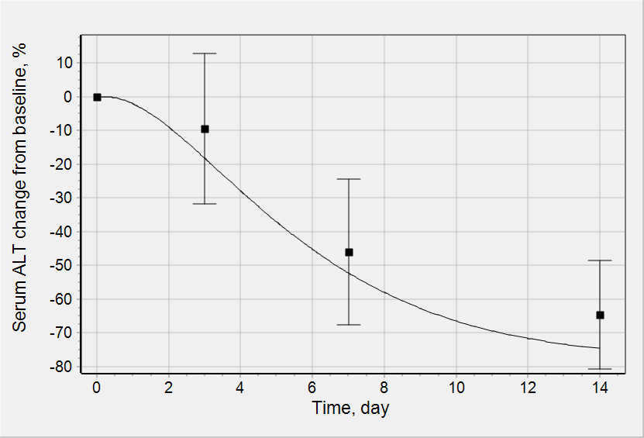
Validation of DAAs PK and PD
The data on HCV decline (GT1 only) during combo treatment and data on ALT during monotherapy and combo treatment was used for model validation
Two types of “efficacy drug-drug interaction” in combo treatments were considered: additive vs synergistic. “Additive” mode corresponds to sum of Emax functions for each DAA in combo. “Synergistic” mode corresponds to product of Emax functions of drugs in combo treatment
EXAMPLES only. In total about 30 validation curves with the same quality is available
400 mg QD SOF + 800-1200 mg daily RBV
400 mg QD SOF + 60 mg QD LDV
50 mg QD GZR
validation
Safety and Antiviral Activity of MK-5172, a Next Generation HCV NS3/4a Protease Inhibitor with a Broad HCV Genotypic Activity Spectrum and Potent Activity Against Known Resistance Mutants, in Genotype 1 and 3 HCV-Infected Patients. AASLD 2011
LLOQ
Lancet. 2014 Feb 8;383(9916):515-23.
LLOQ
validation
N Engl J Med. 2013 Jan 3;368(1):34-44.
validation
400 mg QD SOF + 800-1200 mg daily RBV
100 mg QD GZR + 50 mg QD EBR
800 mg QD GZR
N Engl J Med. 2013 Jan 3;368(1):34-44.
High Efficacy and Safety of the All-Oral Combination Regimen, MK-5172 / MK-8742 ± RBV for 12 Weeks in HCV Genotype 1 Infected Patients: The C-WORTHY Study. APASL 2014
Safety and Antiviral Activity of MK-5172, a Next Generation HCV NS3/4a Protease Inhibitor with a Broad HCV Genotypic Activity Spectrum and Potent Activity Against Known Resistance Mutants, in Genotype 1 and 3 HCV-Infected Patients. AASLD 2011
validation
LLOQ
validation
validation
LLOQ = Low limit of quantification
CONCLUSION: Only additive effect of DAAs in combination allows to reproduce data on combination therapy.

Slide 14
Implementation and calculation of SVR12
SVR12 is sustained viral response at 12 week. This is primary endpoint of clinical trials indicating number of patients with serum HCV RNA below LLOQ 12 weeks after treatment completion. SVR12 is expressed in % from total number of patients involved in clinical trials.
To reproduce SVR12 in the model we assumed that all model parameters (except IC50) are the same for all patients
To take into account variability in patients IC50 for each specific DAA was described as log normal distribution. The mean of the distribution is value obtained from monotherapy fitting and SD was calculated on the basis of in vitro data on resistance for mutated virus (different values of IC50s were available in literature). It is known that HCV can mutate under DAA treatment. These mutations results in changes in IC50
We assumed that IC50s for different DAA in combo treatment are independently distributed
Random values of IC50 from each particular distribution were chosen and virus load dynamics resulted from the particular combo treatment was simulated for the chosen IC50 value
Number of randomly selected values of IC50 corresponds to number of patients involved in particular clinical trials.
For each virtual patient (IC50 value) virus load at 12 weeks after treatment completion was simulated. Basing on the values simulated SVR12 were calculated
Each clinical trial was simulated 10 times. Simulated mean SVR12 value and range was calculated
Model limitations: only SVR12 could be simulated (not RVR, EVR, EOT, SVR4).

Slide 15
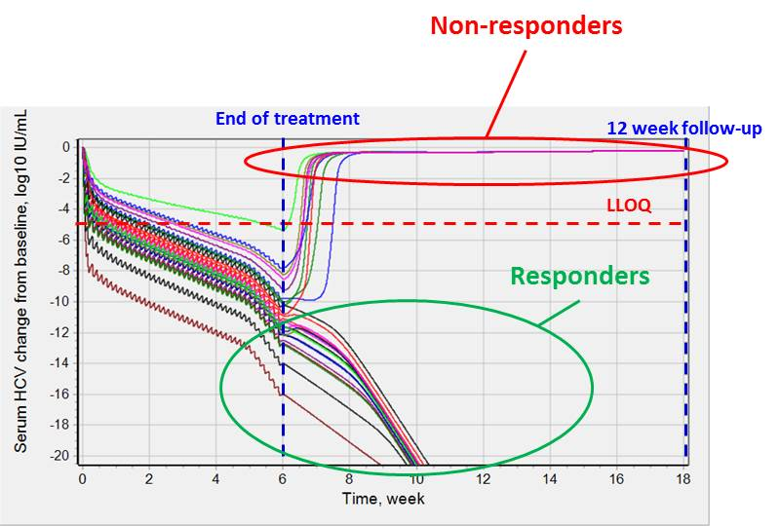
Example of simulations and calculation of predicted SVR12
Implementation and calculation of SVR12
Combo treatment: sofosbuvir (400 mg QD) + ledipasvir (90 mg QD) + ribavirin (1000-1200 mg daily)
Duration of treatment: 6 weeks
Number of patients involved in clinical trial (in accordance with literature data): 25
HCV dynamics for 1 of 10 simulated clinical trials is presented.
16 of 25 patients are responders. 9 are non-responders.
Thus, SVR12 = 16/25 = 64% for this virtual trial.

Slide 16
Calibration of the model against SVR12 data
SVR12 from 3 clinical trials (GT1) was used for model verification:
Treatment | Model SVR12, % |  | (range n)/N | Experimental (excluding lost) SVR12, % | n/N | Clinical Trial ID
 | Mean | Range
SOF (400 mg QD) + LDV (90 mg QD) 12wk | 98.09 | 97.13 - 99.04 | (203 - 207)/209 | 98.56 | 206/209 | NCT01851330
GZR (100 mg QD) + EBR (50 mg QD) + SOF (400 mg QD) 4wk | 38.67 | 23.33 - 50.00 | (7 - 15)/30 | 33.33 | 10/30 | C-SWIFT
SOF (400 mg QD) + LDV (90 mg QD) + RBV (1000-1200 mg daily) 6wk | 51.20 | 36.00 - 64.00 | (9 - 16)/25 | 68.00 | 17/25 | NCT01260350

Slide 17
Validation of the model against SVR12 data
SVR12 from 25 clinical trials (GT1) was used for model validation:
Each clinical trial was simulated 10 times.
Treatment | Model SVR12, % |  | (range n)/N | Experimental (excluding lost) SVR12, % | n/N | Clinical Trial ID
 | Mean | Range
SOF (400 mg QD) + LDV (90 mg QD) 8wk | 95.49 | 92.96 - 98.12 | (198 - 209)/213 | 94.84 | 202/213 | NCT01851330
SOF (400 mg QD) + LDV (90 mg QD) 24wk | 98.83 | 98.13 - 99.53 | (210 - 213)/214 | 99.07 | 212/214 | NCT01701401
GZR (100 mg QD) + EBR (50 mg QD) + SOF (400 mg QD) 6wk | 99.00 | 96.67 - 100 | (29 - 30)/30 | 86.67 | 26/30 | C-SWIFT
ASV (100 mg BID) + DCV (60 mg QD) 24wk | 81.30 | 77.50 - 84.50 | (155 - 169)/200 | 91.00 | 182/200 | NCT01581203
ASV (200 mg BID) + DCV (30 mg BID) + BCV (75 mg BID) 12wk | 98.57 | 96.10 - 100 | (74 - 77)/77 | 92.21 | 71/77 | NCT01455090
ASV (200 mg BID) + DCV (30 mg BID) + BCV (150 mg BID) 12wk | 99.76 | 98.81 - 100 | (83 - 84)/84 | 91.67 | 77/84 | NCT01455090
GZR (100 mg QD) + EBR (50 mg QD) 8wk | 99.68 | 96.77 - 100 | (30 - 31)/31 | 93.55 | 29/31 | NCT01717326
GZR (100 mg QD) + EBR (50 mg QD) 12wk | 100.00 | 100 - 100 | (44 - 44)/44 | 97.73 | 43/44 | NCT01717326
SOF (400 mg QD) + LDV (90 mg QD) + GS-9669 (500 mg QD) 6wk | 58.50 | 40.00 - 80.00 | (8 - 16)/20 | 95.00 | 19/20 | NCT01805882
SOF (400 mg QD) + LDV (90 mg QD) + GS-9669 (500 mg QD) 8wk | 100.00 | 100 - 100 | (8 - 8)/8 | 100.00 | 8/8 | NCT01984294
SOF (400 mg QD) + LDV (90 mg QD) + GS-9669 (500 mg QD) + VDV (200 mg QD) 4wk | 7.92 | 4.17 - 12.50 | (1 - 3)/24 | 20.83 | 5/24 | NCT01805882
SOF (400 mg QD) + LDV (90 mg QD) + VDV (200 mg QD) 4wk | 6.80 | 0 - 16.00 | (0 - 4)/25 | 40.00 | 10/25 | NCT01805882
SOF (400 mg QD) + LDV (90 mg QD) + VDV (200 mg QD) 6wk | 62.61 | 52.17 - 73.91 | (12 - 17)/23 | 73.91 | 17/23 | NCT01805882
SOF (400 mg QD) + GS-5816 (100 mg QD) 8wk | 96.55 | 93.10 - 100 | (27 - 29)/29 | 89.66 | 26/29 | NCT01858766
SOF (400 mg QD) + GS-5816 (100 mg QD) 12wk | 99.29 | 96.43 - 100 | (27 - 28)/28 | 100.00 | 28/28 | NCT01858766
SOF (400 mg QD) + GS-5816 (100 mg QD) + GS-9857 (100 mg QD) 4wk | 42.67 | 13.33 - 66.67 | (2 - 10)/15 | 26.67 | 4/15 | NCT02202980
SOF (400 mg QD) + GS-5816 (100 mg QD) + GS-9857 (100 mg QD) 6wk | 100.00 | 100 - 100 | (15 - 15)/15 | 93.33 | 14/15 | NCT02202980
SOF (400 mg QD) + GS-9669 (500 mg QD) 12wk | 98.75 | 95.83 - 100 | (23 - 24)/24 | 95.83 | 23/24 | NCT01260350
SOF (400 mg QD) + ACH-3102 (50 mg QD) 6 wk | 95.00 | 91.67 - 100 | (11 - 12)/12 | 100.00 | 12/12 | Proxy
SOF (400 mg QD) + ACH-3102 (50 mg QD) 8 wk | 100.00 | 100 - 100 | (12 - 12)/12 | 100.00 | 12/12 | Proxy
SOF (400 mg QD) + DCV (60 mg QD) 12wk | 98.05 | 92.68 - 100 | (38 - 41)/41 | 100.00 | 41/41 | NCT01359644
SOF (400 mg QD) + RBV (1000-1200 mg daily) 24wk | 95.00 | 89.29 - 100 | (25 - 28)/28 | 85.71 | 24/28 | NCT01896193
SOF (400 mg QD) + RBV (1000-1200 mg daily) 16wk | 94.29 | 89.29 - 100 | (25 - 28)/28 | 57.14 | 16/28 | NCT01896193
SOF (400 mg QD) + RBV (1000-1200 mg daily) 12wk | 93.16 | 78.95 - 100 | (15 - 19)/19 | 52.63 | 10/19 | NCT01435044
SVV (400 mg QD) + ACH-3102 (50 mg QD) + RBV (1000-1200 mg daily) 12wk | 100.00 | 100 - 100 | (4 - 4)/4 | 100.00 | 4/4 | NCT01849562
Not all combinations are described perfectly, but all data are described at least in qualitative manner.

Slide 18
Validation of SVR12 in ongoing clinical trials
Results of available ongoing clinical trials (GT1) were predicted:
Each clinical trial was simulated 10 times.
Treatment | Model SVR12, % |  | (range n)/N* | Experimental (excluding lost) SVR12, % | n/N* | Clinical Trial ID
 | Mean | Range
ABT-493 (200 mg QD) + ABT-530 (40 mg QD) 8wk | 100.00 | 100 - 100 | (30 - 30)/30 | ? | ?/30 | NCT02243280
ABT-493 (200 mg QD) + ABT-530 (40 mg QD) 12wk | 100.00 | 100 - 100 | (40 - 40)/40 | ? | ?/40 | NCT02243280
ABT-493 (200 mg QD) + ABT-530 (120 mg QD) 8wk | 100.00 | 100 - 100 | (30 - 30)/30 | ? | ?/30 | NCT02243280
ABT-493 (200 mg QD) + ABT-530 (120 mg QD) 12wk | 100.00 | 100 - 100 | (40 - 40)/40 | ? | ?/40 | NCT02243280
SOF (400 mg QD) + ASV (200 mg BID) + DCV (30 mg BID) + BCV (75 mg BID) 4wk | 0.00 | 0 - 0 | (0 - 0)/15 | ? | ?/15 | NCT02175966
SOF (400 mg QD) + ASV (200 mg BID) + DCV (30 mg BID) + BCV (75 mg BID) 6wk | 8.67 | 0 - 33.33 | (0 - 5)/15 | ? | ?/15 | NCT02175966
SOF (400 mg QD) + GS-5816 (100 mg QD) 12wk | 99.45 | 99.00 - 100 | (198 - 200)/200 | ? | ?/200 | NCT02201940
SOF (400 mg QD) + GS-5816 (100 mg QD) + GS-9857 (100 mg QD) 6wk | 100.00 | 100 - 100 | (30 - 30)/30 | ? | ?/30 | NCT02378935
SOF (400 mg QD) + GS-5816 (100 mg QD) + GS-9857 (100 mg QD) 8wk | 100.00 | 100 - 100 | (30 - 30)/30 | ? | ?/30 | NCT02378935
SOF (400 mg QD) + GS-5816 (100 mg QD) + GS-9857 (100 mg QD) 12wk | 100.00 | 100 - 100 | (30 - 30)/30 | ? | ?/30 | NCT02378935
*total number of patients (N) is assumed on the basis of clinical trial information

Slide 19
Validation of SVR12 in ongoing clinical trials
Results of available ongoing clinical trials (GT1) were predicted:
Each clinical trial was simulated 10 times.
Treatment | Model SVR12, % |  | (range n)/N* | Experimental (excluding lost) SVR12, % | n/N* | Clinical Trial ID
 | Mean | Range
ABT-493 (200 mg QD) + ABT-530 (40 mg QD) 8wk | 100.00 | 100 - 100 | (30 - 30)/30 | ? 97 | ?/30 | NCT02243280
ABT-493 (200 mg QD) + ABT-530 (40 mg QD) 12wk | 100.00 | 100 - 100 | (40 - 40)/40 | ? | ?/40 | NCT02243280
ABT-493 (200 mg QD) + ABT-530 (120 mg QD) 8wk | 100.00 | 100 - 100 | (30 - 30)/30 | ? | ?/30 | NCT02243280
ABT-493 (200 mg QD) + ABT-530 (120 mg QD) 12wk | 100.00 | 100 - 100 | (40 - 40)/40 | ? | ?/40 | NCT02243280
SOF (400 mg QD) + ASV (200 mg BID) + DCV (30 mg BID) + BCV (75 mg BID) 4wk | 0.00 | 0 - 0 | (0 - 0)/15 | ? | ?/15 | NCT02175966
SOF (400 mg QD) + ASV (200 mg BID) + DCV (30 mg BID) + BCV (75 mg BID) 6wk | 8.67 | 0 - 33.33 | (0 - 5)/15 | ? | ?/15 | NCT02175966
SOF (400 mg QD) + GS-5816 (100 mg QD) 12wk | 99.45 | 99.00 - 100 | (198 - 200)/200 | ? 98-99 | ?/200 | NCT02201940
SOF (400 mg QD) + GS-5816 (100 mg QD) + GS-9857 (100 mg QD) 6wk | 100.00 | 100 - 100 | (30 - 30)/30 | ? | ?/30 | NCT02378935
SOF (400 mg QD) + GS-5816 (100 mg QD) + GS-9857 (100 mg QD) 8wk | 100.00 | 100 - 100 | (30 - 30)/30 | ? 100 | ?/30 | NCT02378935
SOF (400 mg QD) + GS-5816 (100 mg QD) + GS-9857 (100 mg QD) 12wk | 100.00 | 100 - 100 | (30 - 30)/30 | ? | ?/30 | NCT02378935
*total number of patients (N) is assumed on the basis of clinical trial information
Model predictions described in abstract submitted to ASCPT2016 in August 2015
Results of CT disclosed at AASLD2015 in November 2015
variability implementation

Slide 20
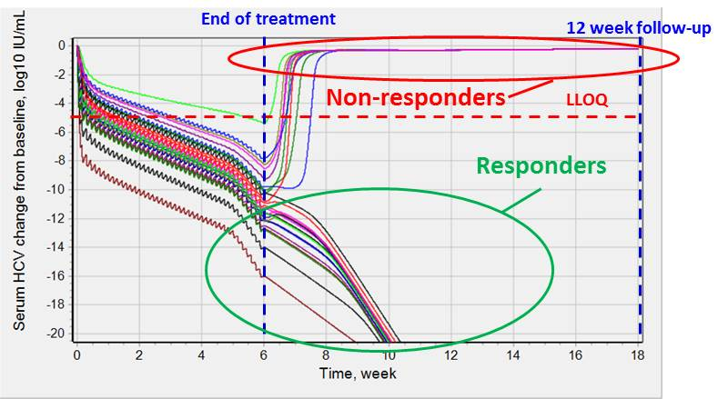
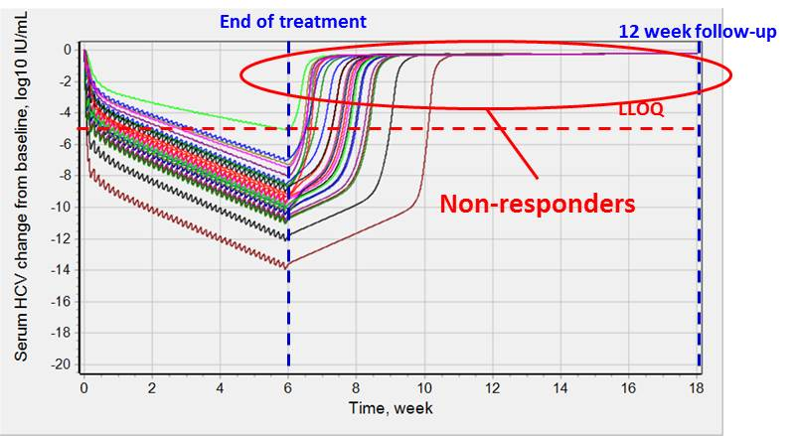
Exploration of role of immune response
Combo treatment: sofosbuvir (400 mg QD) + ledipasvir (90 mg QD) + ribavirin (1000-1200 mg daily)
Duration of treatment: 6 weeks
Number of patients involved in clinical trial (in accordance with literature data): 25
HCV dynamics for 1 of 10 simulated clinical trials is presented.
16 of 25 patients are responders. 9 are non-responders.
Thus, SVR12 = 16/25 = 64% for this virtual trial.
the same treatment for the same patients (with the same efficacy parameters for DAA and RBV) were simulated, but the immune response effect resulted in HCV decline (IR_function) was turned off.
SVR12 = 0
Conclusion: Immune response (IR) results in faster death of infected cells. If there is no IR the number of infected cell after 6 week treatment is enough to restore HCV level in serum. Without IR it is impossible to reproduce treatment with duration less that 12 weeks.

Slide 21
Implementation of Nivolumab effect in model
Nivolumab is PD-1 inhibitor approved for cancer treatment. PD-1 is expressed on CD8 T cells and its binding with PD-L1 on target cell (cancer cell, infected hepatocyte) inhibits specific lysis of target cell by CD8 T cell. Thus, PD-1 inhibitor stimulates immune cells to kill target cells.
Nivolumab PK was reproduced.
Effect of Nivolumab was implemented in the same way as effect of immune response in the model – it stimulates death of infected hepatocytes. Also the effect of nivolumab was added on death of healthy hepatocytes too (safety):
V_apo_vhep = k_apo * vHep * IR_function * Nivolumab_effect
Based on PD data on nivolumab the effect of nivolumab has delay. The same delay as for immune response was added in nivolumab effect.
It is assumed that Nivolumab has similar effect on healthy and infected hepatocytes
Nivolumab

Slide 22
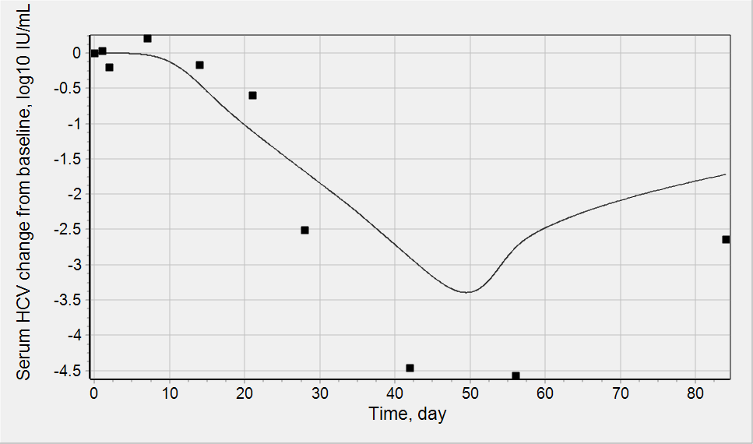
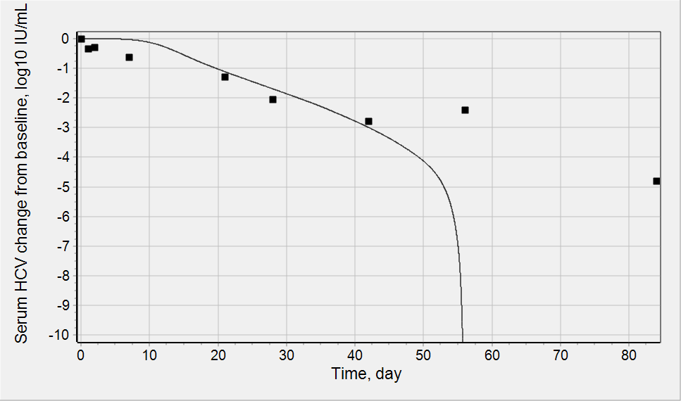
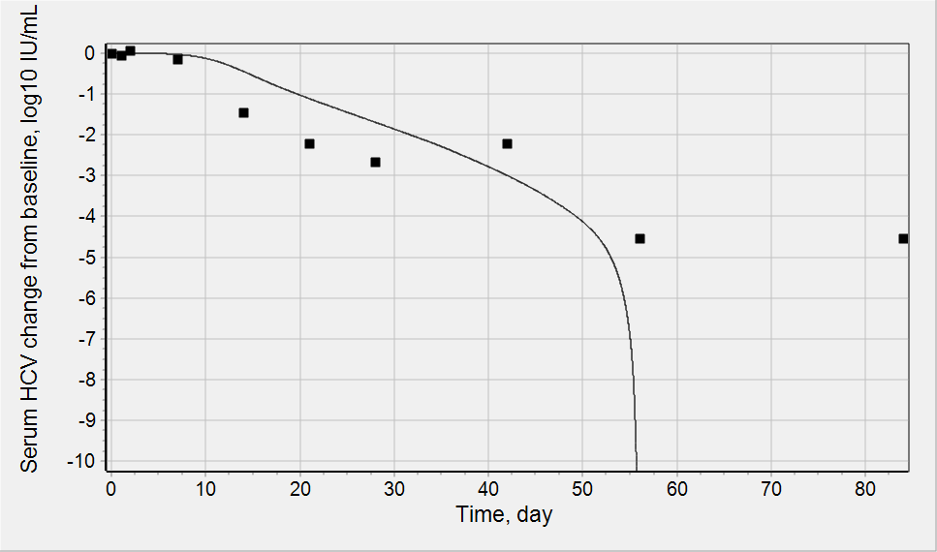
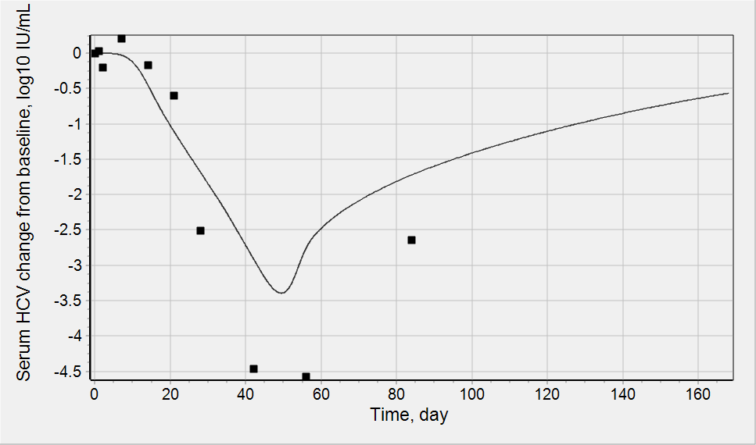
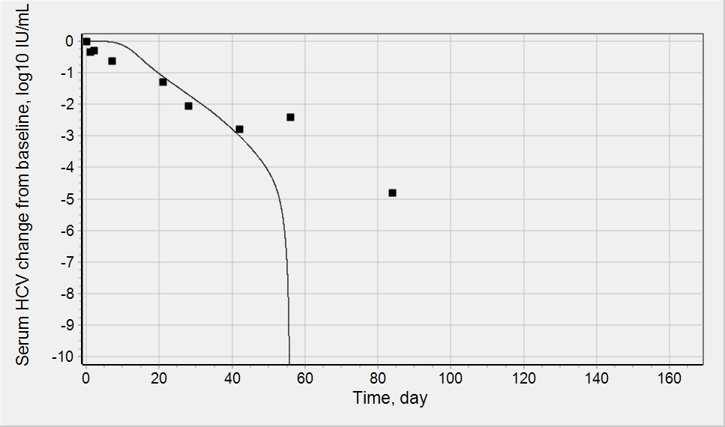
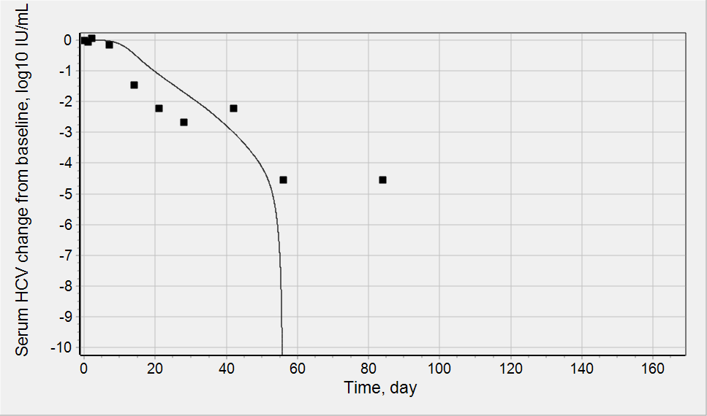
Calibration and validation of Nivolumab effect
There is only one article describing the effect of Nivolumab in HCV patients [PLoS One. 2013 May 22;8(5):e63818].
45 patients were treated with single IV infusion of nivolumab with dose from 0.03 mg/kg to 10 mg/kg.
Only 3 patients have significant (>2 log IU/mL decrease from baseline) serum HCV decline.
We have reproduced these 3 patients (by fitting of constant describing the effect of nivolumab - Keff_inf_nvb). All of them were treated with 10 mg/kg.
Response/nonresponse status of the 3 patients was predicted and compared with info from the paper
Patient 1: Observation during 84 days as in trial
Patient 2: Observation during 84 days as in trial
Patient 3: Observation during 84 days as in trial
fitting
fitting
LLOQ
fitting
LLOQ
Patient A
Patient B
Patient C
Patient 1: Observation during 168 days (+12 weeks follow up)
Patient 2: Observation during 168 days (+12 weeks follow up)
Patient 3: Observation during 168 days (+12 weeks follow up)
LLOQ
LLOQ
Follow-up model result: HCV returns to pre-treatment level
Follow-up clinical result: HCV returns to pre-treatment level
Follow-up model result: completely cure
Follow-up clinical result: HCV was undetectable during 1 year follow up and later
Follow-up model result: completely cure
Follow-up clinical result: HCV returns to pre-treatment level
TRUE
TRUE
FALSE

Slide 23
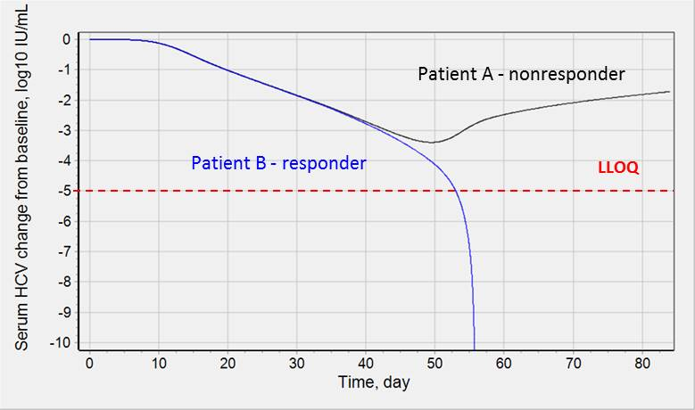
Nivolumab vs DAAs
Simulations of Nivolumab treatment shows that increase in hepatocyte death rate above some threshold level will lead to model switch from chronic HCV steady state into healthy subject steady state. This threshold level of HCV load decrease is above LLOQ.
Simulations of DAA combo treatment shows that there is a threshold level of HCV load. If the DAA treatment allows to reach the threshold level then to model switches from chronic HCV steady state into healthy subject steady state. This threshold level of HCV load decrease is significantly below LLOQ.
Level of infected hepatocytes is also important and together with HCV load at the completion of a therapy they determine responder/non-responder status of a patient (in 12 weeks)
Role of IR stimulators (like Nivolumab etc) can be very important to increase number of responders and decrease therapy duration. Unfortunately there is too little data for validation to check this hypothesis.
DAA combo treatment
Treatment with Nivolumab

Slide 24
CONCLUSIONS
HPLF model satisfactory predicts treatment outcomes observed in clinical trials with DAAs and Nivolumab
Model allows to predict SVR12 in ongoing clinical trials with and predict the DAA combinations
There is no synergistic effect in DAA combo treatments
Higher level of IR resulted from decrease in HCV results in faster death of infected cells. If the modulation of IR is not taken into account the number of infected cell at the end of DAA treatment is enough to restore HCV level in serum. Without IR it is impossible to reproduce treatment with duration less that 12 weeks.
Decrease in infected hepatocytes level (due to treatment with IR stimulators) combined with DAA treatment can be considered as promising way of HCV treatment allowing to increase number of responders and decrease therapy duration.

