Slide 1
Development of Cov19 life cycle model: documentation
Oleg Demin
demin@insysbio.com
2020-05-12

Slide 2
Commit date: 12.05.12 Commit name: 2 steady states in HCV model
Aim: To demonstrate that reproduced HCV model has 2 stable steady states and it can attend them depending on initial value of HCV

Slide 3
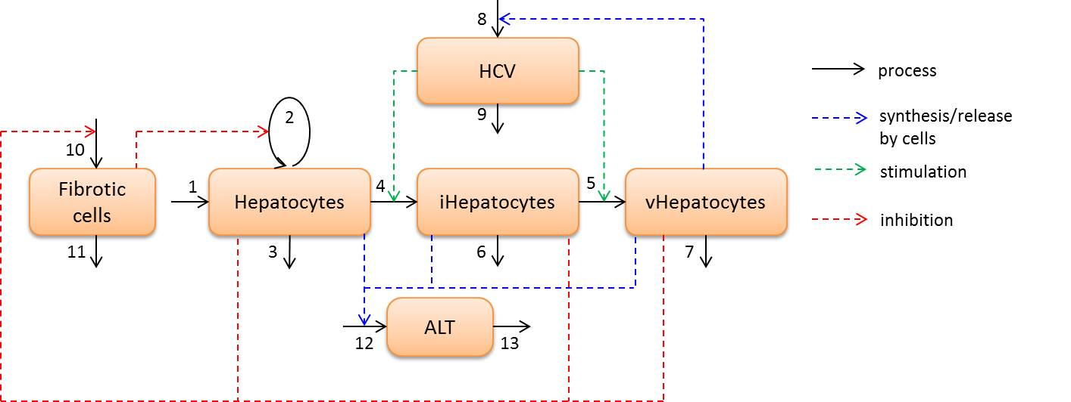
Model scheme and simulation design
Simulation design:
Family of 5 curves with different initial value of HCV: 1000, 200, 40, 8, 1.6

Slide 4
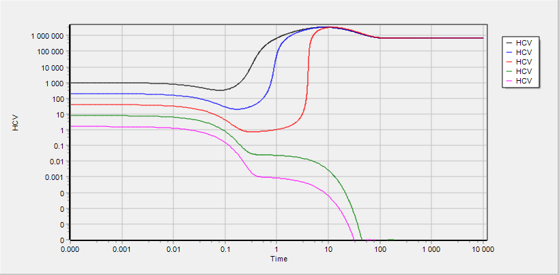
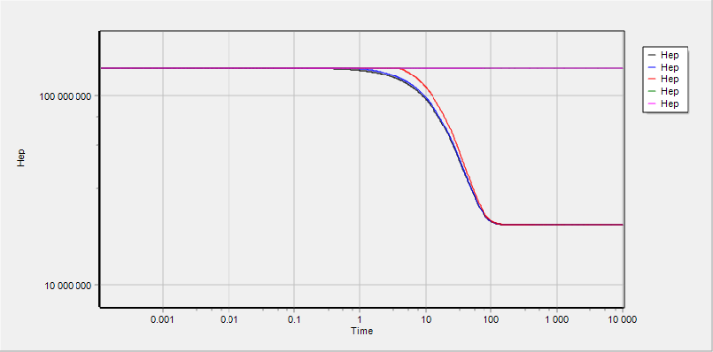
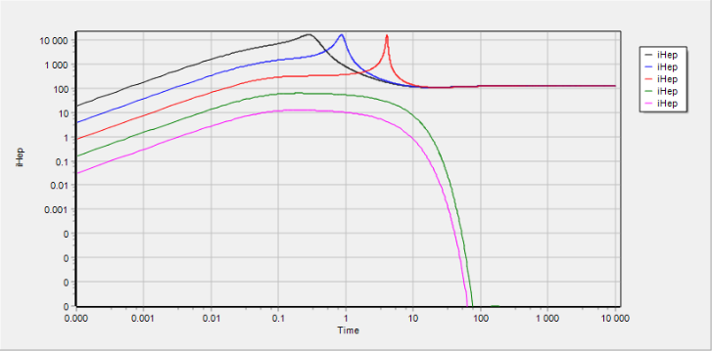
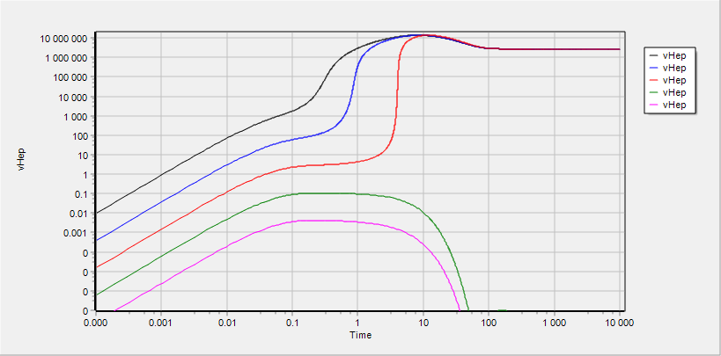
HCV, Hep, iHep and vHep
All variables demonstrate 2 stable steady state

Slide 5
Commit date: 21.05.12 Commit name: initial version (VL_v0.1.0) of SARS-CoV-2 viral dynamics model
Aim: To develop a structure and to perform initial calibration of viral dynamics model for SARS-CoV-2

Slide 6
Model scheme: simple
shedding
shedding
shedding
ACE2
ACE2
ACE2
COV
COV
COV
synthesis
synthesis
synthesis
binding
binding
binding
COV°ACE2
COV°ACE2
COV°ACE2
influx
transition
entry
transition
entry
COV_{ipc}
COV_{ipc}
uncoating
assembling
release
COV_{RNA}
PC
iPC
vPC
replication
COV
death
death
death
degradation
PC - Pneumocytes free of virus
iPC - Pneumocyte with entered but not yet replicated virus
vPC - Pneumocyte with actively replicated virus

Slide 7
Model scheme: detailed
degradation with cell death
degradation with cell death
degradation with cell death
shedding
shedding
shedding
ACE2
ACE2
ACE2
COV
transition with cells
COV
transition with cells
COV
synthesis
synthesis
synthesis
binding
binding
binding
COV°ACE2
COV°ACE2
COV°ACE2
transition with cells
transition with cells
influx
transition
entry
transition
entry
COV_{ipc}
COV_{ipc}
transition with cells
uncoating
COV
release with cell death
COV
assembling
release
COV_{RNA}
PC
iPC
vPC
replication
COV
death
death
death
degradation
COV
PC - Pneumocytes free of virus
iPC - Pneumocyte with entered but not yet replicated virus
vPC - Pneumocyte with actively replicated virus
release with cell death

Slide 8

Model scheme: regulations
degradation with cell death
degradation with cell death
degradation with cell death
shedding
shedding
shedding
ACE2
ACE2
ACE2
COV
transition with cells
COV
transition with cells
COV
synthesis
synthesis
synthesis
binding
binding
binding
COV°ACE2
COV°ACE2
COV°ACE2
transition with cells
transition with cells
influx
transition
entry
transition
entry
COV_{ipc}
COV_{ipc}
transition with cells
uncoating
COV
release with cell death
COV
assembling
release
COV_{RNA}
PC
iPC
vPC
replication
COV
death
death
death
degradation
COV
PC - Pneumocytes free of virus
iPC - Pneumocyte with entered but not yet replicated virus
vPC - Pneumocyte with actively replicated virus
release with cell death

Slide 9
Simulation design

Slide 10
Cells and virus in bulk phase

Slide 11
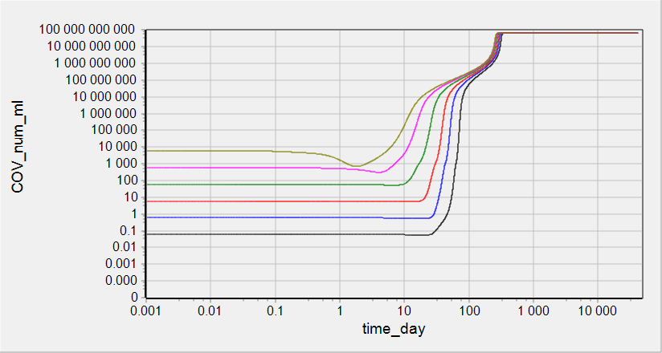
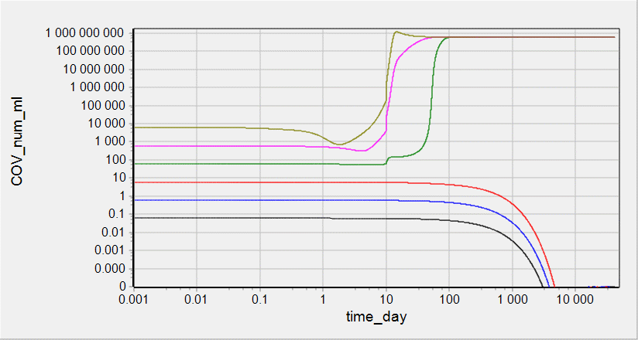
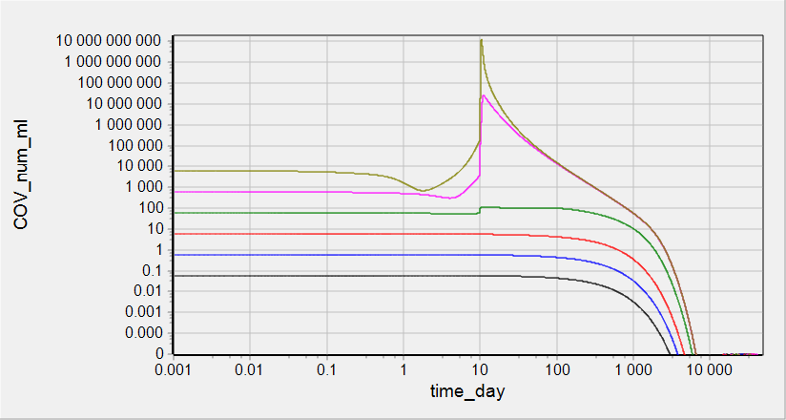
Simulations: COV in surfactant
IR factor = 1
IR factor = 100
IR factor = 1000

Slide 12
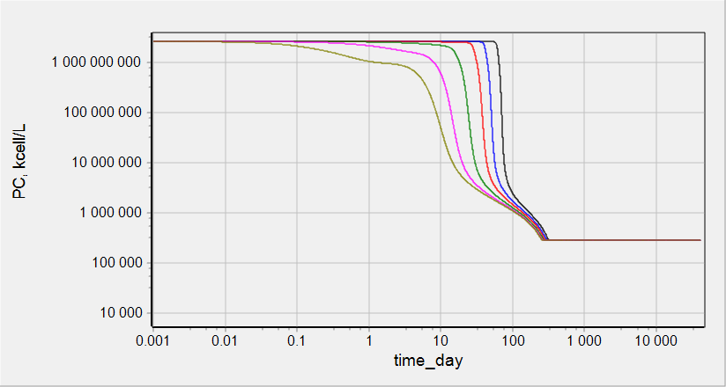
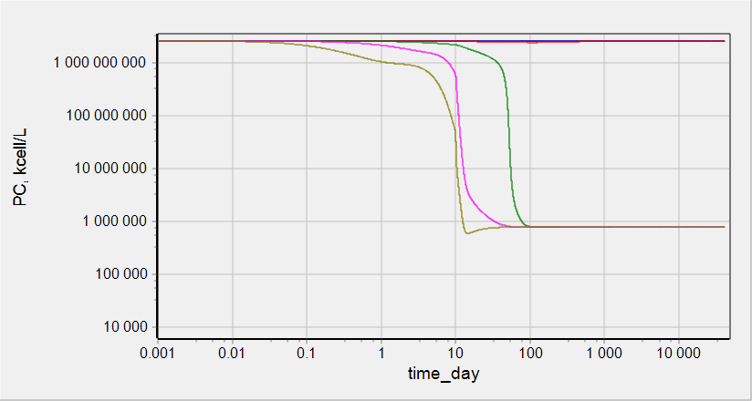
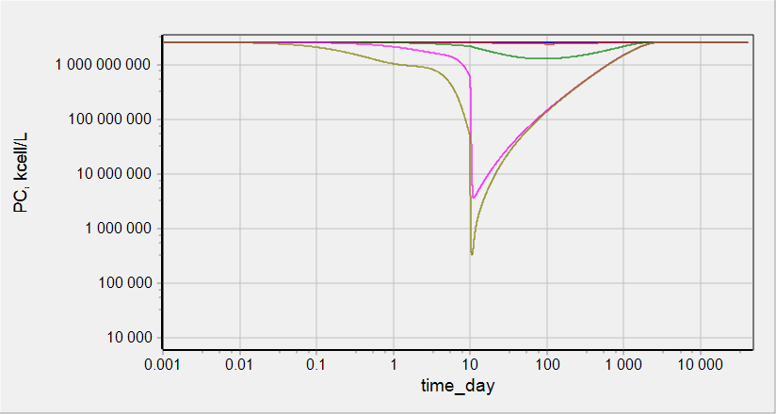
Simulations: PC count
IR factor = 1
IR factor = 100
IR factor = 1000

Slide 13
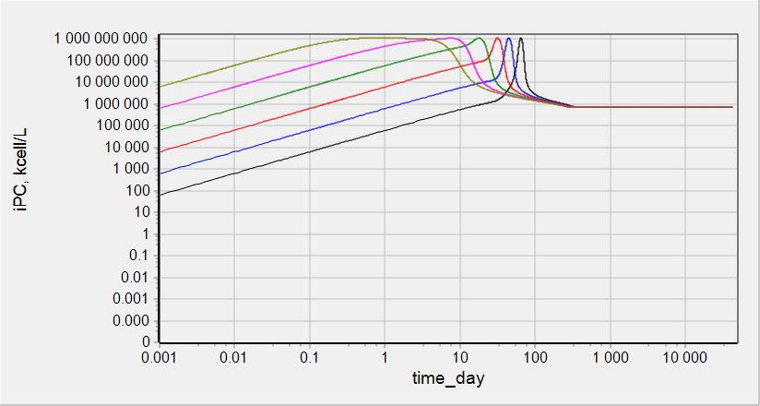
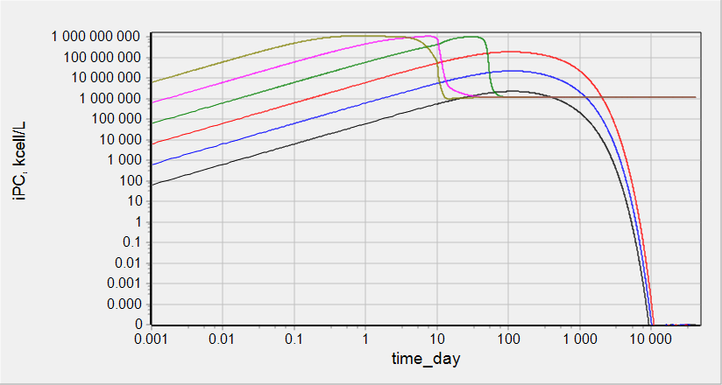
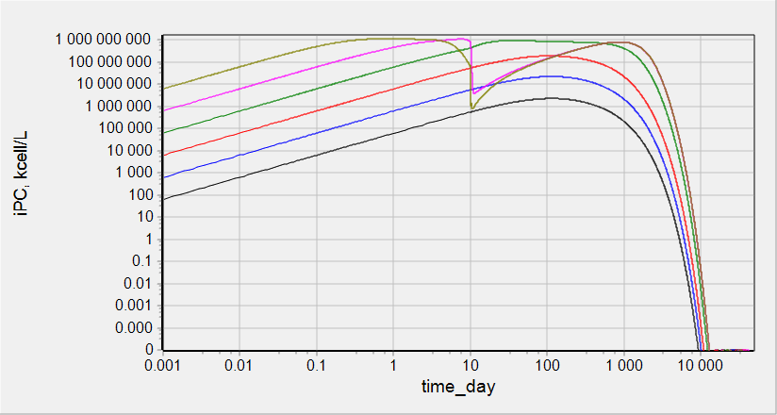
Simulations: iPC count
IR factor = 1
IR factor = 100
IR factor = 1000

Slide 14
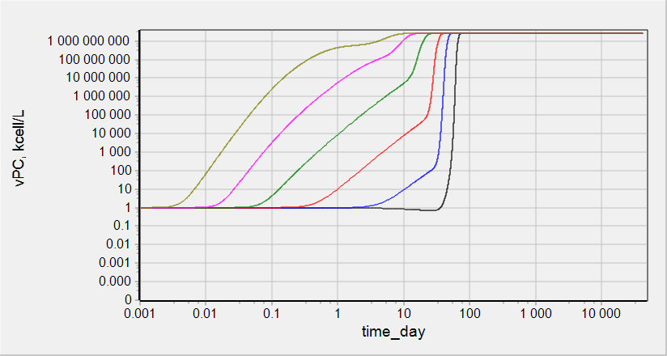
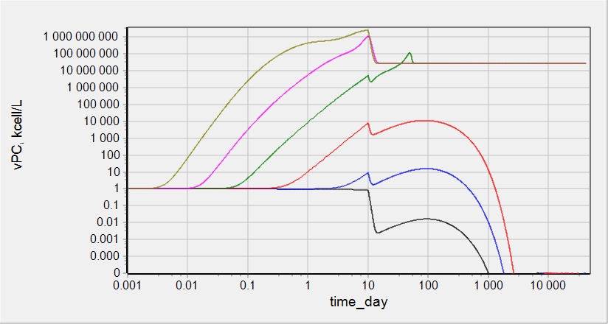
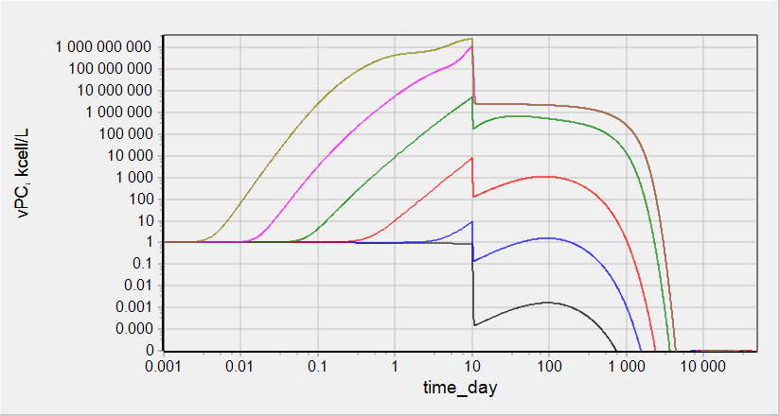
Simulations: vPC count
IR factor = 1
IR factor = 100
IR factor = 1000

Slide 15
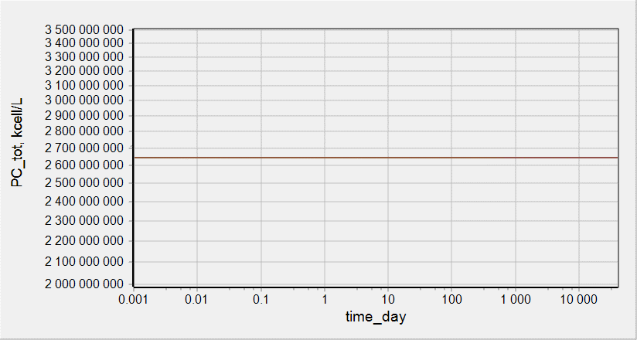
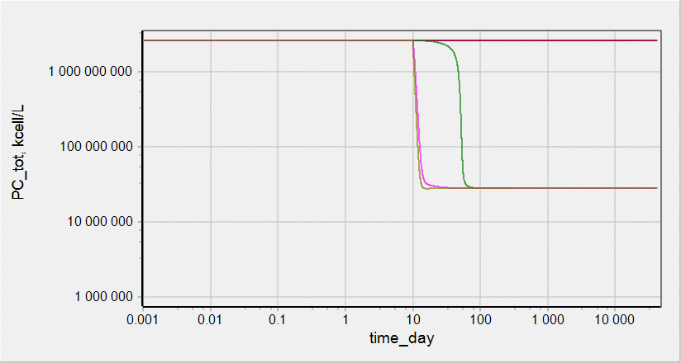
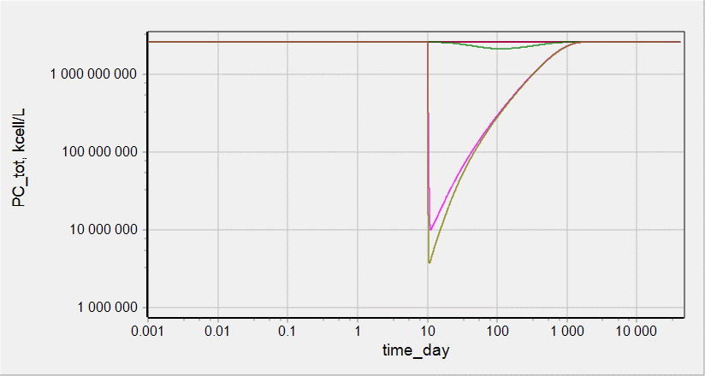
Simulations: total PC count
IR factor = 1
IR factor = 100
IR factor = 1000

Slide 16
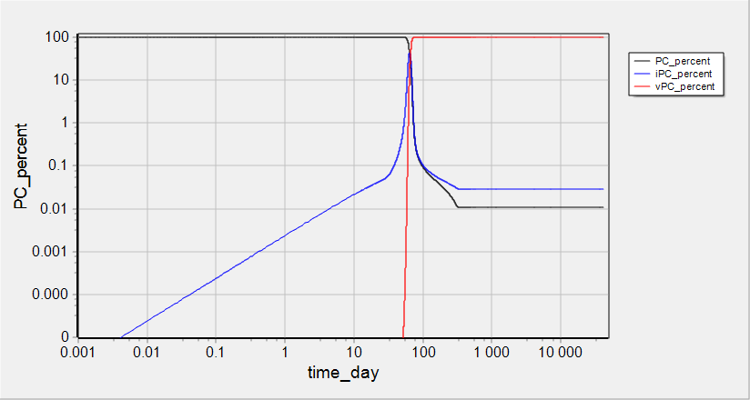
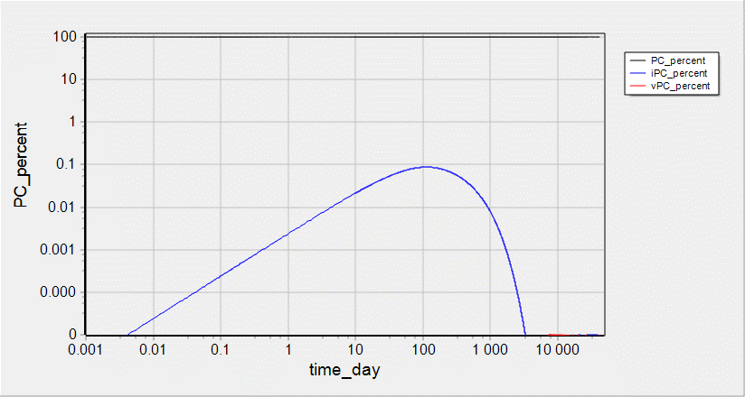
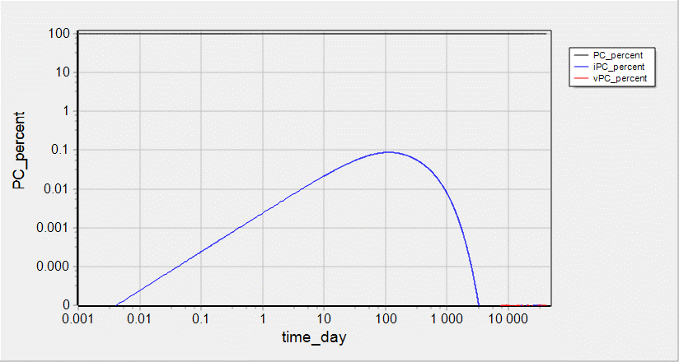
Simulations: % of PC, iPC, vPC at COV=1e-1 item/mL
IR factor = 1
IR factor = 100
IR factor = 1000

Slide 17
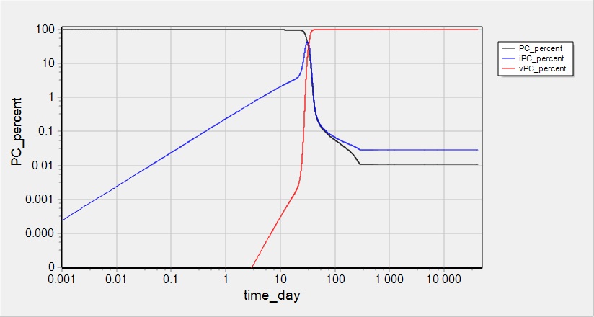
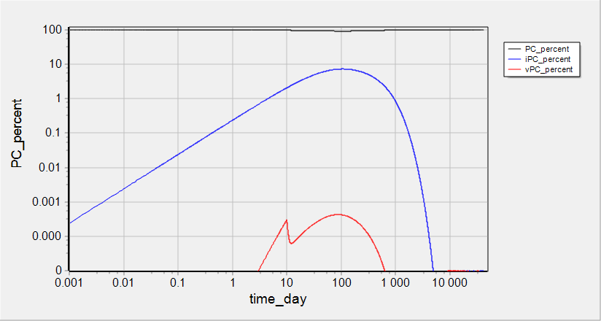
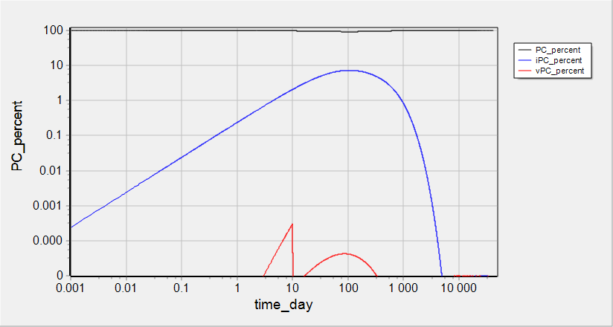
Simulations: % of PC, iPC, vPC at COV=1e1 item/mL
IR factor = 1
IR factor = 100
IR factor = 1000

Slide 18
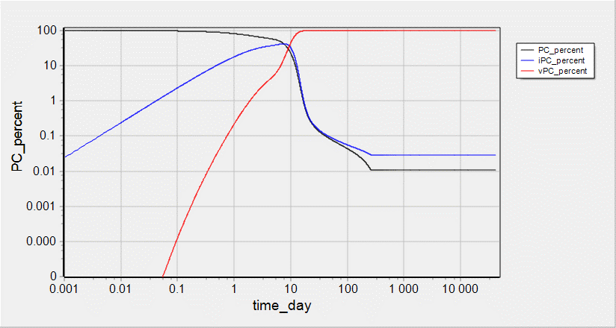
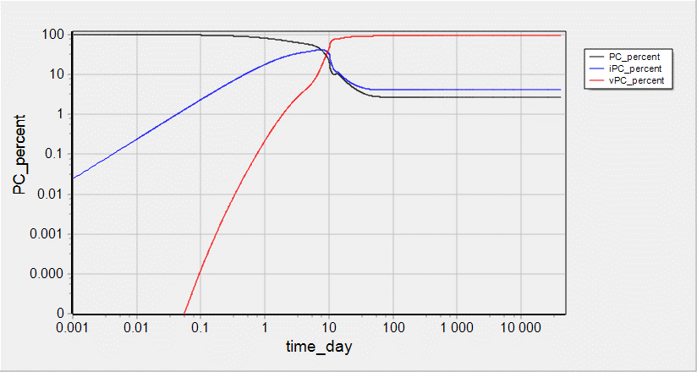
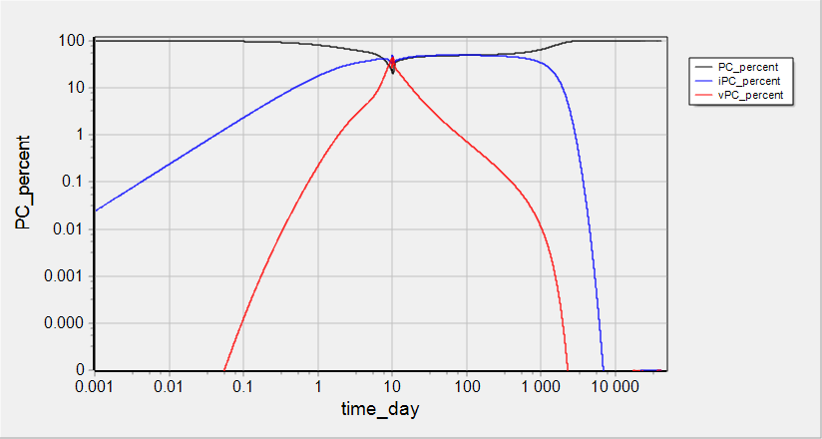
Simulations: % of PC, iPC, vPC at COV=1e3 item/mL
IR factor = 1
IR factor = 100
IR factor = 1000

Slide 19
ACE2 on cell surface

Slide 20
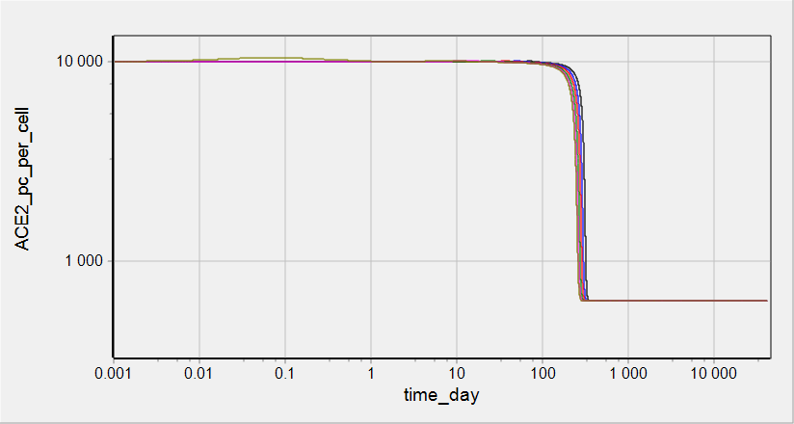
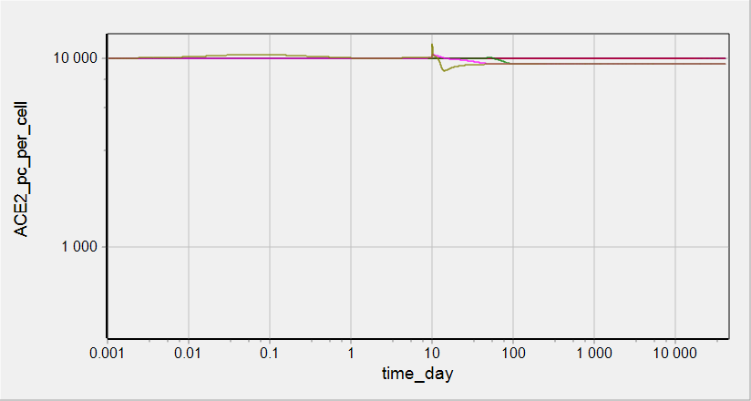
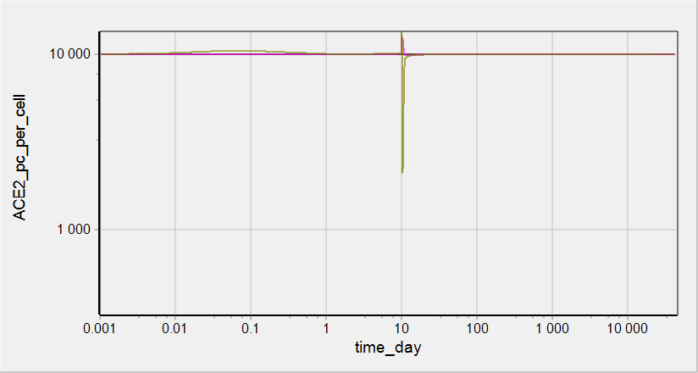
Simulations: ACE2 on PC surface
IR factor = 1
IR factor = 100
IR factor = 1000

Slide 21
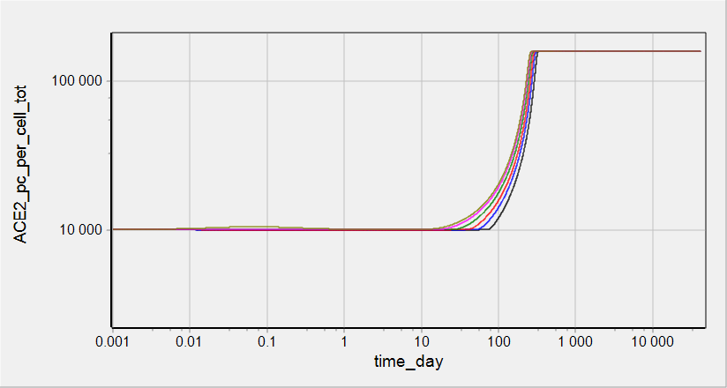
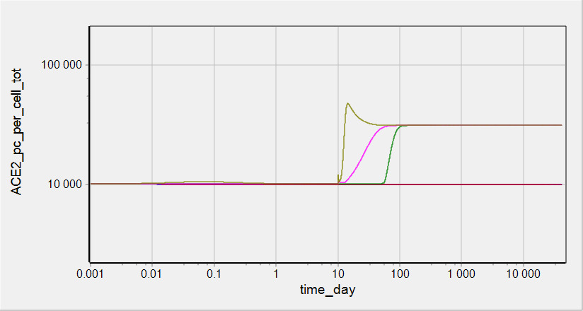
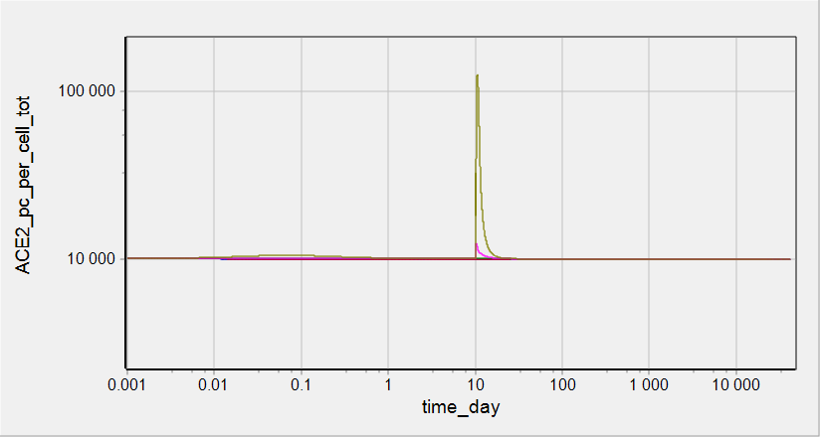
Simulations: total ACE2 on PC surface
IR factor = 1
IR factor = 100
IR factor = 1000

Slide 22
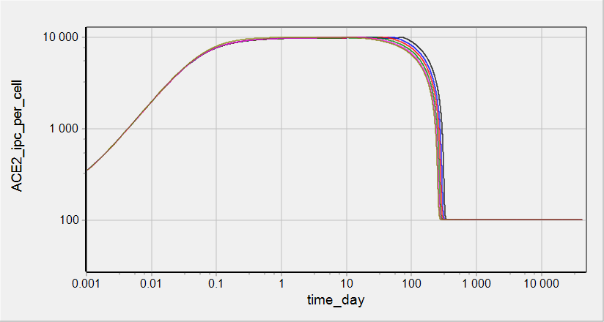
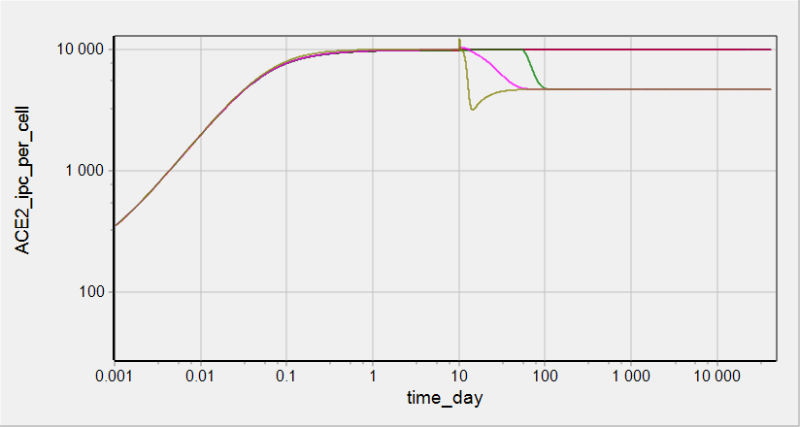
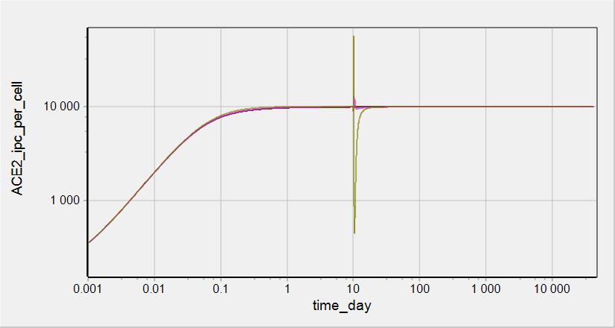
Simulations: ACE2 on iPC surface
IR factor = 1
IR factor = 100
IR factor = 1000

Slide 23
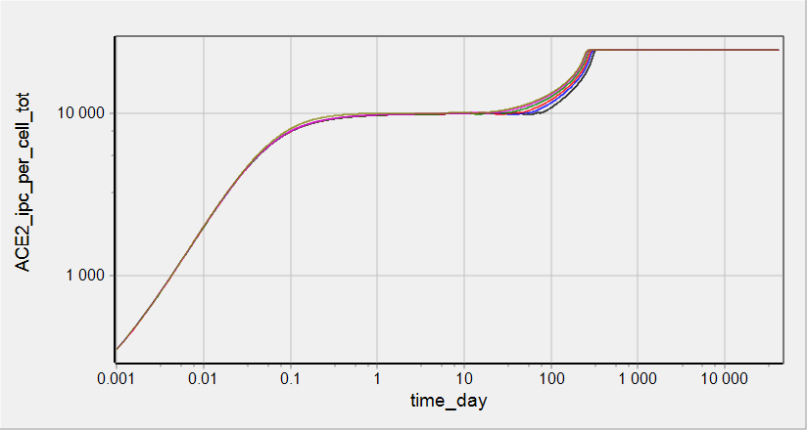
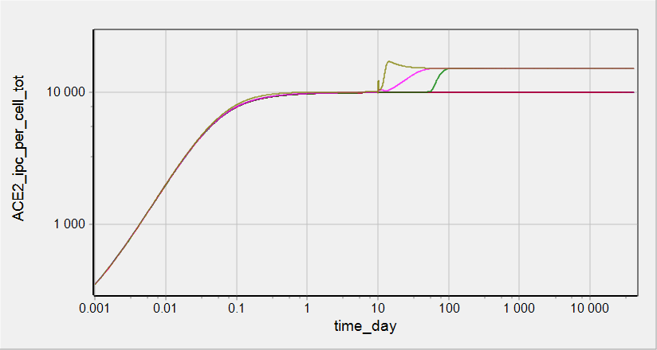
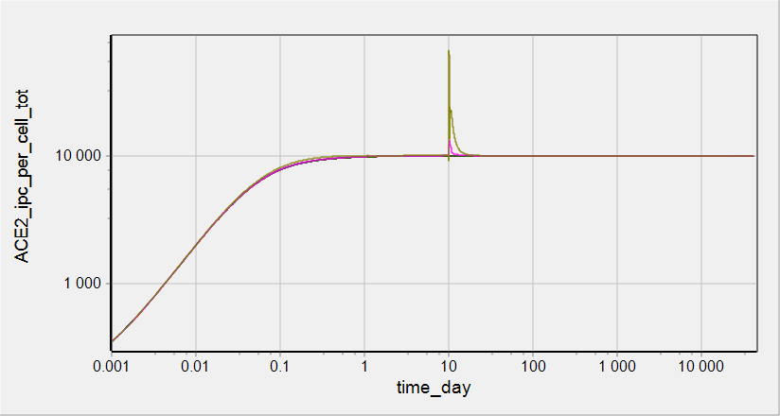
Simulations: total ACE2 on iPC surface
IR factor = 1
IR factor = 100
IR factor = 1000

Slide 24
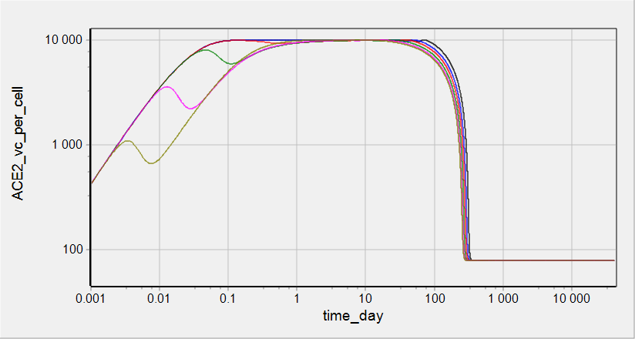
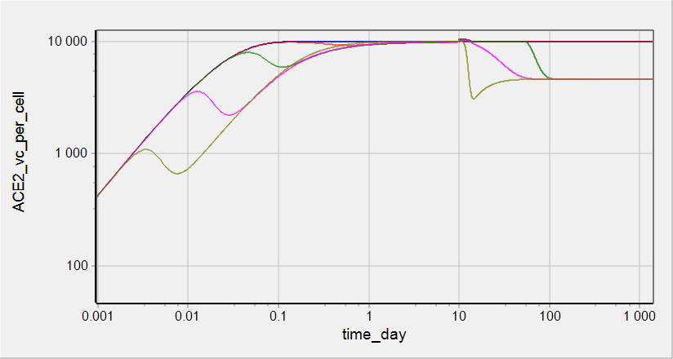
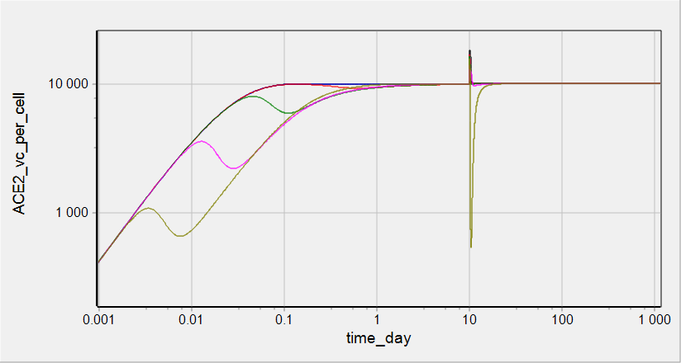
Simulations: ACE2 on vPC surface
IR factor = 1
IR factor = 100
IR factor = 1000

Slide 25
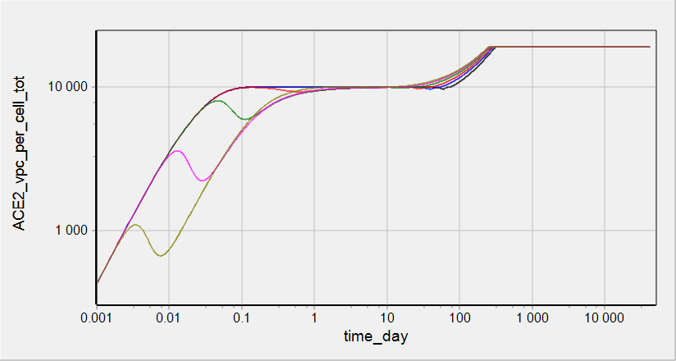
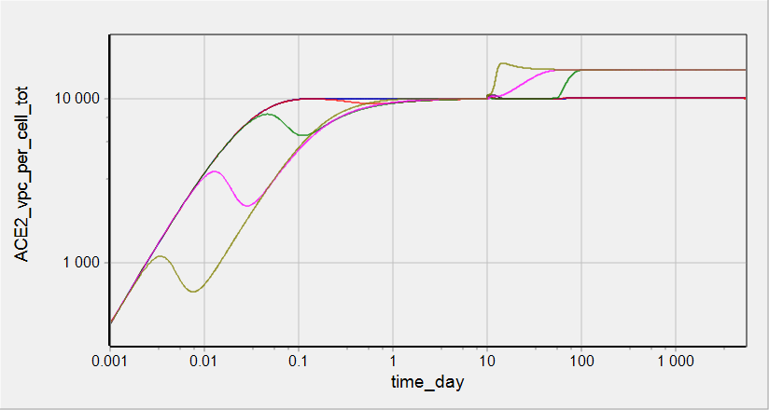
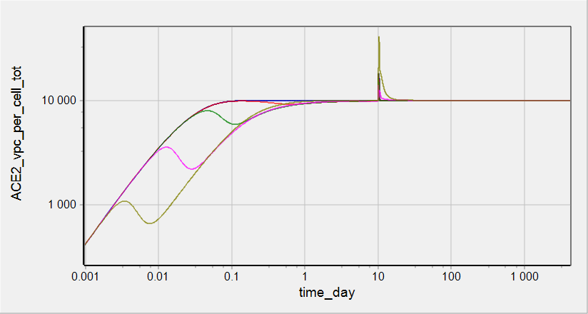
Simulations: total ACE2 on vPC surface
IR factor = 1
IR factor = 100
IR factor = 1000

Slide 26
Virus on cell surface and inside cells

Slide 27
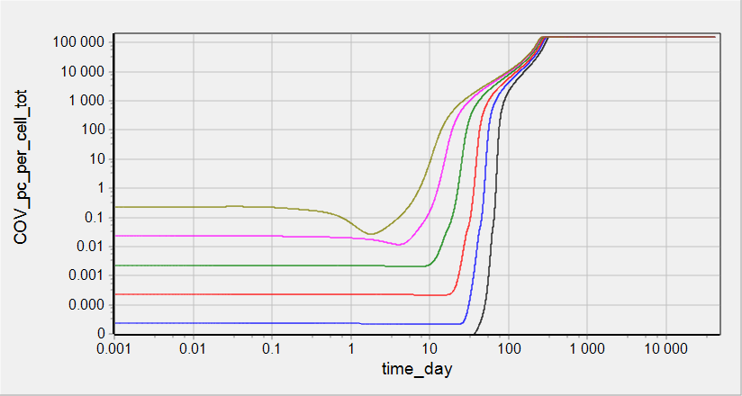
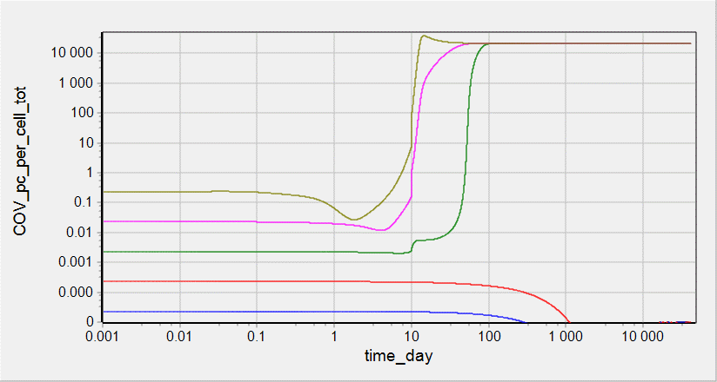
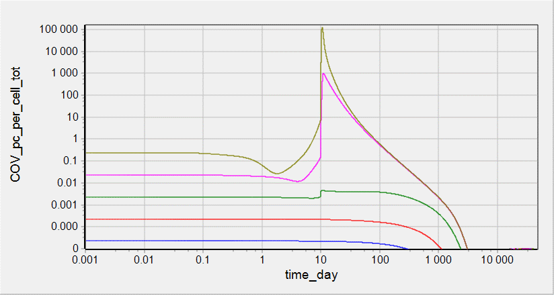
Simulations: total COV on PC
IR factor = 1
IR factor = 100
IR factor = 1000

Slide 28



Simulations: COV_ACE2 on PC surface
IR factor = 1
IR factor = 100
IR factor = 1000

Slide 29



Simulations: total COV on/inside iPC
IR factor = 1
IR factor = 100
IR factor = 1000

Slide 30



Simulations: COV_ACE2 on iPC surface
IR factor = 1
IR factor = 100
IR factor = 1000

Slide 31



Simulations: COV inside iPC
IR factor = 1
IR factor = 100
IR factor = 1000

Slide 32



Simulations: total COV on/inside vPC
IR factor = 1
IR factor = 100
IR factor = 1000

Slide 33



Simulations: COV_ACE2 on vPC surface
IR factor = 1
IR factor = 100
IR factor = 1000

Slide 34



Simulations: COV inside vPC
IR factor = 1
IR factor = 100
IR factor = 1000

Slide 35



Simulations: COV_RNA inside vPC
IR factor = 1
IR factor = 100
IR factor = 1000

Slide 36
Commit date: 26.05.12 Commit name: updated version (VL_v0.1.1) of SARS-CoV-2 viral dynamics model
Aims:
To introduce limitation in number of virions able to bind to PCII cell to avoid non-physiological accumulation of (i) the virions on the cell surface and (ii) virus RNA in nucleus
Reproduction of clinical data on virus load dynamics

Slide 37
Model scheme: simple
Changes in the version in comparison with VL_v0.1.0 is selected by red circles
shedding
shedding
shedding
ACE2
ACE2
ACE2
COV
COV
COV
synthesis
synthesis
synthesis
binding
binding
binding
COV°ACE2
COV°ACE2
COV°ACE2
influx
transition
entry
transition
entry
COV_{ipc}
COV_{ipc}
uncoating
assembling
release
COV_{RNA}
PC
iPC
vPC
replication
COV
death
death
death
degradation
PC - Pneumocytes free of virus
iPC - Pneumocyte with entered but not yet replicated virus
vPC - Pneumocyte with actively replicated virus

Slide 38
Model scheme: detailed
Changes in the version in comparison with VL_v0.1.0 is selected by red circles
degradation with cell death
degradation with cell death
degradation with cell death
shedding
shedding
shedding
ACE2
ACE2
ACE2
COV
transition with cells
COV
transition with cells
COV
synthesis
synthesis
synthesis
binding
binding
binding
COV°ACE2
COV°ACE2
COV°ACE2
transition with cells
transition with cells
influx
transition
entry
transition
entry
COV_{ipc}
COV_{ipc}
transition with cells
uncoating
COV
degradation with cell death
COV
assembling
release
COV_{RNA}
PC
iPC
vPC
replication
COV
death
death
death
degradation
COV
PC - Pneumocytes free of virus
iPC - Pneumocyte with entered but not yet replicated virus
vPC - Pneumocyte with actively replicated virus
degradation with cell death

Slide 39

Model scheme: detailed
Changes in the version in comparison with VL_v0.1.0 is selected by red circles
degradation with cell death
degradation with cell death
degradation with cell death
shedding
shedding
shedding
ACE2
ACE2
ACE2
COV
transition with cells
COV
transition with cells
COV
synthesis
COV°ACE2 per cell
synthesis
COV°ACE2 per cell
synthesis
COV°ACE2 per cell
binding
binding
binding
COV°ACE2
COV°ACE2
COV°ACE2
transition with cells
transition with cells
influx
transition
entry
transition
entry
COV_{ipc}
COV_{ipc}
transition with cells
uncoating
COV
degradation with cell death
COV
assembling
release
COV_{RNA}
PC
iPC
vPC
-
replication
COV
death
death
death
degradation
COV
PC - Pneumocytes free of virus
iPC - Pneumocyte with entered but not yet replicated virus
vPC - Pneumocyte with actively replicated virus
degradation with cell death

Slide 40



Reproduction of clinical data on viral load dynamics
Data taken from Wolfer et al
doi.org/10.1101/2020.03.05.20030502
Sputum viral load was measured for 9 patients
Individual data were averaged and presented as median and range
Activation of Immune Response was modeled as increase in rate constant of cell death. It was implemented via events
Initial value of COV = 16850 copies/mL was chosen to describe clinically measured dynamics of viral load and roughly corresponds to minimal infection dose equal to 1000 (for MERS/SARS-CoV)

