Slide 1
Calibration, validation and key model simulations
Oleg Demin
demin@insysbio.com
2020-05-12

Slide 2
Commit date: 26.05.12 Commit name: updated version (VL_v0.1.1) of SARS-CoV-2 viral dynamics model
Aims:
To introduce limitation in number of virions able to bind to PCII cell to avoid non-physiological accumulation of (i) the virions on the cell surface and (ii) virus RNA in nucleus
Reproduction of clinical data on virus load dynamics

Slide 3
Model scheme: simple
Changes in the version in comparison with VL_v0.1.0 is selected by red circles
shedding
shedding
shedding
ACE2
ACE2
ACE2
COV
COV
COV
synthesis
synthesis
synthesis
binding
binding
binding
COV°ACE2
COV°ACE2
COV°ACE2
influx
transition
entry
transition
entry
COV_{ipc}
COV_{ipc}
uncoating
assembling
release
COV_{RNA}
PC
iPC
vPC
replication
COV
death
death
death
degradation
PC - Pneumocytes free of virus
iPC - Pneumocyte with entered but not yet replicated virus
vPC - Pneumocyte with actively replicated virus

Slide 4
Model scheme: detailed
Changes in the version in comparison with VL_v0.1.0 is selected by red circles
degradation with cell death
degradation with cell death
degradation with cell death
shedding
shedding
shedding
ACE2
ACE2
ACE2
COV
transition with cells
COV
transition with cells
COV
synthesis
synthesis
synthesis
binding
binding
binding
COV°ACE2
COV°ACE2
COV°ACE2
transition with cells
transition with cells
influx
transition
entry
transition
entry
COV_{ipc}
COV_{ipc}
transition with cells
uncoating
COV
degradation with cell death
COV
assembling
release
COV_{RNA}
PC
iPC
vPC
replication
COV
death
death
death
degradation
COV
PC - Pneumocytes free of virus
iPC - Pneumocyte with entered but not yet replicated virus
vPC - Pneumocyte with actively replicated virus
degradation with cell death

Slide 5


Model scheme: regulations
Changes in the version in comparison with VL_v0.1.0 is selected by red circles
degradation with cell death
degradation with cell death
degradation with cell death
shedding
shedding
shedding
ACE2
ACE2
ACE2
COV
transition with cells
COV
transition with cells
COV
synthesis
COV°ACE2 per cell
synthesis
COV°ACE2 per cell
synthesis
COV°ACE2 per cell
binding
binding
binding
COV°ACE2
COV°ACE2
COV°ACE2
transition with cells
transition with cells
influx
transition
entry
transition
entry
COV_{ipc}
COV_{ipc}
transition with cells
uncoating
COV
degradation with cell death
COV
assembling
release
COV_{RNA}
PC
iPC
vPC
-
replication
COV
death
death
death
degradation
COV
PC - Pneumocytes free of virus
iPC - Pneumocyte with entered but not yet replicated virus
vPC - Pneumocyte with actively replicated virus
degradation with cell death

Slide 6
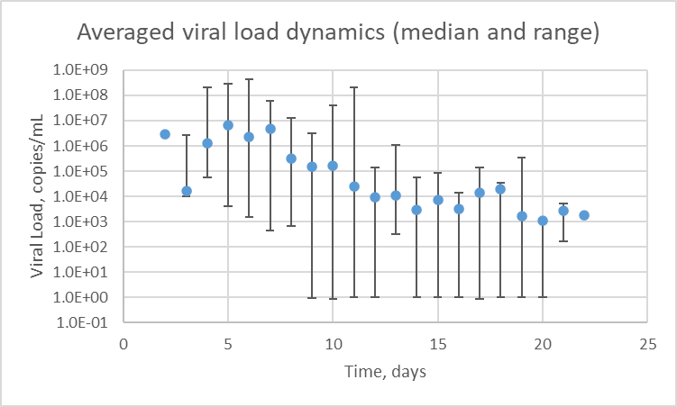
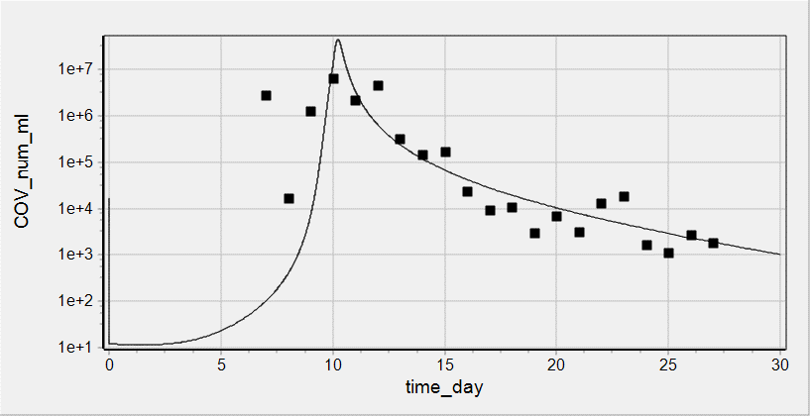
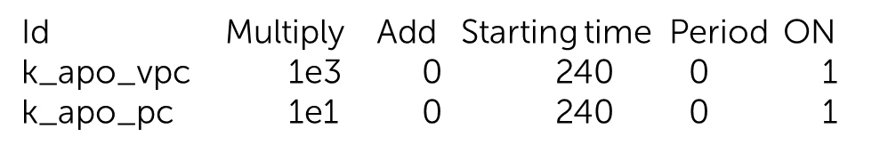
Reproduction of clinical data on viral load dynamics
Data taken from Wolfer et al
doi.org/10.1101/2020.03.05.20030502
Sputum viral load was measured for 9 patients
Individual data were averaged and presented as median and range
Activation of Immune Response was modeled as increase in rate constant of cell death. It was implemented via events
Initial value of COV = 16850 copies/mL was chosen to describe clinically measured dynamics of viral load and roughly corresponds to minimal infection dose equal to 1000 (for MERS/SARS-CoV)

Slide 7
Commit date: 20.06.01 Commit name: updated version (VL_v0.1.2) of SARS-CoV-2 viral dynamics model
Aims:
To introduce new variable COVass_vpc designating assembled virus amount in vPC and implement release of COV from vPC from the variable. Delete release of the virus from COV_vpc.
Cell death leads to release of the virus bound with ACE2 at the cell surface. ACE2 is degraded.
To introduce 2 modes of immune response in empiric way: (i) Spike specific antibodies ( IgG/IgM) interfere binding of virus ACE2 (ii) stimulation of death of infected cells
Introduction of sputum dilution coefficient
Change in parameters k_rep_cov_rna_vpc , k_ass_cov_vpc , kbase_tran_pc_ipc , kbase_tran_ipc_vpc to describe clinically measured data on viral load and percent of subgenomic viral mRNA in sputum

Slide 8
Model scheme: simple
shedding
shedding
shedding
ACE2
ACE2
ACE2
COV
COV
COV
synthesis
synthesis
synthesis
binding
binding
binding
COV°ACE2
COV°ACE2
COV°ACE2
influx
transition
entry
transition
entry
PC
iPC
vPC
COV_{ipc}
COV_{vpc}
uncoating
replication
COVass_{vpc}
assembling
COV_{RNA}
release
COV
release with cell death
death
death
death
degradation
COV_RNA
PC - Pneumocytes free of virus
iPC - Pneumocyte with entered but not yet replicated virus
vPC - Pneumocyte with actively replicated virus
degradation

Slide 9
Model scheme: detailed
degradation with cell death
degradation with cell death
degradation with cell death
shedding
shedding
shedding
ACE2
ACE2
ACE2
COV
transition with cells
COV
transition with cells
COV
synthesis
synthesis
synthesis
binding
binding
binding
release with cell death
COV°ACE2
COV°ACE2
COV°ACE2
transition with cells
transition with cells
influx
transition
entry
transition
entry
PC
iPC
vPC
COV_{ipc}
COV_{vpc}
transition with cells
uncoating
degradation with cell death
degradation with cell death
replication
COVass_{vpc}
assembling
COV_{RNA}
release
COV
release with cell death
release with cell death
death
death
death
degradation
COV_RNA
PC - Pneumocytes free of virus
iPC - Pneumocyte with entered but not yet replicated virus
vPC - Pneumocyte with actively replicated virus
degradation

Slide 10
Model scheme: regulations
degradation with cell death
degradation with cell death
degradation with cell death
shedding
shedding
shedding
ACE2
ACE2
ACE2
COV
transition with cells
COV
transition with cells
COV
synthesis
COV°ACE2 per cell
synthesis
COV°ACE2 per cell
synthesis
COV°ACE2 per cell
binding
binding
binding
release with cell death
COV°ACE2
COV°ACE2
COV°ACE2
transition with cells
transition with cells
influx
transition
entry
transition
entry
PC
iPC
vPC
COV_{ipc}
COV_{vpc}
transition with cells
uncoating
degradation with cell death
degradation with cell death
replication
COVass_{vpc}
assembling
COV_{RNA}
release
COV
release with cell death
release with cell death
death
death
death
degradation
COV_RNA
PC - Pneumocytes free of virus
iPC - Pneumocyte with entered but not yet replicated virus
vPC - Pneumocyte with actively replicated virus
degradation

Slide 11
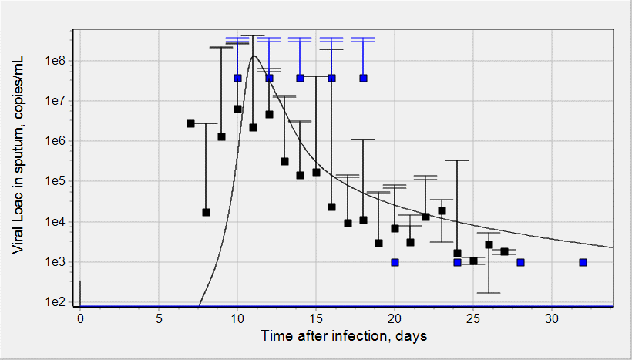
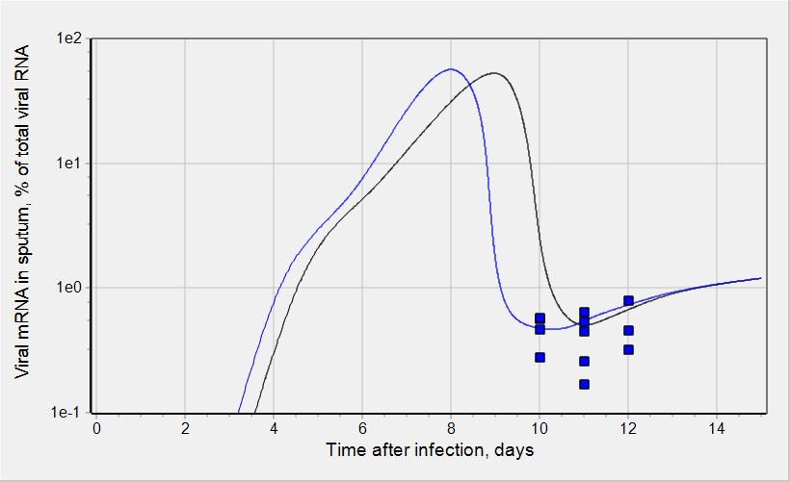
Reproduction of clinical data on viral load dynamics
Viral load and % of viral subgenomic mRNA in sputum were simulated
IR was implemented in empiric way as described earlier with following parameters:
T_sw_ir = 50 {units: h};
ET50_ir = 190 {units: h};
Emax_ir_apo = 800 {units: UL};
n_ir = 5 {units: UL};
Kd_anti_Ab = 14300 {units: pM};
anti_Ab_max = 941000 {units: pM};
Wolfer et al, doi.org/10.1101/
2020.03.05.20030502
Wolfer et al, doi.org/10.1101/
2020.03.05.20030502
Time/value of peak viral load and range of viral shedding [PMID 32315724]
Wolfer et al, doi.org/10.1101/
2020.03.05.20030502
Virus initial concentration: 3370 copies/mL
6740 copies/mL
Virus initial concentration: 3370 copies/mL

Slide 12
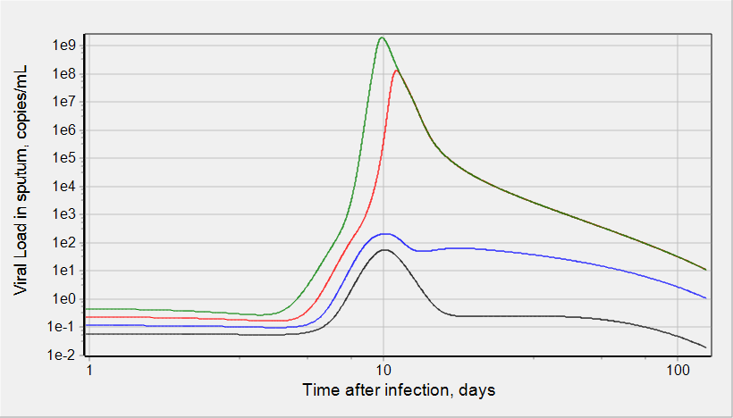
Simulations: Viral load dynamics
Virus initial concentration:
843 copies/mL
1685 copies/mL
3370 copies/mL
6740 copies/mL
Limit of detection
There is a threshold in virus initial concentration.
The values above the threshold lead to substantial and transient virus load in sputum.
The values below the threshold do not allow detect virus in sputum at any time.
Increase in virus initial concentration results in higher peak of viral load which is faster achieved.

Slide 13
Commit date: 20.06.16/20.06.21/20.06.28 Commit name: Mph life cycle - updated version (Mph_v0.1.0)
Aims:
To upgrade right hand sides of Mph life cycle sub-model downloaded from IRT
Estimation of values of static cytokines (GMCSF_ts, GMCSF_pl, IFNg_ts, IL4_ts, IL4_ln, CCL22_ts, CCL22_ln, IL13_ts) on the basis of Cytocon DB and implementation them into the model
Initial estimation of values of cell components of Mph sub-model (PBM_ts, iMph_ts, M1_ts, M2_ts) for HC, COVID19 and NSCLC patients on the basis of Cytocon DB and implementation them into the model; preparation of data file for DBSolve
Initial fitting of cell components of Mph sub-model (PBM_ts, iMph_ts, M1_ts, M2_ts)

Slide 14
Mph sub-model scheme: updated version
Lymph node
Tissue
M1
M2
cell death
cell death
differentiation
differentiation
Ag_ts, IFNg_ts
proliferation
Il4_ts, IL13_ts,
IL10_ts, TGFb_ts
IL10_ts, TGFb_ts
iMph
cell death
GMCSF_ts
differentiation
PBM
CCL2_ts, CXCL10_ts,
TGFb_ts
cell death
migration to TISSUE
Bone marrow
Plasma
PBM
cell death
GMCSF_pl
Migration to OTHER TISSUES
All changes in xlsx file are selected in red font or highlighted with yellow

Slide 15
Tuning of model parameters to describe in vivo baseline data
Data used for fitting: in vivo baseline concentrations measured for HC (M1, M2 for NSCLC patients)
Simulation design: steady state for Antigen (Ag_ts) equal to 0

Slide 16
Simulation of Antigen dose dependence

Slide 17
Commit date: 20.07.12/20.07.19 Commit name: updated version (VL_v0.1.3) of SARS-CoV-2 viral dynamics model
Aims:
To correct errors in units
To change expressions for Emax like functions in order to avoid exponentiation of dimensional variables
To correct error in readout function describing number of virus copies in 1 mL of sputum
To refit experimental data describing clinically measured viral load dynamics in sputum
To perform key simulations with the updated model

Slide 18
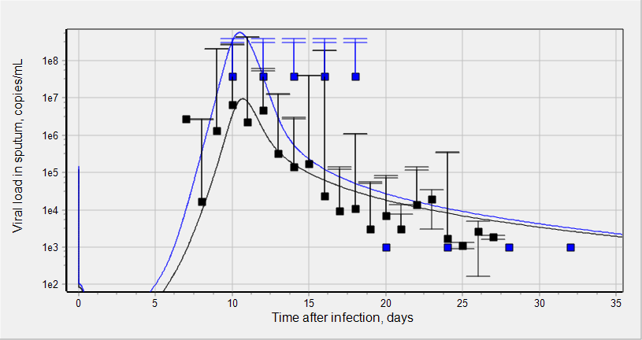
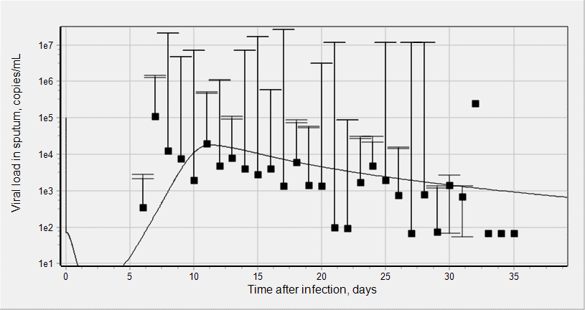
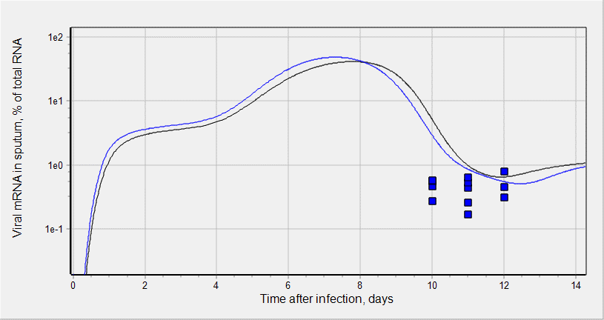
Reproduction of clinical data on viral load dynamics
Viral load and % of viral subgenomic mRNA in sputum were simulated
Following 3 parameters were refitted:
kbase_tran_pc_ipc = 10;//0.25; // {units: 1/pmole/h};
kbase_tran_ipc_vpc = 10;//0.25; // {units: 1/pmole/h};
k_rep_cov_rna_vpc = 0.2;//0.5; // {units: 1/h};
COV initial values in alveolar surfactant and their correspondence to viral concentration in sputum:
COV(0) = 1.7e-3 pM → 1e5 copies/mL
COV(0) = 2e-3 pM → 1.2e5 copies/mL
COV(0) = 2.5e-3 pM → 1.5e5 copies/mL
Wolfer et al, doi.org/10.1101/
2020.03.05.20030502
Time/value of peak viral load and range of viral shedding [PMID 32315724]
Virus initial concentration: 1.2e5 copies/mL
1.5e5 copies/mL
Data were averaged from [PMID 32125362]
Wolfer et al, doi.org/10.1101/
2020.03.05.20030502
Virus initial concentration: 1.2e5 copies/mL
1.5e5 copies/mL
Virus initial concentration: 1e5 copies/mL

Slide 19
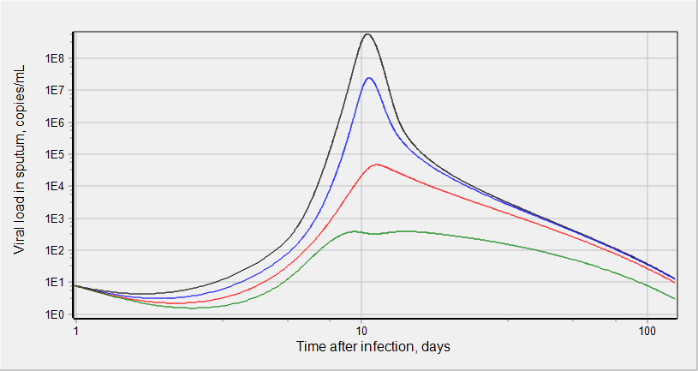
Simulations: Viral load dynamics
Virus initial concentration:
1.5e5 copies/mL
1.25e5 copies/mL
1.04e5 copies/mL
8.68e4 copies/mL
Time of IR switching ON:
50 hour
Limit of detection
There is a threshold in virus initial concentration in sputum.
The values above the threshold lead to substantial and transient virus load in sputum.
The values below the threshold do not allow detect virus in sputum at any time.
Increase in virus initial concentration results in higher peak of viral load which is faster achieved.

Slide 20
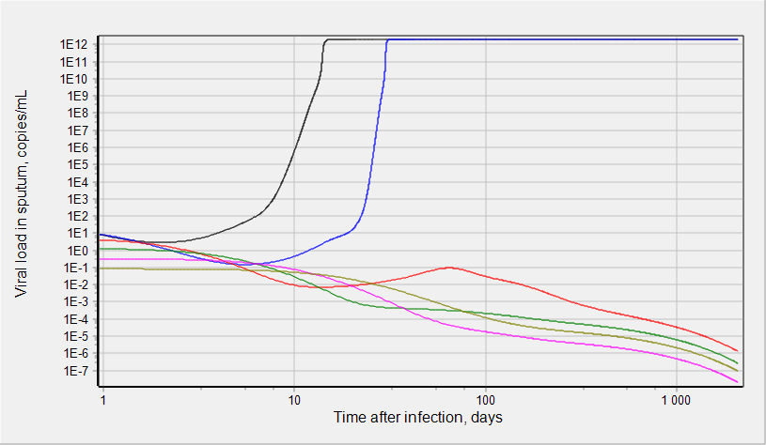
Simulations: Viral load dynamics w/o IR induction
Virus initial concentration:
1.2e5 copies/mL
3e4 copies/mL
7.5e3 copies/mL
1.9e3 copies/mL
4.7e2 copies/mL
1.2e2 copies/mL
Limit of detection
SIMULATION DESIGN: (i) initial COV concentration in alveolar surfactant is varied from 2e-3 to 1.9e-6 pM, (ii) there is no induction of IR, i.e. switch_ir = 0 for any time after infection
RESULTS:
There is a threshold in virus initial concentration. The values above the threshold lead to substantial steady state virus load. The values below the threshold do not allow detect virus in sputum at any time, i.e. viral load tends to steady state value equal to 0.
ODE system has 1 unstable and 2 stable steady states. One of the stable steady states correspond to 0 viral load and other corresponds to very substantial viral load.
Model is able to describes self curing dynamics, i.e., viral load tends to 0 when initial virus concentration is below threshold. If initial virus concentration is above threshold then virtual patient is being infected and viral load tends to very high value with time.

Slide 21
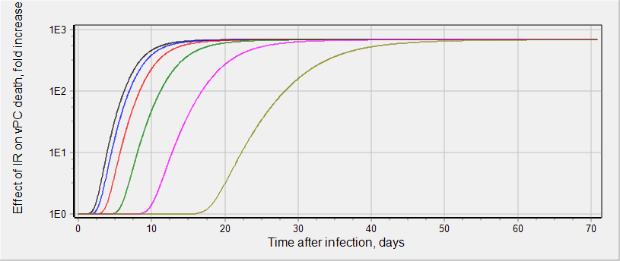
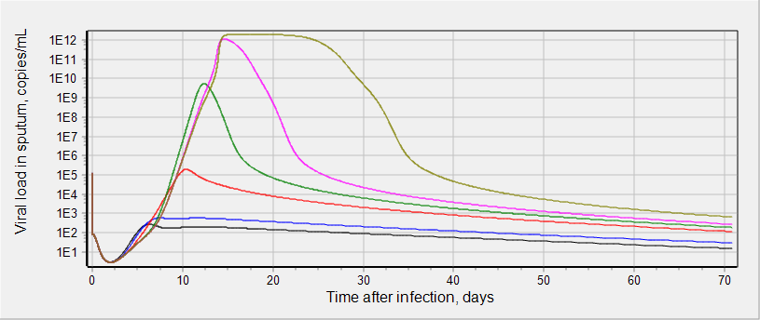
Simulations: Effect of delay in IR on viral load
SIMULATION DESIGN:
Start time of Immune response (IR) was varied from 10 to 320 hours past infection.
Amplitude of IR and virus initial concentration in sputum were kept the same for various start time
At each start time viral load dynamics in sputum was simulated
RESULTS:
Early IR (10 and 20 hours) do not allow detect virus in sputum at any time.
Delay in IR start time substantially increases peak viral load and shifts the peak to later time
Very late IR start time leads to plateau in viral load dynamics with maximal viral load value
Time of IR switching ON:
10 hour
20 hour
40 hour
80 hour
160 hour
320 hour
Virus initial concentration:
1.2e5 copies/mL
Limit of detection

Slide 22
Commit date: 20.09.17 Commit name: updated version (VL_v0.1.4) of SARS-CoV-2 viral dynamics model
Aims:
To correct errors in units
To correct errors in rate law and rule expressions
To refit experimental data describing clinically measured viral load dynamics in sputum
To perform key simulations with the updated model

Slide 23
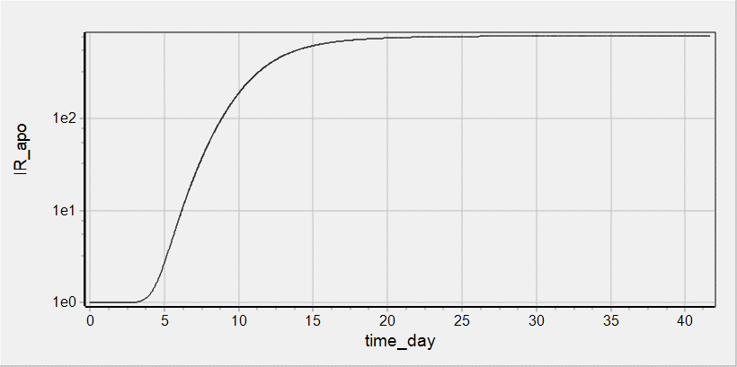
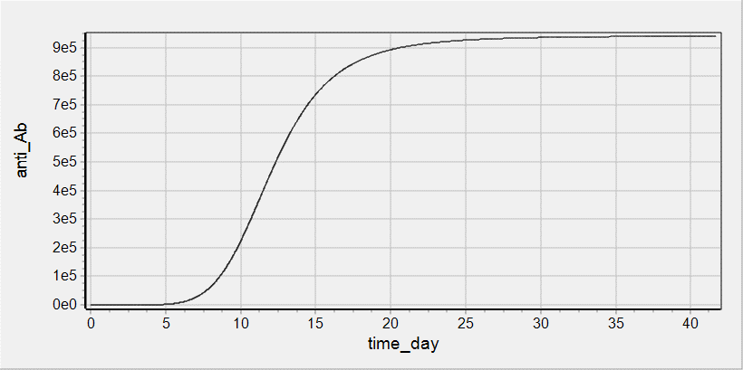
Implementation of Immune Response
Effect of Immune Response (IR) on viral load dynamics was implemented as previously (see description of a Commit dated by 20.07.12/20.07.19):
Increase in vPC death
Decrease in virus binding to the host cell due to increase in anti-Spike antibodies concentration
Event describing the function switch_ir = {0 when time < T_sw_ir; 1 when time > T_sw_ir} was implemented
Following parameter values were applied
T_sw_ir = 50 {units: h};
ET50_ir = 190 {units: h};
Emax_ir_apo = 800 {units: UL};
n_ir = 5 {units: UL};
Kd_anti_Ab = 14300 {units: pM};
anti_Ab_max = 941000 {units: pM};

Slide 24
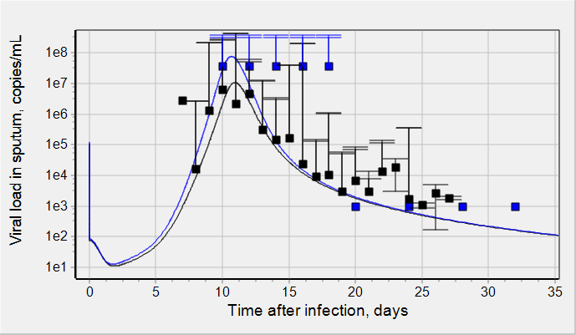
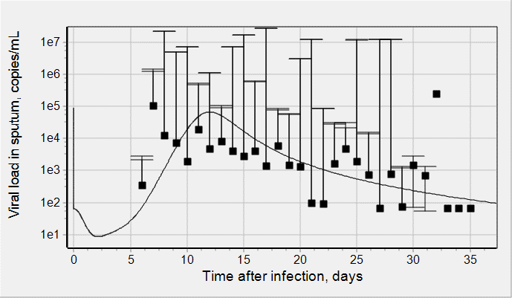
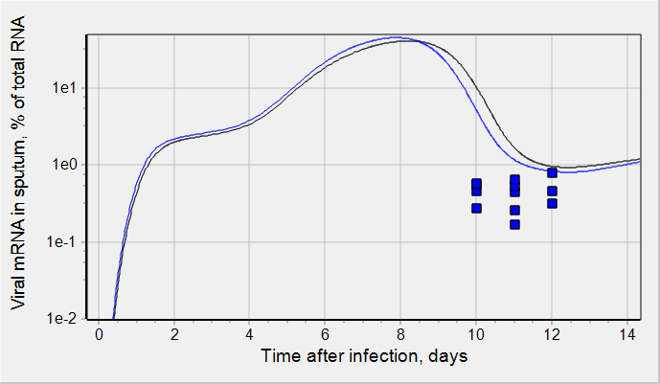
Reproduction of clinical data on viral load dynamics
Viral load and % of viral subgenomic mRNA in sputum were simulated
Following 2 parameters were refitted:
kbase_tran_pc_ipc = 4;//10; // {units: 1/pM/h};
kbase_tran_ipc_vpc = 4;//10; // {units: 1/pM/h};
COV initial values in alveolar surfactant and their correspondence to viral concentration in sputum:
COV(0) = 1.5e-3 pM → 9e4 copies/mL
COV(0) = 1.8e-3 pM → 1.08e5 copies/mL
COV(0) = 2e-3 pM → 1.2e5 copies/mL
Wolfer et al, doi.org/10.1101/
2020.03.05.20030502
Time/value of peak viral load and range of viral shedding [PMID 32315724]
Virus initial concentration: 1.08e5 copies/mL
1.2e5 copies/mL
Data were averaged from [PMID 32125362]
Wolfer et al, doi.org/10.1101/
2020.03.05.20030502
Virus initial concentration: 1.08e5 copies/mL
1.2e5 copies/mL
Virus initial concentration: 9e4 copies/mL

Slide 25
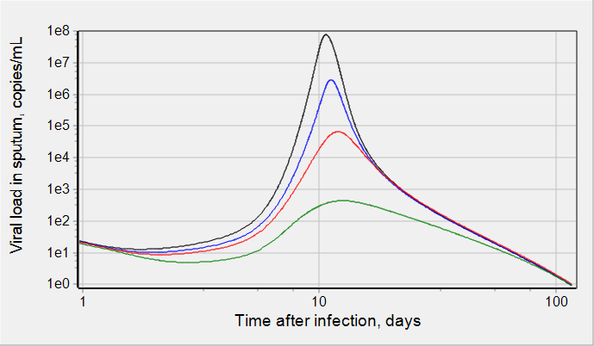
Simulations: Viral load dynamics
Virus initial concentration:
1.2e5 copies/mL
1e5 copies/mL
9e4 copies/mL
5e4 copies/mL
Time of IR switching ON:
50 hour
Limit of detection
There is a threshold in virus initial concentration in sputum.
The values above the threshold lead to substantial and transient virus load in sputum.
The values below the threshold do not allow detect virus in sputum at any time.
Increase in virus initial concentration results in higher peak of viral load which is faster achieved.

Slide 26
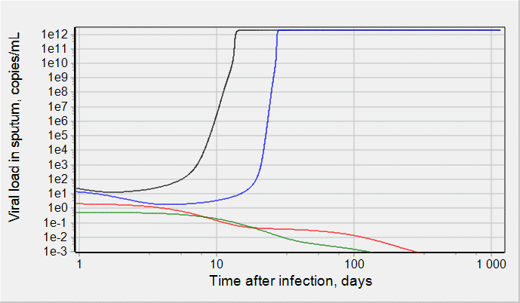
Simulations: Viral load dynamics w/o IR induction
Virus initial concentration:
1.2e5 copies/mL
3e4 copies/mL
3e3 copies/mL
7.5e2 copies/mL
Limit of detection
SIMULATION DESIGN: (i) initial COV concentration in alveolar surfactant is varied from 2e-3 to 1.9e-6 pM, (ii) there is no induction of IR, i.e. switch_ir = 0 for any time after infection
RESULTS:
There is a threshold in virus initial concentration. The values above the threshold lead to substantial steady state virus load. The values below the threshold do not allow detect virus in sputum at any time, i.e. viral load tends to steady state value equal to 0.
ODE system has 1 unstable and 2 stable steady states. One of the stable steady states correspond to 0 viral load and other corresponds to very substantial viral load.
Model is able to describes self curing dynamics, i.e., viral load tends to 0 when initial virus concentration is below threshold. If initial virus concentration is above threshold then virtual patient is being infected and viral load tends to very high value with time.

Slide 27
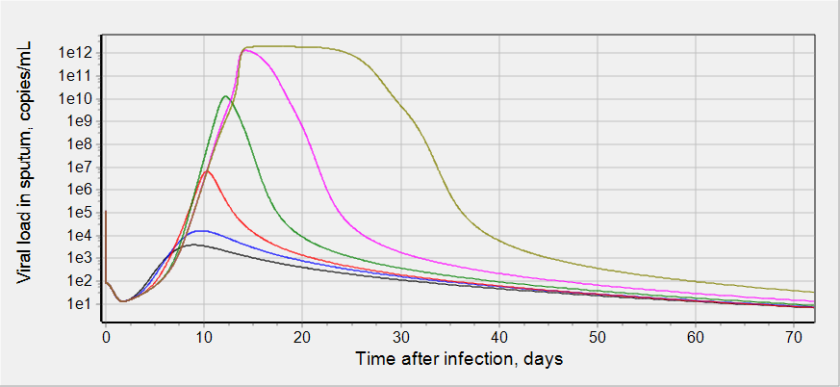
Simulations: Effect of delay in IR on viral load
SIMULATION DESIGN:
Start time of Immune response (IR) was varied from 10 to 320 hours past infection.
Amplitude of IR and virus initial concentration in sputum were kept the same for various start time
At each start time viral load dynamics in sputum was simulated
RESULTS:
Early IR (10 and 20 hours) do not allow detect virus in sputum at any time.
Delay in IR start time substantially increases peak viral load and shifts the peak to later time
Very late IR start time leads to plateau in viral load dynamics with maximal viral load value
Time of IR switching ON:
10 hour
20 hour
40 hour
80 hour
160 hour
320 hour
Virus initial concentration:
1.2e5 copies/mL
Limit of detection

Slide 29
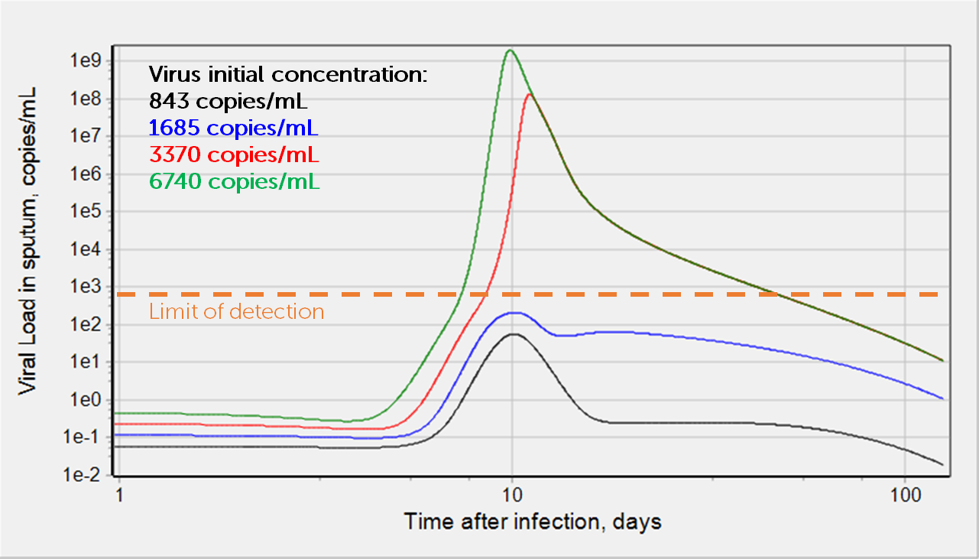
Model simulations and experimental data
Wolfer et al, doi.org/10.1101/
2020.03.05.20030502
Time/value of peak viral load and range of viral shedding [PMID 32315724]
Wolfer et al, doi.org/10.1101/
2020.03.05.20030502
Virus initial concentration: 3370 copies/mL
6740 copies/mL
Virus initial concentration: 3370 copies/mL
Dots are experimental data
Solid lines are model simulations
There is a threshold in virus initial concentration.
The values above the threshold lead to substantial and transient virus load in sputum.
The values below the threshold do not allow detect virus in sputum at any time.
Increase in virus initial concentration results in higher peak of viral load which is faster achieved.

Slide 30
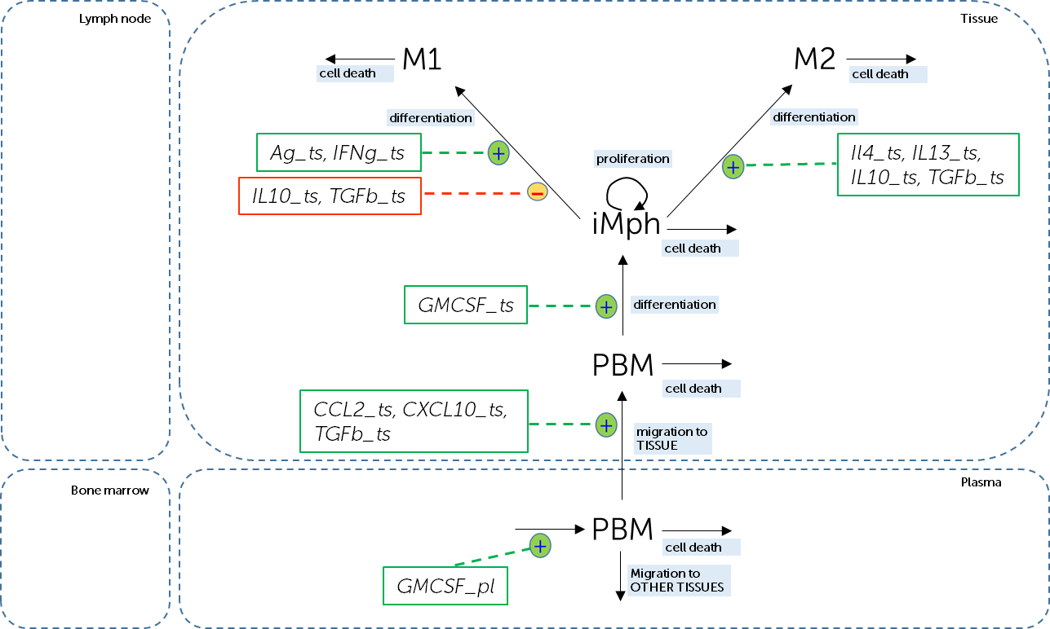
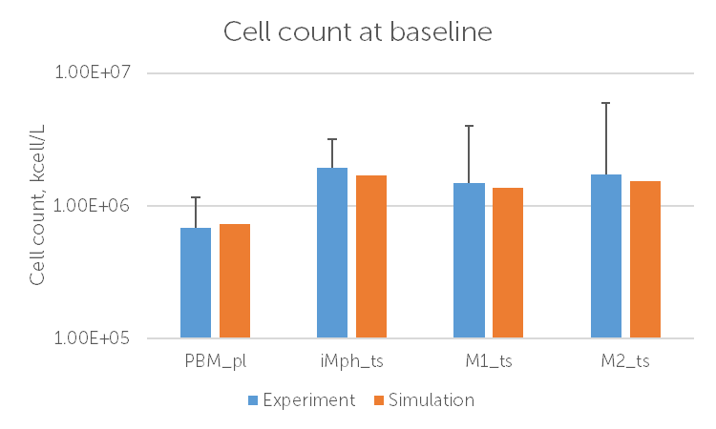
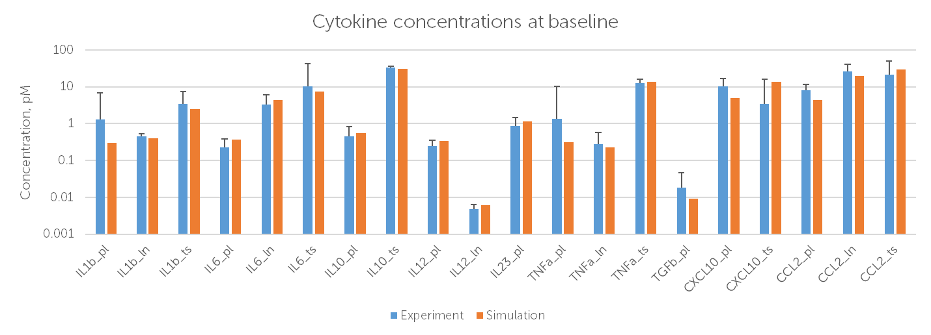
Mph sub-model: scheme and calibration
Sub-model of macrophage (Mph) life cycle was constructed on the basis of Mph passport available in Immune Response Template (https://irt.insysbio.com)
In vivo baseline data for calibration were extracted from Cytocon DB (http://cytocon.insysbio.com)
We have upgraded Mph sub-model to take into account lung specifics and calibrated it against in vivo baseline data measured for healthy subjects

Slide 31
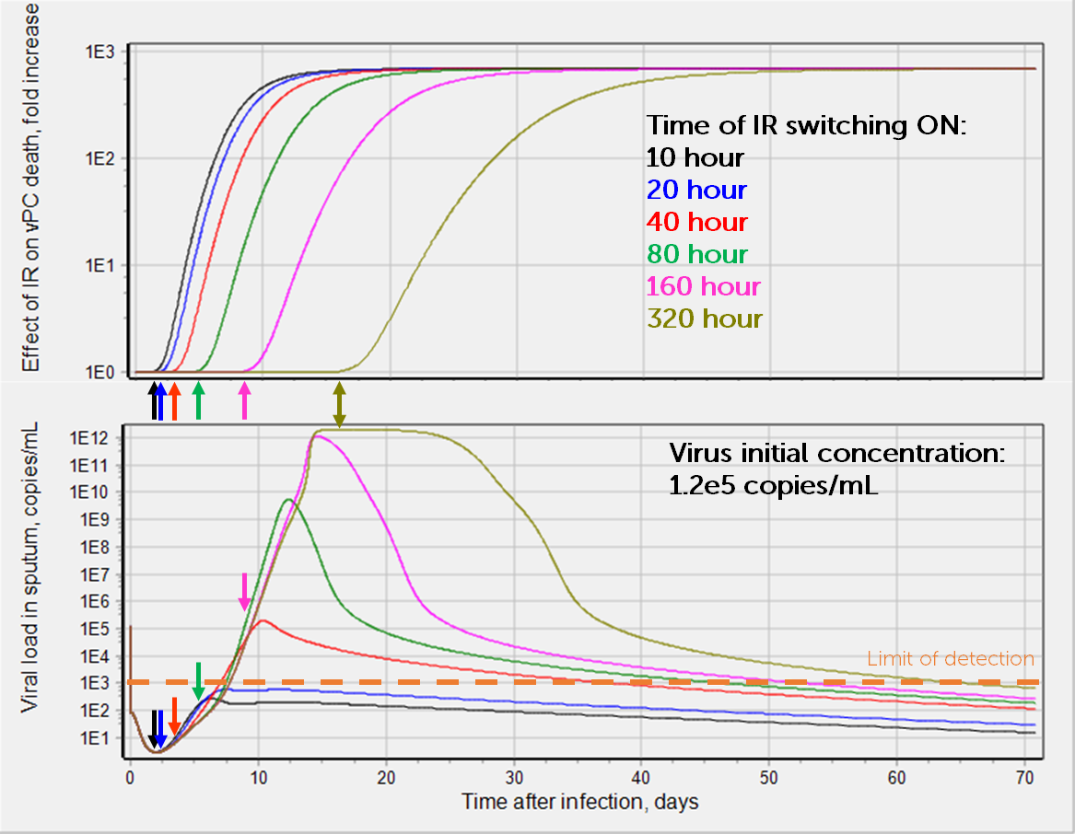
Model simulations: Effect of delay in Immune Response on viral load
SIMULATION DESIGN:
Start time of Immune response (IR) was varied from 10 to 320 hours past infection.
Amplitude of IR and virus initial concentration in sputum were kept the same for various start time
At each start time viral load dynamics in sputum was simulated
RESULTS:
Early IR (10 and 20 hours) do not allow to detect virus in sputum at any time.
Delay in IR start substantially increases peak viral load and shifts the peak to later time
Very late IR start leads to plateau in viral load dynamics with maximal viral load value

Slide 32
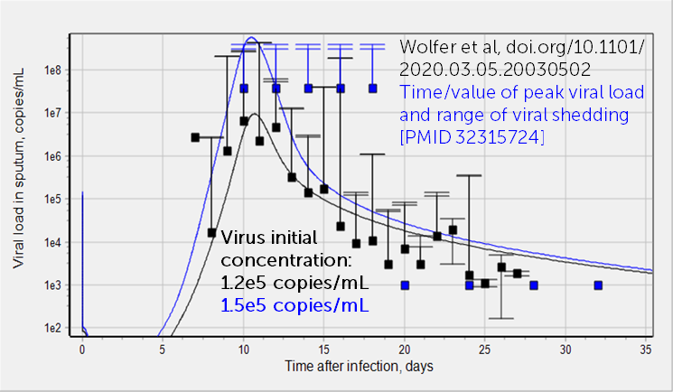
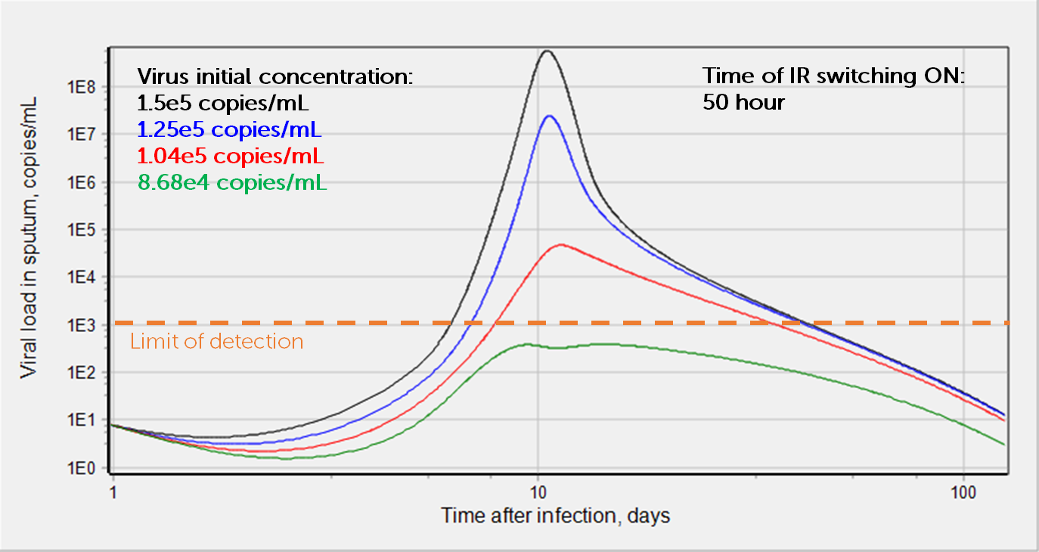
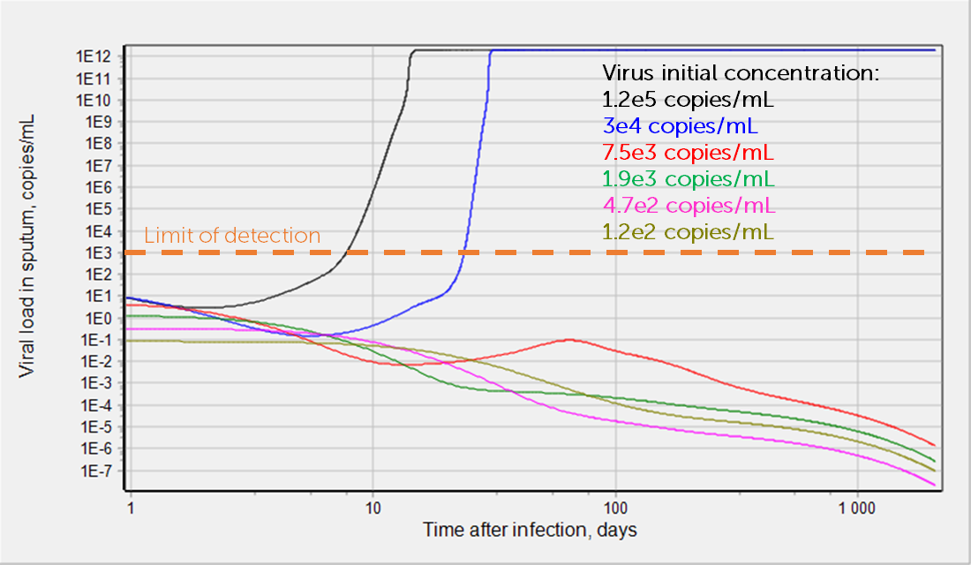
Model simulations: self curing viral load dynamics
Viral load dynamics with IR induction
RESULTS:
ODE system has 1 unstable and 2 stable steady states. One of the stable steady states correspond to 0 viral load and other corresponds to very substantial viral load.
Model is able to describes self curing dynamics, i.e., viral load tends to 0 when initial virus concentration is below threshold. If initial virus concentration is above threshold then virtual patient is being infected and viral load tends to very high value with time.
Viral load dynamics w/o IR induction
infection
self curing dynamics

