Slide 1
VCAP Voting for Visually Handicapped
http://jodanchua.github.io/vcap/
Members:
Chua, Jordan
Ngo, Adrian
Wong, Jeffrey
Wu, Renzo

Slide 2
WHAT IS VCAP?
Voting for Visually Handicapped (eg. Visually Impaired, Legally Blind, Blind)
allows blind voters to vote INDEPENDENTLY without the need of a helper or a “buddy” to vote for them.
Voters can simply choose their selected candidate by listening to the AUDIO of the currently selected candidate
Serves as a DATABASE for the COMELEC as votes can be recorded IMMEDIATELY
Notes:
Visually Impaired: A person is considered visually impaired when, with best correction, he or she has difficulty reading a newspaper, is unable to see objects with peripheral vision, among many other indicators.
Legally blind: This is defined as no better than 20/200 corrected vision in the better eye, or a visual field not extending beyond 20 degrees in the better eye, or a visual efficiency of no more than 20 percent. The "legal" refers to a determination of the person's eligibility for government benefits resulting from his or her visual impairment.
Blindness: A wide array of conditions ranging from a limited ability to see objects with special aids to the absence of light perception. Most people who are blind have some light perception.

Slide 3
How Do Blind People Vote?
Large display version of the ballot paper (for visually impaired)
Braille template ballots
Vote by proxy
Tactile Voting Device
Notes:
Braille template ballots – ballot with a braille template
Problem: not everybody knows how to read braille
Vote by proxy– assign somebody to vote for them or mark their ballot for them
Problem: not voting inependeently
Tactile Voting Device (explained in next slide)

Slide 4
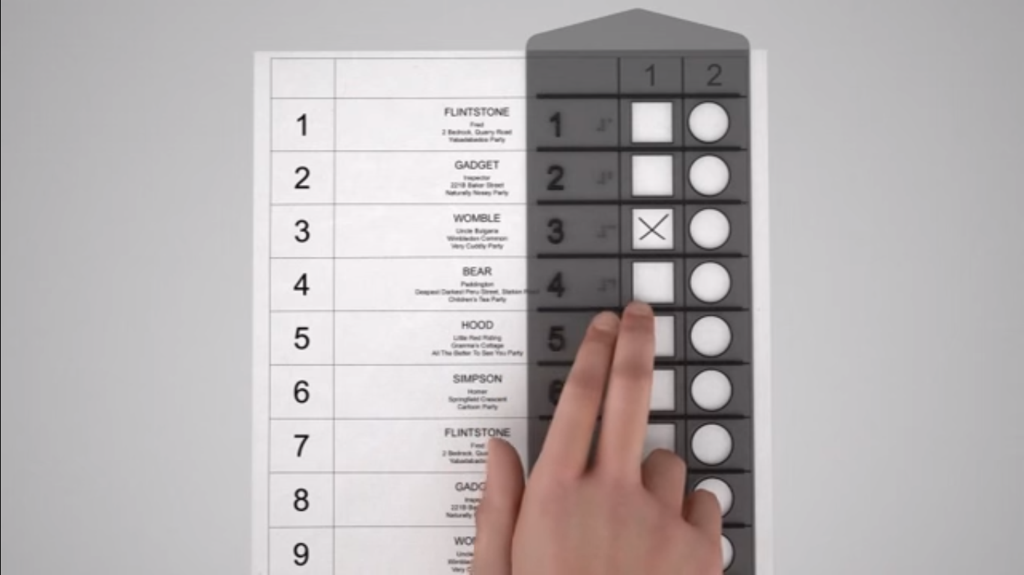
Tactile Voting
https://www.youtube.com/watch?v=Passcgo3yVA 1:57 – 3:07
Notes:
https://www.youtube.com/watch?v=Passcgo3yVA 1:57 – 3:07
Tactile device
1. Attach the device (black paper)
2. Has a NUMBER, BRAILLE EQUIVALENT of the number, SQUARE == 1st choice, CIRCLE == 2nd choice (in the case na may first and second choice)
3. Remove the device.
4. Put Ballot in Ballot Box
Problem: Not everybody knows how to read braille
Voting officials need to read the list of candidates first (not sure) or voter must know the candidate number of his candidate to vote using this device

Slide 5
WHY USE VCAP?
For the VCAP voters
allow them to vote INDEPENDENTLY
LISTEN to the audio of their candidate’s name
Notes:
Importance

Slide 6
WHY USE VCAP?
For the COMELEC
Give COMELEC a DATABASE that would IMMEDIATELY tally votes from the VCAP voters.
Notes:
Importance

Slide 7
Services

Slide 8
Text to Speech
Rest API:
"https://" + t2s.getUsername() + ":" + t2s.getPassword() + "@stream.watsonplatform.net/text-to-speech/api/v1/synthesize?text=You Voted For";

Slide 9
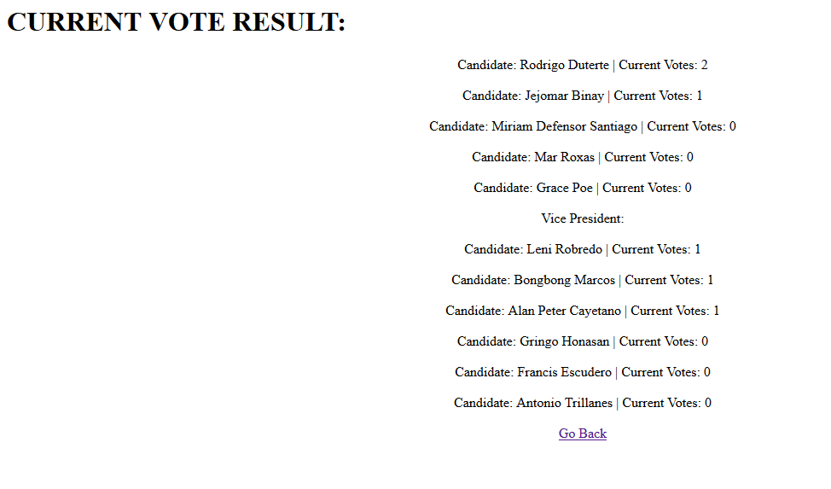
Redis Experimental
Notes:
Redis:
SetOperations
Upload Servlet – add()
Next Servlet – incrementScore()
results.jsp – sortDesc()
- get score()

Slide 10
DEMO

Slide 11
Thank you for using VCAP services.

Slide 12
References
http://www.afb.org/info/living-with-vision-loss/for-job-seekers/for-employers/visual-impairment-and-your-current-workforce/learning-about-blindness/12345
Tactile Voting Device - https://www.youtube.com/watch?v=Passcgo3yVA
http://webarchive.nationalarchives.gov.uk/20080205132216/direct.gov.uk/en/disabledpeople/everydaylifeandaccess/everydayaccess/dg_4018637
https://nfb.org/hava-legislation
https://electiontales.wordpress.com/tag/tactile-voting/
https://www.nidirect.gov.uk/articles/voting-elections-people-disabilities

