Slide 1

Session 1: Tools, data, methods
Chair: Jari Arkko
Presentations
Datatracker interface (Sparks)
BigBang (Benthall)
SODESTREAM (McQuistin)
IETF website analytics (Wood)
Relevant papers:
Using Complex Systems Analysis to Identify Organizational Interventions (Sebastian Benthall)
The ietfdata Library (Stephen McQuistin, Colin Perkins)
The RFC Prolog Database (Marc Petit-Huguenin)
Observations about IETF process measurements (Jari Arkko)
And this, though not a paper: https://www.ietf.org/policies/web-analytics/ (IETF)
Data sources
Access
Analysis
Use

Slide 2
Accessing Datatracker Data
Robert Sparks
IAB AID Workshop
Session 1

Slide 3
What’s available ?
Files (drafts, RFCs, agendas, minutes, photos)
Available over HTTPS and through rsync
Metadata about People, Documents, Groups, Meetings, and more
Stored in SQL, structured as Django Models
Archives of mailing lists
Managed by the mailarchive Django project rather than the datatracker
Details at https://notes.ietf.org/iab-aid-data-resources

Slide 4
Two ways to get to the datatracker data
Set up a local development environment
Using docker (note that the first build will take 40-ish minutes)
Developer database dump refreshed daily
Django shell allows construction of arbitrary querysets
Instructions at https://notes.ietf.org/iab-aid-data-resources
Use the v1 API
Built on Tastiepie
Can just be browsed (xml or json output)
Best accessed with curl and jq
Not as capable as the development environment
Some ordering care needed when retrieving a large number of records

Slide 5
Preview of what you can do
In [3]: Document.objects.filter(documentauthor__person__name= "Robert Sparks").count()
Out[3]: 258
In [4]: Counter(Document.objects.filter(documentauthor__person__name= "Robert Sparks").values_list('type_id',flat=True))
Out[4]: Counter({'draft': 67, 'review': 191})

Slide 6
Preview of what you can do
% curl "https://datatracker.ietf.org/api/v1/doc/document/?states__slug=lc&format=json" \
| jq "[.objects[] | .name]"
[
"draft-eastlake-rfc6931bis-xmlsec-uris",
"draft-ietf-i2nsf-capability-data-model",
"draft-ietf-i2nsf-nsf-monitoring-data-model",
"draft-ietf-httpbis-priority",
"draft-ietf-acme-dtnnodeid",
"draft-ietf-httpbis-http2bis",
"draft-ietf-lamps-samples"
]

Slide 7
What’s in there?
A lot – the datatracker is a large application, with complex data relationships
Over 100,000 documents
Nearly 20,000 people
Over 1000 meetings (including interims)
Minimal PII for People
Names and email addresses
Sometimes Affiliation and Country
No addresses (though those can sometimes be mined from drafts)
No other explicitly captured demographics
See https://notes.ietf.org/iab-aid-datatracker-database-overview

Slide 8
What’s in there: History
Most metadata is saved when a Document, Group, or Person object is modified
Reasonably complete for recent (10 to 15 years) history
Poor for older history – data is often incomplete, and is occasionally completely wrong
The models were designed for tracking the current state of work. Mining the history records can be complicated.
It is very hard, for example, to determine when someone stopped being a chair of a given working group.

Slide 9
Backup slides

Slide 10
What’s in there: Code
Don’t ignore the codebase
Many utilities exist to make data mining easier
Finding the current (or final) IESG ballot state for a document
Extracting authors from text Internet-Drafts
Finding the chain of all documents that ultimately normatively depend on a given document through dependencies on other documents.

Slide 11
Getting started
Explore the development environment and the v1 API
Ask questions:
I’m available at email:rjsparks@nostrum.com and on the IETF Slack
Consider subscribing to tools-discuss@ietf.org

Slide 12
BigBang Update
//
Using
Complex Systems Analysis
to Identify
Organizational Interventions
Sebastian Benthall, PhD
Information Law Institute
NYU School of Law

Slide 13

What is BigBang
A scientific toolkit for studying collaborative communities
Data sources: Email, Git repositories, IETF DataTracker, ListServ, …
Data science tools: using Scientific Python stack
Entity resolution for names and organizations
Social network analysis
Natural language processing on message content
Time series analysis
Information extraction…

Slide 14
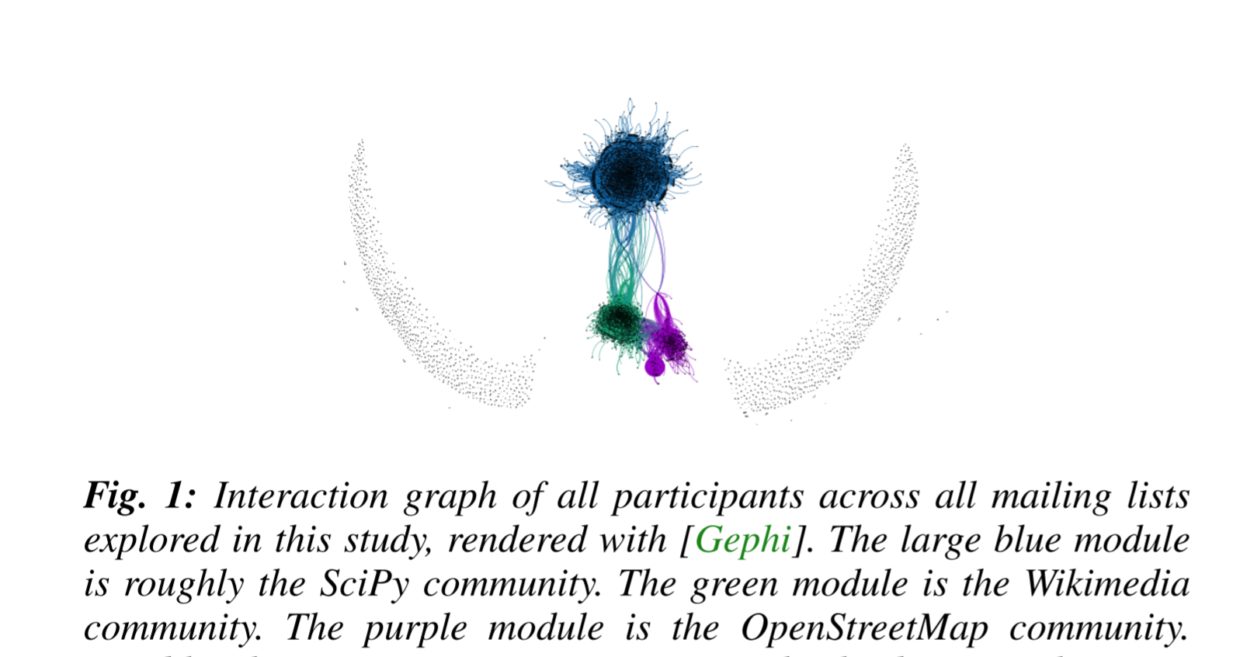
Sebastian Benthall (2015) “Testing Generative Models of Online Collaboration with BigBang.” Proceedings of the 14th Python in Science Conference, 175 - 181, 2015, Eds.Kathryn Huff and James Bergstra, 10.25080/Majora-7b98e3ed-01b

Slide 15
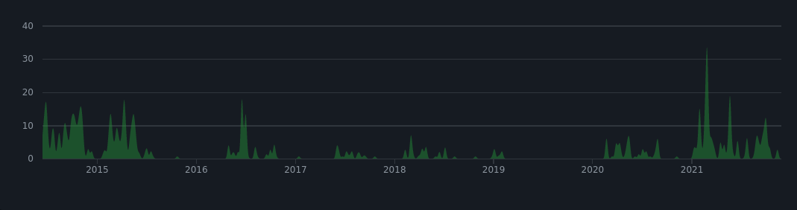
History
2015 - Developed to study open collaborative communities.
2016 - adapted to study human rights advocacy in IETF and ICANN
2020 - Article 19 funds improvements to gender and affiliation detection, IETF datatracker and attendance ingest.
2021 - Article 19 sponsors BigBang Sprint at IETF 110.
2021 - BigBang awarded funding from Prototype Fund

Slide 16





Slide 17
Individual vs. Organizations in IETF
“Participation in the IETF or of its WGs is not fee-based or organizationally defined, but is based upon self-identification and active participation by individuals.” - Tao of IETF
Are the participants in IETF acting as individuals, or as parts of organizations (like companies?)
Normative questions, like:
Are individuals better stewards of the public interest than commercial organizations?
A related, descriptive, question:
How to determine when individuals are acting independently vs. as part of an organizational action.
This is about how to do empirical work that spans levels of abstraction.

Slide 18
Tools, data, and methods
Using BigBang for mailing list analysis
Getting participation in discussion outside of drafting
This data is organized along multiple levels of abstraction.
Email Addresses |  | Working Group 1 | Working Group 2
prefix_a | @domain_x.com | 250 | 10
prefix_b |  | 1 | 50
prefix_c | @domain_y.org | 150 | 20
prefix_d |  | 100 | 30

Slide 19
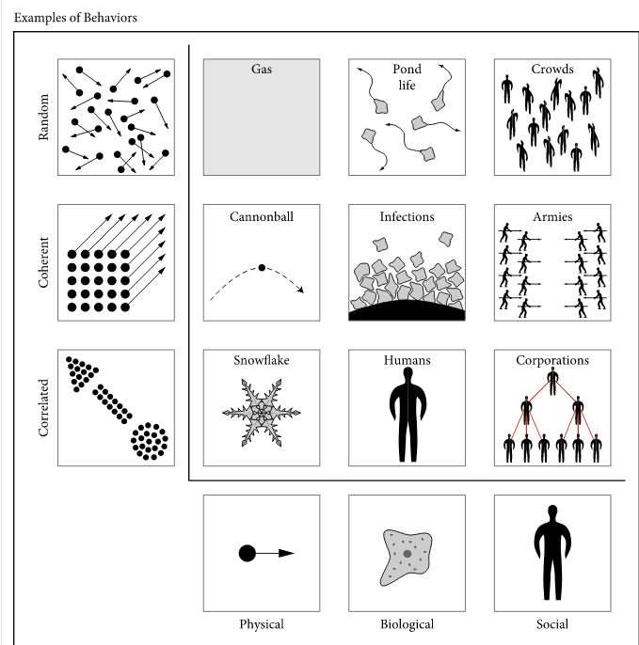
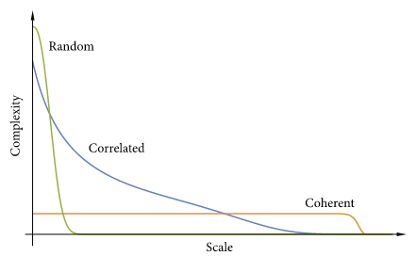
Use the complexity profile of a phenomenon to determine if it is acting randomly or else with a higher organizing principle. (Figures from Siegenfeld and Bar-Yam, Complexity, 2020)

Slide 20
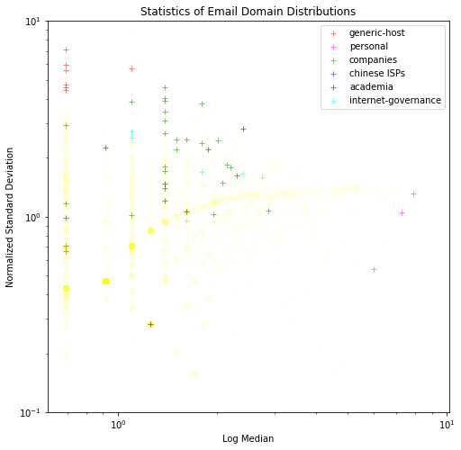
Preliminary results on distributions over prefixes:
Generic email domains:
e.g. gmail.com
high standard deviation
low median
Random organization.
Organizational email domains
E.g. apple.com
higher median
Correlated organization
Personal email addresses
E.g. csperkins.org
low standard deviation
high median
Coherent organization

Slide 21
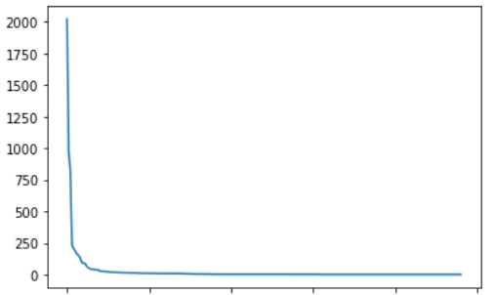
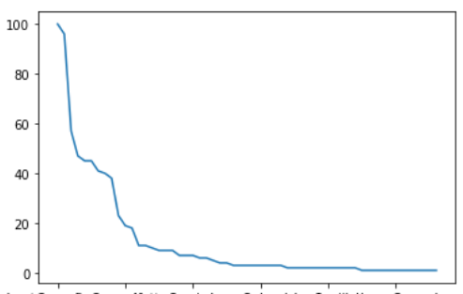
Next steps
Messages to httpbisa
Messages per email - gmail.com
Consider organization within working groups
At individual level
At domain level
Are the working groups random, correlated, or coherent organizations?
Are they a mixture of activities of different types of organizations?
Questions and feedback: spb413@nyu.edu. Thanks!
Many differently affiliated individuals at major differences in scale - random.
Messages per email - google.com
Area under curve indicating corporate strategy.

Slide 22


The ietfdata Library
Stephen McQuistin
Colin Perkins
IAB Workshop on Analyzing IETF Data (AID)
November 29th 2021
This work is funded by the UK Engineering and Physical Sciences Research Council, under grants EP/S033564/1 and EP/S036075/1.

Slide 23

IETF Data
Datatracker
RFC Index
Mail Archives

Slide 24
IETF Data
Datatracker
REST API
RFC Index
Mail Archives
XML file
IMAP

Slide 25

The ietfdata Library
Mail Archives
Datatracker
RFC Index
IMAP
REST API
XML file
MongoDB cache
The ietfdata Library

Slide 26
What data is available?
Author list
Stream
IETF working group and area information, if appropriate
Status (at publication, and current)
Updates/obsoletes relationships between RFCs
RFC Index
Mail Archives
Datatracker

Slide 27
What data is available?
IETF mailing lists, and mirrors, from around 1995
Messages grouped by mailing list
Library provides a thread abstraction
RFC Index
Mail Archives
Datatracker

Slide 28
What data is available?
Documents I-Ds, agendas, bluesheets, charters, minutes, recordings, …
Groups Events, milestones, roles (chairs and ADs), URLs …
Intellectual property disclosures
Mailing list subscriptions
Meetings Registrations, schedule, session details, …
People Names, e-mail addresses, biographies, …
Reviews Requests, reviews, assignments, review teams/directorates, …
RFC Index
Mail Archives
Datatracker

Slide 29
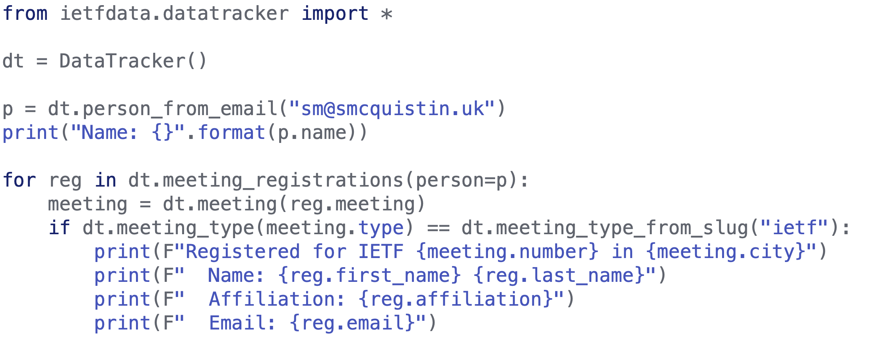
Example: Meeting registrations

Slide 30
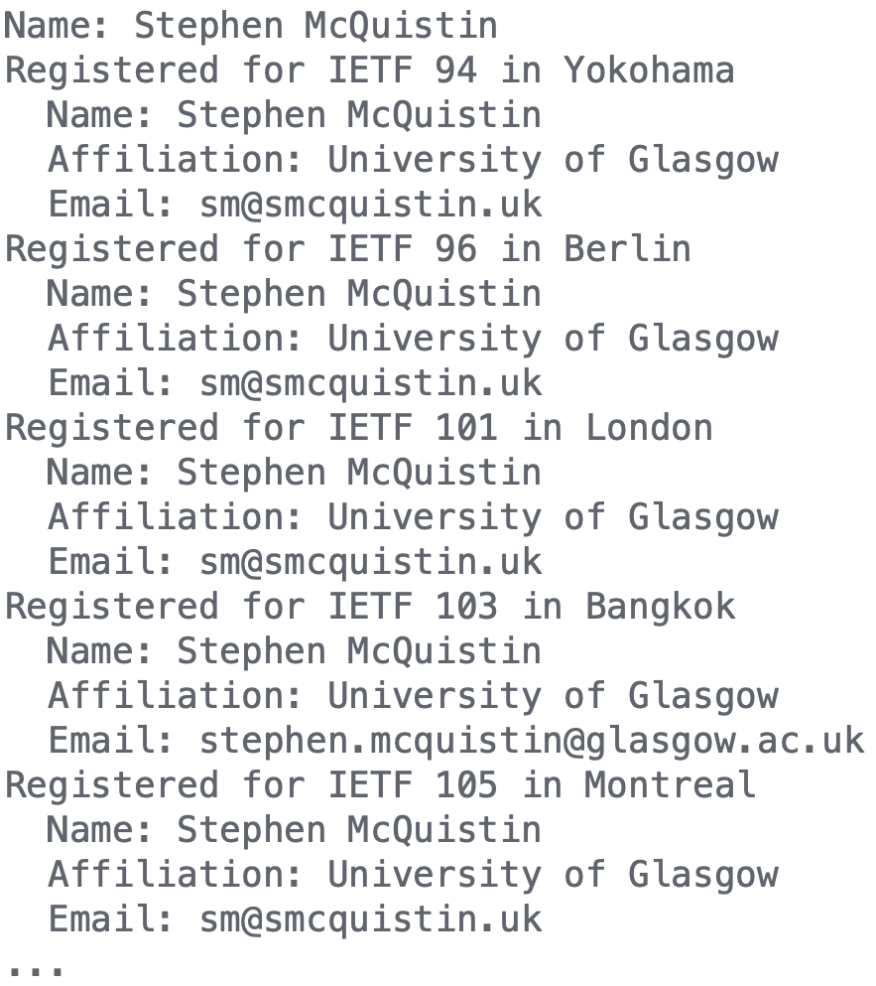
Example: Meeting registrations

Slide 31
Example: Meeting registrations
Finds registrations by person, even if a different e-mail address was used

Slide 32
Summary
The ietfdata library provides a Python API for accessing email archives, the Datatracker, and the RFC Index
Support for caching, to improve performance and reduce load on the IETF’s infrastructure
Available via PyPI, with code and examples on GitHub
Installation via PyPI:
pip install ietfdata
Code and examples:
https://github.com/glasgow-ipl/ietfdata

Slide 33
Examples
More at github.com/glasgow-ipl/ietfdata/tree/master/examples

Slide 34
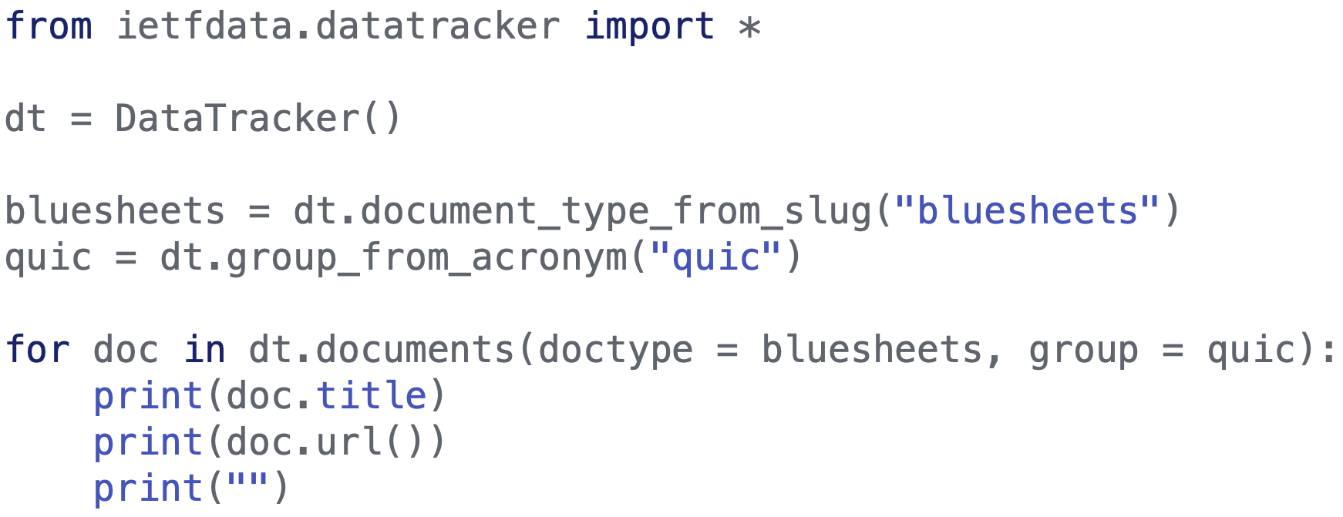
Example: Bluesheets

Slide 35
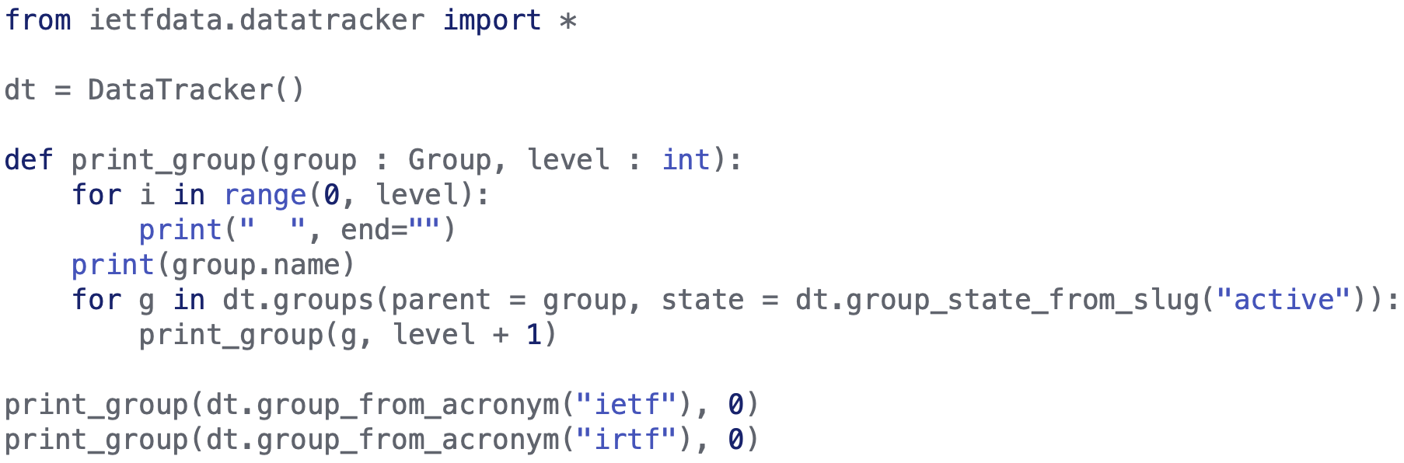
Example: Organisational chart

Slide 36
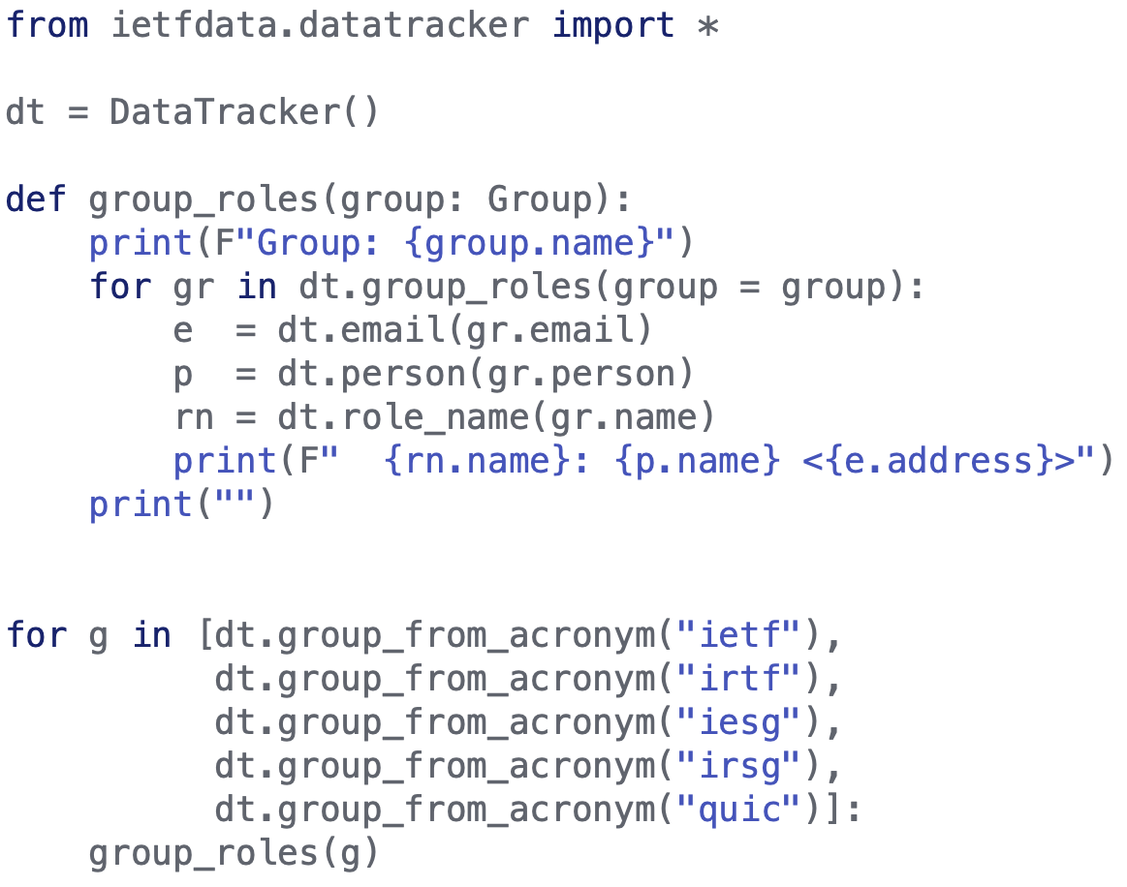
Example: Group roles

