Slide 1
BigBang Update
//
Using
Complex Systems Analysis
to Identify
Organizational Interventions
Sebastian Benthall, PhD
Information Law Institute
NYU School of Law

Slide 2

What is BigBang
A scientific toolkit for studying collaborative communities
Data sources: Email, Git repositories, IETF DataTracker, ListServ, …
Data science tools: using Scientific Python stack
Entity resolution for names and organizations
Social network analysis
Natural language processing on message content
Time series analysis
Information extraction…

Slide 3
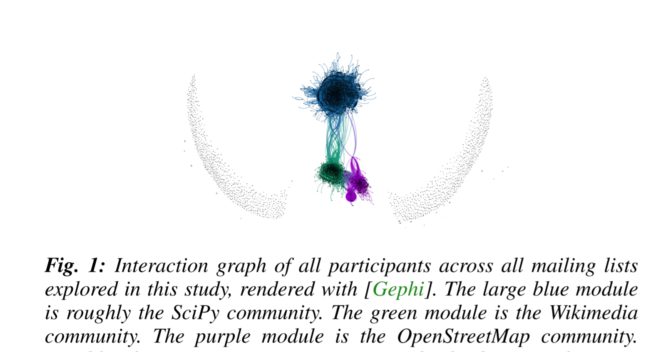
Sebastian Benthall (2015) “Testing Generative Models of Online Collaboration with BigBang.” Proceedings of the 14th Python in Science Conference, 175 - 181, 2015, Eds.Kathryn Huff and James Bergstra, 10.25080/Majora-7b98e3ed-01b

Slide 4
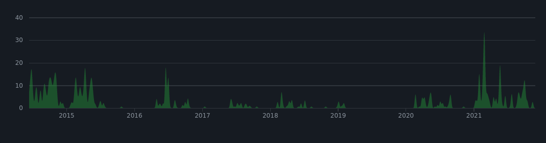
History
2015 - Developed to study open collaborative communities.
2016 - adapted to study human rights advocacy in IETF and ICANN
2020 - Article 19 funds improvements to gender and affiliation detection, IETF datatracker and attendance ingest.
2021 - Article 19 sponsors BigBang Sprint at IETF 110.
2021 - BigBang awarded funding from Prototype Fund

Slide 5





Slide 6
Individual vs. Organizations in IETF
“Participation in the IETF or of its WGs is not fee-based or organizationally defined, but is based upon self-identification and active participation by individuals.” - Tao of IETF
Are the participants in IETF acting as individuals, or as parts of organizations (like companies?)
Normative questions, like:
Are individuals better stewards of the public interest than commercial organizations?
A related, descriptive, question:
How to determine when individuals are acting independently vs. as part of an organizational action.
This is about how to do empirical work that spans levels of abstraction.

Slide 7
Tools, data, and methods
Using BigBang for mailing list analysis
Getting participation in discussion outside of drafting
This data is organized along multiple levels of abstraction.
Email Addresses |  | Working Group 1 | Working Group 2
prefix_a | @domain_x.com | 250 | 10
prefix_b |  | 1 | 50
prefix_c | @domain_y.org | 150 | 20
prefix_d |  | 100 | 30

Slide 8
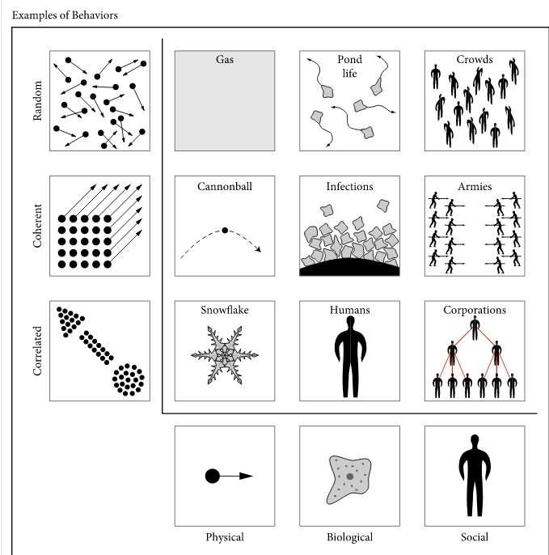
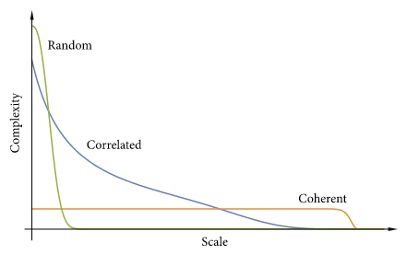
Use the complexity profile of a phenomenon to determine if it is acting randomly or else with a higher organizing principle. (Figures from Siegenfeld and Bar-Yam, Complexity, 2020)

Slide 9
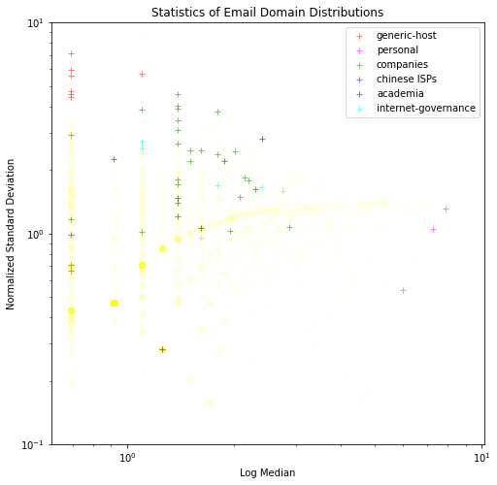
Preliminary results on distributions over prefixes:
Generic email domains:
e.g. gmail.com
high standard deviation
low median
Random organization.
Organizational email domains
E.g. apple.com
higher median
Correlated organization
Personal email addresses
E.g. csperkins.org
low standard deviation
high median
Coherent organization

Slide 10
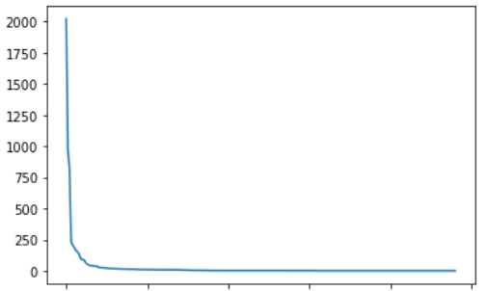
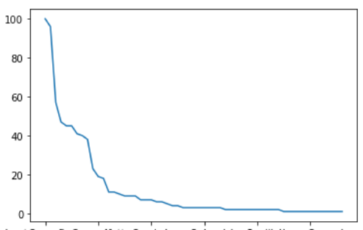
Next steps
Messages to httpbisa
Messages per email - gmail.com
Consider organization within working groups
At individual level
At domain level
Are the working groups random, correlated, or coherent organizations?
Are they a mixture of activities of different types of organizations?
Questions and feedback: spb413@nyu.edu. Thanks!
Many differently affiliated individuals at major differences in scale - random.
Messages per email - google.com
Area under curve indicating corporate strategy.

