Slide 1


The ietfdata Library
Stephen McQuistin
Colin Perkins
IAB Workshop on Analyzing IETF Data (AID)
November 29th 2021
This work is funded by the UK Engineering and Physical Sciences Research Council, under grants EP/S033564/1 and EP/S036075/1.

Slide 2

IETF Data
Datatracker
RFC Index
Mail Archives

Slide 3
IETF Data
Datatracker
REST API
RFC Index
Mail Archives
XML file
IMAP

Slide 4

The ietfdata Library
Mail Archives
Datatracker
RFC Index
IMAP
REST API
XML file
MongoDB cache
The ietfdata Library

Slide 5
What data is available?
Author list
Stream
IETF working group and area information, if appropriate
Status (at publication, and current)
Updates/obsoletes relationships between RFCs
RFC Index
Mail Archives
Datatracker

Slide 6
What data is available?
IETF mailing lists, and mirrors, from around 1995
Messages grouped by mailing list
Library provides a thread abstraction
RFC Index
Mail Archives
Datatracker

Slide 7
What data is available?
Documents I-Ds, agendas, bluesheets, charters, minutes, recordings, …
Groups Events, milestones, roles (chairs and ADs), URLs …
Intellectual property disclosures
Mailing list subscriptions
Meetings Registrations, schedule, session details, …
People Names, e-mail addresses, biographies, …
Reviews Requests, reviews, assignments, review teams/directorates, …
RFC Index
Mail Archives
Datatracker

Slide 8
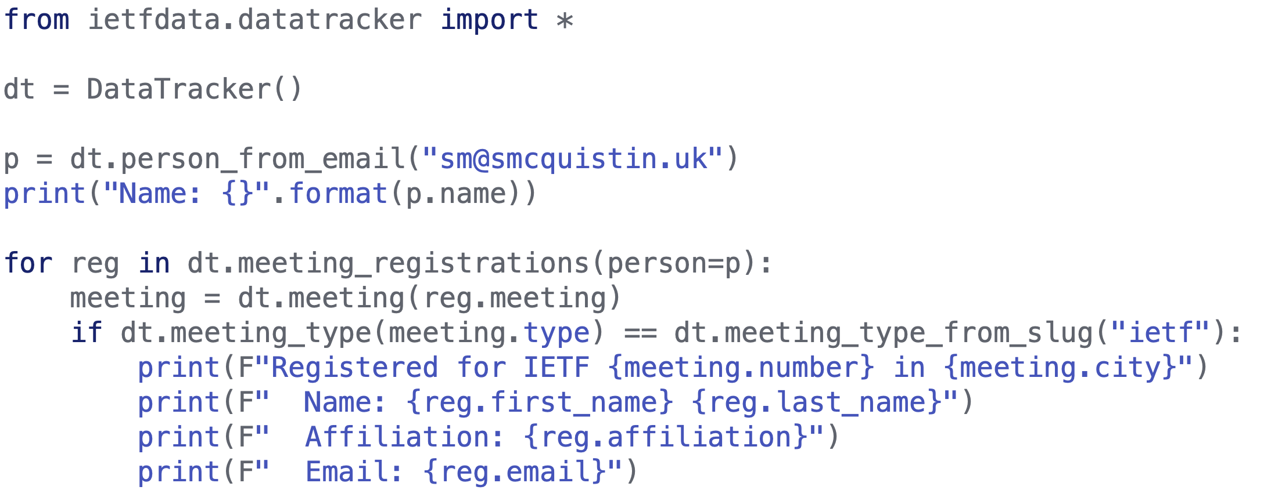
Example: Meeting registrations

Slide 9
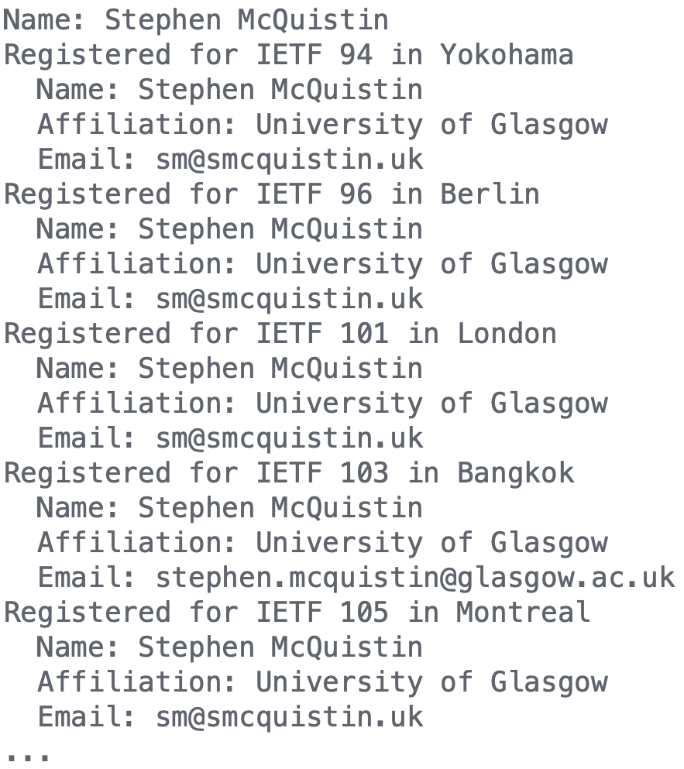
Example: Meeting registrations

Slide 10
Example: Meeting registrations
Finds registrations by person, even if a different e-mail address was used

Slide 11
Summary
The ietfdata library provides a Python API for accessing email archives, the Datatracker, and the RFC Index
Support for caching, to improve performance and reduce load on the IETF’s infrastructure
Available via PyPI, with code and examples on GitHub
Installation via PyPI:
pip install ietfdata
Code and examples:
https://github.com/glasgow-ipl/ietfdata

Slide 12
Examples
More at github.com/glasgow-ipl/ietfdata/tree/master/examples

Slide 13
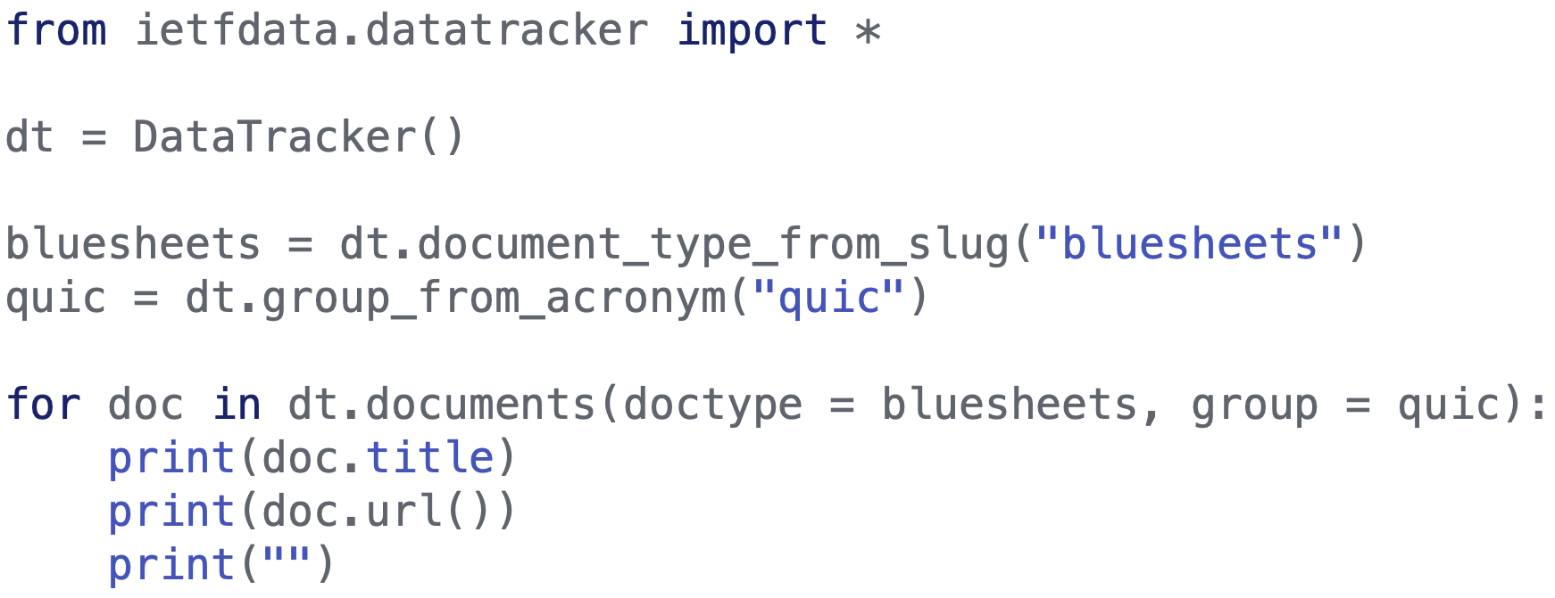
Example: Bluesheets

Slide 14
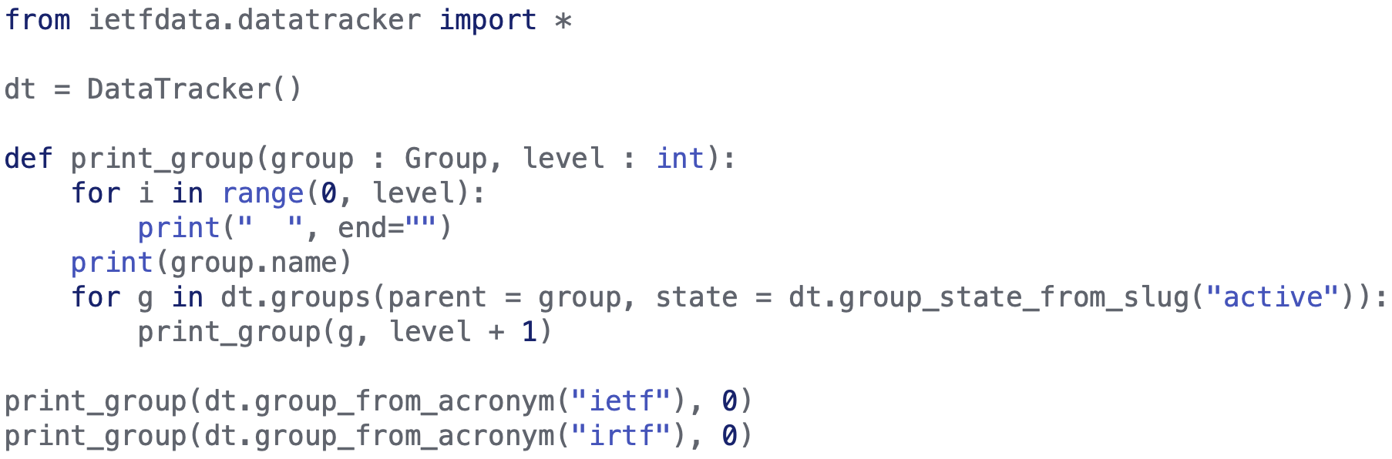
Example: Organisational chart

Slide 15
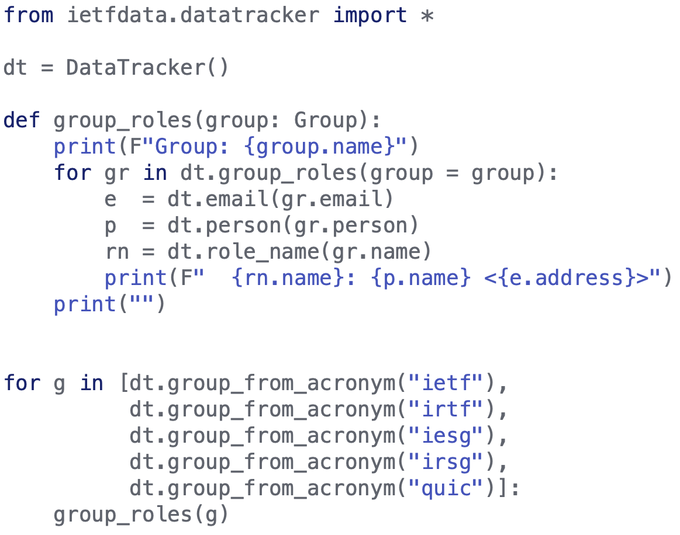
Example: Group roles

