Slide 1
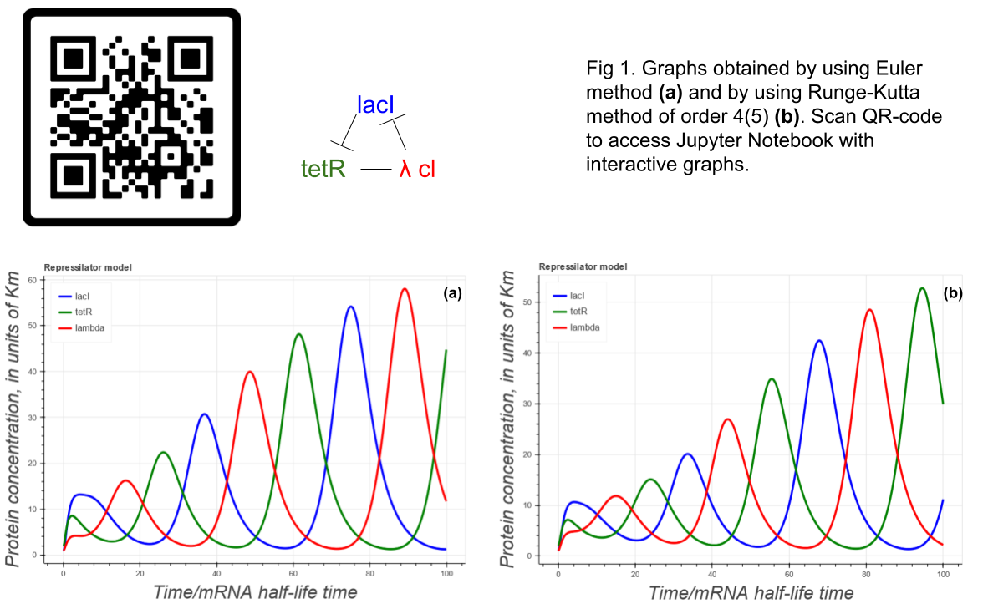
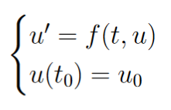
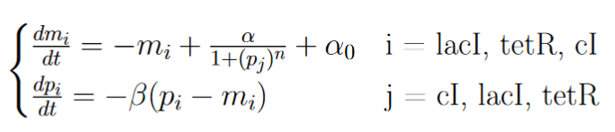

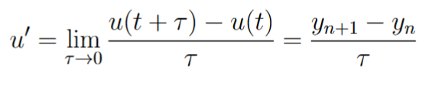
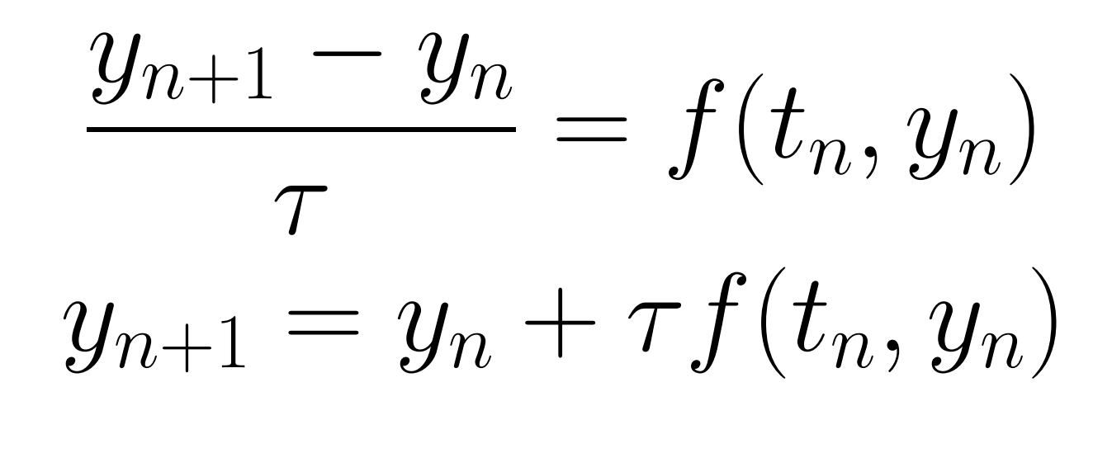

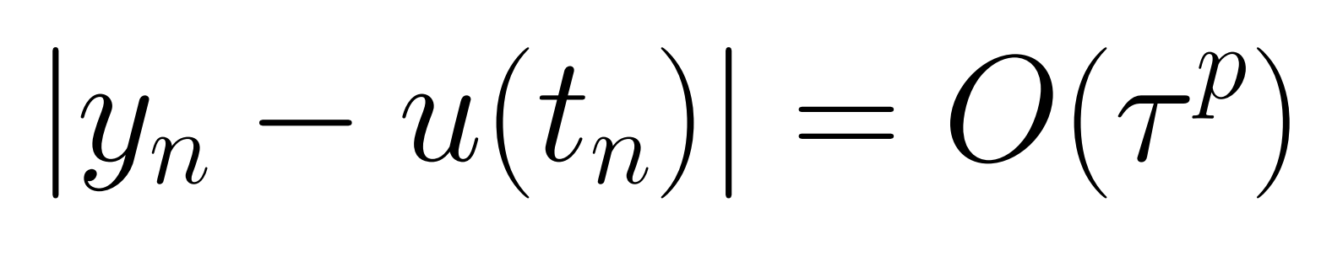
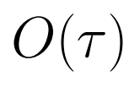
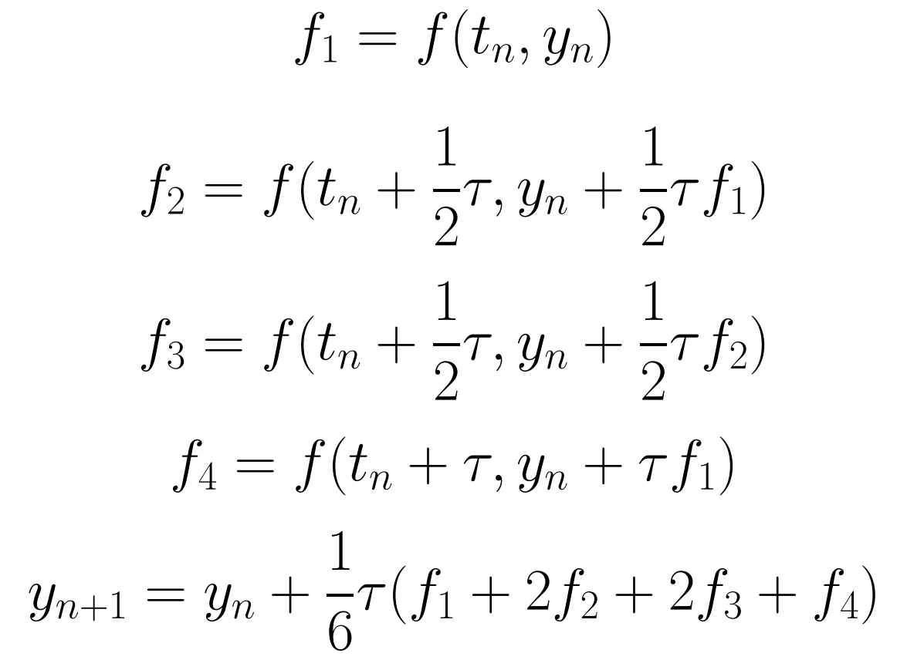
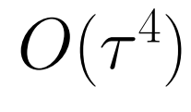
MATHEMATICAL MODELLING OF GENETIC CIRCUITS BASED ON THE REPRESSION OF TRANSCRIPTION Renat S. Vinnikov*, Alexey K. Shaytan *Faculty of Bioengineering and Bioinformatics, Lomonosov Moscow State University *r.vinnikov@intbio.org
Nowadays engineering biology stands at the frontier of life sciences. This science is about applying engineering methods to biological objects to create systems with desired properties. Such systems include genetic circuits which are based on transcription repressors or activators. An important step in the design of these circuits is mathematical modeling. Unfortunately, there is a lack of convenient tools for modeling such systems, the mathematical apparatus is not described in sufficient detail. In this project we have applied our approach to modeling such circuits using Python and its libraries including scipy and bokeh to the classical model of engineering biology - the repressilator. We numerically solve the systems of ODE from the original paper by using the Euler method and explicit Runge-Kutta method of order 4(5). We compare these methods. We present an interactive graph of the dependence of the concentrations of three repressor proteins on time.
Aims and tasks
Results
To understand the derivation of equations in the mathematical model of repressilator from the basic kinetics equations
To build an interactive graph which represents this model using different methods of numerical solving of ODEs and to compare these methods
Building of such plots actually means solving the Cauchy problem - finding the solution of differential equations based on certain initial conditions, consider:
Methods
In order to numerically solve this equation, we need to discretize the ODE with a mesh function:
In order to solve numerically the given systems of ODEs (1) we have used Euler method because it is the most simple one and Runge-Kutta method of order 5(4) because it is widely used in different libraries for solving ODEs. You can see the packages we have used below.
After that we apply explicit Euler method:
Plans
Let’s define truncation error:
The behavior of these oscillations should be described with stability diagram, phase portrait etc.
Converting Jupyter notebooks into web-application would be useful, Voila dashboards could be used for that, however, where are some troubles in using bokeh and Voila in the same project.
This approach is planned to be used in modeling of logical circuits based on the complex of dCas9 and sgRNA as a regulatory element.
The truncation error of this method is O(τ), so the convergence rate is 1 - linear convergence.
References
On the other hand, we can use the Runge-Kutta method of the 4th order:
Elowitz M., Leibler S. A synthetic oscillatory network of transcriptional regulators. Nature 2000 403, 335–338.
Anderson DA, Voigt CA. Competitive dCas9 binding as a mechanism for transcriptional control. Mol Syst Biol. 2021 Nov;17(11):e10512.
Gander M., Vrana J., Voje W. et al. Digital logic circuits in yeast with CRISPR-dCas9 NOR gates. Nat Commun 2017 8, 15459.
Conclusions
By using numerical methods we were able to build an interactive graph which represents the repressilator model.
Future plans include analyzing the current system more thoroughly, making a web-application from Jupyter Notebooks and applying this set of methods to designing different logical circuits.
The truncation error of this method is O(τ 4 , so its convergence rate is 4. That means that this method is more precise than Euler method.

