Slide 1
Normalization

Slide 2
Normalization
Four most commonly used normal forms are first (1NF), second (2NF) and third (3NF) normal forms, and Boyce–Codd normal form (BCNF).
As normalization proceeds, relations become progressively more restricted (stronger) in format and also less vulnerable to update anomalies.
Based on functional dependencies among the attributes of a relation.

Slide 3
Update Anomalies
Relations that contain redundant information may potentially suffer from update anomalies.
Types of update anomalies include:
  Insertion,
  Deletion,
  Modification.

Slide 4


Data Redundancy

Slide 5
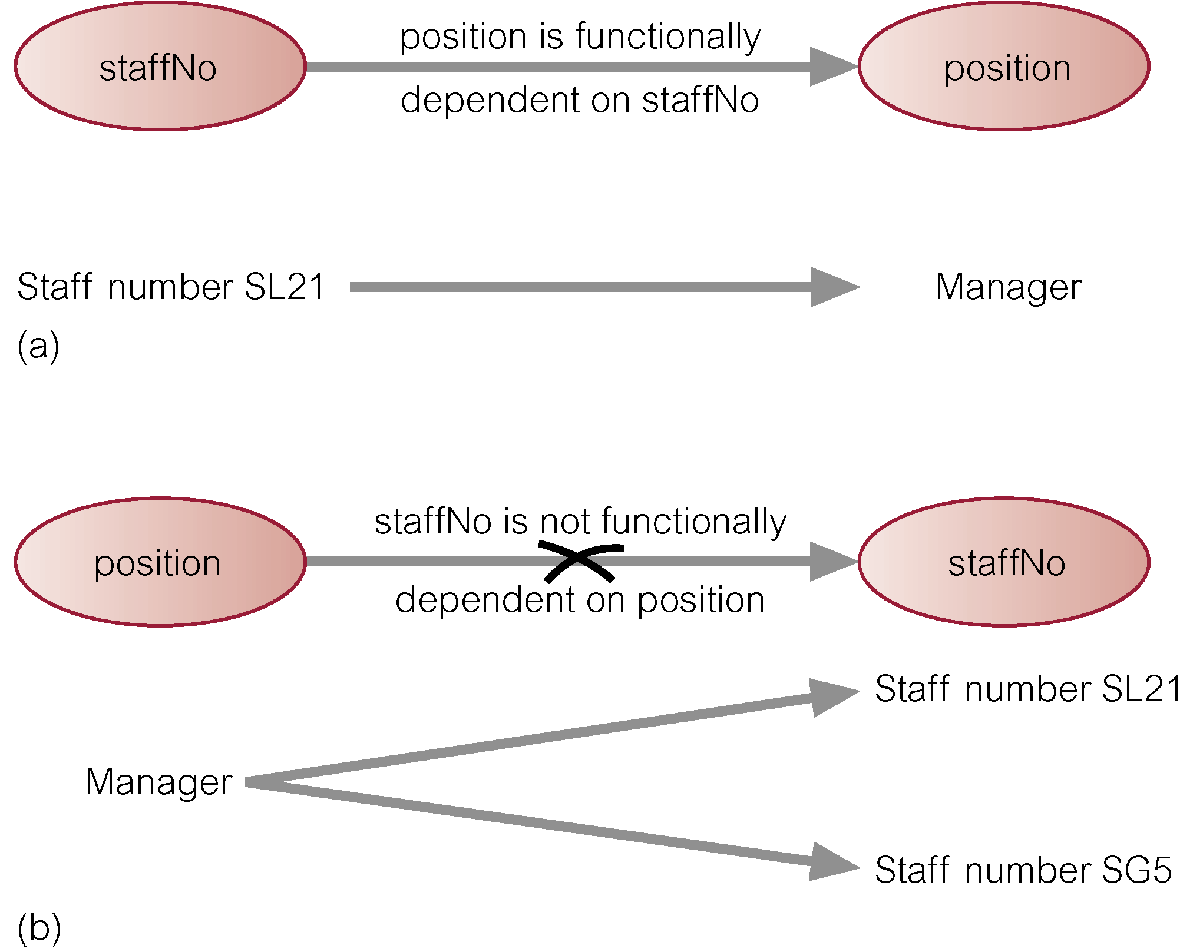
Functional Dependency

Slide 6
Normal forms – by example
Relation R, with attributes (a,b,c,d)
Key is (a,b), i.e., a,b->c,d
1NF – it’s a table (no multiple values in a cell)
2NF – no dependency like a->c
3NF – no dependency like c->d
BCNF – no dependency like c->a

Slide 7
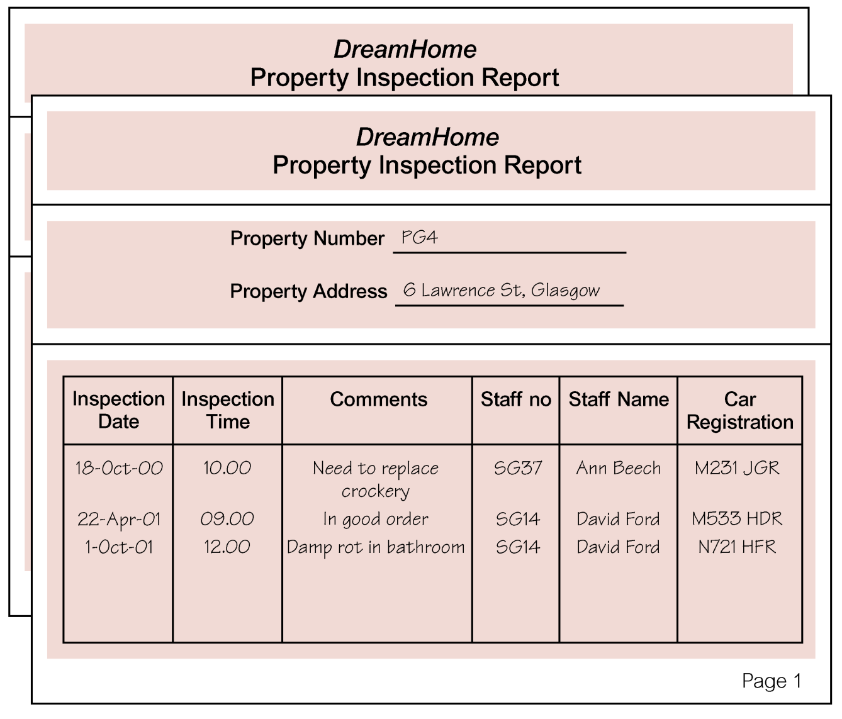
Example : UNF (Unnormalized Normal Form)

Slide 8
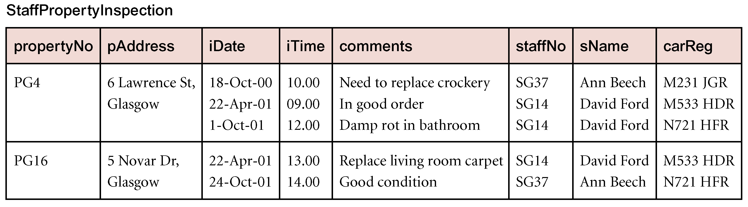
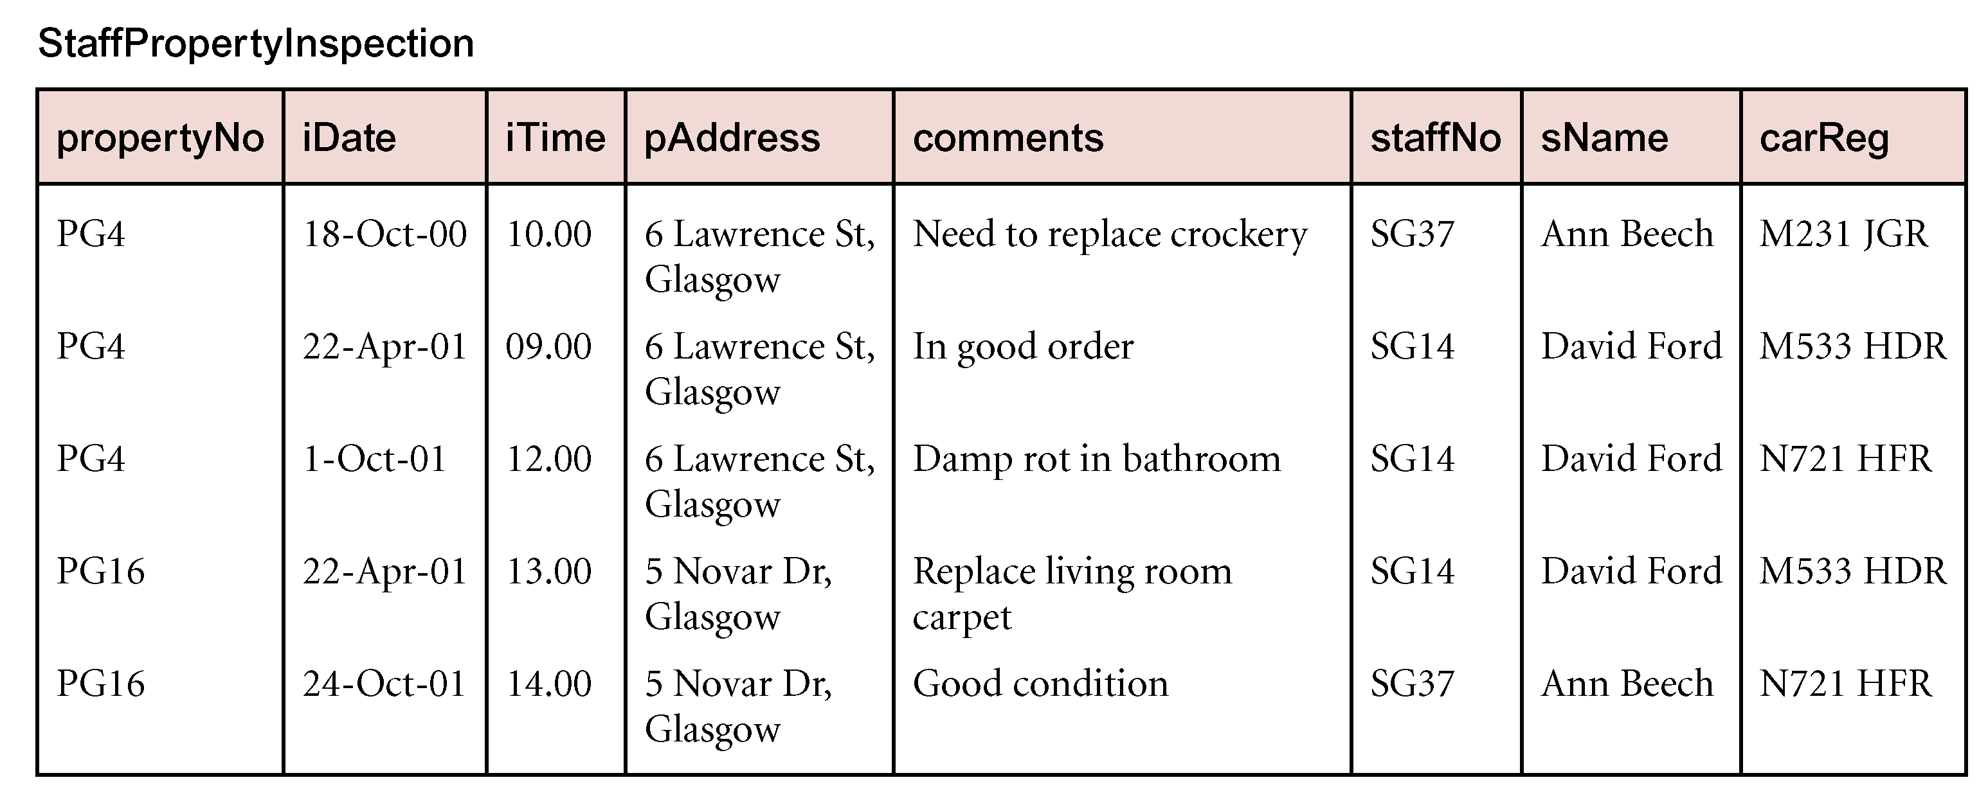
Example : UNF to 1NF

Slide 9
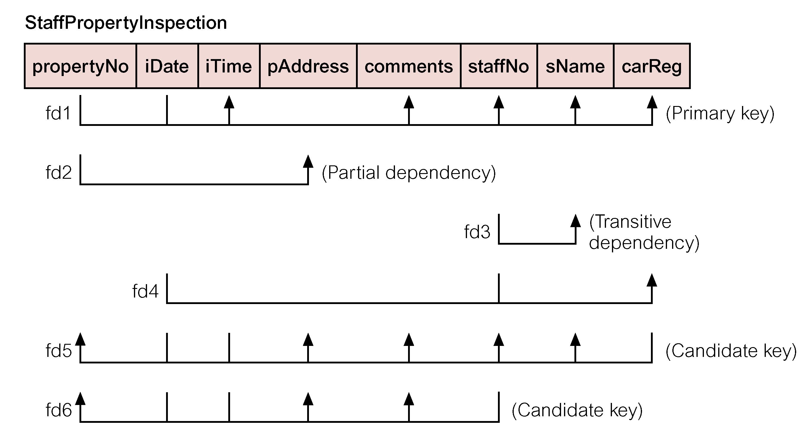
Example: functional dependencies

Slide 10
Example : 1NF to 2NF
StaffPropertyInspection
  (propertyNo, iDate, iTime, pAddress, comments, staffNo, sName, carReg)
propertyNo -> pAddress
Property
  (propertyNo, pAddress)
PropertyInspection
  (propertyNo, iDate, iTime, comments, staffNo, sName, carReg)

Slide 11
Example : 2NF to 3NF
PropertyInspection
  (propertyNo, iDate, iTime, comments, staffNo, sName, carReg)
staffNo -> sName
Staff
  (staffNo, sName)
PropertyInspect
  (propertyNo, iDate, iTime, comments, staffNo, carReg)

Slide 12
Example : 3NF to BCNF
PropertyInspection
  (propertyNo, iDate, iTime, comments, staffNo, carReg)
staffNo, iDate -> carReg
StaffCar
  (staffNo, iDate, carReg)
Inspection
  (propertyNo, iDate, iTime, comments, staffNo)

Slide 13
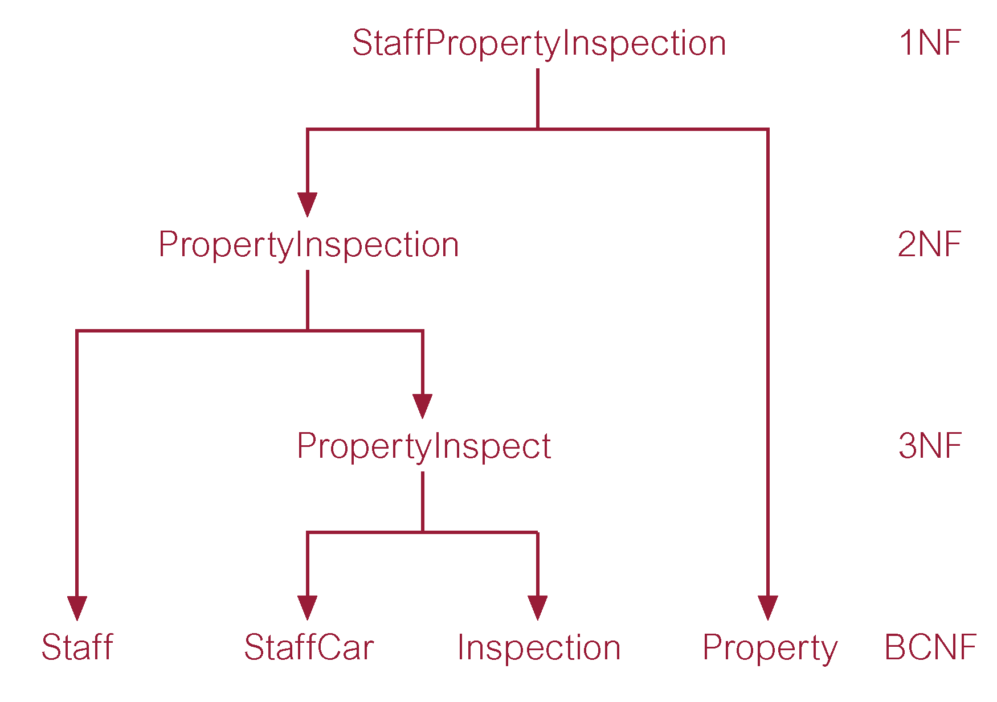
Example: summary

Slide 14
Summary
1NF – a single value per cell
  A relation in which intersection of each row and column contains one and only one value.
2NF – Everything depends on the key
  every non-primary-key attribute is fully dependent on the primary key.
  B is fully dependent on A if B is functionally dependent on A but not on any proper subset of A.
3NF – no transitive dependencies
  no non-primary-key attribute is transitively dependent on the primary key.
  If A->B and B->C then C is transitively dependent on A
BCNF
  every determinant is a candidate key

Slide 15
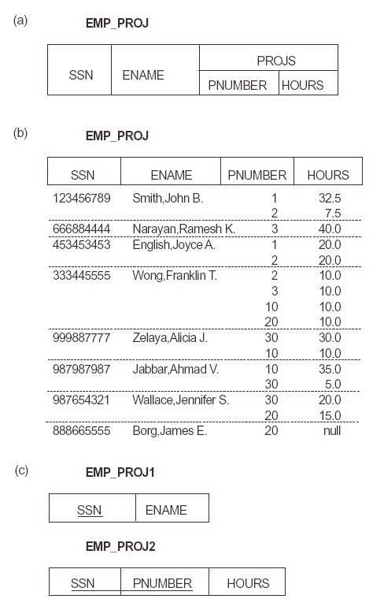

Slide 16
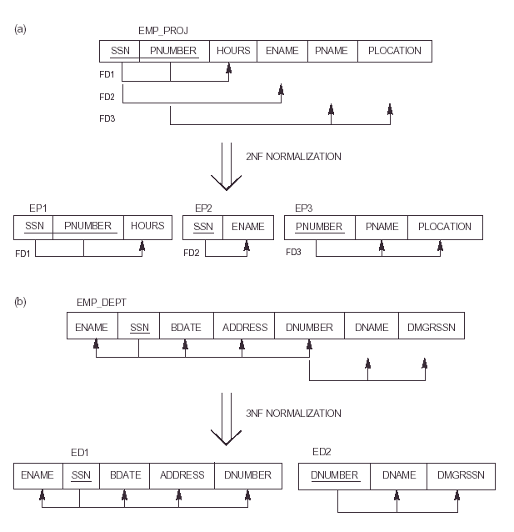

Slide 17
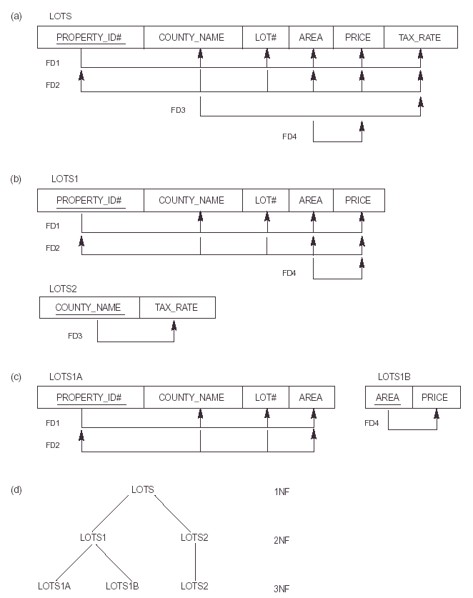

Slide 18
