Slide 1
Longitudinal Modeling of Sleep Timing, Duration, and Social Jetlag Across the Adult Lifespan Using High-Resolution Wearable Data
All of Us Research Program Fitbit sleep phenotyping
Mason Manetta; Angus Burns; Shea Andrews; Yue Leng; Diego Mazzotti
Presenter: Diego R. Mazzotti, Ph.D. (on behalf of Mason Manetta)
42,290 participants | 22.4M filtered nights | 530 mean nights / participant
Support: All of Us Research Program, Office of the Director, NIH

Slide 2
Disclosure Information
To review this speaker’s disclosure information, please visit:
sleepmeeting.org

Slide 3
SLEEP 2026 Photography Policy
Photography is permitted during this lecture unless a no-photography icon is shown.
Photographs are allowed for personal, social, or non-commercial use.
Attendees may not use flash photography or otherwise distract presenters or attendees.

Slide 4
Wearables and Longitudinal Monitoring of Sleep and Circadian Traits
Core output | Definition
Onset | sleep start time
Offset | wake time
Midpoint | center of sleep episode
Duration | sleep window / time asleep
Why this matters
Sleep is important to health and chronic disease risk.
Most large epidemiologic studies rely on self-report or short-term monitoring.
Wearables create scalable, repeated measurements of sleep timing, duration, and variability.
Longitudinal Fitbit data move sleep phenotyping from sparse recall to repeated behavioral measurement.
Published context
Prior All of Us Fitbit analyses have linked wearable-derived sleep measures to clinical phenotypes, motivating higher-resolution longitudinal modeling of sleep behavior.

Slide 5
Sources of Variability
Extrinsic
Weekdays vs. weekends / free days
Seasonality and holidays
Environmental exposures: photoperiod, temperature, humidity, daylight saving time
Intrinsic and social
Age and sex
Employment status and social scheduling constraints
Stable participant-level differences captured by repeated measures
These factors are established individually, but longitudinal wearable data allow them to be modeled together within the same participants.

Slide 6
Study Aim
Characterize demographic and environmental contributors to longitudinal variability in sleep patterns using device-measured Fitbit sleep data from the All of Us Research Program.
Onset: sleep start | Midpoint: sleep timing | Duration: sleep amount

Slide 7
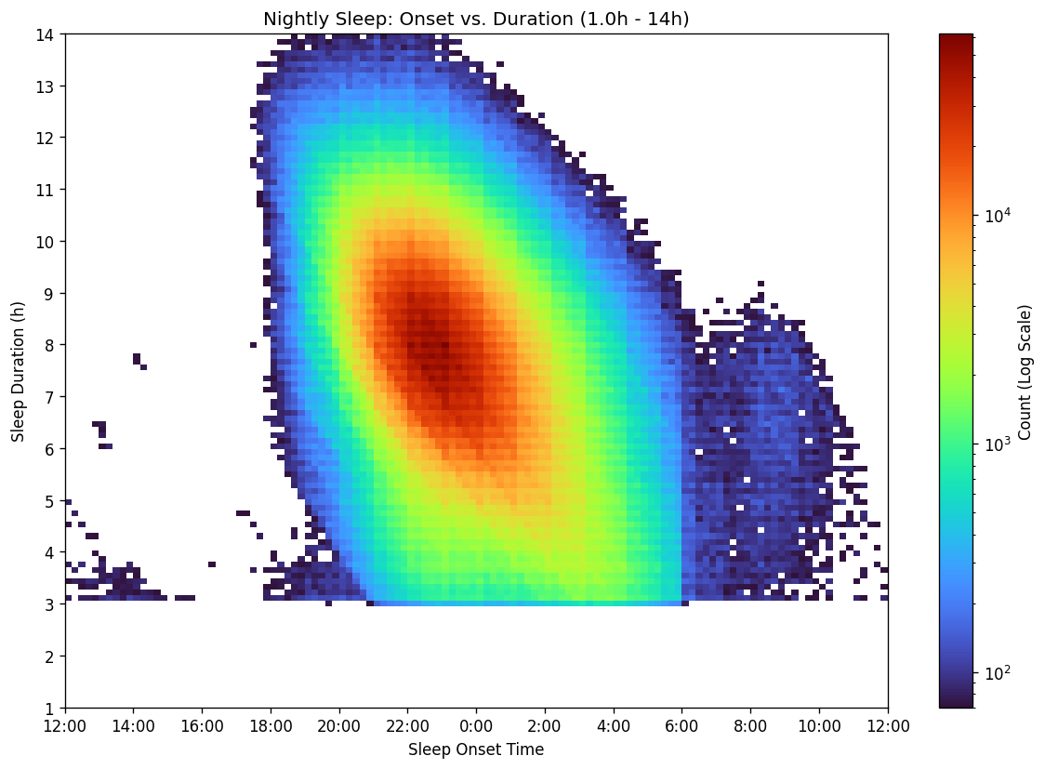
All of Us Research Program and Fitbit Sleep
All of Us
National longitudinal cohort with EHR, survey, genomic, and wearable data.
Participant-level covariates include demographics, employment, BMI, ZIP3 geography, and socioeconomic context.
Fitbit measurements
Sleep daily summaries provide nightly sleep duration.
Sleep-level records provide high-resolution onset/offset information.
Repeated nights allow within-person modeling over age, season, and social schedule.

Slide 8
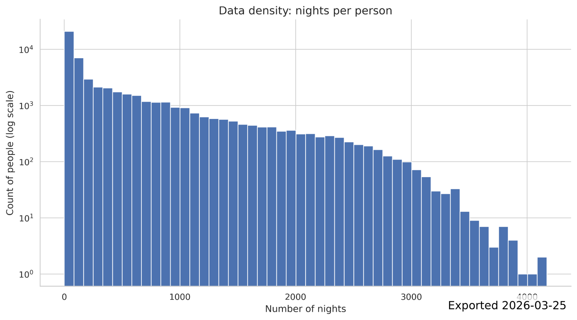
Participant Characteristics
Characteristic | Value
Included participants | 42,290
Filtered sleep nights | 22,428,610
Age | 52 +/- 17 y
Female | 67.4%
Male | 32.3%
Nights recorded | 530 +/- 730
Nightly duration | 447 +/- 65 min
Nightly duration | 7.5 +/- 1.1 h

Slide 9
From Fitbit Records to Nightly Sleep Episodes
Filtering and episode construction
Sleep-level records linked to daily summaries.
Non-primary sleep excluded.
Implausible raw durations excluded: >18h, zero/negative, common sensor artifact values.
Segments clustered into nightly episodes; largest main sleep cluster retained per logical night.
Sleep date assigned using a 6-hour backward shift.

Slide 10
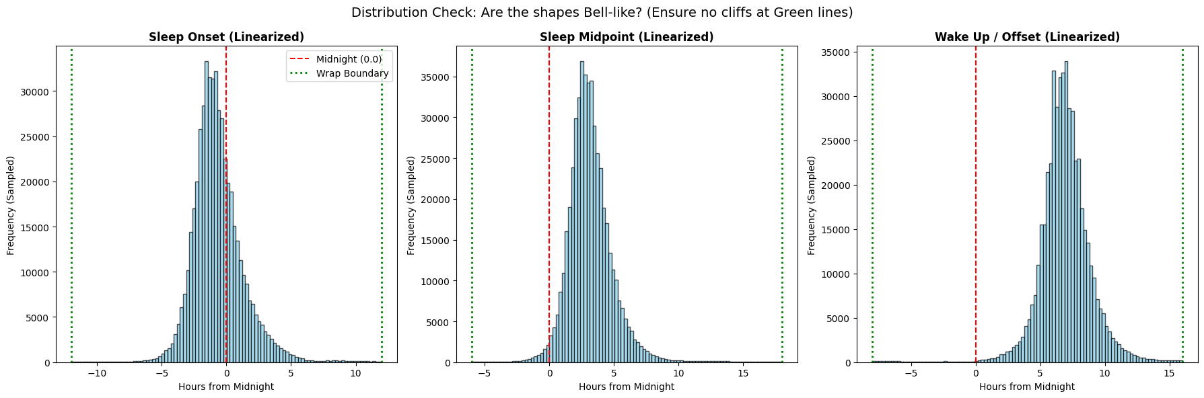
Modeling Strategy
Linear mixed-effects models
Yij ~ poly(ageij, 2) + weekendij x employmenti + sexi + monthij + (1 | personi)
Outcomes: onset, offset, midpoint, duration.
Person random intercept controls stable between-person differences.
Quadratic age captures non-linear lifespan trends.
Employment-by-weekend interaction estimates social constraint/social jetlag patterns.
Time handling
Timing variables were linearized because distributions were primarily unimodal.
Clock times before noon shifted forward by 24h.
Example: 1:00 AM -> 25.0; 11:00 PM -> 23.0.

Slide 11
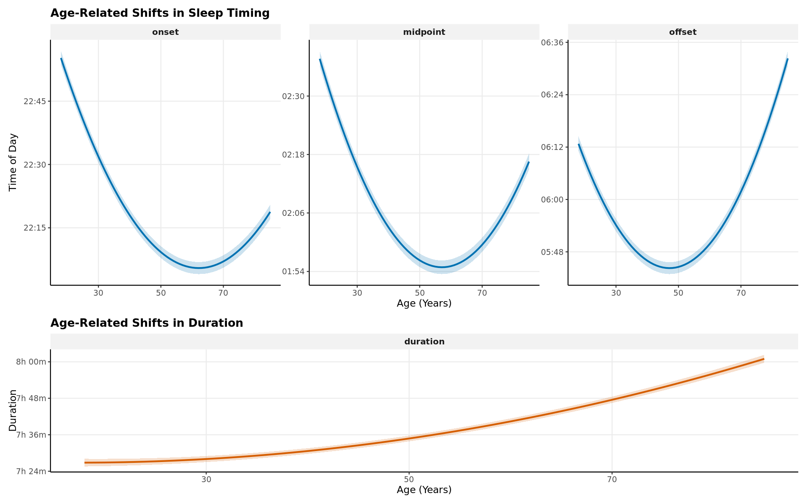
Sleep and Circadian Traits x Age and Sex
Age showed a quadratic association with sleep timing across the adult lifespan.
Model-estimated sleep midpoint advanced by approximately 42 minutes from age 18 to age 57.
Midpoint: 2:37 AM at age 18 vs. 1:54 AM at age 57.
A simple linear age term would miss the lifespan shape of sleep timing.

Slide 12
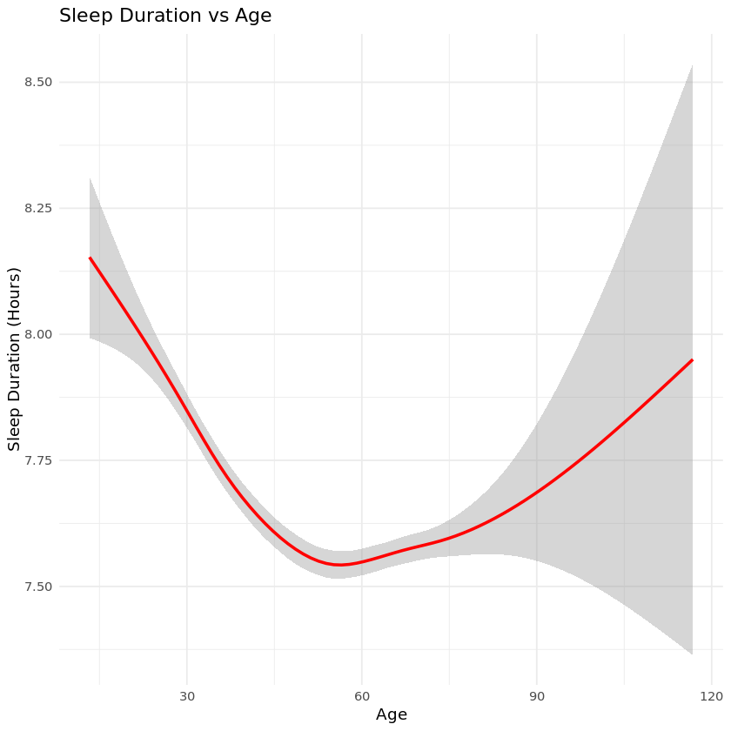
Sleep Duration Across the Adult Lifespan
Duration increased with age in adjusted models.
Estimated gain: >34 minutes between ages 18 and 85.
Age 18: 7.45h; age 85: 8.02h.
Why it matters
Timing and duration change together, so future analyses should consider mutually adjusted timing-duration phenotypes.

Slide 13
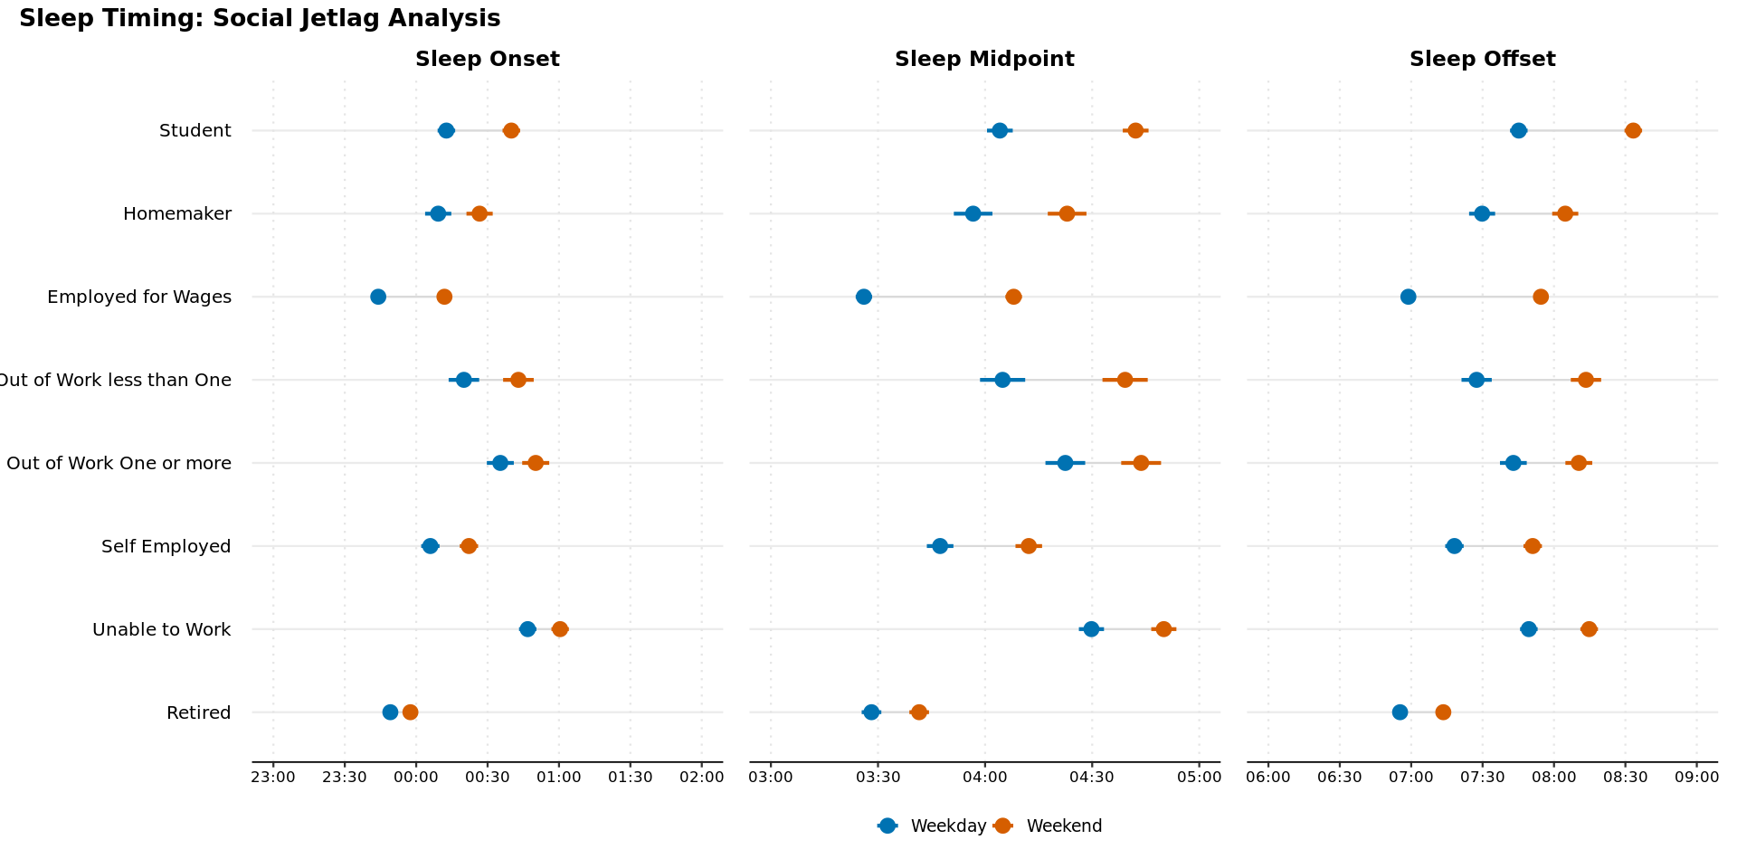
Sleep and Circadian Traits x Other Sociodemographics
Weekend status delayed midpoint, onset, and offset across employment groups.
Participants employed for wages showed the largest midpoint delay.
Employed for wages: weekday midpoint 3:26 AM vs. weekend midpoint 4:08 AM.
Weekend sleep duration extended by approximately 28 minutes.
Social timing constraints are visible in wearable sleep at population scale.

Slide 14
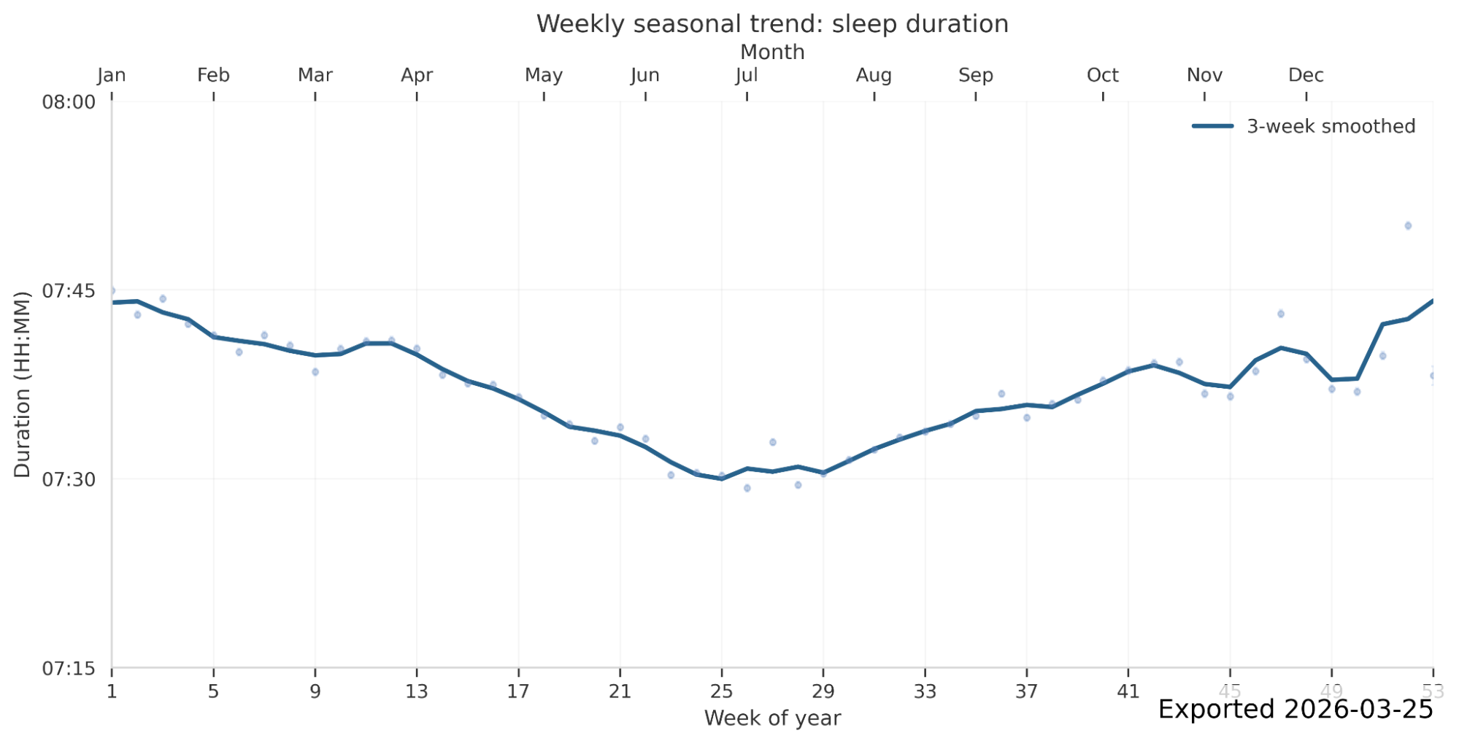
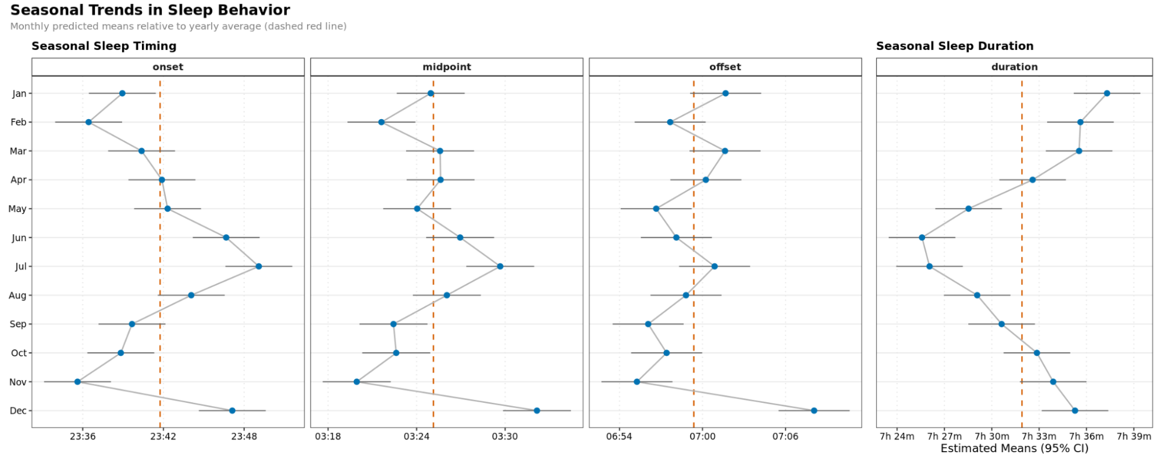
Sleep and Circadian Traits x Environmental Variables
Month terms indicated seasonal differences in sleep behavior.
Sleep duration was approximately 11 minutes lower in June than the January maximum.
Unadjusted weekly trends suggest non-sinusoidal structure, likely mixing photoperiod, calendar behavior, holidays, and DST.

Slide 15
What This Adds
Population-level characterization
Quantifies non-linear age effects in device-measured sleep.
Separates workday/free-day structure from participant-level baselines.
Provides adjusted estimates across employment categories.
Foundation for next-stage analyses
Genetic studies of sleep timing and chronotype.
Clinical risk stratification using longitudinal sleep phenotypes.
Environmental extensions: photoperiod, temperature, humidity, DST.
Large-scale wearable data can turn sleep timing from a sparse self-report phenotype into a longitudinal, model-ready exposure.

Slide 16
Limitations and Interpretation Guardrails
Measurement
Fitbit-derived sleep depends on device classification of main sleep.
Shift work is not directly measured; employment status is a proxy for social schedule constraints.
Linearization works for the observed distribution but may under-represent true night-shift phenotypes.
Cohort and covariates
AoU Fitbit participants are not a probability sample of U.S. adults.
Pregnancy episode exclusion was not feasible in the V8 data context.
ZIP3 geography is coarse for environmental and DST classification.

Slide 17
Conclusions and Future Directions
Sleep timing and duration are dynamically structured by non-linear age effects.
Employment and weekend status reveal strong social timing constraints, including measurable social jetlag.
Seasonal patterns persist at population scale and motivate environmental modeling.
Longitudinal wearable sleep data provide a scalable foundation for personalized circadian epidemiology.

Slide 18
Acknowledgements
University of California, San Francisco
Mason Manetta
Yue Leng, Ph.D.
Shea Andrews, Ph.D.
Harvard Medical School / Brigham and Women’s Hospital
Angus Burns, Ph.D.
University of Kansas Medical Center
Diego R. Mazzotti, Ph.D.
Funding and support
All of Us Research Scholars Program
RTI International All of Us Researcher Academy
National Institutes of Health, Office of the Director
Questions and discussion

Slide 19
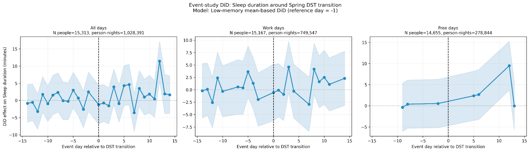
Backup: Validation Against Published AoU Sleep Structure
Reference comparison with published All of Us Fitbit sleep structure; used during extraction validation.

Slide 20
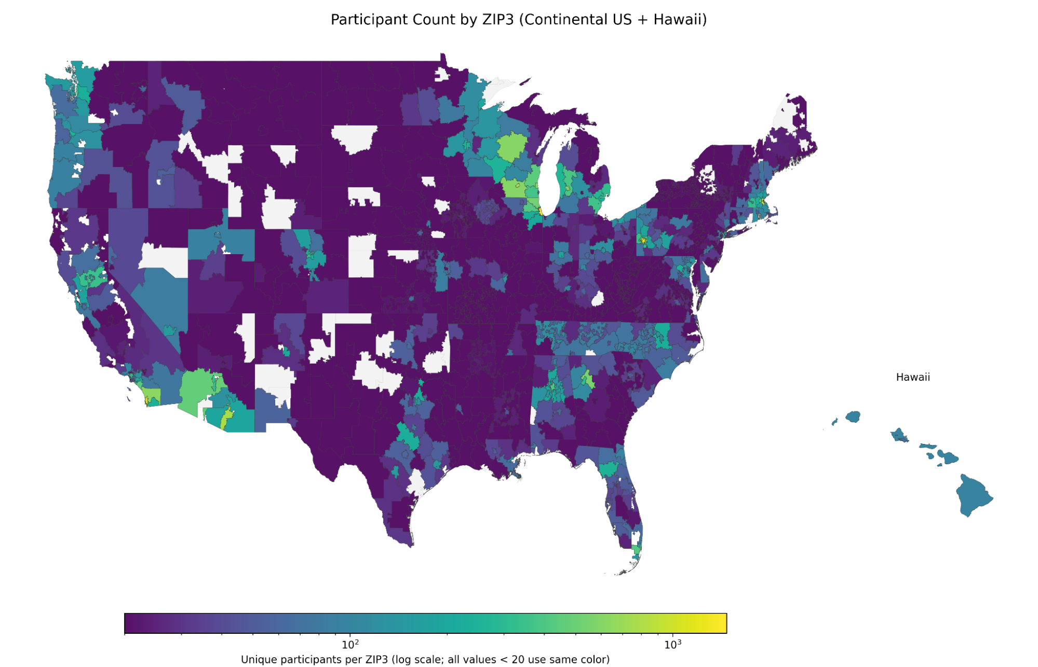
Backup: Geographic and Environmental Extensions
ZIP3 enables coarse geography for SES, DST, photoperiod, and PRISM weather linkage.
Future models can estimate temperature, vapor pressure deficit, precipitation, and photoperiod effects.
Environmental analyses should account for ZIP3 population weighting and non-random participant geography.

Slide 21
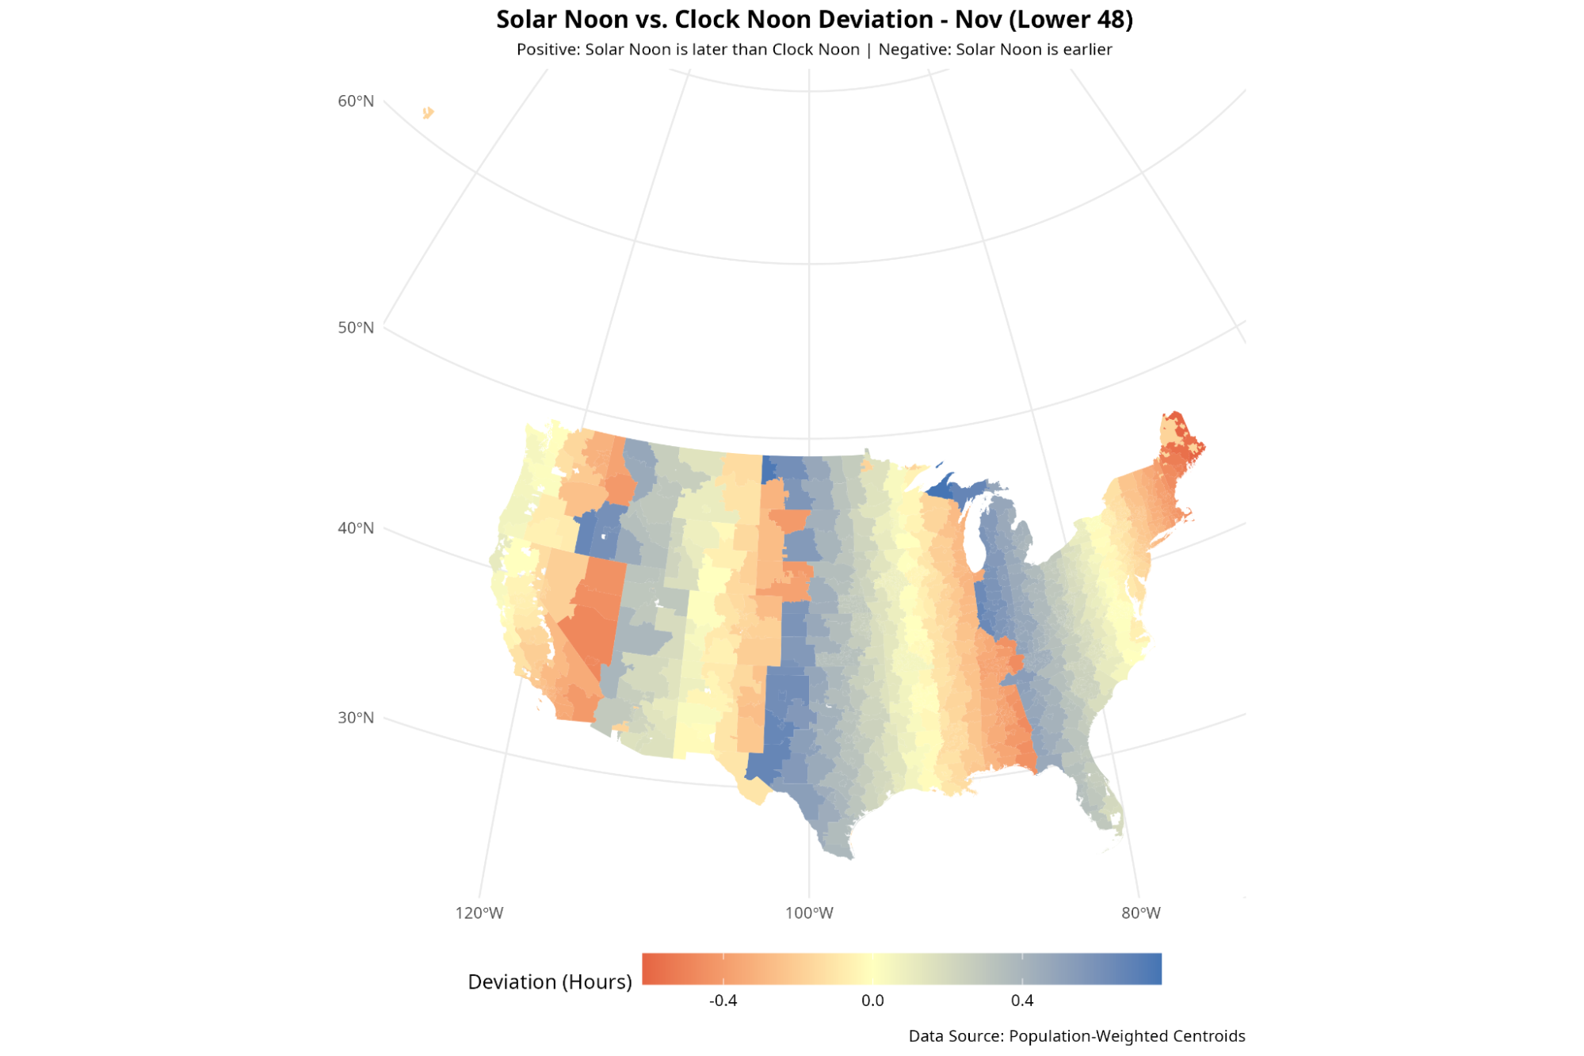
Backup: Daylight Saving Time Design
DST contrast
Classify ZIP3 as DST-observing vs. non-DST control.
Center each person-year using pre-transition baseline days -14 to -7.
Estimate event-day differences around spring/fall transitions.

