Slide 1
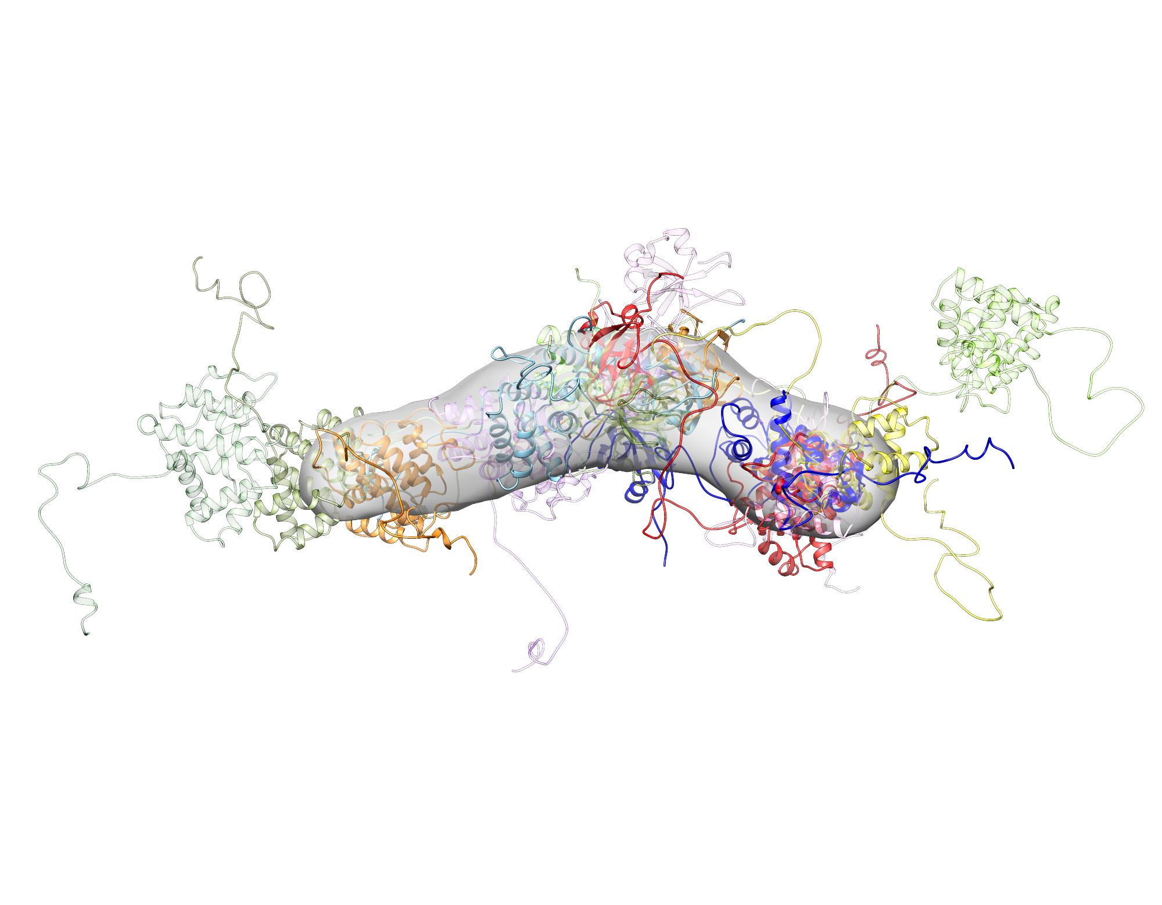
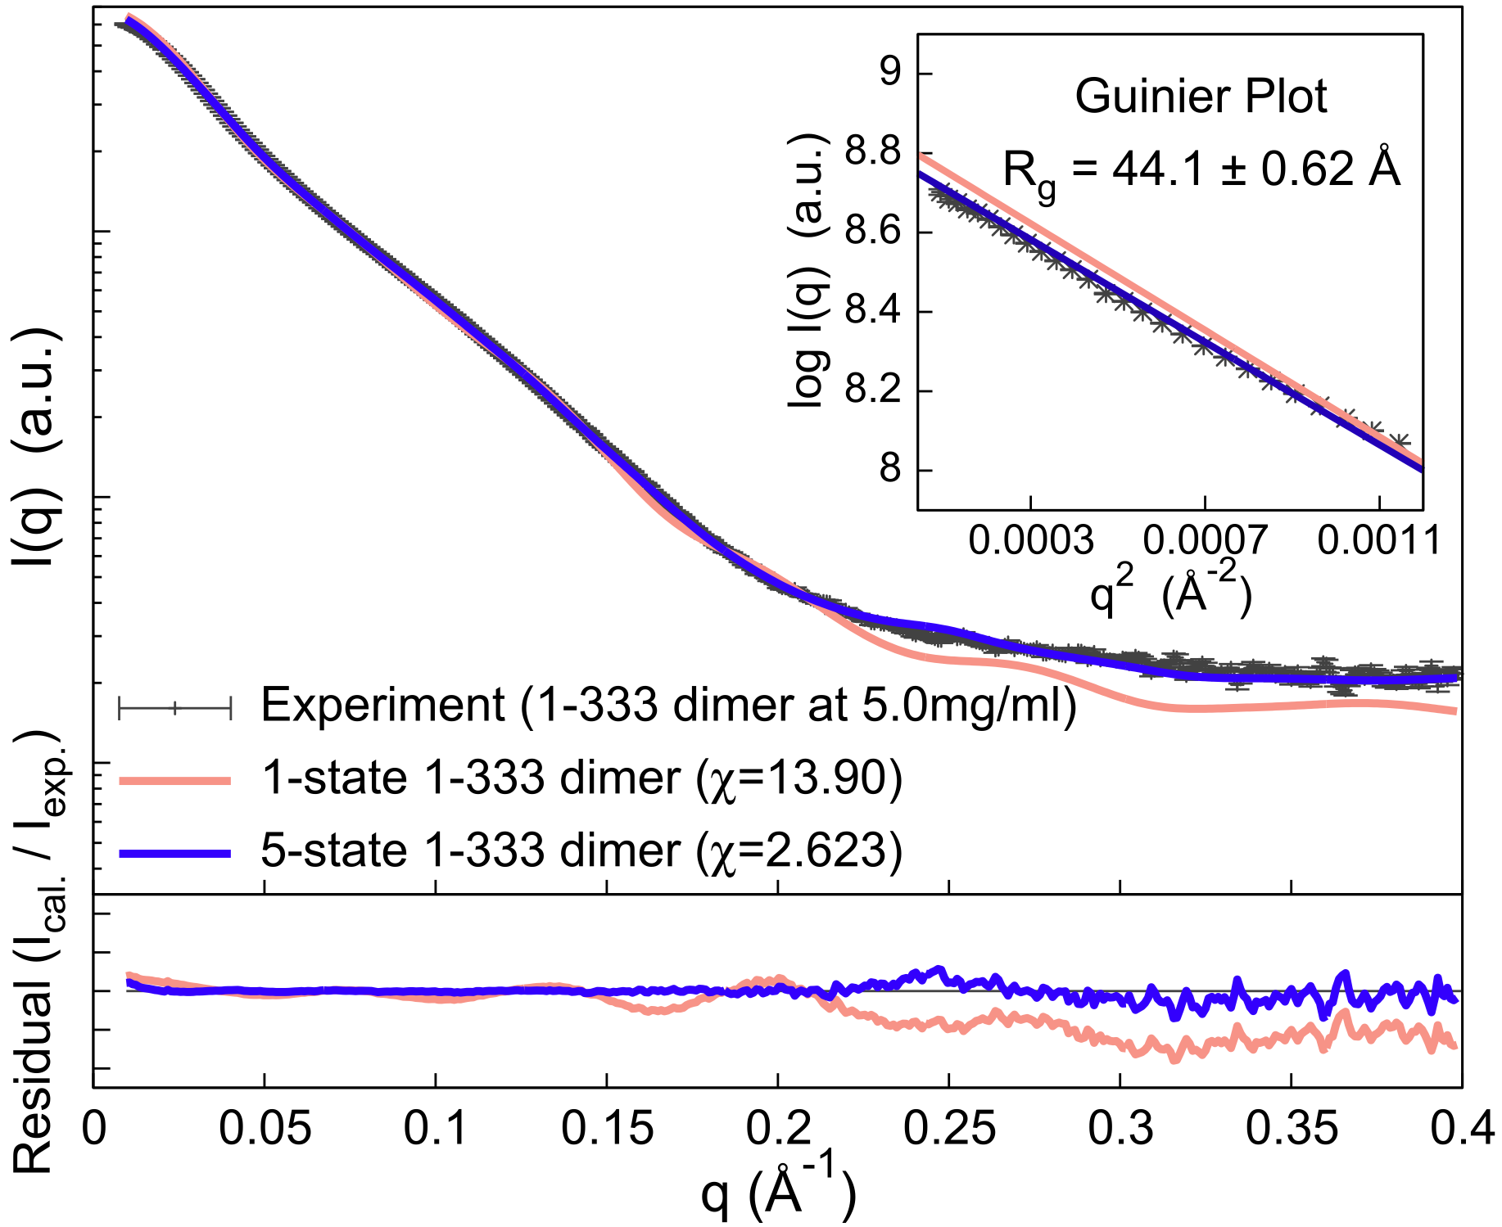

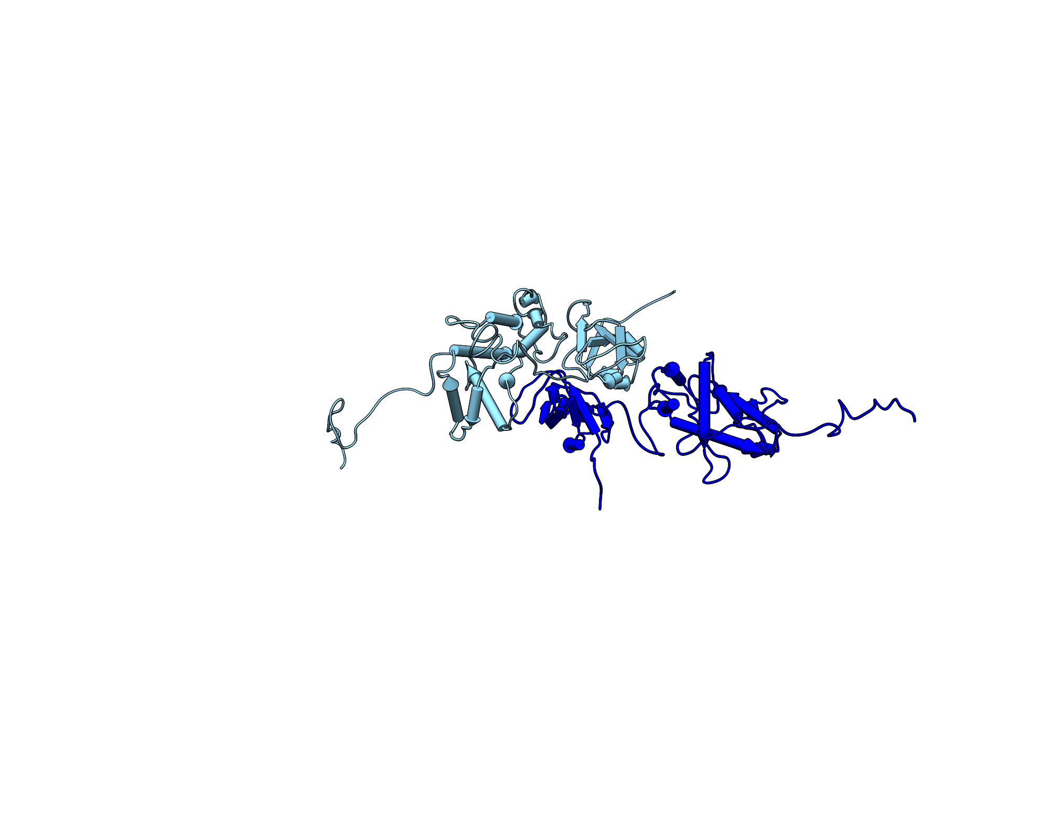
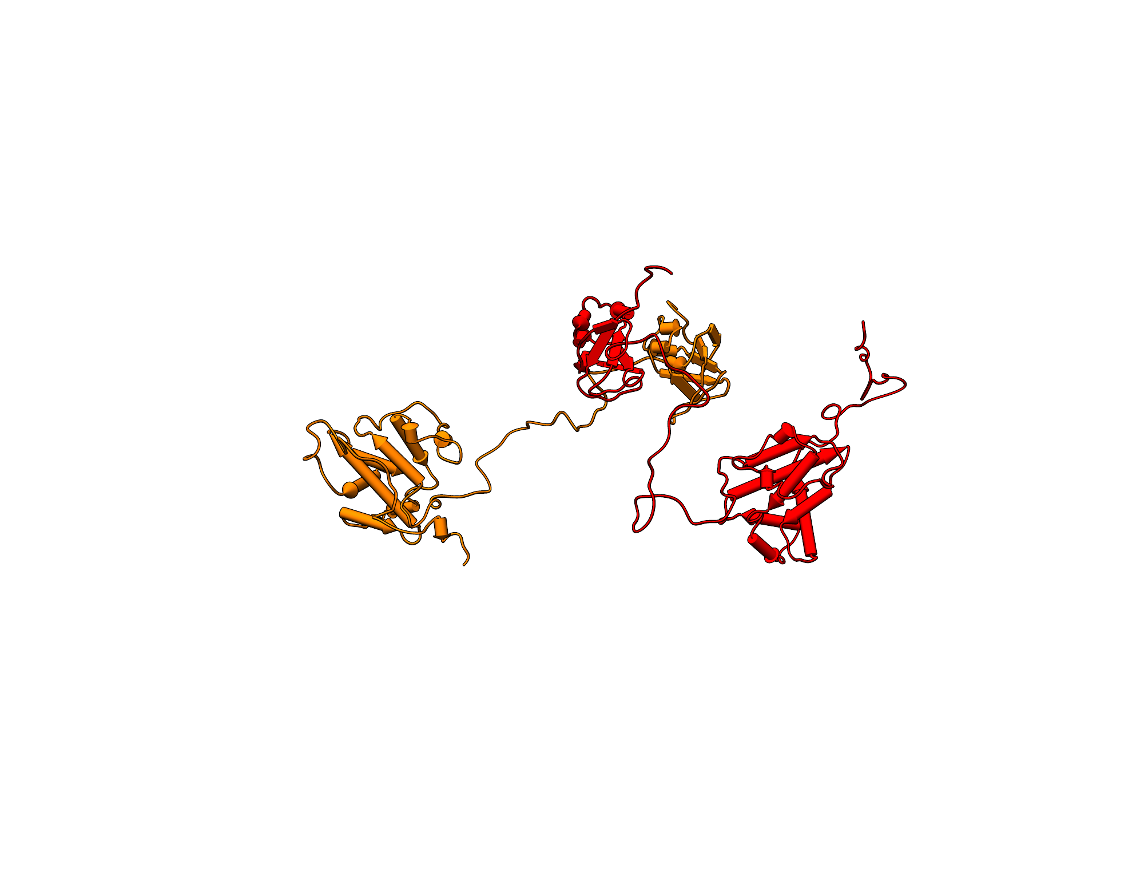
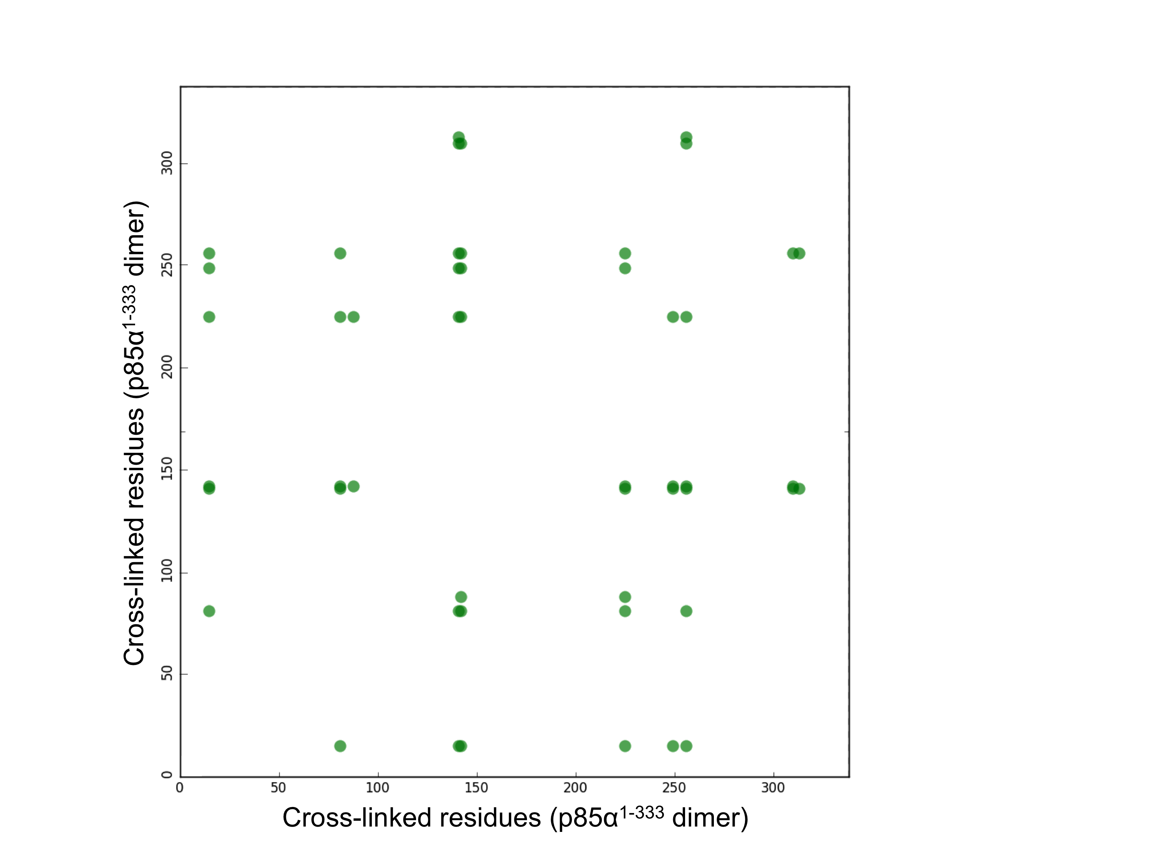
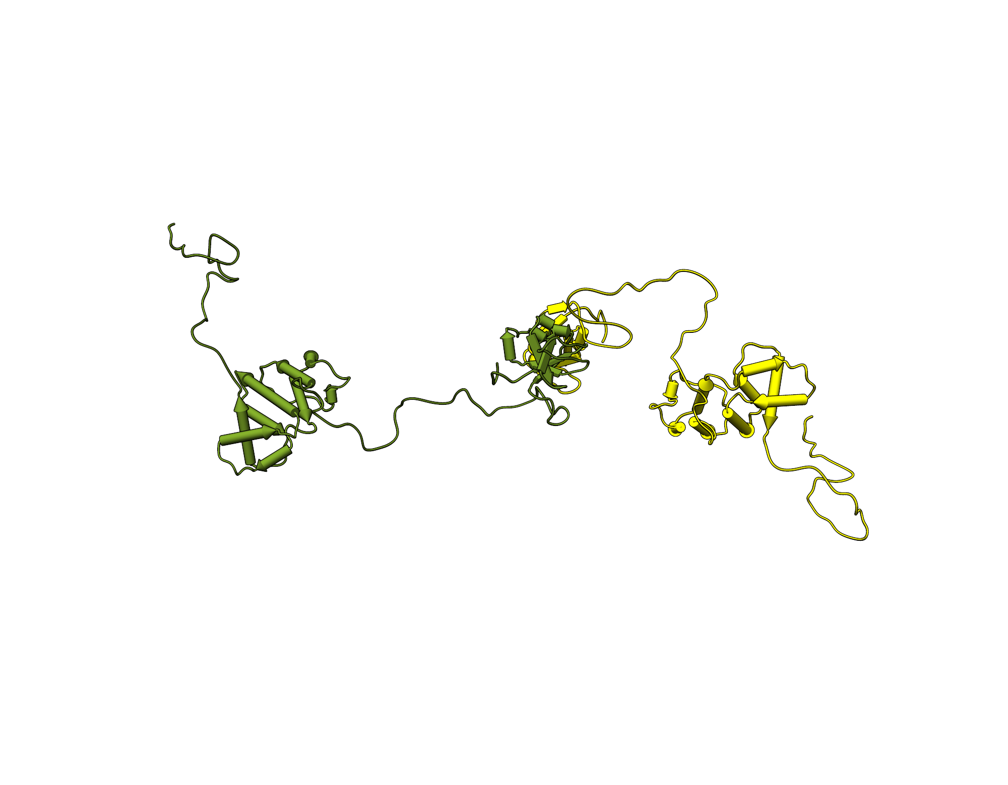
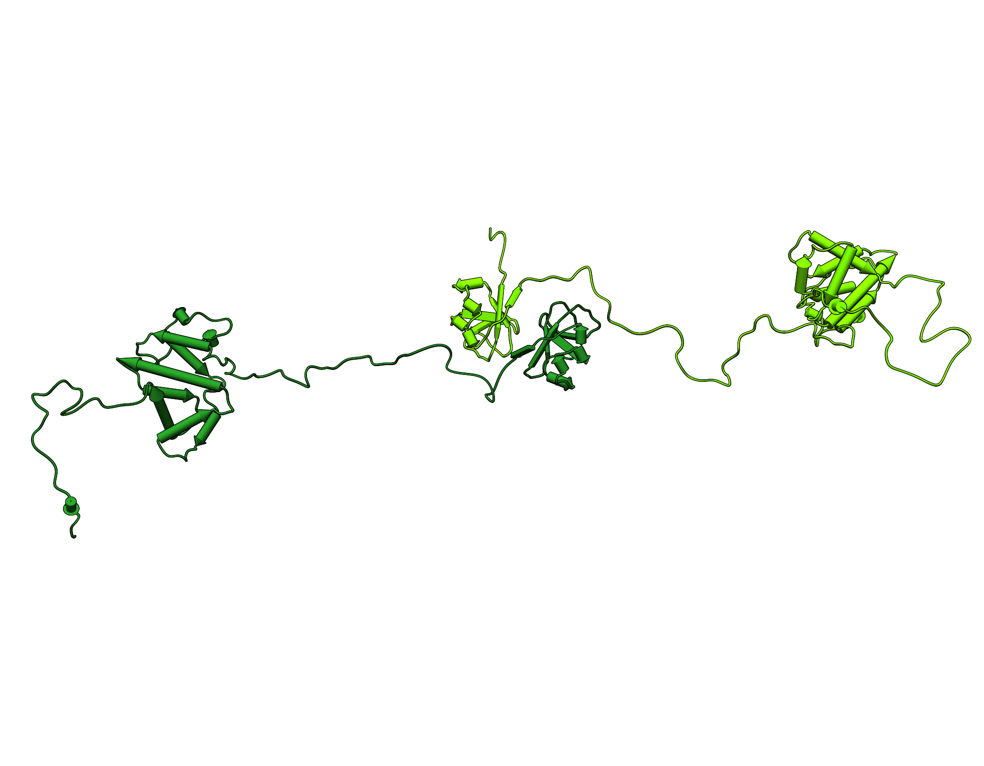
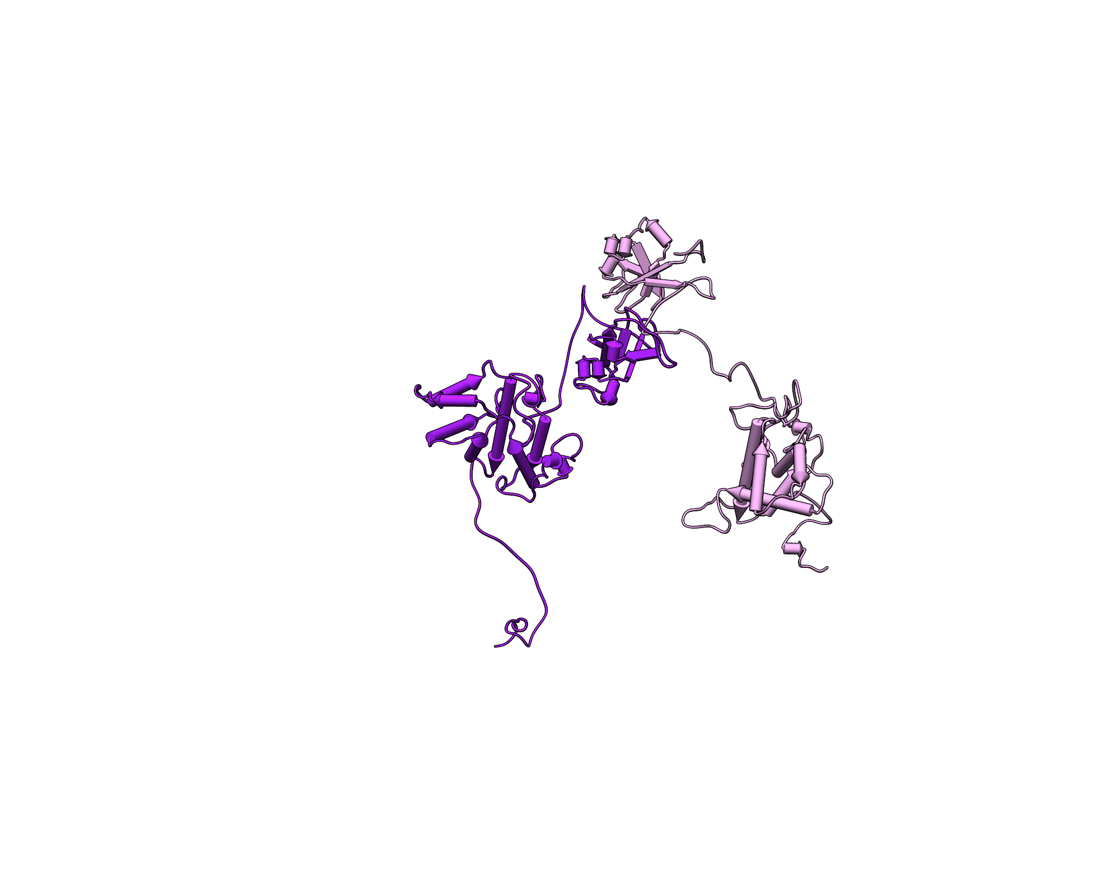
A
B
Ab initio shape by SAXS
~150 Å
C
Major conformational states
p85α¹⁻³³³ dimer
SH3
D
40.3 %
BCR
BCR
SH3
SH3
SH3
SH3
SH3
BCR
27.7 %
BCR
BCR
16.6 %
BCR
Minor conformational states
p85α¹⁻³³³ dimer
SH3
SH3
SH3
SH3
BCR
BCR
BCR
BCR
8.0 %
7.4 %

Slide 2
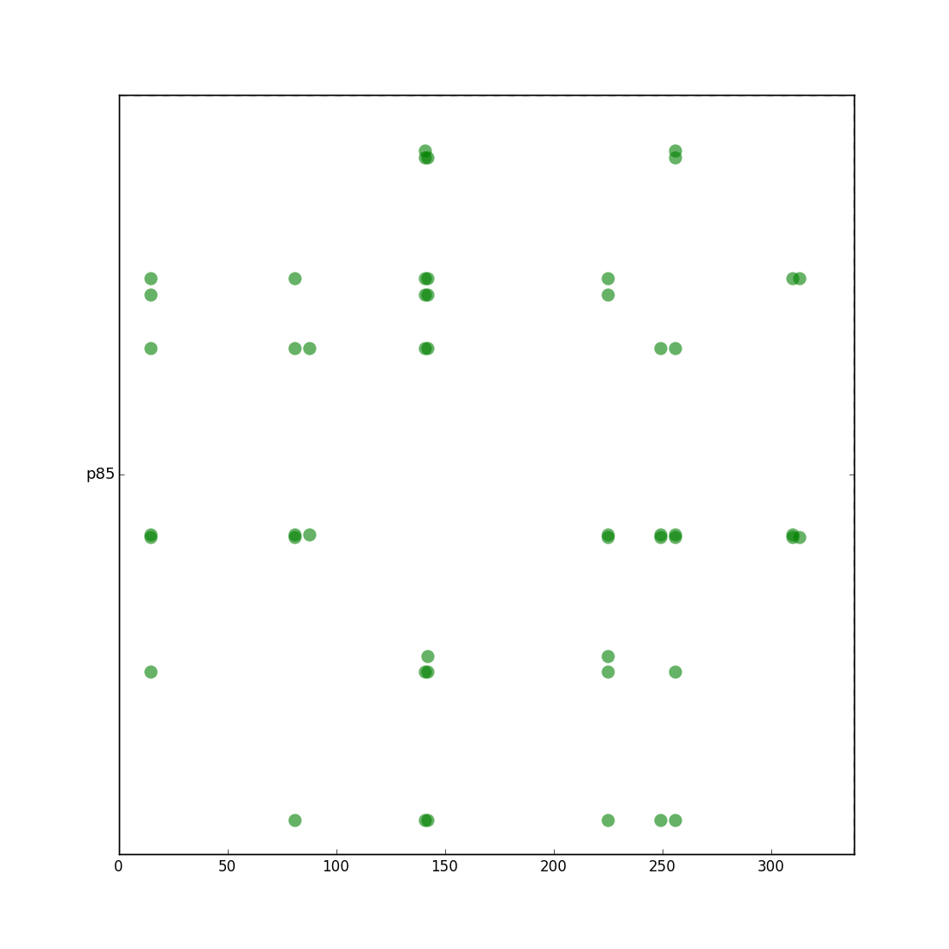
Cross-linked residues (p85α¹⁻³³³ dimer)
Cross-linked residues (p85α¹⁻³³³ dimer)

