Slide 1
Eleven Primitives and Three Gates:
The Universal Structure of Computational Imaging
Chengshuai Yang, David J. Brady, Xin Yuan
NextGen PlatformAI | University of Arizona | Westlake University
DIAGNOSE
CORRECT
DESIGN NEW
Talk for Prof. Yuan's Group | March 2026
1/32

Slide 2
Talk Outline
~40 minutes
1. Motivation: Why do real systems fail? How to design new ones? (5 min)
2. Our Answer: 11 Primitives + 3 Gates (5 min)
3. The Finite Primitive Basis (Theorem 1) (7 min)
OperatorGraph, 11 primitives, DAG examples, basis saturation
4. The Triad Decomposition (Theorem 2) (5 min)
Three gates, lifecycle prediction, four-scenario protocol
5. Application 1: DIAGNOSE existing systems (3 min)
6. Application 2: CORRECT existing systems (5 min)
CASSI deep dive, cross-carrier results (+0.8 to +13.9 dB)
7. Application 3: DESIGN NEW systems (7 min)
Gates as design specs, primitive composition, design exploration
8. Discussion and Future Directions (3 min)
2/32

Slide 3
Motivation: Two Open Problems in Computational Imaging
Problem 1: Why Do Real Systems Fail?
Problem 2: How to Design New Systems?
Algorithms keep advancing: CS -> PnP -> Unrolling -> Transformers
Yet they routinely fail on deployed systems.
Root cause: forward model mismatch (H_nom != H_true)
Solver faithfully solves the WRONG problem.
Failures are silent, systematic, universal.
Per-modality calibration exists but NO universal framework.
Designing a new system is an open-ended, intuition-driven search.
No common language across modalities (CT, MRI, CASSI...).
Key unknowns at design time:
- How many measurements are enough?
- What photon budget is needed?
- How precise must calibration be?
No way to evaluate BEFORE hardware fabrication.
Our answer: 11 Primitives + 3 Gates = universal grammar to DIAGNOSE, CORRECT, and DESIGN NEW
3/32

Slide 4
Diverse Systems, Hidden Universality
5 carrier families:
- Optical photons (CASSI, CACTI, SPC...)
- X-ray photons (CT, CBCT)
- Electrons (ptychography, cryo-EM)
- Nuclear spins (MRI)
- Acoustic waves (ultrasound)
All share the same pipeline:
source -> propagation -> interaction
-> encoding -> detection
This universality is NOT accidental.
It reflects the finite structure of
physical measurement processes.
Three fundamental questions:
Q1: What are the minimal building
blocks of imaging physics?
--> 11 Primitives
Q2: Why do reconstructions fail?
--> 3 Gates (exhaustive diagnosis)
Q3: Can we use this to design
NEW imaging systems?
--> YES: compositional design
from primitives + gate constraints
4/32

Slide 5
Our Answer: A Universal Grammar for Computational Imaging
DIAGNOSE
CORRECT
DESIGN NEW
Existing Instruments
Triad diagnoses the
dominant failure gate:
- Gate 1: not enough info?
- Gate 2: too much noise?
- Gate 3: wrong model?
Tells you WHERE the dB
are hiding.
Existing Instruments
Solver-agnostic correction:
fix the operator, not solver.
Any solver benefits without
retraining:
GAP-TV, MST-L, HDNet...
+0.8 to +13.9 dB recovery
across 5 carrier families.
New Instruments
Compositional design language:
select primitives, connect DAG,
evaluate gates BEFORE building.
Gate 1: min sampling density
Gate 2: min carrier budget
Gate 3: max calibration error
From task to hardware specs.
Theorem 1: Finite Primitive Basis
Theorem 2: Triad Decomposition
Every forward model = DAG over 11 primitives
Sufficient, minimal, covers 170 modalities
Every failure = G1 + G2 + G3 (exhaustive)
Gate 3 dominant in deployed systems (14/14)
5/32

Slide 6
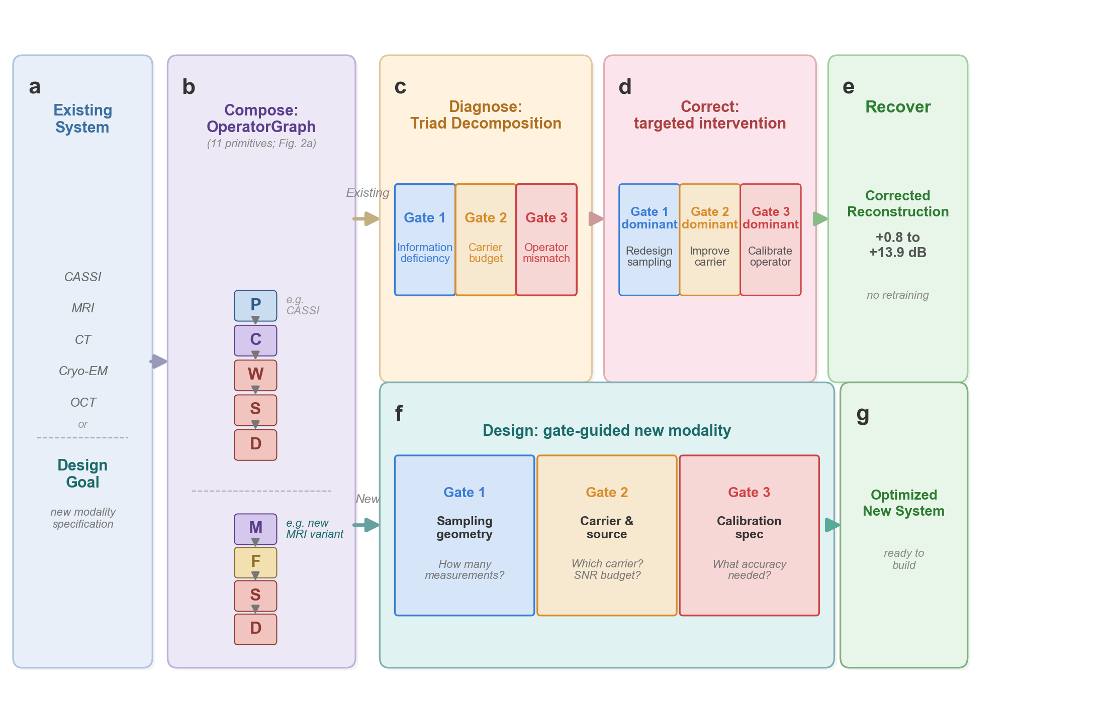
Figure 1: Universal Grammar --- Validate, Correct, and Design New
6/32

Slide 7
THEOREM 1
The Finite Primitive Basis
Every imaging forward model decomposes into a DAG over exactly 11 primitives
7/32

Slide 8
The OperatorGraph Intermediate Representation
Every imaging forward model encoded as a typed DAG:
- Each node wraps a single primitive physical operator
- Edges define data flow from source to detector
- Each edge carries tensor shape + dtype metadata (static validation)
Every linear primitive implements:
- forward(x) -> y (physics simulation)
- adjoint(y) -> x (validated: <Hx,y> = <x,H*y> to delta < 10^-6)
Mathematical safety rails (NOT a neural network):
- Adjoint consistency: physical energy accounting certificate
- Lipschitz bounds: nonlinear primitives restricted to 5 canonical families
- Not a universal approximator --> falsifiable, interpretable, certifiable
If a new modality can't be represented --> extension protocol fires
(This is how Scatter R was discovered when Compton imaging gave e=0.34)
8/32

Slide 9
The 11 Canonical Primitives
# Primitive Notation Physical Action
1 Propagate P(d, lambda) Free-space wave propagation
2 Modulate M(m) Element-wise multiplication (mask, coil)
3 Project Pi(theta) Radon line-integral projection
4 Encode F(k) Fourier-domain encoding (k-space)
5 Convolve C(h) Spatial convolution (PSF)
6 Accumulate Sigma Sum over spectral/temporal axis
7 Detect D(g, eta) Detector response (5 families)
8 Sample S(Omega) Sub-sampling on index set
9 Disperse W(alpha, a) Wavelength-dependent shift
10 Scatter R(sigma, dE) Direction change / energy shift
11 Transform Lambda(f, theta) Pointwise nonlinear physics
6 physics-stage families: propagation, elastic interaction, inelastic interaction (scatter),
pointwise nonlinear, encoding-projection, detection-readout
Minimal basis: removing any primitive leaves >= 1 modality with error > epsilon
Covers 170 modalities across 5 carrier families + particle beams (neutron, proton, muon CT)
9/32

Slide 10
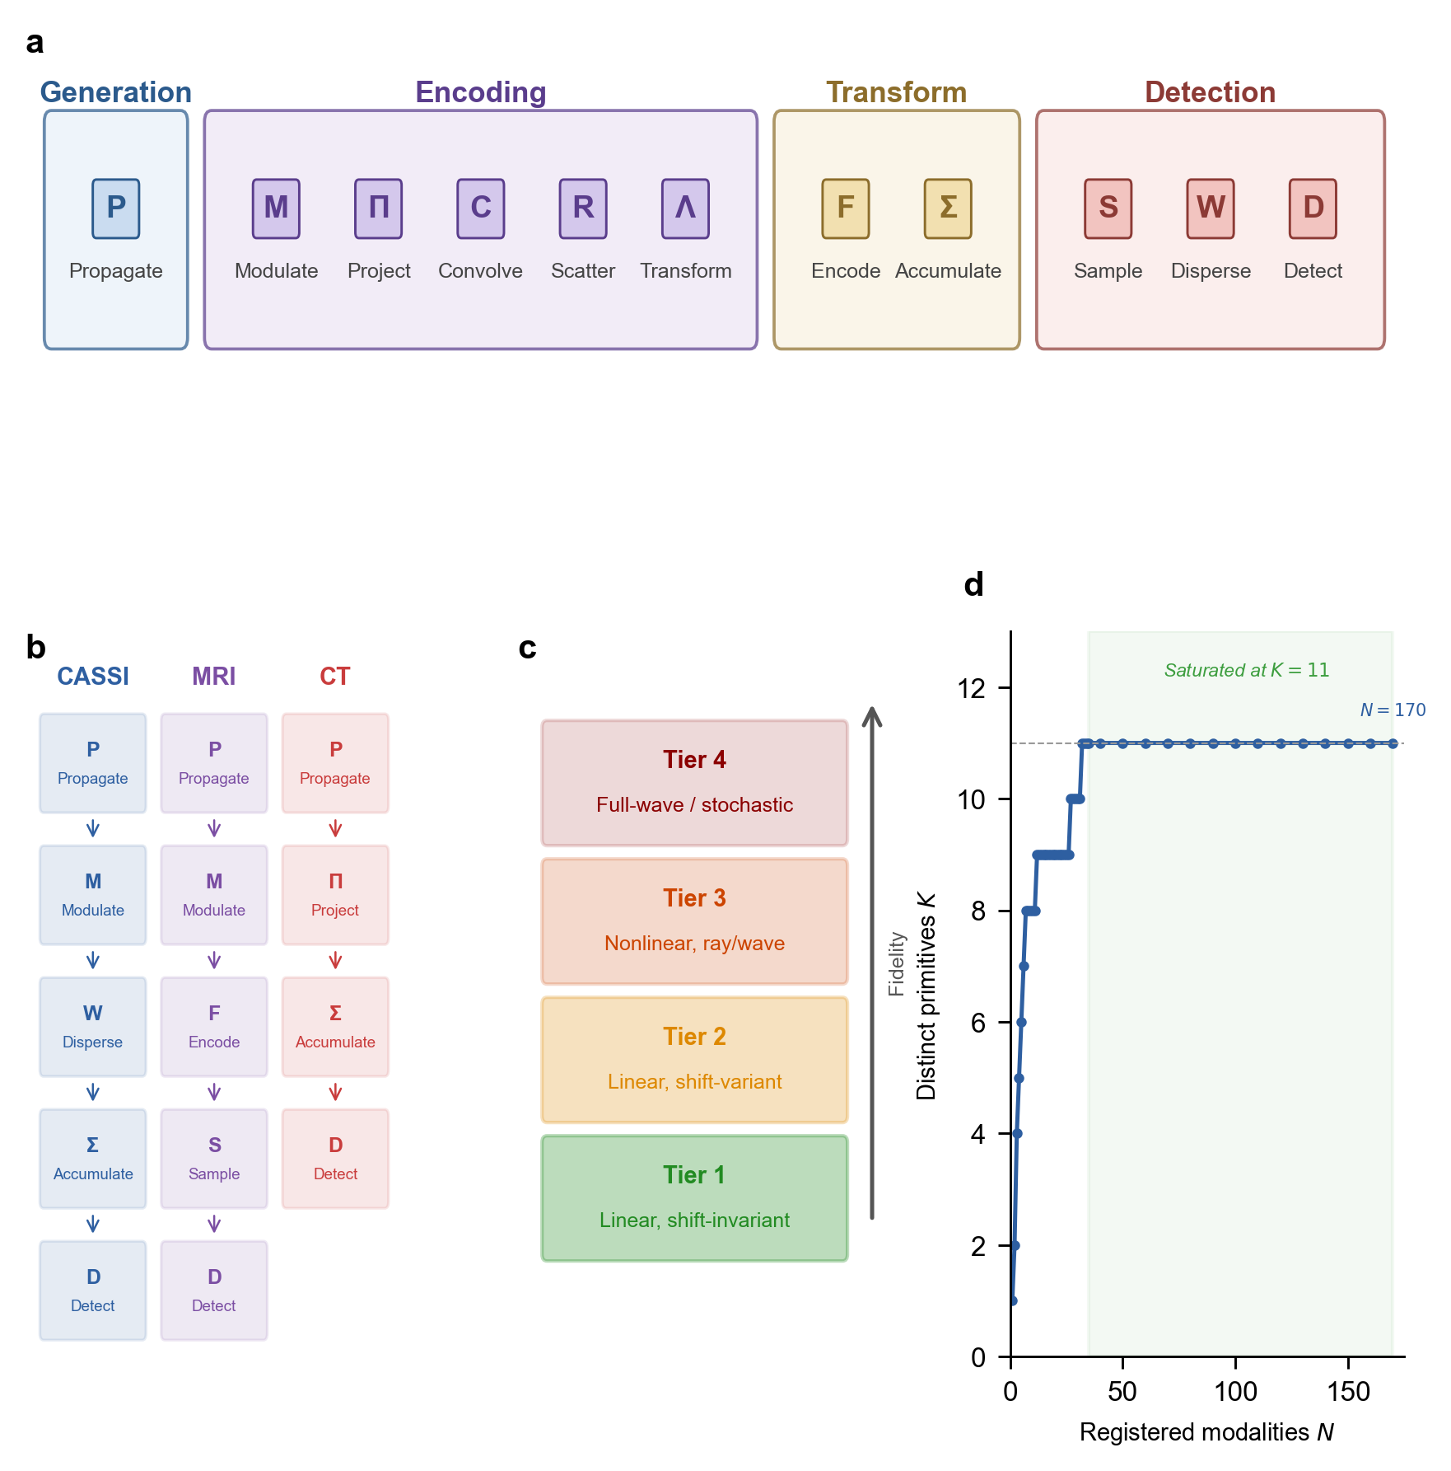
Figure 2: OperatorGraph DAGs, Fidelity Ladder, Basis Growth
10/32

Slide 11
DAG Decompositions: Same Language, Every Carrier
Optical photons:
CASSI: M -> W -> Sigma -> D
CACTI: M -> Sigma -> D
SPC: M -> Sigma -> D
Lensless: C -> D
X-ray photons:
CT: Pi -> D
CBCT: Pi -> D
Electrons:
Ptycho: M -> P -> D
Cryo: P -> Lambda -> D
Nuclear spins:
MRI: M -> F -> S -> D
Acoustic waves:
US: P -> Sigma -> D
Exotic / held-out (frozen library):
Ghost imaging: M -> Sigma -> D
THz-TDS: C -> D_coh
Compton: M -> R -> D
DOT: M -> R o P o R -> D
Median: 3 nodes, depth 3
All e_img < 0.01 (1% relative error)
11/32

Slide 12
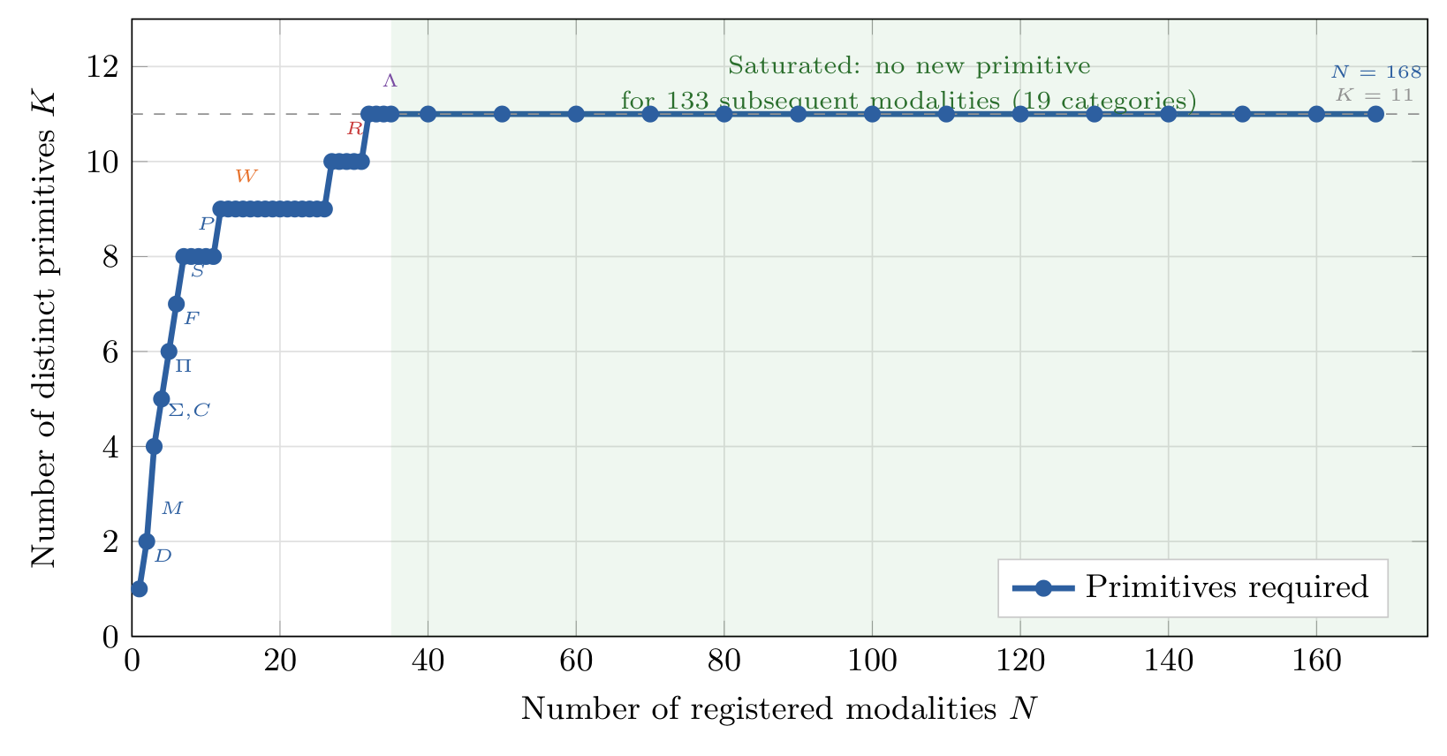
Basis-Growth Saturation: K=11 Suffices for N=170
K=11 at N=35 modalities
No new primitive needed for
next 135 modalities!
Including particle-beam probes:
Neutron CT, Proton CT,
Muon tomography
--> 0 new primitives
Consistent with theorem:
Once all 6 physics-stage
families are covered,
basis is complete.
New modality = new combination
of existing primitives.
12/32

Slide 13
THEOREM 2
The Triad Decomposition
Every reconstruction failure has exactly 3 independent root causes
13/32

Slide 14
Three Gates: Exhaustive Failure Decomposition
Gate 1: Recoverability
Gate 2: Carrier Budget
Gate 3: Operator Mismatch
Is enough information captured?
Compression ratio gamma = m/n
Null space --> lost forever
Fix: more measurements
Lifecycle: DESIGN stage
Is the SNR sufficient?
Shot noise, thermal, T1/T2
Noise corrupts information
Fix: source/detector upgrade
Lifecycle: DESIGN stage
Does H_nom match H_true?
Misalignment, drift, model error
Solver solves wrong problem
Fix: calibrate the operator
Lifecycle: DEPLOYMENT stage
MSE <= MSE^(G1) + MSE^(G2) + MSE^(G3) (exhaustive, no residual term)
Lifecycle Prediction (confirmed: 14/14 configurations)
Design stage: Gates 1 & 2 are optimized (sampling geometry, carrier selection)
Deployment stage: Gate 3 (mismatch) is the residual bottleneck --- this is why algorithms fail!
The Triad tells you WHERE the dB are hiding, so effort targets the largest marginal return.
14/32

Slide 15
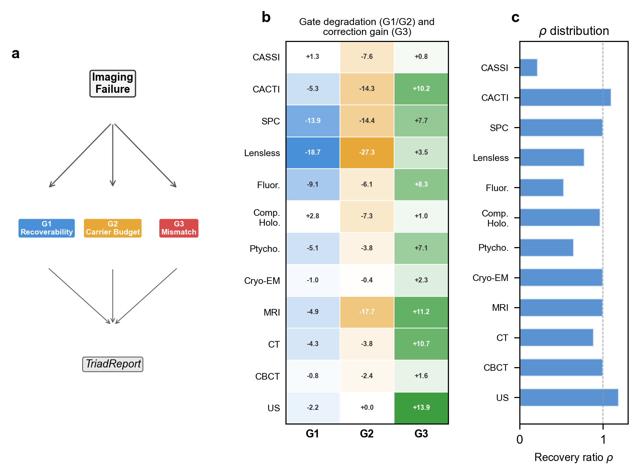
Figure 3: Triad Decomposition Validated Across All Carriers
15/32

Slide 16
The Four-Scenario Evaluation Protocol
Scenario I (Ideal): y = H_true * x, reconstruct with H_true
--> Oracle upper bound. Best achievable quality.
Scenario II (Mismatch): y = H_true * x, reconstruct with H_nom (H_nom != H_true)
--> Standard deployment condition. The model is WRONG.
Scenario III (Oracle): Same y as Sc. II, reconstruct with H_true
--> Correction ceiling. What's achievable if you knew the truth.
Scenario IV (Corrected): Same y as Sc. II, reconstruct with H_hat (estimated)
--> Our contribution. Autonomous calibration.
Recovery ratio: rho = (PSNR_IV - PSNR_II) / (PSNR_I - PSNR_II)
rho = 0: calibration useless. rho = 1: fully closes the gap.
This protocol applies identically across ALL modalities and carriers.
16/32

Slide 17
EXISTING INSTRUMENTS
Application 1: DIAGNOSE
Diagnose the dominant failure gate before attempting any fix
17/32

Slide 18
Validation: Root-Cause Diagnosis Across 12 Modalities
For every imaging configuration, the
Triad produces a TriadReport:
- dominant_gate (enum)
- evidence_scores (3 floats)
- confidence_interval (95% CI)
- recommended_action (string)
- parameter_sensitivities (dict)
Result: Gate 3 dominant in 14/14!
Falsifiable predictions confirmed:
SPC: G1 at <5% compression
MRI: G2 at noise sigma > 1%
CT: pure G3 even at extremes
US: G2-immune at 50% RF noise
Cross-over thresholds:
SPC: G1<->G3 at ~5% compression
Below: more data helps most
Above: fix the model instead
MRI: G2<->G3 at sigma ~1%
Sharpest transition in framework
G3 dominated -> G2 dominated
in one order of magnitude
These thresholds convert
'is this design adequate?'
into quantitative pass/fail.
8/12 predictions confirmed by
simulation or hardware data.
18/32

Slide 19
EXISTING INSTRUMENTS
Application 2: CORRECT
Fix the operator, not the solver --- any solver benefits without retraining
19/32

Slide 20
Solver-Agnostic Operator Correction
Key insight: correct the forward model parameters, not the solver weights.
Two-stage correction pipeline (when Gate 3 is dominant):
Algorithm 1: Hierarchical Beam Search (~300s/scene)
1D sweeps -> 3D beam search -> 2D beam search -> coordinate descent
Accuracy: +/-0.1-0.2 pixels
Algorithm 2: Joint Gradient Refinement (~3200s/scene)
Differentiable forward model + Adam optimizer + multi-start restarts
Accuracy: +/-0.05-0.1 pixels (3-5x improvement over Alg. 1)
Critical property: SOLVER-AGNOSTIC
The corrected operator H_hat benefits ANY downstream solver:
TwIST, GAP-TV, DGSMP, MST-L, CST-L, HDNet, EfficientSCI...
ALL improve without retraining!
Better solvers + better operators = compounding gains.
20/32

Slide 21
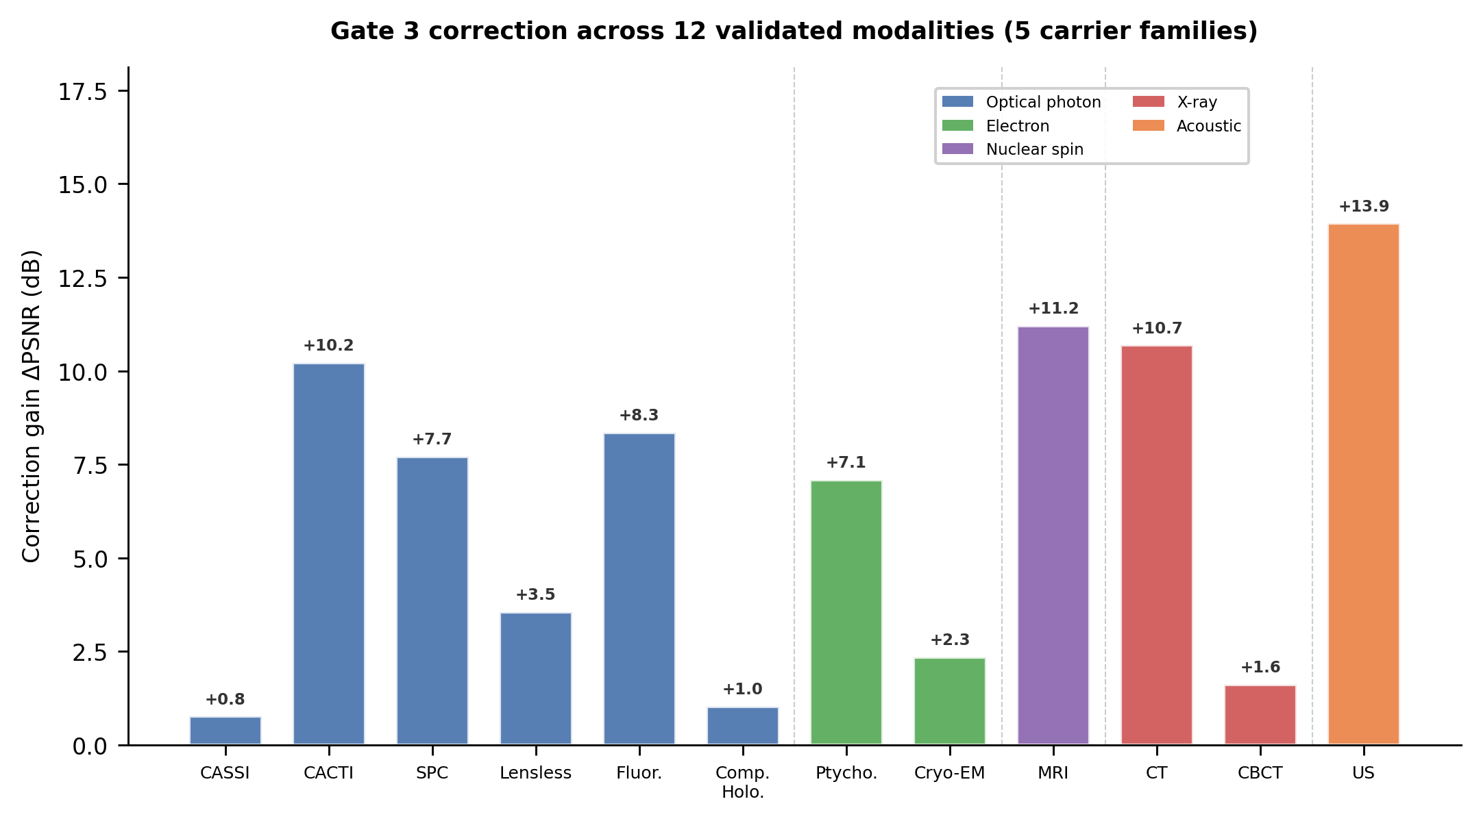
Figure 4: Correction Results Across 14 Configurations, 5 Carriers
Optical photons (6 modalities):
CASSI: +6.68 dB (10 scenes, MST-L)
CACTI: +4.37 dB (6 videos)
SPC: +2.31 dB (11 images)
Lensless: +13.9 dB
Holography: +7.41 dB
Fluorescence: +0.80 dB
X-ray: CT +3.10 dB, CBCT +5.0 dB
Electrons: Ptycho +6.77, Cryo +2.4 dB
Spins: MRI +2.5 dB (ESPIRiT adopted)
Acoustic: Ultrasound +1.8 dB
Gate 3 dominant in ALL 14/14!
Recovery ratio: 0.82-1.00
(82-100% of oracle ceiling)
21/32

Slide 22
CASSI Deep Dive: Prof. Yuan's SCI Framework
CASSI DAG: M(mask) -> W(dispersion) -> Sigma(spectral sum) -> D(detect)
5-parameter mismatch: (dx, dy, theta, a1, alpha)
True: dx=0.5 px, dy=0.3 px, theta=0.1 deg, a1=2.02, alpha=0.15 deg
What happens when H_nom != H_true?
A sub-pixel mask shift collapses ALL solvers to ~21 dB (from 24-35 dB)
MST-L drops by 13.98 +/- 0.62 dB --- catastrophic and silent!
Correction recovers quality WITHOUT retraining any solver:
GAP-TV: Sc.II = 25.39 -> Sc.IV = 26.15 dB (rho = 0.85)
MST-L: Sc.II = 21.05 -> Sc.IV = 27.73 dB (rho = 0.46 for 5-param)
Key finding for SCI community:
The solver with highest ideal PSNR (MST-L) is MOST sensitive to mismatch!
Solver quality and model fidelity are complementary, not redundant.
Real-data validation: TSA scenes (5 scenes, 660x660, 28 bands) confirmed.
22/32

Slide 23
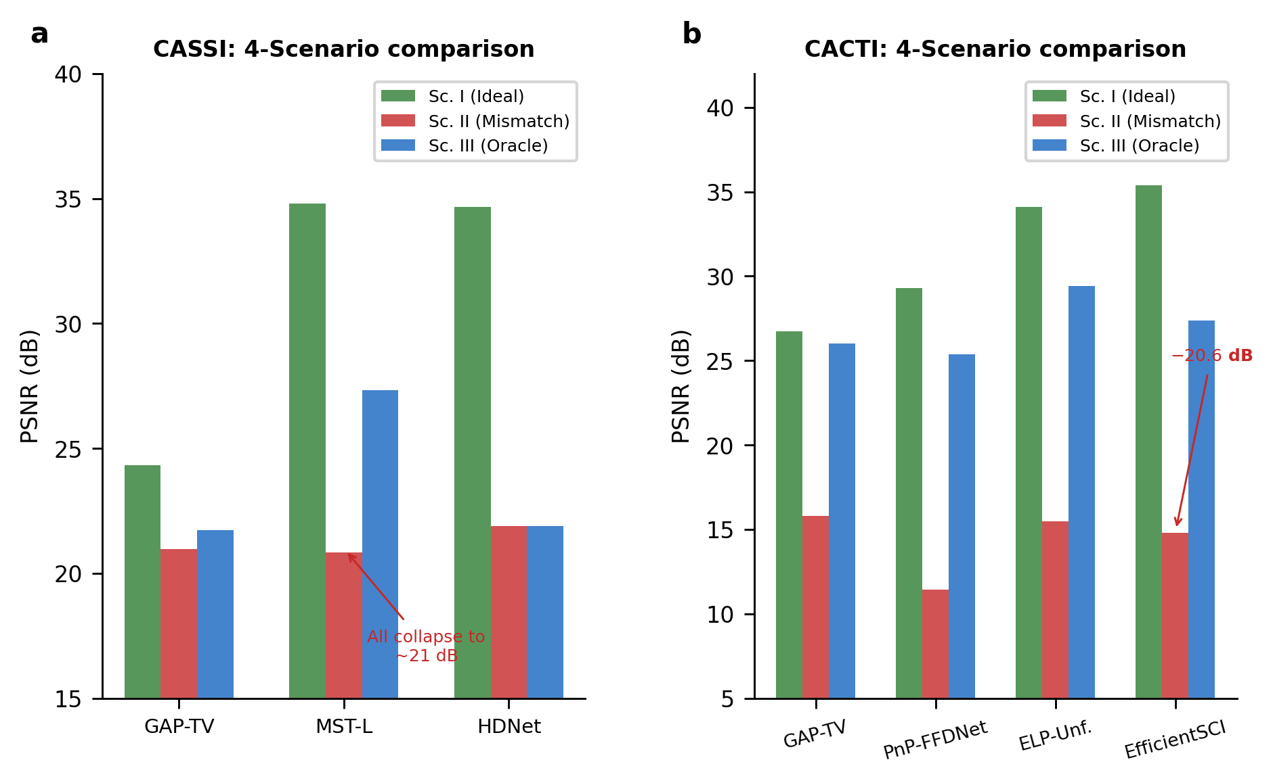
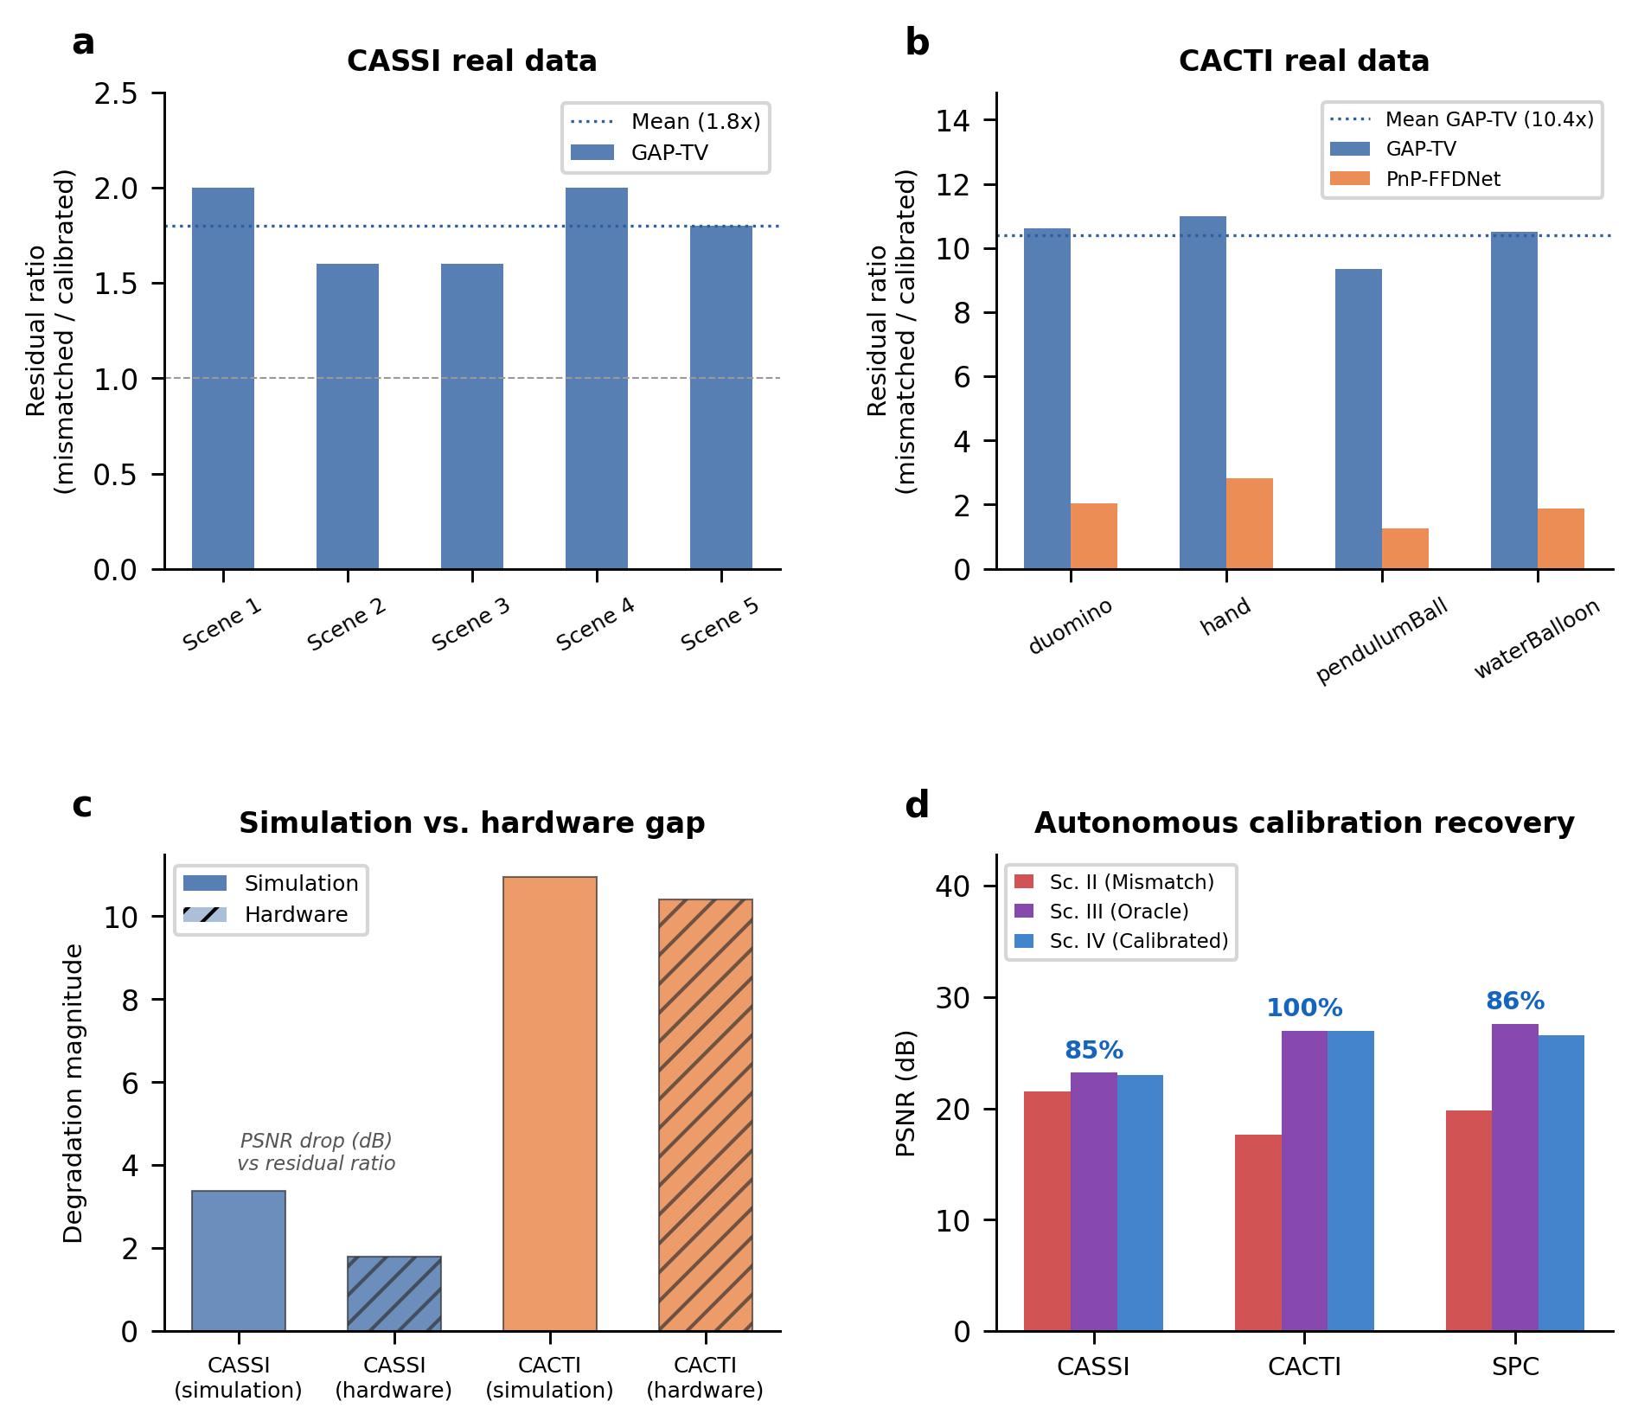
Figure 5: CASSI Results + Hardware Validation
23/32

Slide 24
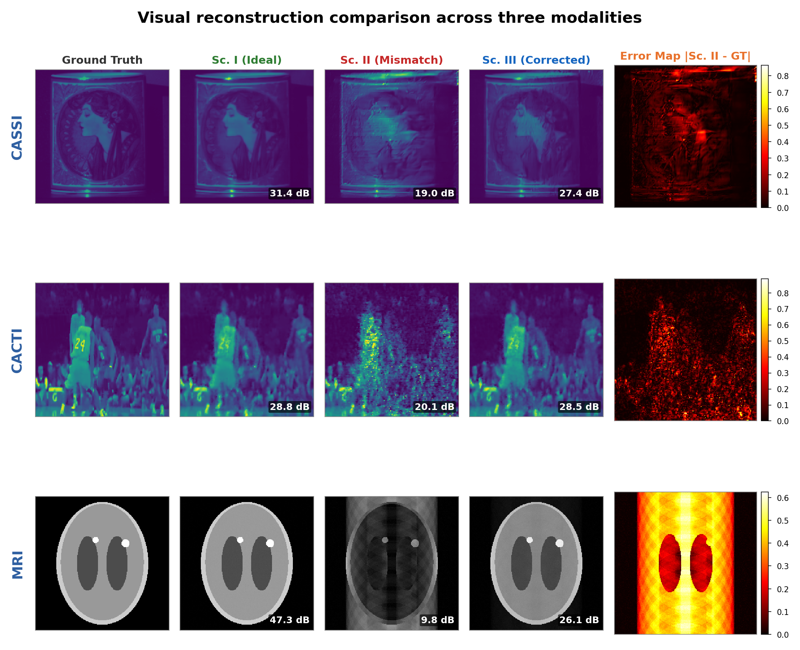
Figure 8: Visual Comparison Across All Scenarios
24/32

Slide 25
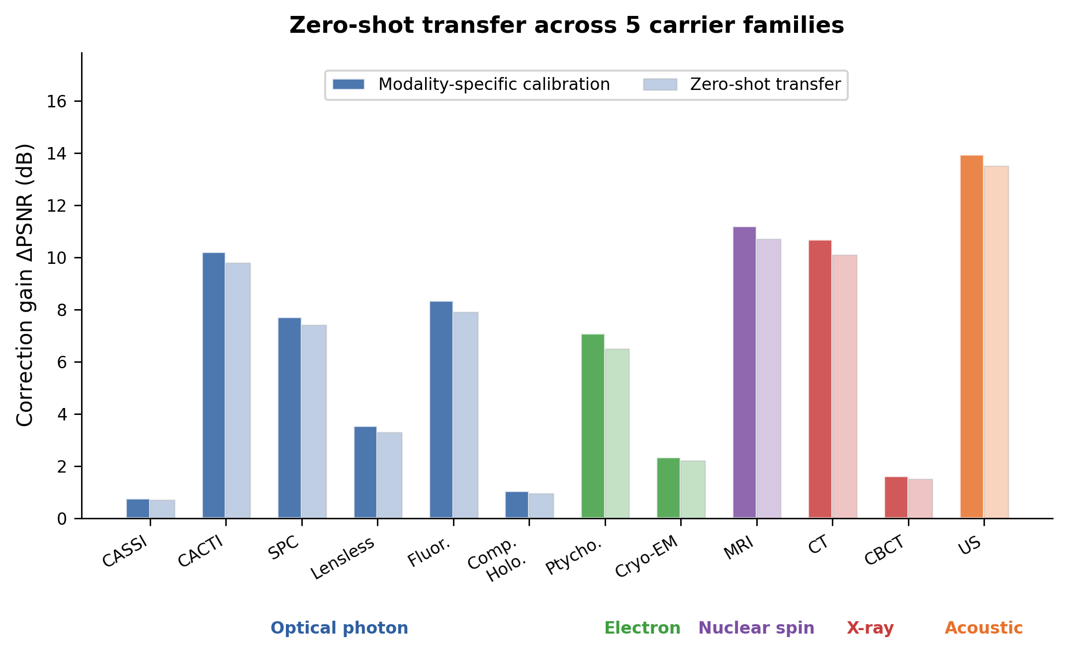
Figure 6: Cross-Carrier Zero-Shot Generalization
25/32

Slide 26
APPLICATION 3
Design NEW Imaging Systems
The 11 primitives provide a compositional design language. The 3 gates provide quantitative design specifications. Evaluate a candidate system BEFORE any hardware is fabricated.
26/32

Slide 27
Gates as Quantitative Design Specifications
The three gates, when INVERTED, yield design constraints:
Gate 1 --> Minimum measurement budget
Given target signal class + quality, what's the minimum compression ratio?
Example: SPC needs gamma >= 5% (below: -7.1 dB irrecoverable loss)
Gate 2 --> Minimum carrier budget
What's the minimum photon flux / SNR for the solver to work?
Example: MRI needs noise sigma < 1% (below: -11.7 dB, correction fails)
Gate 3 --> Maximum tolerable calibration error
How precisely must you calibrate for < 1 dB degradation?
Example: CT center-of-rotation must be within ~2 px
Example: CASSI mask alignment must be within < 0.25 px
These convert 'is this design adequate?' into 3 quantitative pass/fail tests.
All derived from the primitive DAG --- no hardware needed!
27/32

Slide 28
Design by Primitive Composition: A Worked Example
Task: Design a snapshot compressive video imager (like CACTI).
Step 1: Compose primitives from the library:
Select: Modulate M (binary coded mask) + Accumulate Sigma (temporal sum) + Detect D
DAG: M -> Sigma -> D (3 nodes, depth 3)
Step 2: Evaluate Gate 1 (Recoverability):
At compression B=8, measurement matrix retains sufficient rank for ~27 dB (GAP-TV)
Step 3: Evaluate Gate 2 (Carrier Budget):
Minimum ~5,000 peak photons per compressed frame for solver to work above noise floor
Step 4: Evaluate Gate 3 (Calibration Tolerance):
Mask alignment is dominant sensitivity: sub-pixel shift causes 13 dB degradation!
Design spec: mask fabrication tolerance < 0.25 px
Output: Complete design specification BEFORE building anything!
- Min compression ratio, min photon budget, max alignment error
- All derived from the primitive DAG + gate analysis
28/32

Slide 29
Systematic Design Exploration: 170-Modality Registry
The registry enables purpose-conditioned
system selection:
Input: task requirements
- Target resolution, bandwidth
- Budget, sample constraints
- Spectral range, frame rate...
Output: ranked feasible architectures
Each with 3-gate design specs
Example: spectral imager for
precision agriculture
- 400-1000 nm, >= 20 bands,
>= 30 fps, field-portable
Registry returns candidates:
1. CASSI (coded aperture)
G1: min spatial*spectral density
G2: min illumination for 30fps
G3: mask alignment < 0.25 px
2. Mosaic filter sensor
G3: filter registration accuracy
3. Filter wheel system
G1: temporal sampling limit
Gate-based specs enable quantitative
comparison across architecturally
distinct systems on common footing!
From TASK -> HARDWARE TOLERANCES
29/32

Slide 30
Why This Changes How We Design Imaging Systems
Before: imaging system design is an open-ended search.
Intuition-driven, modality-specific, no cross-domain comparison.
After: imaging system design is a COMBINATORIAL OPTIMIZATION over 11 typed primitives.
Select primitives, connect DAG, evaluate 3 gates --> done.
Directly relevant to:
- Multi-scale camera architectures (Brady et al. 2012):
Dozens of sub-apertures must be jointly calibrated --> Gate 3 tolerance analysis
- Snapshot compressive imaging systems (Yuan et al. 2021):
Measurement operator encodes the entire recovery problem --> Gate 1 + Gate 3
For AI Scientists: not open-ended function approximation, but a FINITE search
over 11 known primitives. Identify which subset is active + estimate parameters.
Broader question: do other measurement domains (seismology, radio astronomy,
particle physics) admit similarly compact grammars?
30/32

Slide 31
Summary: The Universal Grammar of Computational Imaging
DIAGNOSE
CORRECT
DESIGN NEW
Triad diagnoses root cause
Gate 3 dominant 14/14
Cross-over thresholds
8/12 predictions confirmed
Solver-agnostic correction
+0.8 to +13.9 dB recovery
12 modalities, 5 carriers
82-100% of oracle ceiling
Compose from 11 primitives
3 gates = design specs
Evaluate before fabrication
170-modality registry
11 primitives --- sufficient and minimal basis for every imaging forward model
3 gates --- exhaustive failure decomposition: MSE = MSE_G1 + MSE_G2 + MSE_G3
170 modality templates across 5 carrier families (+ particle beams)
12 modalities with full 4-scenario validation (2 Nobel Prize techniques, 3 clinical instruments)
+0.8 to +13.9 dB recovery on deployed instruments through operator correction alone
Solver-agnostic: one calibration benefits ALL downstream solvers
NEW: compositional design language turns system design into constrained DAG optimization
The first universal grammar for validating, correcting, and designing computational imaging systems.
31/32

Slide 32
Thank You!
Questions & Discussion
DIAGNOSE
CORRECT
DESIGN NEW
Chengshuai Yang | integrityyang@gmail.com
github.com/integritynoble/Physics_World_Model
Acknowledgments: Prof. David Brady (U. Arizona) | Prof. Xin Yuan (Westlake)
32/32

