Slide 1
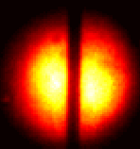
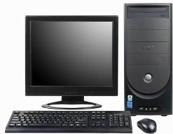
Beam Splitter
Camera Lens
Lens
Lens
Wire
DMD
Thin Paper
Streak Camera
3 ns Laser
532 nm

