Slide 1
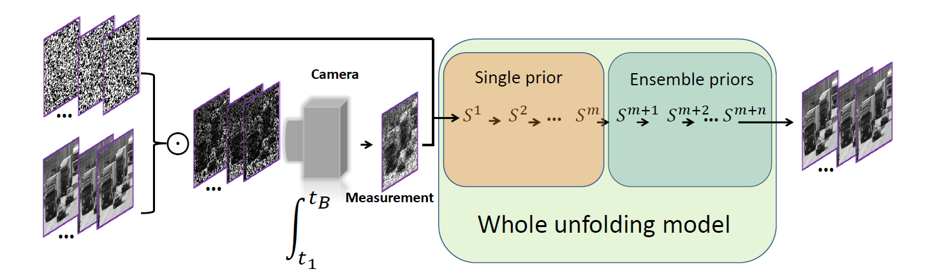
Ensemble unfolding learning algorithm for snapshot compressive imaging

