Slide 1
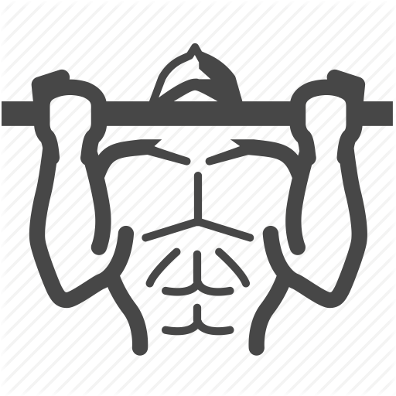
Workout for programmers
And others

Slide 2
What is this project about?
Help to relax your neck muscle
Check on correctness of the exercises
Doing this train in front of computer

Slide 3
Our tasks
Face detection
Tracking
Check on correctness
Continue workout
Stop program.
Offer “try again”

Slide 4
Example

