Slide 1
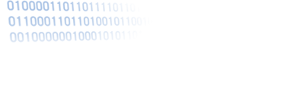

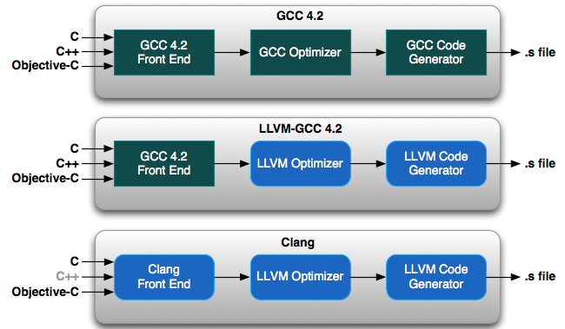

Brief Overview of a Compiler Blackboard Session: Background for ”Serenity” Plugin: an LLVM Persistent Memory Compiler Extension for Worry Free Persistence and Auto-parser “PacManICPy” plugin: an LLVM Source to Source Machine Programming Data Control System
Joseph Tarango
Rapid Automated Machine Programming (RAMP) Group
Rapid Automation-Analysis for Developers (RAAD) Project
Special thanks to Dr. Rajiv Gupta and Dr. Chris Lattner.
Notes:
What most people don’t know about me is I started as a Bio-Chemical, Mathematics, and Physic major focused on becoming a medical doctor (researcher in clinical trials and surgery).
Then when I discovered the power of computer science, electrical engineering, and engineering to solve automate the DNA sequencing faster than anyone in the department has seen with the fewest operations and waste.

Slide 2


What is a Compiler?
A program that translates a program written in one language into a program written in another language.
Source
code
Compiler
Assembly/Machine
code
or
Source code
A Interpreter is a program that reads a program and produces the results of executing that program.
Notes:
example:
GCC, Clang/LLVM, Visual C++, icc, XL C
javac, ECJ (eclipse)
CPyhton, PyPy (Rpython)

Slide 3
Context-Free Grammars
Language
the set of token strings obtained from all possible derivations is the language defined by the CFG.
L(G) = { s | exp ⇒* s}
exp → exp op exp | ( exp ) | number
op → + | - | *
derive
( number - number ) * number
a legal token string
Notes:
here it is programming language (legal token strings)

Slide 4
Compilation Phases
A typical compiler is organized into phases
Phases 1-4: Frontend
Phases 4-6: Backend
Lexical Analysis:
Converts a sequence of characters into words, or tokens
Syntax Analysis:
Converts a sequence of tokens into a parse tree
Semantic Analysis:
Manipulates parse tree to verify symbol and type information
Intermediate Code Generation:
Converts parse tree into a sequence of intermediate code instructions
Optimization:
Manipulates intermediate code to produce a more efficient program
Code Generation:
Translates intermediate code into final (machine/assembly) code
Lexical Analysis
Error
Handling
Syntax Analysis
Symbol
Table
Semantics Analysis
Interm. Code Gen.
Code Opt.
Target Code Gen.

Slide 5
Compilation Phases
Lexical Analysis
Example
“Journey” of a statement
Error
Handling
Syntax Analysis
Symbol
Table
Semantics Analysis
a[i] = 4 + 2
Interm. Code Gen.
Code Opt.
Target Code Gen.

Slide 6
Compilation Phase: 1
Lexical Analysis
input: source code (character stream)
output: token stream & errors
Lexical Analysis
Syntax Analysis
Convert from a sequence of characters into a (shorter) sequence of tokens
Identify and categorize specific character sequences into tokens
Skip comments & whitespace
Handle lexical errors (illegal characters, malformed tokens)
Efficiency is crucial; scanner may perform elaborate input buffering
Tokens are specified as regular expressions
IDENTIFIER=[a-zA-Z][a-zA-Z0-9]*
Lexical Analyzers are implemented by Deterministic Finite Automata (DFAs).
a[i] = 4 + 2
Semantics Analysis
a
[
i
]
=
4
+
2
identifier
left bracket
identifier
right bracket
assignment
number
plus sign
number
Interm. Code Gen.
Code Opt.
Target Code Gen.

Slide 7
Compilation Phase: 2
Syntax Analysis
input: token stream
output: parse tree & errors
Parsing is the act of performing syntax analysis to verify an input program's compliance with the source language. A by-product of this process is typically a tree that represents the structure of the program.
Lexical Analysis
Syntax Analysis
assign
a
[
i
]
=
4
+
2
identifier
left bracket
identifier
right bracket
assignment
number
plus sign
number
subscript
=
expr
a
[
expr
]
add
i
expr
+
expr
4
2

Slide 8
Parsing
Determine the syntax (structure) of a program based on the token sequence; Typically, parser drives scanner
token sequence
Parser
parse/syntax tree
getToken()
Scanner
Parser
parse/
syntax tree
a token
One-Pass

Slide 9
Parse Tree
A labeled tree corresponding to a derivation
Internal nodes: nonterminals
Leaf nodes: terminals
Children – parent relation: a derivation step
(1)
exp
(1)
(2)
(3)
(4)
exp ⇒ exp op exp
⇒ exp op number
⇒ exp + number
⇒ number + number
(3)
(4)
exp
op
exp
(2)
number
+
number
Rightmost Derivation
Notes:
Not necessarily the same: a – b + c

Slide 10
Compilation Phase: 3
Semantics Analysis
input: syntax tree
output: annotated syntax tree & errors
Provides meaning to constructs and structures.
Interpret symbols, types, and their relations with each other.
Lexical Analysis
Syntax Analysis
Semantics Analysis
a[i] = 4 + 2
Interm. Code Gen.
assign
subscript
add
Code Opt.
integer
integer
a
i
4
2
Target Code Gen.
array of integer
integer
integer
integer

Slide 11
Compilation Phase: 4
Intermediate Code (IR) Generation
input: annotated syntax tree
output: IR (three-address code)
Intermediate language is the language of an abstract machine designed to aid in the analysis
List of machine-independent instructions for each procedure or method in the program.
Basic data layout of all variables.
Used in Control and Data flow graph analysis.
Lexical Analysis
Syntax Analysis
Semantics Analysis
assign
a[i] = 4 + 2
Interm. Code Gen.
subscript
add
integer
integer
Code Opt.
a
i
4
2
array of integer
integer
integer
integer
Target Code Gen.
temp. var.
t = 4 + 2
a[i] = t

Slide 12
Compilation Phases: 5
Code Optimizations (many times)
input: IR
output: optimized IR
Synthesis phase transformations
Improve the intermediate code to get a better target code
Put efforts to take maximum advantage of the memory hierarchy
Lexical Analysis
Syntax Analysis
Semantics Analysis
Interm. Code Gen.
t = 4 + 2
a[i] = t
assign
subscript
6
Code Opt.
integer
integer
t = 6
a[i] = t
a
i
Target Code Gen.
array of integer
integer
a[i] = 6
Notes:
constant folding
copy propagation

Slide 13
Compilation Phases: 6
Lexical Analysis
Target Code Gen.
input: IR
output: assembly/machine code
Syntax Analysis
Semantics Analysis
a[i] = 6
Interm. Code Gen.
mov R0, i ;; value of i → R0
mul R0, 4 ;; multiply R0 by 4
mov R1, &a ;; addr of a → R1
add R1, R0 ;; add R0 to R1
mov *R1, 6 ;; 6 → addr in R1
Code Opt.
Target Code Gen.

Slide 14
Compilation Phases: 6
Target Code Generation
input: IR
output: assembly/machine code
Instruction selection on which instructions to use.
Instruction scheduling in which order to put those instructions. Scheduling is a speed optimization that can have a critical effect on pipelined machines.
Register allocation: the allocation of variables to processor registers
Debug data generation if required so the code can be debugged.
Lexical Analysis
Syntax Analysis
Semantics Analysis
Interm. Code Gen.
mov R0, i ;; value of i → R0
mul R0, 4 ;; multiply R0 by 4
mov R1, &a ;; addr of a → R1
add R1, R0 ;; add R0 to R1
mov *R1, 6 ;; 6 → addr in R1
Code Opt.
mov R0, i ;; value of i → R0
shl R0, 2 ;; shift left 2 bits
mov &a[R0], 6 ;; 6 → addr in R1
Target Code Gen.
Notes:
two opportunities:
mul --> shift
more powerful addressing mode (specialized instructions designed for array accessing; faster)

Slide 15
Compilation Phases
Lexical Analysis
Example
“Journey” of a statement
Error
Handling
Syntax Analysis
Symbol
Table
Semantics Analysis
a[i] = 4 + 2
Interm. Code Gen.
mov R0, i
shl R0, 2
mov &a[R0], 6
Code Opt.
Target Code Gen.
Notes:
note:
not statement to instruction mapping, statements are considered together (e.g., for declaration, optimization)

Slide 16
Lexical Analysis (Scanning)
Basic Ideas
divide character stream into tokens
a token is the smallest logical unit in code
common categories:
easy to
enum.
keywords: “if”, “for”, “while”, ...
special symbols: “+”, “-”, “=”, “[”, ...
hard to
enum.
number: “4”, “23”, “6.63”, “001”, ...
ID: “a”, “abs”, “sum”, ...
...
Notes:
a.k.a. Tokenization
smallest: in “x=1.2”, “.2” has no meaning in this code, rather than two symbols.

Slide 17
Finite Automata and State Machines
A finite automaton is an abstract, mathematical machine, also known as a finite state machine, with the following components:
A set of states S
A set of input symbols E (the alphabet)
A transition function move(state, symbol) : new state(s)
A start state S0
A set of final states F
For a deterministic finite automaton (DFA), the function move(state, symbol) goes to at most one state, and symbol is never epsilon.
Finite automata correspond in a 1:1 relationship to transition diagrams; from any transition diagram one can write down the formal automaton in terms of items 1-5 above, and vice versa. To draw the transition diagram
For a finite automaton:
draw a circle for each state s in S; put a label inside the circles to identify each state by number or name
draw an arrow between Si and Sj, labeled with x whenever the transition says to move(Si, x) : Sj
draw a "wedgie" into the start state S0 to identify it
draw a second circle inside each of the final states in F
Notes:
consider a ”language” with only two symbols “<“, “=“, and two tokens “

Slide 18
Appendix
But wait there is more…

Slide 19
Finite Automata
state = 1
while (!EOF)
{
switch(state)
case 1:
if(advance() == ‘<’)
state = 2
else
error & break
case 2:
if(advance() == ‘=’)
state = 3
else
state = 4
case 3:
output token LE
state = 1
case 4:
output token LT
stepback()
state = 1
}
Implementation
hard-coded
< | < | = | = | <
state = 1
=
3
1
<
2
[other]
4
Notes:
consider a ”language” with only two symbols “<“, “=“, and two tokens “

Slide 20
Finite Automata
Implementation
transition table
=
3
1
<
2
< | < | = | = | <
state = 1
[other]
4
 | < | = | action
1 | 2 | err | c = advance()
2 | 4 | 3 | c = advance()
3 | 1 | 1 | output LE
4 | 1 | 1 | output LT; c = stepback()
err | - | - | print error; break
state = 1
c = advance()
while (!EOF)
{
state = Trans[state][c]
action(state)
}
state
Notes:
action of 3 and 4: cancel_read(), state = 1
action of err:

Slide 21
Abstract Syntax Tree (AST)
a.k.a. Syntax Tree
abstract syntactic structure (may miss some syntax details)
token sequence may NOT be recoverable from the AST
still contains all necessary info for translation
*
(34 – 3) * 42
-
42
((34 – 3)) * 42
((34 – 3) * 42)
34
3
Notes:
superficial differences captured by parse tree, ignored by AST

Slide 22
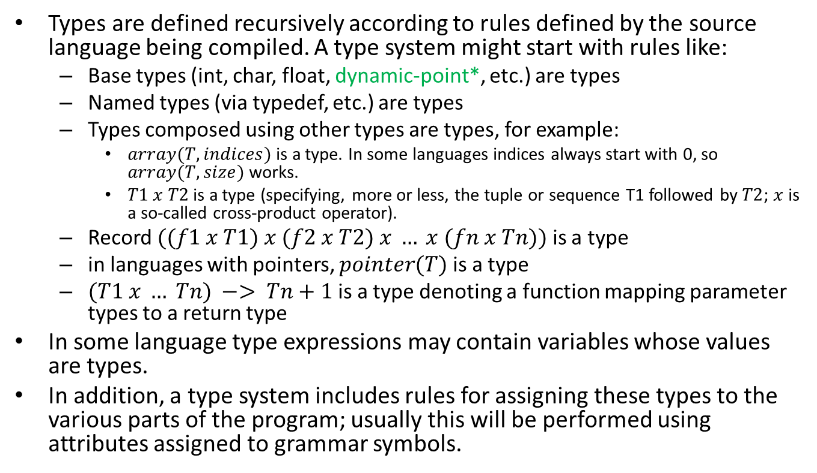
Type Systems
Types are defined recursively according to rules defined by the source language being compiled. A type system might start with rules like:
Base types (int, char, float, dynamic-point*, etc.) are types
Named types (via typedef, etc.) are types
Types composed using other types are types, for example:
$array(T, indices)$is a type. In some languages indices always start with 0, so $array(T, size)$ works.
$T1 x T2$is a type (specifying, more or less, the tuple or sequence T1 followed by $T2$; $x$ is a so-called cross-product operator).
Record $((f1 x T1) x (f2 x T2) x … x (fn x Tn))$is a type
in languages with pointers, $pointer(T)$is a type
$(T1 x … Tn) −> Tn+1$is a type denoting a function mapping parameter types to a return type
In some language type expressions may contain variables whose values are types.
In addition, a type system includes rules for assigning these types to the various parts of the program; usually this will be performed using attributes assigned to grammar symbols.
* Novel Dynamic-Point Type System is recorded in the black board session library.

Slide 23
Run-time Environments
Relationship between source code names and data objects during execution
Scope and bindings of variables
Procedure activations
Basic blocks, parameters, lifetimes, passing by {name, value, reference, copy-restore}
Memory management and layout
Storage location being: static, stack, heap
Library functions
Built-ins, system calls, and copied functions linked into code
Code
Static Data
Stack (Grows Down)
Heap (Up or Down from address space)

Slide 24
