Slide 1
Data Control Management Proposal
Andrea Chamorro (Intern)
Principal Investigator: Joseph Tarango
FSE: Jim Baca
August 8th, 2019
Revision 1.0

Slide 2
Overview
Proposal/Status
Data Control Introduction
Objectives
Gap Analysis and Motivation
Fundamentals
Data Control Gen Stages
Approval Process
Commands
Repos
Tracking File
Reservation Tracker
Data Overview
Changes in FW Source
Locations in FW
H File
Doxygen Comments
Work Flow Overview
Example Flow
Flow Summary
Benefits and Vision
Appendix

Slide 3
Proposal/Status
Proposal
Utilize a data control process through which we can manage telemetry FW source specs, identifiers, classifications, and structure details. Enables:
Classification and auditing of structures for telemetry for each FW build.
Automates the Telemetry Data Content Addition Process.
Status
Code is complete and being reviewed in a closed review before a public code review is ready.

Slide 4
Data Control Introduction

Slide 5
Objectives
Data control is the process through which we can manage telemetry FW source specs, identifiers, classifications, and structure details. It enables classification and auditing of structures for telemetry for each FW build, and automates the Telemetry Data Content Addition Process.
Understand the mechanisms within telemetry so engineers can:
Save all data using available tools.
Verify content.
Provided concise list of telemetry data included.
Characterization of the system setup, usage, and the sequence to the fault event.
Diligently develop a problem statement using the scientific method by reducing scope.
When a fault case is not clear provide feedback for how we can improve the methodology in future engagements.
For more Info see Training: \\amr\ec\proj\fm\NSG\SE\Shares\Firmware\Architecture\Domain Arch - Debug\Telemetry\TelemetryTraining_v6.pptx

Slide 6
Gap Analysis and Motivation
One Liner – Data Control Gen provides means to manage FW structure meta data conveniently and automatically
NSG solution for reserving FW structure UID, major, minor information introduced with Telemetry 2.0 needed
UIDs (unique identifiers) for FW structures cannot conflict with one another
Reservation process for their use is required for security and cross-syncing between branches.
Telemetry 2.0 Introduces new system of “snapshotting” FW structures, creating Meta Data In the Process
Major, Minor Meta Data supported through automatic self-maintenance
Persistence, Security Classification, Dependency, Size, Data Area, Data Group, Name, Assert, Domain, Owner, Description Meta Data are also relevant
Storing and Automatically updating this information enables Data Mining and Data-Based Decisions through Telemetry
Maintaining this Information Manually is Tedious and Prone to Human Error
dataControlGen enables Input Validation, and Formalizes Data Control Creation into a Standard
Free of Dependencies for Convenience and Ease of Use
The python scripts stand independently and are contained in SSDDEV
Removes need to directly interface with non-company tools
Simple Command Line Interface

Slide 7
Data Control Fundamentals

Slide 8
Fundamentals
One Liner: Data Control Gen created to keep data which has local/global requirements which can vary between repositories and builds.
Data Control Info Must Match the Local Repository
AutoGen requires a UID- struct name decoding to parse and tokenize FW Source Code
Major-Minor set information change every time a FW Structure gets updated.
Automation reduces errors and cuts costs of manual maintenance
Static Storage of this Information, Updated on a on-need basis
Data Control Maintains Large Amounts of Information, the common case data does not often change.
Data Control UIDs must be Unique for the same Structure across Repositories
The construction shares a methodology requirement similar to Asserts, thus aspects closely follow the implementation of AssertGen
Database separate from FW source code maintains the UID reservation information
Once a UID has been assigned and confirmed, can are not reserved again until product is no longer supported (3-5 yrs).
Different builds contain different sets of FW structures.
dataControl must allow for the tracking of all structures across all builds, and for each individual build.

Slide 9
Data Control Gen Stages
One Liner: Data Control Gen undergoes three Stages for ensuring accuracy: Editing, Implementation, and Approval
Data Control is a method to reserve and update FW structure relevant data. It includes 3 steps:
Editing
Information (even new structures, and all relevant data) is edited until it is Ready to Confirm. Allows for non-permanent changes and tinkering while FW structure is being coded.
Implementation
Permanent UID assigning is only done when the Structure Data AND the relevant FW Code is ready to implement. It automatic assigns UIDs to new structures and keeps track of which have been reserved remotely. It parallels “pull requesting” UIDs and should be linked to completed structure FW source code to ensure UID reservation validity.
Approval
Confirmation of UID implementations happen as code has Been Reviewed and Pulled Request Approved into Permanent Branches (as opposed to Development Branches). This means a structure cannot be reserved under the same UID, and is permanently identified by that UID.
Ensures downstream correctness, whereas inherent repository lineage ensures upstream correctness

Slide 10
Data Control Repos Overview
Most developers do not have access to directly edit SSDDEV-meta, as it acts like a closed-access database.
For most users, all changes should be made through dataControlGen scripts, located in ssddev, and use of dataControlGen fits into their regular development process.
The datacontrol.h is acc-lock controlled, which means updates are controlled.
Super-users of SSDDEV-meta are super-users of ssddev. They:
Confirm structure FW src code has rightfully been implemented through Code Review.
Approve UIDs immediately preceding pulling FW src changeset into trunk.
If a FW struct addition has been denied, they can routinely clean unaccepted UID reservations.
Open Options:
Maintaining ssddev-meta as a means of restricting data access
Moving ssddev-meta content to ssddev with acc-lock?

Slide 11




Data Control Key Commands
Create
Edit
Implement
Approve
Delete
SSDDEV-meta
superusers

Slide 12
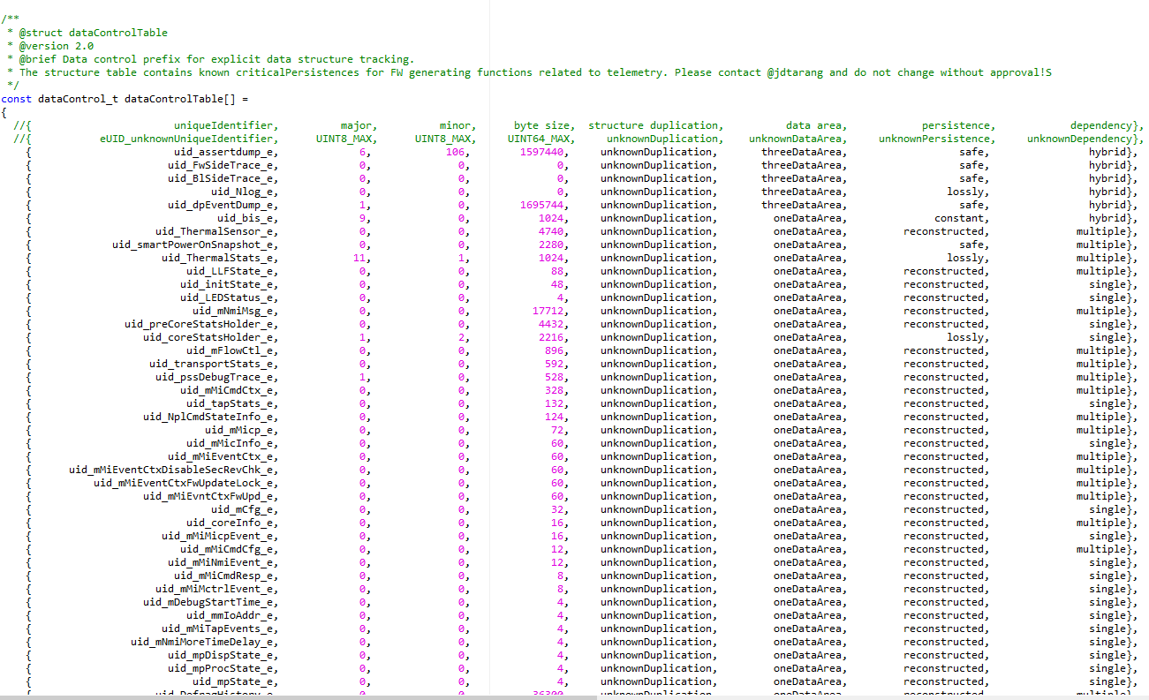
Tracking File and Requirements
There exists a structures.csv file for each repository, and it is reflective of that repository’s current condition.
This file is master file used to generate other datacontrol files used in that repository and develops alongsides the FW src.
dataControlGenMain primarily edits this file.

Slide 13
Data Overview – SSDDEV
Unique Identifier
Assigned automatically, mostly enumerated identifier. Takes precedence over global name for identification.
Telemetry Version
1.0 or 2.0
Auto Parsability
Product, [sub-builds] in which auto-parsing enabled
Major
Automatically tracked, for non-reversible changes to structures.
Minor
Automatically tracked, for small changes and updates to structures.
Persistence
Lossly, safe, constant, reconstructed
Dependency
Single, multiple, hybrid
Security Classification
Secret, Confidential, Public
Byte Size
Decimal. Automatically calculated based on hexadecimal Size
Unique Identifier | Telemetry Version | Autoparsable in Product, [Sub-Builds] | Major | Minor | Persistence | Dependency | Security Classification | Byte Size (Decimal)

Slide 14
Data Overview – SSDDEV, Continued
Data Area
(1,2,3) Telemetry specification for level of precedence in assert dumps
(4,5,6) Items after 3 are internal placeholders.
Structure Duplication
What duplicate structures of it exist, if any
Data Object Group
DiveStats_PART, Transport_PART, DriveStats_FULL, etc.
Global Name
Human-friendly identifier for structure and represents the instance name.
Size
In bytes. Obtained from GHS command.
Within Assert
STD, PLI, MIN, CDR. What assert found in.
Product, [Sub-builds]
What Product and Sub-build use it. If this field is Empty, the structure has been deprecated.
Domain
Core, Platform Services, Transport, etc.
Owner
The one who assigned a description to the structure. Mostly, the FW struct developer and UID implementer.
Description
250 char limit. Sentence describing FW structure use and/or construction.
Data Area | Structure Duplication | Data Object Group | Global Name | Size (Hex) | Within Assert | Product, [Sub-Builds] | Domain | Owner | Description

Slide 15
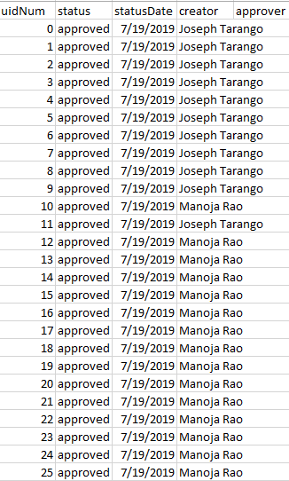
Reservation Tracker and Requirements
Structures-meta.csv contains UID reservation information across all repositories.
This file is master file used to generate other UIDs that have never been used before in any repository to avoid UID duplication.
dataControlGenMeta contains supporting functions for this script.

Slide 16
Data Overview- SSDDEV-meta
Unique Identifier
Typically takes on number value [0,1,2…]
Must identify a structure across all repositories and all versions
Status
Approved, Pending
UID requires Approval to confirm its FW code has been approved (and UID can never be assigned again)
Status Date
MM-DD-YYYY HH:SS:MM
Date of Latest Status Update
Creator
Alphanumerical, Underscores
Name of Person who called –implement
Intended to be creator of structure FW code
Approver
Alphanumerical, Underscores
Intended to be SSDDEV-meta super user who reviewed structure FW src and pulled it to trunk
Unique Identifier | Status | Status Date | Creator | Approver

Slide 17
Data Control in FW Source

Slide 18
Data Control Locations
Source Code
..\src\datacontrol.h
..\src\datacontrol.c
Tracking Files
\tools\lib\datacontrol\structures.csv
Scripts
\dataControlGen.py
\tools\lib\datacontrol\dataControlGenMain.py
meta\DATACONTROL\dataControlGenMeta.py
Meta Data
meta\DATACONTROL\structures_meta.csv

Slide 19
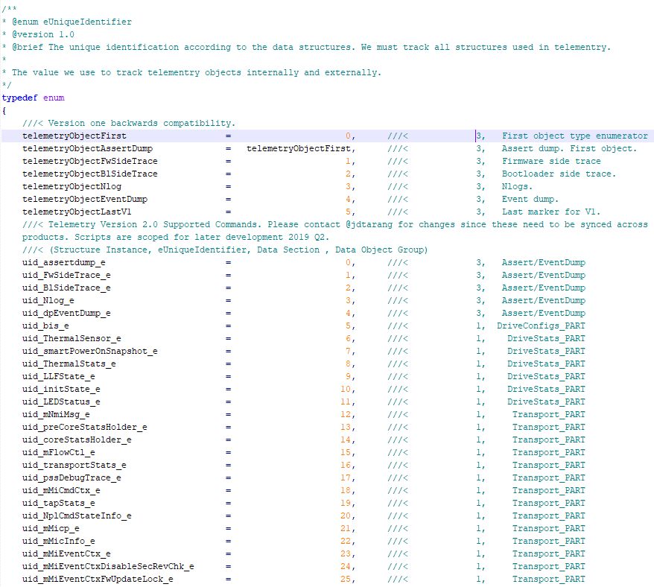
H File and Requirements
Datacontrol.h is a file used for the tracking and matching of uids to their structure names in the firmware structure.
Depending on the repo and project for which it is compiled, datacontrol.h can contain different structs to match the structs supported in that FW build.
It is not pushed to the repo and should be generated when ready to be used.

Slide 20
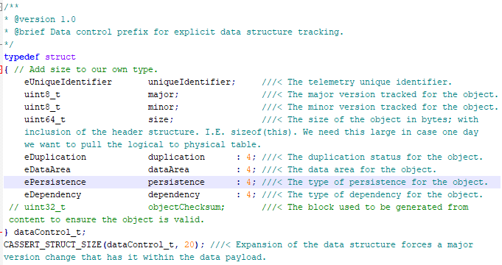
Data Control Doxygen Comments and Requirements
Data Control Type Def Example
struct typedef {
///< Data control Tracking for Telemetry Tracking
///< uniqueIdentifier = unknownIdentifier;
///< major = FWNAME_MAJOR_VERSION;
///< minor = FWNAME_MINOR_VERSION;
///< size = 4;
///< duplication = unknownDuplication;
///< dataArea = unknownDataArea;
///< persistence = unknownPersistence;
///<Dependency = unknownDependency;
header_t header;
container_t dataPayload;
reserve_t reserved[UINT64_MAX-sizeof(header_t)-sizeof(container_t)];
} exampleDataContainer_t; ///< Data control container for Telemetry.
Instance Example
exampleDataContainer_t dataControlContainer; ///< Data control Tracking for Telemetry Tracking. uniqueIdentifier = unknownIdentifier; … Dependency = unknownDependency;

Slide 21
Data Control Flow

Slide 22
Example Workflow
Review Security Guidelines for Data Control
Determine if the data meets the guidelines
Create Data Implementation Plan
Usage Development and/or Business requisite
Determine Data Area, Data Group, Structure Name, Security Classification, Size
Review Control/Data Flow (C/DFG) and Data of the Object Desired
Showcase the usage and impact
Provide urgency of deployment and stakeholders
Timeline for internal and/or external release
Domain Reviewers
Code FW Source, Tag with Doxygen Tag containing Temp eUid
Create and Edit Temporary eUid Data File Locally
Live Code Review
Request Code Promotion
Call Implement on Repo to be Assigned Permanent eUids which don’t Conflict on any Branch
Promoter Approves eUids as they Approve Code
Once Code Pulled, Dispatch notification to Stakeholders

Slide 23
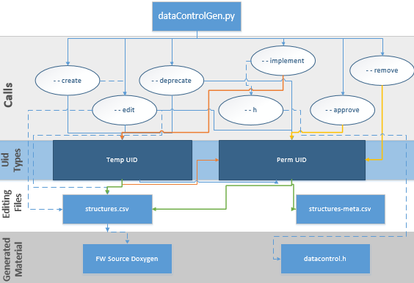
Control Flow Summary

Slide 24
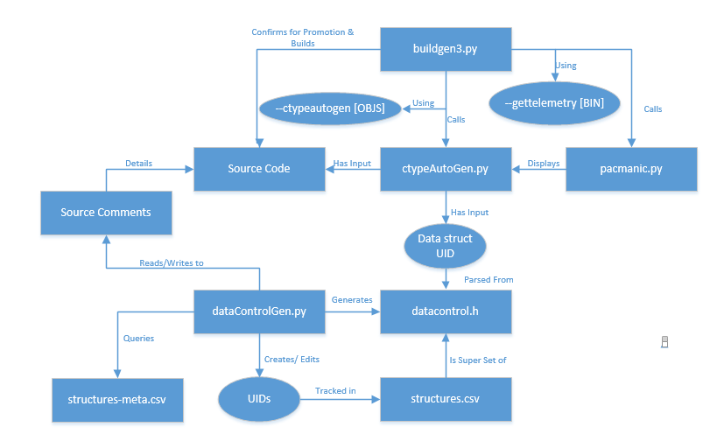
Control Flow Paths

Slide 25
Analysis, Benefits, and Vision

Slide 26
Design Analysis
Pros
Additional Assistance
Functional design is in Python 2 or 3 which extends to data base interactions with ease.
Design is scalable.
Unified Repository Source in SSD-Meta.
Tracks more than just the data used in firmware for data tracking.
Reinforces diligent programming behaviors for more robust documentation in the code.
Educational concepts are similar to assert generation
Cross management of Git to Mercurial
Git natively supports mercurial, we will need system integration support. We will want to create automated scripts to cross check between repositories.
We will need analysis functions to determine highlight deltas between repositories
Product tagging will need to be implemented for updates on firmware releases
Graphical interface for front end analysis

Slide 27
Data Control Benefits and Vision
Unified Source for Editing Multiple Locations As Needed
Data Control Table
Doxygen Tags
Header Files
External Databases
Input Validation
Solution for Human Inputs
Input Data Security
Uses Established Processes
Notifications Handled Same as Code Review
Reviewers are Assigned in Review Me
Data Control Approved through Branch Edits
Moving Forward
Establish BKM
Code Review and Pull
Distribute Created Documentation
Training
Script Improvements

Slide 28
Special Thanks
Andrea Chamorro
Design and application of data control.
Chris Smerz
SSDDev Meta support and feedback
Joe Tarango, Phuong Tran, and Randal Eike
Construction, feedback, methodology, and mentoring
Joe Tarango, Phuong Tran, and Tyler Woods
Data control tracking and detection in firmware
Karl Heichelheim
Support of persistence and code strategies
Julianna Pierce
Clarifications on data structures
Jim Baca and Matt Beyer
Support in opportunities for pairing technical construction

Slide 29
Questions

