Slide 1
AUTO ROUND / 研究设计
通道重排 × 混合 MXFP 激活 × HMT
AutoRound 的算法与工程设计：以 Intel GPU / XPU 为主
让 4 位量化更准
也让实现路径可验证
F1 固定 K 轴重排 + MXFP4
F2 主体 A4 + 少量 A8
HMT 可选、成对补偿、联合优化
13 个固定来源 · 作者图表 · 真实代码落点 · 分阶段开发方案
研究与开发设计 | Intel XPU | 2026-11-05 | 非新功能实测
01
Notes:
通道重排 × 混合 MXFP 激活 × HMT
用户已确认 HMT 为 Hadamard Transform，主要硬件为 Intel GPU/XPU。本交付只做研究和设计。
Evidence boundary: pinned author implementations, author-released figures/data and local source inspected. Direct arXiv full-text access failed. No new-feature model or XPU benchmark was run.

Slide 2
AUTO ROUND / 设计方案
建议：一份计划，两个功能，三层落地
先验证数值与精度，再选择真实硬件路径。默认不升级权重位宽。
F1 / 改变分组
F2 / 分配精度
HMT / 可选增强
离线学习固定置换
激活与权重列同步重排
重新形成 32 元素块
先用完整 W4A4
一次 gather 得到两区
主体激活 MXFP4
少量激活 MXFP8
默认两区权重均 MXFP4
分区后先旋转低区
固定 H32 作为起点
两侧严格配对补偿
学习旋转放后续
参考 QDQ → XPU 解码融合 → 经能力探测的原生运算
研究与开发设计 | Intel XPU | 2026-11-05 | 非新功能实测
02
Notes:
建议：一份计划，两个功能，三层落地
Evidence boundary: pinned author implementations, author-released figures/data and local source inspected. Direct arXiv full-text access failed. No new-feature model or XPU benchmark was run.

Slide 3
AUTO ROUND / 证据与先行工作
先讲证据边界：哪些知道，哪些尚未证明
作者结果、理论推导、开发目标不能混为一谈。
证据级别 | 本次已核验 | 不能据此声称
代码事实 | AutoRound 固定提交；作者算法/内核实现 | 相关路径已完成生产验证
作者报告 | 原始论文图、作者 CSV、固定 README 结果 | 新功能已在 XPU 达到同等收益
推导与设计 | 配对变换公式、预算和对齐计算 | 实际延迟与理论字节成本相同
待验证 | 候选算法、门槛、开发估算 | 已取得精度提升或加速
访问限制：论文站点直连失败；以作者公开实现、作者论文图与原始数据核验。
完整提交与哈希见 evidence.json；不声称通读全部全文或穷尽所有工作。
研究与开发设计 | Intel XPU | 2026-11-05 | 非新功能实测
03
Notes:
先讲证据边界：哪些知道，哪些尚未证明
Evidence boundary: pinned author implementations, author-released figures/data and local source inspected. Direct arXiv full-text access failed. No new-feature model or XPU benchmark was run.

Slide 4
AUTO ROUND / 证据与先行工作
最接近的先行工作，决定创新应放在哪里
不是提出新格式；重点是 AutoRound 优化、XPU 和 MoE 的联合落地。
方向 | 最相关工作 | 本方案的增量
通道重排 | RPTQ；DuQuant | 重构损失驱动、局部性约束
MXFP4 + 旋转 | DuQuant++；FP-Quant | 与 AutoRound rounding 联合选型
少量高精度特征 | LLM.int8 / QUIK / Atom | 默认 W4，激活 A4/A8
混合 MX 通道 | MicroMix（ICLR 2026 分支） | XPU 双分区 ABI、MoE 共享/分桶
数据感知变换 | SpinQuant；WUSH | 成本匹配的进阶探索，不纳入首期
研究与开发设计 | Intel XPU | 2026-11-05 | 非新功能实测
04
Notes:
最接近的先行工作，决定创新应放在哪里
Evidence boundary: pinned author implementations, author-released figures/data and local source inspected. Direct arXiv full-text access failed. No new-feature model or XPU benchmark was run.
R02: RPTQ: Reorder-based Post-training Quantization for Large Language Models
Paper: https://arxiv.org/abs/2304.01089
Repository: hahnyuan/RPTQ4LLM @ 96190691f02be6b27ba24d5a73574dbf9a8336c6
README.md: https://github.com/hahnyuan/RPTQ4LLM/blob/96190691f02be6b27ba24d5a73574dbf9a8336c6/README.md
LICENSE: https://github.com/hahnyuan/RPTQ4LLM/blob/96190691f02be6b27ba24d5a73574dbf9a8336c6/LICENSE
quantize/reorder_utils.py: https://github.com/hahnyuan/RPTQ4LLM/blob/96190691f02be6b27ba24d5a73574dbf9a8336c6/quantize/reorder_utils.py
R03: DuQuant: Distributing Outliers via Dual Transformation Makes Stronger Quantized LLMs
Paper: https://arxiv.org/abs/2406.01721
Repository: Hsu1023/DuQuant @ d56cfc6fe97c34c0eb100fec82fe439865905679
README.md: https://github.com/Hsu1023/DuQuant/blob/d56cfc6fe97c34c0eb100fec82fe439865905679/README.md
LICENSE: https://github.com/Hsu1023/DuQuant/blob/d56cfc6fe97c34c0eb100fec82fe439865905679/LICENSE
imgs/duquant.png: https://github.com/Hsu1023/DuQuant/blob/d56cfc6fe97c34c0eb100fec82fe439865905679/imgs/duquant.png
imgs/ppl.png: https://github.com/Hsu1023/DuQuant/blob/d56cfc6fe97c34c0eb100fec82fe439865905679/imgs/ppl.png
quantize/utils.py: https://github.com/Hsu1023/DuQuant/blob/d56cfc6fe97c34c0eb100fec82fe439865905679/quantize/utils.py
quantize/duquant.py: https://github.com/Hsu1023/DuQuant/blob/d56cfc6fe97c34c0eb100fec82fe439865905679/quantize/duquant.py
R04: DuQuant++: Fine-grained Rotation Enhances Microscaling FP4 Quantization
Paper: https://arxiv.org/abs/2604.17789
Repository: Hsu1023/DuQuant-v2 @ 6c13ec07a3241f2d4ad6415a06403aef43919db9
README.md: https://github.com/Hsu1023/DuQuant-v2/blob/6c13ec07a3241f2d4ad6415a06403aef43919db9/README.md
LICENSE: https://github.com/Hsu1023/DuQuant-v2/blob/6c13ec07a3241f2d4ad6415a06403aef43919db9/LICENSE
quantize/int_linear.py: https://github.com/Hsu1023/DuQuant-v2/blob/6c13ec07a3241f2d4ad6415a06403aef43919db9/quantize/int_linear.py
quantize/quantizer.py: https://github.com/Hsu1023/DuQuant-v2/blob/6c13ec07a3241f2d4ad6415a06403aef43919db9/quantize/quantizer.py
quantize/fp4_ops.py: https://github.com/Hsu1023/DuQuant-v2/blob/6c13ec07a3241f2d4ad6415a06403aef43919db9/quantize/fp4_ops.py
R05: QuaRot: Outlier-Free 4-Bit Inference in Rotated LLMs
Paper: https://arxiv.org/abs/2404.00456
Repository: spcl/QuaRot @ 5008669b08c1f11f9b64d52d16fddd47ca754c5a
README.md: https://github.com/spcl/QuaRot/blob/5008669b08c1f11f9b64d52d16fddd47ca754c5a/README.md
LICENSE: https://github.com/spcl/QuaRot/blob/5008669b08c1f11f9b64d52d16fddd47ca754c5a/LICENSE
img/fig1.png: https://github.com/spcl/QuaRot/blob/5008669b08c1f11f9b64d52d16fddd47ca754c5a/img/fig1.png
R08: QUIK: Towards End-to-end 4-Bit Inference on Generative Large Language Models
Paper: https://arxiv.org/abs/2310.09259
Repository: IST-DASLab/QUIK @ 9558d7121c698174fc93940e0b52c38c746c97ea
README.md: https://github.com/IST-DASLab/QUIK/blob/9558d7121c698174fc93940e0b52c38c746c97ea/README.md
R09: Atom: Low-Bit Quantization for Efficient and Accurate LLM Serving
Paper: https://arxiv.org/abs/2310.19102
Repository: efeslab/Atom @ 7e3618b1a7a7c86e1c93cc909b1510c046d76ac6
README.md: https://github.com/efeslab/Atom/blob/7e3618b1a7a7c86e1c93cc909b1510c046d76ac6/README.md
R10: MicroMix: Efficient Mixed-Precision Quantization with Microscaling Formats for Large Language Models
Paper: https://arxiv.org/abs/2508.02343
Repository: lwy2020/MicroMix @ c57370bc38f999e1f75aada9c4b8a85baa44aaae
README.md: https://github.com/lwy2020/MicroMix/blob/c57370bc38f999e1f75aada9c4b8a85baa44aaae/README.md
utilize.py: https://github.com/lwy2020/MicroMix/blob/c57370bc38f999e1f75aada9c4b8a85baa44aaae/utilize.py
reorder_indices.py: https://github.com/lwy2020/MicroMix/blob/c57370bc38f999e1f75aada9c4b8a85baa44aaae/reorder_indices.py
mgemm/README.md: https://github.com/lwy2020/MicroMix/blob/c57370bc38f999e1f75aada9c4b8a85baa44aaae/mgemm/README.md
mgemm/src/w4a8.cu: https://github.com/lwy2020/MicroMix/blob/c57370bc38f999e1f75aada9c4b8a85baa44aaae/mgemm/src/w4a8.cu
mgemm/src/w4a4.cu: https://github.com/lwy2020/MicroMix/blob/c57370bc38f999e1f75aada9c4b8a85baa44aaae/mgemm/src/w4a4.cu
R11: Bridging the Gap Between Promise and Performance for Microscaling FP4 Quantization
Paper: https://arxiv.org/abs/2509.23202
Repository: IST-DASLab/FP-Quant @ d2e3092f968262c4de5fb050e1aef568a280dadd
README.md: https://github.com/IST-DASLab/FP-Quant/blob/d2e3092f968262c4de5fb050e1aef568a280dadd/README.md
R12: WUSH: Near-Optimal Adaptive Transforms for LLM Quantization
Paper: https://arxiv.org/abs/2512.00956
Repository: IST-DASLab/WUSH @ 0b69f66cb88aae673d63ae8b5fd96ac751c5a957
README.md: https://github.com/IST-DASLab/WUSH/blob/0b69f66cb88aae673d63ae8b5fd96ac751c5a957/README.md
LICENSE: https://github.com/IST-DASLab/WUSH/blob/0b69f66cb88aae673d63ae8b5fd96ac751c5a957/LICENSE
src/block_transform.py: https://github.com/IST-DASLab/WUSH/blob/0b69f66cb88aae673d63ae8b5fd96ac751c5a957/src/block_transform.py
plots/1_toy_example.pdf: https://github.com/IST-DASLab/WUSH/blob/0b69f66cb88aae673d63ae8b5fd96ac751c5a957/plots/1_toy_example.pdf
plots/2_speedup.pdf: https://github.com/IST-DASLab/WUSH/blob/0b69f66cb88aae673d63ae8b5fd96ac751c5a957/plots/2_speedup.pdf
plots/2_speedup.py: https://github.com/IST-DASLab/WUSH/blob/0b69f66cb88aae673d63ae8b5fd96ac751c5a957/plots/2_speedup.py
plots/5_visual.pdf: https://github.com/IST-DASLab/WUSH/blob/0b69f66cb88aae673d63ae8b5fd96ac751c5a957/plots/5_visual.pdf
plots/3_platinum_bench.csv: https://github.com/IST-DASLab/WUSH/blob/0b69f66cb88aae673d63ae8b5fd96ac751c5a957/plots/3_platinum_bench.csv
plots/3_platinum_bench.py: https://github.com/IST-DASLab/WUSH/blob/0b69f66cb88aae673d63ae8b5fd96ac751c5a957/plots/3_platinum_bench.py
plots/3_platinum_bench/10_llama-3.1-8b_table.pdf: https://github.com/IST-DASLab/WUSH/blob/0b69f66cb88aae673d63ae8b5fd96ac751c5a957/plots/3_platinum_bench/10_llama-3.1-8b_table.pdf

Slide 5
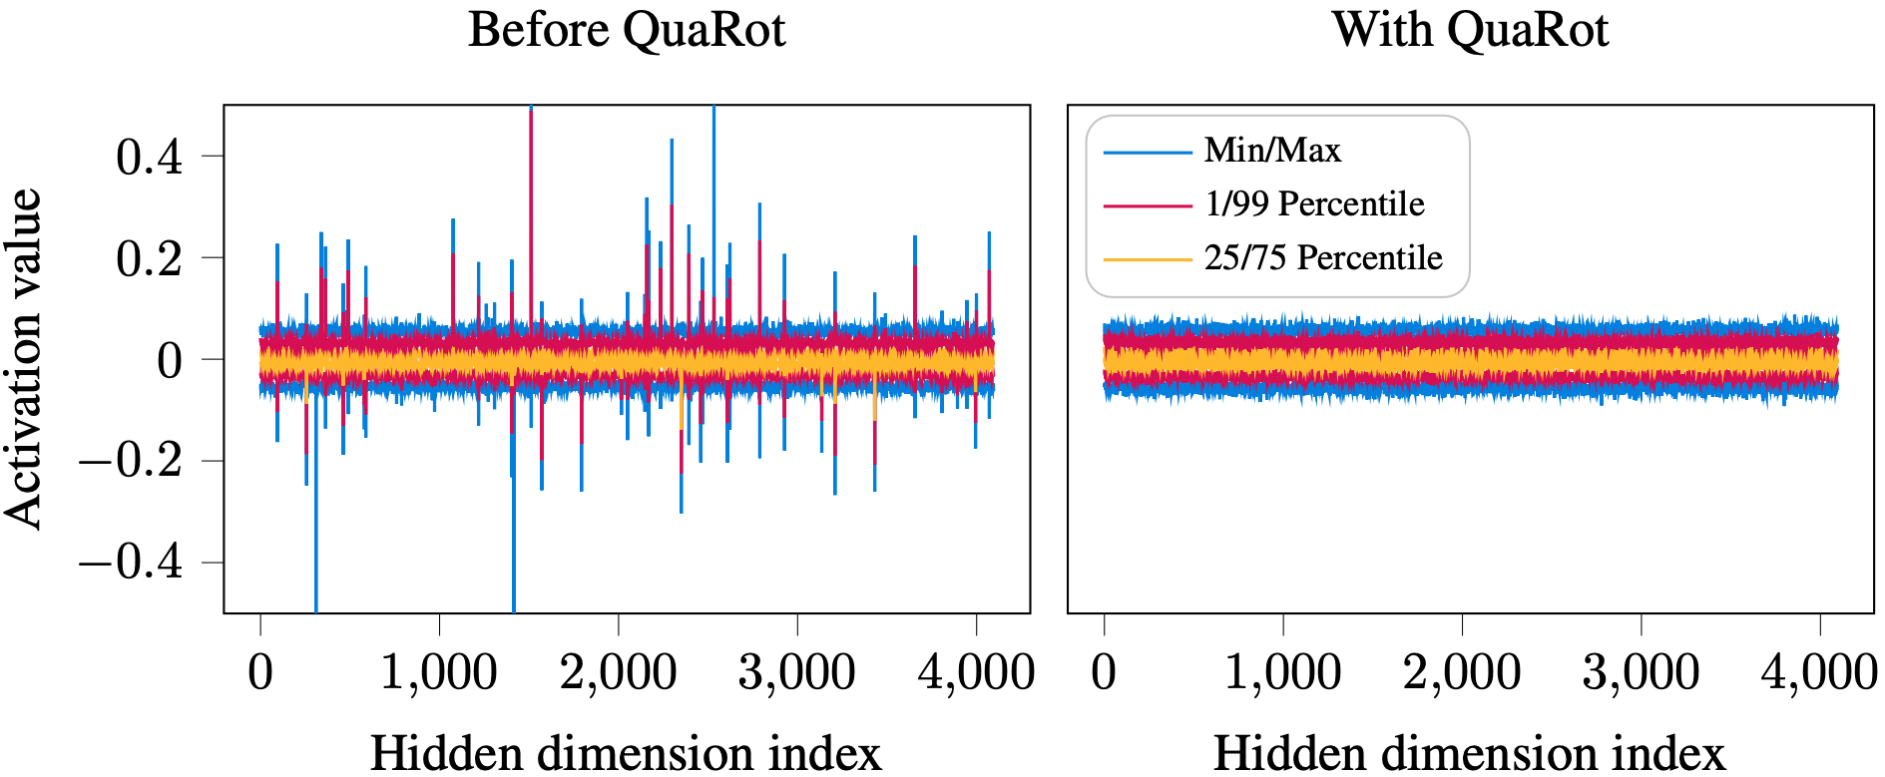
AUTO ROUND / 论文图
QuaRot：成对旋转，而不是单边处理异常值
作者原图 / INT4 工作；用于说明旋转思想，不是 MXFP4 或 XPU 新结果。
核心迁移原则：函数保持不变，量化误差才是优化对象。
来源 R05 · spcl/QuaRot@5008669 · Apache-2.0
研究与开发设计 | Intel XPU | 2026-11-05 | 非新功能实测
05
Notes:
QuaRot：成对旋转，而不是单边处理异常值
Unmodified author-released img/fig1.png, Apache-2.0. Caption/source license retained.
Evidence boundary: pinned author implementations, author-released figures/data and local source inspected. Direct arXiv full-text access failed. No new-feature model or XPU benchmark was run.
R05: QuaRot: Outlier-Free 4-Bit Inference in Rotated LLMs
Paper: https://arxiv.org/abs/2404.00456
Repository: spcl/QuaRot @ 5008669b08c1f11f9b64d52d16fddd47ca754c5a
README.md: https://github.com/spcl/QuaRot/blob/5008669b08c1f11f9b64d52d16fddd47ca754c5a/README.md
LICENSE: https://github.com/spcl/QuaRot/blob/5008669b08c1f11f9b64d52d16fddd47ca754c5a/LICENSE
img/fig1.png: https://github.com/spcl/QuaRot/blob/5008669b08c1f11f9b64d52d16fddd47ca754c5a/img/fig1.png

Slide 6
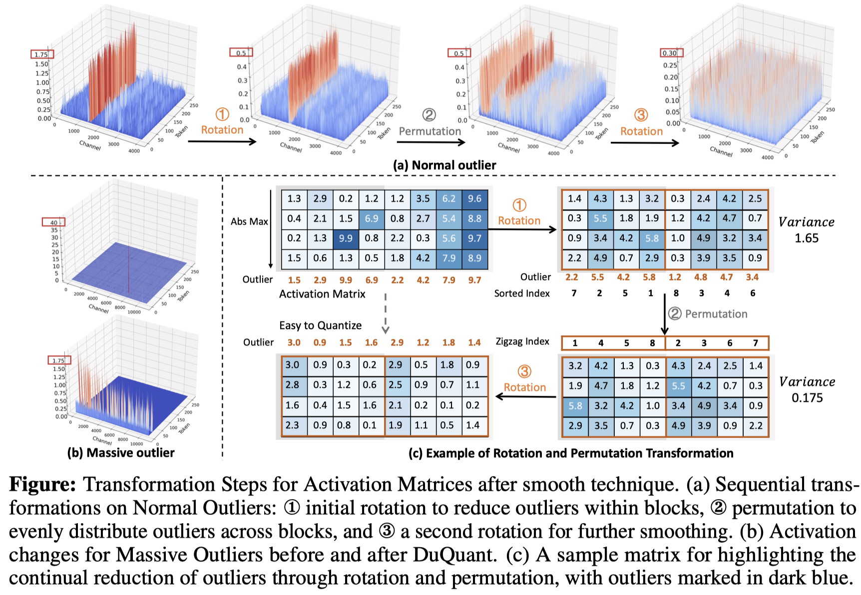
AUTO ROUND / 论文图
DuQuant：旋转 → 置换 → 再旋转
作者原图：先处理块内异常值，再平衡块间分布。不能据此认定随机 shuffle 一定有效。
两种分组目标
无 HMT：相近幅度聚集
有 HMT：测试异常值均摊
二者都用完整 QDQ 验证
更直接的 MXFP4 对照
DuQuant++（2026）
块长 32、细粒度旋转
额外尺度约定需重新对齐
来源 R03 · MIT；R04 为独立的后续 MXFP4 实现。
研究与开发设计 | Intel XPU | 2026-11-05 | 非新功能实测
06
Notes:
DuQuant：旋转 → 置换 → 再旋转
Unmodified DuQuant imgs/duquant.png under MIT. This is the original integer work, not DuQuant++ MXFP4 measurements.
Evidence boundary: pinned author implementations, author-released figures/data and local source inspected. Direct arXiv full-text access failed. No new-feature model or XPU benchmark was run.
R03: DuQuant: Distributing Outliers via Dual Transformation Makes Stronger Quantized LLMs
Paper: https://arxiv.org/abs/2406.01721
Repository: Hsu1023/DuQuant @ d56cfc6fe97c34c0eb100fec82fe439865905679
README.md: https://github.com/Hsu1023/DuQuant/blob/d56cfc6fe97c34c0eb100fec82fe439865905679/README.md
LICENSE: https://github.com/Hsu1023/DuQuant/blob/d56cfc6fe97c34c0eb100fec82fe439865905679/LICENSE
imgs/duquant.png: https://github.com/Hsu1023/DuQuant/blob/d56cfc6fe97c34c0eb100fec82fe439865905679/imgs/duquant.png
imgs/ppl.png: https://github.com/Hsu1023/DuQuant/blob/d56cfc6fe97c34c0eb100fec82fe439865905679/imgs/ppl.png
quantize/utils.py: https://github.com/Hsu1023/DuQuant/blob/d56cfc6fe97c34c0eb100fec82fe439865905679/quantize/utils.py
quantize/duquant.py: https://github.com/Hsu1023/DuQuant/blob/d56cfc6fe97c34c0eb100fec82fe439865905679/quantize/duquant.py
R04: DuQuant++: Fine-grained Rotation Enhances Microscaling FP4 Quantization
Paper: https://arxiv.org/abs/2604.17789
Repository: Hsu1023/DuQuant-v2 @ 6c13ec07a3241f2d4ad6415a06403aef43919db9
README.md: https://github.com/Hsu1023/DuQuant-v2/blob/6c13ec07a3241f2d4ad6415a06403aef43919db9/README.md
LICENSE: https://github.com/Hsu1023/DuQuant-v2/blob/6c13ec07a3241f2d4ad6415a06403aef43919db9/LICENSE
quantize/int_linear.py: https://github.com/Hsu1023/DuQuant-v2/blob/6c13ec07a3241f2d4ad6415a06403aef43919db9/quantize/int_linear.py
quantize/quantizer.py: https://github.com/Hsu1023/DuQuant-v2/blob/6c13ec07a3241f2d4ad6415a06403aef43919db9/quantize/quantizer.py
quantize/fp4_ops.py: https://github.com/Hsu1023/DuQuant-v2/blob/6c13ec07a3241f2d4ad6415a06403aef43919db9/quantize/fp4_ops.py

Slide 7
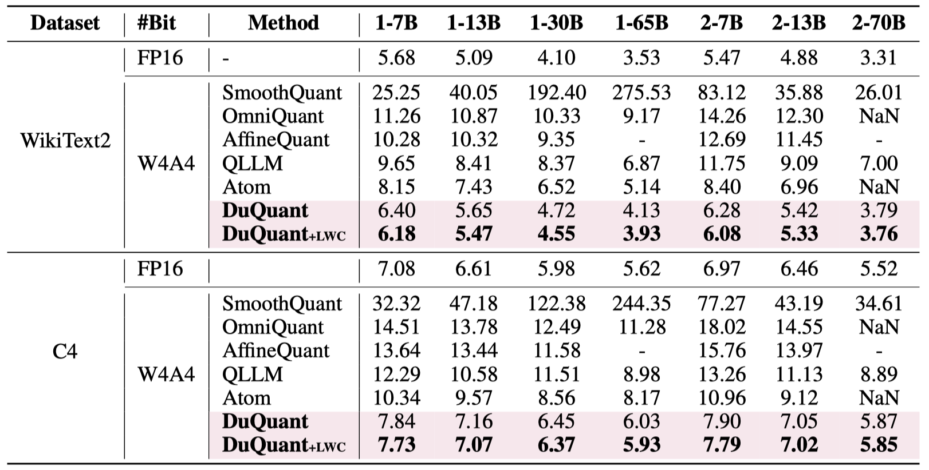
AUTO ROUND / 论文数据
DuQuant 的原始数据表：保留格式和上下文
W4A4 整数实验；1-* / 2-* 为 LLaMA-1 / LLaMA-2。PPL 越低越好。
怎样读这张表
比较同一模型和数据集
保留 NaN 与缺失值
不把 INT4 写成 MXFP4
不外推 Intel 加速比
来源 R03 · Hsu1023/DuQuant@d56cfc6 · MIT
研究与开发设计 | Intel XPU | 2026-11-05 | 非新功能实测
07
Notes:
DuQuant 的原始数据表：保留格式和上下文
Author-released imgs/ppl.png, MIT. NaNs and missing entries remain unchanged. No cross-paper fairness is inferred.
Evidence boundary: pinned author implementations, author-released figures/data and local source inspected. Direct arXiv full-text access failed. No new-feature model or XPU benchmark was run.
R03: DuQuant: Distributing Outliers via Dual Transformation Makes Stronger Quantized LLMs
Paper: https://arxiv.org/abs/2406.01721
Repository: Hsu1023/DuQuant @ d56cfc6fe97c34c0eb100fec82fe439865905679
README.md: https://github.com/Hsu1023/DuQuant/blob/d56cfc6fe97c34c0eb100fec82fe439865905679/README.md
LICENSE: https://github.com/Hsu1023/DuQuant/blob/d56cfc6fe97c34c0eb100fec82fe439865905679/LICENSE
imgs/duquant.png: https://github.com/Hsu1023/DuQuant/blob/d56cfc6fe97c34c0eb100fec82fe439865905679/imgs/duquant.png
imgs/ppl.png: https://github.com/Hsu1023/DuQuant/blob/d56cfc6fe97c34c0eb100fec82fe439865905679/imgs/ppl.png
quantize/utils.py: https://github.com/Hsu1023/DuQuant/blob/d56cfc6fe97c34c0eb100fec82fe439865905679/quantize/utils.py
quantize/duquant.py: https://github.com/Hsu1023/DuQuant/blob/d56cfc6fe97c34c0eb100fec82fe439865905679/quantize/duquant.py

Slide 8
AUTO ROUND / 现有实现
MicroMix：与 F2 最接近的直接先行实现
原创概念重绘，不复制该仓库图片/源码；固定核验 micromix 分支。
通道统计
比例与重排
混合 GEMM
静态收集激活
生成固定排序
按精度分成连续区
原实现含 4 / 6 / 8
W4A4 / W4A8 等
Blackwell 内核
核验到真实 MXFP8 激活 × MXFP4 权重；不应把高分支默认改成 W8A8。
原实现按 128 通道对齐比例；XPU 对齐需重新确定。
MVP 只做 4/8 两区，避免同时引入 FP6 的数值与部署复杂度。
研究与开发设计 | Intel XPU | 2026-11-05 | 非新功能实测
08
Notes:
MicroMix：与 F2 最接近的直接先行实现
Public source inspected, not redistributed. utilize.py sorts channels and allocates aligned ratios; w4a8.cu declares MXFP8 A and MXFP4 B on SM120.
Evidence boundary: pinned author implementations, author-released figures/data and local source inspected. Direct arXiv full-text access failed. No new-feature model or XPU benchmark was run.
R10: MicroMix: Efficient Mixed-Precision Quantization with Microscaling Formats for Large Language Models
Paper: https://arxiv.org/abs/2508.02343
Repository: lwy2020/MicroMix @ c57370bc38f999e1f75aada9c4b8a85baa44aaae
README.md: https://github.com/lwy2020/MicroMix/blob/c57370bc38f999e1f75aada9c4b8a85baa44aaae/README.md
utilize.py: https://github.com/lwy2020/MicroMix/blob/c57370bc38f999e1f75aada9c4b8a85baa44aaae/utilize.py
reorder_indices.py: https://github.com/lwy2020/MicroMix/blob/c57370bc38f999e1f75aada9c4b8a85baa44aaae/reorder_indices.py
mgemm/README.md: https://github.com/lwy2020/MicroMix/blob/c57370bc38f999e1f75aada9c4b8a85baa44aaae/mgemm/README.md
mgemm/src/w4a8.cu: https://github.com/lwy2020/MicroMix/blob/c57370bc38f999e1f75aada9c4b8a85baa44aaae/mgemm/src/w4a8.cu
mgemm/src/w4a4.cu: https://github.com/lwy2020/MicroMix/blob/c57370bc38f999e1f75aada9c4b8a85baa44aaae/mgemm/src/w4a4.cu

Slide 9
AUTO ROUND / 论文数据
直接的 MXFP4 证据：固定 HMT 仍有改进空间
WUSH 作者数据 · Llama-3.1-8B-Instruct · 13 个 Platinum 任务宏平均准确率（%）
作者方法 | 准确率 | 记录
BF16 | 85.33 | 1
RTN-H | 76.41 | 5
RTN-WUSH | 79.34 | 5
GPTQ-WUSH | 79.25 | 5
+2.93 个百分点
RTN-WUSH 相对 RTN-H
仍落后 BF16 5.99 点
记录数不等于独立种子
来源 R12 · 原始 CSV 随包提供 · 图表为可编辑 PowerPoint chart
研究与开发设计 | Intel XPU | 2026-11-05 | 非新功能实测
09
Notes:
直接的 MXFP4 证据：固定 HMT 仍有改进空间
Recomputed from author CSV: per-record 13-task mean, then method mean. RTN-WUSH 79.34116; H 76.41440; GPTQ-WUSH 79.25155; BF16 85.33235. No independent-seed inference.
Evidence boundary: pinned author implementations, author-released figures/data and local source inspected. Direct arXiv full-text access failed. No new-feature model or XPU benchmark was run.
R12: WUSH: Near-Optimal Adaptive Transforms for LLM Quantization
Paper: https://arxiv.org/abs/2512.00956
Repository: IST-DASLab/WUSH @ 0b69f66cb88aae673d63ae8b5fd96ac751c5a957
README.md: https://github.com/IST-DASLab/WUSH/blob/0b69f66cb88aae673d63ae8b5fd96ac751c5a957/README.md
LICENSE: https://github.com/IST-DASLab/WUSH/blob/0b69f66cb88aae673d63ae8b5fd96ac751c5a957/LICENSE
src/block_transform.py: https://github.com/IST-DASLab/WUSH/blob/0b69f66cb88aae673d63ae8b5fd96ac751c5a957/src/block_transform.py
plots/1_toy_example.pdf: https://github.com/IST-DASLab/WUSH/blob/0b69f66cb88aae673d63ae8b5fd96ac751c5a957/plots/1_toy_example.pdf
plots/2_speedup.pdf: https://github.com/IST-DASLab/WUSH/blob/0b69f66cb88aae673d63ae8b5fd96ac751c5a957/plots/2_speedup.pdf
plots/2_speedup.py: https://github.com/IST-DASLab/WUSH/blob/0b69f66cb88aae673d63ae8b5fd96ac751c5a957/plots/2_speedup.py
plots/5_visual.pdf: https://github.com/IST-DASLab/WUSH/blob/0b69f66cb88aae673d63ae8b5fd96ac751c5a957/plots/5_visual.pdf
plots/3_platinum_bench.csv: https://github.com/IST-DASLab/WUSH/blob/0b69f66cb88aae673d63ae8b5fd96ac751c5a957/plots/3_platinum_bench.csv
plots/3_platinum_bench.py: https://github.com/IST-DASLab/WUSH/blob/0b69f66cb88aae673d63ae8b5fd96ac751c5a957/plots/3_platinum_bench.py
plots/3_platinum_bench/10_llama-3.1-8b_table.pdf: https://github.com/IST-DASLab/WUSH/blob/0b69f66cb88aae673d63ae8b5fd96ac751c5a957/plots/3_platinum_bench/10_llama-3.1-8b_table.pdf

Slide 10
AUTO ROUND / 设计方案
格式不混淆：MXFP4、MXFP8、NVFP4
每个数字比较都要先对齐数值 profile。
格式 | 元素 | 共享尺度 | 本方案
MXFP4 | E2M1；最大幅值 6 | E8M0，32 元素 | 低区与默认全部权重
MXFP8 | 默认 E4M3；E5M2 可选 | E8M0，32 元素 | 高激活分区
NVFP4 | E2M1 | 不同块长与尺度约定 | 独立对照，不混报结果
MXFP4 幅值：0 · 0.5 · 1 · 1.5 · 2 · 3 · 4 · 6
ARK / core floor / rceil / CUDA HMT 并非完全同约定。
冻结舍入、零块、符号零、尺度、nibble 顺序；禁止校准与导出悄悄切换 profile。
研究与开发设计 | Intel XPU | 2026-11-05 | 非新功能实测
10
Notes:
格式不混淆：MXFP4、MXFP8、NVFP4
Evidence boundary: pinned author implementations, author-released figures/data and local source inspected. Direct arXiv full-text access failed. No new-feature model or XPU benchmark was run.
R01: Microscaling Data Formats for Deep Learning
Paper: https://arxiv.org/abs/2310.10537
Repository: microsoft/microxcaling @ 7bc41952de394f5cc5e782baf132e7c7542eb4e4
README.md: https://github.com/microsoft/microxcaling/blob/7bc41952de394f5cc5e782baf132e7c7542eb4e4/README.md
mx/formats.py: https://github.com/microsoft/microxcaling/blob/7bc41952de394f5cc5e782baf132e7c7542eb4e4/mx/formats.py
mx/mx_ops.py: https://github.com/microsoft/microxcaling/blob/7bc41952de394f5cc5e782baf132e7c7542eb4e4/mx/mx_ops.py
R04: DuQuant++: Fine-grained Rotation Enhances Microscaling FP4 Quantization
Paper: https://arxiv.org/abs/2604.17789
Repository: Hsu1023/DuQuant-v2 @ 6c13ec07a3241f2d4ad6415a06403aef43919db9
README.md: https://github.com/Hsu1023/DuQuant-v2/blob/6c13ec07a3241f2d4ad6415a06403aef43919db9/README.md
LICENSE: https://github.com/Hsu1023/DuQuant-v2/blob/6c13ec07a3241f2d4ad6415a06403aef43919db9/LICENSE
quantize/int_linear.py: https://github.com/Hsu1023/DuQuant-v2/blob/6c13ec07a3241f2d4ad6415a06403aef43919db9/quantize/int_linear.py
quantize/quantizer.py: https://github.com/Hsu1023/DuQuant-v2/blob/6c13ec07a3241f2d4ad6415a06403aef43919db9/quantize/quantizer.py
quantize/fp4_ops.py: https://github.com/Hsu1023/DuQuant-v2/blob/6c13ec07a3241f2d4ad6415a06403aef43919db9/quantize/fp4_ops.py
R11: Bridging the Gap Between Promise and Performance for Microscaling FP4 Quantization
Paper: https://arxiv.org/abs/2509.23202
Repository: IST-DASLab/FP-Quant @ d2e3092f968262c4de5fb050e1aef568a280dadd
README.md: https://github.com/IST-DASLab/FP-Quant/blob/d2e3092f968262c4de5fb050e1aef568a280dadd/README.md

Slide 11
AUTO ROUND / 设计方案
不变量：激活和权重列必须成对变换
约定 X[M,K]、W[N,K]，Y = X W^T + b。
X' = X[:, p] W' = W[:, p] X' (W')^T = X W^T
正交 HMT
一般可逆 T
R R^T = I
X' = X P R
W' = W P R
X' = X T
W' = W T⁻ᵀ
WUSH 不能套用两侧同乘 T
这是 K 轴重排，不是 token 路由；最终 N 维输出不需要逆置换。
研究与开发设计 | Intel XPU | 2026-11-05 | 非新功能实测
11
Notes:
不变量：激活和权重列必须成对变换
Evidence boundary: pinned author implementations, author-released figures/data and local source inspected. Direct arXiv full-text access failed. No new-feature model or XPU benchmark was run.

Slide 12
AUTO ROUND / 设计方案
F1：要优化跨块成员，而非“打乱”本身
没有跨量化块变化时，shuffle 应作为负对照，而不是收益来源。
原顺序（示意）
0.4
7.8
0.3
6.2
0.5
9.1
候选重排
0.3
0.4
0.5
6.2
7.8
9.1
无 HMT：测试幅度相近的分组
有 HMT：还要测试异常值均摊
按 RMS / 分位数 / log 幅度排序
权重列范数与量化残差共同打分
zigzag / 块交换 / 局部性约束
同样用完整 W4A4 输出损失验证
数值与小方块仅为原创示意；实际共享尺度块为 32 元素。
研究与开发设计 | Intel XPU | 2026-11-05 | 非新功能实测
12
Notes:
F1：要优化跨块成员，而非“打乱”本身
Evidence boundary: pinned author implementations, author-released figures/data and local source inspected. Direct arXiv full-text access failed. No new-feature model or XPU benchmark was run.

Slide 13
AUTO ROUND / 设计方案
F1 搜索：用重构损失，而不只用 amax
先廉价筛选，再短程 AutoRound；排列在调优期间固定。
候选 | 复杂度/目标 | 筛选原则
identity / random | 必须有的基线 | 固定种子；跨块与块内对照
RMS / 分位数排序 | O(K log K) | 幅度相近；加入权重敏感度
zigzag + HMT | 异常值跨旋转块均摊 | 与聚类路线直接对比
局部交换 | 限制 128/256/512 窗口 | 精度收益 + 实际 gather 成本
损失 = ||原层输出 − 完整 QDQ 层输出||² / (||原层输出||² + ε)
QKV / gate-up 等共享输入的消费者联合归一化打分，避免重复 gather。
研究与开发设计 | Intel XPU | 2026-11-05 | 非新功能实测
13
Notes:
F1 搜索：用重构损失，而不只用 amax
Evidence boundary: pinned author implementations, author-released figures/data and local source inspected. Direct arXiv full-text access failed. No new-feature model or XPU benchmark was run.

Slide 14
AUTO ROUND / 设计方案
grouped GEMM：M 轴 routing 与 K 轴 gather 分开
两种重排不要混为一种；保留 top-k 权重和最终 scatter 对应关系。
token × top-k
按 expert 排序
通道计划
grouped GEMM
原 token id
router 权重
M 轴 gather
生成专家区间
K 轴 gather
共享/专家计划
双分区累加
scatter/reduce
MVP：专家组共享计划；gate/up 共用预处理。
下一步：每专家 mask + 固定 K8 档位，按形状/profile/HMT 分桶。
down-proj 是每专家自己的中间激活，不能无条件复用 gate/up 计划。
研究与开发设计 | Intel XPU | 2026-11-05 | 非新功能实测
14
Notes:
grouped GEMM：M 轴 routing 与 K 轴 gather 分开
Evidence boundary: pinned author implementations, author-released figures/data and local source inspected. Direct arXiv full-text access failed. No new-feature model or XPU benchmark was run.

Slide 15
AUTO ROUND / 设计方案
F2：一遍 gather，两段连续输入，沿 K 求和
默认是低区 W4A4 + 高区 W4A8；不是两个完整 K 的 GEMM。
X[:,S4] → Q4
× Q4(W[:,S4])ᵀ
X[M,K]
求和 + b
X[:,S8] → Q8
× Q4(W[:,S8])ᵀ
S4 ∩ S8 = ∅，S4 ∪ S8 = 全部 K；bias 只加一次。
研究与开发设计 | Intel XPU | 2026-11-05 | 非新功能实测
15
Notes:
F2：一遍 gather，两段连续输入，沿 K 求和
Evidence boundary: pinned author implementations, author-released figures/data and local source inspected. Direct arXiv full-text access failed. No new-feature model or XPU benchmark was run.

Slide 16
AUTO ROUND / 设计方案
高分支有三种语义，必须分开报告
权重存储格式、实际操作数格式、量化精度不是同一个概念。
方案 | 高区权重 | 解释
默认 W4A8 | 原始权重 → MXFP4 | 只提高激活精度；严格对应需求
W4 码展开为 W8 操作数 | E2M1 → E4M3 无损码转换 | 权重数值不变；运行时缓存可能增大
可选 W8A8 | 原始权重 → MXFP8 | 权重量化也升级；额外预算、单独消融
E2M1 的有限值可被 E4M3 精确表示，但尺度布局与设备数值仍需验证。
若不支持 A8W4：显式选择无损展开或解码路径。
不允许把 INT4/INT8 内核改名后当作 MXFP4/MXFP8。
研究与开发设计 | Intel XPU | 2026-11-05 | 非新功能实测
16
Notes:
高分支有三种语义，必须分开报告
Evidence boundary: pinned author implementations, author-released figures/data and local source inspected. Direct arXiv full-text access failed. No new-feature model or XPU benchmark was run.
R10: MicroMix: Efficient Mixed-Precision Quantization with Microscaling Formats for Large Language Models
Paper: https://arxiv.org/abs/2508.02343
Repository: lwy2020/MicroMix @ c57370bc38f999e1f75aada9c4b8a85baa44aaae
README.md: https://github.com/lwy2020/MicroMix/blob/c57370bc38f999e1f75aada9c4b8a85baa44aaae/README.md
utilize.py: https://github.com/lwy2020/MicroMix/blob/c57370bc38f999e1f75aada9c4b8a85baa44aaae/utilize.py
reorder_indices.py: https://github.com/lwy2020/MicroMix/blob/c57370bc38f999e1f75aada9c4b8a85baa44aaae/reorder_indices.py
mgemm/README.md: https://github.com/lwy2020/MicroMix/blob/c57370bc38f999e1f75aada9c4b8a85baa44aaae/mgemm/README.md
mgemm/src/w4a8.cu: https://github.com/lwy2020/MicroMix/blob/c57370bc38f999e1f75aada9c4b8a85baa44aaae/mgemm/src/w4a8.cu
mgemm/src/w4a4.cu: https://github.com/lwy2020/MicroMix/blob/c57370bc38f999e1f75aada9c4b8a85baa44aaae/mgemm/src/w4a4.cu

Slide 17
AUTO ROUND / 设计方案
给谁 A8：量化误差增益优先，幅度只是代理
移动通道会改变整个共享尺度块，通道收益并不天然可加。
廉价候选分数
必须真实复算
再做预算选择
RMS × 权重列范数
高分位 / 尾部频次
A4→A8 的误差改善
重新 gather 与分组
两区全部尺度重算
计算完整层输出误差
边界通道交换
固定实际 K8 比较
全模型收益/成本分配
s[j] ≈ ||Q4(W)[:,j]||² × E[err4(xj)² − err8(xj)²]
仅是固定尺度/分组下的筛选代理；最终选择由完整分区 QDQ 决定。
研究与开发设计 | Intel XPU | 2026-11-05 | 非新功能实测
17
Notes:
给谁 A8：量化误差增益优先，幅度只是代理
Evidence boundary: pinned author implementations, author-released figures/data and local source inspected. Direct arXiv full-text access failed. No new-feature model or XPU benchmark was run.

Slide 18
AUTO ROUND / 设计方案
小比例不是连续旋钮：对齐决定真实预算
理论 activation payload，未计 padding、索引、布局、展开缓存；不是性能实测。
K | 目标 | K8 | 实际
768 | 1% | 32 | 4.17%
2048 | 1% | 32 | 1.56%
4096 | 1% | 64 | 1.56%
4096 | 5% | 224 | 5.47%
4.25 + 4ρ bit / activation 元素
6.25% A8 → 4.50 bit，payload +5.88%。
默认不增加 checkpoint 权重位宽。
研究与开发设计 | Intel XPU | 2026-11-05 | 非新功能实测
18
Notes:
小比例不是连续旋钮：对齐决定真实预算
Evidence boundary: pinned author implementations, author-released figures/data and local source inspected. Direct arXiv full-text access failed. No new-feature model or XPU benchmark was run.

Slide 19
AUTO ROUND / 设计方案
HMT 组合：先明确 mask 属于哪个坐标基
推荐从 H1 开始；PR 与 RP 一般不相等。
方案 | 顺序 | 风险/作用
H0 | 分区 → A4/A8，无 HMT | 分离两个功能自身收益
H1 / 推荐 | 原坐标选高区 → 分区 → 仅低区 HMT | 高敏感通道不被混回低区
H2 | 全输入 HMT → 重新校准选通道 | 旧坐标 mask 无效
H3 | 分区 → 两区独立 HMT | 高区小 K 的 padding/开销
H4 | 旋转 → zigzag → 再旋转 | DuQuant 风格；两次变换不免费
先比较 H32 / 随机符号 H32，再扩至 128/256/512；MX 量化 group 始终 32。
研究与开发设计 | Intel XPU | 2026-11-05 | 非新功能实测
19
Notes:
HMT 组合：先明确 mask 属于哪个坐标基
Evidence boundary: pinned author implementations, author-released figures/data and local source inspected. Direct arXiv full-text access failed. No new-feature model or XPU benchmark was run.

Slide 20
AUTO ROUND / 设计方案
统一搜索：离散计划与 AutoRound 交替优化
恢复/重建调优状态，避免旧排列的梯度、尺度与统计被误用。
01
02
03
04
统计与候选
分区与 HMT
短程调优
成本选择
路由加权统计
identity / 聚类 / zigzag
在正确坐标选 S8
重算尺度与完整 QDQ
前 2–4 名跑 AutoRound
独立选型集重排
实测 XPU 成本 Pareto
冻结计划、最终调优
J = 重构损失 + λ × 完整实测延迟 + μ × 驻留字节
研究与开发设计 | Intel XPU | 2026-11-05 | 非新功能实测
20
Notes:
统一搜索：离散计划与 AutoRound 交替优化
Evidence boundary: pinned author implementations, author-released figures/data and local source inspected. Direct arXiv full-text access failed. No new-feature model or XPU benchmark was run.

Slide 21
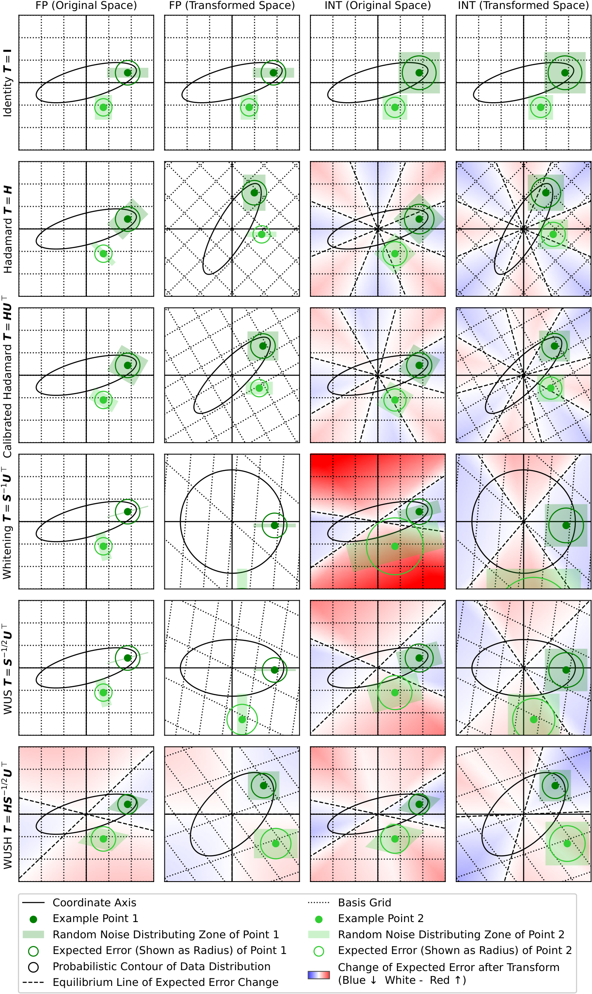
AUTO ROUND / 论文图 / 探索
进阶方向：从固定 HMT 到数据感知变换
WUSH 作者原图：不是所有最优候选都是正交旋转。
为什么值得比较
同时利用权重与激活二阶统计
固定 Hadamard 不一定最优
但理论假设不等于任务保证
为什么不作为首期默认
非正交变换需 W T⁻ᵀ 补偿
稠密小矩阵与尺度成本要实测
与可学习旋转按真实成本对齐
来源 R12 · Apache-2.0 · 左图可放大阅读，解释为本报告原创。
研究与开发设计 | Intel XPU | 2026-11-05 | 非新功能实测
21
Notes:
进阶方向：从固定 HMT 到数据感知变换
Author figure plots/1_toy_example.pdf rasterized without modifying labels/data, Apache-2.0. Theoretical assumptions do not establish this task's optimality.
Evidence boundary: pinned author implementations, author-released figures/data and local source inspected. Direct arXiv full-text access failed. No new-feature model or XPU benchmark was run.
R12: WUSH: Near-Optimal Adaptive Transforms for LLM Quantization
Paper: https://arxiv.org/abs/2512.00956
Repository: IST-DASLab/WUSH @ 0b69f66cb88aae673d63ae8b5fd96ac751c5a957
README.md: https://github.com/IST-DASLab/WUSH/blob/0b69f66cb88aae673d63ae8b5fd96ac751c5a957/README.md
LICENSE: https://github.com/IST-DASLab/WUSH/blob/0b69f66cb88aae673d63ae8b5fd96ac751c5a957/LICENSE
src/block_transform.py: https://github.com/IST-DASLab/WUSH/blob/0b69f66cb88aae673d63ae8b5fd96ac751c5a957/src/block_transform.py
plots/1_toy_example.pdf: https://github.com/IST-DASLab/WUSH/blob/0b69f66cb88aae673d63ae8b5fd96ac751c5a957/plots/1_toy_example.pdf
plots/2_speedup.pdf: https://github.com/IST-DASLab/WUSH/blob/0b69f66cb88aae673d63ae8b5fd96ac751c5a957/plots/2_speedup.pdf
plots/2_speedup.py: https://github.com/IST-DASLab/WUSH/blob/0b69f66cb88aae673d63ae8b5fd96ac751c5a957/plots/2_speedup.py
plots/5_visual.pdf: https://github.com/IST-DASLab/WUSH/blob/0b69f66cb88aae673d63ae8b5fd96ac751c5a957/plots/5_visual.pdf
plots/3_platinum_bench.csv: https://github.com/IST-DASLab/WUSH/blob/0b69f66cb88aae673d63ae8b5fd96ac751c5a957/plots/3_platinum_bench.csv
plots/3_platinum_bench.py: https://github.com/IST-DASLab/WUSH/blob/0b69f66cb88aae673d63ae8b5fd96ac751c5a957/plots/3_platinum_bench.py
plots/3_platinum_bench/10_llama-3.1-8b_table.pdf: https://github.com/IST-DASLab/WUSH/blob/0b69f66cb88aae673d63ae8b5fd96ac751c5a957/plots/3_platinum_bench/10_llama-3.1-8b_table.pdf
R06: SpinQuant: LLM Quantization with Learned Rotations
Paper: https://arxiv.org/abs/2405.16406
Repository: facebookresearch/SpinQuant @ 8f47aa3f00e8662caf1a484153920a07e5281c3a
README.md: https://github.com/facebookresearch/SpinQuant/blob/8f47aa3f00e8662caf1a484153920a07e5281c3a/README.md
LICENSE: https://github.com/facebookresearch/SpinQuant/blob/8f47aa3f00e8662caf1a484153920a07e5281c3a/LICENSE

Slide 22
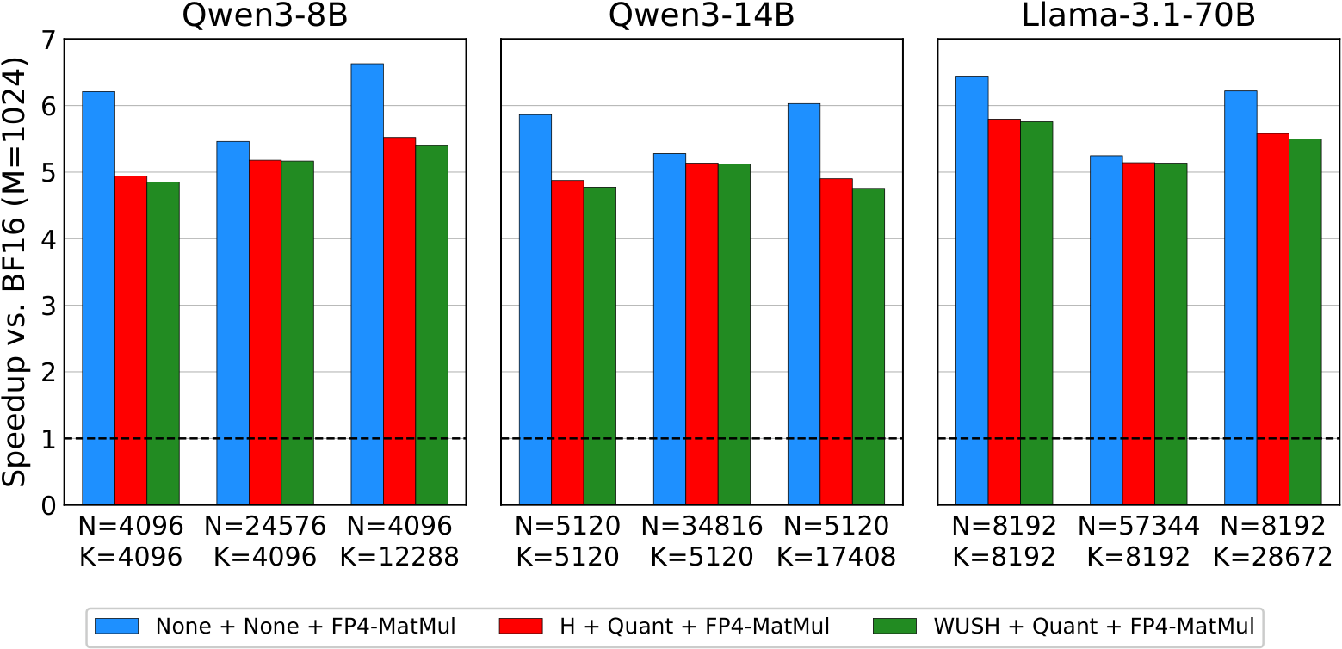
AUTO ROUND / 论文图 / 证据边界
论文速度图能说明什么，不能说明什么
WUSH 作者图 2：M=1024，逐层相对 BF16；不是端到端或 Intel 数据。
变换与量化开销必须计入，但仍可能保留部分内核收益。
图/绘图脚本未明确 GPU 型号，不据此做跨硬件比较。来源 R12 · Apache-2.0。
研究与开发设计 | Intel XPU | 2026-11-05 | 非新功能实测
22
Notes:
论文速度图能说明什么，不能说明什么
Author plots/2_speedup.pdf and plotting arrays inspected. Device model is not established by this figure/script; do not infer it from supported-backend lists.
Evidence boundary: pinned author implementations, author-released figures/data and local source inspected. Direct arXiv full-text access failed. No new-feature model or XPU benchmark was run.
R12: WUSH: Near-Optimal Adaptive Transforms for LLM Quantization
Paper: https://arxiv.org/abs/2512.00956
Repository: IST-DASLab/WUSH @ 0b69f66cb88aae673d63ae8b5fd96ac751c5a957
README.md: https://github.com/IST-DASLab/WUSH/blob/0b69f66cb88aae673d63ae8b5fd96ac751c5a957/README.md
LICENSE: https://github.com/IST-DASLab/WUSH/blob/0b69f66cb88aae673d63ae8b5fd96ac751c5a957/LICENSE
src/block_transform.py: https://github.com/IST-DASLab/WUSH/blob/0b69f66cb88aae673d63ae8b5fd96ac751c5a957/src/block_transform.py
plots/1_toy_example.pdf: https://github.com/IST-DASLab/WUSH/blob/0b69f66cb88aae673d63ae8b5fd96ac751c5a957/plots/1_toy_example.pdf
plots/2_speedup.pdf: https://github.com/IST-DASLab/WUSH/blob/0b69f66cb88aae673d63ae8b5fd96ac751c5a957/plots/2_speedup.pdf
plots/2_speedup.py: https://github.com/IST-DASLab/WUSH/blob/0b69f66cb88aae673d63ae8b5fd96ac751c5a957/plots/2_speedup.py
plots/5_visual.pdf: https://github.com/IST-DASLab/WUSH/blob/0b69f66cb88aae673d63ae8b5fd96ac751c5a957/plots/5_visual.pdf
plots/3_platinum_bench.csv: https://github.com/IST-DASLab/WUSH/blob/0b69f66cb88aae673d63ae8b5fd96ac751c5a957/plots/3_platinum_bench.csv
plots/3_platinum_bench.py: https://github.com/IST-DASLab/WUSH/blob/0b69f66cb88aae673d63ae8b5fd96ac751c5a957/plots/3_platinum_bench.py
plots/3_platinum_bench/10_llama-3.1-8b_table.pdf: https://github.com/IST-DASLab/WUSH/blob/0b69f66cb88aae673d63ae8b5fd96ac751c5a957/plots/3_platinum_bench/10_llama-3.1-8b_table.pdf

Slide 23
AUTO ROUND / 设计方案
AutoRound 落点：复用已有机制，不另起一套
基线 5db1082；新的计划是前处理/量化包装层，不是新 scalar dtype。
层 | 现有机制 | 拟开发增量
方案与数值 | schemes.py；data_type/mxfp.py | 显式计划 schema；复用 4/8 QDQ
组合与校准 | composer；BasePreprocessor | 计划冻结、参考失效、坐标统计
调优与 grouped | wrapper；grouped_experts.py | 分区 QDQ、梯度、计划签名/分桶
XPU 内核 | ARK HMT + MXFP4 原语 | gather / sign / 双区输出 + GEMM 消费
保存与推理 | qlinear_fp；formats；backend | 两区 packed buffers、版本化重载
开关默认关闭；旧模型、旧 preset、旧导出结果保持不变。
研究与开发设计 | Intel XPU | 2026-11-05 | 非新功能实测
23
Notes:
AutoRound 落点：复用已有机制，不另起一套
Evidence boundary: pinned author implementations, author-released figures/data and local source inspected. Direct arXiv full-text access failed. No new-feature model or XPU benchmark was run.

Slide 24
AUTO ROUND / 设计方案
三个真实缺口：hook、packed 消费者、后端能力
代码存在，不等于已经自动进入模型推理路径。
grouped 的 hook 限制
已有 HMT 原语
现有 W4A8 并非 MX
现有在线变换 hook 会退出
部分 grouped 快速路径。
需显式计划阶段，而非只挂 hook。
XPU 原语产出 packed FP4
但不证明已接入 dense / MoE
MXFP4 activation GEMM。
ARK 路径是 INT4 存储
加 INT8 DPAS 计算；
部分 FP8 代码待硬件验证。
把实际分派路径、fallback 原因、workspace 与代码版本纳入 benchmark 记录。
研究与开发设计 | Intel XPU | 2026-11-05 | 非新功能实测
24
Notes:
三个真实缺口：hook、packed 消费者、后端能力
Evidence boundary: pinned author implementations, author-released figures/data and local source inspected. Direct arXiv full-text access failed. No new-feature model or XPU benchmark was run.

Slide 25
AUTO ROUND / XPU 实现
Intel XPU：按代际核验原生计算，而不是按名称猜测
oneDNN 固定主分支提交 4149450；不是用户已安装版本的保证。
架构 | FP8 | FP4 E2M1
Xe-HPC | 转换 | 转换
Xe2-HPG | 转换 | 转换
Xe3-LPG | 转换 | 转换
Xe3p-LPG | 原生 | 转换
Xe3p-XPC | 原生 | 原生
还必须实际创建 primitive：A8W4？块尺度布局？grouped / ragged？
记录 GPU id / 驱动 / oneAPI / oneDNN / ARK 版本；unimplemented 显式失败。
研究与开发设计 | Intel XPU | 2026-11-05 | 非新功能实测
25
Notes:
Intel XPU：按代际核验原生计算，而不是按名称猜测
Datatype table marks native compute vs conversion. Native datatype support does not guarantee mixed A8W4, E8M0 scale layouts, or ragged grouped GEMM.
Evidence boundary: pinned author implementations, author-released figures/data and local source inspected. Direct arXiv full-text access failed. No new-feature model or XPU benchmark was run.
R13: oneDNN datatype hardware limitations and MXFP8 matmul tutorial
Paper: Documentation
Repository: uxlfoundation/oneDNN @ 41494503bcbd60a761c0965ecb8ed6e57922974b
doc/common_concepts/data_types.md: https://github.com/uxlfoundation/oneDNN/blob/41494503bcbd60a761c0965ecb8ed6e57922974b/doc/common_concepts/data_types.md
examples/tutorials/matmul/mxfp_matmul.cpp: https://github.com/uxlfoundation/oneDNN/blob/41494503bcbd60a761c0965ecb8ed6e57922974b/examples/tutorials/matmul/mxfp_matmul.cpp

Slide 26
AUTO ROUND / XPU 实现
内核路线：参考、解码融合、能力通过后的原生
同一 packed ABI 与同一数值契约，三种执行层次。
层次 | 实现 | 收益/限制
Reference | FP32 变换 + QDQ；拼接后高精度 GEMM | 定义正确性；不能用其推理时间代表低位内核
转换计算设备 | load 解码 FP4/FP8；组尺度；FP16/BF16 DPAS | 减少存储和完整解码 workspace；不宣称原生 FP4 算力
原生设备 | 支持的 block-scaled 算子；双分支或融合累加 | 每个 operand/shape/profile 都需能力验证
融合目标：routing + gather + sign + HMT + quantize + pack
研究与开发设计 | Intel XPU | 2026-11-05 | 非新功能实测
26
Notes:
内核路线：参考、解码融合、能力通过后的原生
Evidence boundary: pinned author implementations, author-released figures/data and local source inspected. Direct arXiv full-text access failed. No new-feature model or XPU benchmark was run.

Slide 27
AUTO ROUND / 设计方案
持久化：一份版本化计划贯穿校准、调优、推理
拟议 schema，不是当前可调用 API；不把未知字段塞入会过滤字段的 from_dict。
元数据 | 张量 buffers | 加载校验
version / profile / transform_order | 实际 permutation、sign | 维度、排列完整性、哈希
mask_basis / logical K / padded K4,K8 | 两区 packed 权重 + E8M0 尺度 | 分区不重叠、覆盖 K、组边界
共享计划关系 / 已变换权重标记 | 可选无损展开缓存不当作原权重 | 应用一次；不重复旋转
save → shard/offload → load → generate 都必须保留同一计划。
safetensors buffers；旧 checkpoint 兼容；TP 首期仅 rank-local K 置换。
不支持的 backend 明确报错，只有显式允许时才做带日志的 reference 回退。
研究与开发设计 | Intel XPU | 2026-11-05 | 非新功能实测
27
Notes:
持久化：一份版本化计划贯穿校准、调优、推理
Evidence boundary: pinned author implementations, author-released figures/data and local source inspected. Direct arXiv full-text access failed. No new-feature model or XPU benchmark was run.

Slide 28
AUTO ROUND / 设计方案
正确性：先查不变量，再查编码，最后查网络
不同累加顺序不强求字节相同；匹配 profile 的 packed 编码应严格一致。
层级 | 关键测试
数学 | 配对置换、正交/逆转置、只变一侧负测试、归一化因子
编码 | tie、全零/负零、极值/次正规、NaN/Inf、E8M0 保留值
分区 | 空/全 S8、尾块、重复/越界索引拒绝、bias 一次、padding 保留
grouped | 空专家、热点、top-k scatter、共享/独立计划、签名/fallback
生命周期 | 梯度/STE、quantize-save-load、即时 shard、meta/offload、旧模型
禁用开关时行为不变；不把随机模型的小规模通过当作真实模型精度结论。
研究与开发设计 | Intel XPU | 2026-11-05 | 非新功能实测
28
Notes:
正确性：先查不变量，再查编码，最后查网络
Evidence boundary: pinned author implementations, author-released figures/data and local source inspected. Direct arXiv full-text access failed. No new-feature model or XPU benchmark was run.

Slide 29
AUTO ROUND / 设计方案
实验：公平预算，独立数据，真实 MoE 负载
tiny → dense → MoE；覆盖 prefill 与 decode，而不只测大 M GEMM。
维度 | 推荐矩阵
基线 | BF16；原 MXFP4 RTN / AutoRound；F1、F2、组合，各自 ±HMT
预算 | 相同实际 K8、全部 W4、同校准量/调优轮数；W8 高区单列
形状 | M=1/8/32/128/1024；K=768/2048/4096/11008 等真实投影
MoE | E=8/64/128，top-k=2/8；均衡、长尾、空专家、热点
泛化 | 校准/选型/最终评测分离；代码数学、长上下文、分布外；≥3 种子
记录路由覆盖；强制覆盖样本不能悄悄替代真实 token 权重。
研究与开发设计 | Intel XPU | 2026-11-05 | 非新功能实测
29
Notes:
实验：公平预算，独立数据，真实 MoE 负载
Evidence boundary: pinned author implementations, author-released figures/data and local source inspected. Direct arXiv full-text access failed. No new-feature model or XPU benchmark was run.

Slide 30
AUTO ROUND / 验收设计
建议门槛：是研发目标，不是已经取得的结果
明确区分质量研究成功与硬件算术加速成立。
质量门槛 / 建议
工程门槛 / 建议
2 dense + 1 MoE
选型集中位层误差下降 ≥20%
最终任务/PPL 无实质回退
至少一项实际改善
先测试 K8≤6.25% 档
完整投影延迟 ≤1.10× 基线
记录峰值/驻留显存
整模型 Pareto 决策
总延迟 = routing + gather + HMT + 量化 + 两分支 GEMM + 求和 + scatter
同机、同预算、预热后中位数/p95；kernel / block / TTFT / TPOT 分开报告。
研究与开发设计 | Intel XPU | 2026-11-05 | 非新功能实测
30
Notes:
建议门槛：是研发目标，不是已经取得的结果
Evidence boundary: pinned author implementations, author-released figures/data and local source inspected. Direct arXiv full-text access failed. No new-feature model or XPU benchmark was run.

Slide 31
AUTO ROUND / 探索路线
探索优先级：先解决四个可证伪的问题
后续的学习旋转、动态 mask 和 MXFP6，都应受真实成本约束。
优先级 | 方向 | 可证伪问题
P0 | 误差增益选 A8 | 相同 K8 下，是否胜过只按最大幅度？
P0 | HMT + A8 | 互补还是替代？能否降低必要 A8 预算？
P0 | 局部性约束置换 | 能否保留精度，同时减少随机 gather 损失？
P0 | MoE 共享/专家计划 | 独立计划收益是否覆盖 top-k 重复处理？
P1 | 指数边界、全模型预算、WUSH/SpinQuant | 同成本下是否更好？正确补偿是否可部署？
P2 | 动态 mask、W8/低秩旁路、MXFP6 | 额外精度与额外成本能否单独归因？
研究与开发设计 | Intel XPU | 2026-11-05 | 非新功能实测
31
Notes:
探索优先级：先解决四个可证伪的问题
Evidence boundary: pinned author implementations, author-released figures/data and local source inspected. Direct arXiv full-text access failed. No new-feature model or XPU benchmark was run.

Slide 32
AUTO ROUND / 开发计划
开发里程碑：数值、dense、grouped、持久化闭环
人日是工程估算，不是排期承诺；算法/内核工程师可部分并行。
阶段 | 交付物 | 依赖 | 估算
M0 | 设备能力 / profile / packed ABI / baseline | 实际 XPU | 2–3 人日
M1 | CPU reference / F1-F2 dense / 负对照 | M0 | 4–6
M2 | HMT / 搜索 / AutoRound wrapper | M1 | 5–8
M3 | XPU 前处理融合 / dense 双分支 | M0/M1；HMT 需 M2 | 6–10
M4 | 专家共享计划 / 分桶 / decode | M2/M3 | 6–10
M5 | 导出重载 / shard-TP / 完整评测 | M2/M3；MoE 需 M4 | 5–8
研究与开发设计 | Intel XPU | 2026-11-05 | 非新功能实测
32
Notes:
开发里程碑：数值、dense、grouped、持久化闭环
Evidence boundary: pinned author implementations, author-released figures/data and local source inspected. Direct arXiv full-text access failed. No new-feature model or XPU benchmark was run.

Slide 33
AUTO ROUND / 推荐决策
最终决策：用 Pareto 证据，而不是单项宣传
不把“更准”“更小”“更快”当作同一个结论。
先做 M0 / M1，再决定值得投入哪条内核路线。
保留：同预算下真实精度改善的静态计划。
推进：完整成本受控、能导出重载的 XPU 路径。
停用：校准集好看但泛化变差、或 gather 成本失控的候选。
核心贡献：AutoRound × 通道预算 × HMT × Intel XPU / MoE
研究与开发设计 | Intel XPU | 2026-11-05 | 非新功能实测
33
Notes:
最终决策：用 Pareto 证据，而不是单项宣传
Evidence boundary: pinned author implementations, author-released figures/data and local source inspected. Direct arXiv full-text access failed. No new-feature model or XPU benchmark was run.

Slide 34
AUTO ROUND / 参考与许可
参考来源 1/2：论文入口与固定实现版本
完整作者标题、URL、文件 SHA256、许可和证据说明见 evidence.json 及逐页备注。
ID | 工作/资料 | 论文编号 | 核验提交
R01 | Microscaling / OCP MX | 2310.10537 | 7bc4195
R02 | RPTQ | 2304.01089 | 9619069
R03 | DuQuant | 2406.01721 | d56cfc6
R04 | DuQuant++ | 2604.17789 | 6c13ec0
R05 | QuaRot | 2404.00456 | 5008669
R06 | SpinQuant | 2405.16406 | 8f47aa3
R07 | LLM.int8() / bitsandbytes | 2208.07339 | a616886
图像仅复用明确 MIT / Apache 作者资产；MicroMix / Atom / SpinQuant 不复制插图。
研究与开发设计 | Intel XPU | 2026-11-05 | 非新功能实测
34
Notes:
参考来源 1/2：论文入口与固定实现版本
Evidence boundary: pinned author implementations, author-released figures/data and local source inspected. Direct arXiv full-text access failed. No new-feature model or XPU benchmark was run.
R01: Microscaling Data Formats for Deep Learning
Paper: https://arxiv.org/abs/2310.10537
Repository: microsoft/microxcaling @ 7bc41952de394f5cc5e782baf132e7c7542eb4e4
README.md: https://github.com/microsoft/microxcaling/blob/7bc41952de394f5cc5e782baf132e7c7542eb4e4/README.md
mx/formats.py: https://github.com/microsoft/microxcaling/blob/7bc41952de394f5cc5e782baf132e7c7542eb4e4/mx/formats.py
mx/mx_ops.py: https://github.com/microsoft/microxcaling/blob/7bc41952de394f5cc5e782baf132e7c7542eb4e4/mx/mx_ops.py
R02: RPTQ: Reorder-based Post-training Quantization for Large Language Models
Paper: https://arxiv.org/abs/2304.01089
Repository: hahnyuan/RPTQ4LLM @ 96190691f02be6b27ba24d5a73574dbf9a8336c6
README.md: https://github.com/hahnyuan/RPTQ4LLM/blob/96190691f02be6b27ba24d5a73574dbf9a8336c6/README.md
LICENSE: https://github.com/hahnyuan/RPTQ4LLM/blob/96190691f02be6b27ba24d5a73574dbf9a8336c6/LICENSE
quantize/reorder_utils.py: https://github.com/hahnyuan/RPTQ4LLM/blob/96190691f02be6b27ba24d5a73574dbf9a8336c6/quantize/reorder_utils.py
R03: DuQuant: Distributing Outliers via Dual Transformation Makes Stronger Quantized LLMs
Paper: https://arxiv.org/abs/2406.01721
Repository: Hsu1023/DuQuant @ d56cfc6fe97c34c0eb100fec82fe439865905679
README.md: https://github.com/Hsu1023/DuQuant/blob/d56cfc6fe97c34c0eb100fec82fe439865905679/README.md
LICENSE: https://github.com/Hsu1023/DuQuant/blob/d56cfc6fe97c34c0eb100fec82fe439865905679/LICENSE
imgs/duquant.png: https://github.com/Hsu1023/DuQuant/blob/d56cfc6fe97c34c0eb100fec82fe439865905679/imgs/duquant.png
imgs/ppl.png: https://github.com/Hsu1023/DuQuant/blob/d56cfc6fe97c34c0eb100fec82fe439865905679/imgs/ppl.png
quantize/utils.py: https://github.com/Hsu1023/DuQuant/blob/d56cfc6fe97c34c0eb100fec82fe439865905679/quantize/utils.py
quantize/duquant.py: https://github.com/Hsu1023/DuQuant/blob/d56cfc6fe97c34c0eb100fec82fe439865905679/quantize/duquant.py
R04: DuQuant++: Fine-grained Rotation Enhances Microscaling FP4 Quantization
Paper: https://arxiv.org/abs/2604.17789
Repository: Hsu1023/DuQuant-v2 @ 6c13ec07a3241f2d4ad6415a06403aef43919db9
README.md: https://github.com/Hsu1023/DuQuant-v2/blob/6c13ec07a3241f2d4ad6415a06403aef43919db9/README.md
LICENSE: https://github.com/Hsu1023/DuQuant-v2/blob/6c13ec07a3241f2d4ad6415a06403aef43919db9/LICENSE
quantize/int_linear.py: https://github.com/Hsu1023/DuQuant-v2/blob/6c13ec07a3241f2d4ad6415a06403aef43919db9/quantize/int_linear.py
quantize/quantizer.py: https://github.com/Hsu1023/DuQuant-v2/blob/6c13ec07a3241f2d4ad6415a06403aef43919db9/quantize/quantizer.py
quantize/fp4_ops.py: https://github.com/Hsu1023/DuQuant-v2/blob/6c13ec07a3241f2d4ad6415a06403aef43919db9/quantize/fp4_ops.py
R05: QuaRot: Outlier-Free 4-Bit Inference in Rotated LLMs
Paper: https://arxiv.org/abs/2404.00456
Repository: spcl/QuaRot @ 5008669b08c1f11f9b64d52d16fddd47ca754c5a
README.md: https://github.com/spcl/QuaRot/blob/5008669b08c1f11f9b64d52d16fddd47ca754c5a/README.md
LICENSE: https://github.com/spcl/QuaRot/blob/5008669b08c1f11f9b64d52d16fddd47ca754c5a/LICENSE
img/fig1.png: https://github.com/spcl/QuaRot/blob/5008669b08c1f11f9b64d52d16fddd47ca754c5a/img/fig1.png
R06: SpinQuant: LLM Quantization with Learned Rotations
Paper: https://arxiv.org/abs/2405.16406
Repository: facebookresearch/SpinQuant @ 8f47aa3f00e8662caf1a484153920a07e5281c3a
README.md: https://github.com/facebookresearch/SpinQuant/blob/8f47aa3f00e8662caf1a484153920a07e5281c3a/README.md
LICENSE: https://github.com/facebookresearch/SpinQuant/blob/8f47aa3f00e8662caf1a484153920a07e5281c3a/LICENSE
R07: LLM.int8(): 8-bit Matrix Multiplication for Transformers at Scale
Paper: https://arxiv.org/abs/2208.07339
Repository: bitsandbytes-foundation/bitsandbytes @ a616886cacf86701514f0cb1d6be760f967481c0
README.md: https://github.com/bitsandbytes-foundation/bitsandbytes/blob/a616886cacf86701514f0cb1d6be760f967481c0/README.md

Slide 35
AUTO ROUND / 参考与许可
参考来源 2/2：论文入口与固定实现版本
完整作者标题、URL、文件 SHA256、许可和证据说明见 evidence.json 及逐页备注。
ID | 工作/资料 | 论文编号 | 核验提交
R08 | QUIK | 2310.09259 | 9558d71
R09 | Atom | 2310.19102 | 7e3618b
R10 | MicroMix | 2508.02343 | c57370b
R11 | FP-Quant / MR-GPTQ | 2509.23202 | d2e3092
R12 | WUSH | 2512.00956 | 0b69f66
R13 | oneDNN datatype / MXFP8 tutorial | 主分支文档 | 4149450
图像仅复用明确 MIT / Apache 作者资产；MicroMix / Atom / SpinQuant 不复制插图。
研究与开发设计 | Intel XPU | 2026-11-05 | 非新功能实测
35
Notes:
参考来源 2/2：论文入口与固定实现版本
Evidence boundary: pinned author implementations, author-released figures/data and local source inspected. Direct arXiv full-text access failed. No new-feature model or XPU benchmark was run.
R08: QUIK: Towards End-to-end 4-Bit Inference on Generative Large Language Models
Paper: https://arxiv.org/abs/2310.09259
Repository: IST-DASLab/QUIK @ 9558d7121c698174fc93940e0b52c38c746c97ea
README.md: https://github.com/IST-DASLab/QUIK/blob/9558d7121c698174fc93940e0b52c38c746c97ea/README.md
R09: Atom: Low-Bit Quantization for Efficient and Accurate LLM Serving
Paper: https://arxiv.org/abs/2310.19102
Repository: efeslab/Atom @ 7e3618b1a7a7c86e1c93cc909b1510c046d76ac6
README.md: https://github.com/efeslab/Atom/blob/7e3618b1a7a7c86e1c93cc909b1510c046d76ac6/README.md
R10: MicroMix: Efficient Mixed-Precision Quantization with Microscaling Formats for Large Language Models
Paper: https://arxiv.org/abs/2508.02343
Repository: lwy2020/MicroMix @ c57370bc38f999e1f75aada9c4b8a85baa44aaae
README.md: https://github.com/lwy2020/MicroMix/blob/c57370bc38f999e1f75aada9c4b8a85baa44aaae/README.md
utilize.py: https://github.com/lwy2020/MicroMix/blob/c57370bc38f999e1f75aada9c4b8a85baa44aaae/utilize.py
reorder_indices.py: https://github.com/lwy2020/MicroMix/blob/c57370bc38f999e1f75aada9c4b8a85baa44aaae/reorder_indices.py
mgemm/README.md: https://github.com/lwy2020/MicroMix/blob/c57370bc38f999e1f75aada9c4b8a85baa44aaae/mgemm/README.md
mgemm/src/w4a8.cu: https://github.com/lwy2020/MicroMix/blob/c57370bc38f999e1f75aada9c4b8a85baa44aaae/mgemm/src/w4a8.cu
mgemm/src/w4a4.cu: https://github.com/lwy2020/MicroMix/blob/c57370bc38f999e1f75aada9c4b8a85baa44aaae/mgemm/src/w4a4.cu
R11: Bridging the Gap Between Promise and Performance for Microscaling FP4 Quantization
Paper: https://arxiv.org/abs/2509.23202
Repository: IST-DASLab/FP-Quant @ d2e3092f968262c4de5fb050e1aef568a280dadd
README.md: https://github.com/IST-DASLab/FP-Quant/blob/d2e3092f968262c4de5fb050e1aef568a280dadd/README.md
R12: WUSH: Near-Optimal Adaptive Transforms for LLM Quantization
Paper: https://arxiv.org/abs/2512.00956
Repository: IST-DASLab/WUSH @ 0b69f66cb88aae673d63ae8b5fd96ac751c5a957
README.md: https://github.com/IST-DASLab/WUSH/blob/0b69f66cb88aae673d63ae8b5fd96ac751c5a957/README.md
LICENSE: https://github.com/IST-DASLab/WUSH/blob/0b69f66cb88aae673d63ae8b5fd96ac751c5a957/LICENSE
src/block_transform.py: https://github.com/IST-DASLab/WUSH/blob/0b69f66cb88aae673d63ae8b5fd96ac751c5a957/src/block_transform.py
plots/1_toy_example.pdf: https://github.com/IST-DASLab/WUSH/blob/0b69f66cb88aae673d63ae8b5fd96ac751c5a957/plots/1_toy_example.pdf
plots/2_speedup.pdf: https://github.com/IST-DASLab/WUSH/blob/0b69f66cb88aae673d63ae8b5fd96ac751c5a957/plots/2_speedup.pdf
plots/2_speedup.py: https://github.com/IST-DASLab/WUSH/blob/0b69f66cb88aae673d63ae8b5fd96ac751c5a957/plots/2_speedup.py
plots/5_visual.pdf: https://github.com/IST-DASLab/WUSH/blob/0b69f66cb88aae673d63ae8b5fd96ac751c5a957/plots/5_visual.pdf
plots/3_platinum_bench.csv: https://github.com/IST-DASLab/WUSH/blob/0b69f66cb88aae673d63ae8b5fd96ac751c5a957/plots/3_platinum_bench.csv
plots/3_platinum_bench.py: https://github.com/IST-DASLab/WUSH/blob/0b69f66cb88aae673d63ae8b5fd96ac751c5a957/plots/3_platinum_bench.py
plots/3_platinum_bench/10_llama-3.1-8b_table.pdf: https://github.com/IST-DASLab/WUSH/blob/0b69f66cb88aae673d63ae8b5fd96ac751c5a957/plots/3_platinum_bench/10_llama-3.1-8b_table.pdf
R13: oneDNN datatype hardware limitations and MXFP8 matmul tutorial
Paper: Documentation
Repository: uxlfoundation/oneDNN @ 41494503bcbd60a761c0965ecb8ed6e57922974b
doc/common_concepts/data_types.md: https://github.com/uxlfoundation/oneDNN/blob/41494503bcbd60a761c0965ecb8ed6e57922974b/doc/common_concepts/data_types.md
examples/tutorials/matmul/mxfp_matmul.cpp: https://github.com/uxlfoundation/oneDNN/blob/41494503bcbd60a761c0965ecb8ed6e57922974b/examples/tutorials/matmul/mxfp_matmul.cpp

Slide 36
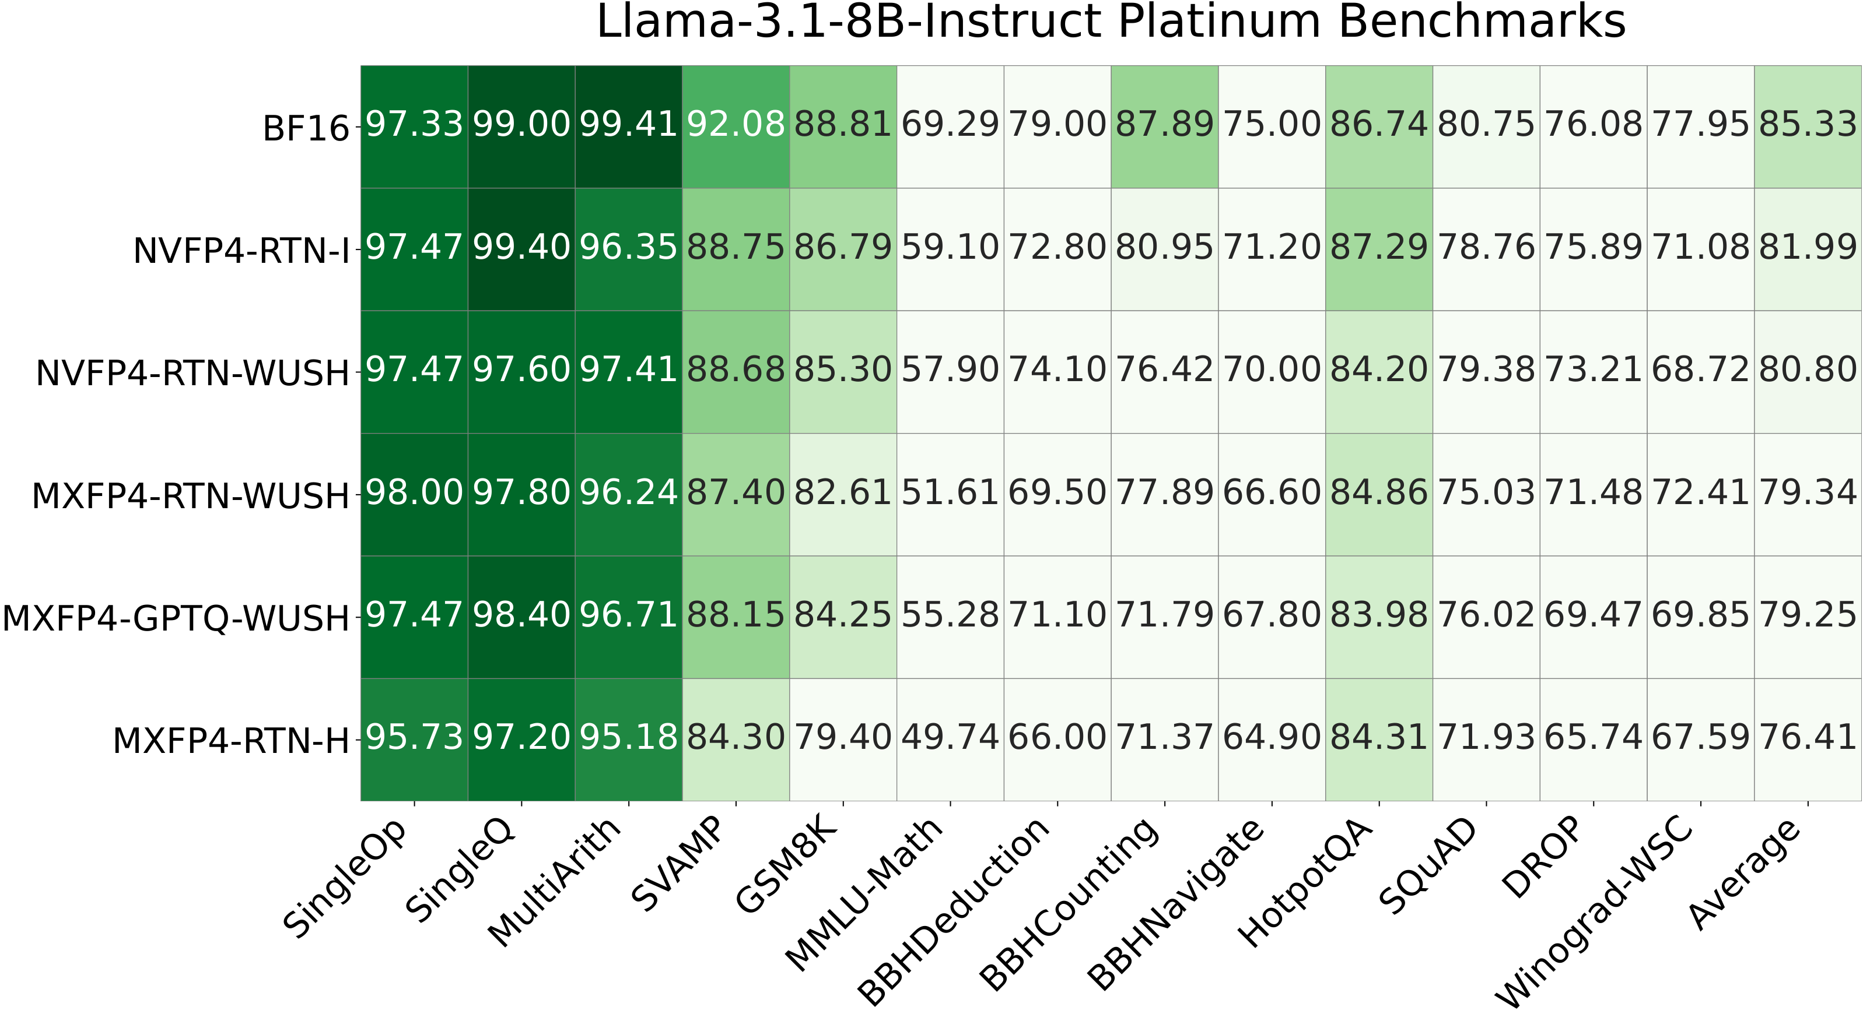
AUTO ROUND / 附录 / 原始论文表
附录：WUSH 作者原始任务明细表
Llama-3.1-8B-Instruct · 图 10 作者发布版本 · 原数据/标签未改动 · 可放大阅读
来源 R12 · Apache-2.0 · 完整许可在本页备注；PDF 包含许可附件。
研究与开发设计 | Intel XPU | 2026-11-05 | 非新功能实测
36
Notes:
附录：WUSH 作者原始任务明细表
Apache-2.0 author figure, rasterized from plots/3_platinum_bench/10_llama-3.1-8b_table.pdf. Full third-party licenses follow in these notes.
Evidence boundary: pinned author implementations, author-released figures/data and local source inspected. Direct arXiv full-text access failed. No new-feature model or XPU benchmark was run.
R12: WUSH: Near-Optimal Adaptive Transforms for LLM Quantization
Paper: https://arxiv.org/abs/2512.00956
Repository: IST-DASLab/WUSH @ 0b69f66cb88aae673d63ae8b5fd96ac751c5a957
README.md: https://github.com/IST-DASLab/WUSH/blob/0b69f66cb88aae673d63ae8b5fd96ac751c5a957/README.md
LICENSE: https://github.com/IST-DASLab/WUSH/blob/0b69f66cb88aae673d63ae8b5fd96ac751c5a957/LICENSE
src/block_transform.py: https://github.com/IST-DASLab/WUSH/blob/0b69f66cb88aae673d63ae8b5fd96ac751c5a957/src/block_transform.py
plots/1_toy_example.pdf: https://github.com/IST-DASLab/WUSH/blob/0b69f66cb88aae673d63ae8b5fd96ac751c5a957/plots/1_toy_example.pdf
plots/2_speedup.pdf: https://github.com/IST-DASLab/WUSH/blob/0b69f66cb88aae673d63ae8b5fd96ac751c5a957/plots/2_speedup.pdf
plots/2_speedup.py: https://github.com/IST-DASLab/WUSH/blob/0b69f66cb88aae673d63ae8b5fd96ac751c5a957/plots/2_speedup.py
plots/5_visual.pdf: https://github.com/IST-DASLab/WUSH/blob/0b69f66cb88aae673d63ae8b5fd96ac751c5a957/plots/5_visual.pdf
plots/3_platinum_bench.csv: https://github.com/IST-DASLab/WUSH/blob/0b69f66cb88aae673d63ae8b5fd96ac751c5a957/plots/3_platinum_bench.csv
plots/3_platinum_bench.py: https://github.com/IST-DASLab/WUSH/blob/0b69f66cb88aae673d63ae8b5fd96ac751c5a957/plots/3_platinum_bench.py
plots/3_platinum_bench/10_llama-3.1-8b_table.pdf: https://github.com/IST-DASLab/WUSH/blob/0b69f66cb88aae673d63ae8b5fd96ac751c5a957/plots/3_platinum_bench/10_llama-3.1-8b_table.pdf
COMPLETE THIRD-PARTY NOTICES AND LICENSES
Apache License
Version 2.0, January 2004
http://www.apache.org/licenses/
TERMS AND CONDITIONS FOR USE, REPRODUCTION, AND DISTRIBUTION
1. Definitions.
"License" shall mean the terms and conditions for use, reproduction,
and distribution as defined by Sections 1 through 9 of this document.
"Licensor" shall mean the copyright owner or entity authorized by
the copyright owner that is granting the License.
"Legal Entity" shall mean the union of the acting entity and all
other entities that control, are controlled by, or are under common
control with that entity. For the purposes of this definition,
"control" means (i) the power, direct or indirect, to cause the
direction or management of such entity, whether by contract or
otherwise, or (ii) ownership of fifty percent (50%) or more of the
outstanding shares, or (iii) beneficial ownership of such entity.
"You" (or "Your") shall mean an individual or Legal Entity
exercising permissions granted by this License.
"Source" form shall mean the preferred form for making modifications,
including but not limited to software source code, documentation
source, and configuration files.
"Object" form shall mean any form resulting from mechanical
transformation or translation of a Source form, including but
not limited to compiled object code, generated documentation,
and conversions to other media types.
"Work" shall mean the work of authorship, whether in Source or
Object form, made available under the License, as indicated by a
copyright notice that is included in or attached to the work
(an example is provided in the Appendix below).
"Derivative Works" shall mean any work, whether in Source or Object
form, that is based on (or derived from) the Work and for which the
editorial revisions, annotations, elaborations, or other modifications
represent, as a whole, an original work of authorship. For the purposes
of this License, Derivative Works shall not include works that remain
separable from, or merely link (or bind by name) to the interfaces of,
the Work and Derivative Works thereof.
"Contribution" shall mean any work of authorship, including
the original version of the Work and any modifications or additions
to that Work or Derivative Works thereof, that is intentionally
submitted to Licensor for inclusion in the Work by the copyright owner
or by an individual or Legal Entity authorized to submit on behalf of
the copyright owner. For the purposes of this definition, "submitted"
means any form of electronic, verbal, or written communication sent
to the Licensor or its representatives, including but not limited to
communication on electronic mailing lists, source code control systems,
and issue tracking systems that are managed by, or on behalf of, the
Licensor for the purpose of discussing and improving the Work, but
excluding communication that is conspicuously marked or otherwise
designated in writing by the copyright owner as "Not a Contribution."
"Contributor" shall mean Licensor and any individual or Legal Entity
on behalf of whom a Contribution has been received by Licensor and
subsequently incorporated within the Work.
2. Grant of Copyright License. Subject to the terms and conditions of
this License, each Contributor hereby grants to You a perpetual,
worldwide, non-exclusive, no-charge, royalty-free, irrevocable
copyright license to reproduce, prepare Derivative Works of,
publicly display, publicly perform, sublicense, and distribute the
Work and such Derivative Works in Source or Object form.
3. Grant of Patent License. Subject to the terms and conditions of
this License, each Contributor hereby grants to You a perpetual,
worldwide, non-exclusive, no-charge, royalty-free, irrevocable
(except as stated in this section) patent license to make, have made,
use, offer to sell, sell, import, and otherwise transfer the Work,
where such license applies only to those patent claims licensable
by such Contributor that are necessarily infringed by their
Contribution(s) alone or by combination of their Contribution(s)
with the Work to which such Contribution(s) was submitted. If You
institute patent litigation against any entity (including a
cross-claim or counterclaim in a lawsuit) alleging that the Work
or a Contribution incorporated within the Work constitutes direct
or contributory patent infringement, then any patent licenses
granted to You under this License for that Work shall terminate
as of the date such litigation is filed.
4. Redistribution. You may reproduce and distribute copies of the
Work or Derivative Works thereof in any medium, with or without
modifications, and in Source or Object form, provided that You
meet the following conditions:
(a) You must give any other recipients of the Work or
Derivative Works a copy of this License; and
(b) You must cause any modified files to carry prominent notices
stating that You changed the files; and
(c) You must retain, in the Source form of any Derivative Works
that You distribute, all copyright, patent, trademark, and
attribution notices from the Source form of the Work,
excluding those notices that do not pertain to any part of
the Derivative Works; and
(d) If the Work includes a "NOTICE" text file as part of its
distribution, then any Derivative Works that You distribute must
include a readable copy of the attribution notices contained
within such NOTICE file, excluding those notices that do not
pertain to any part of the Derivative Works, in at least one
of the following places: within a NOTICE text file distributed
as part of the Derivative Works; within the Source form or
documentation, if provided along with the Derivative Works; or,
within a display generated by the Derivative Works, if and
wherever such third-party notices normally appear. The contents
of the NOTICE file are for informational purposes only and
do not modify the License. You may add Your own attribution
notices within Derivative Works that You distribute, alongside
or as an addendum to the NOTICE text from the Work, provided
that such additional attribution notices cannot be construed
as modifying the License.
You may add Your own copyright statement to Your modifications and
may provide additional or different license terms and conditions
for use, reproduction, or distribution of Your modifications, or
for any such Derivative Works as a whole, provided Your use,
reproduction, and distribution of the Work otherwise complies with
the conditions stated in this License.
5. Submission of Contributions. Unless You explicitly state otherwise,
any Contribution intentionally submitted for inclusion in the Work
by You to the Licensor shall be under the terms and conditions of
this License, without any additional terms or conditions.
Notwithstanding the above, nothing herein shall supersede or modify
the terms of any separate license agreement you may have executed
with Licensor regarding such Contributions.
6. Trademarks. This License does not grant permission to use the trade
names, trademarks, service marks, or product names of the Licensor,
except as required for reasonable and customary use in describing the
origin of the Work and reproducing the content of the NOTICE file.
7. Disclaimer of Warranty. Unless required by applicable law or
agreed to in writing, Licensor provides the Work (and each
Contributor provides its Contributions) on an "AS IS" BASIS,
WITHOUT WARRANTIES OR CONDITIONS OF ANY KIND, either express or
implied, including, without limitation, any warranties or conditions
of TITLE, NON-INFRINGEMENT, MERCHANTABILITY, or FITNESS FOR A
PARTICULAR PURPOSE. You are solely responsible for determining the
appropriateness of using or redistributing the Work and assume any
risks associated with Your exercise of permissions under this License.
8. Limitation of Liability. In no event and under no legal theory,
whether in tort (including negligence), contract, or otherwise,
unless required by applicable law (such as deliberate and grossly
negligent acts) or agreed to in writing, shall any Contributor be
liable to You for damages, including any direct, indirect, special,
incidental, or consequential damages of any character arising as a
result of this License or out of the use or inability to use the
Work (including but not limited to damages for loss of goodwill,
work stoppage, computer failure or malfunction, or any and all
other commercial damages or losses), even if such Contributor
has been advised of the possibility of such damages.
9. Accepting Warranty or Additional Liability. While redistributing
the Work or Derivative Works thereof, You may choose to offer,
and charge a fee for, acceptance of support, warranty, indemnity,
or other liability obligations and/or rights consistent with this
License. However, in accepting such obligations, You may act only
on Your own behalf and on Your sole responsibility, not on behalf
of any other Contributor, and only if You agree to indemnify,
defend, and hold each Contributor harmless for any liability
incurred by, or claims asserted against, such Contributor by reason
of your accepting any such warranty or additional liability.
END OF TERMS AND CONDITIONS
APPENDIX: How to apply the Apache License to your work.
To apply the Apache License to your work, attach the following
boilerplate notice, with the fields enclosed by brackets "[]"
replaced with your own identifying information. (Don't include
the brackets!) The text should be enclosed in the appropriate
comment syntax for the file format. We also recommend that a
file or class name and description of purpose be included on the
same "printed page" as the copyright notice for easier
identification within third-party archives.
Copyright [yyyy] [name of copyright owner]
Licensed under the Apache License, Version 2.0 (the "License");
you may not use this file except in compliance with the License.
You may obtain a copy of the License at
http://www.apache.org/licenses/LICENSE-2.0
Unless required by applicable law or agreed to in writing, software
distributed under the License is distributed on an "AS IS" BASIS,
WITHOUT WARRANTIES OR CONDITIONS OF ANY KIND, either express or implied.
See the License for the specific language governing permissions and
limitations under the License.
MIT License
Copyright (c) 2024 Haobo Xu, Haokun Lin
Permission is hereby granted, free of charge, to any person obtaining a copy
of this software and associated documentation files (the "Software"), to deal
in the Software without restriction, including without limitation the rights
to use, copy, modify, merge, publish, distribute, sublicense, and/or sell
copies of the Software, and to permit persons to whom the Software is
furnished to do so, subject to the following conditions:
The above copyright notice and this permission notice shall be included in all
copies or substantial portions of the Software.
THE SOFTWARE IS PROVIDED "AS IS", WITHOUT WARRANTY OF ANY KIND, EXPRESS OR
IMPLIED, INCLUDING BUT NOT LIMITED TO THE WARRANTIES OF MERCHANTABILITY,
FITNESS FOR A PARTICULAR PURPOSE AND NONINFRINGEMENT. IN NO EVENT SHALL THE
AUTHORS OR COPYRIGHT HOLDERS BE LIABLE FOR ANY CLAIM, DAMAGES OR OTHER
LIABILITY, WHETHER IN AN ACTION OF CONTRACT, TORT OR OTHERWISE, ARISING FROM,
OUT OF OR IN CONNECTION WITH THE SOFTWARE OR THE USE OR OTHER DEALINGS IN THE
SOFTWARE.
THIRD-PARTY FIGURES AND DATA / THIRD-PARTY LICENSE NOTICES
This package reproduces only the assets listed below, under the licenses of their pinned author repositories. It does not assert a license for every figure or the full text of the corresponding papers.
DuQuant: imgs/duquant.png and imgs/ppl.png.
Copyright (c) 2024 Haobo Xu, Haokun Lin. MIT License.
The original copyright and complete license are in DuQuant_MIT.txt.
QuaRot: img/fig1.png. Ashkboos et al., spcl/QuaRot.
Apache License, Version 2.0; complete license in Apache-2.0.txt.
WUSH: plots/1_toy_example.pdf, plots/2_speedup.pdf, plots/3_platinum_bench/10_llama-3.1-8b_table.pdf, and plots/3_platinum_bench.csv. Chen et al., IST-DASLab/WUSH.
Apache License, Version 2.0; complete license in Apache-2.0.txt.
PDF figures were rasterized without changing their labels or data.
Every source URL, revision, original hash, output hash and modification is recorded in ../evidence.json. Paper results are the authors' reported results, not measurements of the proposed AutoRound features.
MicroMix and Atom figures/source code are not redistributed. Their repository license metadata did not establish a reusable license. SpinQuant figures/source code are not redistributed (noncommercial terms).
Original diagrams and newly typeset numeric tables in this package are not reproductions of those projects' artwork or code.

