Slide 1
AUTO ROUND / RESEARCH DESIGN
Channel permutations × mixed-MXFP activations × HMT
Algorithm and implementation design for AutoRound, targeting Intel GPUs / XPU
Higher-fidelity 4-bit quantization
A verifiable route to XPU deployment
F1 Fixed K-axis permutations + MXFP4
F2 Mostly A4 + a small A8 subset
HMT Optional, paired, jointly optimized
13 pinned sources · Author figures and data · Concrete integration points · Staged development
Research and implementation design | Intel XPU | 2026-11-05 | No new-feature benchmarks
01
Notes:
Channel permutations × mixed-MXFP activations × HMT
HMT means a normalized Hadamard transform. Intel GPU/XPU is the primary target. This deliverable covers research and design, not an implemented feature.
Evidence boundary: pinned author implementations, author-released figures/data and local source inspected. Direct arXiv full-text access failed. No new-feature model or XPU benchmark was run.

Slide 2
AUTO ROUND / DESIGN
One shared plan, two features, three execution tiers
Validate numerics and accuracy before choosing hardware paths. Keep all weights at 4 bits by default.
F1 / Regroup channels
F2 / Allocate precision
HMT / Optional transform
Learn a fixed offline permutation
Permute activations and weights
Rebuild 32-element groups
Start with all-W4A4
One gather, two partitions
Mostly MXFP4 activations
A small MXFP8 subset
MXFP4 weights in both branches
Rotate the low partition first
Start with fixed H32
Apply matched compensation
Defer learned rotations
Reference QDQ → Decode-fused XPU kernels → Capability-verified native ops
Research and implementation design | Intel XPU | 2026-11-05 | No new-feature benchmarks
02
Notes:
One shared plan, two features, three execution tiers
Evidence boundary: pinned author implementations, author-released figures/data and local source inspected. Direct arXiv full-text access failed. No new-feature model or XPU benchmark was run.

Slide 3
AUTO ROUND / EVIDENCE AND PRIOR ART
Evidence boundaries: verified facts vs. open questions
Author results, theoretical calculations, and development targets are different types of evidence.
Evidence | Inspected in this study | Does not establish
Code facts | Pinned AutoRound source; author algorithms and kernels | Production readiness of these paths
Author reports | Original figures, author CSV, pinned README results | Equivalent gains for the new features on XPU
Theory / design | Paired-transform algebra, budgets, alignment | Latency scaling with theoretical byte cost
Unverified | Candidate algorithms, gates, effort estimates | Achieved accuracy gains or speedups
Paper hosts were unreachable; evidence comes from author code, released figures, and original data.
Full revisions and hashes: evidence.json. This is neither a full-text nor an exhaustive literature review.
Research and implementation design | Intel XPU | 2026-11-05 | No new-feature benchmarks
03
Notes:
Evidence boundaries: verified facts vs. open questions
Evidence boundary: pinned author implementations, author-released figures/data and local source inspected. Direct arXiv full-text access failed. No new-feature model or XPU benchmark was run.

Slide 4
AUTO ROUND / EVIDENCE AND PRIOR ART
Closest prior art: where the contribution should lie
Not a new format: focus on AutoRound optimization, XPU deployment, and MoE integration.
Direction | Closest prior art | Proposed contribution
Channel reordering | RPTQ；DuQuant | Reconstruction-driven, locality-constrained search
MXFP4 + rotations | DuQuant++；FP-Quant | Joint selection with AutoRound rounding
High-precision subset | LLM.int8 / QUIK / Atom | W4 weights by default; A4/A8 activations
Mixed-MX channels | MicroMix (ICLR 2026 branch) | XPU split ABI; MoE sharing and bucketing
Data-aware transforms | SpinQuant；WUSH | Cost-matched advanced research; not MVP
Research and implementation design | Intel XPU | 2026-11-05 | No new-feature benchmarks
04
Notes:
Closest prior art: where the contribution should lie
Evidence boundary: pinned author implementations, author-released figures/data and local source inspected. Direct arXiv full-text access failed. No new-feature model or XPU benchmark was run.
R02: RPTQ: Reorder-based Post-training Quantization for Large Language Models
Paper: https://arxiv.org/abs/2304.01089
Repository: hahnyuan/RPTQ4LLM @ 96190691f02be6b27ba24d5a73574dbf9a8336c6
README.md: https://github.com/hahnyuan/RPTQ4LLM/blob/96190691f02be6b27ba24d5a73574dbf9a8336c6/README.md
LICENSE: https://github.com/hahnyuan/RPTQ4LLM/blob/96190691f02be6b27ba24d5a73574dbf9a8336c6/LICENSE
quantize/reorder_utils.py: https://github.com/hahnyuan/RPTQ4LLM/blob/96190691f02be6b27ba24d5a73574dbf9a8336c6/quantize/reorder_utils.py
R03: DuQuant: Distributing Outliers via Dual Transformation Makes Stronger Quantized LLMs
Paper: https://arxiv.org/abs/2406.01721
Repository: Hsu1023/DuQuant @ d56cfc6fe97c34c0eb100fec82fe439865905679
README.md: https://github.com/Hsu1023/DuQuant/blob/d56cfc6fe97c34c0eb100fec82fe439865905679/README.md
LICENSE: https://github.com/Hsu1023/DuQuant/blob/d56cfc6fe97c34c0eb100fec82fe439865905679/LICENSE
imgs/duquant.png: https://github.com/Hsu1023/DuQuant/blob/d56cfc6fe97c34c0eb100fec82fe439865905679/imgs/duquant.png
imgs/ppl.png: https://github.com/Hsu1023/DuQuant/blob/d56cfc6fe97c34c0eb100fec82fe439865905679/imgs/ppl.png
quantize/utils.py: https://github.com/Hsu1023/DuQuant/blob/d56cfc6fe97c34c0eb100fec82fe439865905679/quantize/utils.py
quantize/duquant.py: https://github.com/Hsu1023/DuQuant/blob/d56cfc6fe97c34c0eb100fec82fe439865905679/quantize/duquant.py
R04: DuQuant++: Fine-grained Rotation Enhances Microscaling FP4 Quantization
Paper: https://arxiv.org/abs/2604.17789
Repository: Hsu1023/DuQuant-v2 @ 6c13ec07a3241f2d4ad6415a06403aef43919db9
README.md: https://github.com/Hsu1023/DuQuant-v2/blob/6c13ec07a3241f2d4ad6415a06403aef43919db9/README.md
LICENSE: https://github.com/Hsu1023/DuQuant-v2/blob/6c13ec07a3241f2d4ad6415a06403aef43919db9/LICENSE
quantize/int_linear.py: https://github.com/Hsu1023/DuQuant-v2/blob/6c13ec07a3241f2d4ad6415a06403aef43919db9/quantize/int_linear.py
quantize/quantizer.py: https://github.com/Hsu1023/DuQuant-v2/blob/6c13ec07a3241f2d4ad6415a06403aef43919db9/quantize/quantizer.py
quantize/fp4_ops.py: https://github.com/Hsu1023/DuQuant-v2/blob/6c13ec07a3241f2d4ad6415a06403aef43919db9/quantize/fp4_ops.py
R05: QuaRot: Outlier-Free 4-Bit Inference in Rotated LLMs
Paper: https://arxiv.org/abs/2404.00456
Repository: spcl/QuaRot @ 5008669b08c1f11f9b64d52d16fddd47ca754c5a
README.md: https://github.com/spcl/QuaRot/blob/5008669b08c1f11f9b64d52d16fddd47ca754c5a/README.md
LICENSE: https://github.com/spcl/QuaRot/blob/5008669b08c1f11f9b64d52d16fddd47ca754c5a/LICENSE
img/fig1.png: https://github.com/spcl/QuaRot/blob/5008669b08c1f11f9b64d52d16fddd47ca754c5a/img/fig1.png
R08: QUIK: Towards End-to-end 4-Bit Inference on Generative Large Language Models
Paper: https://arxiv.org/abs/2310.09259
Repository: IST-DASLab/QUIK @ 9558d7121c698174fc93940e0b52c38c746c97ea
README.md: https://github.com/IST-DASLab/QUIK/blob/9558d7121c698174fc93940e0b52c38c746c97ea/README.md
R09: Atom: Low-Bit Quantization for Efficient and Accurate LLM Serving
Paper: https://arxiv.org/abs/2310.19102
Repository: efeslab/Atom @ 7e3618b1a7a7c86e1c93cc909b1510c046d76ac6
README.md: https://github.com/efeslab/Atom/blob/7e3618b1a7a7c86e1c93cc909b1510c046d76ac6/README.md
R10: MicroMix: Efficient Mixed-Precision Quantization with Microscaling Formats for Large Language Models
Paper: https://arxiv.org/abs/2508.02343
Repository: lwy2020/MicroMix @ c57370bc38f999e1f75aada9c4b8a85baa44aaae
README.md: https://github.com/lwy2020/MicroMix/blob/c57370bc38f999e1f75aada9c4b8a85baa44aaae/README.md
utilize.py: https://github.com/lwy2020/MicroMix/blob/c57370bc38f999e1f75aada9c4b8a85baa44aaae/utilize.py
reorder_indices.py: https://github.com/lwy2020/MicroMix/blob/c57370bc38f999e1f75aada9c4b8a85baa44aaae/reorder_indices.py
mgemm/README.md: https://github.com/lwy2020/MicroMix/blob/c57370bc38f999e1f75aada9c4b8a85baa44aaae/mgemm/README.md
mgemm/src/w4a8.cu: https://github.com/lwy2020/MicroMix/blob/c57370bc38f999e1f75aada9c4b8a85baa44aaae/mgemm/src/w4a8.cu
mgemm/src/w4a4.cu: https://github.com/lwy2020/MicroMix/blob/c57370bc38f999e1f75aada9c4b8a85baa44aaae/mgemm/src/w4a4.cu
R11: Bridging the Gap Between Promise and Performance for Microscaling FP4 Quantization
Paper: https://arxiv.org/abs/2509.23202
Repository: IST-DASLab/FP-Quant @ d2e3092f968262c4de5fb050e1aef568a280dadd
README.md: https://github.com/IST-DASLab/FP-Quant/blob/d2e3092f968262c4de5fb050e1aef568a280dadd/README.md
R12: WUSH: Near-Optimal Adaptive Transforms for LLM Quantization
Paper: https://arxiv.org/abs/2512.00956
Repository: IST-DASLab/WUSH @ 0b69f66cb88aae673d63ae8b5fd96ac751c5a957
README.md: https://github.com/IST-DASLab/WUSH/blob/0b69f66cb88aae673d63ae8b5fd96ac751c5a957/README.md
LICENSE: https://github.com/IST-DASLab/WUSH/blob/0b69f66cb88aae673d63ae8b5fd96ac751c5a957/LICENSE
src/block_transform.py: https://github.com/IST-DASLab/WUSH/blob/0b69f66cb88aae673d63ae8b5fd96ac751c5a957/src/block_transform.py
plots/1_toy_example.pdf: https://github.com/IST-DASLab/WUSH/blob/0b69f66cb88aae673d63ae8b5fd96ac751c5a957/plots/1_toy_example.pdf
plots/2_speedup.pdf: https://github.com/IST-DASLab/WUSH/blob/0b69f66cb88aae673d63ae8b5fd96ac751c5a957/plots/2_speedup.pdf
plots/2_speedup.py: https://github.com/IST-DASLab/WUSH/blob/0b69f66cb88aae673d63ae8b5fd96ac751c5a957/plots/2_speedup.py
plots/5_visual.pdf: https://github.com/IST-DASLab/WUSH/blob/0b69f66cb88aae673d63ae8b5fd96ac751c5a957/plots/5_visual.pdf
plots/3_platinum_bench.csv: https://github.com/IST-DASLab/WUSH/blob/0b69f66cb88aae673d63ae8b5fd96ac751c5a957/plots/3_platinum_bench.csv
plots/3_platinum_bench.py: https://github.com/IST-DASLab/WUSH/blob/0b69f66cb88aae673d63ae8b5fd96ac751c5a957/plots/3_platinum_bench.py
plots/3_platinum_bench/10_llama-3.1-8b_table.pdf: https://github.com/IST-DASLab/WUSH/blob/0b69f66cb88aae673d63ae8b5fd96ac751c5a957/plots/3_platinum_bench/10_llama-3.1-8b_table.pdf

Slide 5
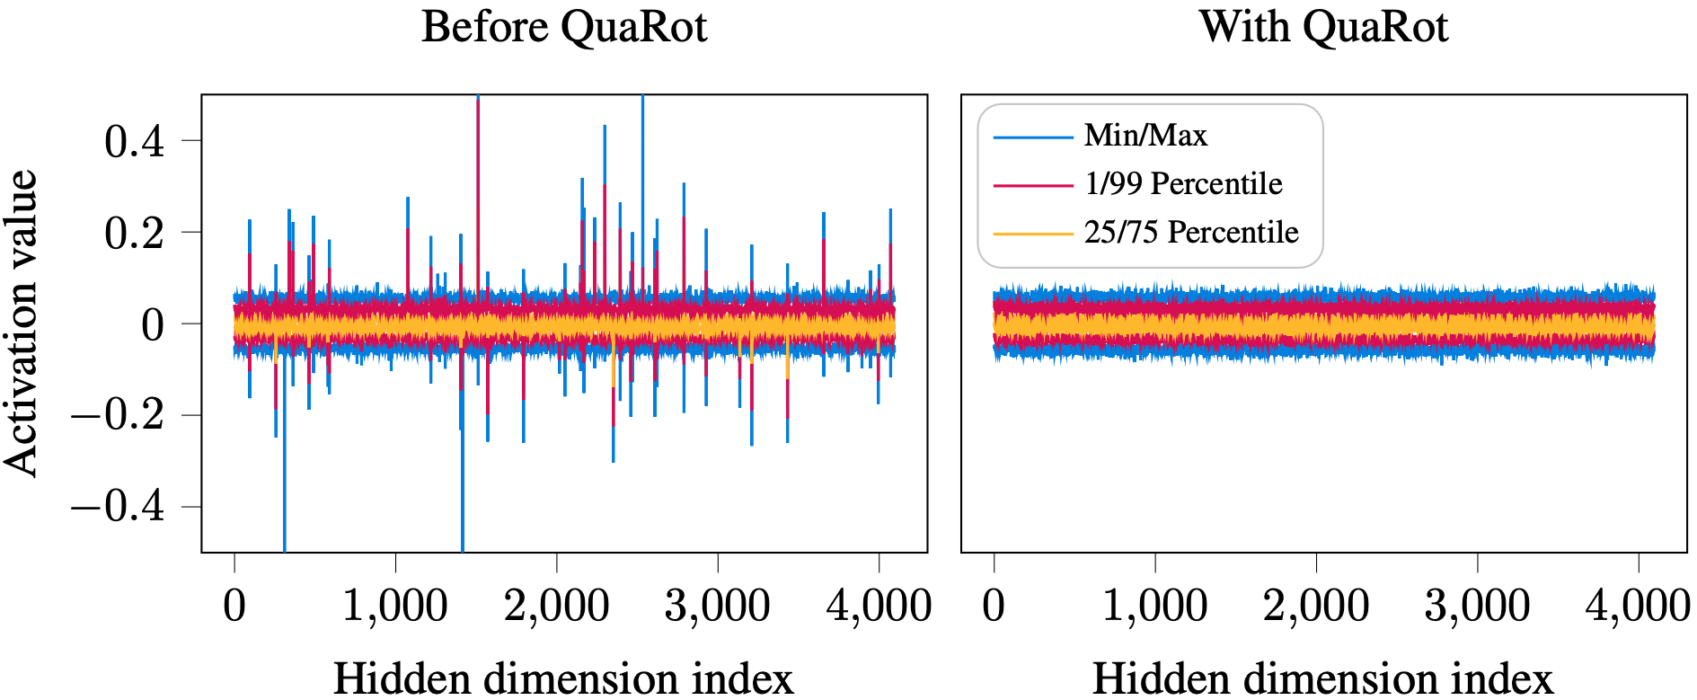
AUTO ROUND / AUTHOR FIGURE
QuaRot: paired rotations, not one-sided outlier handling
Original author figure, integer INT4 work. Illustrates rotations; not a new MXFP4 or XPU result.
Preserve the function; optimize the quantization error.
Source R05 · spcl/QuaRot@5008669 · Apache-2.0
Research and implementation design | Intel XPU | 2026-11-05 | No new-feature benchmarks
05
Notes:
QuaRot: paired rotations, not one-sided outlier handling
Unmodified author-released img/fig1.png, Apache-2.0. Caption/source license retained.
Evidence boundary: pinned author implementations, author-released figures/data and local source inspected. Direct arXiv full-text access failed. No new-feature model or XPU benchmark was run.
R05: QuaRot: Outlier-Free 4-Bit Inference in Rotated LLMs
Paper: https://arxiv.org/abs/2404.00456
Repository: spcl/QuaRot @ 5008669b08c1f11f9b64d52d16fddd47ca754c5a
README.md: https://github.com/spcl/QuaRot/blob/5008669b08c1f11f9b64d52d16fddd47ca754c5a/README.md
LICENSE: https://github.com/spcl/QuaRot/blob/5008669b08c1f11f9b64d52d16fddd47ca754c5a/LICENSE
img/fig1.png: https://github.com/spcl/QuaRot/blob/5008669b08c1f11f9b64d52d16fddd47ca754c5a/img/fig1.png

Slide 6
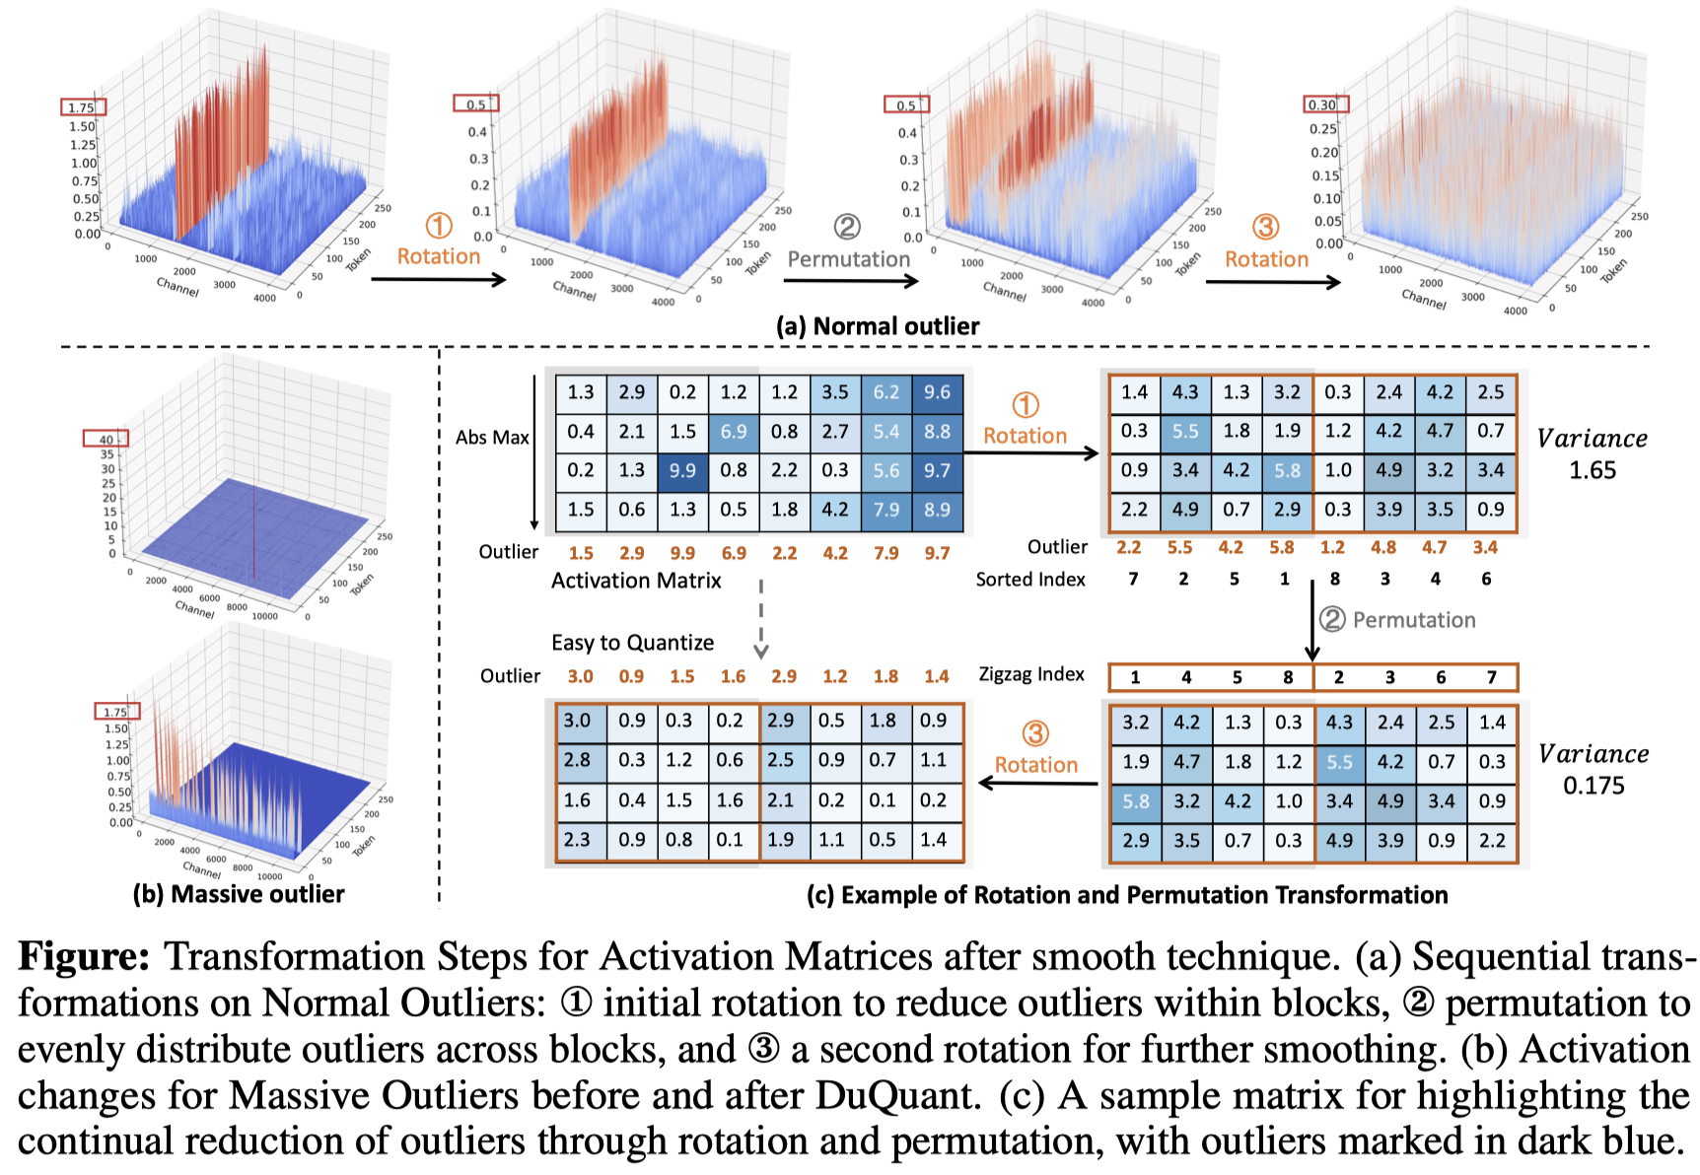
AUTO ROUND / AUTHOR FIGURE
DuQuant: rotate → permute → rotate
Author figure: handle within-block outliers, then balance blocks. Random shuffling is not guaranteed to help.
Two grouping objectives
Without HMT: cluster magnitudes
With HMT: test outlier balancing
Validate both with complete QDQ
A direct MXFP4 baseline
DuQuant++ (2026)
Fine-grained, dimension-32 rotation
Align its extra scale conventions
Source R03 · MIT. R04 is the separate, later MXFP4 implementation.
Research and implementation design | Intel XPU | 2026-11-05 | No new-feature benchmarks
06
Notes:
DuQuant: rotate → permute → rotate
Unmodified DuQuant imgs/duquant.png under MIT. This is the original integer work, not DuQuant++ MXFP4 measurements.
Evidence boundary: pinned author implementations, author-released figures/data and local source inspected. Direct arXiv full-text access failed. No new-feature model or XPU benchmark was run.
R03: DuQuant: Distributing Outliers via Dual Transformation Makes Stronger Quantized LLMs
Paper: https://arxiv.org/abs/2406.01721
Repository: Hsu1023/DuQuant @ d56cfc6fe97c34c0eb100fec82fe439865905679
README.md: https://github.com/Hsu1023/DuQuant/blob/d56cfc6fe97c34c0eb100fec82fe439865905679/README.md
LICENSE: https://github.com/Hsu1023/DuQuant/blob/d56cfc6fe97c34c0eb100fec82fe439865905679/LICENSE
imgs/duquant.png: https://github.com/Hsu1023/DuQuant/blob/d56cfc6fe97c34c0eb100fec82fe439865905679/imgs/duquant.png
imgs/ppl.png: https://github.com/Hsu1023/DuQuant/blob/d56cfc6fe97c34c0eb100fec82fe439865905679/imgs/ppl.png
quantize/utils.py: https://github.com/Hsu1023/DuQuant/blob/d56cfc6fe97c34c0eb100fec82fe439865905679/quantize/utils.py
quantize/duquant.py: https://github.com/Hsu1023/DuQuant/blob/d56cfc6fe97c34c0eb100fec82fe439865905679/quantize/duquant.py
R04: DuQuant++: Fine-grained Rotation Enhances Microscaling FP4 Quantization
Paper: https://arxiv.org/abs/2604.17789
Repository: Hsu1023/DuQuant-v2 @ 6c13ec07a3241f2d4ad6415a06403aef43919db9
README.md: https://github.com/Hsu1023/DuQuant-v2/blob/6c13ec07a3241f2d4ad6415a06403aef43919db9/README.md
LICENSE: https://github.com/Hsu1023/DuQuant-v2/blob/6c13ec07a3241f2d4ad6415a06403aef43919db9/LICENSE
quantize/int_linear.py: https://github.com/Hsu1023/DuQuant-v2/blob/6c13ec07a3241f2d4ad6415a06403aef43919db9/quantize/int_linear.py
quantize/quantizer.py: https://github.com/Hsu1023/DuQuant-v2/blob/6c13ec07a3241f2d4ad6415a06403aef43919db9/quantize/quantizer.py
quantize/fp4_ops.py: https://github.com/Hsu1023/DuQuant-v2/blob/6c13ec07a3241f2d4ad6415a06403aef43919db9/quantize/fp4_ops.py

Slide 7
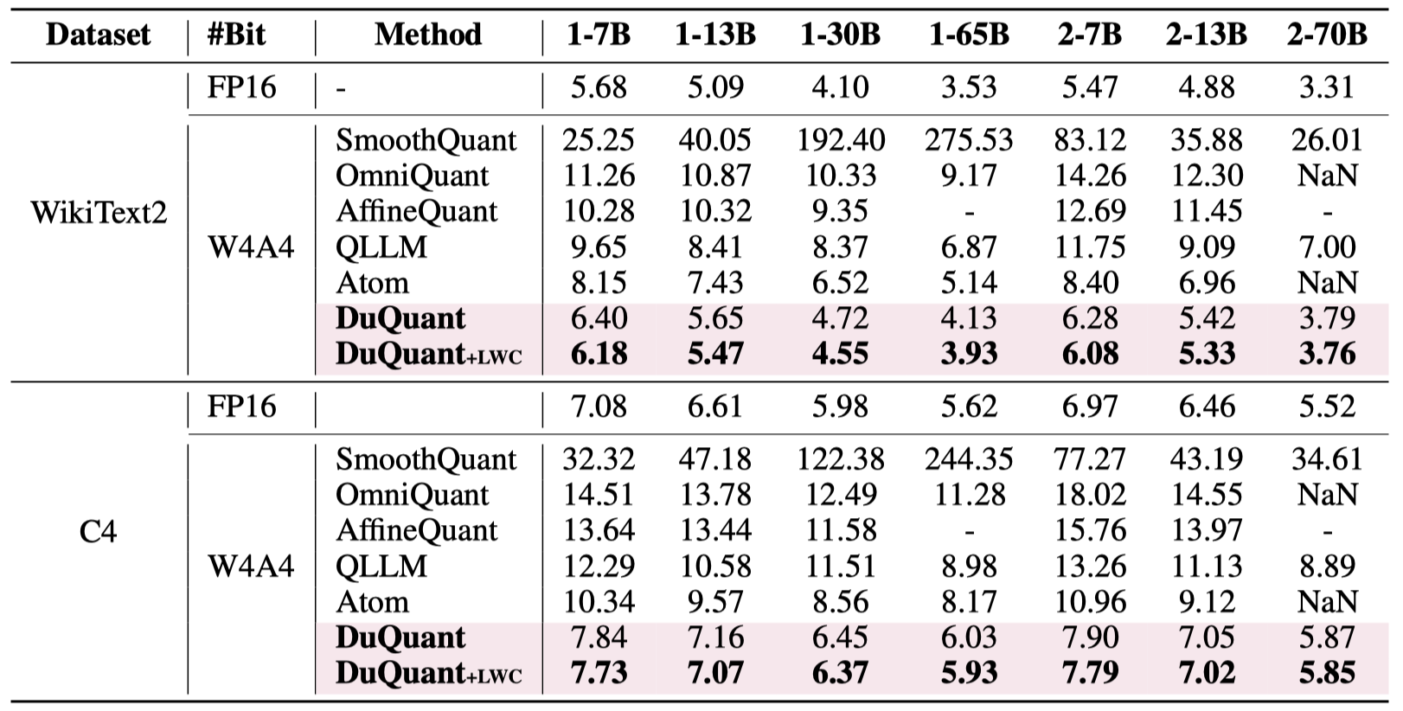
AUTO ROUND / AUTHOR DATA
DuQuant results: preserve the format and context
Integer W4A4; 1-* / 2-* denote LLaMA-1 / LLaMA-2. Lower perplexity is better.
How to read
Compare like for like.
Keep NaN and gaps.
INT4 is not MXFP4.
No Intel speed claim.
Source R03 · Hsu1023/DuQuant@d56cfc6 · MIT
Research and implementation design | Intel XPU | 2026-11-05 | No new-feature benchmarks
07
Notes:
DuQuant results: preserve the format and context
Author-released imgs/ppl.png, MIT. NaNs and missing entries remain unchanged. No cross-paper fairness is inferred.
Evidence boundary: pinned author implementations, author-released figures/data and local source inspected. Direct arXiv full-text access failed. No new-feature model or XPU benchmark was run.
R03: DuQuant: Distributing Outliers via Dual Transformation Makes Stronger Quantized LLMs
Paper: https://arxiv.org/abs/2406.01721
Repository: Hsu1023/DuQuant @ d56cfc6fe97c34c0eb100fec82fe439865905679
README.md: https://github.com/Hsu1023/DuQuant/blob/d56cfc6fe97c34c0eb100fec82fe439865905679/README.md
LICENSE: https://github.com/Hsu1023/DuQuant/blob/d56cfc6fe97c34c0eb100fec82fe439865905679/LICENSE
imgs/duquant.png: https://github.com/Hsu1023/DuQuant/blob/d56cfc6fe97c34c0eb100fec82fe439865905679/imgs/duquant.png
imgs/ppl.png: https://github.com/Hsu1023/DuQuant/blob/d56cfc6fe97c34c0eb100fec82fe439865905679/imgs/ppl.png
quantize/utils.py: https://github.com/Hsu1023/DuQuant/blob/d56cfc6fe97c34c0eb100fec82fe439865905679/quantize/utils.py
quantize/duquant.py: https://github.com/Hsu1023/DuQuant/blob/d56cfc6fe97c34c0eb100fec82fe439865905679/quantize/duquant.py

Slide 8
AUTO ROUND / EXISTING IMPLEMENTATION
MicroMix: the closest implementation precedent for F2
Original concept diagram; no copied artwork or code. Inspected the pinned micromix branch.
Channel statistics
Ratios and ordering
Mixed GEMM
Collect activation statistics
Produce a fixed ordering
Contiguous precision regions
Original: 4 / 6 / 8
W4A4 / W4A8 and more
Blackwell kernels
Verified MXFP8 activations × MXFP4 weights. Keep the high branch W4A8 by default.
Its 128-channel alignment is implementation-specific; determine XPU constraints separately.
MVP: two A4/A8 partitions. Defer FP6 numeric and deployment complexity.
Research and implementation design | Intel XPU | 2026-11-05 | No new-feature benchmarks
08
Notes:
MicroMix: the closest implementation precedent for F2
Public source inspected, not redistributed. utilize.py sorts channels and allocates aligned ratios; w4a8.cu declares MXFP8 A and MXFP4 B on SM120.
Evidence boundary: pinned author implementations, author-released figures/data and local source inspected. Direct arXiv full-text access failed. No new-feature model or XPU benchmark was run.
R10: MicroMix: Efficient Mixed-Precision Quantization with Microscaling Formats for Large Language Models
Paper: https://arxiv.org/abs/2508.02343
Repository: lwy2020/MicroMix @ c57370bc38f999e1f75aada9c4b8a85baa44aaae
README.md: https://github.com/lwy2020/MicroMix/blob/c57370bc38f999e1f75aada9c4b8a85baa44aaae/README.md
utilize.py: https://github.com/lwy2020/MicroMix/blob/c57370bc38f999e1f75aada9c4b8a85baa44aaae/utilize.py
reorder_indices.py: https://github.com/lwy2020/MicroMix/blob/c57370bc38f999e1f75aada9c4b8a85baa44aaae/reorder_indices.py
mgemm/README.md: https://github.com/lwy2020/MicroMix/blob/c57370bc38f999e1f75aada9c4b8a85baa44aaae/mgemm/README.md
mgemm/src/w4a8.cu: https://github.com/lwy2020/MicroMix/blob/c57370bc38f999e1f75aada9c4b8a85baa44aaae/mgemm/src/w4a8.cu
mgemm/src/w4a4.cu: https://github.com/lwy2020/MicroMix/blob/c57370bc38f999e1f75aada9c4b8a85baa44aaae/mgemm/src/w4a4.cu

Slide 9
AUTO ROUND / AUTHOR DATA
MXFP4 evidence: fixed HMT leaves room to improve
WUSH author data · Llama-3.1-8B-Instruct · Macro accuracy over 13 Platinum tasks (%)
Author method | Accuracy | Count
BF16 | 85.33 | 1
RTN-H | 76.41 | 5
RTN-WUSH | 79.34 | 5
GPTQ-WUSH | 79.25 | 5
+2.93 percentage points
RTN-WUSH versus RTN-H
Still 5.99 pp below BF16
Records are not verified seeds
Source R12 · Original CSV included · Editable PowerPoint chart
Research and implementation design | Intel XPU | 2026-11-05 | No new-feature benchmarks
09
Notes:
MXFP4 evidence: fixed HMT leaves room to improve
Recomputed from author CSV: per-record 13-task mean, then method mean. RTN-WUSH 79.34116; H 76.41440; GPTQ-WUSH 79.25155; BF16 85.33235. No independent-seed inference.
Evidence boundary: pinned author implementations, author-released figures/data and local source inspected. Direct arXiv full-text access failed. No new-feature model or XPU benchmark was run.
R12: WUSH: Near-Optimal Adaptive Transforms for LLM Quantization
Paper: https://arxiv.org/abs/2512.00956
Repository: IST-DASLab/WUSH @ 0b69f66cb88aae673d63ae8b5fd96ac751c5a957
README.md: https://github.com/IST-DASLab/WUSH/blob/0b69f66cb88aae673d63ae8b5fd96ac751c5a957/README.md
LICENSE: https://github.com/IST-DASLab/WUSH/blob/0b69f66cb88aae673d63ae8b5fd96ac751c5a957/LICENSE
src/block_transform.py: https://github.com/IST-DASLab/WUSH/blob/0b69f66cb88aae673d63ae8b5fd96ac751c5a957/src/block_transform.py
plots/1_toy_example.pdf: https://github.com/IST-DASLab/WUSH/blob/0b69f66cb88aae673d63ae8b5fd96ac751c5a957/plots/1_toy_example.pdf
plots/2_speedup.pdf: https://github.com/IST-DASLab/WUSH/blob/0b69f66cb88aae673d63ae8b5fd96ac751c5a957/plots/2_speedup.pdf
plots/2_speedup.py: https://github.com/IST-DASLab/WUSH/blob/0b69f66cb88aae673d63ae8b5fd96ac751c5a957/plots/2_speedup.py
plots/5_visual.pdf: https://github.com/IST-DASLab/WUSH/blob/0b69f66cb88aae673d63ae8b5fd96ac751c5a957/plots/5_visual.pdf
plots/3_platinum_bench.csv: https://github.com/IST-DASLab/WUSH/blob/0b69f66cb88aae673d63ae8b5fd96ac751c5a957/plots/3_platinum_bench.csv
plots/3_platinum_bench.py: https://github.com/IST-DASLab/WUSH/blob/0b69f66cb88aae673d63ae8b5fd96ac751c5a957/plots/3_platinum_bench.py
plots/3_platinum_bench/10_llama-3.1-8b_table.pdf: https://github.com/IST-DASLab/WUSH/blob/0b69f66cb88aae673d63ae8b5fd96ac751c5a957/plots/3_platinum_bench/10_llama-3.1-8b_table.pdf

Slide 10
AUTO ROUND / DESIGN
Keep MXFP4, MXFP8, and NVFP4 distinct
Align numeric profiles before comparing any reported numbers.
Format | Element | Shared scale | Role in this design
MXFP4 | E2M1; maximum magnitude 6 | E8M0, 32 elements | Low activations; all weights by default
MXFP8 | E4M3 default; E5M2 optional | E8M0, 32 elements | High activation partition
NVFP4 | E2M1 | Different groups and scale conventions | Separate baseline; do not mix results
MXFP4 magnitudes: 0 · 0.5 · 1 · 1.5 · 2 · 3 · 4 · 6
ARK, core floor/rceil, and CUDA HMT use different numeric conventions.
Freeze rounding, zero blocks, signed zero, scales, and nibble order across calibration and export.
Research and implementation design | Intel XPU | 2026-11-05 | No new-feature benchmarks
10
Notes:
Keep MXFP4, MXFP8, and NVFP4 distinct
Evidence boundary: pinned author implementations, author-released figures/data and local source inspected. Direct arXiv full-text access failed. No new-feature model or XPU benchmark was run.
R01: Microscaling Data Formats for Deep Learning
Paper: https://arxiv.org/abs/2310.10537
Repository: microsoft/microxcaling @ 7bc41952de394f5cc5e782baf132e7c7542eb4e4
README.md: https://github.com/microsoft/microxcaling/blob/7bc41952de394f5cc5e782baf132e7c7542eb4e4/README.md
mx/formats.py: https://github.com/microsoft/microxcaling/blob/7bc41952de394f5cc5e782baf132e7c7542eb4e4/mx/formats.py
mx/mx_ops.py: https://github.com/microsoft/microxcaling/blob/7bc41952de394f5cc5e782baf132e7c7542eb4e4/mx/mx_ops.py
R04: DuQuant++: Fine-grained Rotation Enhances Microscaling FP4 Quantization
Paper: https://arxiv.org/abs/2604.17789
Repository: Hsu1023/DuQuant-v2 @ 6c13ec07a3241f2d4ad6415a06403aef43919db9
README.md: https://github.com/Hsu1023/DuQuant-v2/blob/6c13ec07a3241f2d4ad6415a06403aef43919db9/README.md
LICENSE: https://github.com/Hsu1023/DuQuant-v2/blob/6c13ec07a3241f2d4ad6415a06403aef43919db9/LICENSE
quantize/int_linear.py: https://github.com/Hsu1023/DuQuant-v2/blob/6c13ec07a3241f2d4ad6415a06403aef43919db9/quantize/int_linear.py
quantize/quantizer.py: https://github.com/Hsu1023/DuQuant-v2/blob/6c13ec07a3241f2d4ad6415a06403aef43919db9/quantize/quantizer.py
quantize/fp4_ops.py: https://github.com/Hsu1023/DuQuant-v2/blob/6c13ec07a3241f2d4ad6415a06403aef43919db9/quantize/fp4_ops.py
R11: Bridging the Gap Between Promise and Performance for Microscaling FP4 Quantization
Paper: https://arxiv.org/abs/2509.23202
Repository: IST-DASLab/FP-Quant @ d2e3092f968262c4de5fb050e1aef568a280dadd
README.md: https://github.com/IST-DASLab/FP-Quant/blob/d2e3092f968262c4de5fb050e1aef568a280dadd/README.md

Slide 11
AUTO ROUND / DESIGN
Invariant: transform activations and weight columns together
Convention: X[M,K], W[N,K], Y = X W^T + b.
X' = X[:, p] W' = W[:, p] X' (W')^T = X W^T
Orthogonal HMT
General invertible T
R R^T = I
X' = X P R
W' = W P R
X' = X T
W' = W T^(-T)
WUSH needs inverse-transpose compensation
Permute K channels, not tokens. The N-dimensional output needs no inverse permutation.
Research and implementation design | Intel XPU | 2026-11-05 | No new-feature benchmarks
11
Notes:
Invariant: transform activations and weight columns together
Evidence boundary: pinned author implementations, author-released figures/data and local source inspected. Direct arXiv full-text access failed. No new-feature model or XPU benchmark was run.

Slide 12
AUTO ROUND / DESIGN
F1: optimize cross-block membership, not shuffling itself
Without changing quantization-block membership, reordering is a negative control, not a source of gain.
Original order (illustration)
0.4
7.8
0.3
6.2
0.5
9.1
Candidate order
0.3
0.4
0.5
6.2
7.8
9.1
Without HMT: cluster magnitudes
With HMT: test outlier balancing
Sort by RMS, quantile, or log magnitude
Include weight norms and quantization residuals
Zigzag, block swaps, locality constraints
Validate with complete W4A4 output loss
Original illustrative values and boxes; actual shared-scale groups contain 32 elements.
Research and implementation design | Intel XPU | 2026-11-05 | No new-feature benchmarks
12
Notes:
F1: optimize cross-block membership, not shuffling itself
Evidence boundary: pinned author implementations, author-released figures/data and local source inspected. Direct arXiv full-text access failed. No new-feature model or XPU benchmark was run.

Slide 13
AUTO ROUND / DESIGN
F1 search: use reconstruction loss, not amax alone
Cheap screening, then short AutoRound runs. Freeze permutations during tuning.
Candidate | Cost / objective | Selection rule
identity / random | Required baselines | Fixed seeds; cross-block and within-block controls
RMS / quantile sort | O(K log K) | Similar magnitudes; include weight sensitivity
zigzag + HMT | Balance outliers across rotation blocks | Compare directly against clustering
Local swaps | Bounded 128/256/512-channel windows | Accuracy gain + actual gather cost
Loss = ||Y_ref - Y_qdq||² / (||Y_ref||² + ε)
Jointly normalize losses for shared-input consumers such as QKV and gate/up; reuse the gather.
Research and implementation design | Intel XPU | 2026-11-05 | No new-feature benchmarks
13
Notes:
F1 search: use reconstruction loss, not amax alone
Evidence boundary: pinned author implementations, author-released figures/data and local source inspected. Direct arXiv full-text access failed. No new-feature model or XPU benchmark was run.

Slide 14
AUTO ROUND / DESIGN
Grouped GEMM: separate M-axis routing and K-axis gathers
These are different reorderings. Preserve top-k weights and the final scatter correspondence.
token × top-k
Sort by expert
Channel plan
grouped GEMM
Original token ID
Router weight
M-axis gather
Expert segments
K-axis gather
Shared / expert plan
Accumulate both partitions
scatter/reduce
MVP: shared plans by expert group; gate/up share preprocessing.
Next: expert masks with fixed K8 buckets, grouped by shape, profile, and HMT.
Down-proj consumes expert-specific intermediate activations; gate/up plans cannot be reused unconditionally.
Research and implementation design | Intel XPU | 2026-11-05 | No new-feature benchmarks
14
Notes:
Grouped GEMM: separate M-axis routing and K-axis gathers
Evidence boundary: pinned author implementations, author-released figures/data and local source inspected. Direct arXiv full-text access failed. No new-feature model or XPU benchmark was run.

Slide 15
AUTO ROUND / DESIGN
F2: one gather, two contiguous partitions, sum over K
Default: W4A4 low branch + W4A8 high branch, not two full-K GEMMs.
X[:,S4] → Q4
× Q4(W[:,S4])ᵀ
X[M,K]
Sum + b
X[:,S8] → Q8
× Q4(W[:,S8])ᵀ
S4 and S8 are disjoint and cover all K. Add bias exactly once.
Research and implementation design | Intel XPU | 2026-11-05 | No new-feature benchmarks
15
Notes:
F2: one gather, two contiguous partitions, sum over K
Evidence boundary: pinned author implementations, author-released figures/data and local source inspected. Direct arXiv full-text access failed. No new-feature model or XPU benchmark was run.

Slide 16
AUTO ROUND / DESIGN
Report the three high-branch semantics separately
Stored format, compute operand representation, and quantization precision are different concepts.
Variant | High-partition weights | Interpretation
Default W4A8 | Original weights → MXFP4 | Only activation precision increases
W4 codes → W8 operands | Lossless E2M1 → E4M3 code expansion | Weight values unchanged; resident caches may grow
Optional W8A8 | Original weights → MXFP8 | Higher weight precision too; separate budget and ablation
Finite E2M1 values are exactly representable in E4M3; validate scale layout and device numerics.
If A8W4 is unsupported, explicitly select lossless expansion or decode.
Relabeling an INT4/INT8 kernel does not make it an MXFP4/MXFP8 kernel.
Research and implementation design | Intel XPU | 2026-11-05 | No new-feature benchmarks
16
Notes:
Report the three high-branch semantics separately
Evidence boundary: pinned author implementations, author-released figures/data and local source inspected. Direct arXiv full-text access failed. No new-feature model or XPU benchmark was run.
R10: MicroMix: Efficient Mixed-Precision Quantization with Microscaling Formats for Large Language Models
Paper: https://arxiv.org/abs/2508.02343
Repository: lwy2020/MicroMix @ c57370bc38f999e1f75aada9c4b8a85baa44aaae
README.md: https://github.com/lwy2020/MicroMix/blob/c57370bc38f999e1f75aada9c4b8a85baa44aaae/README.md
utilize.py: https://github.com/lwy2020/MicroMix/blob/c57370bc38f999e1f75aada9c4b8a85baa44aaae/utilize.py
reorder_indices.py: https://github.com/lwy2020/MicroMix/blob/c57370bc38f999e1f75aada9c4b8a85baa44aaae/reorder_indices.py
mgemm/README.md: https://github.com/lwy2020/MicroMix/blob/c57370bc38f999e1f75aada9c4b8a85baa44aaae/mgemm/README.md
mgemm/src/w4a8.cu: https://github.com/lwy2020/MicroMix/blob/c57370bc38f999e1f75aada9c4b8a85baa44aaae/mgemm/src/w4a8.cu
mgemm/src/w4a4.cu: https://github.com/lwy2020/MicroMix/blob/c57370bc38f999e1f75aada9c4b8a85baa44aaae/mgemm/src/w4a4.cu

Slide 17
AUTO ROUND / DESIGN
Who gets A8? Error reduction first, magnitude as a proxy
Moving channels changes entire shared-scale groups. Per-channel gains are not inherently additive.
Cheap candidate scores
Recompute QDQ
Then allocate the budget
RMS × weight-column norm
Upper quantile / tail frequency
A4→A8 quantization-error gain
Regather and rebuild groups
Recompute all partition scales
Measure full-layer output error
Swap boundary channels
Compare at matched actual K8
Allocate model-wide gain / cost
s[j] ≈ ||Q4(W)[:,j]||² × E[err4(xj)² − err8(xj)²]
A screening proxy only: decide using complete post-partition QDQ.
Research and implementation design | Intel XPU | 2026-11-05 | No new-feature benchmarks
17
Notes:
Who gets A8? Error reduction first, magnitude as a proxy
Evidence boundary: pinned author implementations, author-released figures/data and local source inspected. Direct arXiv full-text access failed. No new-feature model or XPU benchmark was run.

Slide 18
AUTO ROUND / DESIGN
Small ratios are discrete: alignment sets the actual budget
Theoretical activation payload only: excludes padding, indices, layouts, and expanded caches. Not a benchmark.
K | Target | K8 | Actual
768 | 1% | 32 | 4.17%
2048 | 1% | 32 | 1.56%
4096 | 1% | 64 | 1.56%
4096 | 5% | 224 | 5.47%
4.25 + 4ρ bits / activation element
6.25% A8 → 4.50 bits; payload +5.88%.
No default increase in checkpoint weight bits.
Research and implementation design | Intel XPU | 2026-11-05 | No new-feature benchmarks
18
Notes:
Small ratios are discrete: alignment sets the actual budget
Evidence boundary: pinned author implementations, author-released figures/data and local source inspected. Direct arXiv full-text access failed. No new-feature model or XPU benchmark was run.

Slide 19
AUTO ROUND / DESIGN
HMT combinations: define the mask coordinate basis
Start with H1. In general, PR and RP are not equal.
Variant | Order | Purpose / risk
H0 | Partition → A4/A8; no HMT | Isolate F1/F2 effects
H1 / recommended | Select in original basis → partition → low-only HMT | Keep sensitive channels out of low precision
H2 | Full-input HMT → recalibrate channel selection | Old-basis masks are invalid
H3 | Partition → independent HMT in each branch | Padding / overhead at small high-partition K
H4 | Rotate → zigzag → rotate | DuQuant-style; two transforms are not free
Compare H32 and random-sign H32 first, then 128/256/512. MX quantization groups stay at 32.
Research and implementation design | Intel XPU | 2026-11-05 | No new-feature benchmarks
19
Notes:
HMT combinations: define the mask coordinate basis
Evidence boundary: pinned author implementations, author-released figures/data and local source inspected. Direct arXiv full-text access failed. No new-feature model or XPU benchmark was run.

Slide 20
AUTO ROUND / DESIGN
Unified search: alternate discrete plans and AutoRound
Restore or rebuild tuning state: do not reuse gradients, scales, or statistics from the old ordering.
01
02
03
04
Stats / candidates
Partitions / HMT
Short tuning
Cost selection
Route-weighted statistics
identity / cluster / zigzag
Use the correct S8 basis
Recompute scales + QDQ
AutoRound: top 2–4 plans
Rerank on selection data
Measured XPU-cost Pareto
Freeze plan; final tuning
J = reconstruction loss + λ × measured total latency + μ × resident bytes
Research and implementation design | Intel XPU | 2026-11-05 | No new-feature benchmarks
20
Notes:
Unified search: alternate discrete plans and AutoRound
Evidence boundary: pinned author implementations, author-released figures/data and local source inspected. Direct arXiv full-text access failed. No new-feature model or XPU benchmark was run.

Slide 21
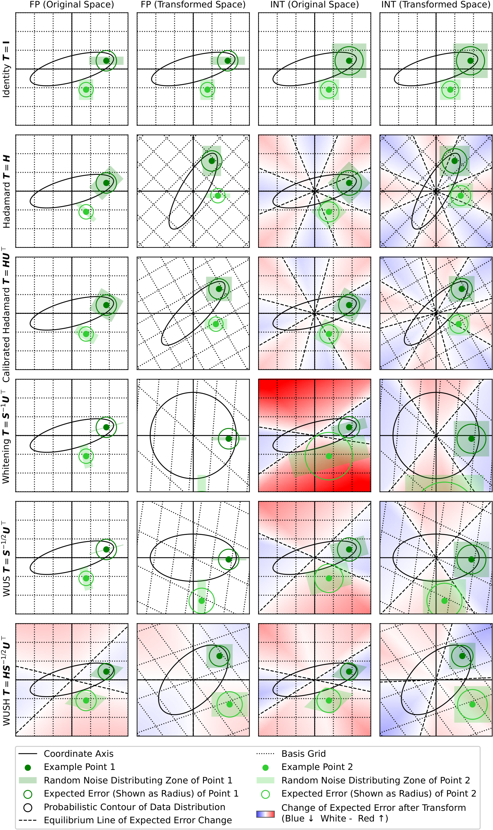
AUTO ROUND / AUTHOR FIGURE / RESEARCH
Beyond fixed HMT: data-aware transforms
Original WUSH figure: not every optimal candidate is an orthogonal rotation.
Why compare?
Use weight and activation second moments
Fixed Hadamard need not be optimal
Theory assumptions are not task guarantees
Why not the MVP default?
Non-orthogonal T needs W T^(-T)
Measure dense-block and scale overhead
Compare learned rotations at matched cost
Source R12 · Apache-2.0 · Zoom the original figure; commentary is original to this report.
Research and implementation design | Intel XPU | 2026-11-05 | No new-feature benchmarks
21
Notes:
Beyond fixed HMT: data-aware transforms
Author figure plots/1_toy_example.pdf rasterized without modifying labels/data, Apache-2.0. Theoretical assumptions do not establish this task's optimality.
Evidence boundary: pinned author implementations, author-released figures/data and local source inspected. Direct arXiv full-text access failed. No new-feature model or XPU benchmark was run.
R12: WUSH: Near-Optimal Adaptive Transforms for LLM Quantization
Paper: https://arxiv.org/abs/2512.00956
Repository: IST-DASLab/WUSH @ 0b69f66cb88aae673d63ae8b5fd96ac751c5a957
README.md: https://github.com/IST-DASLab/WUSH/blob/0b69f66cb88aae673d63ae8b5fd96ac751c5a957/README.md
LICENSE: https://github.com/IST-DASLab/WUSH/blob/0b69f66cb88aae673d63ae8b5fd96ac751c5a957/LICENSE
src/block_transform.py: https://github.com/IST-DASLab/WUSH/blob/0b69f66cb88aae673d63ae8b5fd96ac751c5a957/src/block_transform.py
plots/1_toy_example.pdf: https://github.com/IST-DASLab/WUSH/blob/0b69f66cb88aae673d63ae8b5fd96ac751c5a957/plots/1_toy_example.pdf
plots/2_speedup.pdf: https://github.com/IST-DASLab/WUSH/blob/0b69f66cb88aae673d63ae8b5fd96ac751c5a957/plots/2_speedup.pdf
plots/2_speedup.py: https://github.com/IST-DASLab/WUSH/blob/0b69f66cb88aae673d63ae8b5fd96ac751c5a957/plots/2_speedup.py
plots/5_visual.pdf: https://github.com/IST-DASLab/WUSH/blob/0b69f66cb88aae673d63ae8b5fd96ac751c5a957/plots/5_visual.pdf
plots/3_platinum_bench.csv: https://github.com/IST-DASLab/WUSH/blob/0b69f66cb88aae673d63ae8b5fd96ac751c5a957/plots/3_platinum_bench.csv
plots/3_platinum_bench.py: https://github.com/IST-DASLab/WUSH/blob/0b69f66cb88aae673d63ae8b5fd96ac751c5a957/plots/3_platinum_bench.py
plots/3_platinum_bench/10_llama-3.1-8b_table.pdf: https://github.com/IST-DASLab/WUSH/blob/0b69f66cb88aae673d63ae8b5fd96ac751c5a957/plots/3_platinum_bench/10_llama-3.1-8b_table.pdf
R06: SpinQuant: LLM Quantization with Learned Rotations
Paper: https://arxiv.org/abs/2405.16406
Repository: facebookresearch/SpinQuant @ 8f47aa3f00e8662caf1a484153920a07e5281c3a
README.md: https://github.com/facebookresearch/SpinQuant/blob/8f47aa3f00e8662caf1a484153920a07e5281c3a/README.md
LICENSE: https://github.com/facebookresearch/SpinQuant/blob/8f47aa3f00e8662caf1a484153920a07e5281c3a/LICENSE

Slide 22
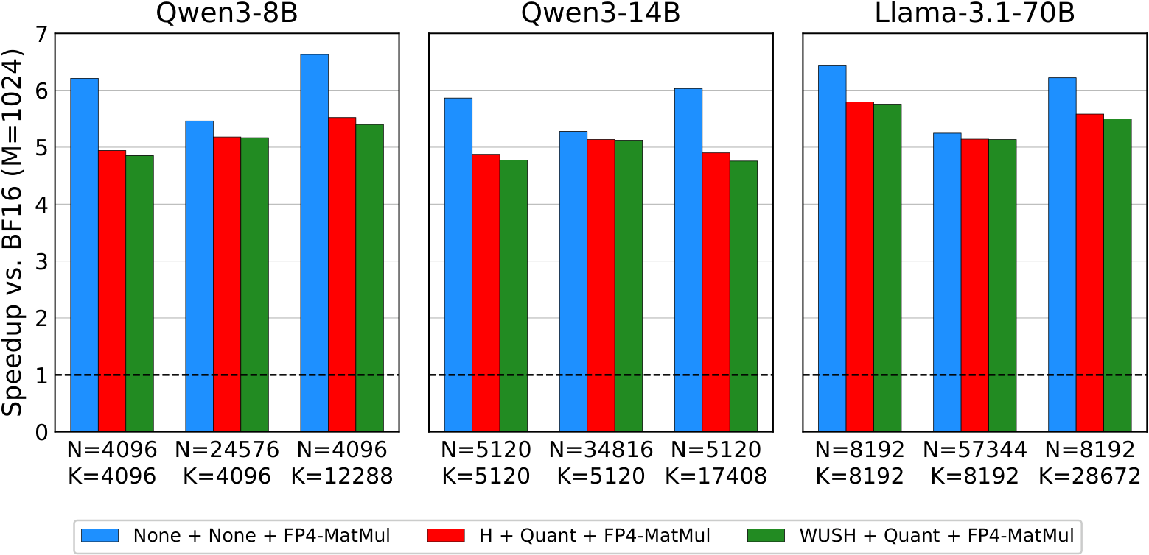
AUTO ROUND / AUTHOR FIGURE / EVIDENCE LIMITS
What a paper speed chart can and cannot establish
WUSH author figure 2: per-layer speedup vs. BF16 at M=1024. Not end-to-end or Intel data.
Include transform and quantization overhead; some kernel gains may still remain.
The figure/script does not establish a GPU model. No cross-hardware claim. Source R12 · Apache-2.0.
Research and implementation design | Intel XPU | 2026-11-05 | No new-feature benchmarks
22
Notes:
What a paper speed chart can and cannot establish
Author plots/2_speedup.pdf and plotting arrays inspected. Device model is not established by this figure/script; do not infer it from supported-backend lists.
Evidence boundary: pinned author implementations, author-released figures/data and local source inspected. Direct arXiv full-text access failed. No new-feature model or XPU benchmark was run.
R12: WUSH: Near-Optimal Adaptive Transforms for LLM Quantization
Paper: https://arxiv.org/abs/2512.00956
Repository: IST-DASLab/WUSH @ 0b69f66cb88aae673d63ae8b5fd96ac751c5a957
README.md: https://github.com/IST-DASLab/WUSH/blob/0b69f66cb88aae673d63ae8b5fd96ac751c5a957/README.md
LICENSE: https://github.com/IST-DASLab/WUSH/blob/0b69f66cb88aae673d63ae8b5fd96ac751c5a957/LICENSE
src/block_transform.py: https://github.com/IST-DASLab/WUSH/blob/0b69f66cb88aae673d63ae8b5fd96ac751c5a957/src/block_transform.py
plots/1_toy_example.pdf: https://github.com/IST-DASLab/WUSH/blob/0b69f66cb88aae673d63ae8b5fd96ac751c5a957/plots/1_toy_example.pdf
plots/2_speedup.pdf: https://github.com/IST-DASLab/WUSH/blob/0b69f66cb88aae673d63ae8b5fd96ac751c5a957/plots/2_speedup.pdf
plots/2_speedup.py: https://github.com/IST-DASLab/WUSH/blob/0b69f66cb88aae673d63ae8b5fd96ac751c5a957/plots/2_speedup.py
plots/5_visual.pdf: https://github.com/IST-DASLab/WUSH/blob/0b69f66cb88aae673d63ae8b5fd96ac751c5a957/plots/5_visual.pdf
plots/3_platinum_bench.csv: https://github.com/IST-DASLab/WUSH/blob/0b69f66cb88aae673d63ae8b5fd96ac751c5a957/plots/3_platinum_bench.csv
plots/3_platinum_bench.py: https://github.com/IST-DASLab/WUSH/blob/0b69f66cb88aae673d63ae8b5fd96ac751c5a957/plots/3_platinum_bench.py
plots/3_platinum_bench/10_llama-3.1-8b_table.pdf: https://github.com/IST-DASLab/WUSH/blob/0b69f66cb88aae673d63ae8b5fd96ac751c5a957/plots/3_platinum_bench/10_llama-3.1-8b_table.pdf

Slide 23
AUTO ROUND / DESIGN
AutoRound integration: extend existing mechanisms
Baseline 5db1082. A preprocessing / quantization plan, not a new scalar datatype.
Layer | Existing mechanism | Required extension
Schemes / numerics | schemes.py；data_type/mxfp.py | Explicit plan schema; reuse 4/8-bit QDQ
Composition / calibration | composer；BasePreprocessor | Freeze plans; invalidate references; basis-aware stats
Tuning / grouped | wrapper；grouped_experts.py | Partition QDQ, gradients, signatures, buckets
XPU kernels | ARK HMT + MXFP4 primitive | Gather / signs / split outputs + GEMM consumers
Persistence / inference | qlinear_fp；formats；backend | Two packed partitions; versioned reload
Default off. Preserve existing models, presets, and exported results.
Research and implementation design | Intel XPU | 2026-11-05 | No new-feature benchmarks
23
Notes:
AutoRound integration: extend existing mechanisms
Evidence boundary: pinned author implementations, author-released figures/data and local source inspected. Direct arXiv full-text access failed. No new-feature model or XPU benchmark was run.

Slide 24
AUTO ROUND / DESIGN
Three real gaps: hooks, packed consumers, capabilities
Code existence does not establish integration into a model's actual inference path.
Grouped hooks
An existing HMT primitive
Existing W4A8 is not MX
Online transform hooks disqualify
some grouped fast paths.
Add explicit plan execution, not just hooks.
The XPU primitive emits packed FP4.
That does not establish dense / MoE
MXFP4 activation GEMM integration.
ARK uses INT4 storage
with INT8 DPAS compute.
Some FP8 paths await hardware validation.
Benchmark the actual dispatch, fallback reason, workspace, and code revision.
Research and implementation design | Intel XPU | 2026-11-05 | No new-feature benchmarks
24
Notes:
Three real gaps: hooks, packed consumers, capabilities
Evidence boundary: pinned author implementations, author-released figures/data and local source inspected. Direct arXiv full-text access failed. No new-feature model or XPU benchmark was run.

Slide 25
AUTO ROUND / XPU IMPLEMENTATION
Intel XPU: probe native compute, do not assume it
Pinned oneDNN main commit 4149450; not a guarantee about the installed release.
Architecture | FP8 | FP4 E2M1
Xe-HPC | Conversion | Conversion
Xe2-HPG | Conversion | Conversion
Xe3-LPG | Conversion | Conversion
Xe3p-LPG | Native | Conversion
Xe3p-XPC | Native | Native
Still probe the primitive: A8W4? Block-scale layouts? Grouped / ragged support?
Record GPU ID, driver, oneAPI, oneDNN, and ARK revisions. Explicitly reject unimplemented paths.
Research and implementation design | Intel XPU | 2026-11-05 | No new-feature benchmarks
25
Notes:
Intel XPU: probe native compute, do not assume it
Datatype table marks native compute vs conversion. Native datatype support does not guarantee mixed A8W4, E8M0 scale layouts, or ragged grouped GEMM.
Evidence boundary: pinned author implementations, author-released figures/data and local source inspected. Direct arXiv full-text access failed. No new-feature model or XPU benchmark was run.
R13: oneDNN datatype hardware limitations and MXFP8 matmul tutorial
Paper: Documentation
Repository: uxlfoundation/oneDNN @ 41494503bcbd60a761c0965ecb8ed6e57922974b
doc/common_concepts/data_types.md: https://github.com/uxlfoundation/oneDNN/blob/41494503bcbd60a761c0965ecb8ed6e57922974b/doc/common_concepts/data_types.md
examples/tutorials/matmul/mxfp_matmul.cpp: https://github.com/uxlfoundation/oneDNN/blob/41494503bcbd60a761c0965ecb8ed6e57922974b/examples/tutorials/matmul/mxfp_matmul.cpp

Slide 26
AUTO ROUND / XPU IMPLEMENTATION
Kernel tiers: reference, decode-fused, verified native
One packed ABI and one numeric contract across three execution tiers.
Tier | Implementation | Benefits / limits
Reference | FP32 transform + QDQ; concatenated high-precision GEMM | Correctness oracle; its runtime is not low-bit kernel speed
Conversion devices | Decode FP4/FP8 on load; group scales; FP16/BF16 DPAS | Reduce storage / decode workspace; no native FP4 throughput claim
Native devices | Supported block-scaled ops; dual branches or fused accumulation | Verify every operand / shape / numeric profile
Fusion target: routing + gather + sign + HMT + quantize + pack
Research and implementation design | Intel XPU | 2026-11-05 | No new-feature benchmarks
26
Notes:
Kernel tiers: reference, decode-fused, verified native
Evidence boundary: pinned author implementations, author-released figures/data and local source inspected. Direct arXiv full-text access failed. No new-feature model or XPU benchmark was run.

Slide 27
AUTO ROUND / DESIGN
Persist one versioned plan across the entire lifecycle
Proposed schema, not a callable API. Do not pass unknown fields to a filtering from_dict.
Metadata | Tensor buffers | Load-time validation
version / profile / transform_order | Actual permutation and signs | Dimensions, valid permutation, hashes
mask_basis / logical K / padded K4,K8 | Partitioned packed weights + E8M0 scales | Disjoint, full K coverage, group boundaries
Shared-plan links / transformed-weight flag | Optional expanded caches are not original weights | Apply once; prevent double rotation
Keep the same plan through save → shard/offload → load → generate.
safetensors buffers; legacy checkpoints; rank-local K permutations for initial TP support.
Reject unsupported backends; reference fallback must be explicitly enabled and logged.
Research and implementation design | Intel XPU | 2026-11-05 | No new-feature benchmarks
27
Notes:
Persist one versioned plan across the entire lifecycle
Evidence boundary: pinned author implementations, author-released figures/data and local source inspected. Direct arXiv full-text access failed. No new-feature model or XPU benchmark was run.

Slide 28
AUTO ROUND / DESIGN
Correctness: algebra first, then encoding, then models
Accumulation orders may differ; packed codes must match the corresponding numeric reference.
Level | Required tests
Algebra | Paired permutation, orthogonal / inverse transpose, one-sided negative tests, normalization
Encoding | Ties, zero groups / signed zero, extremes / subnormals, NaN/Inf, reserved E8M0
Partitions | Empty / full S8, tails, invalid indices rejected, one bias, retained padded coordinates
grouped | Empty experts, hotspots, top-k scatter, shared / independent plans, signatures / fallback
Lifecycle | Gradients / STE, quantize-save-load, immediate shards, meta/offload, legacy models
Disabled features must preserve behavior. Tiny random-model checks are not real-model accuracy evidence.
Research and implementation design | Intel XPU | 2026-11-05 | No new-feature benchmarks
28
Notes:
Correctness: algebra first, then encoding, then models
Evidence boundary: pinned author implementations, author-released figures/data and local source inspected. Direct arXiv full-text access failed. No new-feature model or XPU benchmark was run.

Slide 29
AUTO ROUND / DESIGN
Experiments: fair budgets, separate data, real MoE loads
Tiny → dense → MoE. Include prefill and decode, not only large-M GEMM.
Axis | Recommended matrix
Baselines | BF16; existing MXFP4 RTN / AutoRound; F1, F2, combined; each ±HMT
Budgets | Match actual K8, all-W4, calibration data, tuning iterations; separate optional W8
Shapes | M=1/8/32/128/1024; real projections, e.g. K=768/2048/4096/11008
MoE | E=8/64/128, top-k=2/8; balanced, long-tail, empty experts, hotspots
Generalization | Separate calibration / selection / final data; code/math, long context, OOD; ≥3 seeds
Track routing coverage. Forced-coverage samples must not silently replace real token weights.
Research and implementation design | Intel XPU | 2026-11-05 | No new-feature benchmarks
29
Notes:
Experiments: fair budgets, separate data, real MoE loads
Evidence boundary: pinned author implementations, author-released figures/data and local source inspected. Direct arXiv full-text access failed. No new-feature model or XPU benchmark was run.

Slide 30
AUTO ROUND / ACCEPTANCE CRITERIA
Proposed gates: development targets, not achieved results
Accuracy / compression research can succeed without low-bit arithmetic acceleration.
Quality gate / proposed
Engineering gate / proposed
2 dense + 1 MoE model
Median selection-layer error down ≥20%
No material final PPL/task regression
At least one real improvement
Start with K8≤6.25% buckets
Complete projection latency ≤1.10× baseline
Record peak / resident memory
Decide on full-model Pareto results
Total latency = routing + gather + HMT + quantization + both GEMMs + sum + scatter
Same device and budget; post-warmup median/p95. Report kernel / block / TTFT / TPOT separately.
Research and implementation design | Intel XPU | 2026-11-05 | No new-feature benchmarks
30
Notes:
Proposed gates: development targets, not achieved results
Evidence boundary: pinned author implementations, author-released figures/data and local source inspected. Direct arXiv full-text access failed. No new-feature model or XPU benchmark was run.

Slide 31
AUTO ROUND / RESEARCH PRIORITIES
Research priorities: four falsifiable questions first
Constrain later learned rotations, dynamic masks, and MXFP6 by actual implementation cost.
Priority | Direction | Falsifiable question
P0 | Error-gain A8 selection | Better than maximum-magnitude selection at matched K8?
P0 | HMT + A8 | Complementary or substitutes? Can HMT reduce the needed A8 budget?
P0 | Locality-constrained permutations | Retain accuracy while reducing random-gather cost?
P0 | Shared / expert MoE plans | Do expert-specific gains justify top-k preprocessing duplication?
P1 | Exponent boundaries, global budget, WUSH / SpinQuant | Better at matched cost? Is the correct compensation deployable?
P2 | Dynamic masks, W8 / low-rank paths, MXFP6 | Can additional accuracy and additional cost be attributed separately?
Research and implementation design | Intel XPU | 2026-11-05 | No new-feature benchmarks
31
Notes:
Research priorities: four falsifiable questions first
Evidence boundary: pinned author implementations, author-released figures/data and local source inspected. Direct arXiv full-text access failed. No new-feature model or XPU benchmark was run.

Slide 32
AUTO ROUND / DEVELOPMENT PLAN
Milestones: numerics, dense, grouped, persistence
Person-days are effort estimates, not schedule commitments. Algorithm and kernel work can partly overlap.
Stage | Deliverable | Dependencies | Effort
M0 | Device capabilities / numeric profile / packed ABI / baseline | Actual XPU | 2–3 person-days
M1 | CPU reference / F1-F2 dense / negative controls | M0 | 4–6
M2 | HMT / search / AutoRound wrapper | M1 | 5–8
M3 | Fused XPU preprocessing / dual-branch dense | M0/M1; HMT needs M2 | 6–10
M4 | Shared expert plans / bucketing / decode | M2/M3 | 6–10
M5 | Export-reload / shards-TP / full evaluation | M2/M3; MoE needs M4 | 5–8
Research and implementation design | Intel XPU | 2026-11-05 | No new-feature benchmarks
32
Notes:
Milestones: numerics, dense, grouped, persistence
Evidence boundary: pinned author implementations, author-released figures/data and local source inspected. Direct arXiv full-text access failed. No new-feature model or XPU benchmark was run.

Slide 33
AUTO ROUND / RECOMMENDATION
Final decision: Pareto evidence, not isolated claims
More accurate, smaller, and faster are three different conclusions.
Complete M0 / M1 before selecting the kernel investment.
Keep static plans with real accuracy gains at a matched budget.
Advance XPU paths with controlled total cost and export/reload support.
Reject candidates that overfit calibration data or have excessive gather cost.
Core contribution: AutoRound × channel budgets × HMT × Intel XPU / MoE
Research and implementation design | Intel XPU | 2026-11-05 | No new-feature benchmarks
33
Notes:
Final decision: Pareto evidence, not isolated claims
Evidence boundary: pinned author implementations, author-released figures/data and local source inspected. Direct arXiv full-text access failed. No new-feature model or XPU benchmark was run.

Slide 34
AUTO ROUND / REFERENCES AND LICENSES
References 1/2: papers and pinned implementations
Full titles, URLs, file SHA256, licenses, and evidence notes: evidence.json and speaker notes.
ID | Work / reference | Paper ID | Pinned commit
R01 | Microscaling / OCP MX | 2310.10537 | 7bc4195
R02 | RPTQ | 2304.01089 | 9619069
R03 | DuQuant | 2406.01721 | d56cfc6
R04 | DuQuant++ | 2604.17789 | 6c13ec0
R05 | QuaRot | 2404.00456 | 5008669
R06 | SpinQuant | 2405.16406 | 8f47aa3
R07 | LLM.int8() / bitsandbytes | 2208.07339 | a616886
Only licensed MIT / Apache author assets are reproduced. No MicroMix / Atom / SpinQuant artwork.
Research and implementation design | Intel XPU | 2026-11-05 | No new-feature benchmarks
34
Notes:
References 1/2: papers and pinned implementations
Evidence boundary: pinned author implementations, author-released figures/data and local source inspected. Direct arXiv full-text access failed. No new-feature model or XPU benchmark was run.
R01: Microscaling Data Formats for Deep Learning
Paper: https://arxiv.org/abs/2310.10537
Repository: microsoft/microxcaling @ 7bc41952de394f5cc5e782baf132e7c7542eb4e4
README.md: https://github.com/microsoft/microxcaling/blob/7bc41952de394f5cc5e782baf132e7c7542eb4e4/README.md
mx/formats.py: https://github.com/microsoft/microxcaling/blob/7bc41952de394f5cc5e782baf132e7c7542eb4e4/mx/formats.py
mx/mx_ops.py: https://github.com/microsoft/microxcaling/blob/7bc41952de394f5cc5e782baf132e7c7542eb4e4/mx/mx_ops.py
R02: RPTQ: Reorder-based Post-training Quantization for Large Language Models
Paper: https://arxiv.org/abs/2304.01089
Repository: hahnyuan/RPTQ4LLM @ 96190691f02be6b27ba24d5a73574dbf9a8336c6
README.md: https://github.com/hahnyuan/RPTQ4LLM/blob/96190691f02be6b27ba24d5a73574dbf9a8336c6/README.md
LICENSE: https://github.com/hahnyuan/RPTQ4LLM/blob/96190691f02be6b27ba24d5a73574dbf9a8336c6/LICENSE
quantize/reorder_utils.py: https://github.com/hahnyuan/RPTQ4LLM/blob/96190691f02be6b27ba24d5a73574dbf9a8336c6/quantize/reorder_utils.py
R03: DuQuant: Distributing Outliers via Dual Transformation Makes Stronger Quantized LLMs
Paper: https://arxiv.org/abs/2406.01721
Repository: Hsu1023/DuQuant @ d56cfc6fe97c34c0eb100fec82fe439865905679
README.md: https://github.com/Hsu1023/DuQuant/blob/d56cfc6fe97c34c0eb100fec82fe439865905679/README.md
LICENSE: https://github.com/Hsu1023/DuQuant/blob/d56cfc6fe97c34c0eb100fec82fe439865905679/LICENSE
imgs/duquant.png: https://github.com/Hsu1023/DuQuant/blob/d56cfc6fe97c34c0eb100fec82fe439865905679/imgs/duquant.png
imgs/ppl.png: https://github.com/Hsu1023/DuQuant/blob/d56cfc6fe97c34c0eb100fec82fe439865905679/imgs/ppl.png
quantize/utils.py: https://github.com/Hsu1023/DuQuant/blob/d56cfc6fe97c34c0eb100fec82fe439865905679/quantize/utils.py
quantize/duquant.py: https://github.com/Hsu1023/DuQuant/blob/d56cfc6fe97c34c0eb100fec82fe439865905679/quantize/duquant.py
R04: DuQuant++: Fine-grained Rotation Enhances Microscaling FP4 Quantization
Paper: https://arxiv.org/abs/2604.17789
Repository: Hsu1023/DuQuant-v2 @ 6c13ec07a3241f2d4ad6415a06403aef43919db9
README.md: https://github.com/Hsu1023/DuQuant-v2/blob/6c13ec07a3241f2d4ad6415a06403aef43919db9/README.md
LICENSE: https://github.com/Hsu1023/DuQuant-v2/blob/6c13ec07a3241f2d4ad6415a06403aef43919db9/LICENSE
quantize/int_linear.py: https://github.com/Hsu1023/DuQuant-v2/blob/6c13ec07a3241f2d4ad6415a06403aef43919db9/quantize/int_linear.py
quantize/quantizer.py: https://github.com/Hsu1023/DuQuant-v2/blob/6c13ec07a3241f2d4ad6415a06403aef43919db9/quantize/quantizer.py
quantize/fp4_ops.py: https://github.com/Hsu1023/DuQuant-v2/blob/6c13ec07a3241f2d4ad6415a06403aef43919db9/quantize/fp4_ops.py
R05: QuaRot: Outlier-Free 4-Bit Inference in Rotated LLMs
Paper: https://arxiv.org/abs/2404.00456
Repository: spcl/QuaRot @ 5008669b08c1f11f9b64d52d16fddd47ca754c5a
README.md: https://github.com/spcl/QuaRot/blob/5008669b08c1f11f9b64d52d16fddd47ca754c5a/README.md
LICENSE: https://github.com/spcl/QuaRot/blob/5008669b08c1f11f9b64d52d16fddd47ca754c5a/LICENSE
img/fig1.png: https://github.com/spcl/QuaRot/blob/5008669b08c1f11f9b64d52d16fddd47ca754c5a/img/fig1.png
R06: SpinQuant: LLM Quantization with Learned Rotations
Paper: https://arxiv.org/abs/2405.16406
Repository: facebookresearch/SpinQuant @ 8f47aa3f00e8662caf1a484153920a07e5281c3a
README.md: https://github.com/facebookresearch/SpinQuant/blob/8f47aa3f00e8662caf1a484153920a07e5281c3a/README.md
LICENSE: https://github.com/facebookresearch/SpinQuant/blob/8f47aa3f00e8662caf1a484153920a07e5281c3a/LICENSE
R07: LLM.int8(): 8-bit Matrix Multiplication for Transformers at Scale
Paper: https://arxiv.org/abs/2208.07339
Repository: bitsandbytes-foundation/bitsandbytes @ a616886cacf86701514f0cb1d6be760f967481c0
README.md: https://github.com/bitsandbytes-foundation/bitsandbytes/blob/a616886cacf86701514f0cb1d6be760f967481c0/README.md

Slide 35
AUTO ROUND / REFERENCES AND LICENSES
References 2/2: papers and pinned implementations
Full titles, URLs, file SHA256, licenses, and evidence notes: evidence.json and speaker notes.
ID | Work / reference | Paper ID | Pinned commit
R08 | QUIK | 2310.09259 | 9558d71
R09 | Atom | 2310.19102 | 7e3618b
R10 | MicroMix | 2508.02343 | c57370b
R11 | FP-Quant / MR-GPTQ | 2509.23202 | d2e3092
R12 | WUSH | 2512.00956 | 0b69f66
R13 | oneDNN datatype / MXFP8 tutorial | Main-branch docs | 4149450
Only licensed MIT / Apache author assets are reproduced. No MicroMix / Atom / SpinQuant artwork.
Research and implementation design | Intel XPU | 2026-11-05 | No new-feature benchmarks
35
Notes:
References 2/2: papers and pinned implementations
Evidence boundary: pinned author implementations, author-released figures/data and local source inspected. Direct arXiv full-text access failed. No new-feature model or XPU benchmark was run.
R08: QUIK: Towards End-to-end 4-Bit Inference on Generative Large Language Models
Paper: https://arxiv.org/abs/2310.09259
Repository: IST-DASLab/QUIK @ 9558d7121c698174fc93940e0b52c38c746c97ea
README.md: https://github.com/IST-DASLab/QUIK/blob/9558d7121c698174fc93940e0b52c38c746c97ea/README.md
R09: Atom: Low-Bit Quantization for Efficient and Accurate LLM Serving
Paper: https://arxiv.org/abs/2310.19102
Repository: efeslab/Atom @ 7e3618b1a7a7c86e1c93cc909b1510c046d76ac6
README.md: https://github.com/efeslab/Atom/blob/7e3618b1a7a7c86e1c93cc909b1510c046d76ac6/README.md
R10: MicroMix: Efficient Mixed-Precision Quantization with Microscaling Formats for Large Language Models
Paper: https://arxiv.org/abs/2508.02343
Repository: lwy2020/MicroMix @ c57370bc38f999e1f75aada9c4b8a85baa44aaae
README.md: https://github.com/lwy2020/MicroMix/blob/c57370bc38f999e1f75aada9c4b8a85baa44aaae/README.md
utilize.py: https://github.com/lwy2020/MicroMix/blob/c57370bc38f999e1f75aada9c4b8a85baa44aaae/utilize.py
reorder_indices.py: https://github.com/lwy2020/MicroMix/blob/c57370bc38f999e1f75aada9c4b8a85baa44aaae/reorder_indices.py
mgemm/README.md: https://github.com/lwy2020/MicroMix/blob/c57370bc38f999e1f75aada9c4b8a85baa44aaae/mgemm/README.md
mgemm/src/w4a8.cu: https://github.com/lwy2020/MicroMix/blob/c57370bc38f999e1f75aada9c4b8a85baa44aaae/mgemm/src/w4a8.cu
mgemm/src/w4a4.cu: https://github.com/lwy2020/MicroMix/blob/c57370bc38f999e1f75aada9c4b8a85baa44aaae/mgemm/src/w4a4.cu
R11: Bridging the Gap Between Promise and Performance for Microscaling FP4 Quantization
Paper: https://arxiv.org/abs/2509.23202
Repository: IST-DASLab/FP-Quant @ d2e3092f968262c4de5fb050e1aef568a280dadd
README.md: https://github.com/IST-DASLab/FP-Quant/blob/d2e3092f968262c4de5fb050e1aef568a280dadd/README.md
R12: WUSH: Near-Optimal Adaptive Transforms for LLM Quantization
Paper: https://arxiv.org/abs/2512.00956
Repository: IST-DASLab/WUSH @ 0b69f66cb88aae673d63ae8b5fd96ac751c5a957
README.md: https://github.com/IST-DASLab/WUSH/blob/0b69f66cb88aae673d63ae8b5fd96ac751c5a957/README.md
LICENSE: https://github.com/IST-DASLab/WUSH/blob/0b69f66cb88aae673d63ae8b5fd96ac751c5a957/LICENSE
src/block_transform.py: https://github.com/IST-DASLab/WUSH/blob/0b69f66cb88aae673d63ae8b5fd96ac751c5a957/src/block_transform.py
plots/1_toy_example.pdf: https://github.com/IST-DASLab/WUSH/blob/0b69f66cb88aae673d63ae8b5fd96ac751c5a957/plots/1_toy_example.pdf
plots/2_speedup.pdf: https://github.com/IST-DASLab/WUSH/blob/0b69f66cb88aae673d63ae8b5fd96ac751c5a957/plots/2_speedup.pdf
plots/2_speedup.py: https://github.com/IST-DASLab/WUSH/blob/0b69f66cb88aae673d63ae8b5fd96ac751c5a957/plots/2_speedup.py
plots/5_visual.pdf: https://github.com/IST-DASLab/WUSH/blob/0b69f66cb88aae673d63ae8b5fd96ac751c5a957/plots/5_visual.pdf
plots/3_platinum_bench.csv: https://github.com/IST-DASLab/WUSH/blob/0b69f66cb88aae673d63ae8b5fd96ac751c5a957/plots/3_platinum_bench.csv
plots/3_platinum_bench.py: https://github.com/IST-DASLab/WUSH/blob/0b69f66cb88aae673d63ae8b5fd96ac751c5a957/plots/3_platinum_bench.py
plots/3_platinum_bench/10_llama-3.1-8b_table.pdf: https://github.com/IST-DASLab/WUSH/blob/0b69f66cb88aae673d63ae8b5fd96ac751c5a957/plots/3_platinum_bench/10_llama-3.1-8b_table.pdf
R13: oneDNN datatype hardware limitations and MXFP8 matmul tutorial
Paper: Documentation
Repository: uxlfoundation/oneDNN @ 41494503bcbd60a761c0965ecb8ed6e57922974b
doc/common_concepts/data_types.md: https://github.com/uxlfoundation/oneDNN/blob/41494503bcbd60a761c0965ecb8ed6e57922974b/doc/common_concepts/data_types.md
examples/tutorials/matmul/mxfp_matmul.cpp: https://github.com/uxlfoundation/oneDNN/blob/41494503bcbd60a761c0965ecb8ed6e57922974b/examples/tutorials/matmul/mxfp_matmul.cpp

Slide 36
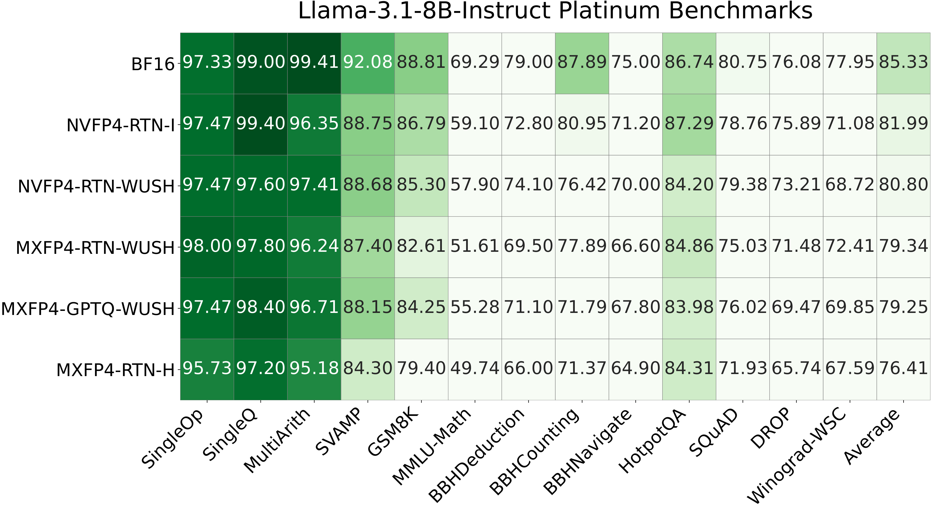
AUTO ROUND / APPENDIX / ORIGINAL AUTHOR TABLE
Appendix: the original WUSH task-level result table
Llama-3.1-8B-Instruct · Author-released figure 10 · Unmodified data and labels · Zoom to read
Source R12 · Apache-2.0 · Complete licenses in these notes and attached to the PDF.
Research and implementation design | Intel XPU | 2026-11-05 | No new-feature benchmarks
36
Notes:
Appendix: the original WUSH task-level result table
Apache-2.0 author figure, rasterized from plots/3_platinum_bench/10_llama-3.1-8b_table.pdf. Full third-party licenses follow in these notes.
Evidence boundary: pinned author implementations, author-released figures/data and local source inspected. Direct arXiv full-text access failed. No new-feature model or XPU benchmark was run.
R12: WUSH: Near-Optimal Adaptive Transforms for LLM Quantization
Paper: https://arxiv.org/abs/2512.00956
Repository: IST-DASLab/WUSH @ 0b69f66cb88aae673d63ae8b5fd96ac751c5a957
README.md: https://github.com/IST-DASLab/WUSH/blob/0b69f66cb88aae673d63ae8b5fd96ac751c5a957/README.md
LICENSE: https://github.com/IST-DASLab/WUSH/blob/0b69f66cb88aae673d63ae8b5fd96ac751c5a957/LICENSE
src/block_transform.py: https://github.com/IST-DASLab/WUSH/blob/0b69f66cb88aae673d63ae8b5fd96ac751c5a957/src/block_transform.py
plots/1_toy_example.pdf: https://github.com/IST-DASLab/WUSH/blob/0b69f66cb88aae673d63ae8b5fd96ac751c5a957/plots/1_toy_example.pdf
plots/2_speedup.pdf: https://github.com/IST-DASLab/WUSH/blob/0b69f66cb88aae673d63ae8b5fd96ac751c5a957/plots/2_speedup.pdf
plots/2_speedup.py: https://github.com/IST-DASLab/WUSH/blob/0b69f66cb88aae673d63ae8b5fd96ac751c5a957/plots/2_speedup.py
plots/5_visual.pdf: https://github.com/IST-DASLab/WUSH/blob/0b69f66cb88aae673d63ae8b5fd96ac751c5a957/plots/5_visual.pdf
plots/3_platinum_bench.csv: https://github.com/IST-DASLab/WUSH/blob/0b69f66cb88aae673d63ae8b5fd96ac751c5a957/plots/3_platinum_bench.csv
plots/3_platinum_bench.py: https://github.com/IST-DASLab/WUSH/blob/0b69f66cb88aae673d63ae8b5fd96ac751c5a957/plots/3_platinum_bench.py
plots/3_platinum_bench/10_llama-3.1-8b_table.pdf: https://github.com/IST-DASLab/WUSH/blob/0b69f66cb88aae673d63ae8b5fd96ac751c5a957/plots/3_platinum_bench/10_llama-3.1-8b_table.pdf
COMPLETE THIRD-PARTY NOTICES AND LICENSES
Apache License
Version 2.0, January 2004
http://www.apache.org/licenses/
TERMS AND CONDITIONS FOR USE, REPRODUCTION, AND DISTRIBUTION
1. Definitions.
"License" shall mean the terms and conditions for use, reproduction,
and distribution as defined by Sections 1 through 9 of this document.
"Licensor" shall mean the copyright owner or entity authorized by
the copyright owner that is granting the License.
"Legal Entity" shall mean the union of the acting entity and all
other entities that control, are controlled by, or are under common
control with that entity. For the purposes of this definition,
"control" means (i) the power, direct or indirect, to cause the
direction or management of such entity, whether by contract or
otherwise, or (ii) ownership of fifty percent (50%) or more of the
outstanding shares, or (iii) beneficial ownership of such entity.
"You" (or "Your") shall mean an individual or Legal Entity
exercising permissions granted by this License.
"Source" form shall mean the preferred form for making modifications,
including but not limited to software source code, documentation
source, and configuration files.
"Object" form shall mean any form resulting from mechanical
transformation or translation of a Source form, including but
not limited to compiled object code, generated documentation,
and conversions to other media types.
"Work" shall mean the work of authorship, whether in Source or
Object form, made available under the License, as indicated by a
copyright notice that is included in or attached to the work
(an example is provided in the Appendix below).
"Derivative Works" shall mean any work, whether in Source or Object
form, that is based on (or derived from) the Work and for which the
editorial revisions, annotations, elaborations, or other modifications
represent, as a whole, an original work of authorship. For the purposes
of this License, Derivative Works shall not include works that remain
separable from, or merely link (or bind by name) to the interfaces of,
the Work and Derivative Works thereof.
"Contribution" shall mean any work of authorship, including
the original version of the Work and any modifications or additions
to that Work or Derivative Works thereof, that is intentionally
submitted to Licensor for inclusion in the Work by the copyright owner
or by an individual or Legal Entity authorized to submit on behalf of
the copyright owner. For the purposes of this definition, "submitted"
means any form of electronic, verbal, or written communication sent
to the Licensor or its representatives, including but not limited to
communication on electronic mailing lists, source code control systems,
and issue tracking systems that are managed by, or on behalf of, the
Licensor for the purpose of discussing and improving the Work, but
excluding communication that is conspicuously marked or otherwise
designated in writing by the copyright owner as "Not a Contribution."
"Contributor" shall mean Licensor and any individual or Legal Entity
on behalf of whom a Contribution has been received by Licensor and
subsequently incorporated within the Work.
2. Grant of Copyright License. Subject to the terms and conditions of
this License, each Contributor hereby grants to You a perpetual,
worldwide, non-exclusive, no-charge, royalty-free, irrevocable
copyright license to reproduce, prepare Derivative Works of,
publicly display, publicly perform, sublicense, and distribute the
Work and such Derivative Works in Source or Object form.
3. Grant of Patent License. Subject to the terms and conditions of
this License, each Contributor hereby grants to You a perpetual,
worldwide, non-exclusive, no-charge, royalty-free, irrevocable
(except as stated in this section) patent license to make, have made,
use, offer to sell, sell, import, and otherwise transfer the Work,
where such license applies only to those patent claims licensable
by such Contributor that are necessarily infringed by their
Contribution(s) alone or by combination of their Contribution(s)
with the Work to which such Contribution(s) was submitted. If You
institute patent litigation against any entity (including a
cross-claim or counterclaim in a lawsuit) alleging that the Work
or a Contribution incorporated within the Work constitutes direct
or contributory patent infringement, then any patent licenses
granted to You under this License for that Work shall terminate
as of the date such litigation is filed.
4. Redistribution. You may reproduce and distribute copies of the
Work or Derivative Works thereof in any medium, with or without
modifications, and in Source or Object form, provided that You
meet the following conditions:
(a) You must give any other recipients of the Work or
Derivative Works a copy of this License; and
(b) You must cause any modified files to carry prominent notices
stating that You changed the files; and
(c) You must retain, in the Source form of any Derivative Works
that You distribute, all copyright, patent, trademark, and
attribution notices from the Source form of the Work,
excluding those notices that do not pertain to any part of
the Derivative Works; and
(d) If the Work includes a "NOTICE" text file as part of its
distribution, then any Derivative Works that You distribute must
include a readable copy of the attribution notices contained
within such NOTICE file, excluding those notices that do not
pertain to any part of the Derivative Works, in at least one
of the following places: within a NOTICE text file distributed
as part of the Derivative Works; within the Source form or
documentation, if provided along with the Derivative Works; or,
within a display generated by the Derivative Works, if and
wherever such third-party notices normally appear. The contents
of the NOTICE file are for informational purposes only and
do not modify the License. You may add Your own attribution
notices within Derivative Works that You distribute, alongside
or as an addendum to the NOTICE text from the Work, provided
that such additional attribution notices cannot be construed
as modifying the License.
You may add Your own copyright statement to Your modifications and
may provide additional or different license terms and conditions
for use, reproduction, or distribution of Your modifications, or
for any such Derivative Works as a whole, provided Your use,
reproduction, and distribution of the Work otherwise complies with
the conditions stated in this License.
5. Submission of Contributions. Unless You explicitly state otherwise,
any Contribution intentionally submitted for inclusion in the Work
by You to the Licensor shall be under the terms and conditions of
this License, without any additional terms or conditions.
Notwithstanding the above, nothing herein shall supersede or modify
the terms of any separate license agreement you may have executed
with Licensor regarding such Contributions.
6. Trademarks. This License does not grant permission to use the trade
names, trademarks, service marks, or product names of the Licensor,
except as required for reasonable and customary use in describing the
origin of the Work and reproducing the content of the NOTICE file.
7. Disclaimer of Warranty. Unless required by applicable law or
agreed to in writing, Licensor provides the Work (and each
Contributor provides its Contributions) on an "AS IS" BASIS,
WITHOUT WARRANTIES OR CONDITIONS OF ANY KIND, either express or
implied, including, without limitation, any warranties or conditions
of TITLE, NON-INFRINGEMENT, MERCHANTABILITY, or FITNESS FOR A
PARTICULAR PURPOSE. You are solely responsible for determining the
appropriateness of using or redistributing the Work and assume any
risks associated with Your exercise of permissions under this License.
8. Limitation of Liability. In no event and under no legal theory,
whether in tort (including negligence), contract, or otherwise,
unless required by applicable law (such as deliberate and grossly
negligent acts) or agreed to in writing, shall any Contributor be
liable to You for damages, including any direct, indirect, special,
incidental, or consequential damages of any character arising as a
result of this License or out of the use or inability to use the
Work (including but not limited to damages for loss of goodwill,
work stoppage, computer failure or malfunction, or any and all
other commercial damages or losses), even if such Contributor
has been advised of the possibility of such damages.
9. Accepting Warranty or Additional Liability. While redistributing
the Work or Derivative Works thereof, You may choose to offer,
and charge a fee for, acceptance of support, warranty, indemnity,
or other liability obligations and/or rights consistent with this
License. However, in accepting such obligations, You may act only
on Your own behalf and on Your sole responsibility, not on behalf
of any other Contributor, and only if You agree to indemnify,
defend, and hold each Contributor harmless for any liability
incurred by, or claims asserted against, such Contributor by reason
of your accepting any such warranty or additional liability.
END OF TERMS AND CONDITIONS
APPENDIX: How to apply the Apache License to your work.
To apply the Apache License to your work, attach the following
boilerplate notice, with the fields enclosed by brackets "[]"
replaced with your own identifying information. (Don't include
the brackets!) The text should be enclosed in the appropriate
comment syntax for the file format. We also recommend that a
file or class name and description of purpose be included on the
same "printed page" as the copyright notice for easier
identification within third-party archives.
Copyright [yyyy] [name of copyright owner]
Licensed under the Apache License, Version 2.0 (the "License");
you may not use this file except in compliance with the License.
You may obtain a copy of the License at
http://www.apache.org/licenses/LICENSE-2.0
Unless required by applicable law or agreed to in writing, software
distributed under the License is distributed on an "AS IS" BASIS,
WITHOUT WARRANTIES OR CONDITIONS OF ANY KIND, either express or implied.
See the License for the specific language governing permissions and
limitations under the License.
MIT License
Copyright (c) 2024 Haobo Xu, Haokun Lin
Permission is hereby granted, free of charge, to any person obtaining a copy
of this software and associated documentation files (the "Software"), to deal
in the Software without restriction, including without limitation the rights
to use, copy, modify, merge, publish, distribute, sublicense, and/or sell
copies of the Software, and to permit persons to whom the Software is
furnished to do so, subject to the following conditions:
The above copyright notice and this permission notice shall be included in all
copies or substantial portions of the Software.
THE SOFTWARE IS PROVIDED "AS IS", WITHOUT WARRANTY OF ANY KIND, EXPRESS OR
IMPLIED, INCLUDING BUT NOT LIMITED TO THE WARRANTIES OF MERCHANTABILITY,
FITNESS FOR A PARTICULAR PURPOSE AND NONINFRINGEMENT. IN NO EVENT SHALL THE
AUTHORS OR COPYRIGHT HOLDERS BE LIABLE FOR ANY CLAIM, DAMAGES OR OTHER
LIABILITY, WHETHER IN AN ACTION OF CONTRACT, TORT OR OTHERWISE, ARISING FROM,
OUT OF OR IN CONNECTION WITH THE SOFTWARE OR THE USE OR OTHER DEALINGS IN THE
SOFTWARE.
THIRD-PARTY FIGURES AND DATA / THIRD-PARTY LICENSE NOTICES
This package reproduces only the assets listed below, under the licenses of their pinned author repositories. It does not assert a license for every figure or the full text of the corresponding papers.
DuQuant: imgs/duquant.png and imgs/ppl.png.
Copyright (c) 2024 Haobo Xu, Haokun Lin. MIT License.
The original copyright and complete license are in DuQuant_MIT.txt.
QuaRot: img/fig1.png. Ashkboos et al., spcl/QuaRot.
Apache License, Version 2.0; complete license in Apache-2.0.txt.
WUSH: plots/1_toy_example.pdf, plots/2_speedup.pdf, plots/3_platinum_bench/10_llama-3.1-8b_table.pdf, and plots/3_platinum_bench.csv. Chen et al., IST-DASLab/WUSH.
Apache License, Version 2.0; complete license in Apache-2.0.txt.
PDF figures were rasterized without changing their labels or data.
Every source URL, revision, original hash, output hash and modification is recorded in ../evidence.json. Paper results are the authors' reported results, not measurements of the proposed AutoRound features.
MicroMix and Atom figures/source code are not redistributed. Their repository license metadata did not establish a reusable license. SpinQuant figures/source code are not redistributed (noncommercial terms).
Original diagrams and newly typeset numeric tables in this package are not reproductions of those projects' artwork or code.

