Slide 1
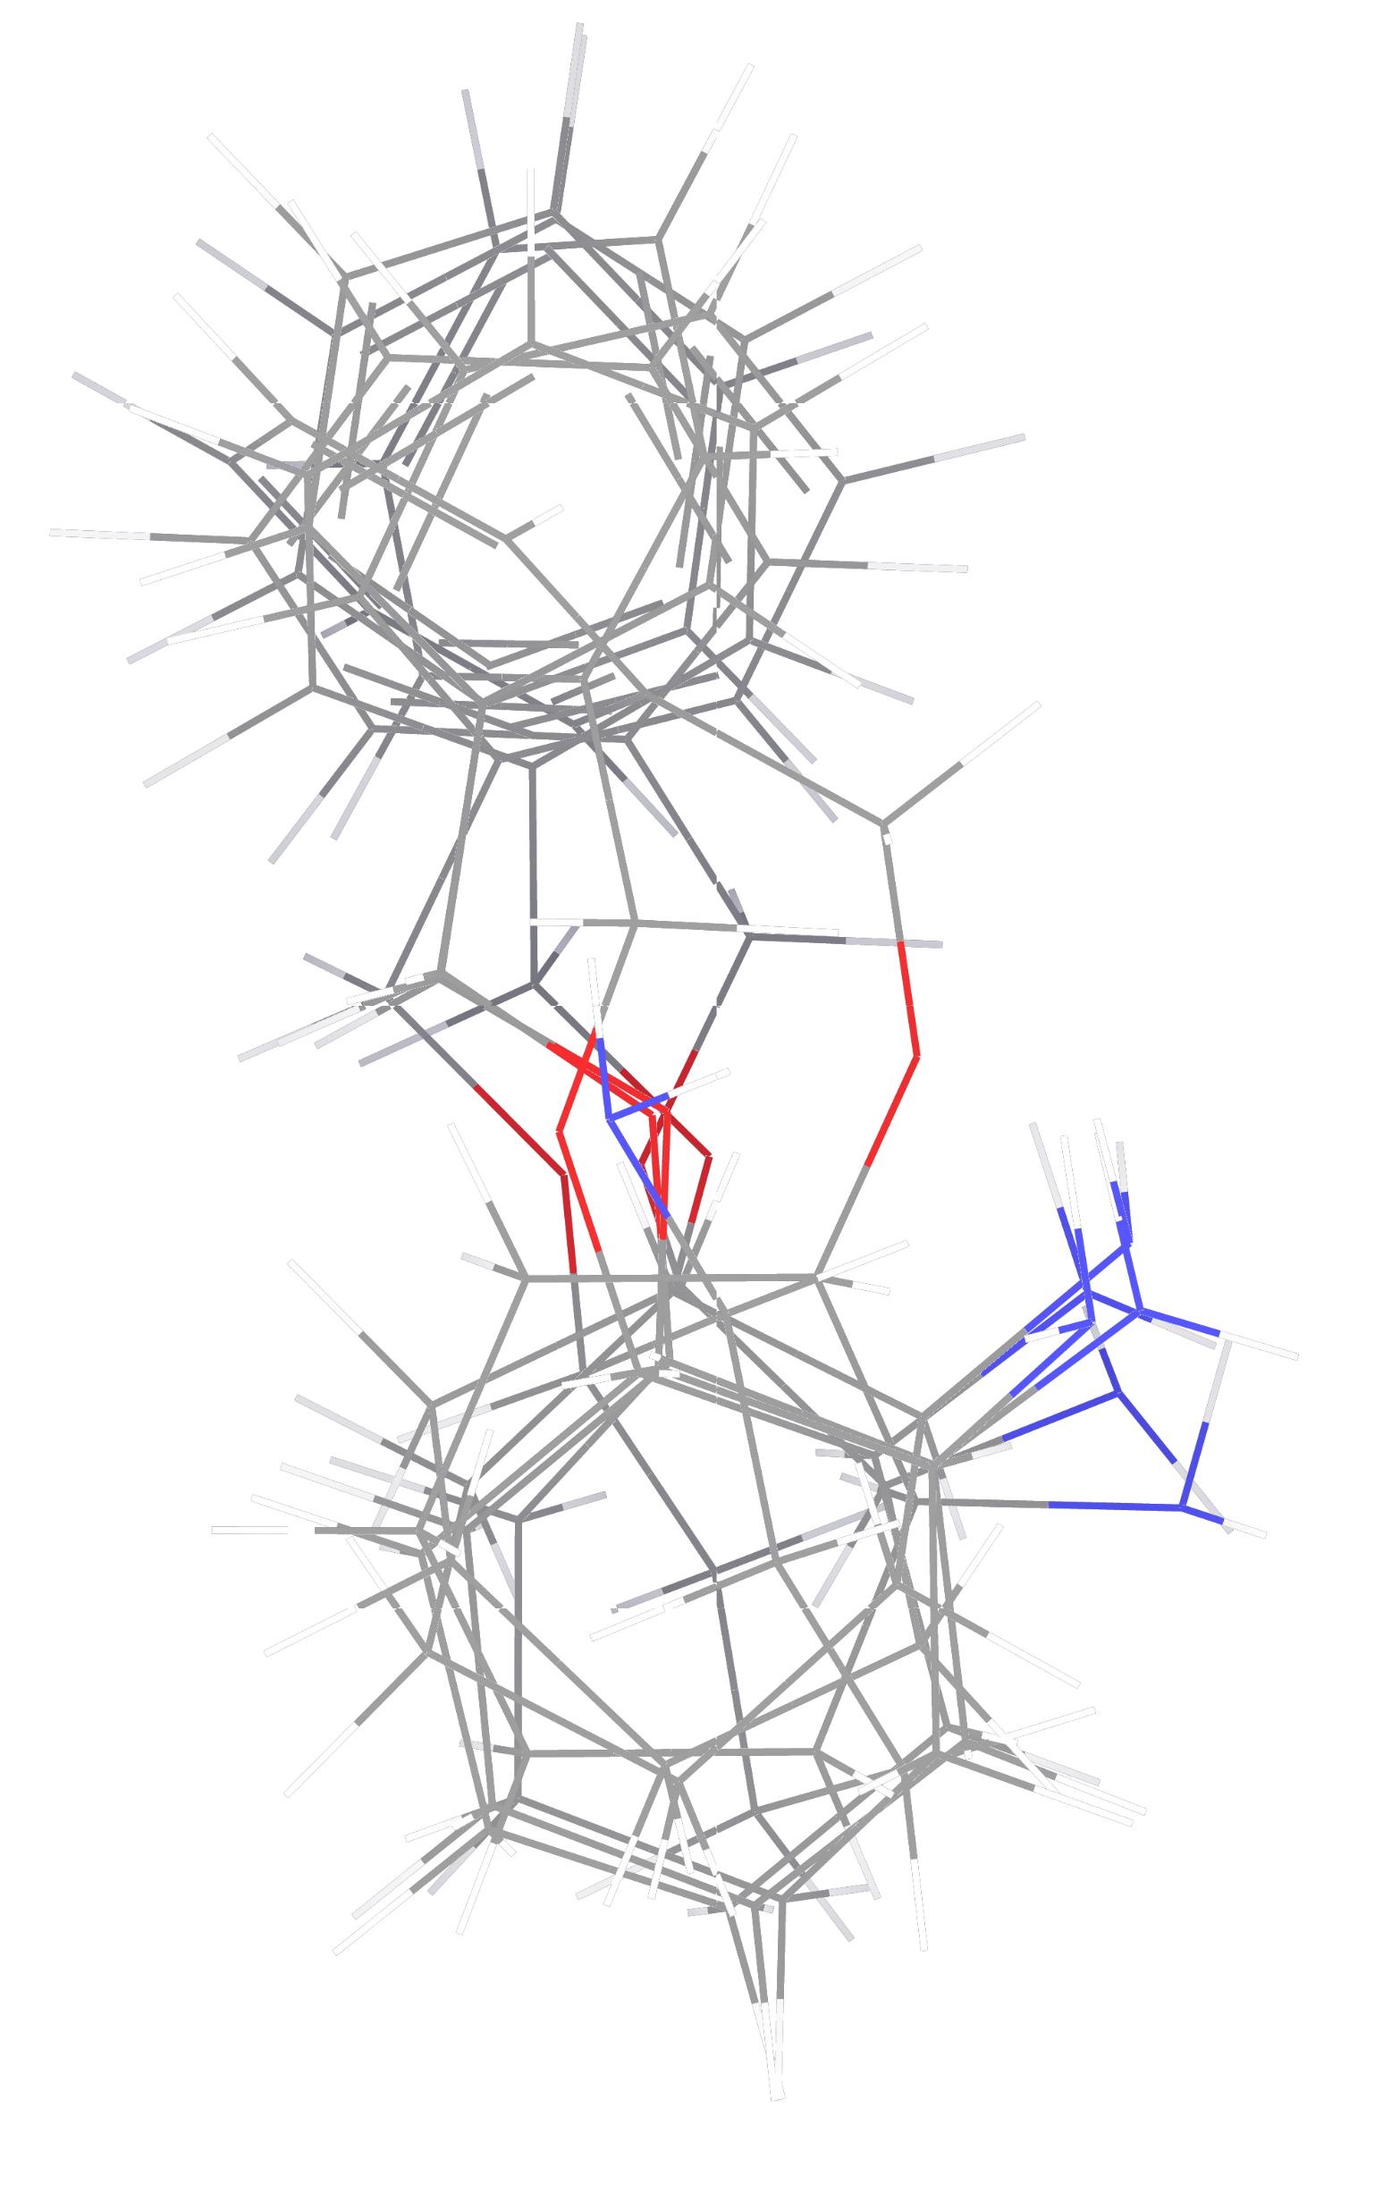
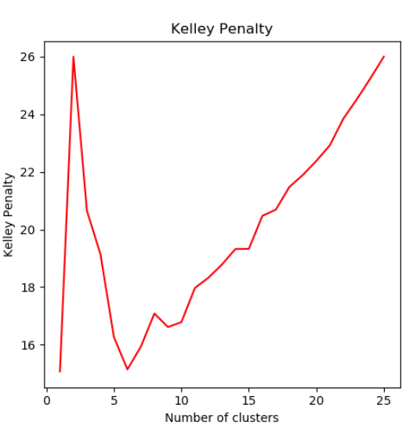

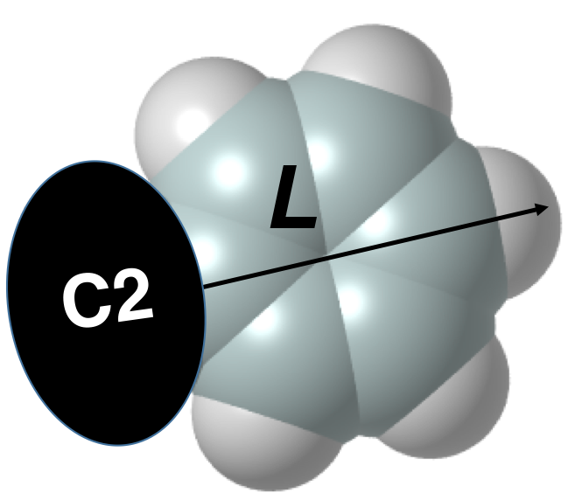
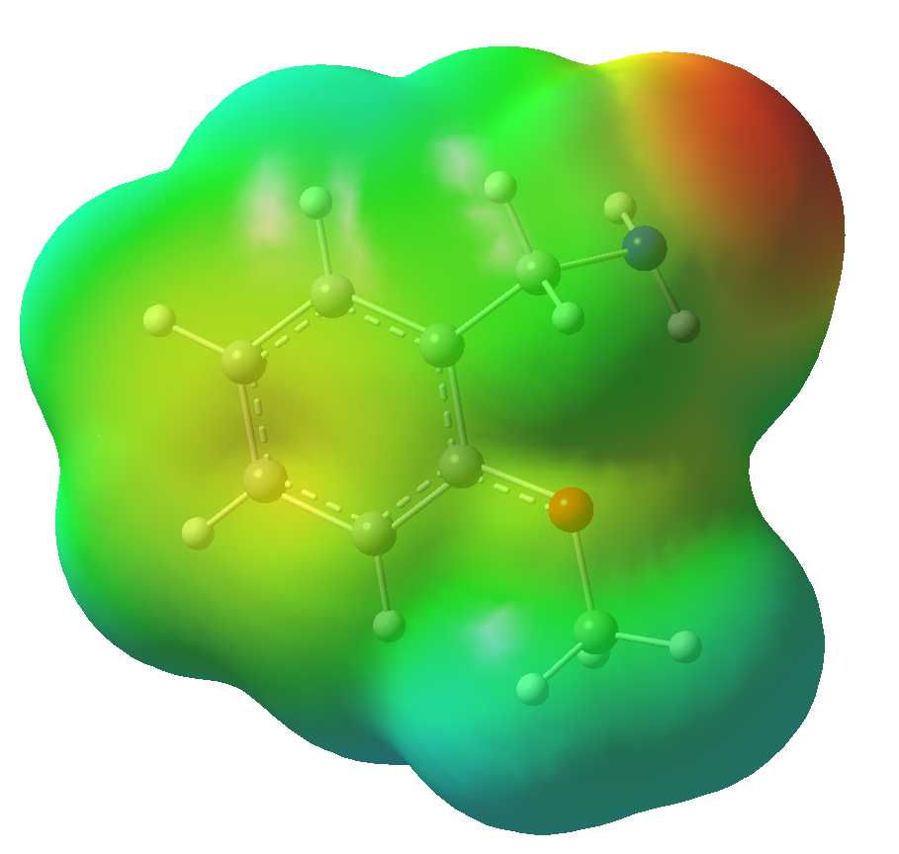
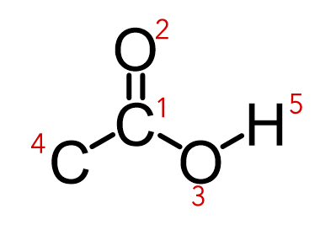
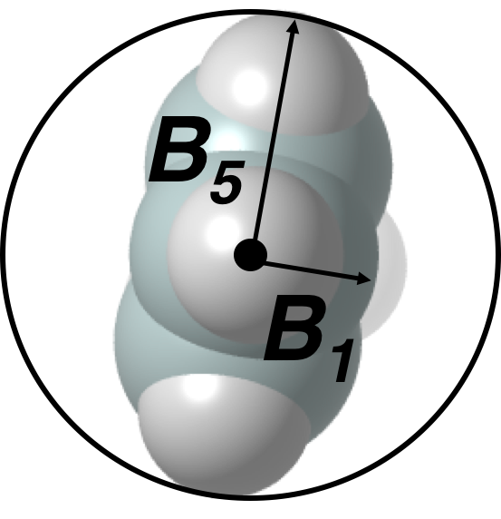

Workflow
Identify Possible Substrates
SMILES to .sdf Files
MacroModel Conformational Search
MacroModel Clustering + .maegz to .sdf Files
Confirm clustering
SMILES_to_sdf.py
cluster based on Kelley penalty value
if >20 confs.
Acids: 8,676
Open Babel
prep_MM_npsh.bash
mm_reference.com
MM_clustering_and_
converting.bash
check_manual_
clustering.bash
Export SMILES to Excel
Get Properties
Atom Number Collection
Check .log Files
Gaussian Geometry Optimization + Single Point
Generate job files
normal job termination
+ no imaginary frequencies
one job per conformer
post_processing.bash
log_check_for_
processing.py
Opt: B3LYP/6-31G(d,p)
SP: M062X/def2tzvp
get_properties_
notebook.ipynb
get_properties_
notebook.ipynb
Group script: Convert Gaussian

Slide 2
Automated Get_Properties_Notebook
Implemented Descriptors
Partially Implemented / Not Generalizable
energies (goodvibes)
nbo
nmr
angle
dihedral angle
distance
plane angle
total time
frontier molecular orbitals
Volume
polarizability
dipole
Sterimol (morfeus)
buried Sterimol (morfeus)
buried volume (morfeus)
buried volume scan (morfeus)
pyramidalization (morfeus)
SASA & sphericity (morfeus)
Sterimol (dbstep)
Sterimol2Vec (dbstep)
Hirshfeld charges
ChelpG
IR stretching frequency – works for one stretch in the input range
Ask Melissa or Brittany for a sample if you want to modify these to your needs:
Buried Volume: hemispheres, quadrants, and octants (morfeus)
Nborbs – can be customized depending the types of orbital occupancy/energies you want out
Not Implemented
e, thermos, efg, tz_e - use goodvibes instead
imaginary frequencies - should be done in log check
qpole
method
route lines
nmr tensors
dorbs
buried volume (dbstep) - takes significantly longer than morfeus
Vol2Vec (dbstep) - takes significantly longer than morfeus Vbur scan
cavity (volume & surface area from solvation model)

