Slide 1

ArmV8 Architecture
AI Infusion

Slide 2
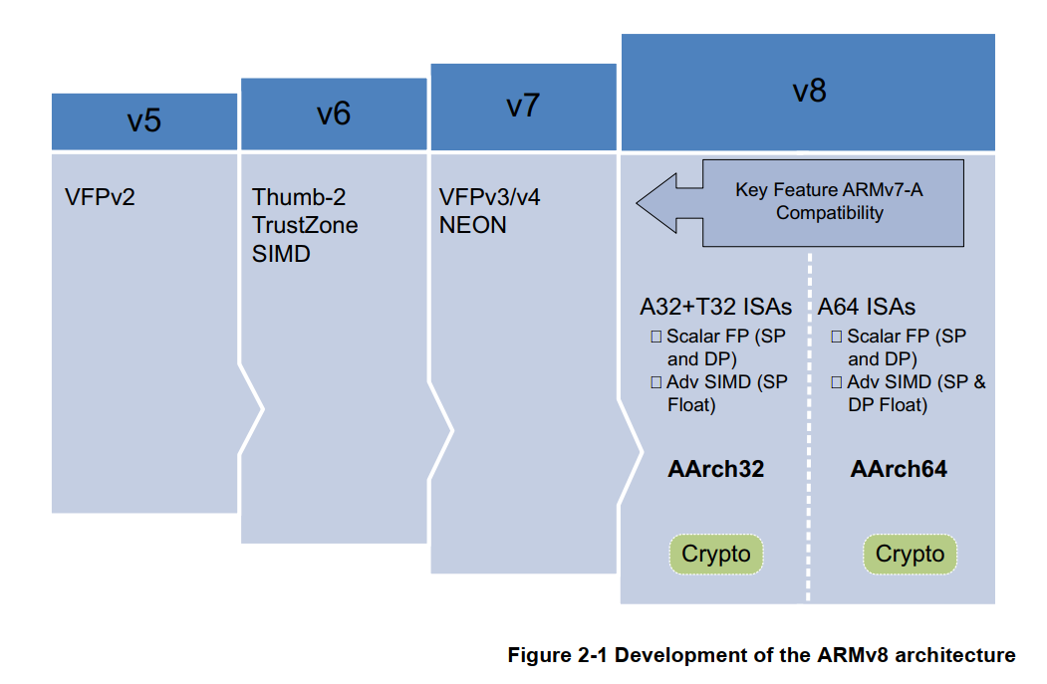
ARM Development

Slide 3
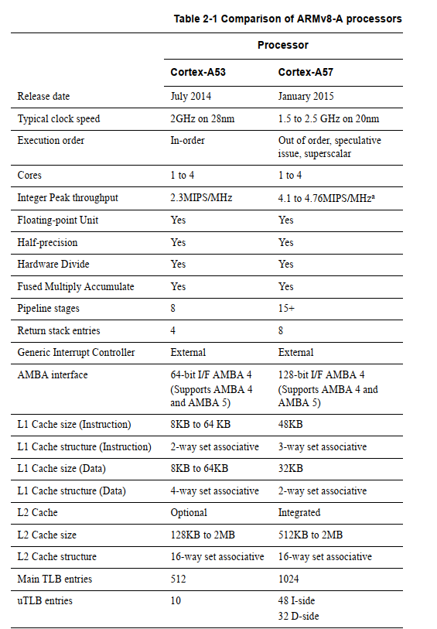
Cortex A-57 Vs Cortex-A53

Slide 4
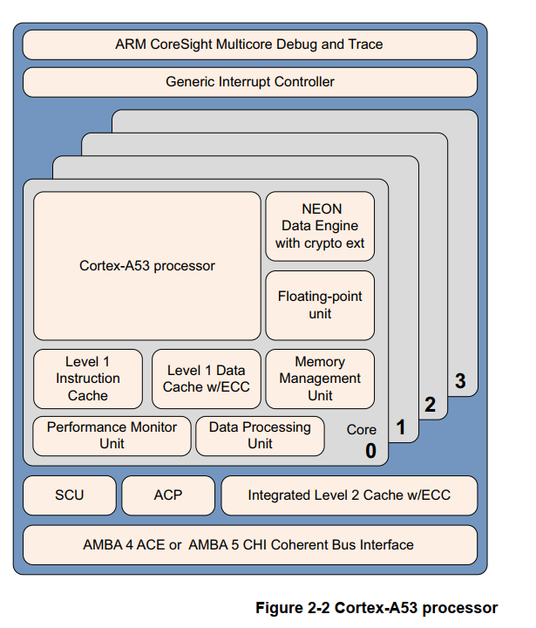
Cortex A-53

Slide 5
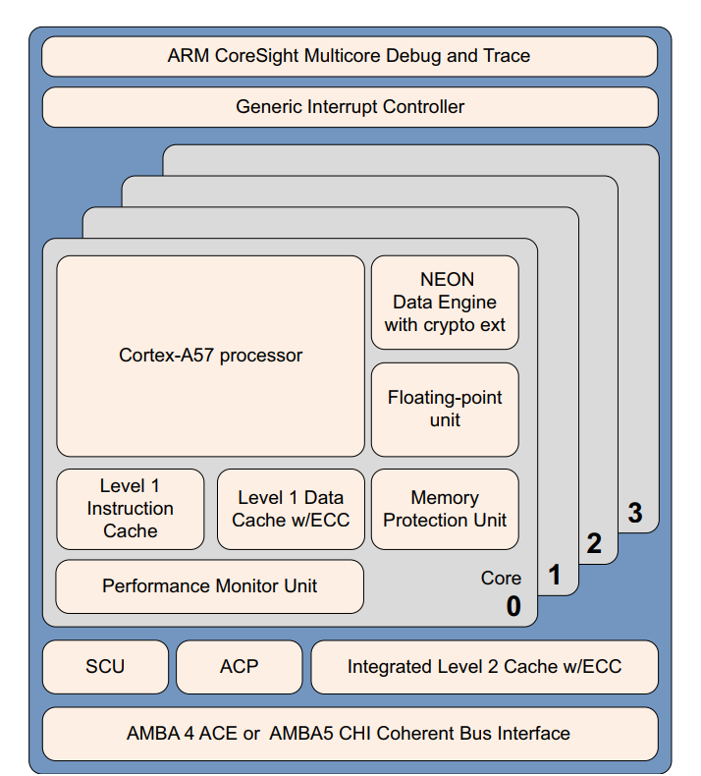
Cortex-A57

Slide 6
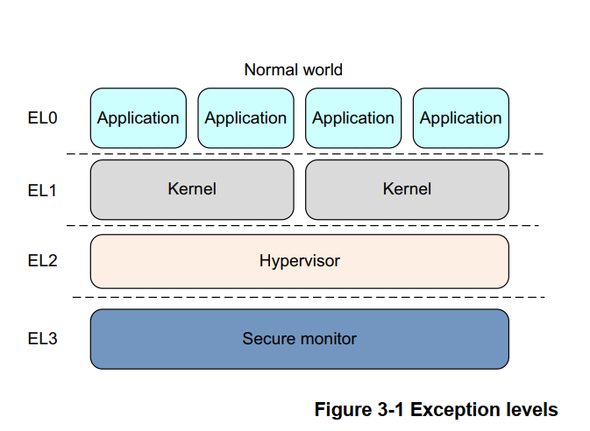
Exception Levels

Slide 7
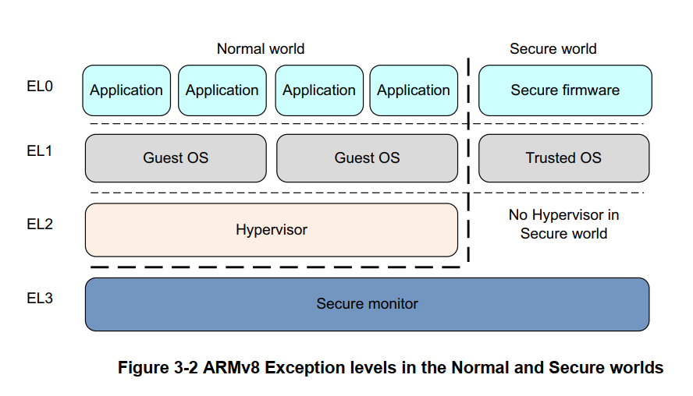
Exception Level Contd..

Slide 8
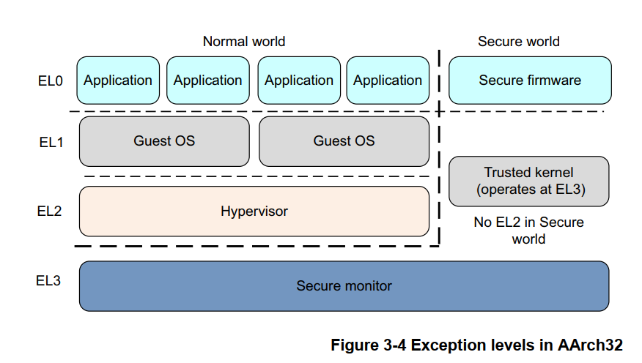
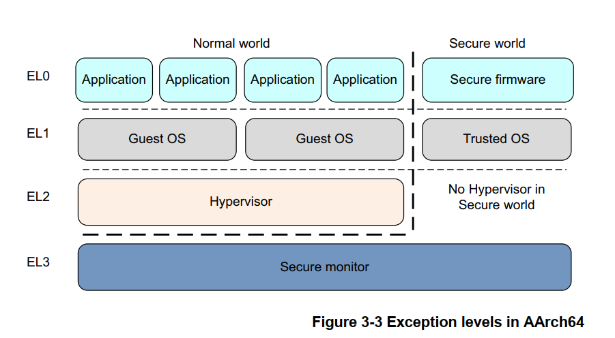
AARCH32 & AARCH64

Slide 9
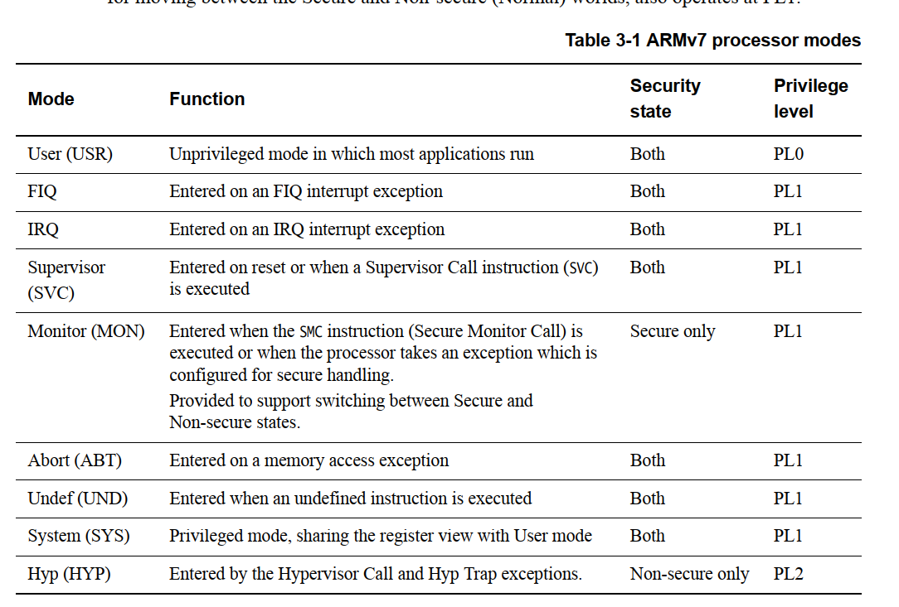
Processor Modes on ARMv7

Slide 10
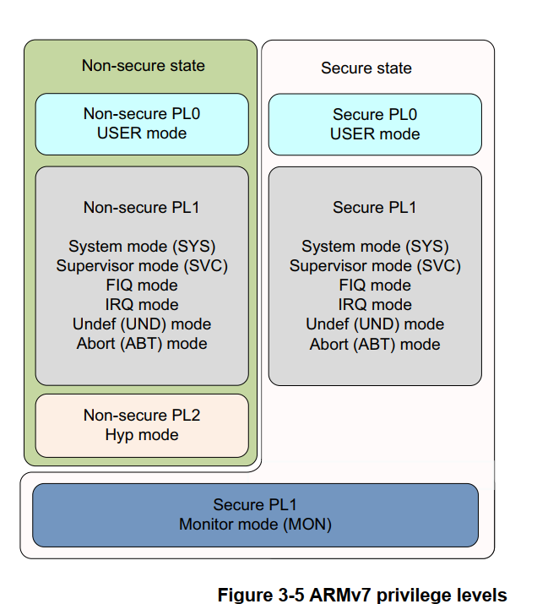
ARMv7 Privilege Levels

Slide 11
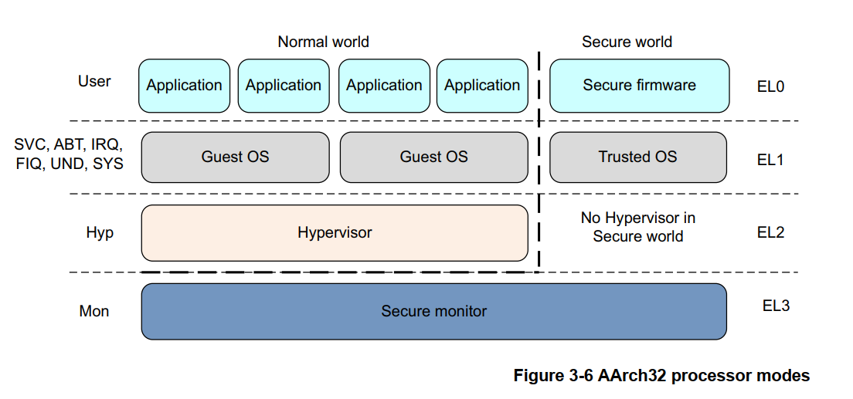
AARCH32 Processor Modes

Slide 12
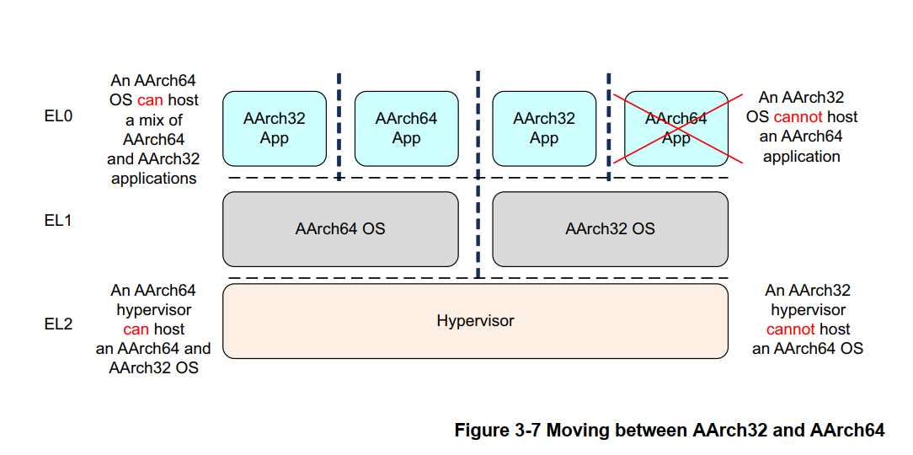
Moving between AARCH32 and AARCH64

Slide 13
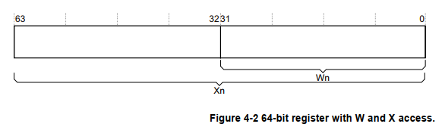
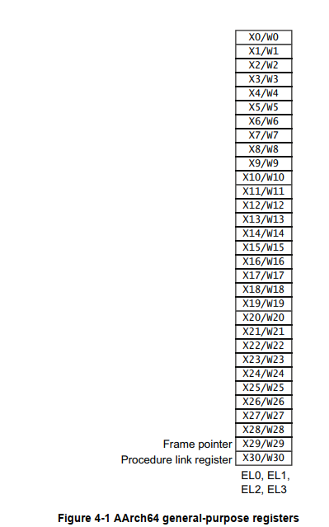
Registers in AARCH64

Slide 14
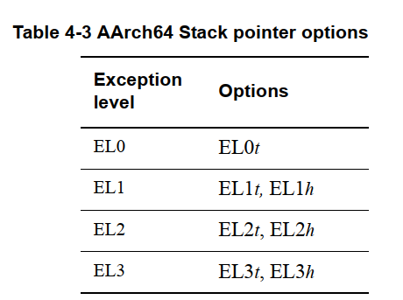
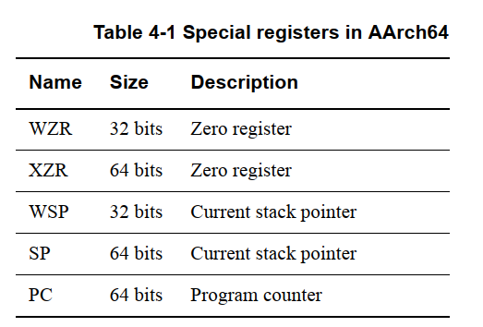
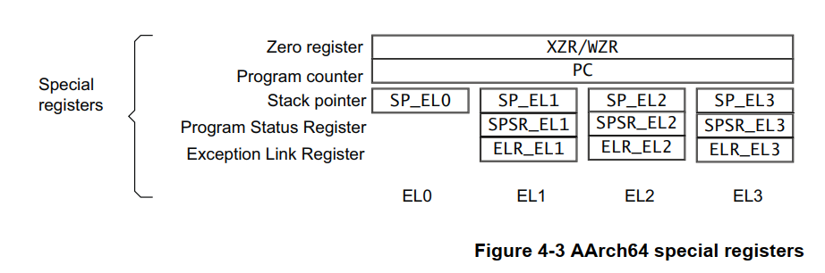
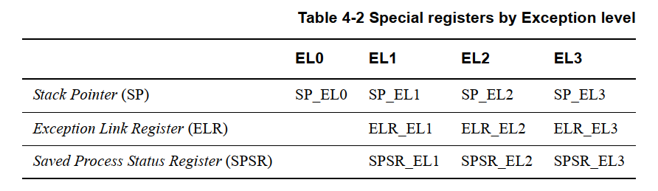
Registers in AARCH64

Slide 15
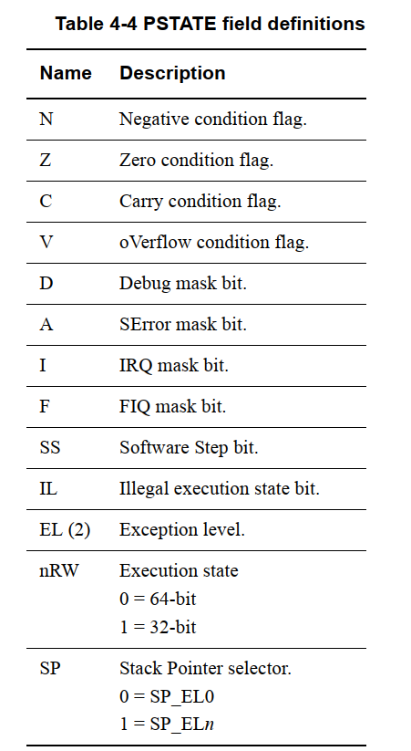
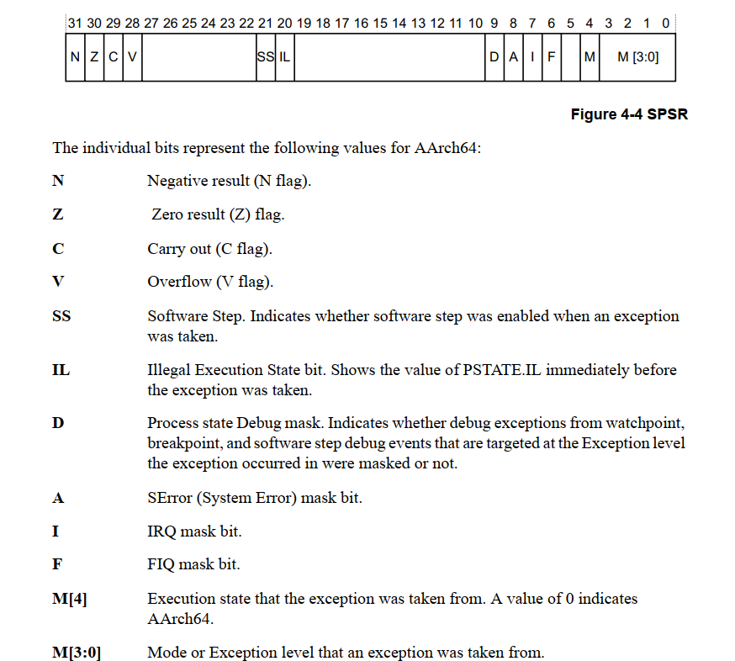
Registers in AARCH64

Slide 16
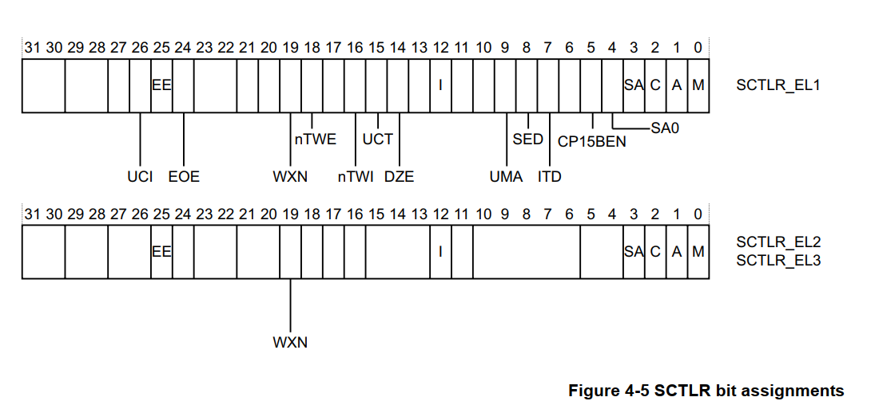
Registers in AARCH64

Slide 17
Register Details
CTR_EL0 | Cache Type R | SCTLR | System Control R
TTBR0,TTBR1 | Translation Table
ACTLR_ELn | Auxiliary Control R
CCSIDR_ELn | Current Cache Size ID R
CLIDR_ELn | Cache Level ID R
CNTFRQ_ELn | Counter Time Frequency Register
CNTPCT_Eln | Counter-timer Physical Counter Register
CNTKCTL_Eln | Counter-timer Kernel Control Register
Refer Section 4.3

Slide 18
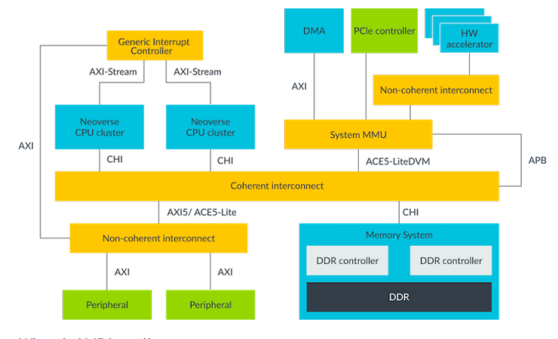
Soc Design

Slide 19
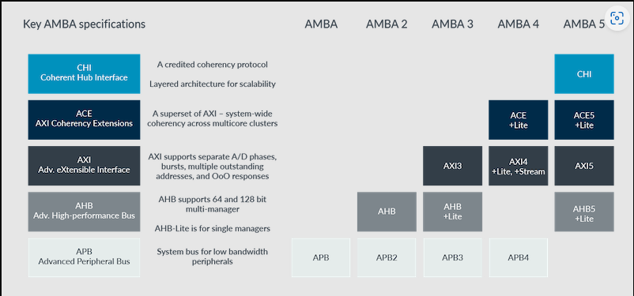
AMBA

Slide 20
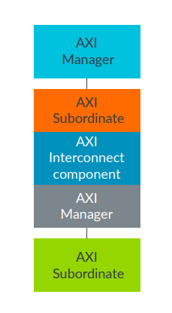
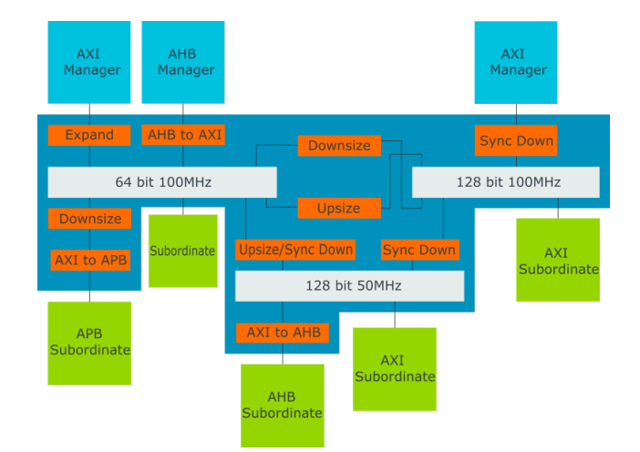
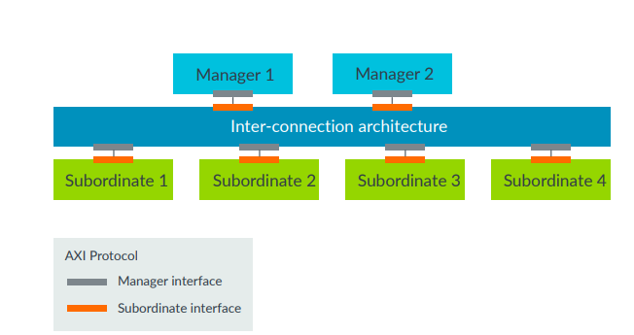
AXI

Slide 21
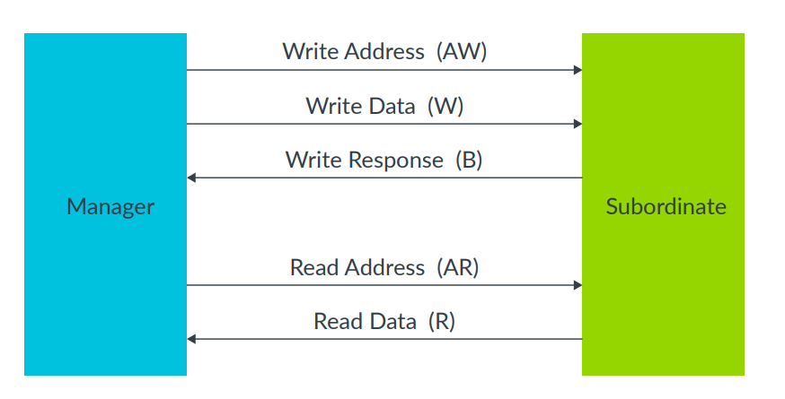
BUS Transaction

Slide 22

SDM 845 /Kyro GPU/Pixel 3

Slide 23
