Slide 1

Business Plan
Presentation Format
The investor presentation must be clear, concise and compelling to:
  Generate investor interest and build confidence
  Lead to additional investor meetings
Should be 20-30 minutes in length
Charts, graphics, pictures and verbiage should be simple and easily read (no “eye tests”)
Each slide should have between 3 and 6 bullets that are succinct (no paragraphs, uncluttered)
Presentation format may vary depending on the company but the following format provides a reasonable order and flow –it is but one approach to making investor presentations.

Slide 2
Order of Presentation
Introduction
Problem
Solution
Market, Customers
Competitive landscape
Business and Revenue Models
Management Team
Financial Projections Funding
Timeline
Summary

Slide 3
Introduction
Briefly introduce yourself and your company
  Company name and company logo
  Presenters names (give titles if pertinent)
Slide time: approximately 30 seconds

Slide 4

Introduction--continued
[this is a very important slide that requires lots of time to create because it must be succinct, comprehensive and COMPELLING]
Brief overview of company (elevator pitch)
    What exactly the company does (stated succinctly)
    What products or services are offered
    What problem is being solved, and
    Why these products or services are compelling, e.g., “…the only product that enables [solution] to [the problem]…”
Slide time: approximately 1 minute

Slide 5
The Problem/Opportunity/Need
Define the problem or need in the market
Describe how significant or prevalent the problem may be
If appropriate, describe why now is the right time for a solution
Provide a “problem” scenario that provides a basis for your company’s product or service
Slide time: 60 to 90 seconds

Slide 6
The Solution
(1 to 2 slides)
Clearly and succinctly describe the company’s product or service that will address the problem
Illustrate the company’s solution with graphics, pictures or videos as necessary (keep this very simple)
Provide brief list of features, benefits and advantages
  What is the value proposition for the customer (How well will the product or service solve the problem)?
    Cost savings, convenience, reliability, etc. (be specific)
Describe “barriers to entry” created by your product (e.g., patents)
Slide Time: Approximately 01:30 (May require more than one slide)

Slide 7
The Solution
Provide an understandable, practicle example of how your product/service works or what it does.

Slide 8
Sample Feature-Benefits Table
Features | Benefits
Slide Time: Approximately 60 seconds

Slide 9
Company Status/Progress
Build investor confidence in your company
  Domain expertise of management and staff
  Customers and contracts established (letters of intent)
  Strategic partnerships established
  Product development status—describe milestones achieved to reduce risk (e.g., alpha or beta testing)
  Other significant information to validate or reduce risk
Slide Time: Approximately 60 seconds

Slide 10
The Market
(2 to 5 slides)
Describe market size, growth, trends and maturity
  Industry and market segment data (see sample, next slide)
Market challenges
What market segment(s) are served by the company?
What is the company’s potential in the market?
  Estimated Revenue Growth in graphic or tabular form (see next slides, for examples)
  Market share projections are optional
Slide Time: Approximately 90 seconds
(More than one slide may be required)

Slide 11
Global Market for [your product]
Region | Demand (US $ MM) | % Globe
Asia | 1700 | 32
Europe | 1500 | 30
North America | 1300 | 25
Latin America | 415 | 8
Africa | 200 | 4
Others | 64 | 1
Slide Time: Approximately 60 seconds

Slide 12
US Market with key segments
City | World Rank | US $ MM | % Country | % World
New York | 1 | 865 | 22.8 | 5.3
Los Angeles | 3 | 300 | 8.3 | 1.9
Chicago | 4 | 285 | 8 | 1.8
Dallas | 21 | 105 | 2.8 | 0.64
San Jose | 22 | 104 | 2.8 | 0.63
San Francisco | 23 | 103 | 2.7 | 0.62
San Diego | 26 | 100 | 2.6 | 0.61
Slide Time: Approximately 60 seconds

Slide 13
Customers
Describe the company’s current and potential customers
  Profile of the optimal customer
  Value proposition to customer
  Validation of Customer Acceptance
    Customer Feedback, Survey Data, Testimonials
    Purchases, Letters of Intent
    Partners
  Example of customer

Slide 14
Competition and Advantage
(2 TO 3 SLIDES)
Competition
Describe the direct (competing product or service) and indirect competition (alternative solution) for your company and its product or service.
Describe specific strengths, weaknesses, and opportunities related to competition.
Describe how your product, technology or service differentiates itself from the competition? [very important]
Competitive Advantage
What is the company’s competitive advantage?
  Why will customers buy your product or service over the competition?
  Show a competitive matrix to illustrate differentiation (see next slide)
Subject Time: Approximately 2 minutes (more than 1 slide)

Slide 15
Competitive Comparison
(see next slide for optional approach)
Product | Advantages | Disadvantages
Product A ~$12/100 units
Product B ~$30/100 units
Product C ~$17/100 units
My Company Product ~$9/100 units

Slide 16
Competitive Matrix
Product | Feature A | Feature B | Feature C | Feature D | Feature E
MY PRODUCT | ● | ● | ● | ● | ●
Product 1 | ● |  | ●
Product 2 | ● | ● | ●
Product 3 | ● | ● |  |  | ●
Product 4 | ● | ● |  | ●
Product 5 |  | ● | ● |  | ●
Product 6 |  | ● |  | ●

Slide 17
Competitive Positioning
Yikes
Your Company, Inc.
Zowie
Flexibility
Gizmo
Gadget.com
Thingamabob
Yippee
Functionality

Slide 18
End First Section

Slide 19
Business Model and Marketing Plan
(2 TO 5 SLIDES)
Describe the company’s business and revenue model
  What is the overall business strategy?
  How will you sell your product or service (distributors, internet)?
  How will the company generate revenue for its product or service?
  Describe the sales cycle for the company’s product or service
Describe the Marketing Plan (if appropriate)
  What is the go-to -market strategy?
  What is the pricing model? Gross margin?
  How will you access customers? (including advert. and promo.)
  How will your product or service be distributed?
  What customer support will be needed?
Note any commitments from partners, distributors, granting agencies, etc. regarding benefits of your product
Slide Time: Approximately 90 seconds

Slide 20
Regulatory Issues
(not necessarily included in all investor presentations)
Include pertinent info regarding FDA, FTC, or other pertinent government agency

Slide 21
Management Team, Advisors
Build investor confidence with team
  Credentials, proven track record, domain experience (do not include weak credentials )
  Describe skill and experience gaps to be filled
List the company’s leadership team
  Include name, position, experience (abbrev.)
  These are credentialed experts
List of company Directors and Advisors
  Include name, summary of experience

Slide 22
Financial Projections
Provide 3-5 year financial projections for the company (abbreviated chart or graph—see next slide)
  Include financial projections to show year-to-year growth (show a basic income statement table—see next slide for an example)
  Is the company overstating or understating market share and/or growth?
  Can the company scale its operations as it grows?
List major facts and assumptions
  Are the assumptions believable and achievable?
Slide Time: Approximately 90 seconds

Slide 23
Financial Projections:
Income Statement Summary
 | 2008 | 2009 | 2010 | 2011 | 2012
Revenue | 500 | 5,207 | 12,203 | 25,565 | 51,894
COGS | 402 | 3,270 | 7,179 | 14,395 | 29,145
Gross Profit | 102 | 1,937 | 5,024 | 11,170 | 22,749
Oper Exp | 4,318 | 3,572 | 4,229 | 8,165 | 16,445
Net Income | (4,216) | (1,635) | 795 | 3,005 | 6,304

Slide 24
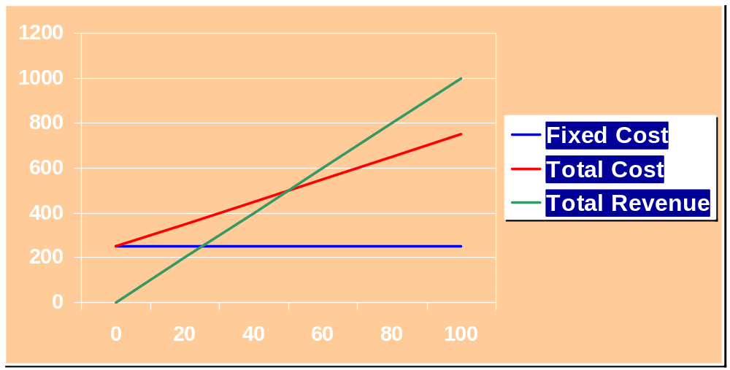
Financial Projections:
Break Even Analyis
Break-Even
TR = TC
Revenue
}
Variable Cost
Units Sold
[
Total Fixed Cost
]
B/E(Quantity) =
Price per Unit – Var. Cost per Unit

Slide 25
Funding
What funding has the company received to date?
  Amounts and sources
How will the company be financed?
How much money is the company currently seeking from Investors?
  How will the funds be used? (use tabular format—see next slide for an example)
  What key value-building milestones will be achieved with funds (market test, market expansion, etc.)
Anticipated future funding needs
What are the exit strategies for the company? (when?)
What is the expected ROI for investors
Slide Time: Approximately 2 minutes (this section is more than one slide)

Slide 26
Startup Budget/Use of Proceeds
First year Budget | Cost
Salaries | 510,000
Repairs & maintenance | 8,400
Local Advertising | 5,000
Marketing | 51,400
Accounting and legal | 5,000
Rent | 17,798
Internet & Telephone | 5,940
Equipment | 48,000
Domain Name | 10
Total | $651,548

Slide 27
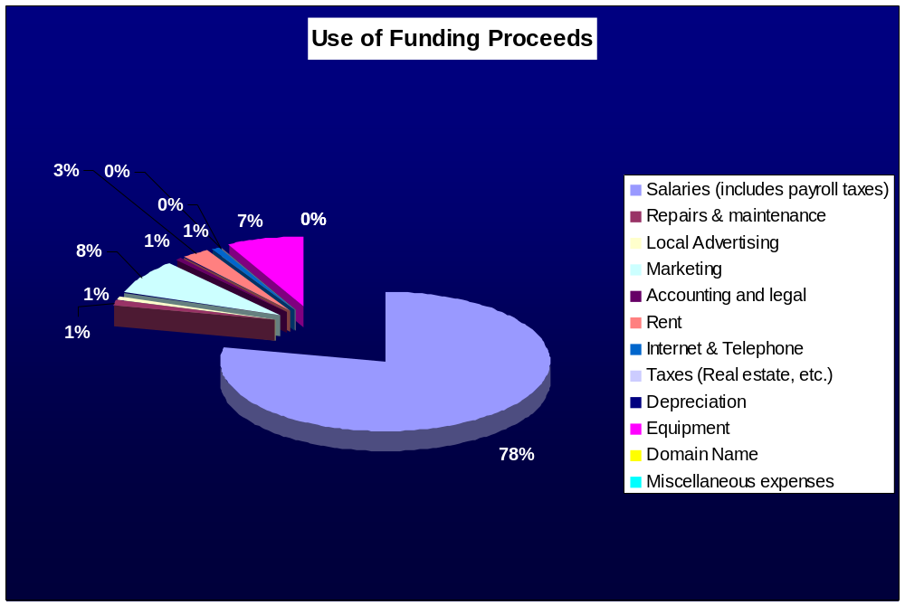
Use of Proceeds Breakdown

Slide 28
Timeline
Use a Gantt Chart for key milestones or use the preferred model shown on the next slide.

Slide 29
Timeline of Milestones
Idea
Primary Research
Feasibility Analysis
Relationships Secured
Business Plan
Prototype Install (Fall Gardens)
Funds Raised
Neighborhood Mkt.
Initial Contracts
JAN
FEB
MAR
APR
MAY
JUN
JUL
AUG
SEP
OCT
NOV
DEC

Slide 30
Value-Added Milestones Timeline (Sample)
2nd Financing
$1Million
1st Financing
$660K
2007
2008
Development
Milestone 1
December
Break-even
Milestone
July
Product 1
First Sales
Sales Milestone
December
Beta Test
Milestone
Product 1
Partnered*
2nd Product
Development
Milestone
Sept.
* Company retains co-dev./co-promotion rights

Slide 31
Summary
What do you want your audience to remember about the company?
  Unique and Sizeable Opportunity
  Unique product or service
  Competitive Advantage, Strengths
  Marketing Approach, Customers, Sales Pipeline
  Intellectual property
  Management team
  Other…

