Slide 1

Data Marketplace Deloitte PoV
January 2024

Slide 2
Data Marketplace - Guiding principles to seamlessly discover, access and utilize data
The right User Experience – Building a marketplace experience that will serve a broad audience from business users to data scientists. This will improve adoption and scaling of the marketplace.
Robust Search capabilities – A robust and flexible search capability is critical to achieving user satisfaction and focused search results.
Trusted Datasets – User must have confidence in the data products and associated metadata that is in the marketplace. Ensuring quality and data lineage is key to building trust.
Early Adopter Feedback – A targeted rollout plan focused on a set of use cases will create awareness, enable early feedback from users, generate new ideas and create “marketplace champions”
Balanced data management | governance – Ensure the right access for the right purpose in a timely and streamlined manner. Too tight controls will turn users away, you must find the right balance while maintaining compliance.
Data products enablement – To ensure an ideal user experience, once a user has access to data, they should be able to quickly connect their KPI, dashboard or analytical tool of choice to start their analysis.
Enhanced Collaboration – Create an environment that encourages collaboration and knowledge sharing. This will help improve the data literacy of the organization and create new ways of working.
Notes:
10/18 Ryan comments - Not a technical metadata discovery tool but more focused on business users

Slide 3
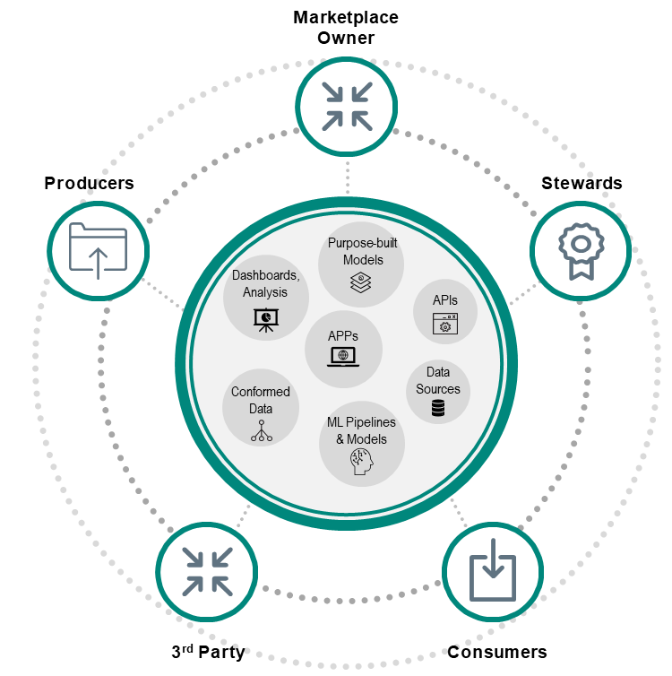
Pain points addressed through Data Marketplace for Deloitte clients
PAIN POINT
MARKETPLACE
MARKETPLACE OUTCOMES
Limited Data Visibility
Accelerate Time to Insights
Proliferation of siloed data sources and analytical outputs limits the use of these assets, creates inefficiencies, and duplicative work
Decrease time to discover and access data
Decrease time spent accessing analytics
Improve visibility to data for a broad group of stakeholders of varying skill levels via a centralized solution
Access and Governance
Improved ROI and Efficiencies
Getting access to data and/or analytic outputs can be time consuming and governance policies can be difficult to understand
Reduce redundant data acquisition
Reduce time to onboard new resources
Reduced time from ingestion to availability
Optimize investments in data
Standards, Quality and Collaboration
Improved Standards, Quality and Compliance
Inconsistencies in data quality and how data are described across the organization, impacting the ability for collaboration amongst stakeholders
Data Marketplaces drive DnA adoption and ROI by encouraging people across the enterprise to leverage data, making data discovery easier, and enhancing democratization and data literacy
Reduce time spent on data quality resolution
Improved data standards and collaboration
Improved compliance with governance and data use rights
Notes:
10/18 Ryan comments - Not a technical metadata discovery tool but more focused on business users

Slide 4
Common capabilities enabled for our clients
MATURED Prudential capabilities exist
Capabilities can be augmented by DELOITTE
PERSONALIZED USER EXPERIENCE
WORKFLOWS & NOTIFICATIONS
Dynamic cataloging capabilities to house diverse knowledge entities (e.g., data products, analytics products etc.) in one central location
Business friendly user experience designed for a broad set of users
Clients can apply their branding and color schemes
Configurable personas and user permissions on platform
Configurable workflows to establish governance processes for different assets e.g., request data product access, publish data products, initiate new data asset request etc..
Flexible rule-engine to customize notifications based on specific scenarios e.g., change of analysis status, approval of data access etc.
DMP
COLLABORATION
DATA & ANALYTICS CATALOG
Ability to provide real time feedback through comments, tags and ‘likes’ supporting collaboration across functional groups
Out of the box and Custom reporting capabilities to reports on system usage and adoption
Industry standard pre-defined baseline metadata models for multiple LS data domains for data & analytics product
Data Stewards can easily manage metadata (upload, edit etc.) from the UI (bulk upload also supported)
Track metadata version history through UI
EXTERNAL MARKETPLACE INTEGRATION
SEARCH AND DISCOVERY
Integrate with external marketplace i.e., Snowflake Data Marketplace/AWS Data Exchange)
Google like search across the knowledge entities
Knowledge graph, association-based search
Search documents (txt, PDF, excel, word, ppt etc.) uploaded on the platform
ACCELERATORS FOR PLATFORM INTEGRATION
DAE follows API first design enabling easy integration with enterprise systems
Accelerators available to enable integration with enterprise services e.g., Alation, Immuta etc.
STANDARD VOCABULARY
Built in vocabulary service that can be integrated with client’s existing master and reference metadata services
KNOWLEDGE GRAPH BASED RECOMMENDATION
Recommends related entities utilizing auto generated knowledge graph
META DATA AGGREGATOR
Auto-Discovery- metadata Aggregator allows for automatic discovery and collection of metadata
4
Notes:
10/18 Ryan comments - Not a technical metadata discovery tool but more focused on business users

Slide 5
Our understanding & Perspective
Deloitte has worked with multiple clients to build tailored Enterprise Data Marketplace. We understand that your pain points unique to the industry. Deloitte can leverage learnings and reusable assets that we have built to expedite the enhancement of existing Data Marketplace solution at Prudential
Current landscape…
Initial Data Marketplace solution exists as of today at Prudential
Data is hydrated in two distinct enterprise data platform in Prudential
AWS
Snowflake
Limited taxonomies & Data products available as of today
Getting access to data or analytical output is time consuming for data scientists and reporting analysts
Marketplace for different personas eg. Data Scientists, ML Engineers, Report analysts etc. to seamlessly access data from EDP
Integrations to various AI/ ML models, catalogs, metadata repos, access request processes/systems and data previews
User friendly Marketplace UI to enable to share and reuse Data Products within Prudential’s privacy guidelines and security controls
Facilitate data being “published” into Marketplace
Self-Service capabilities for users to obtain information and training and bring their own applications
Learning & Recommendations
How does it benefit?
LEADING PRACTICES
What do we implement?
BUSINESS STRATEGIES
Accelerate time to insights by 20-25%
Reduce time from ingestion to availability for new data products by > 30%
Intuitive user friendly UI to access and onboard data products, analytical tools, KPIs and Dashboards
Scalable Architecture and Flexible solution tailored to technical and business needs, ability to bring your own tool to consume data in the format consumers want
Notes:
10/18 Ryan comments - Not a technical metadata discovery tool but more focused on business users

Slide 6
Our Approach to enable your Data Marketplace vision
Upon high level analysis of your current ecosystem, we propose to bring in the right combination of people, process and technology aspects to help you realize your Data Marketplace vision.
Release 3
(~4 months)
Self service capabilities that drive user adoption and stickiness with marketplace
Release 2
(~4 months)
Release 1
(~4 months)
Advanced capabilities enabled by automation and artificial intelligence
Foundational capabilities to enhance and access data through the marketplace
Enable cross functional and enterprise-wide usage by providing access to all consumers. Conduct roadshows to drive awareness
Data Marketplace Capabilities Enhancements
Increase user adoption (create ~50 user base)
Provide data wrangling/ munging capabilities on marketplace to enable users to self-serve by combining data sets to meet their needs
Define domain, sub domains and governance policies including rules/policies and enhance data taxonomy for data products
Define limited user-personas with roles & responsibilities to access data marketplace
Curated and consumable digital information derived from one or more datasets to support generation of business insights and outcomes.
Demand driven data provisioning from AWS and Snowflake EDP into Data Marketplace
Define consumption patterns i.e. API access, object storage, etc.
Establishing and publishing governance rules to marketplace for building trust
Build access framework and configure rules to provide access to limited users
Integrate data marketplace portal with newer data assets i.e. Tableau, model 365
Self-service and personalization features allowing users to search data products based on tags, metadata and provide data preview
Define data taxonomy and ontology to organize data and map data assets to data products
Workflow based access provisioning mechanism to grant quick access to requested data asset
People
Process
Technology
Notes:
10/18 Ryan comments - Not a technical metadata discovery tool but more focused on business users

Slide 7
Capability Map for a Data Marketplace
Deloitte understands that Prudential has already invested in several of below capabilities in their data marketplace. We will work with you to assess current capabilities and either augment or develop new capabilities in collaborative manner using Deloitte automation and AI accelerators
PREPARATION AND INTERLINKING SERVICES
STEWARDSHIP AND PUBLISHING SERVICES
EXPLORATION SERVICES
COLLABORATION / FEEDBACK
PROVISIONING WORKFLOW SERVICES
OPERATIONAL SERVICES & ANALYTICS
Integrated Data Asset
Community Collaboration
Advanced Filtering
Sharing Between Colleagues
Marketplace Storefront UI
Persona based data access/authentication
Enterprise Governance
Centralized Workflow
Personalized Experience
Data Rating and Feedback
Access Provisioning
Marketplace Analytics
Source System Integrations
Data Lineage/Quality Certification
Data Recommendations
Automated Provisioning
Self Service/BYOT
Data Profiling and Sampling
Metadata Validation and Articulation
Ask the Expert
Automated Data Classification
Data Lineage Publishing
Data Products
Release 1
Release 2
Metadata Onboarding Curation, & Tagging
Data Taxonomy
Cross-Platform Search
Release 3
Capability exists but requires enhancements
New capability
We acknowledge that certain capabilities are already present within Prudential; however, there may be a need for enhancement through Release 1, 2 and 3
Notes:
10/18 Ryan comments - Not a technical metadata discovery tool but more focused on business users

Slide 8
Data Marketplace – Tool Comparison
DATA MARKETPLACE
We had ratings out of 5 for each of these parameter which were converted to Harvey ball. Next set of slides are detailed in nature.
Proper tool selection can be obtained post clear requirement discovery by Prudential
Below is a comprehensive comparison of these platforms based on these critical parameters
Feature | Microsoft Fabric | Informatica | HARBR
Access Control | Fabric provides role-based access control (RBAC) to manage who can perform operations on the Service Fabric cluster. Access to service applications can be managed at the microservice level, allowing for granular control | Informatica provides comprehensive access control mechanisms at various levels—project, folder, and object. It uses both role-based and user-based access controls to finely tune who can see or manipulate data and data processes | Harbr likely implements granular RBAC, allowing data owners to specify who can view, edit, or manage datasets and data products at a very detailed level.
Connectivity | It integrates with Azure Active Directory (AAD) for authentication, ensuring that only authenticated and authorized users can deploy and manage services. | It integrates with enterprise authentication solutions like LDAP and SAML, providing secure and compliant access management within corporate environments. | Harbr probably supports integration with various identity providers using OAuth, SAML, or similar protocols for secure authentication, similar to Informatica but more focused on data exchange environments.
Compliance and Standards | Fabric supports the compliance standards provided by the Azure platform, which includes a broad set of compliance certifications like ISO, HIPAA, and more. | Informatica’s governance capabilities are geared towards ensuring that data handling and processing meet industry standards and regulatory requirements, such as GDPR, HIPAA, and others. It provides tools for data masking, data quality management, and compliance reporting, which are critical for data governance. | Harbr is likely designed to comply with GDPR, which governs data protection and privacy in the European Union but applies to any organization dealing with the data of EU citizens. If Harbr is used within healthcare sectors in the United States, it would need to ensure compliance with HIPAA, which involves safeguarding personal health information (PHI) through administrative, physical, and technical safeguards.
Application Governance | It offers features like service discovery, health monitoring, and dynamic service scaling, which are crucial for maintaining governance over distributed applications. Logging and monitoring are robust, allowing for detailed tracking and auditing of service behaviors and issues. | Informatica shines in data governance with its robust set of tools designed to ensure data quality, data lineage, metadata management, and secure data integration practices. | Harbr specializes in the governance of data products, including quality control, cataloging, and compliance tracking. It implements robust security protocols, including encryption and potentially data localization, to meet specific regulatory standards.
Disclaimer: Comparison provided is at very high level. Actual comparison may vary after discovery of Prudential applications, persona , data etc.

Slide 9
Appendix

Slide 10
High level activities by each release
 | M1 | M2 | M3 | M4 | M5 | M6 | M7 | M8 | M9 | M10 | M11 | M12
Define limited user-personas with roles & responsibilities to access data marketplace
Demand driven data provisioning from AWS and Snowflake EDP into Data Marketplace
Build access framework and configure rules to provide access to limited users
Define data taxonomy and ontology to organize data and map data assets to defined taxonomy
Increase user adoption (create ~50 user base)
Define domain, sub domains and governance policies including rules/policies and enhance data taxonomy for new data assets
Define consumption patterns i.e. API access, object storage, etc.
Integrate data marketplace portal with newer data assets i.e. Tableau, model 365
Workflow based access provisioning mechanism to grant quick access to requested data asset
Elevate user utilization(advance user onboarding)
Enabling cross functional and enterprise-wide usage by providing access to all consumers
Provide data wrangling/ munging capabilities on marketplace to enable users to self-serve by combining data sets to meet their needs
Curated and consumable digital information derived from one or more datasets to support generation of business insights and outcomes.
Further integrate the data marketplace portal with additional data assets to ensure ongoing optimization and expansion.
Establishing and publishing governance rules to marketplace for building trust
Self-service and personalization features allowing users to search data products based on tags, metadata and provide data preview
Release 1
Release 2
Release 3
Notes:
10/18 Ryan comments - Not a technical metadata discovery tool but more focused on business users

Slide 11
Capabilities, deliverables and business outcomes enabled in each release
Release
Capabilities enhanced
Products enabled
Deliverables
Business outcomes impacted
Release 1
Persona based data access/ auth.
Standard data taxonomy
Data Products
Data access framework. Workflow req.
Data product req. & design
Standard data taxonomy
Decrease time to discover and access data
Improve visibility to data for a broad group of stakeholders of varying skill levels via a centralized solution
Metadata onboarding, curation, tagging
Data products by domain
Release 2
Centralized workflow
Standard search & discovery
Data Products
Reporting DB
Centralized workflows
1-2 data products enabled
Improved data management capabilities
Reduce redundant data acquisition
Reduce time to onboard new resources
Reduced time from ingestion to availability
Improved data standards and collaboration
Metadata validation & articulation
Data products expanded by domains | subdomains
Data lineage | Data quality certification
Integrated data assets for data products, reporting
Release 3
Optimized workflows
Advanced filters
Data Products
Reporting DB
Analytics Products
Metadata aggregator
Additional data products
Marketplace storefront Features & Functionalities
Optimize investments in data
Reduce time spent on data quality resolution
Improved compliance with governance and data use rights
Faster time to results with advanced search and filters
Increased personalization and marketplace storefront features
Enhanced community collaborations
Metadata aggregator with auto-discovery
Self-service enablement | Bring your own tool
Enterprise governance
Integrated data assets for analytics
Marketplace storefront UI enablement
Ratings & feedbacks

Slide 12
Deloitte’s implementation of Data Marketplace at Global Pharmaceutical Company
CASE STUDY
Client use case
Multinational pharmaceutical company found its enterprise data fragmented and hard to find and trust, there by limiting potential for advanced analytics. Major pain points included:
Voluminous data with proliferation of data systems / tools and inconsistent data models, making it difficult to merge data sets and limiting its cross-functional value
No central catalog for data assets, lack of clear ownership, and absence of data access governance
Approach
1
2
3
Set up Data Marketplace Foundation
Pilot and socialize Data Marketplace for Key Business Function
Leverage Improved User Engagement to Expand Footprint
Set up Data Catalog infrastructure using Collibra and metadata connectors for key data sources
Defined target operating model including taxonomies and data stewardship roles
Implemented process workflow for data access provisioning
Set up Data Marketplace for pilot business function and data domain
Onboarded critical data elements for pilot use case with their lineage and glossaries
Set up access governance for key data sources to enable automated data access patterns
Socialized pilot effort across enterprise through campaigns and roadshows
Created operationalization template for business functions and data domains based on outcome of pilot effort
Expanded Data Marketplace by onboarding assets for additional functions and domains
Set up dashboarding and measurement of catalog usage based on enterprise level KPIs to drive user adoption
Outcome
Enabled self-discovery, access, and trust of data with:
Centralized catalog-enabled marketplace with search and lineage capabilities
Standardized processes and procedures for data access and lifecycle management
Defined roles and responsibilities for data ownership, access management, and metadata curation
…and enabled long term results by:
Enabling, measuring, and reporting data and metadata quality metrics
Removing fragmented siloes in data landscape and enabling cross-functional collaboration through improved enterprise data visibility

Slide 13
Key user experiences enabled
CASE STUDY
Experience 1: Find data
Taxonomy (domain hierarchy)
Data Collections
Data Assets
Terms of Use
Usage Context
Experience 4: Access
Access workflows
Approval-based workflow
Qualification-based workflow
Experience 3:
Trust data
Data Profiling
Data Quality Rules
Thresholds & Scorecards
Experience 2:
Understand data
Business Glossary
Relationships
Lineage
Target Personas
Data Domain Owner
Data Engineer
Data Analyst
Data Steward
Data Scientist
Data Producer
Data Integrator
3rd Party
13
Notes:
10/18 Ryan comments - Not a technical metadata discovery tool but more focused on business users

Slide 14
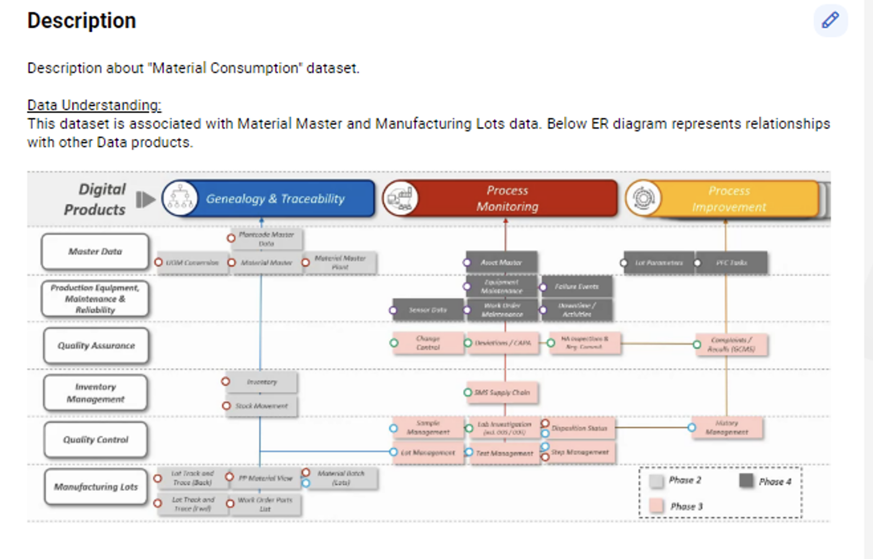
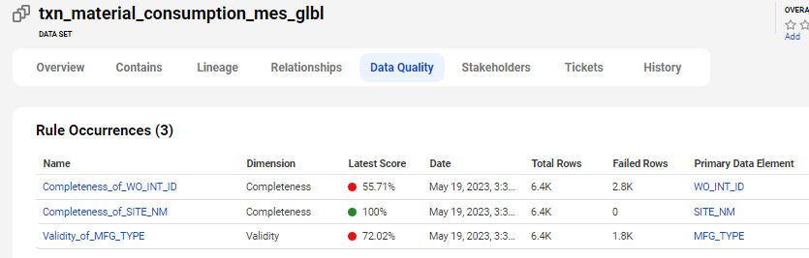
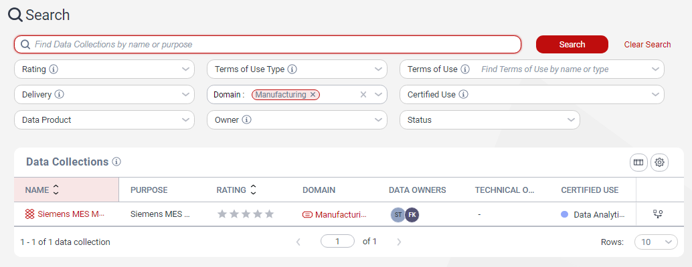
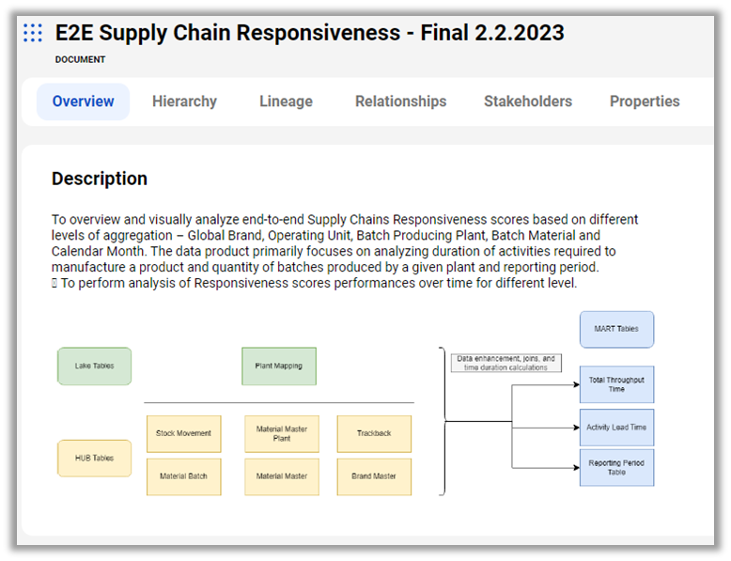
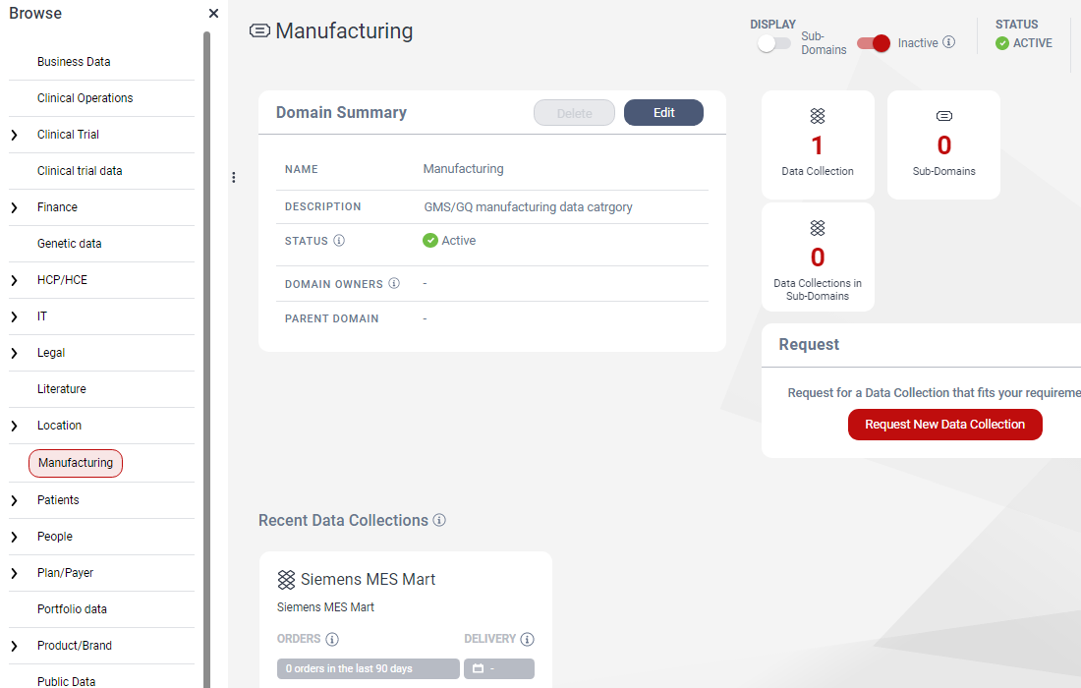
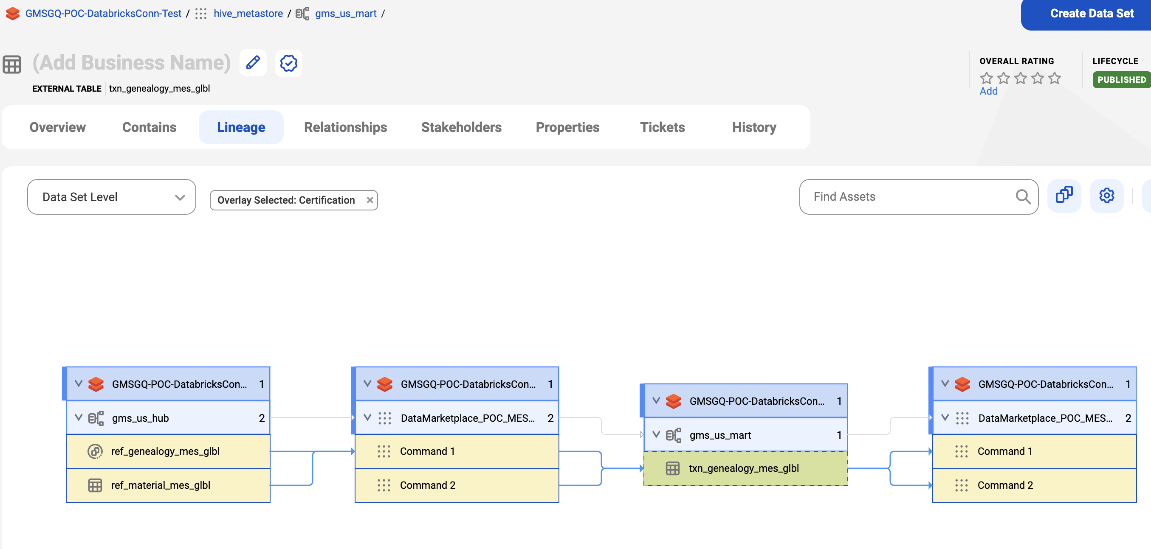
Data Marketplace – sample screenshots by experience
CASE STUDY
Find Data
Understand Data
Trust Data – Data Quality Scores
Access Data
Notes:
10/18 Ryan comments - Not a technical metadata discovery tool but more focused on business users

Slide 15



Data Marketplace – "LeanIX for Data" and "Catalog of Catalogs" Design
CASE STUDY
Data Marketplace
GMSGQ Marketplace
Forward
Log
ZS
APIs/Integration
Data Domain Metadata
Scalable Platform
LeanIX for Data
Data Marketplace
LeanIX
Scalable Platform
ETL Tools
AWS Glue
Databricks
DWH (BW, DWC, …)
Catalogs
Catalog X
Glue Catalog
Unity Catalog
Catalog Y
API Marketplace
External Data
AWS Data Exchange
Share With External
E2E Pipeline
AWS Data Exchange
Databricks Marketplace
Orchestration
Databricks Marketplace
Lineage information flow:
Pipeline step sending lineage to domain’s catalog (e.g. UC)
Domain’s catalog to global catalog of catalogs
15

Slide 16
























Our approach to enable a Marketplace to drive Data & Analytics Products
Data Product
Data Consumption (B2X)
”
Search & Browse
Curated and consumable digital information derived from one or more datasets to support generation of business insights and outcomes. They are highly governed to make them discoverable and shareable.
Provider
Data Onboarding
”
ORDER
Data Contracts
Data Products
Data Preparation
Data Services
Marketplace
Subscription
Key Features
Provider
Access Workflow
CURATED
TRUSTWORTHY
VERSIONED
Internationalization: GDPR, Brazil’s LGPD, Argentina’s PDP(L/A) and other regulatory compliance
GOVERNED
SEARCHABLE
INTEROPERABLE
Data Preparation: Providers to curate data products based on regional features and requirements
Internationalization: Enabling data products based on GDPR, Brazil’s LGPD, Argentina’s PDP(L/A) and other local regulatory requirements for seamless adaptation
Data Services: Self Service APIs to import data from providers and provide subscription-based access to data consumers
Subscription: Allow consumers to access and augment data products by combining with other information and republish the enriched data product
Search & Browse: Allow consumers to search data products based on metadata and tags and provide data preview
Access Workflow: Workflow based access provisioning mechanism to grant access to a data product
Copyright © 2021 Deloitte Development LLC. All rights reserved.
16
Notes:
10/18 Ryan comments - Not a technical metadata discovery tool but more focused on business users

Slide 17
Thank You

