Slide 1
Teradata to Snowflake Migration
Project overview for the Deloitte Delivery Team

Slide 2
Project Overview and Scope
Migrate the Cisco Enterprise Data Warehouse (EDW) from on-premise Teradata to the Snowflake cloud platform.
Largest AI & Data engagement at Cisco
7th largest deal for Snowflake’s fiscal 2026 (RPO of $133M over 3 years)
Scope: Only Wave 2 is in focus for this Statement of Work (SOW), which includes migrating all finance-related data pipelines and Business Objects (BO) applications required for finance functions. This is ~1/3rd of the overall scope.
Engagement Details:
Current State: Teradata, INFA PC, BTEQs, Control-M, Business Objects (BO)
Target State: Snowflake, DBT Models, Control-M/Airflow, BO
Volumetrics: ~1,350 tables, 4,300 Informatica PowerCenter jobs (90% converted to BTEQ/SQL), 3 BO and 133K reports universes
Approach: Lift and shift migration from Teradata to Snowflake
Release Strategy: 3 release (1A, 1B and 1C). This will require forward and backward bridging. Avoid release in month 3 and FYQ4.
Parallel Run: 3-month parallel run for each release. Must include quarter end
Snowflake Setup: Account setup, RBAC, cataloging, administration, etc. will be Cisco’s responsibility
Ingestion: Cisco’s custom ingestion framework CCI will be used for repointing ingestion from Teradata to Snowflake
GCP BQ Dependency: Common Hierarchies and gross ARR are on GCP BQ and are being replicated to Snowflake
Downstream Applications: Testing will be Cisco’s responsibility. Minimize the impact on downstream applications – keys need to be same
Acceptance Criteria (Success Measures):
100% of in-scope pipelines and up to 200 BO reports tested in Snowflake UAT
100% data parity between Teradata and Snowflake excluding mutually agreed up exceptions
≥10% average ETL/report performance improvement over Teradata. No refactoring.
0 open Severity 1 defects at production cutover
Full stakeholder (Cisco) sign-off on each deliverable/milestone—deficiencies are to be promptly resolved at Supplier cost
Cisco awarded us the contract, even though our fees were ~40% higher than those of the competition.

Slide 3
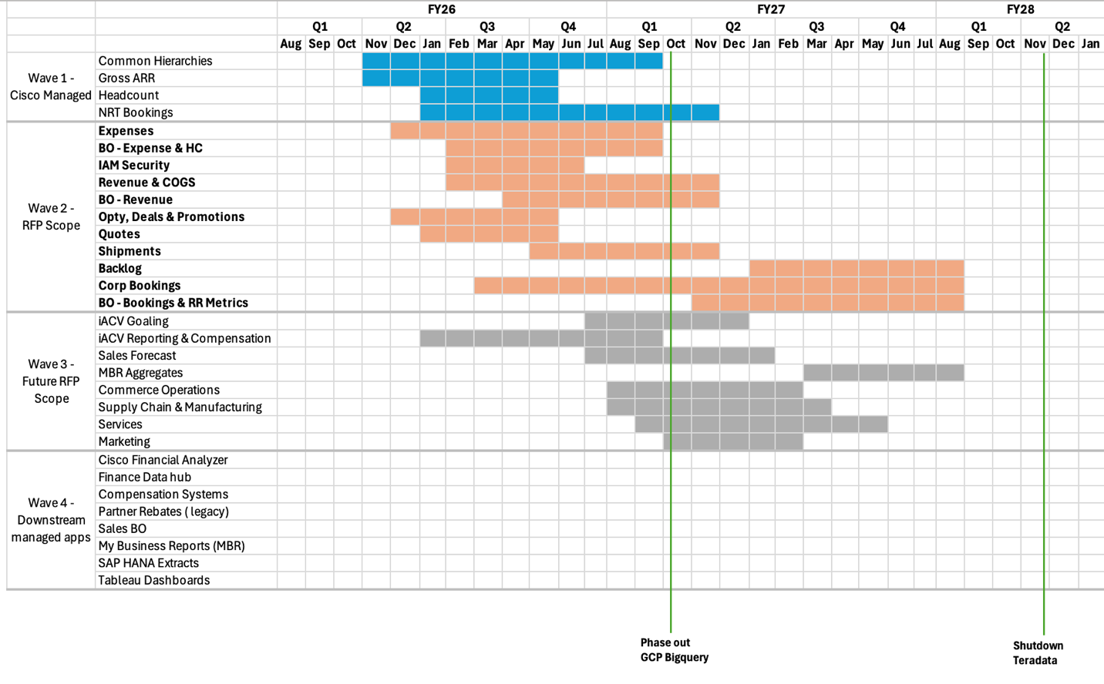
Project Timeline
Severe financial implications of missing timelines
Key Milestones
Phase out GCP BigQuery: Marked at Q1 FY27 (Sep–Oct 2026)
Project must be completed (all waves) before end of Aug ’27.
Hard deadline to decouple from Teradata by Nov ‘27.
Shutdown Teradata: Marked at Q2 FY28 (Jan–Feb 2028)
Future Pipeline
Delivery excellence of wave 2 will lead to we getting wave 3 and 4 (~200% of wave 2 scope)
Other opportunities depend on the execution of wave 2 (AI COE, FP&A Management Reporting, etc.)

Slide 4
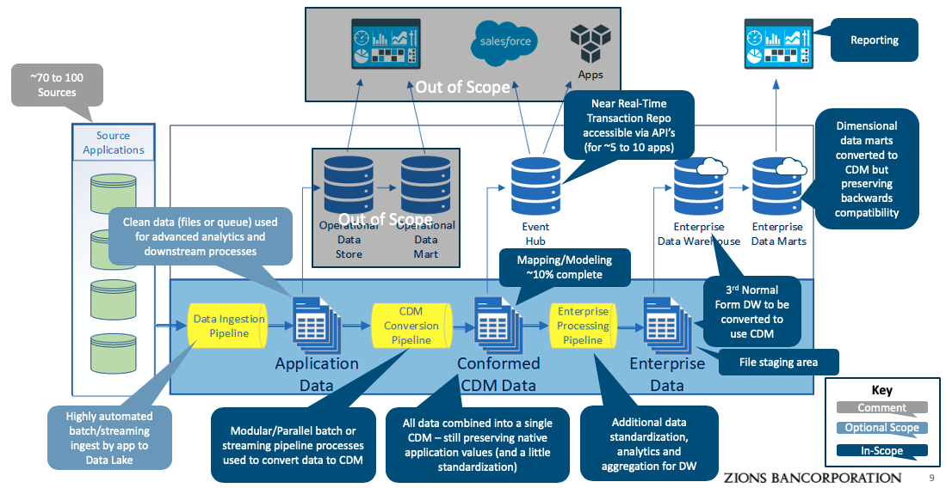
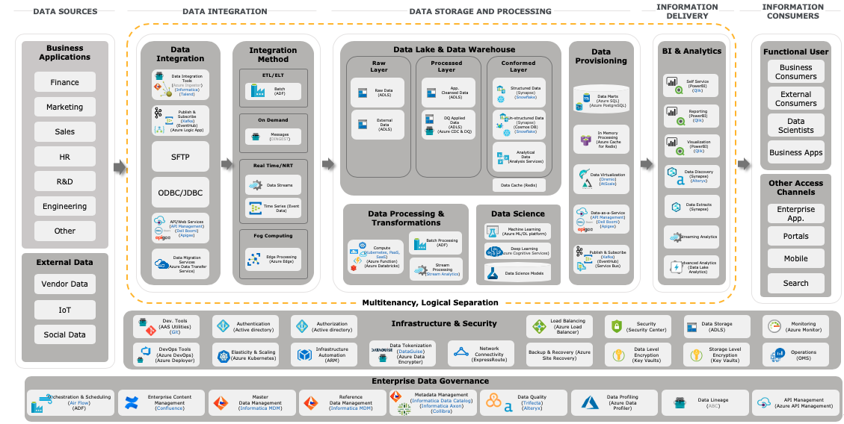
Migration Approach
We bring market leading automation across each of the implementation phases to successfully deliver.
ENTERPRISE DATA ANALYTICS AND MODERNIZATION – AUTOMATION LED APPROACH
1a
Discovery and Migration Planning
1b
Implement: Minimum Viable Product (“MVP”) – “Expenses”
2
Scale-out: Enhance and Optimize
3
Parallel Run, Data Ops, Hypercare
Establish Foundation
Continuous Delivery of Domain Applications
Parallel Runs
The execution of parallel runs for ETL pipelines and data reconciliation between Teradata and Snowflake .
Incorporate dependencies and co-relationships between data and Domains Assets
Modernization PODs
Integration Management
Prioritize Use Cases, Enterprise and Domain Assets and Source Systems
Migration assessment, Roadmap and plan, Validate use case and data domain tranches
Domain PODs
Other PODs
Adoption of Future Target State Platform
Pool of SMEs
(Platforms, Tools, Domain etc.)
Agile Delivery
Dev Ops
Execution Model (Delivery PODs)
Enable new capabilities
Technology Blueprinting
AWS/Snowflake/Informatica/DBT/BO Center of Excellence
(Automation frameworks)
Technology Tooling Options
Hypercare
Provide support to ensure SLAs are met, resolve any defects, and stabilize operations. Address any defects promptly and confirm closure only after all critical issues are resolved and plan for handover to Data Ops.
Foundation Services (Refactor)
Automation Frameworks
Upstream & Downstream dependencies
Conformed Data Model
Integration Patterns
Current State Architecture
Audit, Balance & Control Framework
Automation Framework evaluation
Future State Architecture
MVP Use Case Implementation
Data Mgmt. & Security
Data Certification
Updated Migration Roadmap and Refined Future State Architecture
Data Security enabled
Governance & Security
Program Management & Governance
Establish the key functions required to govern program strategy and execution, manage staffing needs, monitor delivery progress and quality, and provide change management support
Iteratively migrate use cases/data domains to production for in scope wave 2 workloads

Slide 5
Summary of All Accelerators to be leveraged for Snowflake Migration
Accelerator | Purpose | Migration Design and Plan | MVP | Re-platform | Testing
Deloitte Informatica Parser | Parsing of Informatica Jobs to separate mappings and database native code | ✓ | ✓
Deloitte ETL Reverse Engineering | Dependency and Complexity Analysis, Scope Confirmation and Source to Target Mapping | ✓
Snowflake SnowConvert AI | Teradata Object Conversion Coverage and Efficiency Analysis during Migration Design and Plan and Conversion of Teradata database objects (tables, views, SQLs, BTeQs, Stored Procedures, etc.) to Snowflake objects during MVP and Re-platform | ✓ | ✓ | ✓ | ✓
Deloitte ETL Code Converter | Conversion of Informatica mappings to SnowSQL |  | ✓ | ✓
Deloitte DBT Code Converter v1 | ETL pipelines conversion to DBT (SnowSQL) |  | ✓ | ✓ | ✓
Deloitte DBT Code Converter v2 | ETL pipelines conversion to DBT Models |  | ✓ | ✓ | ✓
Deloitte Orchestration Agent | Agent to orchestrate ETL Code Conversion |  | ✓ | ✓ | ✓
Cisco CCI | Data migration from Teradata to Snowflake |  | ✓ | ✓ | ✓
Deloitte ETL Code Tester | Data testing tool for data parity testing, data reconciliation and validation |  |  | ✓ | ✓
Deloitte DRECT | Report Reconciliation, Validation & Testing |  |  | ✓ | ✓

Slide 6

Discovery and Migration Planning
This is a foundational step in migrating from Teradata to Snowflake. This phase focuses on doing a discovery to confirm the scope, dependencies, complexities, architecture, constraints and priorities for the migration. The goal is to develop a roadmap, detailed execution plan and MVP scope.
Legend:
Cisco
Deloitte
Input
Assess
Accelerators
Deliverables/Outcomes
Business Imperatives
Dimensions for Assessment
Purpose
Accelerators
Dimensions for Assessment
Priorities
Volume of objects and workloads
Separate Informatica XML & DB native code
Informatica Parser
Migration Scope and Backlog Validation
1
Constraints
Domains & Use Cases
Complexity Analysis Report
Scope
Technical Objects
Projected Accelerator Efficiency Report
Database Objects
Dependencies and Complexities
MVP Scope
ETL Objects
Reporting Objects
Dependency and Complexity Analysis
ETL Reverse Engineering
Re-platform Roadmap
Architecture & Tech BOM
Job Orchestration
Migration Plan
Business Functions & Downstream Apps.
Technical Debt
Effort Estimation
Business Functions
Downstream Apps
Accelerator Efficiencies
Technical Debt Remediation Plan
Accelerators and Access
Cisco Dependencies
Non-functional Requirements
Conversion efficiency Teradata Code to SnowSQL
SnowConvert AI
Accelerators Setup
Non-functional Requirements
Developer Access

Slide 7

Implement Minimal Viable Product (“MVP”)
Conduct an end-to-end MVP migration to validate the coverage and efficiency of accelerators for Cisco. Outcomes and lessons learned from this phase will help us refine the overall migration roadmap and timeline, if necessary. We will use Expenses for the MVP.
Legend:
Cisco
Deloitte
Input
Assess
Accelerators
Deliverables/Outcomes
MVP environment
Dimensions for Assessment
Purpose
Accelerators
Dimensions for Assessment
Accelerators
Volume of objects and workloads
Separate Informatica XML & DB native code
Informatica Parser
MVP
Instantiated Architecture
Developer Access Provisioned
Accelerator Efficiency Report
Scope
Convert INFA XML code to SnowSQL
ETL Code Converter
Accelerators
Effort Estimation
Projected Accelerator Efficiencies
Dependencies and Complexities
Convert Teradata Code to SnowSQL
SnowConvert AI
Re-platform Backlog and Plan
MVP scope
Architecture & Tech BOM
Orchestrate accelerators to reduce manual intervention
Orchestration Agent
Migration Roadmap
Database Objects
ETL Objects
Technical Debt
Historical Data Migration
CCI
Accelerator Usage Recommendations
Reporting Objects
Resourcing and PODs
Job Orchestration
Accelerator Efficiencies
Convert SnowSQL code to DBT
DBT Code Converter v1
Roadmap and Estimation
Testing and Implementation Accelerator Setup
Effort Estimation
Non-functional Requirements
DBT Code Converter v2
Accelerator Enhancements Backlog
Roadmap

Slide 8
Scale-out – Re-platform, Enhance and Optimize (Track 1A, 1B, 1C)
Using the updated migration, Scale-out Phase starts execution of the migration roadmap to re-platform from Teradata to Snowflake using a POD based delivery model.
Legend:
Cisco
Deloitte
Input
Assess
Accelerators
Deliverables/Outcomes
Development environment
Dimensions for Assessment
Purpose
Accelerators
Dimensions for Assessment
Accelerators
Conversion Accuracy
Convert INFA XML code to SnowSQL
ETL Code Converter
Repointed Ingestion
Instantiated Architecture
Developer Access Provisioned
Convert Teradata code to SnowSQL
SnowConvert AI
ETL/ELT Conversion Package
Delivery Velocity
2
Orchestrate accelerators to reduce manual intervention
Data Assist Orchestration Agent
Converted ETL Pipelines
Re-platform scope
Accelerator Efficiencies
Orchestration Package
Historical data migration
CCI
3
Database Objects
ETL Objects
Non-functional Requirements
Unit Testing Results
Reporting Objects
Data testing tool for data parity testing
ETL Code Tester
Teradata & Snowflake Difference Impact
4
Business Objects Application Conversion Package
Job Orchestration
Automated report testing
DRECT
Ingestion Repointing
History Data Migration for SIT
SIT Readiness
Convert SnowSQL code to DBT
DBT Code Converter v1
SIT Test Plan
Non-Functional Requirements
BAT Test Plans
DBT Code Converter v2
SIT Test Cases
Benchmarks & SLEs/SLAs

Slide 9
Parallel Run, Data Ops, Optimize (Track 1A, 1B, 1C)
Perform automation-led SIT and BAT using set-based, exception-based testing approach. Monitor performance and optimize prioritized workloads to meet SLEs/SLAs.
Legend:
Cisco
Deloitte
Input
Assess
Accelerators
Deliverables/Outcomes
Test Environment & Data
Dimensions for Assessment
Purpose
Accelerators
Dimensions for Assessment
Teradata & Snowflake Test Bed
Conversion Accuracy
Convert Teradata code to SnowSQL
SnowConvert AI
SIT Testing Results
Incremental Loads Data
BAT Test Plans
BAT Testing Results
Results Comparison to Legacy
Orchestrate accelerators to reduce manual intervention
Orchestration Agent
Performance Testing Results
Testing Scope
Defect Severity and Volume
Historical data migration
CCI
Defect Prioritization and Resolution Report
Database Objects
ETL Objects
Data Reconciliation Report
Non-functional Requirements
Data testing tool for data parity testing
ETL Code Tester
Reporting Objects
ETL/ELT Conversion Package
2
Job Orchestration
Teradata & Snowflake Difference Impact
Automated report testing
DRECT
Orchestration Package
Ingestion Repointing
3
Performance
Performance Benchmarks
4
Business Objects Application Conversion Package
Convert SnowSQL code to DBT
DBT Code Converter v1
Data Validation and Sign-off
5
Non-Functional Requirements
Report Reconciliation
DBT Code Converter v2
Final Documentation Package
Benchmarks & SLEs/SLAs
6

Slide 10
Key Deliverables & Milestones
Deliverables by phase
Deliverables
Critical Activities
Outcomes/Acceptance Criteria
Migration Design and Plan
Migration Plan and Backlog Validation | Develop migration plan, map dependencies, validate inventory, create MVP scope and sprint roadmap for Wave 2 (Tracks 1A, 1B &1C) | Roadmap finalized, plan signed off, all planning tasks complete
ETL/ELT Conversion Package | Migrate and optimize Teradata scripts, Informatica jobs, UDFs, and views for Snowflake compatibility; validate execution in test/BAT environments. | Conversion of all in-scope ETL/ELT jobs to Snowflake
Orchestration Package | Build DBT models, configure Control-M jobs, document dependencies | Control-M jobs operational in test, dependencies & schedule validated
Business Object Application conversion package | Convert BO universes/reports to Snowflake, adapt IAM security | Reports equivalent, improved runtime, validated security controls
Data Validation & Signoff | Perform unit/integration/BAT, data lineage reconciliation, stakeholder validation | The goal is 99.5%* data reconciliation; any mismatches will be analyzed and documented
Final Documentation Package | Prepare migration, validation, lineage docs, post-cutover/support materials | Editable docs delivered, summary/support guides ready
01
Scale-out – Re-platform, Enhance and Optimize
02
03
04
Parallel Run, Data Ops, Optimize
05
06
Note: 99.5% data parity to be targeted for critical data entities

Slide 11


Team Organization
Our joint team combines Cisco’s deep knowledge of its current capabilities, pain points, and aspirations with Deloitte’s experienced specialists – including many whom you already know and trust.
CISCO EXECUTIVE SPONSORS
DELOITTE EXECUTIVE SPONSORS
STEERING COMMITTEE
RISK AND QUALITY
PROGRAM LEADERSHIP
Cisco Internal QA | Deloitte QA
Cisco Program Manager | Deloitte Lead Engagement Partner Technical Leader
PROJECT MANAGEMENT
CORE DELIVERY POD
Cisco Product Owners | Deloitte Program Manager Delivery Leader
Cisco PMO Change Coordinator | Deloitte PMO – Onshore PMO – Offshore
ARCHITECTS
DATA POD 1
DATA POD 2
DATA POD 3
Cisco Enterprise Architect Product Owner | Deloitte Solution Architect Data Architect
Cisco Business Analyst | Deloitte Data Engineer Lead Data Engineer 1 Data Engineer 2 Dev Ops Engineer 1
Cisco Business Analyst | Deloitte Data Engineer Lead Data Engineer 1 Data Engineer 2 Dev Ops Engineer 1
Cisco Business Analyst | Deloitte Data Engineer Lead Data Engineer 1 Dev Ops Engineer 1
Discovery
REPORTING POD
QA POD
INNOVATION POD
Cisco Business Analyst Product Owner | Deloitte Data Lead - 1 Data Lead - 2 Data Lead - 3 Reporting Tech Lead Data Engineer AI Architect
Cisco Business Analyst Product Owner | Deloitte Reporting Lead Reporting Engineer 1 Reporting Engineer 2
Cisco Business Tester BAT Lead | Deloitte Testing Lead Test Engineer 1 Test Engineer 2 Test Engineer 3 Test Engineer 4
Deloitte Data Engineer Backend API Engineer AI Engineer

Slide 12
Key Stakeholders
Here are the key Cisco stakeholders
Stakeholder | Title/Role | Description
Nilesh Kulkarni | VP of Data Analytics
Chiranjeevi Koyi (Chiru) | Director: Data Engineering
Virendra Singh | Director, Data Platforms
Harish Sabhnani | Data Platforms Leader | On Virendra’s team. We will work very closely with Harish.
Terence O’Donovan | IT Architect
Devi Kumarappan | Director, Engineering: CX Data Platform and Operations

