Slide 1
Financial Operations Dashboards Wireframes
27th – 28th May, 2025

Slide 2

Agenda
Requirements Summary
Financial Operations Reporting Architecture
Dimensions & Key Performance Indicators
Wireframes Summary Page Cost Management Performance Management Product Usage
New Product Onboard Forecast

Slide 3
Requirements Summary
Category | Category | Requirement | Priority (1- Low 5 - High) | Applicable Persona
 |  |  |  | EDF Platform | Data Producers | Data Consumers
Cost Management | Budget & Alerting | To identify and set budget limits for different functional roles, data product, department. Alerts as spending nears or exceeds predefined thresholds / budget. | 4 | ✓ | ✓ | ✓
 | Anomaly Detection | Detect and flag anomalies, such as sudden spikes in spend or usage during the day, week or month. | 4 | ✓ | ✓ | ✓
 | Contract Management | Analyze and compare Snowflake contract terms vs actual usage to identify consumption trends and gaps. | 5 | ✓
 | Credit Usage visibility | Provide detailed breakdown of Snowflake credit usage, segmented by data producers and consumers. Highlight top users and identify unusual consumption patterns over time. | 5 | ✓ | ✓ | ✓
 | Forecasting & Historical Analysis | Use historical data to forecast future expenses and usage. | 5 | ✓
 | Snowflake spending by BU | Monitor spending by Business Unit (BU) to identify cost trends, compare expenditures over time. | 5 | ✓ | ✓ | ✓
Performance Management | Storage Management | Identify storage utilization and split between Permanent, Transient and Temporary tables. | 3 | ✓ | ✓
 | Query performance Metrics | Identify long-running queries, query origin, top data consumers and their usage patterns. Average query response time per data product. | 4 | ✓ | ✓ | ✓
 | Warehouse usage monitoring | Granular monitoring of warehouse usage and identify underutilized or over-provisioned warehouses. | 5 | ✓

Slide 4
Requirements Summary
Category | Category | Requirement | Priority (1- Low 5 - High) | Applicable Persona
 |  |  |  | EDF Platform | Data Producers | Data Consumers
Product Usage | Data product usage patterns by roles | Identify which roles are most engaged with specific data products, frequency of usage and cost driving factors. | 5 | ✓ | ✓
 | Comparison across producers & consumers | Usage split between data producers and data consumers. Split between cost of producing data products and the costs of consuming them. | 5 | ✓ | ✓
 | Cost / Usage by consumption tools | Monitor cost and usage by different data consumption tools to identify the most and least cost-effective tools. | 3 | ✓ | ✓
 | Impact Analysis | Identify users or teams impacted by changes in data products. | 4 |  | ✓
 | Transparency on data usage | To provide actionable insights on data product usage vs data users/groups by functional roles | 3 | ✓
 | Query consumption Pattern | To display the query consumption time, query frequency, response time for queries within a specific data product. Identifying top consumers of data and understanding their usage patterns. | 4 |  | ✓
 | Dashboard Improvement | Enhance interactivity with filters, drill-up/downs views for monthly, weekly and daily usage, tooltips and ability to customize views by persona. | 5 | ✓ | ✓
 | Usage Trend | Data product usage comparison by Month, Quarter, Year | 5

Slide 5



Financial Operations Reporting Architecture
Below architecture depicts the method of data extraction required for financial operations dashboards:
The dataset loaded from multiple Snowflake accounts through the AWS based pipelines into Snowflake Source Data Product layer will be considered as a source for the dashboards
Modeled layer will be created on the Curated Data Product layer in Snowflake
Global Org Admin Account
AWS based ingestion pipelines
Source Data Products
Curated Data Products
FinOps
Users, Data Producers, Data Consumers
Information/ Account Usage Schema
Information/ Account Usage Schema
Information/ Account Usage Schema
Account 1
Account 2
Account 3
PFG: Currently Present
Deloitte: To be Built

Slide 6
Dimensions and Key Performance Indicators
Below are the identified dimensions and Key Performance indicators identified from the requirements
Snowflake Platform Dimensions
Account
Warehouse
Database
Schema
Objects
Service Type
Credit Type
Query Status
Storage Type
Data Transfer (Category)
Query Type
Query Text(Query ID)
Time Dimensions
Yearly
Quarterly
Monthly
Weekly
Daily
Hourly
Organizational Dimensions
Organization
Environment
Accounts
Warehouse
BU/Division
Department
Data Products
Users/Role
KPIs(Measures)
Credits
Contract Capacity (balance)
Rollover Capacity (balance)
Total Capacity (balance)
Total Enterprise Currency Usage
Contract Capacity/ Roll Over Balance (USD)
Budget
Data Transfer (GB)
Queries Count
Queries Execution Time
Local/Remote Spillage (MB/GB)
Cluster Count
Storage(GB/TB)
Warehouse/DB/Table Size
Query Text

Slide 7
Summary Page

Slide 8
Summary Page
Landing Page – Provides link to jump to dashboards
Dashboard Link-1
Dashboard Link-2
Dashboard Link-3
Cost Management
Performance Management
Product Usage
Overview
Storage Management
Data Product Usage pattern by roles
Usage overview
Query Performance Metrics
Comparison across Producers vs consumers
Usage details
Warehouse Usage Monitoring
Usage Trend
Division usage overview
Query Consumption Pattern
Forecast overview
Impact Analysis
Cost/Usage by Consumption Tool
Transparency on Data Usage

Slide 9
Cost Management

Slide 10
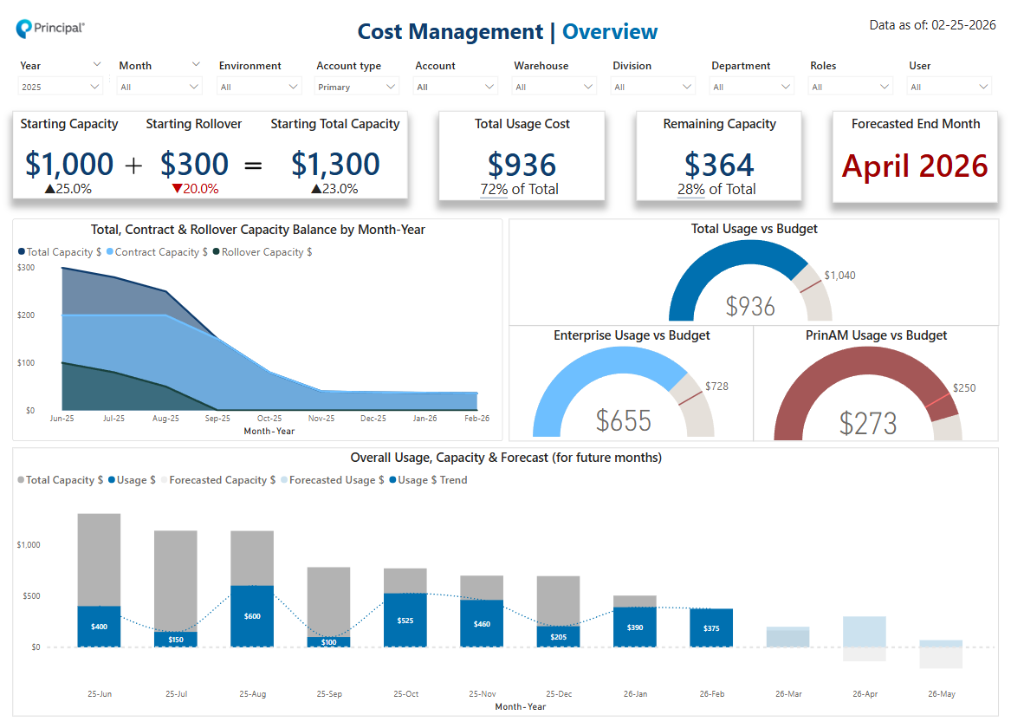
Cost Management – Overview
Quick view to understand the cost management overview , budgeting and forecasting.
1
2
3
4

Slide 11
Cost Management – Overview page summary
# | Category | Category Priority | Chart type | Description | Assessment: Required, Aspirational | Implementation Priority
1 | Contract management | 5 | Card visuals | Aggregated KPI Cards showing the contract, rollover and total capacity with respective comparison to PY, alongside total usage cost and remaining capacity balance with respective comparison to total capacity and the forecasted end month. | Required
2 | Contract management | 5 | Area chart | Shows the total capacity, contract capacity and rollover capacity balance trend by month for current year. | Required
3 | Budgeting & alerting | 4 | Gauge charts | Shows the actual usage vs defined budget for the total usage and by divisions, alongside conditionally changes color based on criteria if above or below budget. | Aspirational
4 | Forecasting & Historical Analysis​ | 5 | Clustered column chart | Shows the overall usage, capacity balance remaining by month along with the forecast for upcoming months to get an understanding of credits exhaustion. | Required

Slide 12
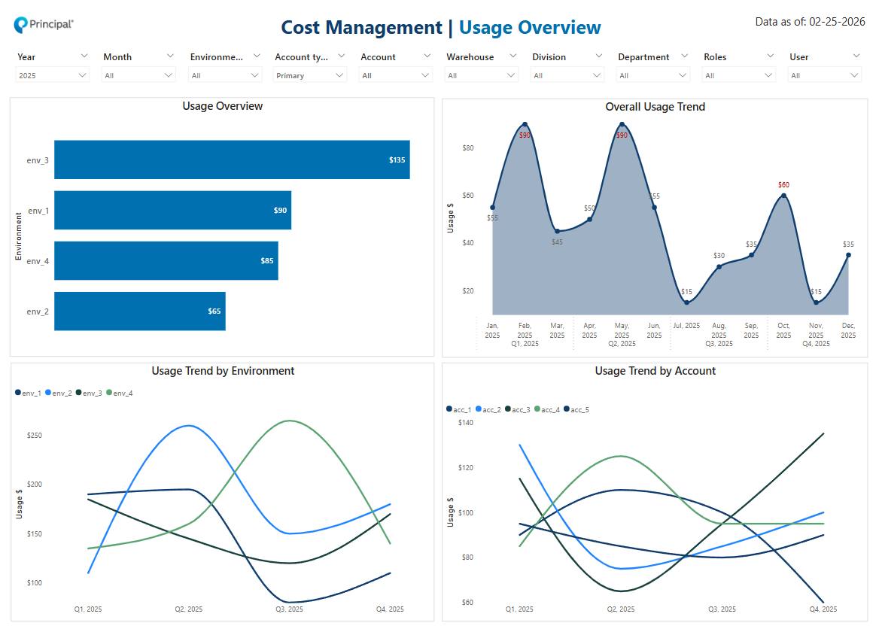
Cost Management – Usage overview
Quick view to understand the usage metrics and trends.
1
2
3
4

Slide 13
Cost Management – Usage overview page summary
# | Category | Category Priority | Chart type | Description | Assessment: Required, Aspirational | Implementation Priority
1 | Credit usage visibility | 5 | Bar chart | Shows the usage by environment, account and warehouse in a single view with drill capability from higher to lower and vice-versa. | Required
2 | Credit usage visibility, Anomaly detection | 5 | Area chart | Depicts the overall usage trend by quarter, month, week, day in a single view with drill capability from higher to lower and vice-versa and conditional formatting to highlight anomalies. | Required
3 | Credit usage visibility | 5 | Line chart | Depicts the usage trend for different environments trends by quarter, month, week, day in a single view with drill capability from higher to lower and vice-versa. | Aspirational
4 | Credit usage visibility | 5 | Line chart | Depicts the usage trend for different accounts trends by quarter, month, week, day in a single view with drill capability from higher to lower and vice-versa. | Aspirational

Slide 14
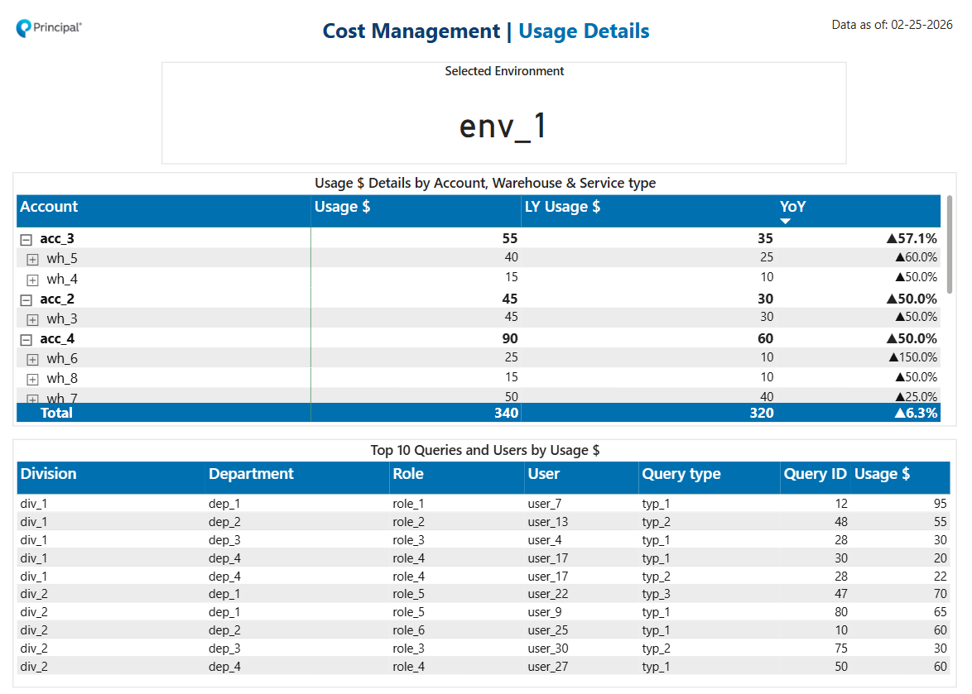
Cost Management – Usage details
Drill through page to provide additional insights into the usage details based upon the filter context
Drill-through page
1
2
3

Slide 15
Cost Management – Usage details page summary
# | Category | Category Priority | Chart type | Description | Assessment: Required, Aspirational | Implementation Priority
1 | Credit usage visibility | 5 | Card visual | Displays the name of the selected environment for which additional insights are being shown. | Required
2 | Credit usage visibility | 5 | Matrix visual | Displays the hierarchy in rows such as accounts, warehouse etc. which maps to the selected environment and in values shows different measures such as usage, LY usage and year over year % change. | Required
3 | Credit usage visibility | 5 | Table visual | Shows the top 5 users and their corresponding division, department etc. alongside query type, query ID and the respective usage. | Required

Slide 16
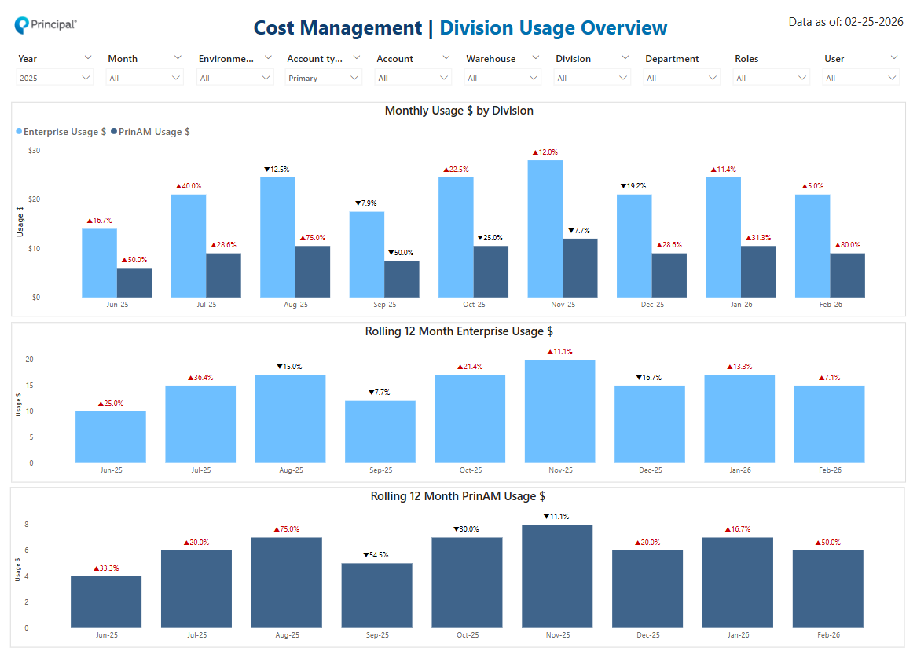
Cost Management – Division usage overview
Quick view to understand the monthly usage by division across time.
1
2
3

Slide 17
Cost Management – Division usage overview page summary
# | Category | Category Priority | Chart type | Description | Assessment: Required, Aspirational | Implementation Priority
1 | Snowflake spending by BU | 5 | Clustered column chart | Depicts the monthly usage by division and compares it with PY, alongside conditionally changes the label color based on increase/decrease in usage patterns. | Required
2 | Snowflake spending by BU | 5 | Clustered column chart | Depicts the rolling 12 months enterprise division usage and compares it with PY, alongside conditionally changes the label color based on increase/decrease in usage patterns. | Aspirational
3 | Snowflake spending by BU | 5 | Clustered column chart | Depicts the rolling 12 months prinam division usage and compares it with PY, alongside conditionally changes the label color based on increase/decrease in usage patterns. | Aspirational

Slide 18
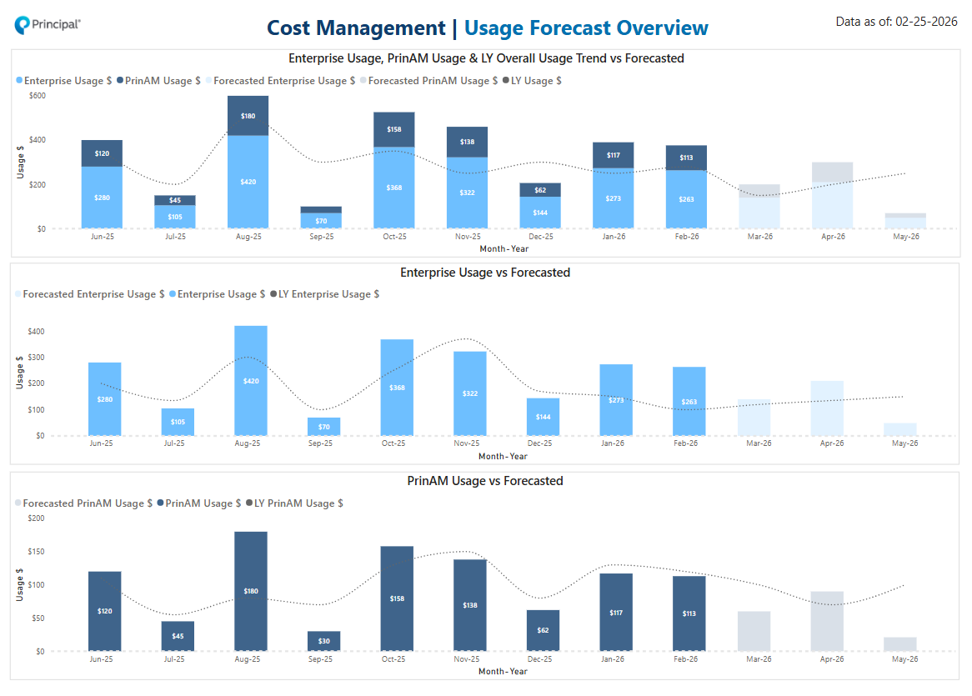
Cost Management – Usage forecast overview
Quick view to understand the actual usage trend vs forecast across the organization and within each respective divisions
1
2
3

Slide 19
Cost Management – Usage forecast overview summary
# | Category | Category Priority | Chart type | Description | Assessment: Required, Aspirational | Implementation Priority
1 | Forecasting & Historical Analysis | 5 | Line & stacked column chart | Depicts the overall monthly enterprise usage cost, prinam usage cost vs forecasted as columns, alongside the overall LY usage cost trend in the form of a line. | Required
2 | Forecasting & Historical Analysis | 5 | Line & clustered column chart | Depicts the enterprise division’s monthly usage vs forecasted as columns, alongside the PY usage trend in the form of a line. | Required
3 | Forecasting & Historical Analysis | 5 | Line & clustered column chart | Depicts the prinam division’s monthly usage vs forecasted as columns, alongside the PY usage trend in the form of a line. | Required

Slide 20
Performance Management

Slide 21
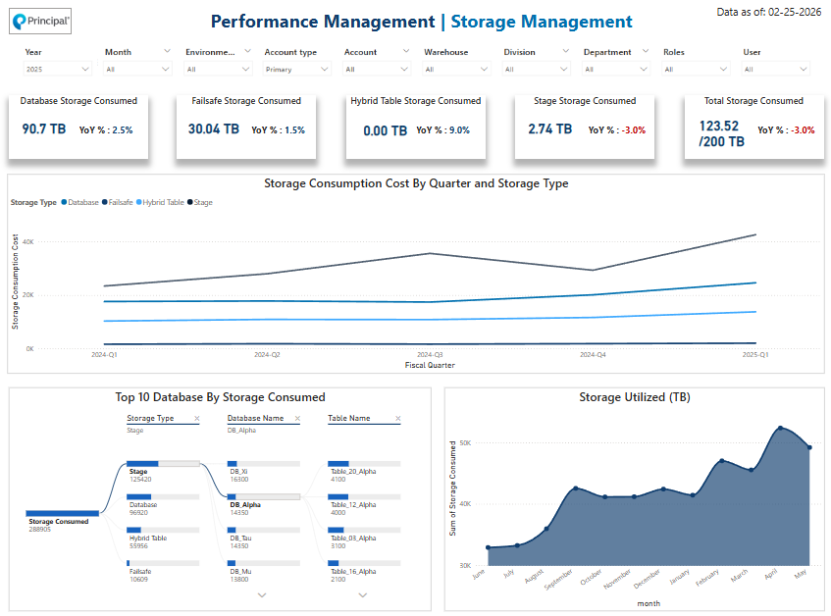
Performance Management – Storage Management
View of Storage status and storage consumption pattern by Snowflake objects
1
2
3
4

Slide 22
Performance Management – Storage Management summary
# | Category | Category Priority | Chart type | Description | Assessment: Required, Aspirational | Implementation Priority
1 | Storage Management | 3 | Card Visuals | Depicts the storage consumed by different storage types for current quarter along with YoY values. | Required
2 | Storage Management | 3 | Line Chart | Depicts the shows the trend of storage consumption by different storage types based on fiscal quarter, month and week. | Required
3 | Storage Management | 3 | Decomposition Tree | These two charts shows that, top 10 databases and tables by storage consumed. | Required
4 | Storage Management | 3 | Area Chart | Depicts the overall storage space in TB will be shown, | Required

Slide 23
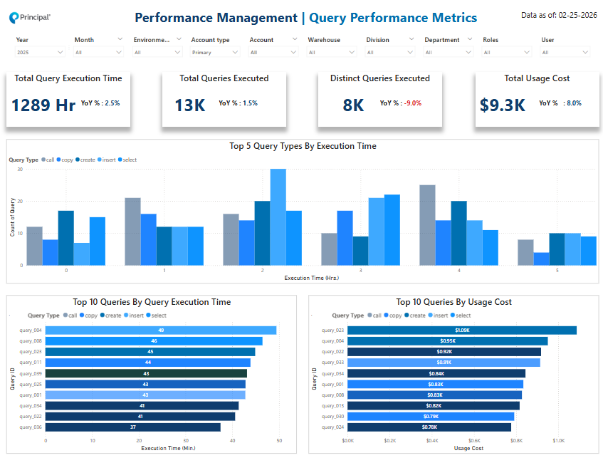
Performance Management – Query Performance Metrics
Quick view to understand the query performance metrics that shows query execution time and usage cost.
1
2
3

Slide 24
Performance Management – Query Performance Metrics
# | Category | Category Priority | Chart type | Description | Assessment: Required, Aspirational | Implementation Priority
1 | Query Performance Management | 4 | Card Visuals | This shows total query execution time, queries executed, and storage consumed for this quarter along with YoY values . | Required
2 | Query Performance Management | 4 | Clustered Column Chart | This visual shows the count of different types of queries by execution time. | Required
3 | Query Performance Management | 4 | Stacked Bar chart | This visual depicts the top 10 queries by users and by query execution time. | Required

Slide 25
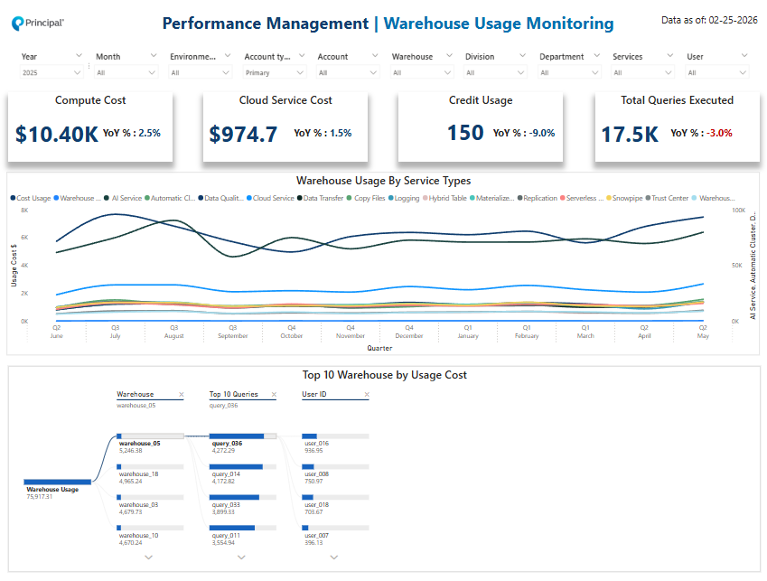
Performance Management – Warehouse Usage Monitoring
Quick view to understand the Warehouse usage monitoring that shows warehouse usage by different services, usage cost etc.
1
2
2
3

Slide 26
Performance Management – Warehouse Usage Monitoring
# | Category | Category Priority | Chart type | Description | Assessment: Required, Aspirational | Implementation Priority
1 | Warehouse Usage Monitoring | 5 | Card Visuals | Shows different types of credits consumed and total queries executed in the current qtr. along with YoY values . | Required
2 | Warehouse Usage Monitoring | 5 | Line Chart | This shows the total credit capacity and credit used by quarter and month. | Required
3 | Warehouse Usage Monitoring | 5 | Decomposition Tree | Depicts the top 10 warehouses by different credit used. | Required

Slide 27
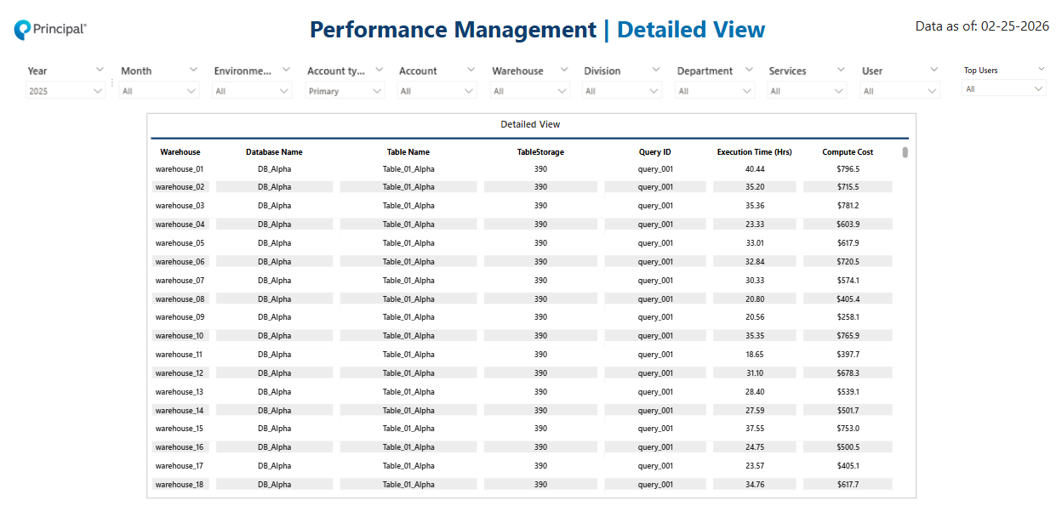
Performance Management – Detailed View
Quick view to show details of all the database, warehouse, Queries executed, usage cost etc.
1

Slide 28
Performance Management – Detailed View summary
# | Category | Category Priority | Chart type | Description | Assessment: Required, Aspirational | Implementation Priority
1 | Detailed View Page | 5 | Table Visual | Shows different types of credits consumed and total queries executed, total cost consumed, all data base, warehouse and user account details. | Required

Slide 29
Product Usage

Slide 30
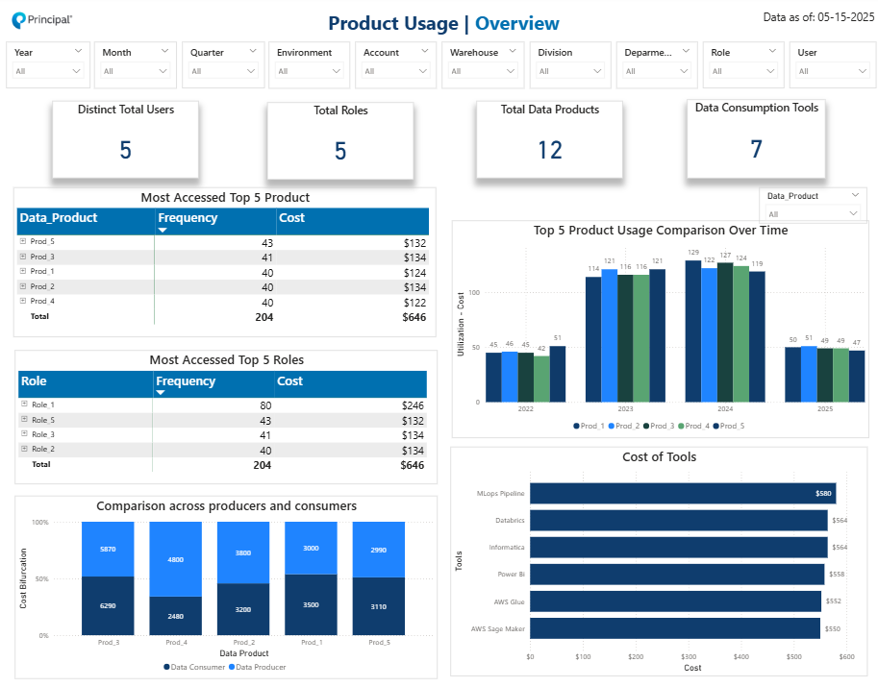
Product Usage – Overview
Quick view to understand the product usage trend over time, producers and consumers.
1
3
2
4

Slide 31
Product Usage – Overview summary
# | Category | Category Priority | Chart type | Description | Assessment: Required, Aspirational | Implementation Priority
1 | Data product usage patterns by roles | 5 | Matrix Chart | Depicts the top 5 Product usage by roles by frequency | Required
2 | Comparison across producers and consumers | 5 | Stacked column chart | Depicts the credit usage comparison between producers and consumers. | Required
3 | Usage Trend | 5 | Clustered Column Chart | Depicts the product usage comparison over time. | Required
4 | Cost / Usage by consumption tools | 5 | Clustered Bar Chart | Depicts the usage by different consumer tools. | Required

Slide 32
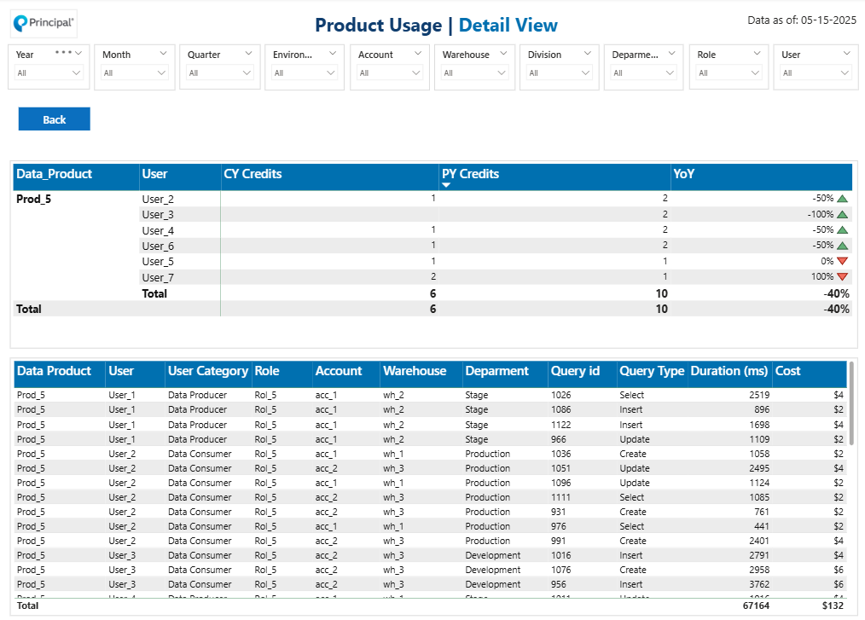
Product Usage – Detail View
Quick view to understand the product usage.

Slide 33
New Product Onboard Forecast

Slide 34
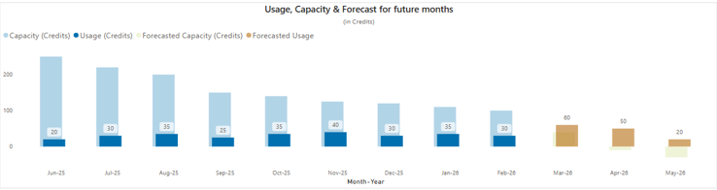
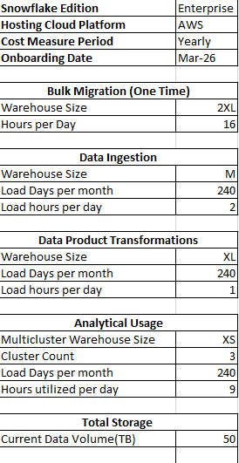
Present Forecast
New Team Onboard Forecast - Option 1 (Preferred)
Current Forecast
New Forecast post onboarding new data product
Increased Forecast Numbers

Slide 35
New Team Onboard Forecast - Option 2 (Client Selected)
Current forecast Table
Enter details in the config table
Input Parameters
Config Table
Curated Data Product
Data Product Team
Snowflake Platform Team
Snowflake Platform Team
Current Forecast
New Forecast

