Slide 1
Project Proposal
ECE 554
Spring 2017
https://drive.google.com/drive/folders/0B39iZIIrMjl8MFBUeTBIMkxRMzQ?usp=sharing
Link for my folder with sharing files

Slide 2
FPGA implementation of Nintendo Entertainment System (NES)

Slide 3
Team Members
Pavan Holla,
Eric Sullivan,
Jonathan Ebert,
Patrick Yang

Slide 4
Motivation
Understand how the Nintendo Entertainment System worked from a hardware perspective
We would have to recreate the logic for each digital component of the NES
CPU (6502)
Picture Processing Unit
DMA
Audio Processing Unit (As stretch goal)
This is often done in software emulators but rarely in an HDL so this is a somewhat unique project
We have found a few reports of this being successfully done at other schools in similar classes to 554. And failures as well.

Slide 5
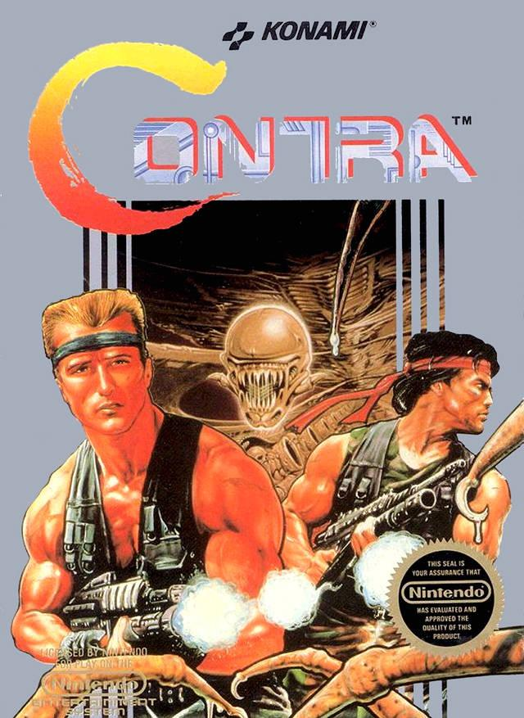
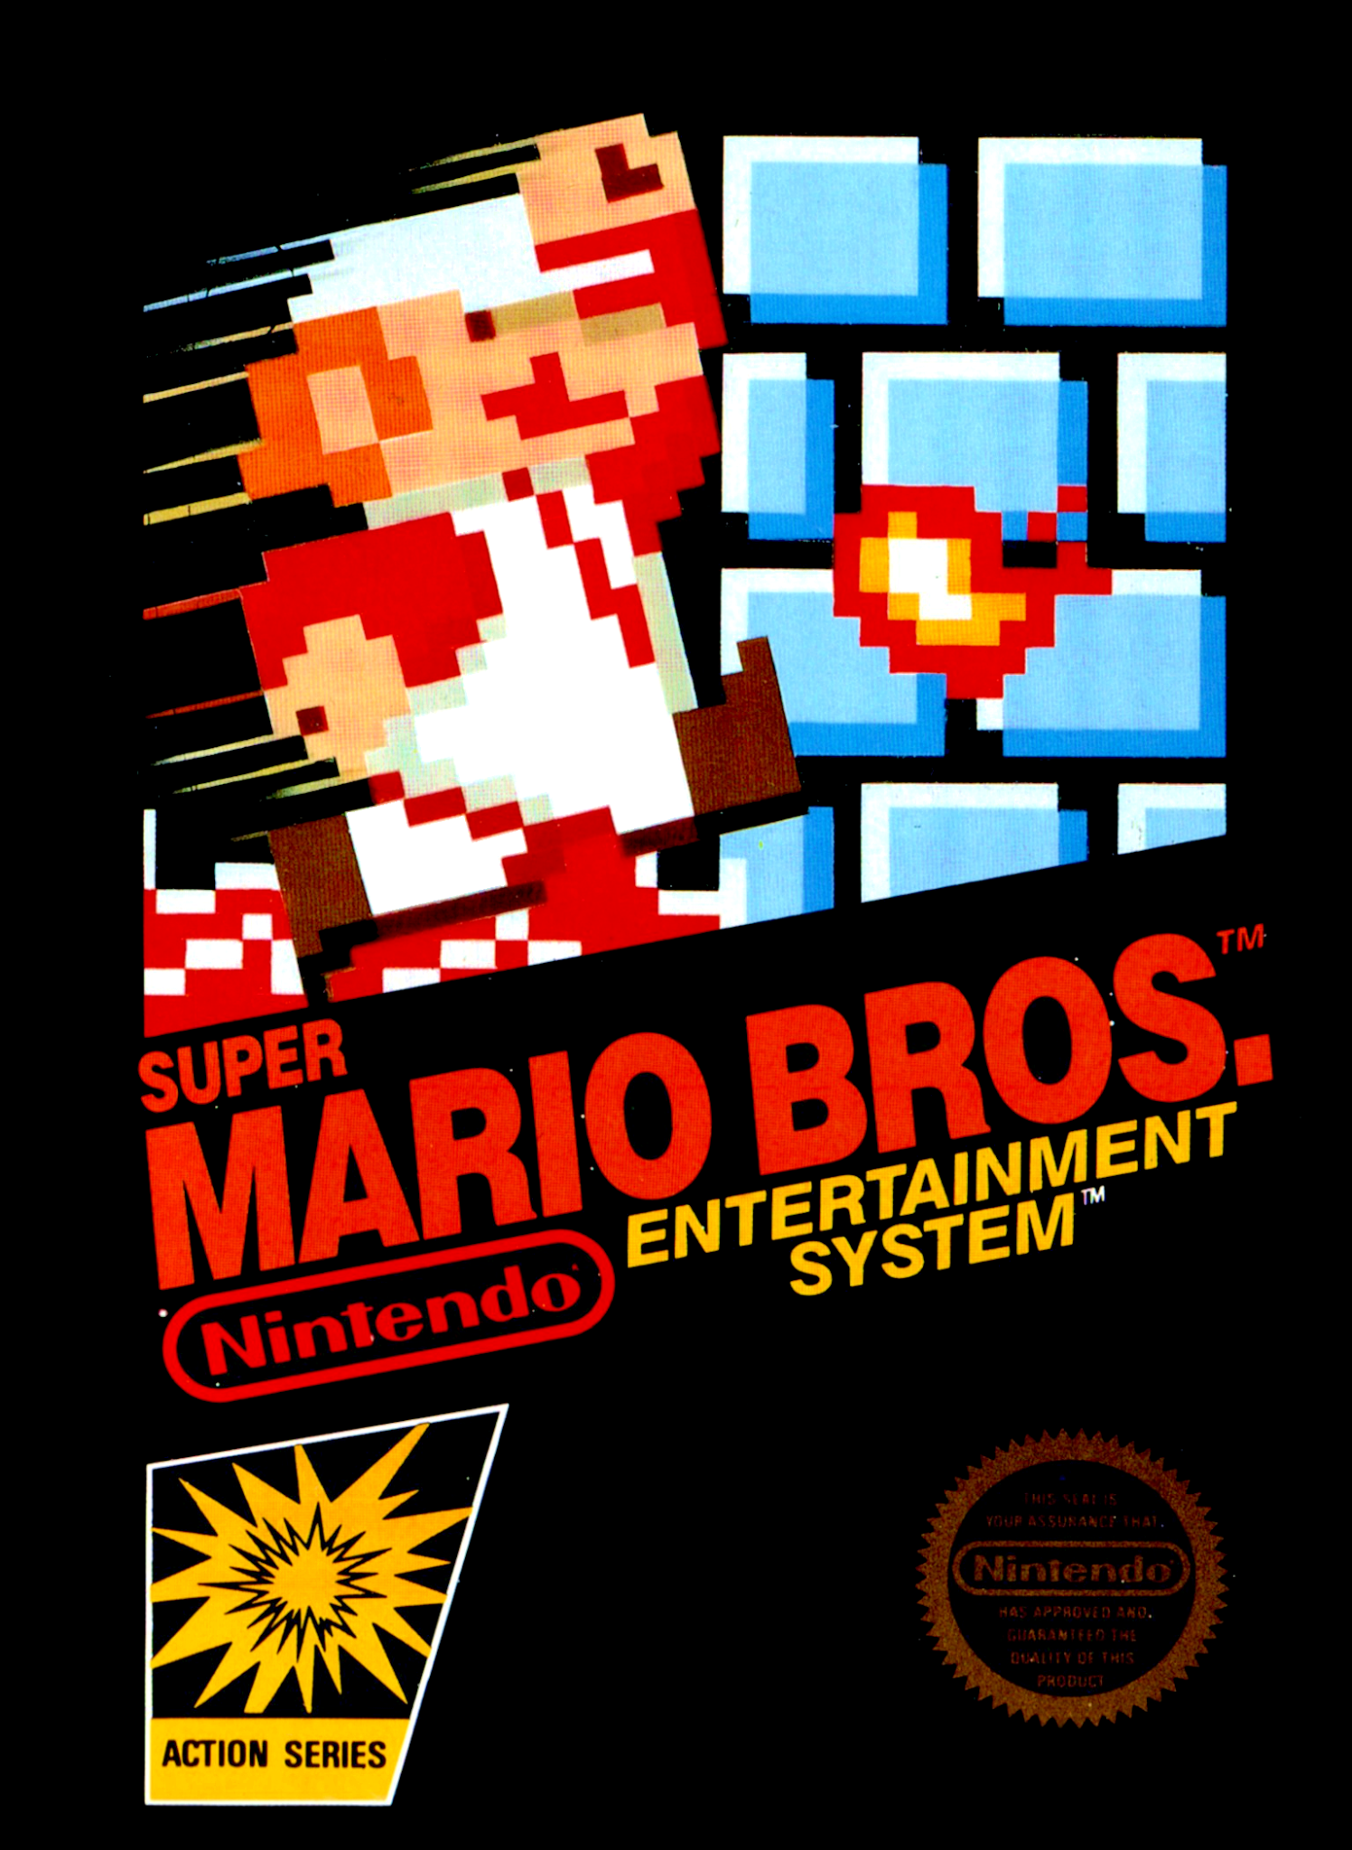
Goals
Create a system capable of running software that was written for the NES
Such great software titles include
Super Mario Bros. 1-3
Contra
Legend of Zelda
Punch-Out!!

Slide 6
Peripherals
Controller
VGA
Audio Output

Slide 7
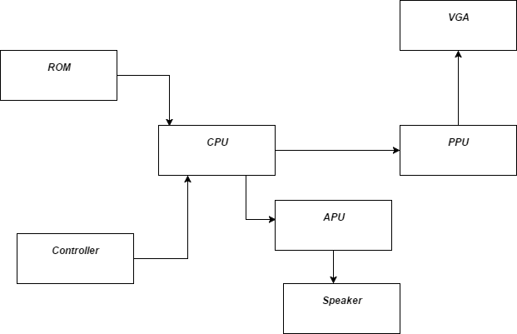
NES block diagram

Slide 8
CPU/ISA description
151 Instructions, 13 addressing modes
2 cycle pipeline - fetch and decode. Instructions can take up to 6 cycles.
Supports interrupts
Cycle accurate implementation, verified against a cycle accurate simulator.

Slide 9
Picture Processing Unit
Generates composite video with 240 lines
Will need to find a way to convert this to VGA
Configuration registers are mapped in the CPUs address space ($2000-$20007)
Also has own address space (10 KB of memory and 8 KB from the ROM)
Runs at a clock rate 4X higher than that of the CPU

Slide 10
Audio Processing Unit
Also contains registers mapped into the CPUs address space
$4000-$4013
Allows the creation of noise of five separate channels
Two pulse channels
Triangle channel
Noise channel (Random)
Delta modulation (For DCPM samples)
Will have to convert these signals into something the audio codec on our board can understand

Slide 11
Software Development
Create a custom assembler in order to debug specific problems on small amounts of code
Could also create a disassembler if time permits

Slide 12
DMA/Mapper/Controller/UART
Direct Memory Access - Used to copy sprite data from CPU memory to sprite memory for the PPU.
Mapper - Each game cart used one of several different mappers. These mappers are used to switch between different memory banks in the cartridge.
Controller - Controller input is mapped into the CPU address space so we could use our UART controller of accept input and then place this data into memory.

Slide 13
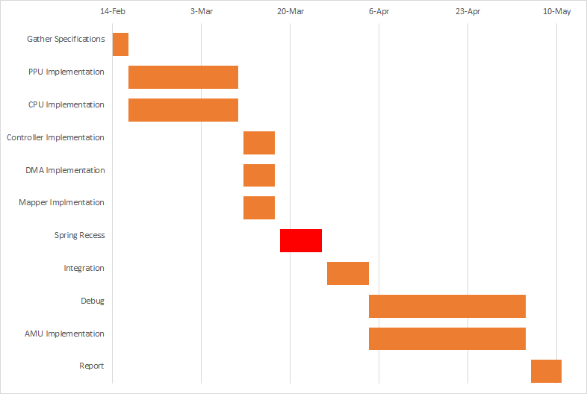
https://drive.google.com/file/d/0B39iZIIrMjl8NGJoOTRLeGtYVzQ/view?usp=sharing
link of the excel file for modification

