Slide 1
FPGANES
(Four People Generating a Nintendo Entertainment System)
Progress Update & Testing and Demo Plan

Slide 2
Progress Update

Slide 3
CPU Progress
Submodules integrated(Fetch, Decode, ALU, Registers)
Testing started
Basic instructions going through
Arithmetic
Branch
Transfer register to register
Programming an automated testbench
cycle accurate
registers
status
PC

Slide 4
PPU Progress
Each individual sub component is now functional
PPU Register Interface
Background Renderer
Sprite Renderer
Object Attribute Memory
Integration on the PPU as a whole is starting
Should be done by the end of today or tomorrow

Slide 5

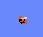
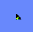
PPU Progres
A slight roadblock I ran into was finding a good way to test the sprite renderer
Could not find any OAM dumps online
There are still a few things that need to be implemented to make it “perfect”
8x16 sprites
No sprite overflow bug
Next major step is to get the PPU integrated with VGA and seeing something on a real monitor

Slide 6
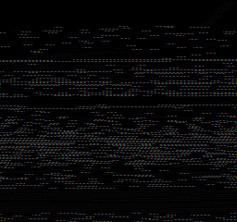
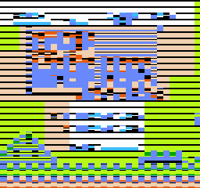
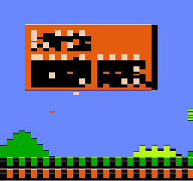
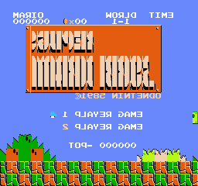

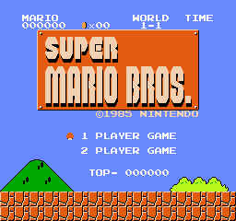

Slide 7
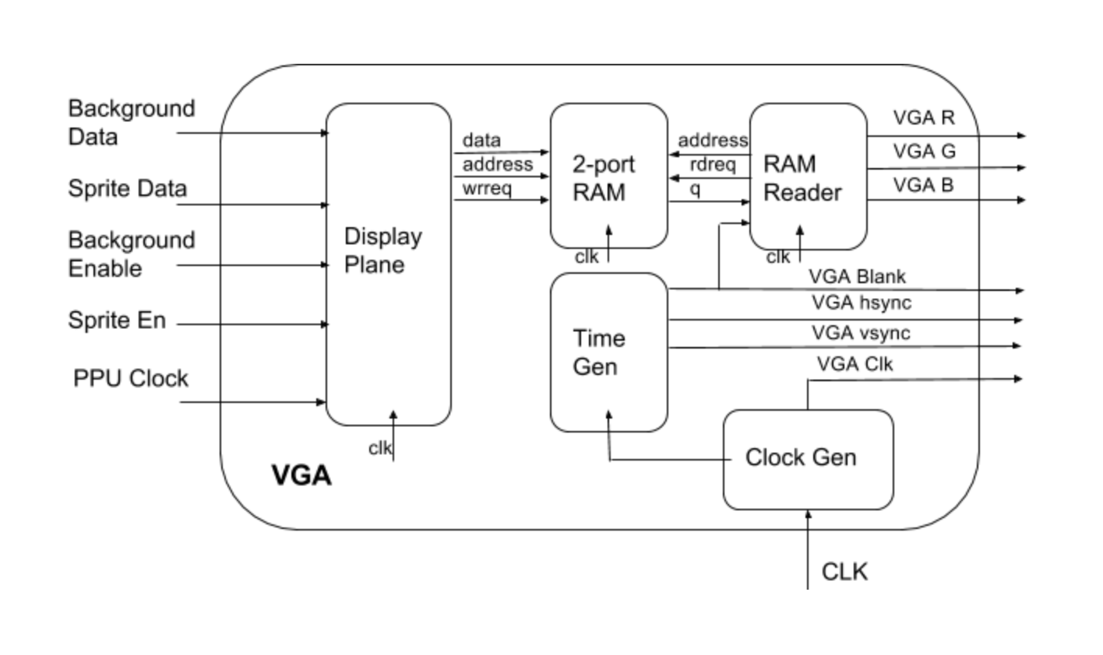
VGA Progress
All verilog modules written
Correctly reads from dedicated RAM and outputs to display
Testing VGA - PPU interface (Display Plane)

Slide 8
Controller Simulator Progress
Java application for UI complete and responds to user key presses
Used Java Simple Serial Connector library to communicate via com ports
Need to test interface with FPGA
Will use SPART from Lab 1 to display rx data on the LEDs to verify COM port communication

Slide 9
Controller Hardware Progress
Modified SPART from Lab 1 to always communicate at 38400 baud
Updated Driver from Lab 1 to be the controller
Continuously receives data from SPART
When written to from CPU, reloads button states from received data
When read from, shifts out button states one by one
Tested Driver using simple testbench

Slide 10
IP Reuse
Existing modules for APU, DMA and Mapper
Sanity check on modules taking time
Code not simulator friendly.
Memory interface issues.

Slide 11
Testing Methods

Slide 12
CPU Testing
Hand coded basic tests.
Comprehensive test suite -18000 instructions with corner case testing
Methods
Hack testsuite and load into a NES Rom.
Run on a NES emulator and generate trace into a text file
Run the automated testbench and generate trace with same format into a test file
Compare the two text files.
Find conflicts and resolve
Repeat step 5

Slide 13
PPU Testing
Test from the bottom up
Each unit has been tested individually at this point
Just need to do each of the circles in the diagram
Will have a hard time doing exhaustive tests
My final test bench will be similar to my current ones for the bg/spr rendering
Need to add support for rendering several frames at once

Slide 14
PPU Testing
Top Level PPU testbench will test
Moving sprites around the screen from one frame to another
Flipping sprites both vertically and horizontally
Changing the name tables in VRAM to alter the background
Fine scrolling in both the x and y direction
Coarse scrolling in both the x and y direction
Testbench will render multiple frames which can be stitched together

Slide 15
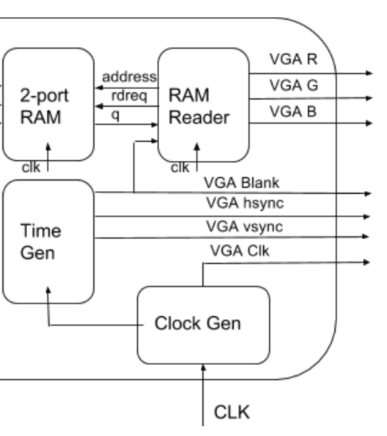
VGA Testing
Using Time Gen from Lab 2, so we have already verified correctness
Display Plane
Hand-written testbench to verify Display Plane works correctly
Once PPU is done we can load PPU and VGA onto FPGA and see if it renders background
RAM Reader
Will initialize RAM with one “frame” of PPU data and verify that the VGA correctly reads from the RAM and displays frame on display

Slide 16
Controller Testing
Controller driver tested with top-level controller testbench (We already know that the SPART module works from Lab 1)
Testing simulator and hardware interface
Will write a simple processor to read and write from top-level controller block and output the button states to the LEDs
This will be loaded onto the FPGA and connected to the simulator via SPART
We will visually be able to see if the simulator is correctly working with the hardware via the LEDs

Slide 17
Integration
CPU testing - 2 weeks
PPU +VGA testing - 2 weeks
Integration - 2weeks
( CPU, PPU, VGA, Controller, DMA, APU, Mapper )

Slide 18
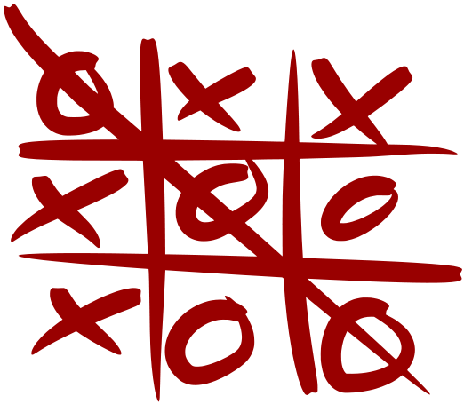

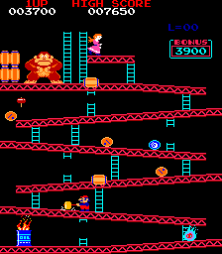
Demo
VS

Slide 19
Demo
Either of
Mario
Two people working on Mario
Depends on successful integration of all modules!
Tic-Tac-Toe
Two people
Uses only our modules - no APU, and our own software
Write code in assembly on our assembler

Slide 20
Timelines

Slide 21
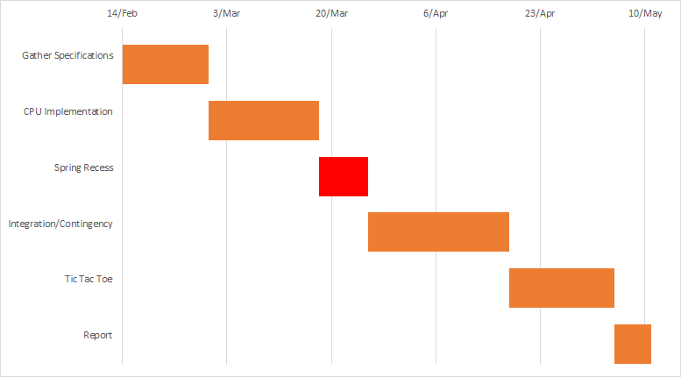
Pavan

Slide 22
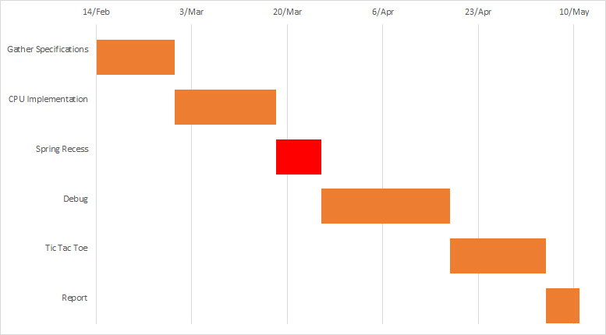
Patrick

Slide 23
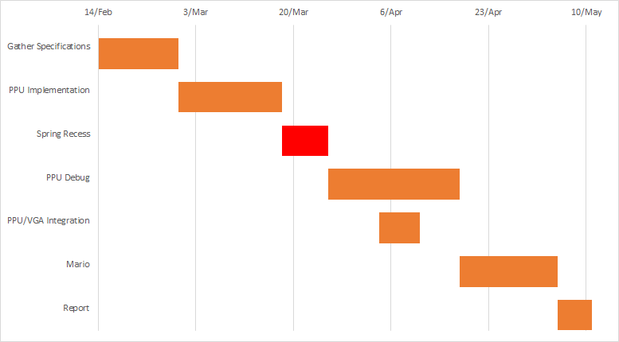
Eric

Slide 24
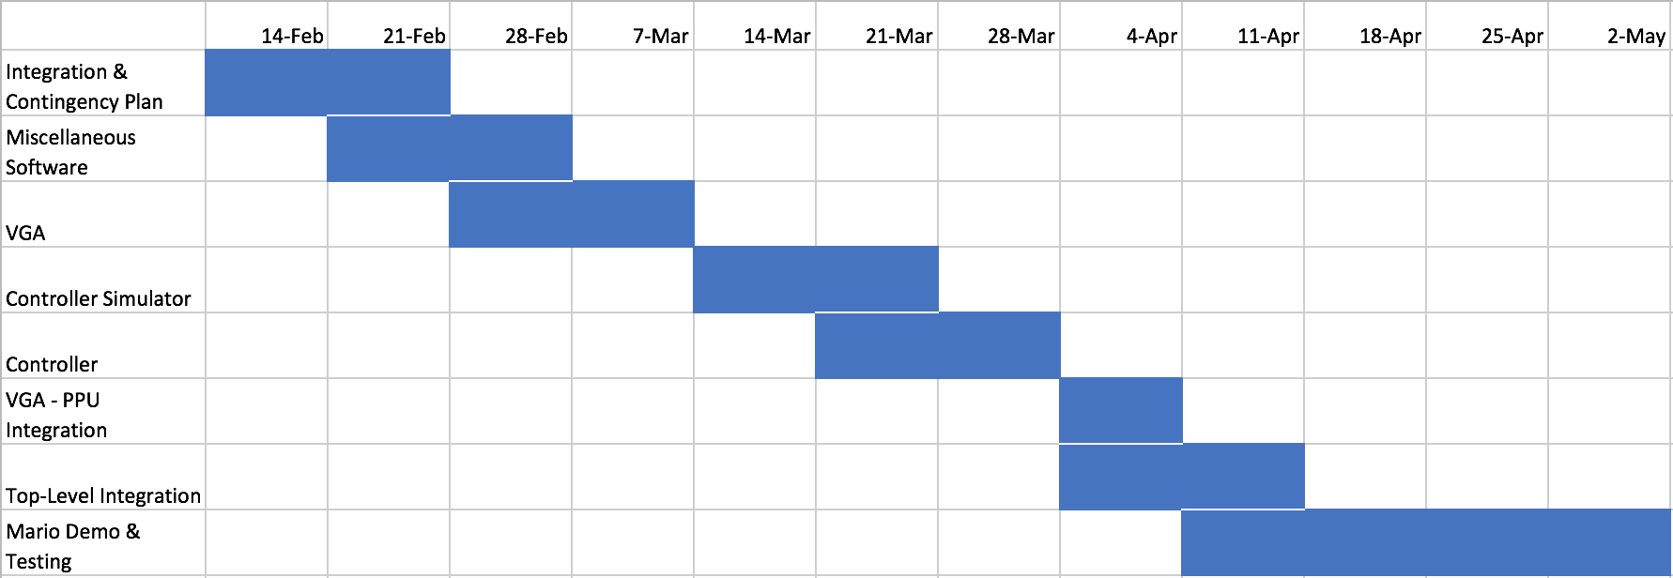
Jon

