Slide 1
How to use Local Docker as SSH Host in Clion
Notes:
<编号>

Slide 2
0. Machine Species of Docker
For native Ubuntu, just follow the readme.md and install docker via command lines.
  Please skip Section 0 or go to Docker on Ubuntu
For Windows, most are the same, but please note the following specifies before continue:
  You should have power shell and run in administrator
  All of the following linux commands are available and the same in the power shell of Windows 11
  Do not use CMD or other command lines!
Notes:
<编号>

Slide 3
Docker on Windows 11
Go to https://docs.docker.com/desktop/install/windows-install/, follow the guides
Reboot computer, run docker desktop as administrator
  Do not skip the rebooting!!!!!
  Possible problems: https://stackoverflow.com/questions/61530874/docker-how-do-i-add-myself-to-the-docker-users-group-on-windows
After the Docker GUI shows up, just leave it there
Now go to the following, using power shell adm, as if it is Ubuntu rather than Windows
  The differences, if any, are highlight
Notes:
<编号>

Slide 4
Docker on Ubuntu
Just run DockerOnNativeUbuntu.sh at docker/
Wait and fishing a while… That’s it
Notes:
<编号>

Slide 5
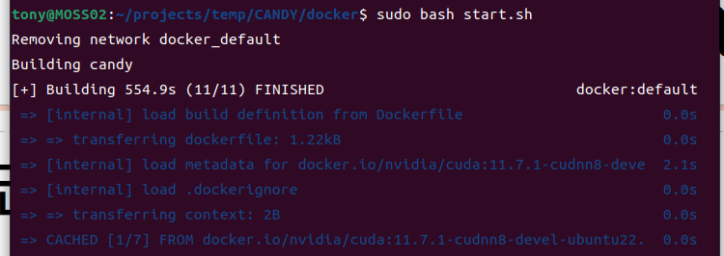
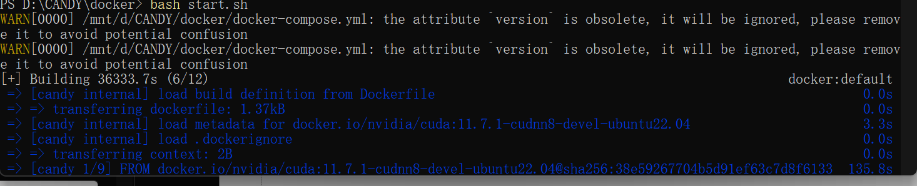
1. Create the container as follows (Ubuntu)
Please just run without sudo in Windows
If you windows has docker with wsl, just follow the picture
If your windows has only docker, than use ./start.sh instead of bash start.sh
Notes:
<编号>

Slide 6
1. Create the container as follows (Windows 11)
You’d better not use C:
Run ‘cd’ to the folder where there is this *.pdf
Please just run without sudo in Windows as above
If you windows has docker with wsl, just follow the picture
If your windows has only docker, than use ./start.sh instead of bash start.sh
Notes:
<编号>

Slide 7
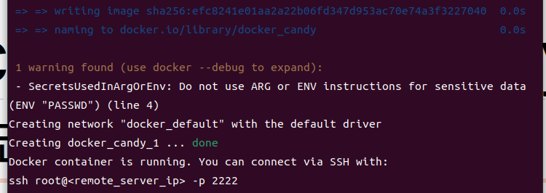
If you go to play War thunder and go back in 20 minutes, you should see this
Notes:
<编号>

Slide 8
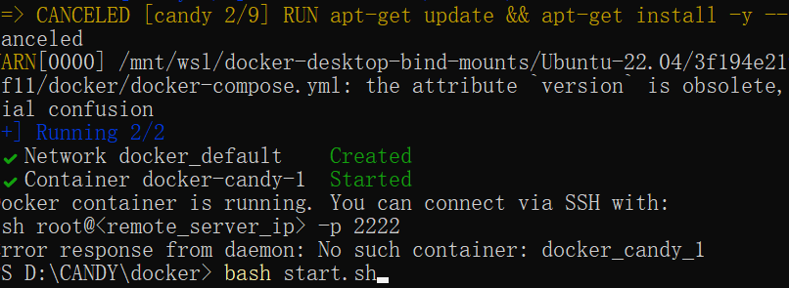
For Windows, there may be some power shell bugs, but pls just ignore
(The ‘error response’ is a false alarm)
Notes:
<编号>

Slide 9
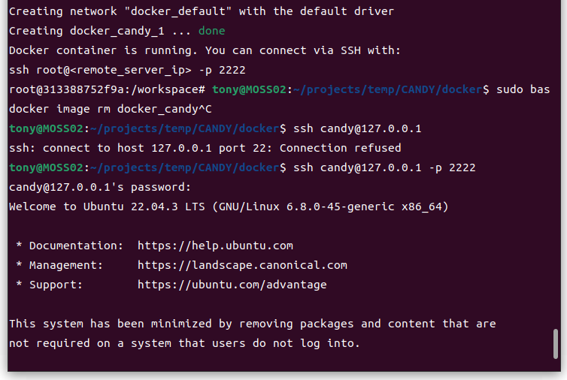
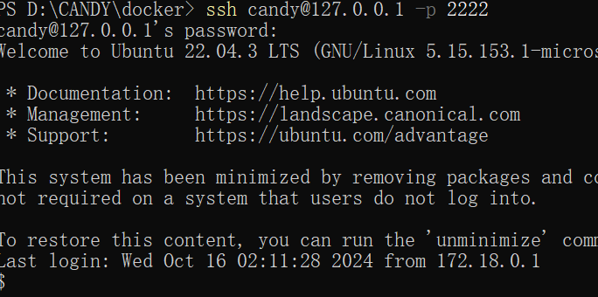
Then do something like this
Notes:
<编号>

Slide 10
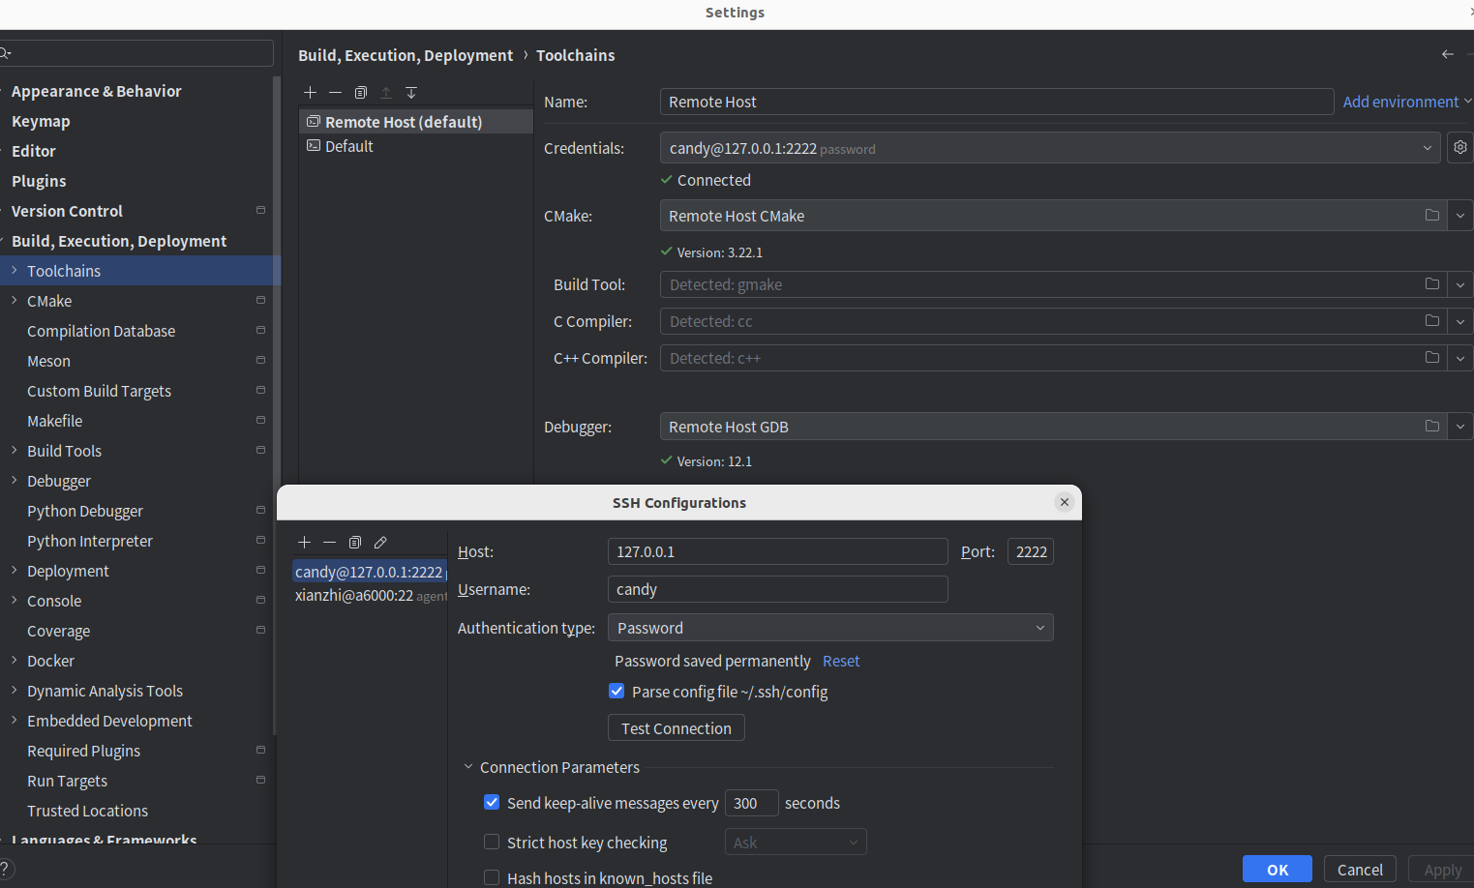
2. Go to Clion, add the host
Do change the port into 2222!
Notes:
<编号>

Slide 11
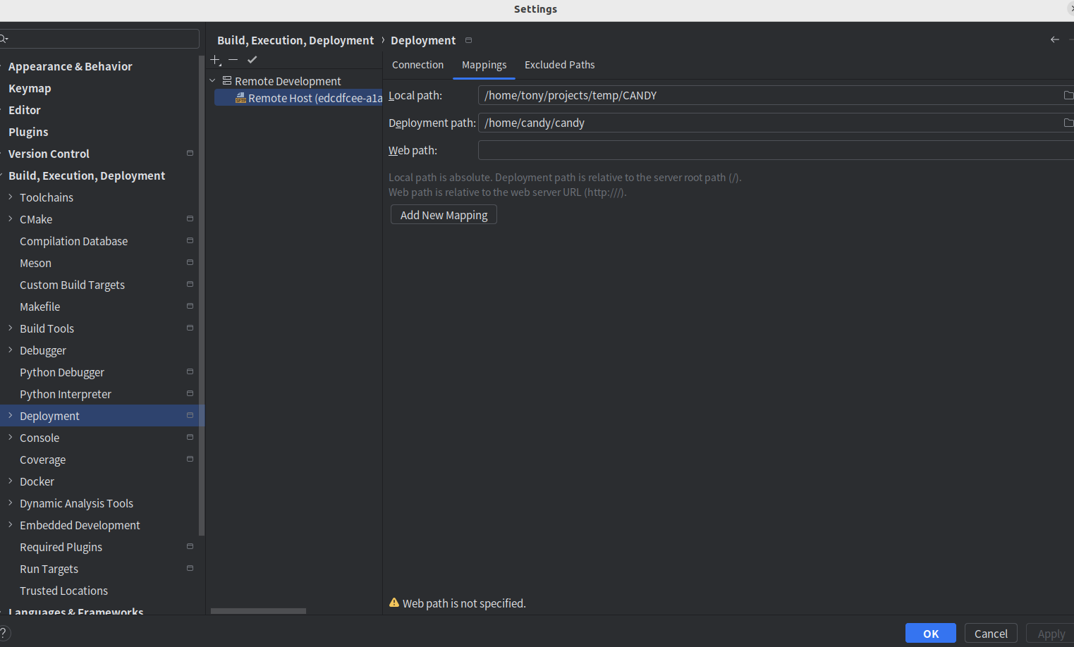
3. Change the mapping
Notes:
<编号>

Slide 12
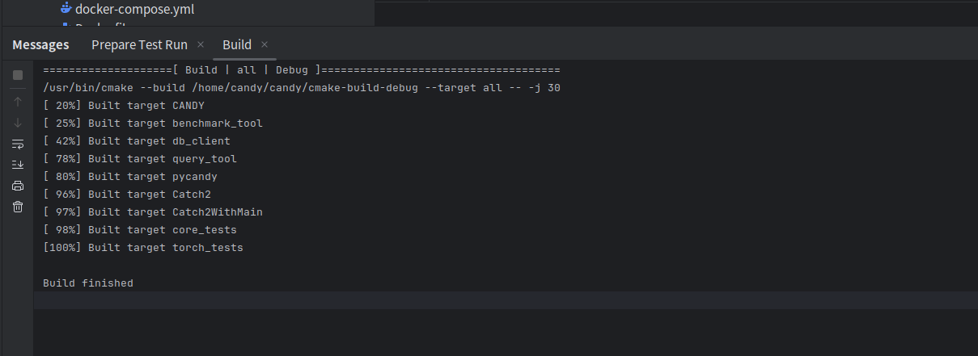
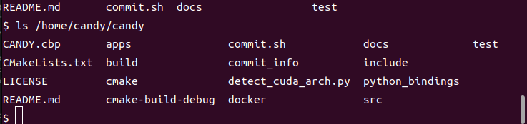
4. Restart Clion, force cmake to refresh, and enjoy!
Notes:
<编号>

