Slide 1
How to use Local Docker as SSH Host in Clion

Slide 2
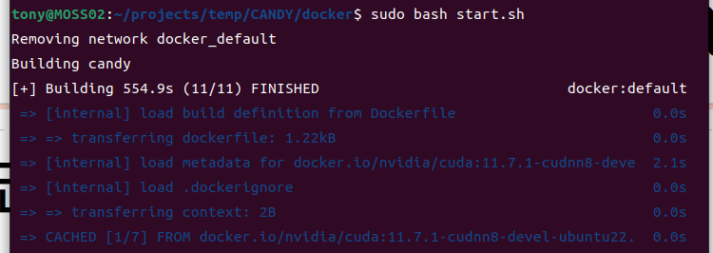
1. Create the container as follows

Slide 3
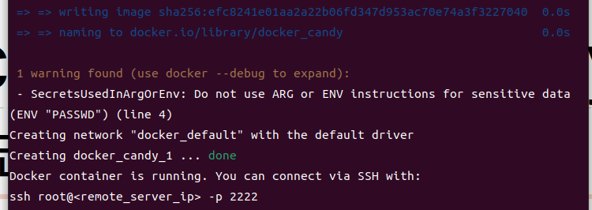
If you go to play War thunder and go back in 20 minutes, you should see this

Slide 4
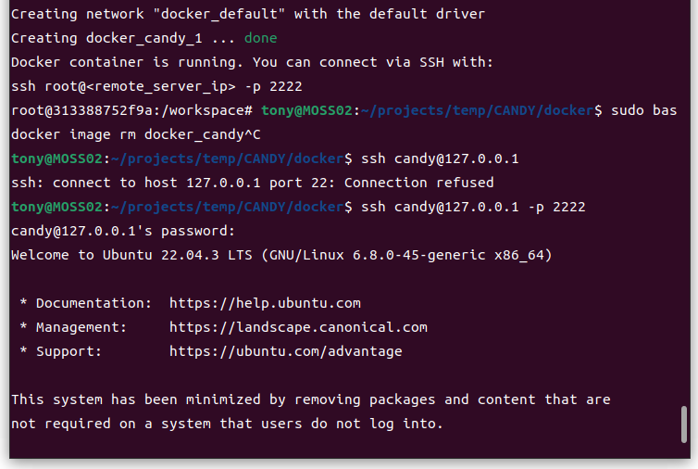
Then do something like this

Slide 5
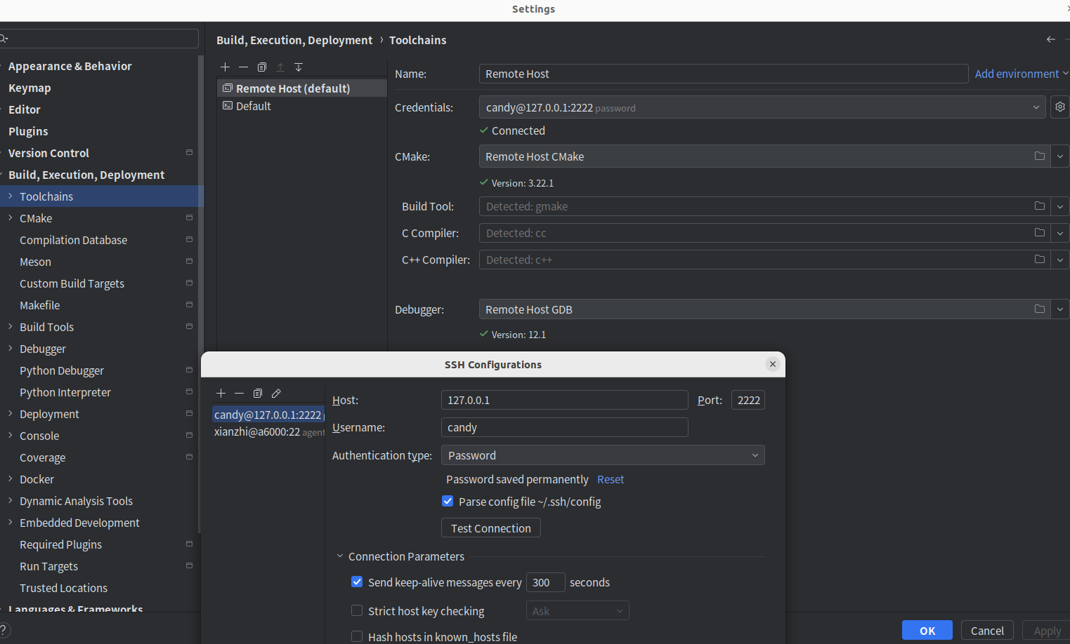
2. Go to Clion, add the host
Do change the port into 2222!

Slide 6
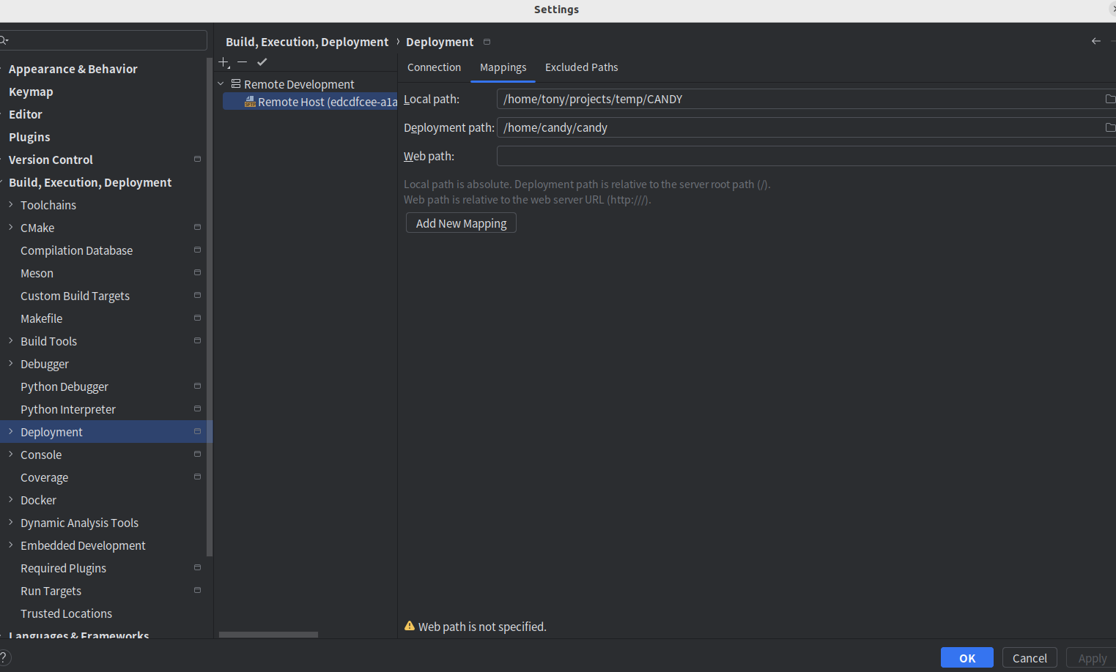
3. Change the mapping

Slide 7
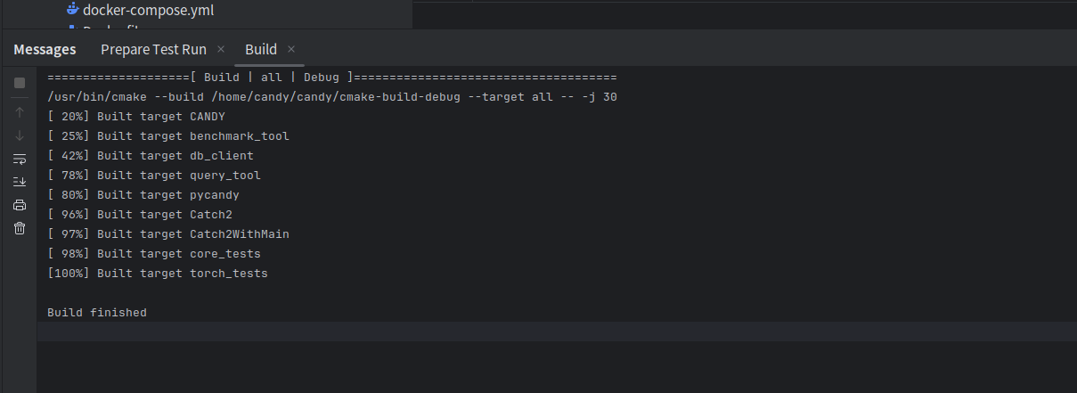
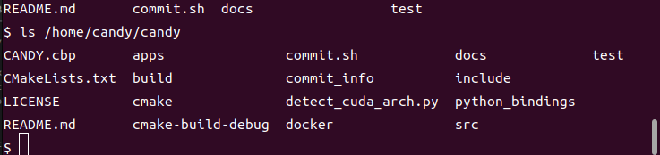
4. Restart Clion, force cmake to refresh, and enjoy!

