Slide 1
Pictet Group
Theodoros Messinis, Younes Azoum, Alfredo Lazarte
Enterprise Email Assistant
18.12.2025 Geneva

Slide 2
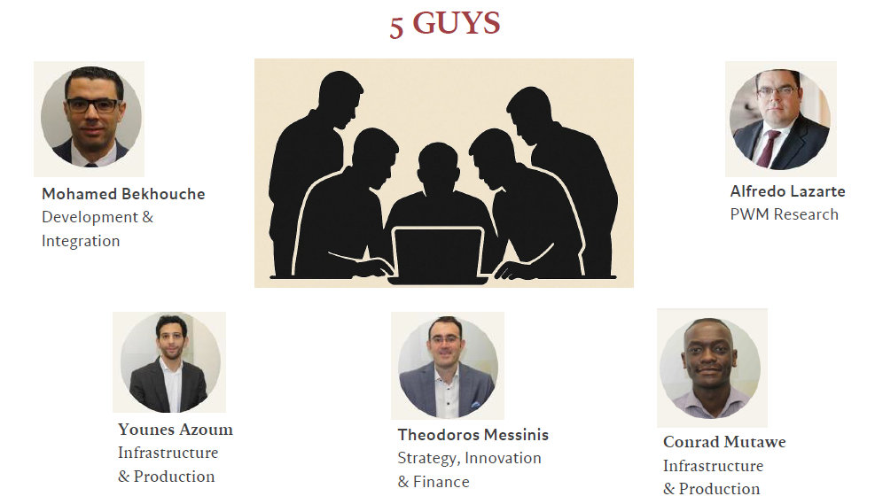
The Team
Pictet AI CUP
Pictet Group

Slide 3
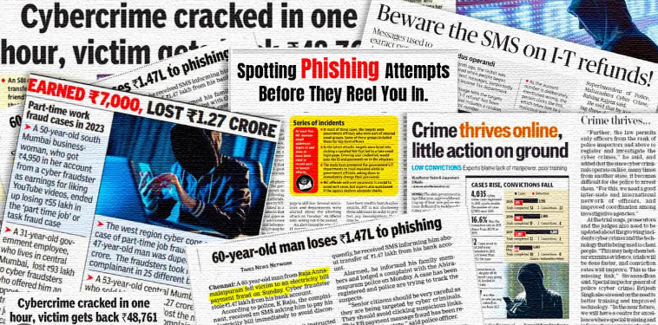
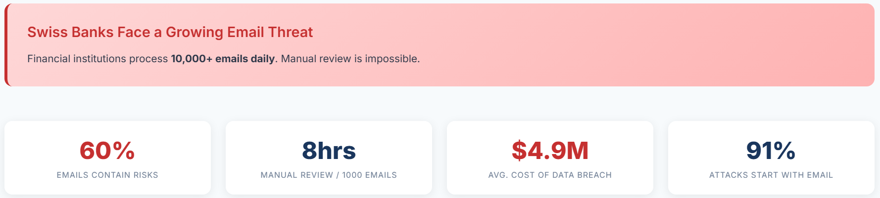
Driving Innovation: Addressing Email Risks in Finance
Pictet AI CUP
Pictet Group
“It takes 20 years to build a reputation and a few minutes of cyber-incident to ruin it.” – Stephane Nappo
“ Traditional rule-based filters catch only 60% of sophisticated attacks ”

Slide 4

Our Solution
Pictet AI CUP
Pictet Group
Enterprise Email Assistant
An Intelligent Email Security & Compliance Platform
Streamlined Weekly Meetings: Automatically schedules and organizes your meetings to ensure no important discussions are missed.
3 Specialized AI Teams: Each Solving critical Banking Challenges – Fraud Investigation, Compliance & AML, and Investment Research.
Revolutionized Email Management: Our AI-driven Email Assistant simplifies inbox management, boosting productivity in today’s fast-paced digital world.

Slide 5
LIVE DEMO
Pictet AI CUP

