Slide 1
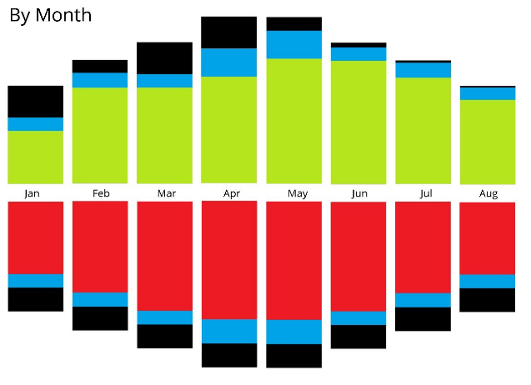
next period link
period
interval
previous period link
parent period link
Next
Week
04/02/2019 - 10/02/2019
Previous
Month
child period totals
(harvest, store, enjoy, grid)
Monday Tuesday Wednesday Thursday Friday Saturday Sunday
child period headings
child period link

