Slide 1

www.globalbigdataconference.com
www.globalbigdataconference.com
Twitter : @bigdataconf
Twitter : @bigdataconf

Slide 2
Introductory BootCamp:
Turning Raw Data into a Useful Working Predictive Model
Mark Jack
Summary
Frank Hasbani PMP, CSM & Klimka Szwaykowska PhD & Mark A. Jack PhD
Anova Analytics LLC, Roswell, GA – May-July 2016
Anovaanalytics.com

Slide 3
Topics -
Introduction to Data Science and R
Getting and Cleaning the Data
Data Munging and Data Wrangling
Visualization
Statistical Inference
Machine Learning – Regression and Classification
Model Building and Estimation
Final Project

Slide 4
Introduction to Data Science and R Studio

Slide 5
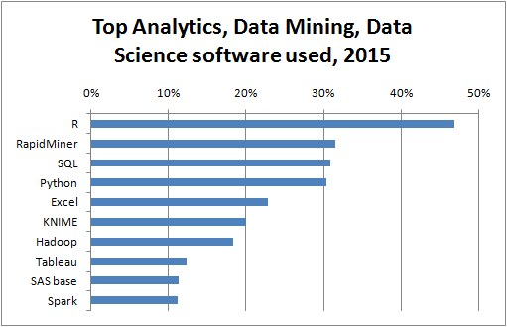
2800 voters. The participation by region was: US/Canada (41.5%), Europe (38.4%), Asia (8.2%), Latin America (6.3%), Australia/NZ (3.1%), Africa/MidEast (2.5%).
http://www.kdnuggets.com/2015/05/poll-r-rapidminer-python-big-data-spark.html

Slide 6
What is R?
A free software programming language and software environment for statistical computing and graphics.
Dialect of the S programming language with lexical scoping semantic inspired by Scheme.
Provides linear and nonlinear modeling, classical statistical tests, time-series analysis, classification, clustering, and more...
Cross-platform: Windows, Linux, MAC OSX.
Hadley Wickham: Advanced R, http://adv-r.had.co.nz
Grolemund & Wickham: R for Data Science, http://r4ds.had.co.nz
RStudio IDE: https://www.rstudio.com

Slide 7
Packages
Packages extend functionality of R.
http://cran.r-project.org/web/packages
8825 available packages as of July 25, 2016.
repository → installed → loaded
library(help="package")
Datasets:
  data(mtcars); help(mtcars)
Example: Library for support vector machines (libsvm)
  install.packages("e1071")
  library(e1071)
  detach("package:e1071")

Slide 8
Getting and Cleaning the Data

Slide 9
Getting and Cleaning Data Content
Downloading data files
Reading data
Data formats: Excel, XML, JSON, MySQL, HDF5, Web, ...
Merging data
Reshaping data
Summarizing data
Finding and replacing data
Data resources

Slide 10
Reading Data
There are a few principal functions to read data into R:
`read.table`, `read.csv`, for reading tabular data
`readLines`, for reading lines of a text file
`source`, for reading in R code files (`inverse` of `dump`)
`dget`, for reading in R code files (`inverse` of `dput`)
`load`, for reading in saved workspaces
`unserialize`, for reading single R objects in binary form

Slide 11
Data Munging and Data Wrangling

Slide 12
Data Wrangling/Munging/Manipulation
Raw vs. tidy data
Subsetting
Regular expression
Ordering
Summarizing
Reshaping
Merging
Editing

Slide 13
Data Wrangling/Munging/Manipulation
R Studio Packages:
plyr - "split-apply-combine" approach to R data.
dplyr - a faster and more powerful version of plyr.
shiny – interactive graphical websites.
data.table - a much faster version of data.frame, very well suited for larger datasets, with powerful split+apply, merge, etc. functionality; alternative to plyr.
likert - visualize the results with likert-style questionnaire data.

Slide 14
Data Wrangling/Munging/Manipulation
‘dplyr’ functionality:
Five basic verbs:
filter, select, arrange, mutate, summarise (+ group_by)
Can work with data stored in databases and data tables
Inner join, left join, semi-join, anti-join
Window functions for calculating ranking, offsets, and more
Better than ‘plyr’ if you’re only working with data frames (though it doesn’t yet duplicate all of the plyr functionality)

Slide 15
Data Wrangling/Munging/Manipulation
Example:
Use of dplyr commands on ‘hflights’ data set to subset,
re-organize and manipulate data frame and compute
aggregated results.
File: dplyrTraining.R
Use of dplyr commands on ‘mtcars’ data set
File: dplyrTraining2.R

Slide 16
Visualization

Slide 17
Plotting Systems
Three different plotting systems:
base graphics
lattice graphics
graphical processing language (GPL)
R’s base graphics plotting command: plot()
A ‘grammar of graphics’ - New graphing library ggplot2:
An abstraction which makes thinking, reasoning and communicating graphics easier.
Developed by Leland Wilkinson (“The Grammar of Graphics”, 1999/2005).
High-level package for creating statistical graphics.
A rich set of components + user friendly wrappers.

Slide 18
Grammar of Graphics - ggplot2 library
Library ggplot2 (http://had.co.nz/ggplot2):
Two basic methods to create plots, qplot() and ggplot().
qplot(): different set of assumptions and default settings to speed the creating of graphs (lattice graphics)
ggplot(): layered plots with different aesthetics, facets, scales and axes, and data sources (GPL)
Basic command line calls:
qplot(x, y, data = data)
ggplot(data, aes(x, y)) + geom_point()

Slide 19
Graphical Processing Language - ggplot
ggplot():
Components:
  Data
  Geometric object (geom)
  Statistical transformation (stat)
  Scales
  Coordinate system
  (+ Position adjustment,
  facetting)
Plot definition:
ggplot(data, mapping) +
layer(
stat = “”,
geom = “”,
position = “”,
geom_params = list(),
stat_params = list(),
)

Slide 20
Examples – plot() and ggplot()
Plotting with base graphics in R using ‘plot()’:
File: baseplotting.R
Plotting with ‘ggplot()’:
File: ggplot2.R
R Studio’s ggplot2 cheat sheet:
File: ggplot2-cheatsheet.pdf

Slide 21
Statistical Inference

Slide 22
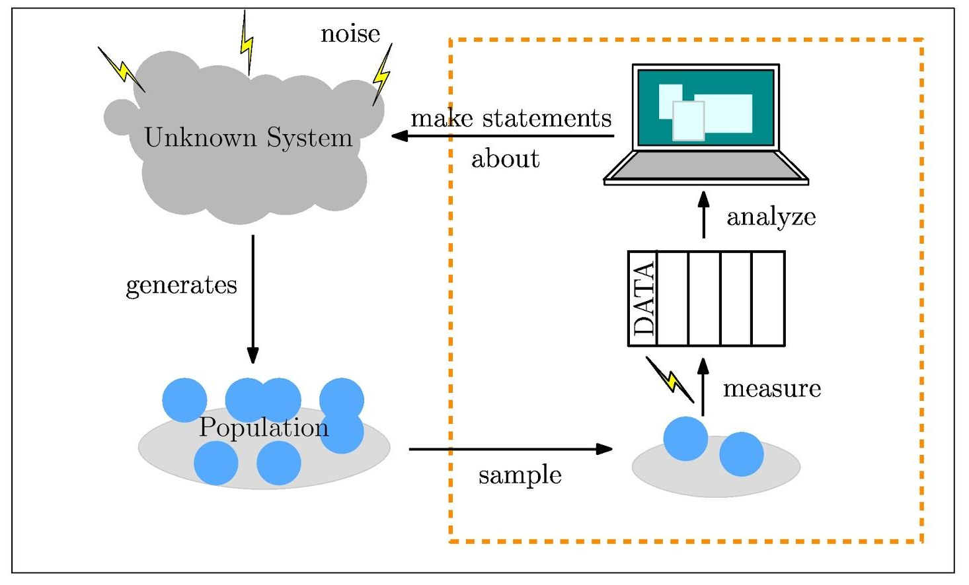
What is Statistical Inference

Slide 23
Statistical Hypothesis Testing
Can be used to compare two statistical data sets, or to compare a data set obtained by sampling with synthetic data from an idealized model.
Hypothesis testing allows us to distinguish--in a statistically meaningful way, between the null hypothesis and an alternative that we propose to test.
Example: We want to test whether singing to a Lima bean makes it grow faster.
  Null hypothesis: the mean heights of bean sprouts after 10 days are equal for beans that have been sung to, and a non-musical control group.
  Alternate hypothesis: The mean height of the beans in the sung-to group is larger than that of the control group.

Slide 24
Example: Coin Flip
Say we flip a coin 100 times and end up with the following results:
The coin lands HEADS 66 times.
The coin lands TAILS 34 times.
Can we conclude that the coin is biased?
Here, the null hypothesis is that we have a fair coin:
p(HEADS) = p(TAILS) = ½
And the alternate hypothesis is that the coin is not fair.

Slide 25
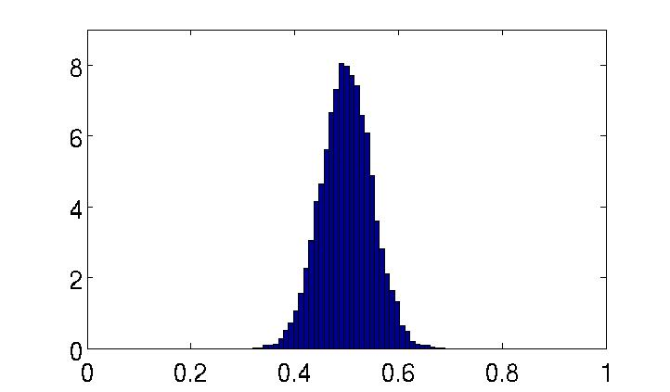
Example: Coin Flip
Given a known fair coin, we run 10,000 experiments of 100 coin flips. We record HEADS as 0 and TAILS as 1, and find the mean value for each experiment:
Experiment 1:
44 HEADS, 56 TAILS - mean = 0.56
Experiment 2:
62 HEADS, 38 TAILS - mean = 0.38
Experiment 3:
56 HEADS, 44 TAILS - mean = 0.44
Experiment 4:
45 HEADS, 55 TAILS - mean = 0.55

Slide 26
Example: Coin Flip
Given a known fair coin, we run 10,000 experiments of 100 coin flips. We record HEADS as 0 and TAILS as 1, and find the mean value for each experiment:
Our observation (mean = 0.34) does not seem so likely if the coin is fair!
Experiment 1:
44 HEADS, 56 TAILS - mean = 0.56
Experiment 2:
62 HEADS, 38 TAILS - mean = 0.38
Experiment 3:
56 HEADS, 44 TAILS - mean = 0.44
Experiment 4:
45 HEADS, 55 TAILS - mean = 0.55

Slide 27
Machine Learning
- Regression and Classification

Slide 28
Machine Learning
What is Prediction?
Sampling from a probability distribution
=> Create training data set with a prediction function
Components:
  Question
  Input Data = Training data
  Features - predictor and outcome variables
  Algorithm with tunable parameters
  (e.g. regression coefficients)
  Evaluation – test data set, validation data set

Slide 29
Machine Learning
Functions for prediction study in the “caret” library:
Preprocessing: preProcess()
Data splitting: createDataPartition(), createResample(),
createTimeSlices()
Do training/testing: train()
Run prediction algorithm: predict()
Provide statistics / error measurements
for model comparison: confusionMatrix()

Slide 30
Preprocessing Your Data
For best performance of machine-learning algorithms, data needs to be prepared in a specific form, i.e. pre-processed:
􏰀Instance based methods more effective if input variables have the same scale. 􏰀
Regression methods work better if input variables are standardized.
Use “caret” package in R:
Standalone: Pre-process multiple data sets.
Use functions preProcess() and predict().
Training: Process training data during model evaluation.
Use functions preProcess() and train().

Slide 31
Preprocessing Your Data
Examples:
􏰀zv: remove attributes with a zero variance
(all the same value).
nzv: remove attributes with a near zero variance
(close to the same value).
scale: divide values by standard deviation.
center: subtract mean from values.
range: normalize values.
pca: transform data to the principal components.
ica: transform data to the independent components.
Other transforms: BoxCox, 􏰀YeoJohnson, 􏰀expoTrans, etc.

Slide 32
Multiple Linear Regression and Interpreting Regression Coefficients
Model to estimate outcome y by multiple predictor variables x_{i}:
Estimated value
C_{i}: regression coefficient for effect of x_{i} on y with all other predictors x_{j} held fixed
Issues:
Variables x_{i} are typically correlated. Thus, changing one will also change the impact of the other on the outcome y.
Causality is not always clear, i.e. which variable x_{i} causes the other to change.

Slide 33
Machine Learning
- Regression and Hypothesis Testing
You can use hypothesis testing to test
null hypothesis H₀ – there is NO relationship between
outcome y and predictor x (i.e. )
vs.
alternative hypothesis H_{A} - there is a relationship between
y and x (i.e. )

Slide 34
Examples - Linear Regression
Example 1 – Linear model for ‘Old Faithful’ eruptions data
  library(caret); data(faithful); set.seed(333)
  inTrain <- createDataPartition(y=faithful$waiting, p=0.5, list=FALSE)
  trainFaith <- faithful[inTrain, ]; testFaith <- faithful[!inTrain, ]
  head(trainFaith)
  plot(trainFaith$waiting, trainFaith$eruptions, pch=19, col="blue", xlab="Waiting", ylab="Duration")
  lm1 <- lm(eruptions ~ waiting, data=trainFaith)
  summary(lm1)
  plot(trainFaith$waiting, trainFaith$eruptions, pch=19, col="blue", xlab="Waiting", ylab="Duration")
  lines(trainFaith$waiting, lm1$fitted, lwd=3)
Example 2 – File LinearRegressionLab.R

Slide 35
Classification
You can use Linear Regression (in principle) for classification:
The outcome Y is binary (there are only two categories/classes),
Make a prediction based on a threshold for the classification function, e.g. if then predict Y=1, otherwise Y=0.
This is equivalent to linear discriminant analysis.
Con: Probabilities may come out larger than 1 or negative.
Alternative: Logistic regression.

Slide 36
Classification
- Linear Discriminant Analysis & Bayes Theorem

Slide 37
Model Building and Estimation

Slide 38
Testing and Tuning Predictive Algorithms
Testing Predictive Algorithms:
Best Algorithm for a Problem – Algorithms to Test in R
Comparing Performance of Predictive Algorithms:
  Prepare Dataset
  Train Models
  Compare Models
  Choose the Best Model
Tuning Predictive Algorithms:
  Get Better Accuracy from Top Algorithms
  Tune Predictive Algorithms
  Test Setup
  Tune Using Caret
  Craft Your Own Parameter Search

Slide 39
Improving upon Models
Resampling Methods To Estimate Model Accuracy:
  Estimating Model Accuracy
  Data Split – Training Set, Test Set and Validation Set
  Bootstrap
  k-fold Cross Validation
  Repeated k-fold Cross Validation
  Leave-One-Out Cross Validation
  Tips for Evaluating Algorithms
Combine Predictions from Multiple Models:
  Increase the Accuracy Of Your Models
  Ensemble Methods
  Boosting Algorithms
  Bagging Algorithms
  Stacking Algorithms

Slide 40
Decision Trees, Bagging and Random Forests
Example:
Salaries of MLB baseball players based on number of hits
and years played in the league.
(G. James, D. Witten, T. Hastie and R. Tibshirani, An Introduction to Statistical Learning
with Applications in R, http://www-bcf.usc.edu/~gareth/ISL)

Slide 41
Bagging (bootstrap aggregation)
– bootstrap tree-based model e.g. random forests
Idea:
Take a set of independent observations Z₁, …, Z_{n} with variance and then take their average, and thus reduce variance by n.
The variance of the mean is given as .
=> Take bootstrap samples and create a decision tree for each sample.
Take average predictions from all bootstrap samples = ‘bagging’.
Decision Trees, Bagging and Random Forests

Slide 42
Support Vector Machines
Which classifier do you pick? Maximum margin classifier (hyperplane)
(function svm() in e1071 library) (James et al., http://www-bcf.usc.edu/~gareth/ISL)
Constrained optimization problem:
with
subject to
for all points i = 1,…,N

Slide 43
Support Vector Machines
Problems:
Non-separable data: Typically if N > p, you might not be able to find a classifier.
Noisy data where a classifier would change dramatically due to an outlier.
-> ‘Soft margins’ with some points on the wrong side of the margin or decision boundary.
-> Convex optimization problem: Nonlinear decision boundaries using a classifier
in an enlargened feature space by including interaction terms
Classifiers and kernel functions
Example:
radial classifier
(svm() in e1071)
(James et al., http://www-bcf.usc.edu/~gareth/ISL)

Slide 44
Final Project

Slide 45
Final Project of Participants
Examples:
Regression model for analysis of ‘mtcars’ data set:
Files: - R Markdown: RegressionModelProject.Rmd
- HTML output via knitr (integrated feature in R Studio):
RegressionModelProject.html
Model estimation for ‘fitbit’ human motion data:
File – run_analysis_ML.R

Slide 46
What Else is Out There?
Presentations & Publications & Interactive Web Applications:
  RMarkdown– Create publications with integrated Latex formulas
  and executable R code chunks and keep it with your data:
  http://rmarkdown.rstudio.com
  Rpubs – Make documents publicly available: https://rpubs.com
  Rpres – Create interactive presentations with R code snippets:
  https://rpubs.com/mjgrav2001/mtcars-presentation
  Shinyapps - Create interactive web applications:
  http://shiny.rstudio.com/gallery
Big Data: SparkR - Deploy predictive analytics tools for Big Data:
https://spark.apache.org
Workflow Management: Example: KNIME on Microsoft Azure:
http://knime.org

Slide 47
Thank You!
Questions ???

Slide 49
Resources:
Quora: List of machine learning resources
https://www.quora.com/How-do-I-learn-machine-learning-1
Science: List of machine learning resourceshttp://www.sciencemag.org/site/feature/data/compsci/machine_learning.xhtml
Andrew NG (Stanford, Coursera)
https://www.coursera.org/learn/machine-learning/
MIT Open Coursewarehttp://ocw.mit.edu/courses/electrical-engineering-and-computer-science/6-867-machine-learning-fall-2006/lecture-notes/
Kaggle ­ machine learning competitions
https://www.kaggle.com/

Slide 50
Resources:
Cheat Sheet for Linear Regression and Classification in R:http://blog.revolutionanalytics.com/2012/08/cheat-sheet-for-prediction-and-classification-models-in-r.html
Linear classification in R: http://machinelearningmastery.com/linear-classification-in-r/
Classification tree models in R: http://www.r-bloggers.com/classification-tree-models/
Tbschirani & Hastie: Elements of Statistical Learning (book).
R Library: ISLR.
“caret” package: http://caret.r­forge.r­project.org/

