Slide 1
SciPhi – The road to the top500
‌‌Kurt J. Strosahl (strosahl@jlab.org)
System Administrator: Lustre, HPC
Scientific Computing Group, Thomas Jefferson National Accelerator Facility

Slide 2
Thomas Jefferson National Accelerator Facility (JLAB)
Continuous Electron Beam Accelerator Facility
Not a Physicist
Scientific Computing group
Long term data storage for data produced by the accelerator
Provide computing power to process the data to physicists working with the lab and the LQCD (lattice quantum chromodynamic) project.

Slide 3
What metric does the top500 use
FLOPS: Floating-point Operations Per Second
Measured using the Linpack benchmark
Our system reached 425.9 TFLOPS/s with 16,896 cores, ranked 397
Current #1 is at 93,014.6 TFLOPS with 10,649,600 cores

Slide 4
Knights Landing (KNL) Xeon Phi
Multi Integrated Cores (MIC), first released in 2011
Each core is individually slower, with performance coming from code parallelization
16GB MCDRAM on-chip
x86 architecture
Configurable
MCDRAM usage
Cache / flat
Cores
Quad / All2All
~> lscpu
Architecture: x86_64
CPU op-mode(s): 32-bit, 64-bit
Byte Order: Little Endian
CPU(s): 256
On-line CPU(s) list: 0-255
Thread(s) per core: 4
Core(s) per socket: 64
Socket(s): 1
NUMA node(s): 1
Vendor ID: GenuineIntel
CPU family: 6
Model: 87
Model name: Intel(R) Xeon Phi(TM) CPU 7230 @ 1.30GHz
Stepping: 1
CPU MHz: 1404.101
BogoMIPS: 2594.02
L1d cache: 32K
L1i cache: 32K
L2 cache: 1024K
NUMA node0 CPU(s): 0-255

Slide 5
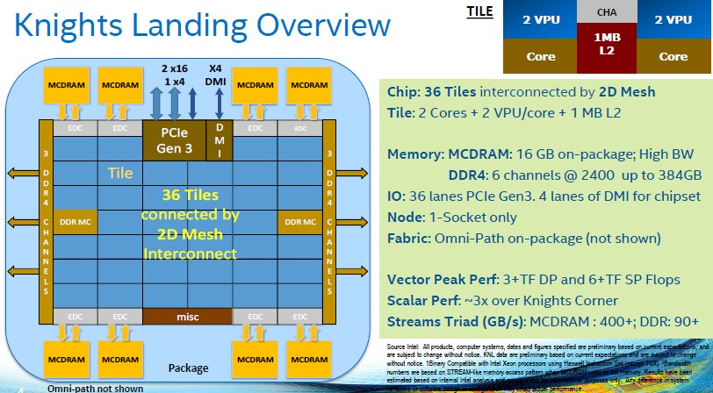
KNL cont

Slide 6
The Compute node
In addition to the Xeon Phi processor each of the 264 compute nodes has the following:
Intel Omnipath Architecture connection
4 channels at 25 Gb/s speed giving a total of 100 Gb/s
Comparable to EDR Infiniband
Intel Motherboard, providing direct access to OPA interface
96GB of RAM
1TB Hard disk
Runs CentOS 7.2 with a custom kernel provided by Intel
Is a blade in a chassis of 4 nodes.

Slide 7
Building the cluster
Physical installation provided by vendor (Koi Computing)
Basic Build on a test system (install OS, basic network configuration)
Work with Intel support to get correct kernel, drivers, bios
Configure a single compute node.
Network drivers, configuration
Kernel and software (xppsl stack)
Use configuration management software to build entire cluster
We used the Salt Stack, but any CM software can do it.

Slide 8
GPUs, the competition
Provide custom hardware for performing matrix operations
Are very fast, for certain types of problems
Have a high power consumption, and a high heat output
Require specialized code (CUDA)

Slide 9
Production Use
System shared among a number of different projects (torque pbs and maui scheduler manages)
Users have access to a compiler suit from Intel with advanced debugging and optimization tools
System has access to a 2.3PB file system to enable transfer and storage of large data sets
Has had near 100% utilization since going into production in October

Slide 10
Issues encountered
The build is more complicated than other builds
Requires installation of kernel, rebooting, than installation of opa software
On chip memory (MCDRAM) seems to have higher than expected rates of failure.
Initial BIOS did not regulate the fans, instead running them at max speed at all times.
Cluster was very noisy
BIOS update resolved this issue
Update of BIOS was done using Intel provided tool that allowed patching to be done via script submitted through the scheduler

Slide 11
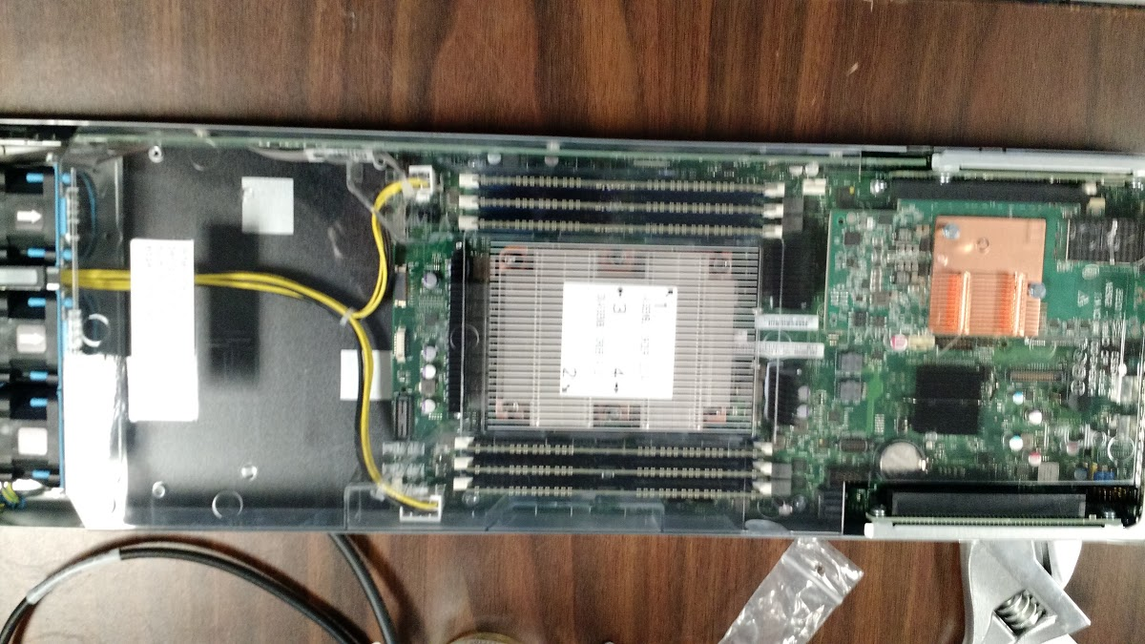
Questions?

