Slide 1
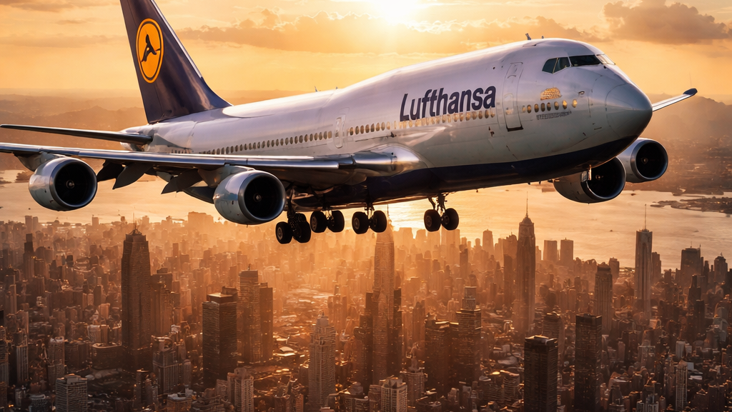
Say Yes to the World

Slide 2
Data-Driven Analysis of Flight Delays and Cancellations at Lufthansa Airlines
Using Power BI for Operational Insights and Decision Support

Slide 3
Project Introduction
This project was conducted by a individual data analytics focusing on applying Business Intelligence and data visualization techniques to real airline operational data.
Team expertise includes:
Data modeling and transformation
DAX-based analytical measures
Power BI dashboard design
Business-oriented insight generation

Slide 4
Project Goals
The primary goals of this project were to:
Analyze flight delays and cancellations at Lufthansa Airlines
Identify key operational bottlenecks
Distinguish between true delay vs. process delay
Understand peak vs. off-peak operational pressure
Build a decision-ready Power BI dashboard for management use

Slide 5
Key Achievements
✔ Built a structured fact-based data model ✔ Developed advanced DAX measures for delay and performance analysis ✔ Identified peak operational hours impacting delays ✔ Designed interactive Power BI dashboards ✔ Converted raw data into actionable business insights

Slide 6
Key Findings & Data Analysis Results Executive KPI Summary (Dashboard Overview)
Total Flights
Delayed Flights
Cancelled Flights
On-Time Flights
Total True Delay Minutes
Total Process Delay Minutes

Slide 7
Project Goal
The primary goal of this project is to analyze flight delays and cancellations at Lufthansa Airlines using a data-driven Business Intelligence approach and to translate operational insights into actionable business development recommendations.
Specifically, this project aims to:
Quantify and analyze flight delays and cancellations to understand their frequency, severity, and passenger impact
Differentiate between true passenger delays and internal process delays, highlighting Lufthansa’s delay-absorption capability
Identify key operational drivers of delays, including aircraft type, flight day patterns, and peak vs off-peak operations
Assess operational reliability and resilience, focusing on on-time performance, recovery effectiveness, and cancellation risk
Highlight high-impact risk areas where delays or cancellations generate disproportionate cost and customer dissatisfaction
Provide business-oriented recommendations to improve operational efficiency, reduce delay and cancellation risk, and support strategic decision-making
The ultimate objective is to support Lufthansa’s operational optimization and business development efforts by delivering a decision-ready Power BI dashboard and executive-level insights that enable targeted improvements in punctuality, cost control, and customer experience.

Slide 8
PESTLE Analysis
Lufthansa Airlines
(Flight Operations & Delay Analytics Project)
This PESTLE analysis evaluates the external factors influencing Lufthansa Airlines’ flight operations, with a specific focus on delays, cancellations, peak vs off-peak performance, and operational efficiency, as analyzed through Power BI. P – Political Factors
European aviation regulations (EASA, ICAO, national aviation authorities) strongly influence Lufthansa’s operational standards, flight scheduling, and delay reporting requirements.
Air Traffic Control (ATC) policies across European airspace significantly impact congestion, slot availability, and departure punctuality.
Political events such as ATC strikes, airport staff strikes, or cross-border airspace restrictions frequently lead to systemic delays and cancellations for Lufthansa.
Bilateral and multilateral international air service agreements determine Lufthansa’s route access, frequency, and airport slot allocations.
Heightened security and border control policies increase turnaround times, particularly on international routes.
E – Economic Factors
Fuel price volatility is one of the largest cost drivers for Lufthansa and directly affects operational decisions, including scheduling buffers and aircraft utilization.
Flight delays and cancellations generate substantial financial costs, including passenger compensation, rebooking, crew overtime, and operational disruption.
Peak-hour congestion increases operational inefficiencies, resulting in higher cost per flight during high-demand periods. Economic slowdowns lead to cost-optimization strategies, often reducing operational slack and increasing delay risk.
Seasonal demand fluctuations (business vs leisure travel) create imbalances between peak and off-peak operations, directly affecting delay patterns. S – Social Factors
Passenger expectations for on-time performance and transparent communication are extremely high for a premium carrier like Lufthansa.
Frequent delays negatively impact brand reputation and customer loyalty, especially among business travelers.
Peak-hour delays disproportionately affect time-sensitive corporate passengers, Lufthansa’s core customer segment.
Social media and travel review platforms amplify negative delay experiences, increasing reputational risk.
Increased passenger awareness of EU261 compensation rights places additional pressure on Lufthansa to minimize delays.

Slide 9
T – Technological Factors
Lufthansa relies on complex flight operations systems, aircraft telemetry, airport IT platforms, and ATC data feeds to manage punctuality and delays.
Power BI analytics enables Lufthansa to:
Identify delay causes and patterns
Compare peak vs off-peak operational performance
Analyze true delay vs process delay gaps
Limited real-time integration between aircraft operations, ground handling, and airport systems can still contribute to avoidable delays.
Advanced analytics and AI present future opportunities for:
Delay prediction
Crew and aircraft rotation optimization
Proactive disruption management
E – Environmental Factors
Weather conditions (fog, snow, storms, heatwaves) remain a primary external cause of flight delays for Lufthansa.
Climate change increases the frequency of extreme weather events, particularly impacting summer peak operations.
Prolonged ground delays and airborne holding increase fuel consumption and carbon emissions.
Lufthansa faces growing pressure to reduce environmental impact while maintaining operational reliability.
Efficient delay management directly supports Lufthansa’s sustainability and emissions reduction goals.

Slide 10
L – Legal Factors
EU passenger rights regulations (EU261) impose mandatory compensation for delays and cancellations, creating direct financial exposure.
Accurate classification of delay causes is legally critical to determine compensation eligibility.
Misreporting or misclassification of delays can lead to legal disputes, regulatory penalties, and reputational damage.
Lufthansa must comply with GDPR when handling passenger, flight, and operational data used in analytics.
Increasing regulatory scrutiny reinforces the need for transparent, data-driven delay reporting.
Strategic Insight for Lufthansa Airlines
This analysis highlights that flight delays at Lufthansa are not purely operational issues but are driven by a complex interaction of political, economic, technological, environmental, and legal factors.
By leveraging Power BI–based flight and delay analytics, Lufthansa can:
Identify high-risk peak-hour operational windows
Reduce avoidable delays through process optimization
Improve cost efficiency and customer satisfaction
Strengthen regulatory compliance and reporting accuracy
Support long-term sustainability and operational resilience

Slide 11
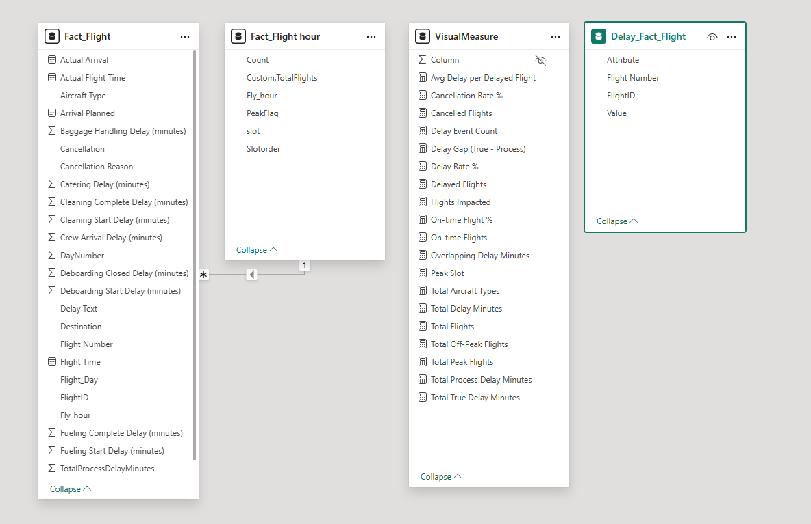
Data Modeling Approach
The analysis is built on a central Fact_Flight table containing flight-level operational data.
Supporting analytical tables were created to enable time-based and peak/off-peak analysis.
Calculated measures (DAX) were used for KPIs such as delays, cancellations, on-time rate, and true vs process delay.
The model follows a fact-driven analytical design, optimized for performance and business insight generation.

Slide 12


Operational Volume & Reliability
Total Flights: 1,680
On-time Flights: 1,178 (70.12% on-time performance)
Delayed Flights: 374 (22.26% delay rate)
Cancelled Flights: 128 (7.62% cancellation rate)
“Out of 1,680 Lufthansa flights, just over 70% operated on time. Approximately 22% experienced delays, while cancellations remained below 8%, indicating overall operational stability with clear opportunities to improve punctuality.”
This slide provides a high-level overview of Lufthansa’s operational performance. Out of 1,680 flights, around 70% operated on time, while roughly 22% experienced delays and cancellations stayed below 8%, reflecting a stable operation with room for punctuality improvement.
What is particularly interesting is the difference between internal delays and passenger impact. Lufthansa records more than 170,000 minutes of internal process delays, but only about 35,000 minutes are felt by passengers.
This gap highlights Lufthansa’s ability to absorb operational inefficiencies through buffer times, schedule flexibility, and recovery mechanisms—protecting customer experience despite internal complexity. Operational resilience allows Lufthansa to shield passengers from most internal delays.

Slide 13

Delay Severity: Passenger vs Internal Impact
Total True Delay Minutes (Passenger Impact): 35,152
Total Process Delay Minutes (Internal Operations): 170,749
“A key insight is the significant gap between internal process delays and passenger-experienced delays. While Lufthansa accumulates over 170,000 minutes of internal operational delays, only about 35,000 minutes are ultimately passed on to passengers.”
This indicates strong delay-absorption capability through:
Buffer time management
Schedule flexibility
Operational recovery mechanisms
This slide provides a high-level overview of Lufthansa’s operational performance. Out of 1,680 flights, around 70% operated on time, while roughly 22% experienced delays and cancellations stayed below 8%, reflecting a stable operation with room for punctuality improvement.
What is particularly interesting is the difference between internal delays and passenger impact. Lufthansa records more than 170,000 minutes of internal process delays, but only about 35,000 minutes are felt by passengers.
This gap highlights Lufthansa’s ability to absorb operational inefficiencies through buffer times, schedule flexibility, and recovery mechanisms—protecting customer experience despite internal complexity.

Slide 14
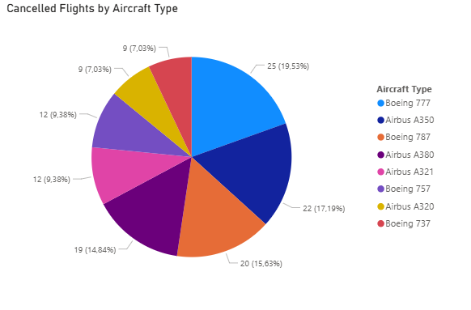
Interpretation of the Statistics
A 7.62% cancellation rate indicates that cancellations are not negligible, but they are significantly lower than delay occurrences (22.26%).
The majority of operational disruptions are therefore handled as delays rather than cancellations, suggesting:
Effective recovery and re-scheduling strategies
A preference for absorbing disruption operationally instead of cancelling flights outright
Total Flight : 1680
Total Cancel Flight : 128 Cancel ratio: 7.62%
Comparative Context
While 22.26% of flights experience delays, only 7.62% are cancelled, meaning:
Many disrupted flights are successfully recovered
Operational buffers and contingency planning prevent escalation from delay to cancellation
Business Impact
Positive:
Lower cancellation rates protect customer trust and brand reputation
Reduced compensation and re-accommodation costs compared to cancellations
Risk Area:
Each cancelled flight has a disproportionately high cost impact compared to delayed flights
Even small reductions in cancellations can yield large financial and customer-satisfaction gains
Risk Area
Each cancelled flight carries a disproportionately high cost impact compared to delayed flights:
Passenger dissatisfaction
Missed connections
Regulatory and compensation exposure
Even small reductions in cancellations can generate outsized financial and customer-experience gains
“Although Lufthansa operates in a disruption-prone environment, only 7.62% of flights are cancelled. This shows strong operational control, with most disruptions being managed through delays rather than cancellations. Further reducing cancellations—even marginally—would deliver significant cost savings and customer experience benefits.”

Slide 15
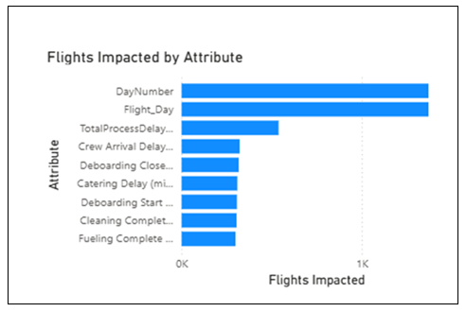
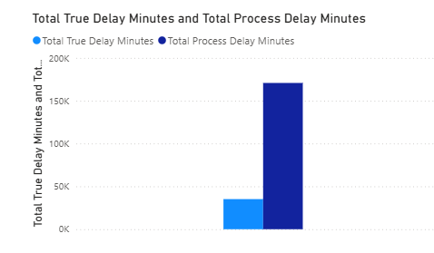
Flights Impacted by Attribute:
This chart highlights the operational and scheduling attributes that have impacted the highest number of Lufthansa flights.
The strongest impact is driven by day-level patterns and overall process-related delays, while individual operational activities such as crew arrival, catering, deboarding, and cleaning contribute comparatively less.
This clearly indicates that flight delays are systemic and pattern-based, rather than the result of isolated operational incidents.
Total True Delay Minutes vs Total Process Delay Minutes
This chart compares the actual delay experienced by passengers with the total internal process-related delay minutes.
Although total process delays are significantly higher, only a portion of that delay translates into true passenger delay. This demonstrates Lufthansa’s ability to absorb operational inefficiencies through buffer time, scheduling flexibility, and recovery mechanisms.
Business Impact
Operational efficiency opportunity: High process-related delays point to inefficiencies in ground operations and aircraft turnaround activities.
Cost reduction potential: Optimizing internal processes can reduce operational costs, even when passenger delays are already partially mitigated.
Service quality protection: Effective delay absorption helps preserve customer satisfaction and maintain on-time performance standards.
Strategic optimization focus: Process-level improvements deliver higher impact than addressing isolated delay causes.

Slide 16
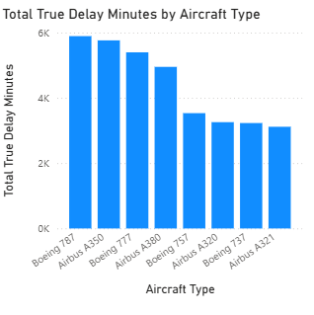
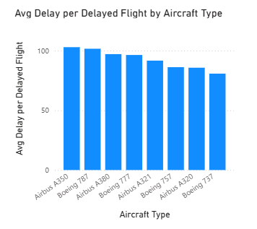
Executive Explanation:
This slide analyzes delay impact by aircraft type from two complementary perspectives: total passenger delay minutes and average delay per delayed flight.
Wide-body aircraft—specifically the Boeing 787, Airbus A350, and Boeing 777—generate the highest total delay minutes. This indicates that delays affecting long-haul fleets have a broader passenger impact due to longer flight durations and higher passenger volumes.
At the same time, these aircraft also show a higher average delay per delayed flight, confirming that when delays occur on wide-body aircraft, they tend to be more severe rather than short, recoverable disruptions.
Overall, this demonstrates that operational issues impacting long-haul fleets have a disproportionately large effect on Lufthansa’s total delay performance.
Business Insight (Executive-Focused):
Primary optimization opportunity: Wide-body aircraft turnaround, maintenance coordination, and crew readiness
High leverage area: Even small efficiency improvements on long-haul fleets can lead to significant passenger delay reduction
Strategic implication: Delay-reduction initiatives should prioritize aircraft types with the highest combined impact × severity

Slide 17
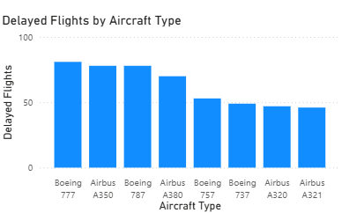
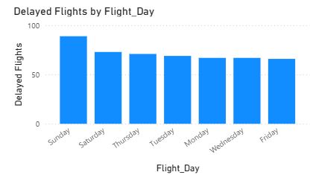
Executive Explanation:
This slide analyzes how frequently delays occur, focusing on two dimensions: aircraft type and day of the week.
The upper chart shows that wide-body aircraft—particularly the Boeing 777, Airbus A350, and Boeing 787—experience the highest number of delayed flights. These aircraft are heavily utilized on long-haul routes and typically operate during high-demand time windows, increasing their exposure to operational disruptions.
The lower chart highlights day-level delay patterns, where weekend and early-week days show a higher concentration of delayed flights. This suggests that traffic density, passenger volume, and network complexity vary significantly by day, influencing delay risk.
Together, these charts indicate that delay frequency is not random but strongly influenced by fleet composition and scheduling patterns.
Business Insight:
Key risk factor: Peak-hour and peak-day utilization of wide-body aircraft
Operational opportunity:
Smoother schedule distribution across days
Additional buffer time for long-haul aircraft during high-risk periods
Strategic takeaway: Reducing delay frequency requires capacity-aware scheduling, not only reactive delay management

Slide 18
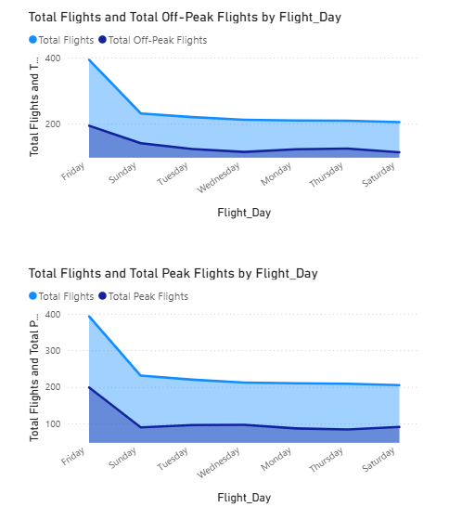
Total Flights vs Off-Peak Flights by Flight Day (Top Chart)
Explanation: This chart illustrates the distribution of total flights compared with off-peak flights across different days of the week.
Friday shows the highest overall flight volume, indicating strong end-of-week travel demand.
After Friday, total flight volume drops sharply on Sunday and then stabilizes during weekdays.
Off-peak flights follow a similar pattern but remain consistently lower than total flights, reflecting structured scheduling outside peak hours.
Total Flights vs Peak Flights by Flight Day (Bottom Chart)
Explanation: This chart compares total flights with peak-hour flights across the week.
Peak flights are most concentrated on Friday, aligning with high passenger demand.
After the weekend, peak flight volumes decrease and remain relatively flat during weekdays.
The gap between total flights and peak flights highlights that only a portion of daily operations occur during peak hours, even on high-traffic days.

Slide 19
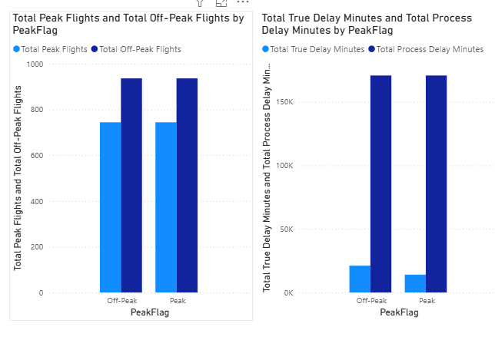
Total Peak vs Off-Peak Flights (Left Chart)
This chart compares the volume of flights operated during peak and off-peak hours.
Off-peak flights are slightly higher in number than peak flights.
Peak flights represent a smaller share of total operations, but they are strategically important because they occur during high-demand time windows.
True Delay Minutes vs Process Delay Minutes (Right Chart)
This chart compares:
Total Process Delay Minutes (internal operational delays), and
Total True Delay Minutes (actual passenger-experienced delays).
Key observations:
Process delay minutes are extremely high in both peak and off-peak periods.
However, true passenger delay minutes are significantly lower, especially during peak hours.
Interpretation: Although internal operational delays increase during peak hours, only a portion of that delay is passed on to passengers.
Business Impact (Use This Section as Highlight)
Operational strength: Lufthansa demonstrates strong delay-absorption capability during peak hours
Risk indicator: High internal process delays signal hidden inefficiencies in ground operations and turnaround activities
Optimization opportunity: Reducing process-level delays—even slightly—can significantly lower operational cost without impacting customer experience

Slide 20
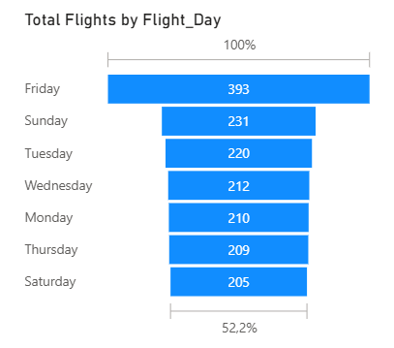
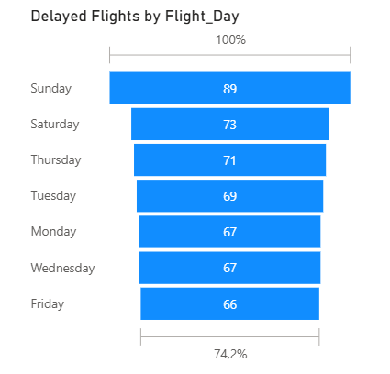
Total Flights by Flight Day (Left / Top Chart)
Explanation: This chart shows the total number of Lufthansa flights operated on each day of the week.
Key Observations:
Friday records the highest number of flights (393), indicating strong end-of-week travel demand.
After Friday, total flight volume drops sharply on Sunday (231) and then remains relatively stable during weekdays.
Saturday has the lowest total flight volume (205), reflecting reduced business and commuter travel.
Interpretation: Lufthansa’s weekly schedule is clearly demand-driven, with capacity peaking toward the end of the workweek and stabilizing during regular weekdays.
Delayed Flights by Flight Day (Right / Bottom Chart)
Explanation: This chart shows the number of delayed flights for each day of the week.
Key Observations:
Sunday has the highest number of delayed flights (89), despite not having the highest total flight volume.
Friday, although the busiest day, has the lowest delayed flights (66).
Delay counts remain relatively high on Saturday and Thursday, indicating operational pressure during weekends.
Interpretation: Flight delays are not directly proportional to flight volume. Instead, they appear to be influenced by operational recovery challenges, weekend scheduling constraints, and aircraft/crew rotation patterns.
Story (after the visual): “Although Friday has the highest number of flights, it records the lowest delays. Sunday, despite lower traffic, experiences the highest delays—indicating recovery challenges rather than capacity issues.”

Slide 21
Combined Insight (Very Important for Presentation)
High traffic does not automatically mean high delays.
Lufthansa performs operationally strongest on Fridays, managing the highest traffic with comparatively fewer delays.
Sundays represent a risk day, where fewer flights still result in more delays—suggesting:
tighter turnaround buffers,
accumulated delays from the week,
limited recovery windows before the new week begins.
Business Impact & Recommendations
Operational Insight:
Fridays demonstrate best-practice scheduling and buffer management.
Sundays expose systemic recovery and turnaround inefficiencies.
Actionable Recommendations:
Reallocate buffer time, crew availability, and ground resources toward Sunday operations.
Apply Friday-style scheduling discipline to weekend operations.
Focus improvement efforts on day-level planning, not just peak-hour optimization.
Strategic Value:
Small operational improvements on Sundays can significantly reduce weekly delay totals.
Better recovery planning improves on-time performance without increasing capacity.

Slide 22
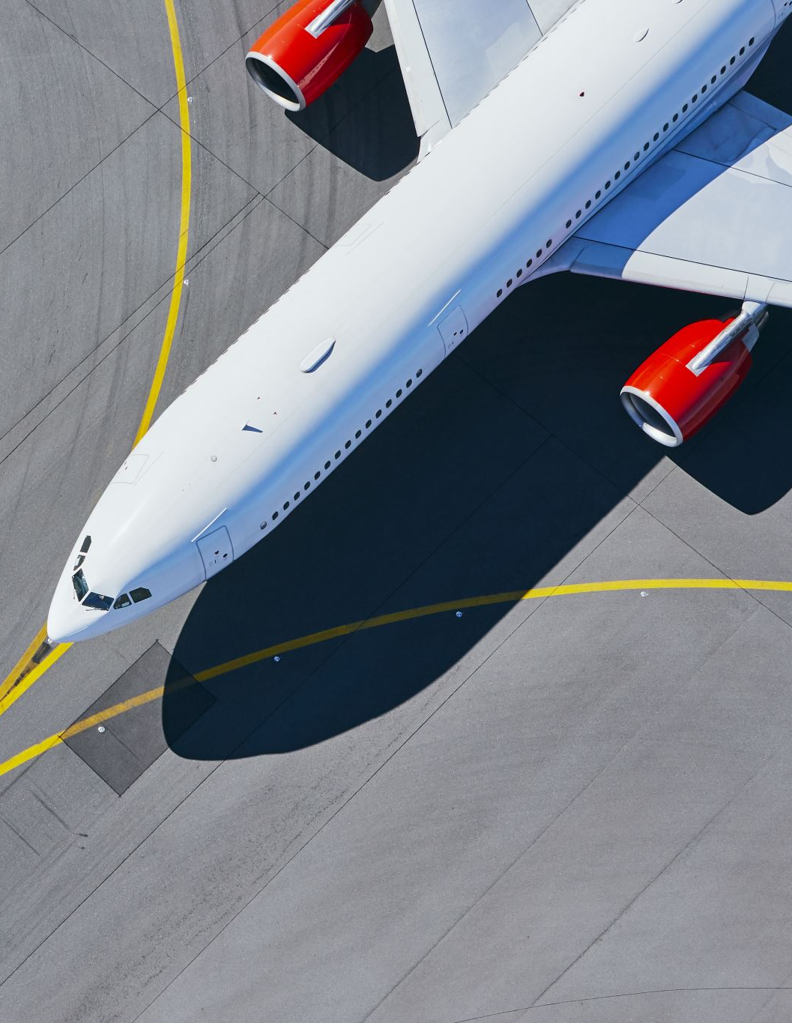
Storytelling
Lufthansa Airlines
This project analyzed flight delays and cancellations at Lufthansa Airlines using Power BI to understand when, why, and where operational disruptions occur, and how effectively they are absorbed before impacting passengers.
The analysis shows that high traffic volume does not automatically lead to high delays. Lufthansa performs operationally strongest on Fridays, handling the highest number of flights with the lowest delay impact, indicating strong scheduling discipline and buffer management.
In contrast, Sundays emerge as a risk day. Despite lower flight volumes, Sundays experience the highest number of delayed flights, suggesting accumulated disruptions, tighter recovery windows, and reduced operational flexibility at the end of the weekly cycle.
A key insight is the large gap between internal process delay minutes and actual passenger delay minutes. Although Lufthansa records over 170,000 minutes of internal process delays, only about 35,000 minutes translate into real passenger delays. This demonstrates a strong delay-absorption capability through buffer times, schedule flexibility, and recovery mechanisms.
Cancellation analysis further reinforces this strength. Out of 1,680 flights, only 128 flights (7.62%) were cancelled, while 22.26% experienced delays. This indicates that Lufthansa prioritizes delay recovery over flight cancellations, protecting customer trust and minimizing high-cost disruption events.
Overall, the findings confirm that Lufthansa’s delays are systemic and pattern-based, not driven by isolated operational failures, and that process optimization offers higher impact than reactive fixes.

Slide 23
Business Recommendations:
1. Strengthen Sunday Operations
Reallocate buffer time, crew availability, and ground resources toward Sunday schedules
Apply Friday-level recovery discipline to weekend operations
2. Focus on Process-Level Optimization
Prioritize turnaround, ground handling, and crew coordination improvements
Small reductions in process delays can significantly lower overall delay exposure
3. Optimize Wide-Body Aircraft Operations
Wide-body fleets (A350, B787, B777) generate the highest delay impact
Improve long-haul turnaround planning and maintenance coordination
4. Reduce Cancellations Further
Each cancelled flight carries disproportionately high financial and reputational cost
Even marginal cancellation reductions yield strong ROI and customer satisfaction gains
5. Expand Advanced Analytics
Use predictive analytics to identify high-risk days, aircraft types, and peak windows
Support proactive disruption management instead of reactive recovery
Strategic Value for Lufthansa
Improved on-time performance without increasing capacity
Lower operational costs through targeted process improvements
Stronger customer trust and brand reliability
Better regulatory and compensation risk management

