Slide 1
DIDComm Realtime Communication & Actionable Notification Interface

Slide 2
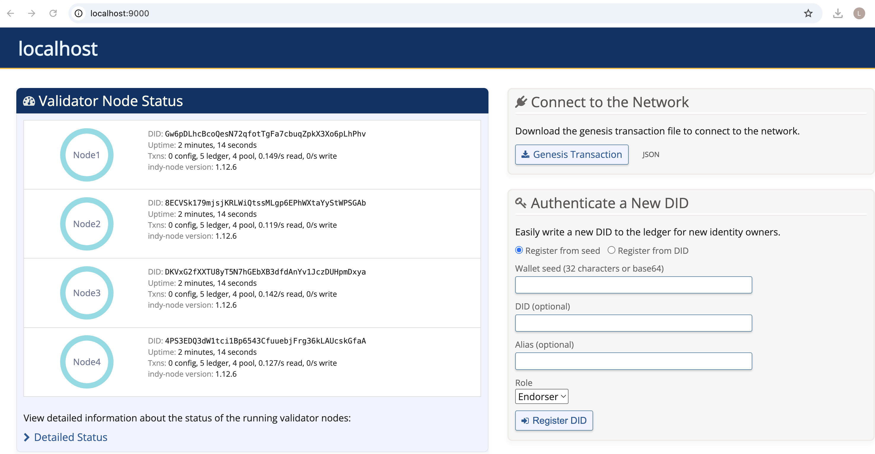
The von-network: testing environment
Infrastructure: 4-node local Indy ledger running in Docker.
Provenance: BC Gov-maintained testbed for SSI development.
What it stores: Public DIDs, schemas, and revocation registries.
What it doesn't: No private user data; personal attributes stay in the wallet.
Notes:
"For our verifiable data registry, we are running a local VON network. This provides us with a fully controlled environment consisting of four Indy ledger nodes running in Docker containers. It is the industry-standard testbed maintained by the Government of British Columbia.
Crucially, this ledger only stores public trust data—specifically DIDs, schemas, and revocation registries. It does not store any private user attributes; those remain securely inside the wallet to ensure privacy by design."

Slide 3
Issuer ACA-Py writes REVOC_REG_ENTRY
VON ledger
txn at seq 8742
ledger-watcher polls + classifies
event-normaliser signs + publishes
rabbitmq-root
topic match: ssi.gov.#
rabbitma-gov
topic match per wallet
broker-bridge-gov wraps in DIDComm
ACA-Py wallet
vdr-notify plugin
audit-log
appends to chain
Flutter app
renders activity card
Notes:
General example flow

Slide 4
Issuer ACA-Py writes REVOC_REG_ENTRY
VON ledger
txn at seq 8742
ledger-watcher polls + classifies
event-normaliser signs + publishes
rabbitmq-root
topic match: ssi.gov.#
rabbitma-gov
topic match per wallet
Role: Issuer (utilizing ACA-Py / Aries Cloud Agent Python framework).
Action: Executes a REVOC_REG_ENTRY transaction.
Purpose: Updates the revocation registry to reflect that a specific credential is no longer valid.
Data: Only public cryptographic state; no PII (Personally Identifiable Information) involved.
broker-bridge-gov wraps in DIDComm
ACA-Py wallet
vdr-notify plugin
audit-log
appends to chain
Flutter app
renders activity card

Slide 5
Issuer ACA-Py writes REVOC_REG_ENTRY
VON ledger
txn at seq 8742
ledger-watcher polls + classifies
event-normaliser signs + publishes
rabbitmq-root topic match: ssi.gov.#
rabbitma-gov topic match per wallet
VON Ledger: Local Hyperledger Indy network (running 4 nodes in Docker).
Source of Truth: Acts as a decentralized Verifiable Data Registry (VDR).
Transaction Processing: Receives and validates the REVOC_REG_ENTRY from the Issuer.
Immutable Record: Assigns a unique sequence number (e.g., seq 8742) to the revocation event.
Accessibility: Provides a public endpoint for the ledger-watcher to detect state changes in real-time.
broker-bridge-gov wraps in DIDComm
ACA-Py wallet vdr-notify plugin
audit-log
appends to chain
Flutter app renders activity card
Notes:
VON Ledger: Local Hyperledger Indy network (running 4 nodes in Docker).
Source of Truth: Acts as a decentralized Verifiable Data Registry (VDR).
Transaction Processing: Receives and validates the REVOC_REG_ENTRY from the Issuer.
Immutable Record: Assigns a unique sequence number (e.g., seq 8742) to the revocation event.
Accessibility: Provides a public endpoint for the ledger-watcher to detect state changes in real-time.

Slide 6
Issuer ACA-Py writes REVOC_REG_ENTRY
VON ledger
txn at seq 8742
ledger-watcher polls + classifies
event-normaliser signs + publishes
rabbitmq-root topic match: ssi.gov.#
rabbitma-gov topic match per wallet
Role: Acts as a bridge between the VON Ledger and the notification system.
Polling: Continuously monitors the ledger for new transactions in real-time.
Detection: Identifies specific events, such as the REVOC_REG_ENTRY at sequence 8742.
Extraction: Retrieves the raw Indy txn JSON directly from the ledger.
Classification: Categorizes the data as a relevant event for the user’s wallet.
Deployment: Runs as a standalone microservice (Docker container) within the infrastructure.
broker-bridge-gov wraps in DIDComm
ACA-Py wallet vdr-notify plugin
audit-log
appends to chain
Flutter app renders activity card
Notes:
"The ledger-watcher is a service designed to bridge the gap between the ledger and our notification system. It constantly polls the VON Ledger for new transactions. Once it detects sequence 8742, it extracts the raw transaction data—the 'Indy txn JSON'—and classifies it as a relevant event for the user's wallet."

Slide 7
Issuer ACA-Py writes REVOC_REG_ENTRY
VON ledger
txn at seq 8742
ledger-watcher polls + classifies
event-normaliser signs + publishes
rabbitmq-root
topic match: ssi.gov.
rabbitma-gov
topic match per wallet
broker-bridge-gov wraps in DIDComm
ACA-Py wallet vdr-notify plugin
audit-log
appends to chain
The message should then be sent to the broker, which is responsible for distributing the data to the wallets.
But broker are Untrusted Infrastructure: The message broker is treated as a potentially insecure transport layer that could delay, drop, or duplicate messages.
End-to-End Integrity: To prevent forgery, the Event-Normaliser signs every notification using its Private Key before it enters the broker.
Flutter app renders activity card
Notes:
The message should then be sent to the broker, which is responsible for distributing the data to the wallets. But since broker could get manipulated and are untrusted infrastructure, we need the event normalizer to sign it.

Slide 8
Issuer ACA-Py writes REVOC_REG_ENTRY
VON ledger
txn at seq 8742
ledger-watcher polls + classifies
event-normaliser signs + publishes
rabbitmq-root
topic match: ssi.gov.
rabbitma-gov
topic match per wallet
broker-bridge-gov wraps in DIDComm
ACA-Py wallet vdr-notify plugin
audit-log
appends to chain
Not the rabbitmy gov module, sends it to the right wallet.
But we need to be carefully with scalizability here, it make sense to have more than one broker.
Flutter app renders activity card
Notes:
Not the rabbitmy gov module, sends it to the right wallet.
But we need to be carefully with scalizability here, it make sense to have more than one broker.

Slide 9
Issuer ACA-Py writes REVOC_REG_ENTRY
VON ledger
txn at seq 8742
ledger-watcher polls + classifies
event-normaliser signs + publishes
rabbitmq-root
topic match: ssi.gov.
rabbitma-gov
topic match per wallet
broker-bridge-gov wraps in DIDComm
ACA-Py wallet vdr-notify plugin
audit-log
appends to chain
Flutter app renders activity card
Broker-Bridge-Gov: Encapsulates the notification into a DIDComm envelope to ensure end-to-end encryption across the "untrusted" broker.
Notes:
Broker-Bridge-Gov: Encapsulates the notification into a DIDComm envelope to ensure end-to-end encryption across the "untrusted" broker.

Slide 10
Issuer ACA-Py writes REVOC_REG_ENTRY
VON ledger
txn at seq 8742
ledger-watcher polls + classifies
event-normaliser signs + publishes
rabbitmq-root
topic match: ssi.gov.
rabbitma-gov
topic match per wallet
broker-bridge-gov wraps in DIDComm
ACA-Py wallet vdr-notify plugin
audit-log
appends to chain
Flutter app renders activity card
ACA-Py VDR-Notify Plugin: Connects the Aries Cloud Agent to the ledger, enabling it to bridge blockchain events to the notification stream.
Notes:
ACA-Py VDR-Notify Plugin: Connects the Aries Cloud Agent to the ledger, enabling it to bridge blockchain events to the notification stream.

Slide 11
Issuer ACA-Py writes REVOC_REG_ENTRY
VON ledger
txn at seq 8742
ledger-watcher polls + classifies
event-normaliser signs + publishes
rabbitmq-root
topic match: ssi.gov.
rabbitma-gov
topic match per wallet
broker-bridge-gov wraps in DIDComm
ACA-Py wallet vdr-notify plugin
audit-log
appends to chain
Flutter app renders activity card
Audit-Log: Records every lifecycle event of a notification (e.g., "sent", "received") to ensure accountability.
Append-to-Chain: Persists the audit logs to an immutable ledger for transparent and tamper-proof verification.
Notes:
Audit-Log: Records every lifecycle event of a notification (e.g., "sent", "received") to ensure accountability.
Append-to-Chain: Persists the audit logs to an immutable ledger for transparent and tamper-proof verification.

Slide 12
Issuer ACA-Py writes REVOC_REG_ENTRY
VON ledger
txn at seq 8742
ledger-watcher polls + classifies
event-normaliser signs + publishes
rabbitmq-root
topic match: ssi.gov.
rabbitma-gov
topic match per wallet
Persistent Listener: Maintains a real-time connection to a Regional Broker queue using the dart_amqp or STOMP protocol.
Signature Verification: Validates the Event-Normaliser’s cryptographic signature locally to ensure message authenticity.
Targeted Consumption: Only receives messages bound to its specific DID (e.g., ssi.gov.revoke.did:sov:...), ensuring data relevance.
UI/UX Trigger: Instantly renders an Activity Card (e.g., "Credential Revoked") to inform the user of ledger changes.
Resource Efficiency: Replaces power-hungry ledger polling with an efficient "push" notification model.
broker-bridge-gov wraps in DIDComm
ACA-Py wallet vdr-notify plugin
audit-log
appends to chain
Flutter app renders activity card
Notes:
Persistent Listener: Maintains a real-time connection to a Regional Broker queue using the dart_amqp or STOMP protocol.
Signature Verification: Validates the Event-Normaliser’s cryptographic signature locally to ensure message authenticity.
Targeted Consumption: Only receives messages bound to its specific DID (e.g., ssi.gov.revoke.did:sov:...), ensuring data relevance.
UI/UX Trigger: Instantly renders an Activity Card (e.g., "Credential Revoked") to inform the user of ledger changes.
Resource Efficiency: Replaces power-hungry ledger polling with an efficient "push" notification model.

Slide 13
Currently implemented state
Notes:
Show the actual state how we implemented it.

Slide 14
What to do next.
Notes:
Show how to fullfill the task.

Slide 15
