Slide 1
Adversarial Examples
Deep Learning: Bryan Pardo, Northwestern University, Fall 2020

Slide 2


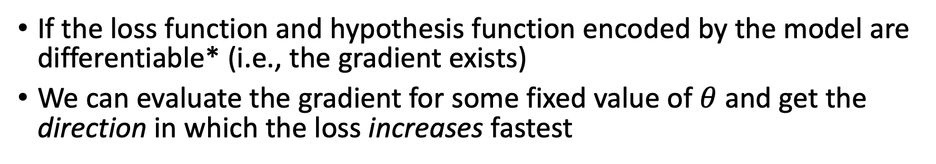
What does the gradient tell us?
If the loss function and hypothesis function encoded by the model are differentiable* (i.e., the gradient exists)
We can evaluate the gradient for some fixed value of $θ$ and get the direction in which the loss increases fastest
*or subdifferentiable
Notes:
This is a graph of the “loss landscape” for a univariate model

Slide 3
Gradient Descent Pseudocode
Initialize $θ^{(0)}$
Repeat until stopping condition met:
$θ^{(t+1)} =θ^{(t)}−η∇L(X,Y;θ^{(t)}$)
Return $θ^{(t_{max})}$
$θ^{(t)}$ are the parameters of the model at time step t
$∇L(X,Y;θ^{(t)}$) is the gradient of the loss function with respect to model parameters $θ^{(t)}$
$η$ controls the step size
$θ^{(t_{max})}$ is the set of parameters that did best on the loss function.
Notes:
Remind students of the similarity with adaptive epsilon updates in reinforcement learning

Slide 4
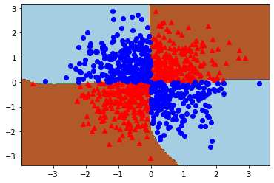
What are these things really learning?
Learned decision surface for XOR problem

Slide 5
What are these things really learning?
Learned decision surface for XOR problem

Slide 6
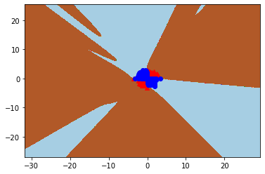
What are these things really learning?
Same decision surface zoomed out

Slide 7
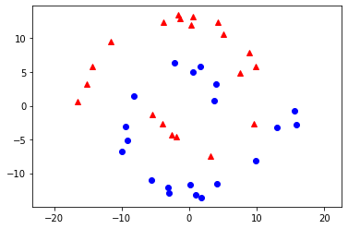
Spirals data

Slide 8
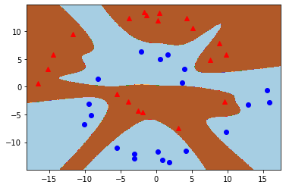

Decision surface a human might draw

Slide 9
Actual decision surface learned by a network
100% perfect accuracy on labeling

Slide 10
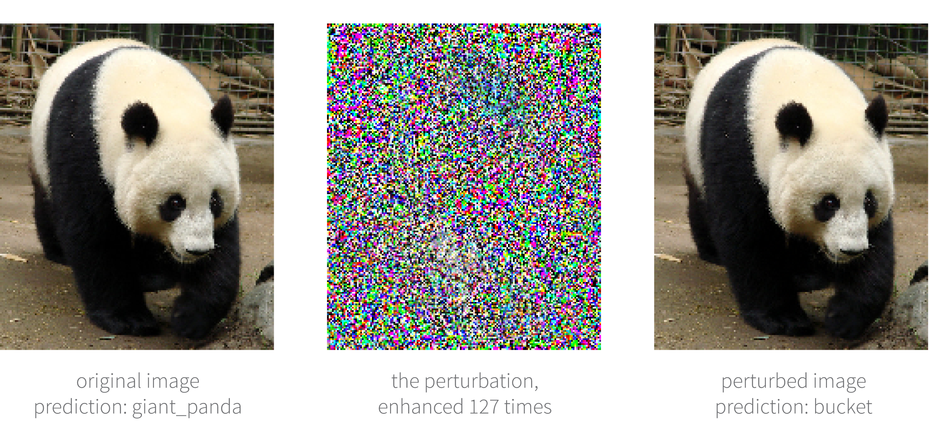
In 2 dimensions, a bad surface is obvious
What about in 2 million dimensions?
One of these was labeled “panda” by a trained net.
The other was labeled “bucket”. Which is which?
Image from: https://www.borealisai.com/en/blog/advertorch-adversarial-training-tool-implement-attack-and-defence-strategies/

Slide 11
The one on the right is a “perturbed” image
PANDA
BUCKET

Slide 12



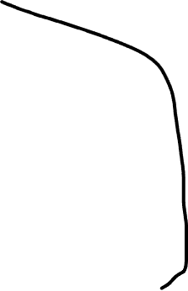

Gradient descent is moving the decision boundary

Slide 13
What if we move a datapoint instead?

Slide 14
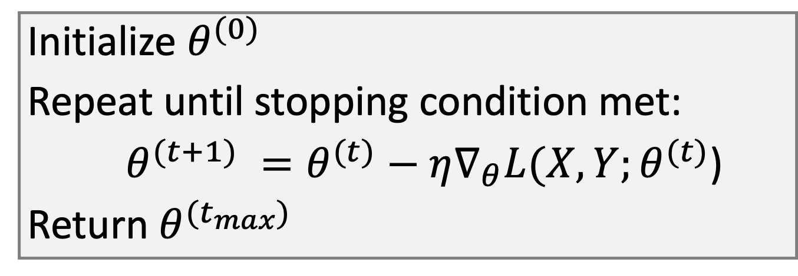
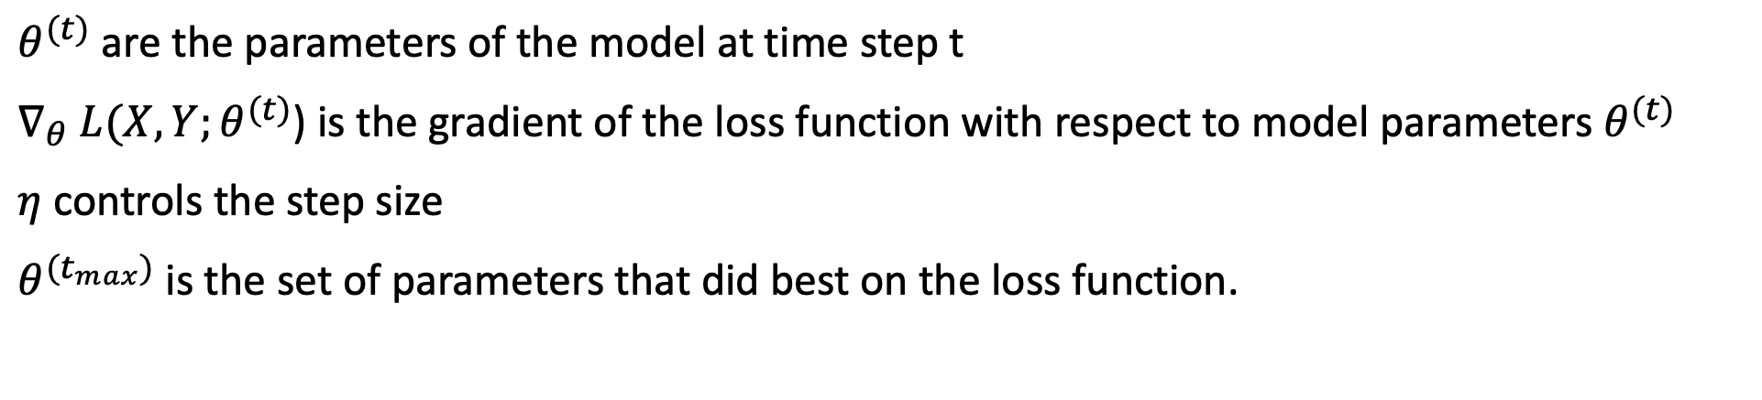
Gradient Descent Pseudocode
Initialize $θ^{(0)}$
Repeat until stopping condition met:
$θ^{(t+1)} =θ^{(t)}−η∇_{θ}L(X,Y;θ^{(t)}$)
Return $θ^{(t_{max})}$
$θ^{(t)}$ are the parameters of the model at time step t
$∇_{θ} L(X,Y;θ^{(t)}$) is the gradient of the loss function with respect to model parameters $θ^{(t)}$
$η$ controls the step size
$θ^{(t_{max})}$ is the set of parameters that did best on the loss function.
Notes:
Remind students of the similarity with adaptive epsilon updates in reinforcement learning

Slide 15
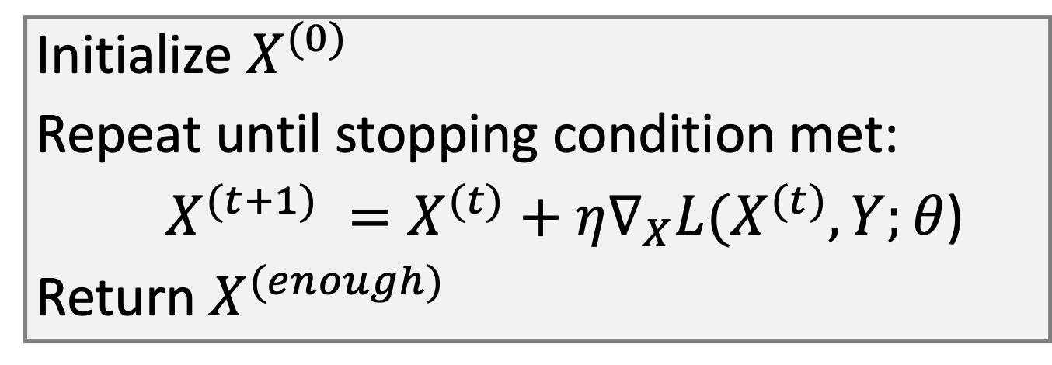
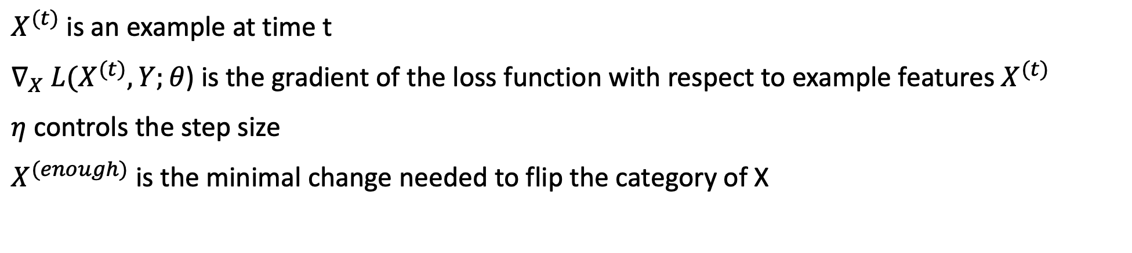
Just flip which thing we’re optimizing
Initialize $X^{(0)}$
Repeat until stopping condition met:
$X^{(t+1)} =X^{(t)}+η∇_{X}L(X^{(t)},Y;θ$)
Return${ X}^{(enough)}$
$X^{(t)}$ is an example at time t
$∇_{X} L(X^{(t)},Y;θ$) is the gradient of the loss function with respect to example features${ X}^{(t)}$
$η$ controls the step size
$X^{(enough)}$ is the minimal change needed to flip the category of X
Notes:
Remind students of the similarity with adaptive epsilon updates in reinforcement learning

Slide 16
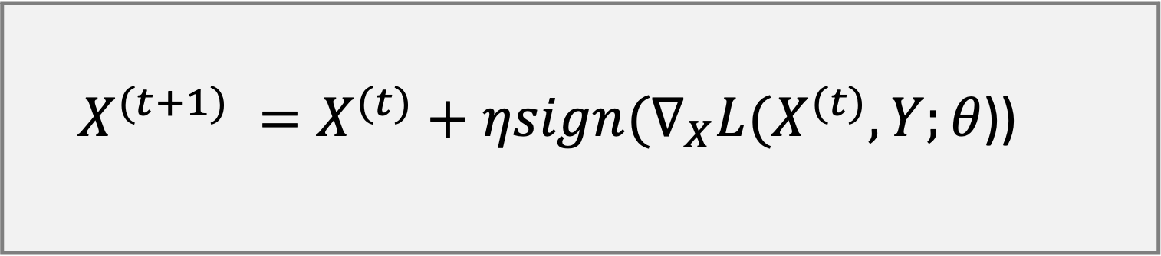
Even Simpler: Fast Gradient Sign method
$X^{(t+1)} =X^{(t)}+ηsign(∇_{X}L(X^{(t)},Y;θ\text{)}$)
EXPLAINING AND HARNESSING ADVERSARIAL EXAMPLES
Ian J. Goodfellow, Jonathon Shlens & Christian Szegedy, ICLR 2015
Notes:
Remind students of the similarity with adaptive epsilon updates in reinforcement learning

Slide 17
Gradient Sign attack
The pixels are all independent dimensions
Find the gradient in the pixel space
Add noise along the gradient (a little bit of noise for every pixel)
Do it right and the image looks the same to the user…
…but looks entirely different to the network.

Slide 18
Yes. It’s just that easy

Slide 19
Why…..
….does this gradient-based attack make sense?
…did they use the sign of the gradient multiplied by a fixed step size, instead of the actual gradient?

