Slide 1
Attention Networks
Bryan Pardo
Deep Learning
Northwestern University
Deep Learning: Bryan Pardo, Northwestern University, Fall 2020

Slide 2
Language model recap

Slide 3
The goal: predict the next token
Each sentence is its own label.
Given “An apple is…”, predict “good” as the next word.
Our model output will be a probability distribution over the 1003 element vector (top 1000 words + start + start + other).
We can use cross-entropy loss, comparing the one-hot vector to the probability vector output by the model.

Slide 4

Generating a new sentence with the model
Continue till you generate a stop token
She
likes
cheese
STOP
Sample from the conditional
distribution output by the model
Random initialization
$$[s_{1}(t−1),…,s_{n}(t−1)]$$
START She likes cheese

Slide 5
Let’s think about translation

Slide 6
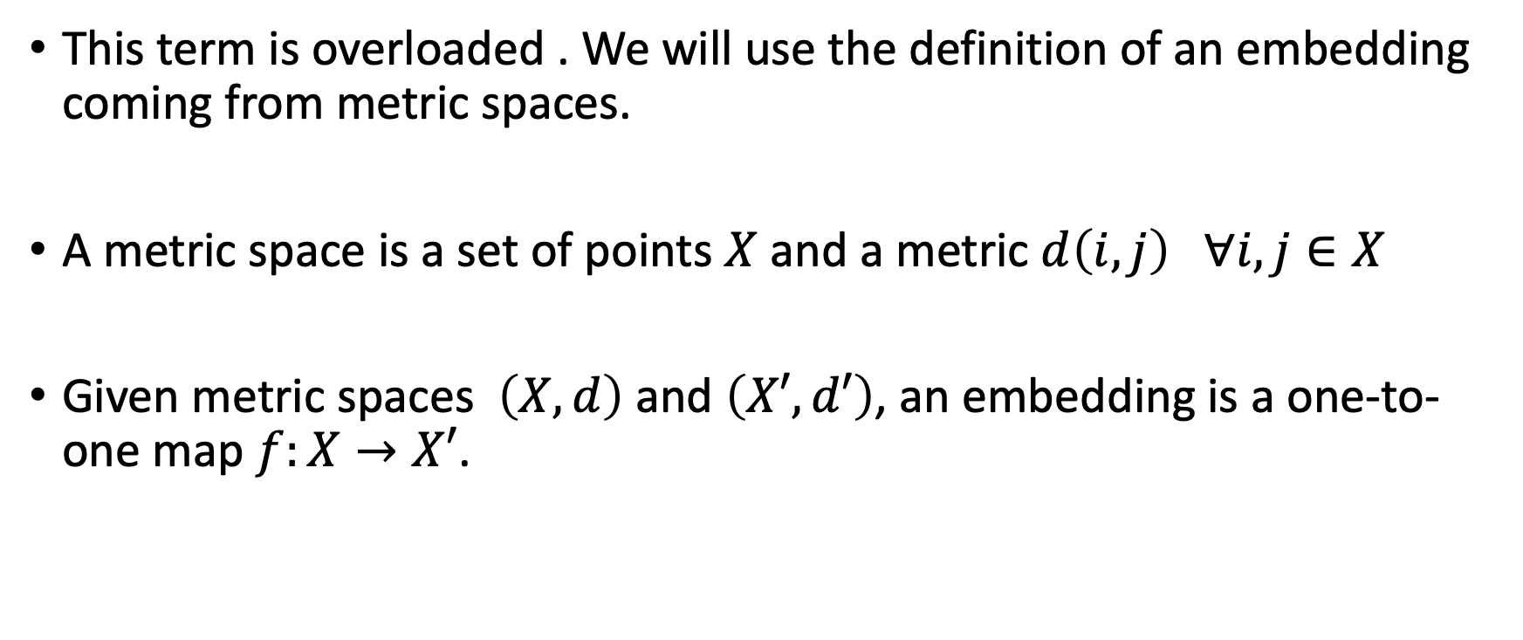
What’s an “embedding”?
This term is overloaded . We will use the definition of an embedding coming from metric spaces.
A metric space is a set of points $X$ and a metric $d\left(i,j\right) ∀i,j∈X$
Given metric spaces $\left(X,d\right)$ and $\left(X′,d′\right)$, an embedding is a one-to-one map $f:X→X′$.

Slide 7
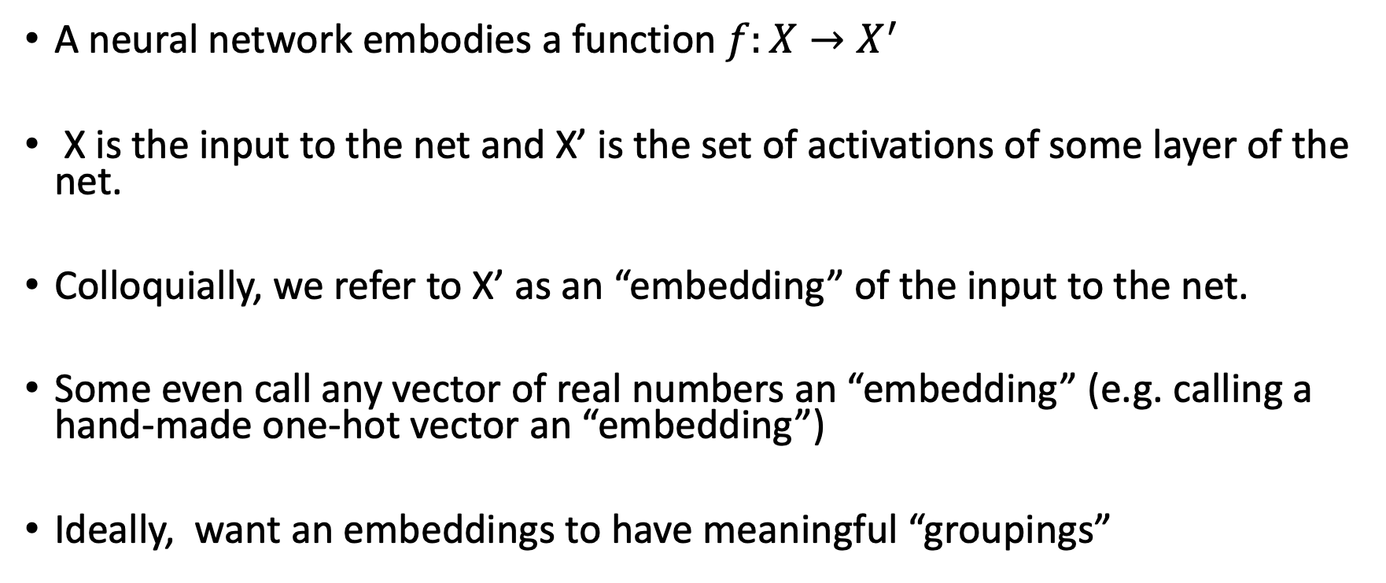
What’s an “embedding”?
A neural network embodies a function $f:X→X^{′}$
X is the input to the net and X’ is the set of activations of some layer of the net.
Colloquially, we refer to X’ as an “embedding” of the input to the net.
Some even call any vector of real numbers an “embedding” (e.g. calling a hand-made one-hot vector an “embedding”)
Ideally, want an embeddings to have meaningful “groupings”

Slide 8
What is “conditioning”?
Term borrowed from statistics & probability ( a conditional distribution)
Our language model (or seq2seq model) outputs a probability distribution over the set of words, we want to modify our probability estimates about the next word based on what we know about the prior sequence. This modification is called “conditioning”
UNCONDITIONED: P(next_word) : just about any word is likely
CONDITIONED: P(next_word | “Two plus two equals”) : “four” is most likely

Slide 9
Going from English to Spanish
English: She likes cheese.
Spanish: A ella le gusta el queso.
What’s different about these two sentences?
Number of words.
Ordering of words.
Which noun is doing the acting.

Slide 10
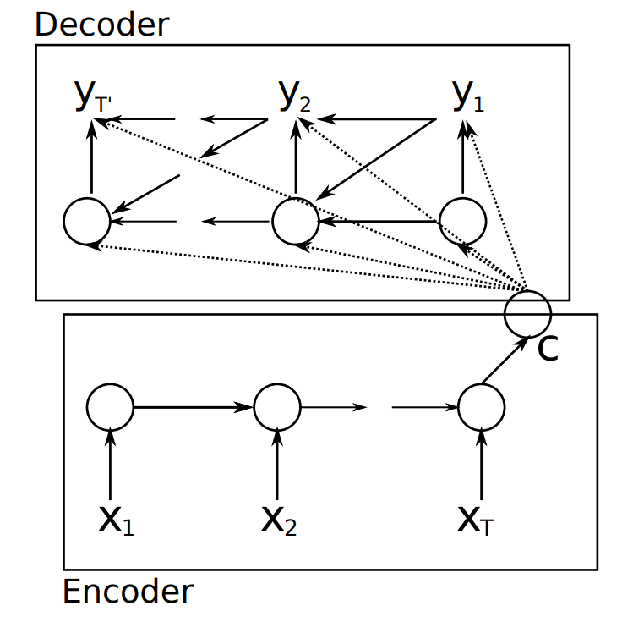
A two-part network
We need something to wrap up the ”meaning” of the sentence in a way that gets past all these surface grammatical differences
We need something to turn that “meaning” into the language of our choice.
This is an encoder/decoder network.
Cho, K., Van Merriënboer, B., Gulcehre, C., Bahdanau, D., Bougares, F., Schwenk, H., & Bengio, Y. (2014). Learning phrase representations using RNN encoder-decoder for statistical machine translation. arXiv:1406.1078.

Slide 11
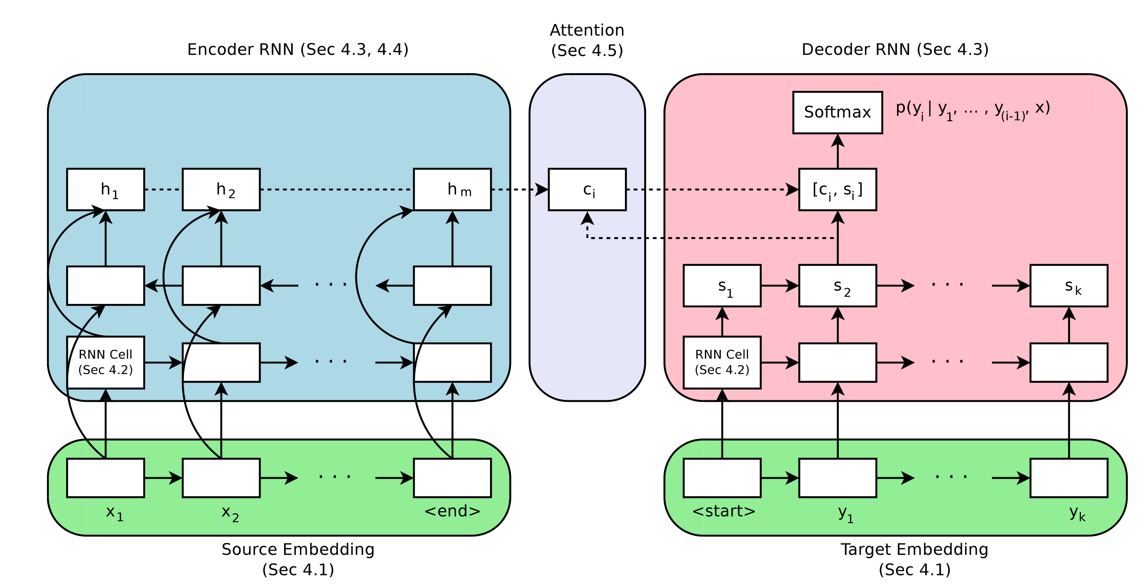

A general framework for seq2seq (with attention)
$$h_{n}$$
Britz, D., Goldie, A., Luong, M. T., & Le, Q. (2017). Massive exploration of neural machine translation architectures. arXiv preprint arXiv:1703.03906.

Slide 12
The encoder
Each h is a vector concatenating the hidden state of all the cells in the forward direction and also the cells in the backward direction.
Note that it is bi-directional
Typically this RNN is an LSTM (or a GRU)
Each is a token (e.g. a word) encoded in an embedding (e.g. one-hot encoding)
Britz, D., Goldie, A., Luong, M. T., & Le, Q. (2017). Massive exploration of neural machine translation architectures. arXiv preprint arXiv:1703.03906.

Slide 13


Making a fixed-length context vector
The context is a function of the encoder’s full output sequence
$$c={q(h}_{1},h_{2},…,h_{m})$$
Ignore this back arrow for now
The first seq2seq model* just used the last state as the context
$${q(h}_{1},h_{2},…,h_{m})=h_{m}$$
* Cho, K., Van Merriënboer, B., Gulcehre, C., Bahdanau, D., Bougares, F., Schwenk, H., & Bengio, Y. (2014). Learning phrase representations using RNN encoder-decoder for statistical machine translation. arXiv:1406.1078.

Slide 14
Using context in generation
The final output is a probability distribution over the classes (words) of the output language
The context is introduced to the decoder here
s is the state of the decoder (a vector of RNN outputs). Its size depends on the the layer size.
$$h_{n}$$
The previous token output by the decoder
Britz, D., Goldie, A., Luong, M. T., & Le, Q. (2017). Massive exploration of neural machine translation architectures. arXiv preprint arXiv:1703.03906.

Slide 15

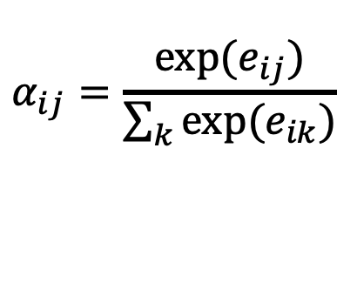
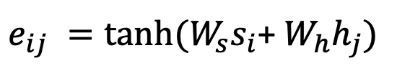
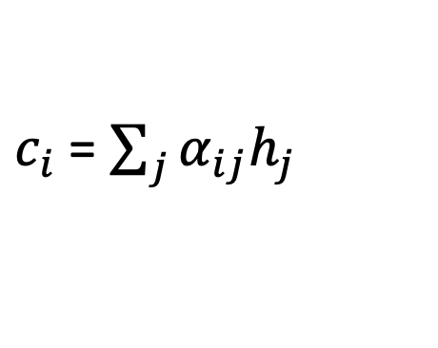
Using decoder state to guide “attention”
The context at decoder step i is attention-weighted sum of the full sequence of encoder states.
$c_{i}$= $\sum_{j}{α_{ij}h_{j}}$
Attention weights are normalized with a softmax.
$$α_{ij}=\frac{exp⁡(e_{ij})}{\sum_{k}{exp⁡(e_{ik})}}$$
$$h_{n}$$
Un-normalized attention for each encoder step is determined by a small feed-forward network
$e_{ij} =tanh⁡(W_{s}s_{i}$+ $W_{h}h_{j})$
$W_{s }$and $W_{h}$ are learned weight matrices
Britz, D., Goldie, A., Luong, M. T., & Le, Q. (2017). Massive exploration of neural machine translation architectures. arXiv preprint arXiv:1703.03906.

Slide 16
Questions about our network
The single-layer feed-forward network that implements attention is called “additive” attention. Can you say why?
What are some implications of these design choices for….
The ability to completely ignore an uninteresting portion of the context?
The ability to selectively attend to any portion of the input sequence?
How does the context (aka attention) from state i-1 influence the decoder state i? How is that different from the previous architecture

Slide 17
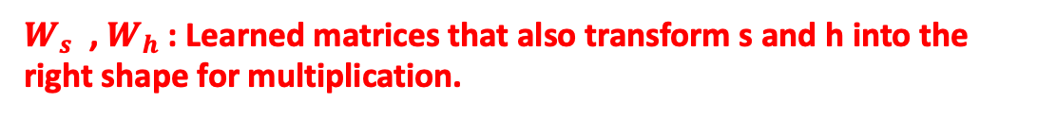
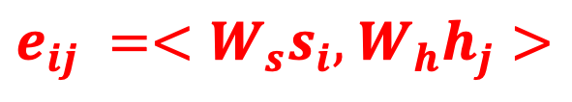
Multiplicative attention
The context at decoder step i is attention-weighted sum of the full sequence of encoder states.
$c_{i}$= $\sum_{j}{α_{ij}h_{j}}$
Attention weights are normalized with a softmax.
$$α_{ij}=\frac{exp⁡(e_{ij})}{\sum_{k}{exp⁡(e_{ik})}}$$
$$h_{n}$$
Weights are determined by multiplying the decoder state by the hidden state.
$e_{ij} =<W_{s}s_{i},$ $W_{h}h_{j}>$
$W_{s}$ , $W_{h}$: Learned matrices that also transform s and h into the right shape for multiplication.
Britz, D., Goldie, A., Luong, M. T., & Le, Q. (2017). Massive exploration of neural machine translation architectures. arXiv preprint arXiv:1703.03906.

Slide 18
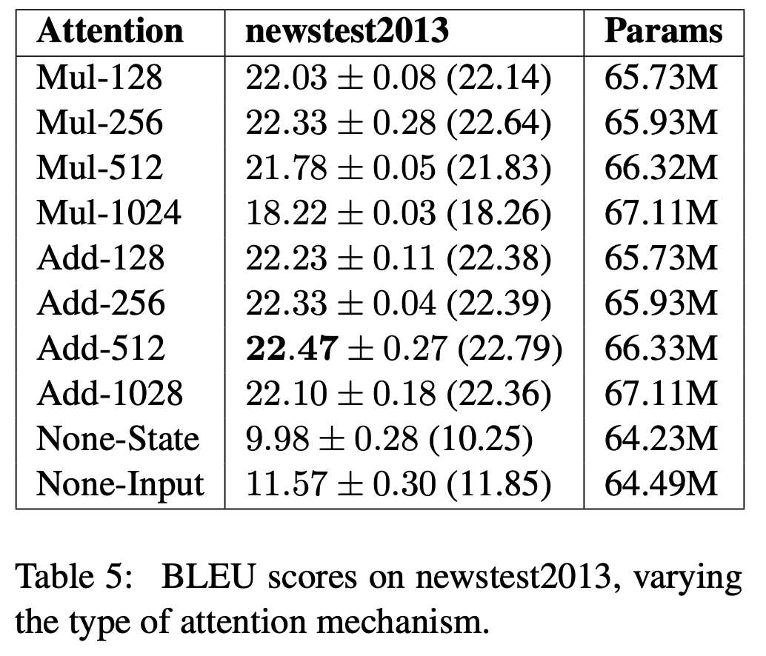
How much does attention help?
BLEU scores are a measure of language translation quality
Higher is better.
Additive attention with hidden-state vectors of size 512 were the best
Despite this, multiplicative attention is the most-used now.
Britz, D., Goldie, A., Luong, M. T., & Le, Q. (2017). Massive exploration of neural machine translation architectures. arXiv preprint arXiv:1703.03906.

Slide 19
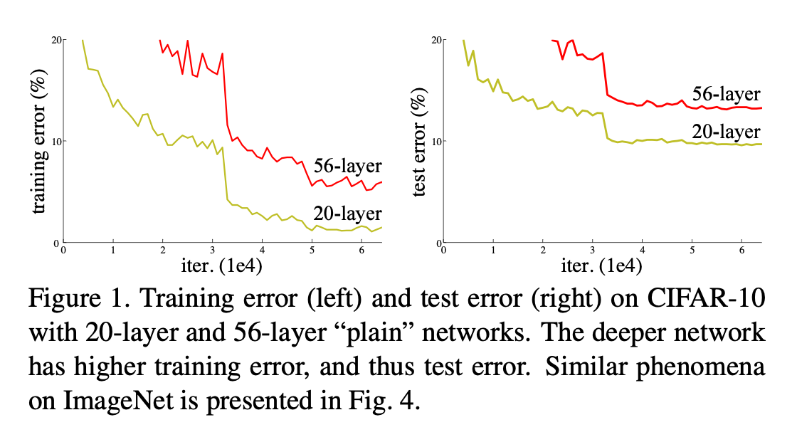
Have I mentioned residual connections?
How do you decide how many layers your network should have?
Too shallow: not enough representational power.
Too deep risks slow convergence, poor local minimum
He, K., Zhang, X., Ren, S., & Sun, J. (2016). Deep residual learning for image recognition. In Proceedings of the IEEE conference on computer vision and pattern recognition (pp. 770-778)

Slide 20
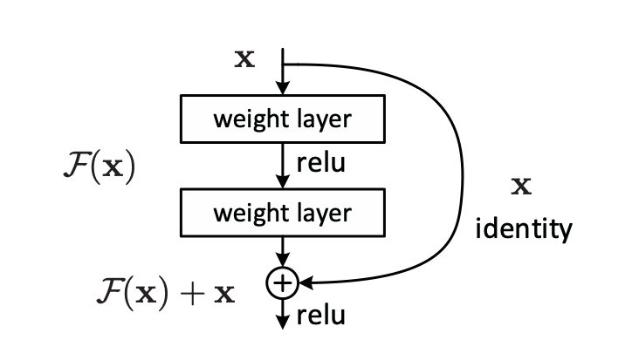
ResNets
Build a network out of skippable layers
Sum the output of the previous layer with the output of this weight layer, before applying the activation function
If this layer’s weights aren’t adding anything, bypass it
This allows VERY DEEP nets.
He, K., Zhang, X., Ren, S., & Sun, J. (2016). Deep residual learning for image recognition. In Proceedings of the IEEE conference on computer vision and pattern recognition (pp. 770-778)

Slide 21
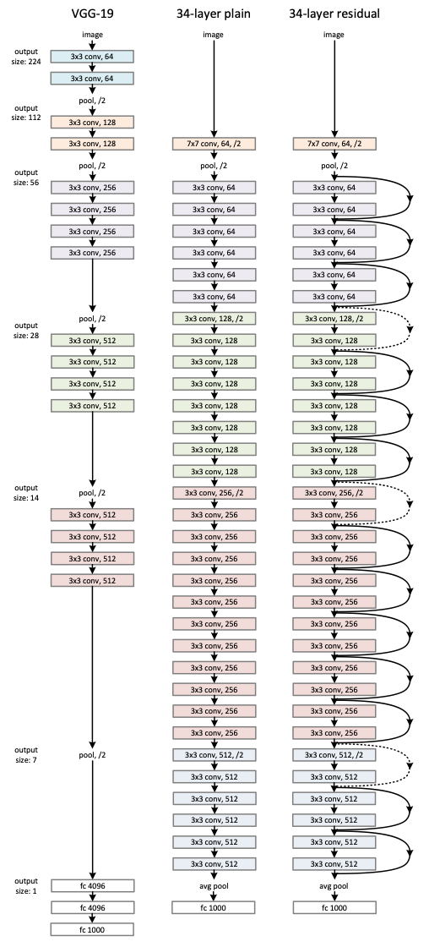
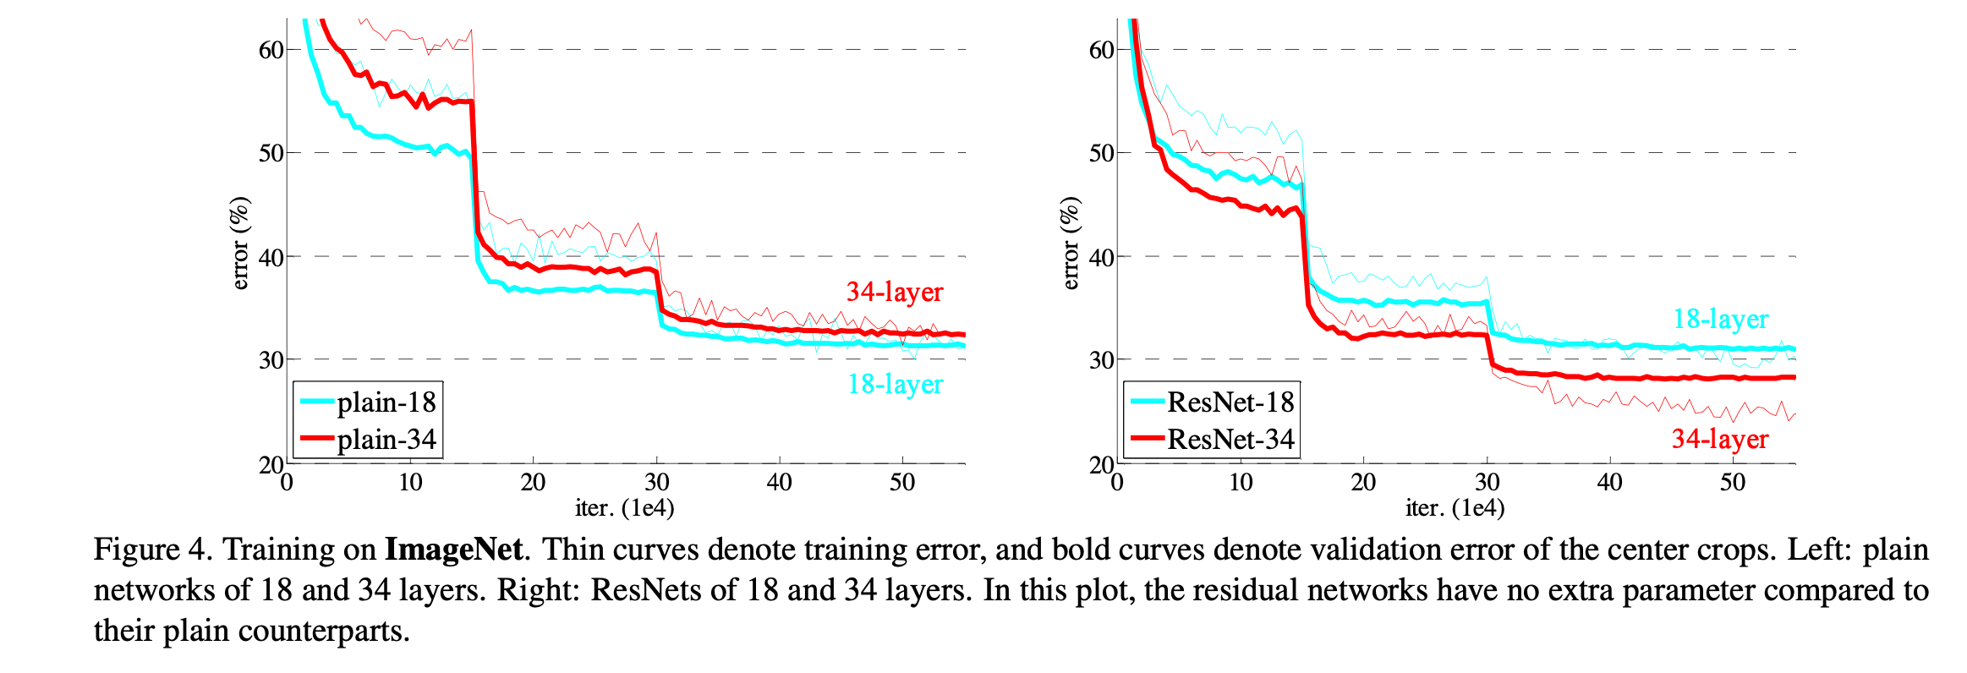
A 34 layer ResNet
He, K., Zhang, X., Ren, S., & Sun, J. (2016). Deep residual learning for image recognition. In Proceedings of the IEEE conference on computer vision and pattern recognition (pp. 770-778)

Slide 22
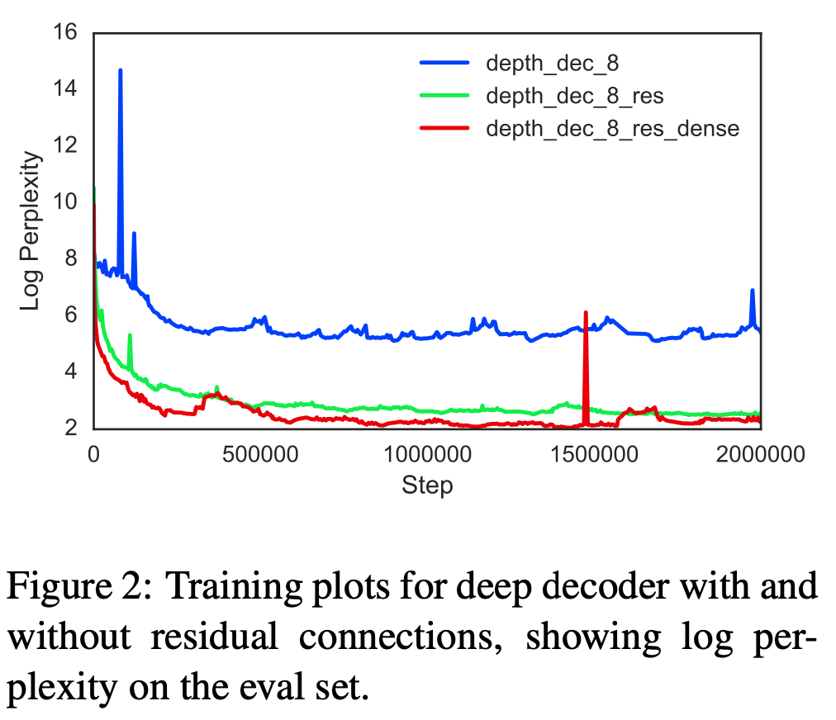
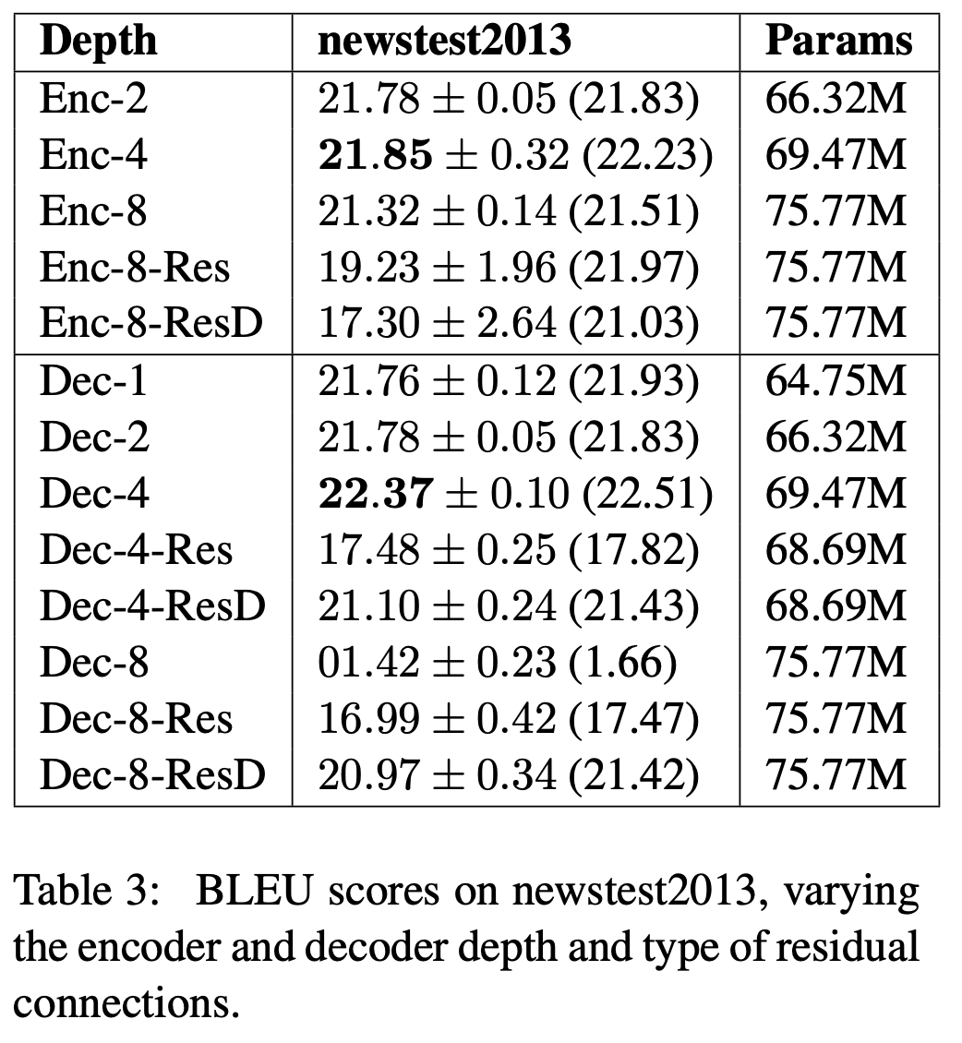
Residual connections in Seq2Seq models
Britz, D., Goldie, A., Luong, M. T., & Le, Q. (2017). Massive exploration of neural machine translation architectures. arXiv preprint arXiv:1703.03906.

