Slide 1
Multilayer Percetprons
Bryan Pardo
Deep Learning
Northwestern University
Deep Learning: Bryan Pardo, Northwestern University, Fall 2020

Slide 2
Combining perceptrons can make any Boolean function
x₀
?
x₁
?
x₀
?
?
XOR
?
x₀
?
?
?
x₂
?
…if you can set the weights & connections right

Slide 3
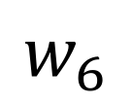
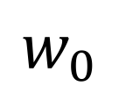
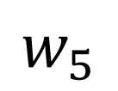
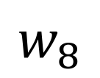
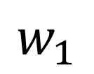
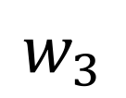
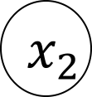
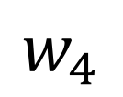
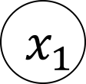
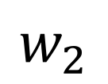
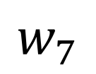
Problem with a step function: Assignment of error
1
Stymies multi-layer weight learning
Limits us to a single layer of units
Thus, only linear functions
You can hand-wire XOR perceptrons, but the sytem can’t learn XOR with perceptrons
$$w_{0}$$
1
$$w_{1}$$
$$x_{1}$$
$$w_{7}$$
$$w_{5}$$
$$w_{2}$$
$$w_{3}$$
$$w_{6}$$
$$x_{2}$$
$$w_{4}$$
$$w_{8}$$
1

Slide 4
Linear Units & Delta Rule

Slide 5

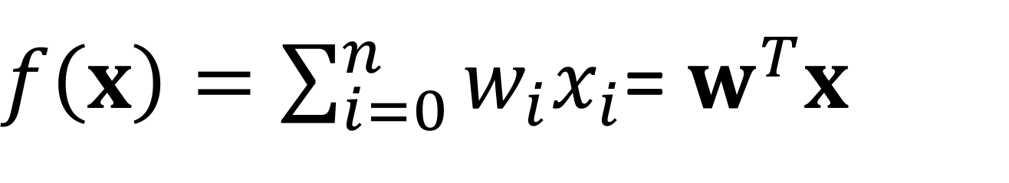

Solution: Remove the step function
$$f\left(x\right)$$
$$w^{T}x$$
$f\left(x\right)=\sum_{i=0}^{n}{w_{i}x_{i}}$= $w^{T}x$

Slide 6
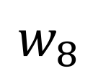
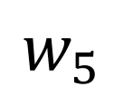
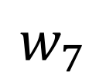
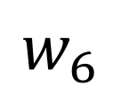
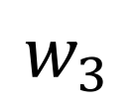
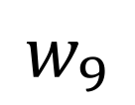
Better & worse than a perceptron
1
All changes in input result in changed output
This gives us a gradient everywhere
We can learn multiple layers of weights.
Combining linear functions only gives you linear functions
you can’t represent XOR
$$w_{5}$$
1
$$w_{1}$$
$$x_{1}$$
$$w_{7}$$
$$w_{9}$$
$$w_{2}$$
$$w_{3}$$
$$w_{8}$$
$$x_{2}$$
$$w_{4}$$
$$w_{6}$$
1

Slide 7
Many linear units: Only linear decisions
This is XOR.
A multilayer perceptron with linear units CANNOT learn XOR

Slide 8
The Sigmoid Unit
Rumelhart, David E., James L. McClelland, and PDP Research Group. Parallel distributed processing. Vol. 1. Cambridge, MA, USA:: MIT press, 1987.

Slide 9
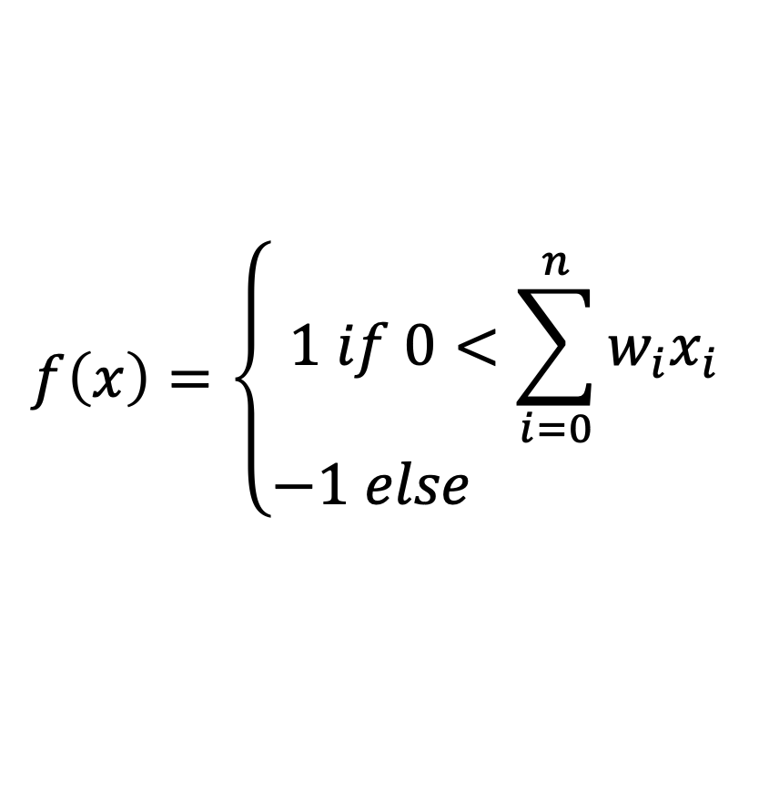
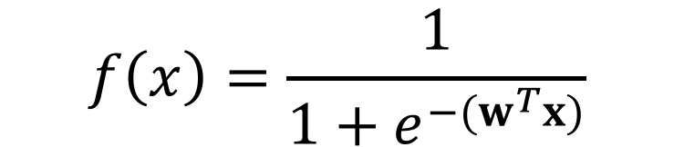
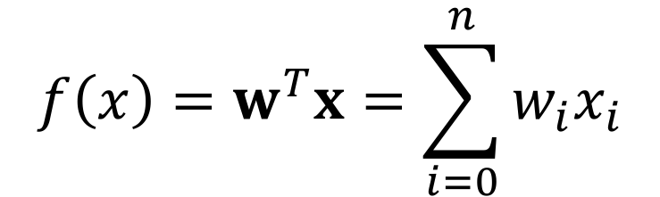
Sigmoid (aka Logistic) function: best of both
$$f\left(x\right)=\left\{\begin{matrix}1 if 0<\sum_{i=0}^{n}{w_{i}x_{i}} \\ −1 else \end{matrix}\right.$$
Perceptron
Linear
Sigmoid
$$f\left(x\right)=w^{T}x=\sum_{i=0}^{n}{w_{i}x_{i}}$$
$$f\left(x\right)=\frac{1}{1+e^{−(w^{T}x)}}$$

Slide 10
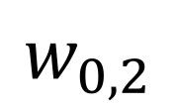
A network of sigmoid units
Small changes in input result in output
This gives us a gradient everywhere
We can learn multiple layers of weights.
Combining layers gives non-linear functions
1
$$w_{0}$$
1
$$w_{1}$$
$$x_{1}$$
$$w_{7}$$
$$w_{5}$$
$$w_{2}$$
$$w_{3}$$
$$w_{6}$$
$$x_{2}$$
$$w_{4}$$
$$w_{0,2}$$
1

Slide 11
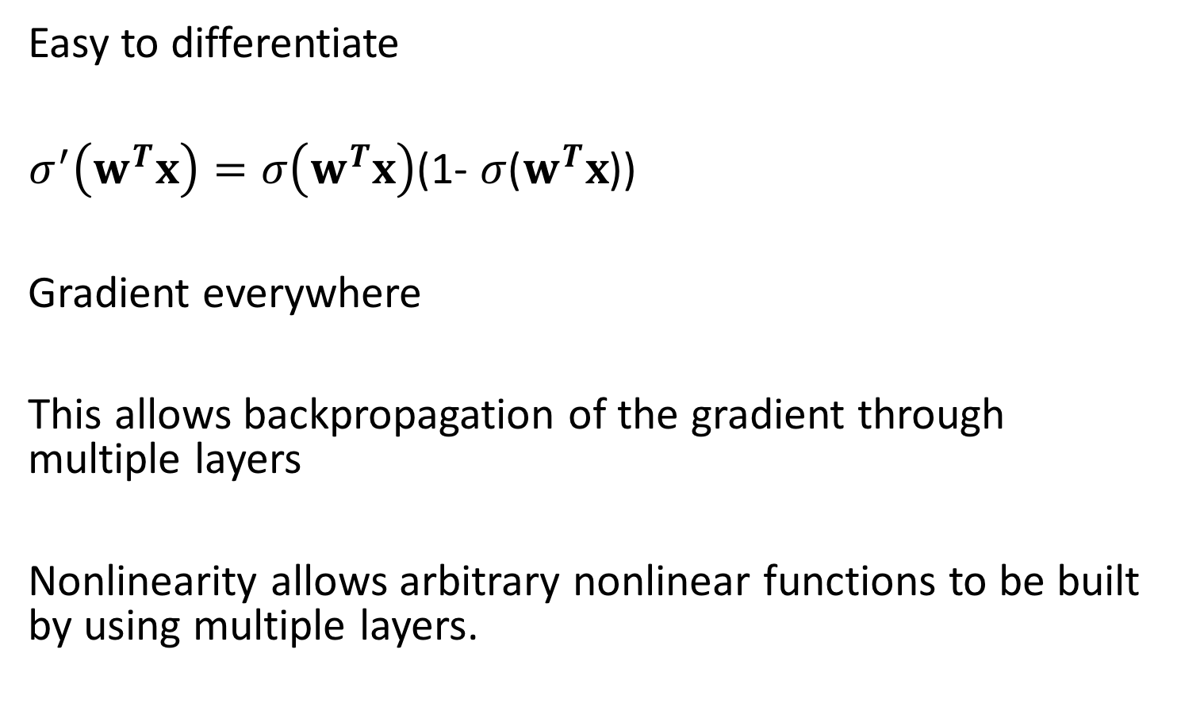
Sigmoid changes (almost) everything
Easy to differentiate
$σ^{′}\left(w^{T}x\right)=σ\left(w^{T}x\right)$(1- $σ$($w^{T}x$))
Gradient everywhere
This allows backpropagation of the gradient through multiple layers
Nonlinearity allows arbitrary nonlinear functions to be built by using multiple layers.

Slide 12
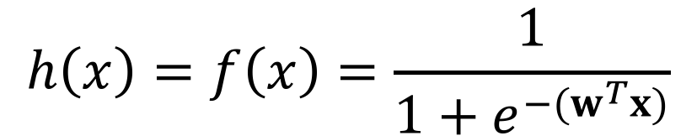
Example objective J : sum of squared errors
$$h\left(x\right)=f\left(x\right)=\frac{1}{1+e^{−(w^{T}x)}}$$
Gradient non-zero everywhere!

Slide 13
Multilayer Perceptron with sigmoid units
This is XOR.
A multilayer perceptron with sigmoid units CAN learn XOR…or any other arbitrary Boolean function.

Slide 14
The promise of many layers
Each layer learns an abstraction of its input representation (we hope)
As we go up the layers, representations become increasingly abstract
The hope is that the intermediate abstractions facilitate learning functions that require non-local connections in the input space (recognizing rotated & translated digits in images, for example)
Modern neural networks are up to 100 layers deep

Slide 15
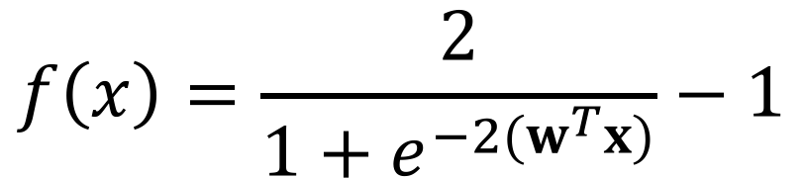
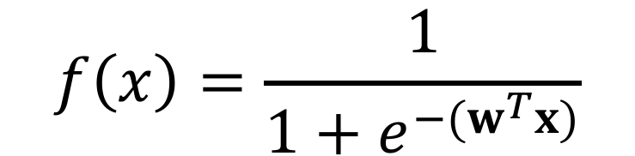
TanH: A shifted sigmoid
$$f\left(x\right)=\frac{1}{1+e^{−(w^{T}x)}}$$
Sigmoid
TanH
$$f\left(x\right)=\frac{2}{1+e^{−2(w^{T}x)}}−1$$

Slide 16
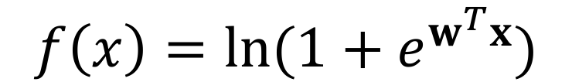

Rectified Linear Unit (ReLU) & Soft Plus :
ReLU
Soft Plus
Both can be combined in layers to make non-linear functions
$$f\left(x\right)=max⁡(0,w^{T}x)$$
$$f\left(x\right)=ln⁡(1+e^{w^{T}x})$$

Slide 17
“One Hot” Encoding
A vector of values where a single element is 1 and all the rest are 0
Common way to encode the true label, y, in a multi-class labeling problem
Can be interpreted as a probability distribution
y = 0 0 1 0 0 0 0 0 0 0
y = 0 0 0 0 0 1 0 0 0 0

Slide 18
Probability distribution

Slide 19
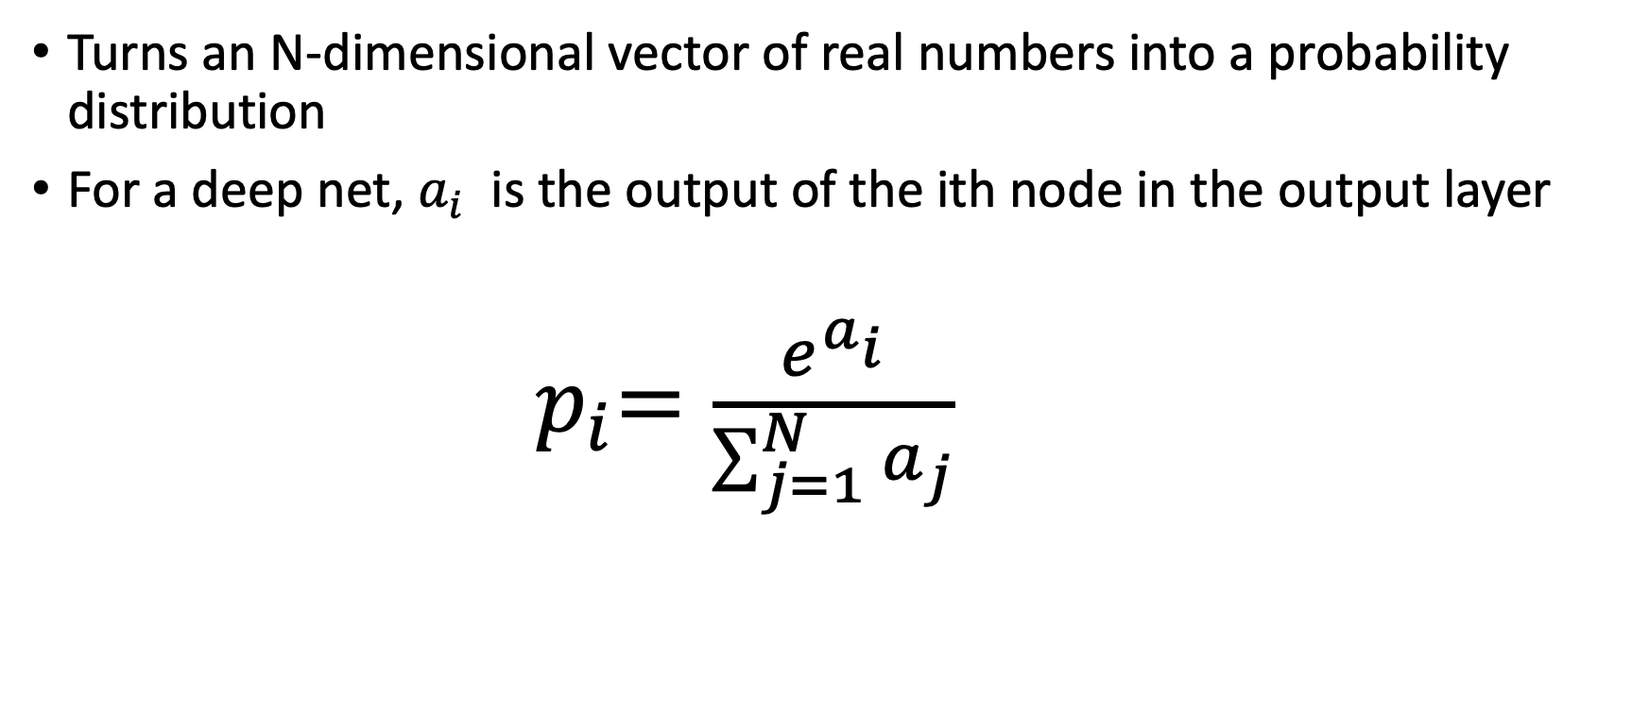
Soft Max Function
Turns an N-dimensional vector of real numbers into a probability distribution
For a deep net, $a_{i}$ is the output of the ith node in the output layer
${ p}_{i}=\frac{e^{a_{i}}}{\sum_{j=1}^{N}{a_{j}}}$

Slide 20
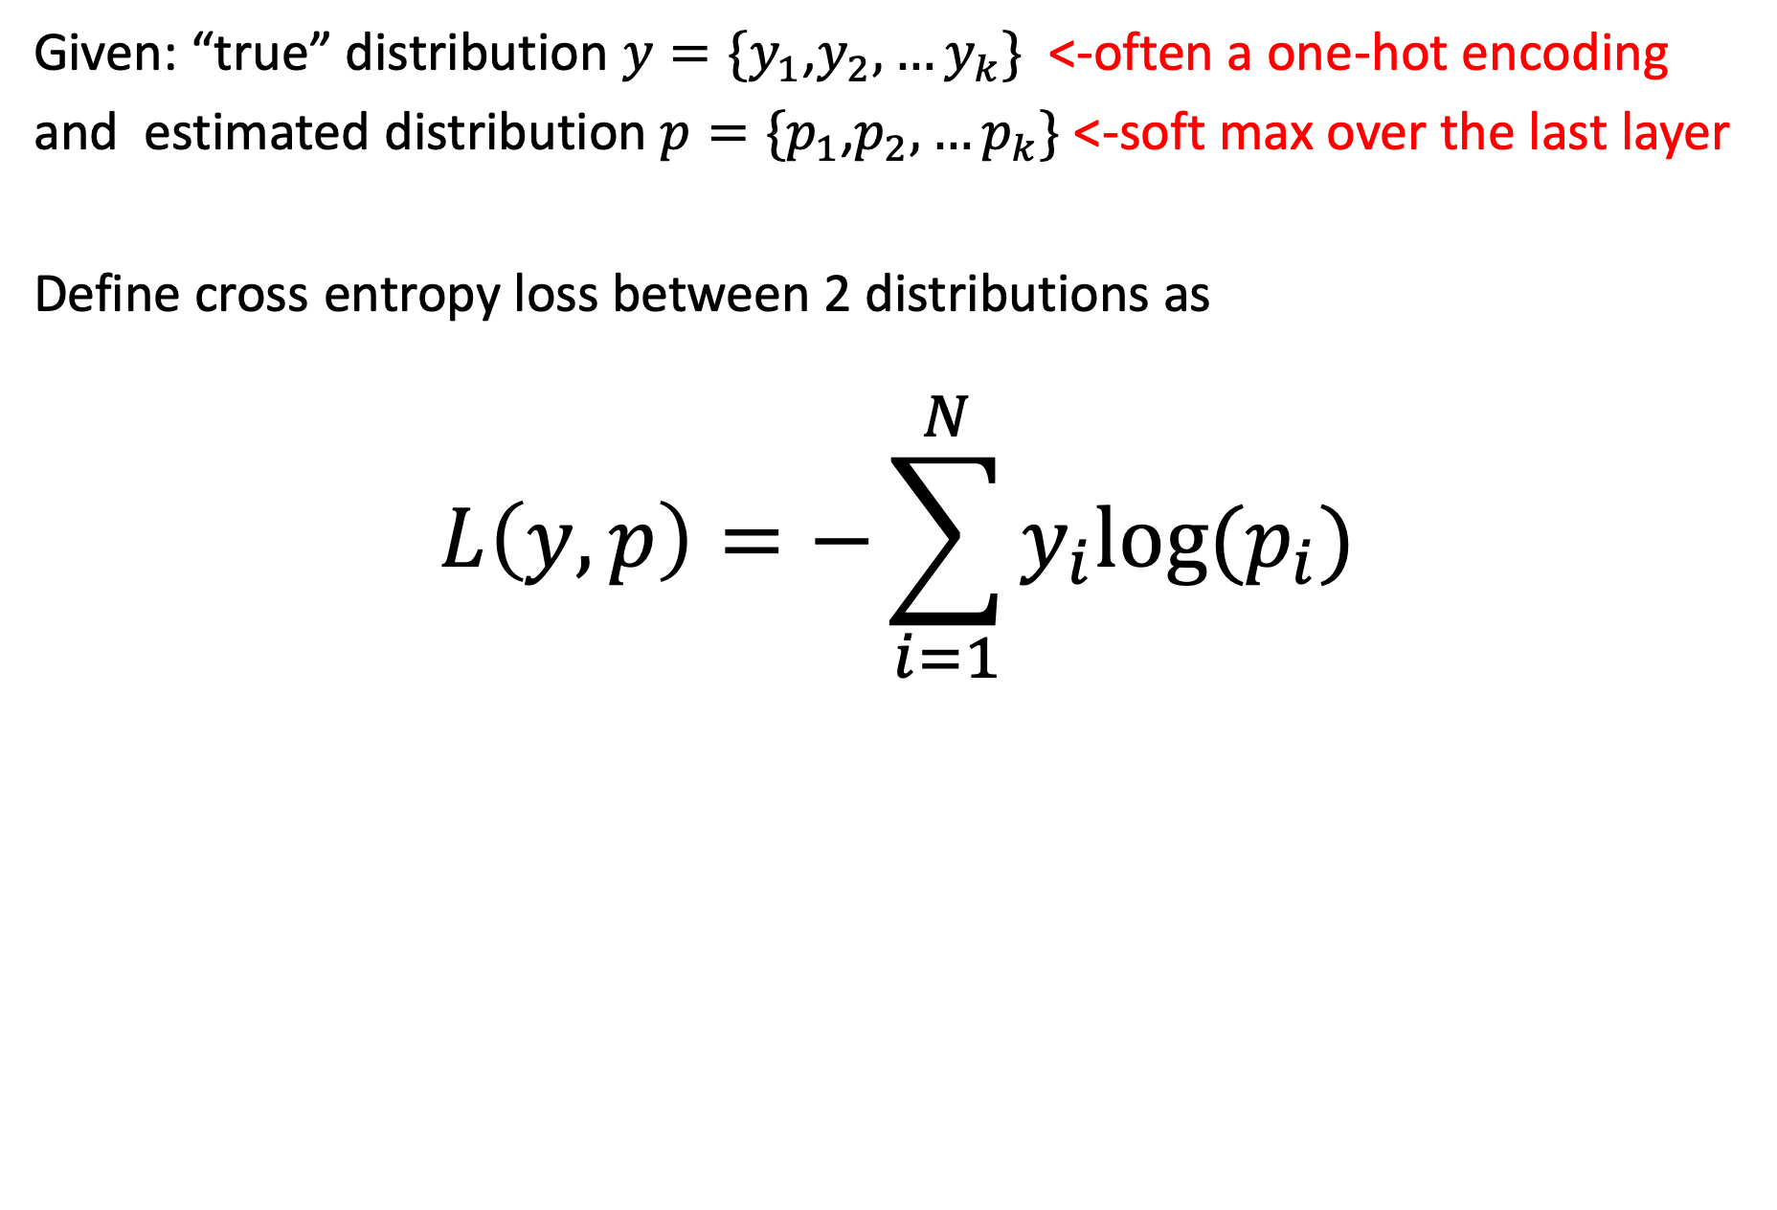
Cross Entropy Loss Function
Given: “true” distribution $y=\{y_{1}$,$y_{2},…y_{k}\}$ <-often a one-hot encoding
and estimated distribution $p=\{p_{1}$,$p_{2},…p_{k}\}$ <-soft max over the last layer
Define cross entropy loss between 2 distributions as
$$L\left(y,p\right)=−\sum_{i=1}^{N}{y_{i}log⁡(p_{i}})$$

Slide 21
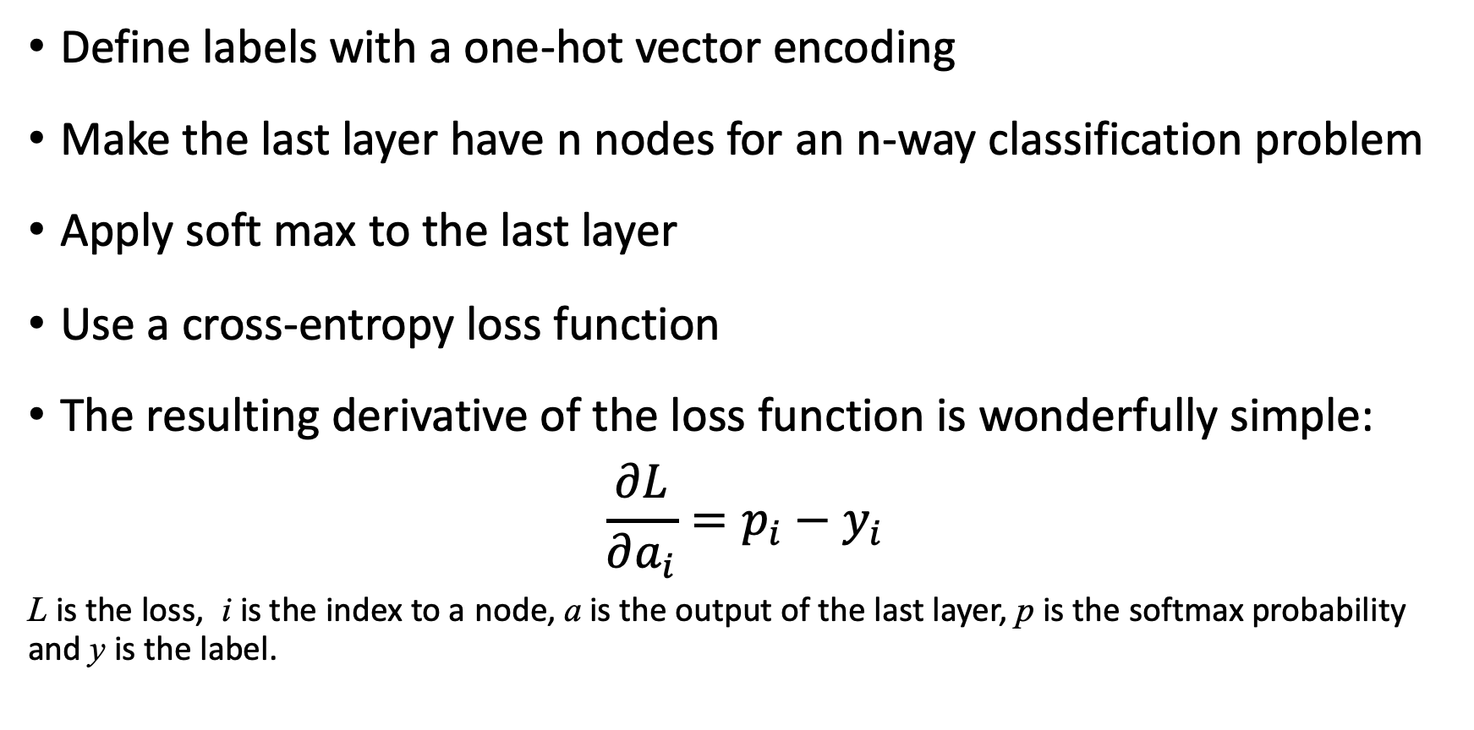
A common approach…
Define labels with a one-hot vector encoding
Make the last layer have n nodes for an n-way classification problem
Apply soft max to the last layer
Use a cross-entropy loss function
The resulting derivative of the loss function is wonderfully simple:
$$\frac{∂L}{∂a_{i}}=p_{i}−y_{i}$$
L is the loss, i is the index to a node, a is the output of the last layer, p is the softmax probability and y is the label.

Slide 22
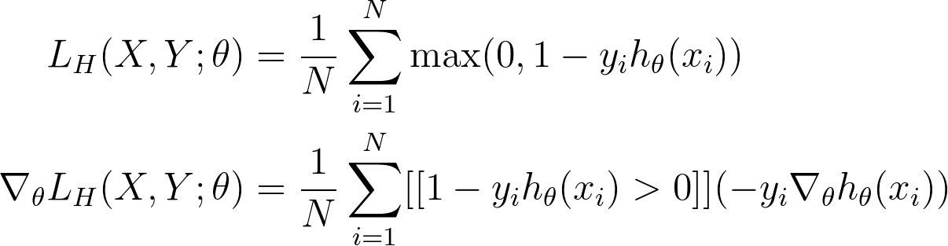


Hinge Loss
Loss only happens if the data is on the wrong side of the line.
Notes:
Outlier behavior and canonical example behavior for squared loss are very different

Slide 23
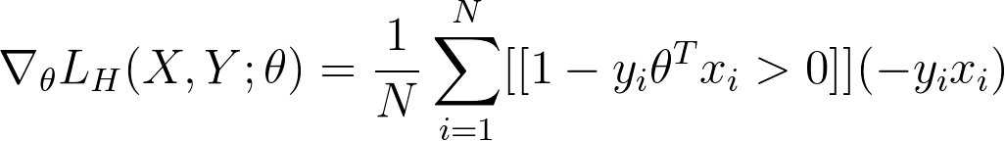
Hinge Loss
The loss function:
The gradient of the loss function is…
For example, if we use a linear model $h_{θ}\left(x_{i}\right)=θ^{T}x_{i}$,
Notes:
Outlier behavior and canonical example behavior for squared loss are very different

Slide 24
Design choices
Define the function you want to learn
Determine an encoding for the data
Pick a network architecture
  Number of layers (between 3 and 100)
  Activation functions function (tanh,ReLU, linear)
  Select how units connect within and between layers
Pick a gradient descent algorithm
Pick regularization approach (e.g. dropout)

Slide 25
Classifying images of digits

Slide 26
A possibility: one fully-connected hidden layer
INPUT LAYER
HIDDEN LAYER
OUTPUT LAYER
0
1
2
3
4
5
6
7
One input
per pixel
8
9
One hidden node per
potential shifted image
(what activation function?)
One output node
per category
(Sigmoid? ReLU?)
Each node is connected to EVERY node in the prior layer
(it is just too many lines to draw)

Slide 27
Another possibility
INPUT LAYER
HIDDEN 1
HIDDEN 2
HIDDEN 3
OUTPUT
1
2
3
4
5
6
7
8
One input
per pixel
9
ReLU
Max Pool
Linear
Sigmoid
HUGE DESIGN SPACE!

