Slide 1
The Perceptron
Rosenblatt, Frank. "The perceptron: A model for information storage and organization in the brain." Psychological review 65.6 (1958): 386.
Deep Learning: Bryan Pardo, Northwestern University, Fall 2020

Slide 2
The Perceptron
Rosenblatt, F. (1958). The perceptron: A probabilistic model for information storage and organization in the brain. Psychological Review, 65(6), 386-408
The “first wave” in neural networks
A linear classifier

Slide 3
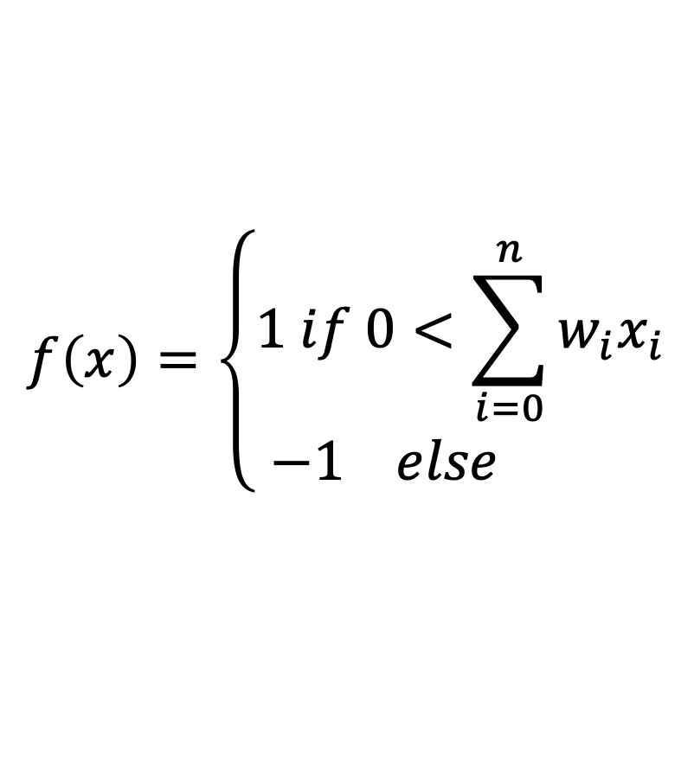
A single perceptron
x₁
x₀
Bias x₀=1
w₁
w₀
x₂
w₂
$$f\left(x\right)=\left\{\begin{matrix}1 if 0<\sum_{i=0}^{n}{w_{i}x_{i}} \\ −1 else \end{matrix}\right.$$
Input vector
x₃
w₃
x₄
w₄
Step function
output
x₅
w₅
Sum of weighted input

Slide 4

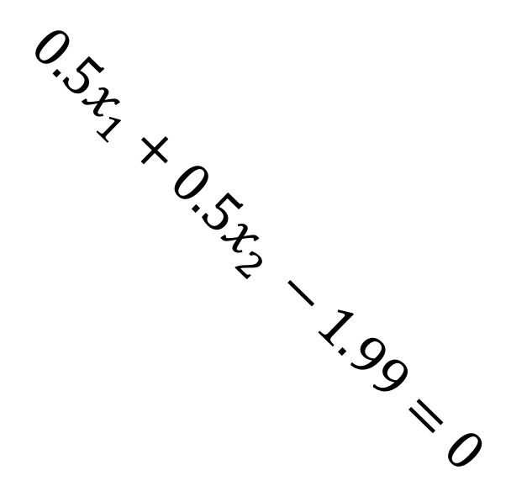
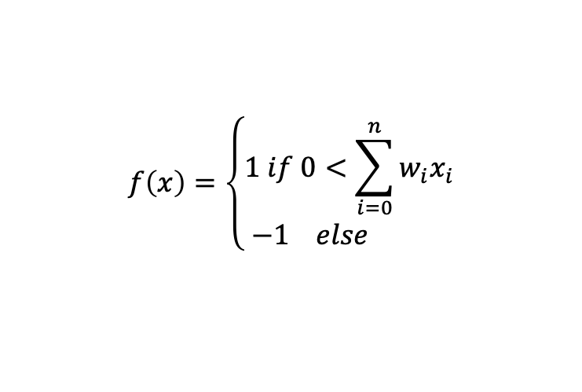


Weights define a hyperplane in the input space
$$2$$
1
1 region
-1.99
x₁
0.5
$$f\left(x\right)=\left\{\begin{matrix}1 if 0<\sum_{i=0}^{n}{w_{i}x_{i}} \\ −1 else \end{matrix}\right.$$
$${0.5x}_{1}+{0.5x}_{2 }−1.99=0$$
$$x_{2}$$
x₂
0.5
-1 region
0
$$x_{1}$$
2

Slide 5


Different logical functions are possible
$$2$$
1
1 region
-1.99
x₁
0.5
$$f\left(x\right)=\left\{\begin{matrix}1 if 0<\sum_{i=0}^{n}{w_{i}x_{i}} \\ −1 else \end{matrix}\right.$$
$${0.5x}_{1}+{0.5x}_{2 }−1.99=0$$
$$x_{2}$$
x₂
0.5
-1 region
AND
0
$$x_{1}$$
2
If we say that the input data is all binary (0 or 1) then this line works as an AND….if, when the function outputs -1, we map that to 0 instead.

Slide 6
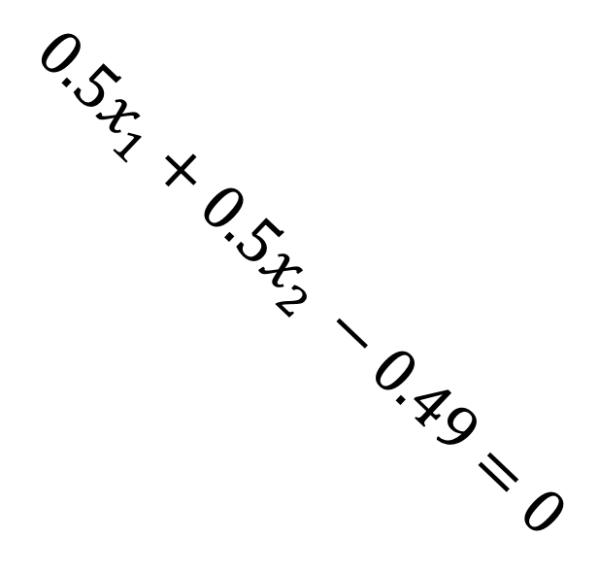
Different logical functions are possible
$$2$$
1
-0.49
x₁
0.5
1 region
$$f\left(x\right)=\left\{\begin{matrix}1 if 0<\sum_{i=0}^{n}{w_{i}x_{i}} \\ −1 else \end{matrix}\right.$$
$$x_{2}$$
x₂
$${0.5x}_{1}+{0.5x}_{2 }−0.49=0$$
0.5
-1 region
OR
0
If we say that the input data is all binary (0 or 1) then this line works as an AND….if, when the function outputs -1, we map that to 0 instead.
$$x_{1}$$
2

Slide 7


And, Or, Not are easy to define
$$1$$
1
-1 region
.1
x₁
0
$${−x}_{2}=0$$
$$f\left(x\right)=\left\{\begin{matrix}1 if 0<\sum_{i=0}^{n}{w_{i}x_{i}} \\ −1 else \end{matrix}\right.$$
$$x_{2}$$
x₂
-1
1 region
NOT
-1
If we say that the input data is all binary (0 or 1) then this line works as an AND….if, when the function outputs -1, we map that to 0 instead.

Slide 8
One perceptron: Only linear decisions
This is XOR.
It can’t learn XOR.

Slide 9
Combining perceptrons can make any Boolean function
…if you can set the weights & connections right
x₀
?
x₁
?
x₀
?
?
XOR
?
x₀
?
?
?
x₂
?
How would you set the weights and connections to make XOR?

Slide 10
Classifying image data with a single perceptron
Class 1
Class -1
Each image is an m by n array of pixel values.
Assume each pixel is set to 0 or 1.
Define a set of weights that would separate class 1 from class -1.

Slide 11
Classifying image data with a single perceptron
Class 1
Class -1
Class ???
Now…given your weights, which class would the new image be?
Can you define a new set of weights that groups this new image in with the opposite class?

Slide 12
Classifying image data with a single perceptron
Class 1
Class -1
Class ???
Class ???
What is a solution that generalizes so that all the circles with no dot in the middle go in the same class?
Would your solution generalize to a situation with a bigger or smaller circle with no dot?

Slide 13
Classifying image data with a single perceptron
Class 1
Class -1
Now…given your weights, which class would the new image be?
Can you define a new set of weights that groups this new image in with the opposite class?

Slide 14
Discrimination Learning Task
There is a set of possible examples
Each example is a vector of k real valued attributes
A target function maps X onto a categorical variable Y
The DATA is a set of tuples <example, response value>
Find a hypothesis h such that...

Slide 15
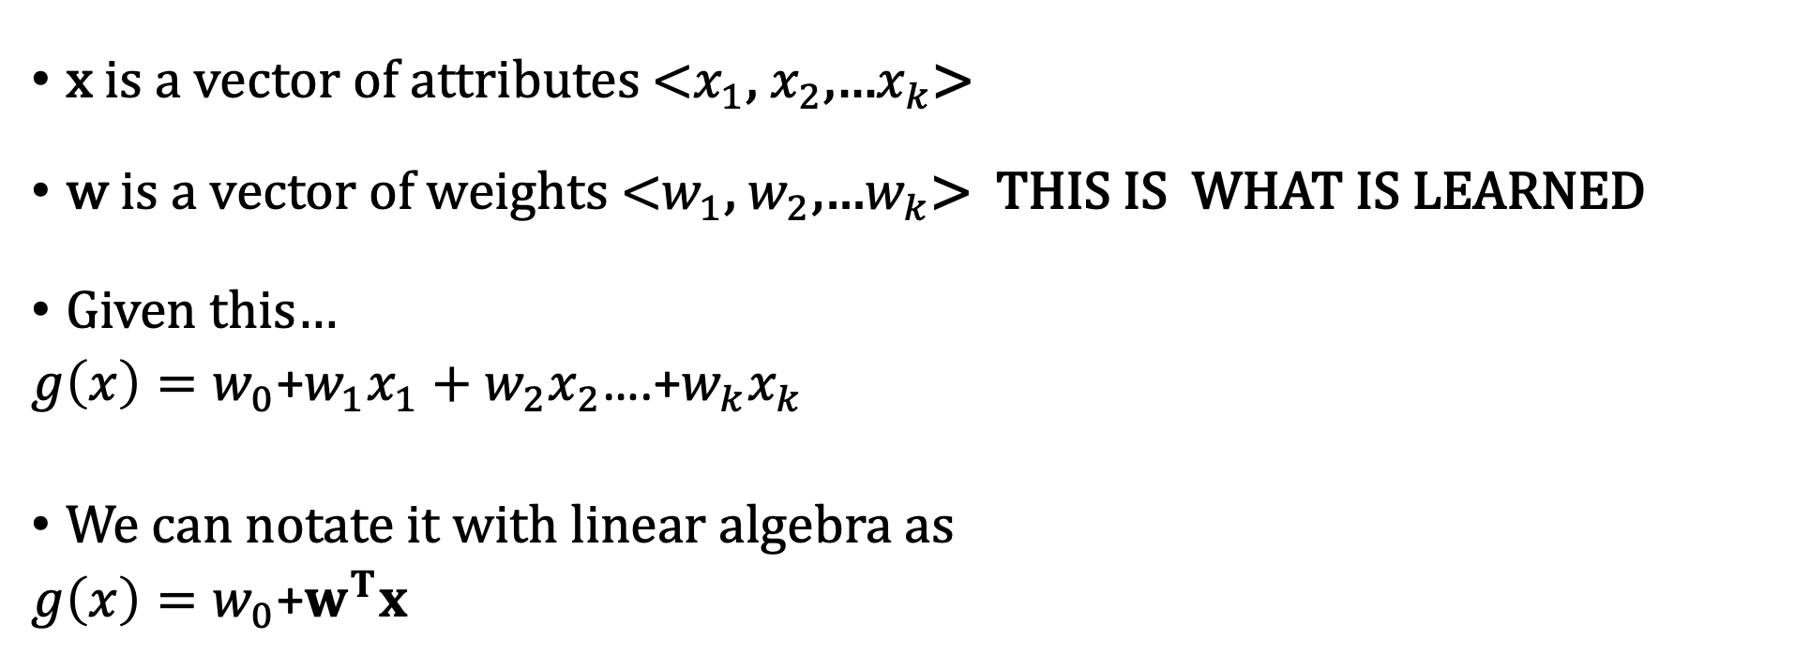
Perceptrons are linear models.
x is a vector of attributes <$x_{1}$, $x_{2}$,…$x_{k}$>
w is a vector of weights <$w_{1}$, $w_{2}$,…$w_{k}$> THIS IS WHAT IS LEARNED
Given this…
$g\left(x\right)=w_{0}$+$w_{1}x_{1}+w_{2}x_{2}$….+$w_{k}x_{k}$
We can notate it with linear algebra as
$g\left(x\right)=w_{0}$+$w^{T}x$

Slide 16
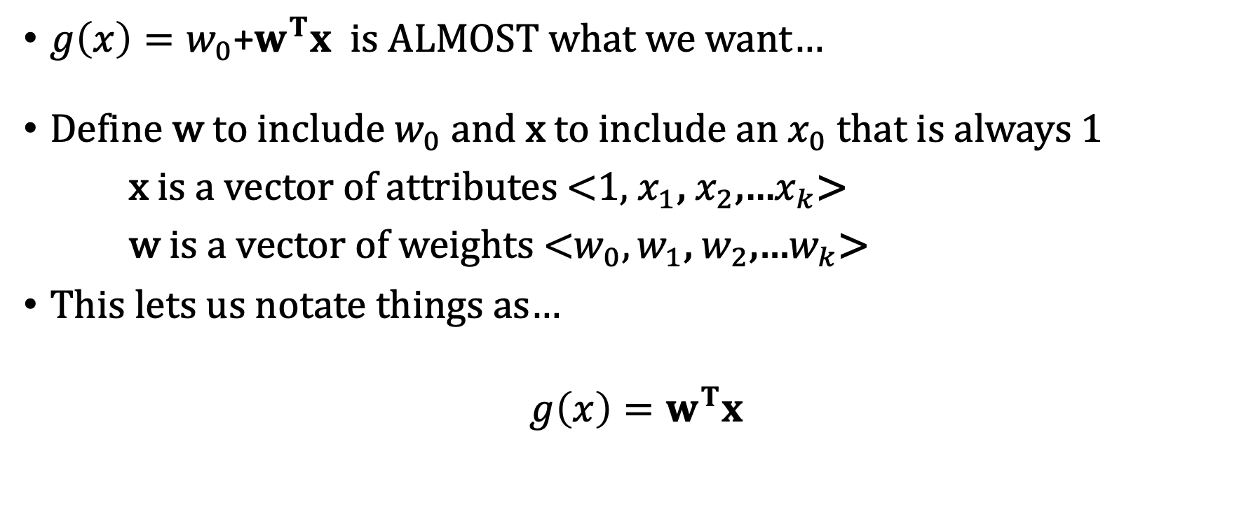
It is more convenient if…
$g\left(x\right)=w_{0}$+$w^{T}x$ is ALMOST what we want…
Define w to include $w_{0}$ and x to include an $x_{0}$ that is always 1
x is a vector of attributes <1, $x_{1}$, $x_{2}$,…$x_{k}$>
w is a vector of weights <${w_{0},w}_{1}$, $w_{2}$,…$w_{k}$>
This lets us notate things as…
$$g\left(x\right)=w^{T}x$$

Slide 17
Two-Class Classification
defines a decision boundary that splits the space in two
If a line exists that does this without error, the classes
are linearly separable
x₂
x₁

Slide 18
Loss/Objective function
To train a model (e.g. learn the weights of a useful line) we define a measure of the ”goodness” of that model. (e.g. the number of misclassified points).
We make that measure a function of the parameters of the model (and the data).
This is called a loss function, or an objective function.
We want to minimize the loss (or maximize the objective) by picking good model parameters.

Slide 19
Loss/Objective function
Let’s define an objective (aka “loss”) function that directly measures the thing we want to get right
Then let’s try and find the line that minimizes the loss.
How about basing our loss function on the number of misclassifications?

Slide 20

sum of squared errors (SSE)
$$=w^{T}x$$
SSE = 16

Slide 21
sum of squared errors (SSE)
$$=w^{T}x$$
SSE = 0

Slide 22
No closed form solution!
For many objective (aka loss) functions we can’t find a formula to to get the best model parameters, like one can with regression.
The objective function from the previous slide is one of those ”no closed form solution” functions.
This means we must try various guesses for what the weights should be.
Let’s look at the perceptron approach.

Slide 23
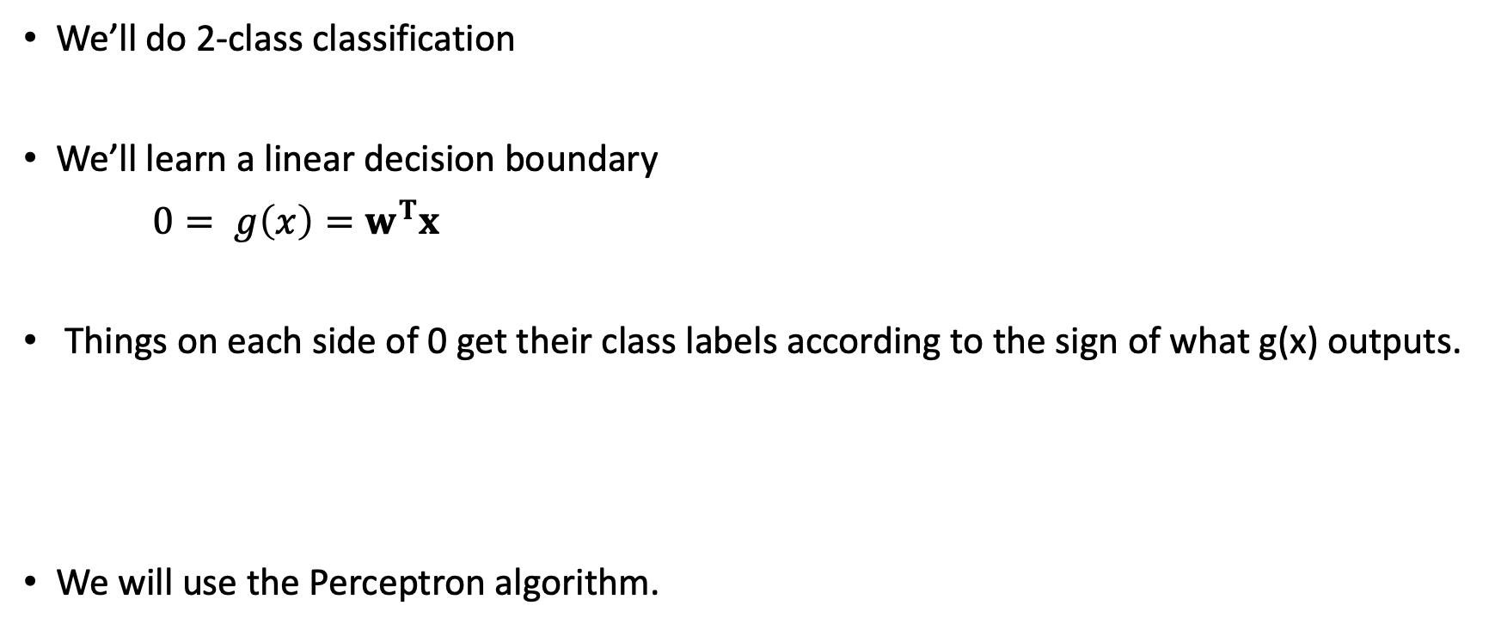
Let’s learn a decision boundary
We’ll do 2-class classification
We’ll learn a linear decision boundary
$0= g\left(x\right)=w^{T}x$
Things on each side of 0 get their class labels according to the sign of what g(x) outputs.
We will use the Perceptron algorithm.

Slide 24






An example
Goal: classify as +1 and as -1 by putting a line between them.
10
Our objective function is…
$$g\left(x\right)>0$$
$${ (w}^{T}x)y>0$$
(2,6)
(5,7)
Start with a randomly placed line.
$${w=[w}_{0 },w_{1}{,w}_{2}]=[−5, 0, 1]$$
$$x_{2}$$
$$g\left(x\right)<0$$
Measure the objective for each point.
$$x_{1}$$
10
Move the line if the objective isn’t met.

Slide 25
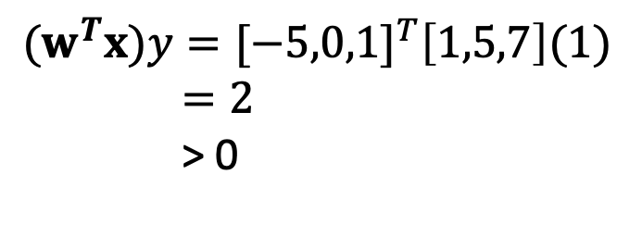
An example
Goal: classify as +1 and as -1 by putting a line between them.
10
Our objective function is…
$$g\left(x\right)>0$$
$${ (w}^{T}x)y>0$$
(2,6)
(5,7)
Start with a randomly placed line.
$${w=[w}_{0 },w_{1}{,w}_{2}]=[−5, 0, 1]$$
$$x_{2}$$
$$g\left(x\right)<0$$
${(w}^{T}x)y={[−5,0,1]}^{T}\left[1,5,7\right](1$)
$=2$
> 0
$$x_{1}$$
10
Objective met. Don’t move the line.

Slide 26
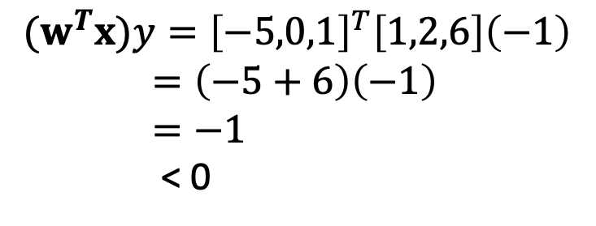
An example
Goal: classify as +1 and as -1 by putting a line between them.
10
Our objective function is…
$$g\left(x\right)>0$$
$${ (w}^{T}x)y>0$$
(2,6)
(5,7)
Start with a randomly placed line.
$${w=[w}_{0 },w_{1}{,w}_{2}]=[−5, 0, 1]$$
$$x_{2}$$
$$g\left(x\right)<0$$
$${(w}^{T}x)y={\left[−5,0,1\right]}^{T}\left[1,2,6\right]\left(−1\right)$$
$=\left(−5+6\right)\left(−1\right)$
$=−1$
< 0
$$x_{1}$$
10
Objective not met. Move the line.

Slide 27
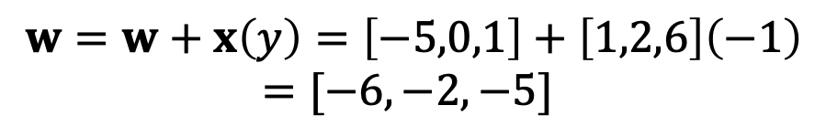

An example
Goal: classify as +1 and as -1 by putting a line between them.
10
Our objective function is…
$$g\left(x\right)>0$$
$${ (w}^{T}x)y>0$$
(2,6)
(5,7)
Start with a randomly placed line.
$${w=[w}_{0 },w_{1}{,w}_{2}]=[−5, 0, 1]$$
$$x_{2}$$
$$g\left(x\right)<0$$
Let’s update the line by doing $w=w+yx$.
$$x_{1}$$
10
$$w=w+x\left(y\right)=\left[−5,0,1\right]+\left[1,2,6\right]\left(−1\right)$$
$=[−6,−2,−5]$

Slide 28
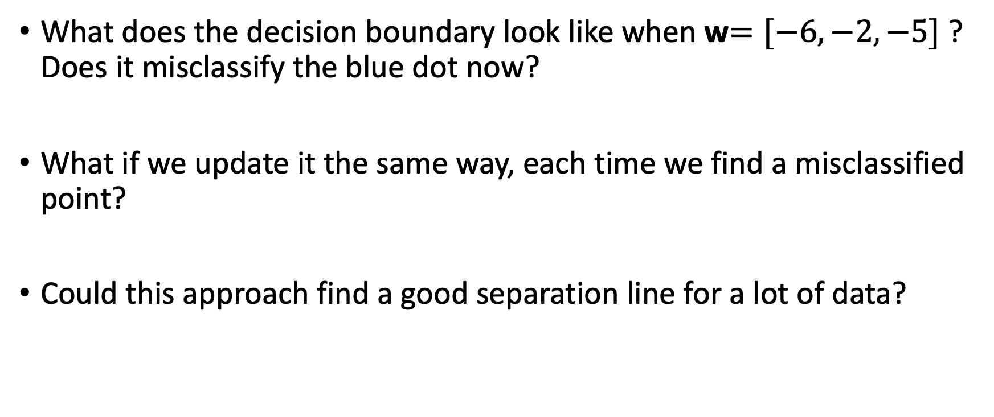
Now what ?
What does the decision boundary look like when w$=[−6,−2,−5]$ ? Does it misclassify the blue dot now?
What if we update it the same way, each time we find a misclassified point?
Could this approach find a good separation line for a lot of data?

Slide 29
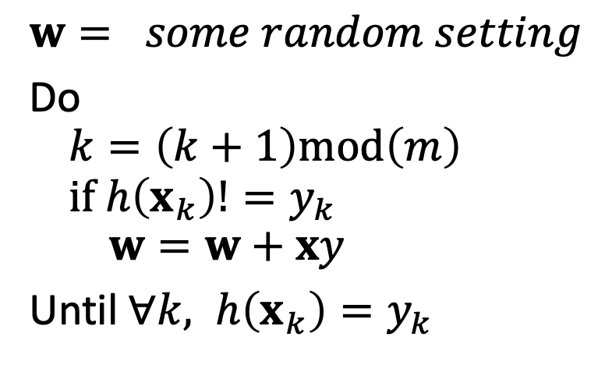


Perceptron Algorithm
The decision boundary
The classification function
$$0= g\left(x\right)=w^{T}x$$
$$m=\left|D\right|=size of data set$$
The weight update algorithm
$$w= some random setting$$
Do
$$k=\left(k+1\right)mod\left(m\right)$$
$$if h\left(x_{k}\right)!=y_{k}$$
$$w=w+xy$$
Until $∀k, h\left(x_{k}\right)=y_{k}$
Warning: Only guaranteed to terminate if classes are linearly separable!
This means you have to add another exit condition for when you’ve gone through the data too many times and suspect you’ll never terminate.

Slide 30
Perceptron Algorithm
Example:
Red is the positive class Blue is the negative class
Notes:
In this example let’s just pretend there is not a w_0, that it is at the origin.

Slide 31
Perceptron Algorithm
Example (cont’d):
Red is the positive class Blue is the negative class

Slide 32
Perceptron Algorithm
Example (cont’d):
Red is the positive class Blue is the negative class

Slide 33
Perceptron Algorithm
Example (cont’d):
Red is the positive class Blue is the negative class

Slide 34
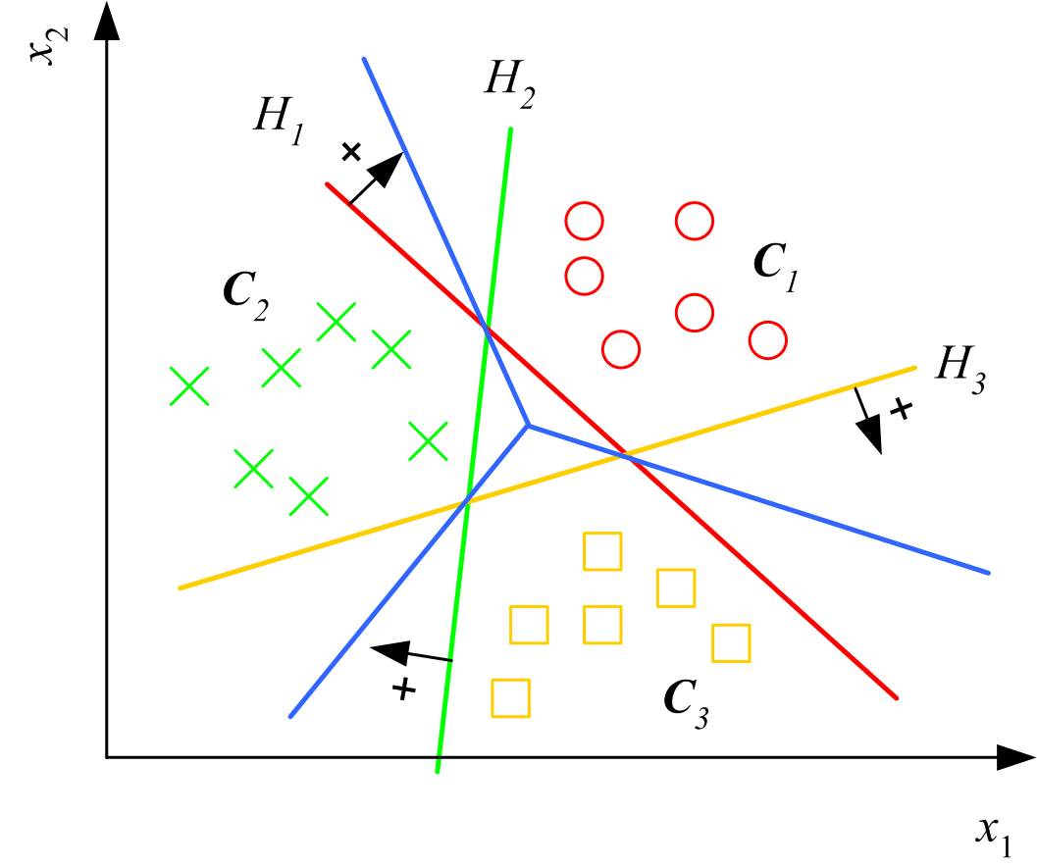
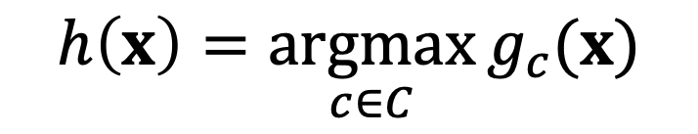
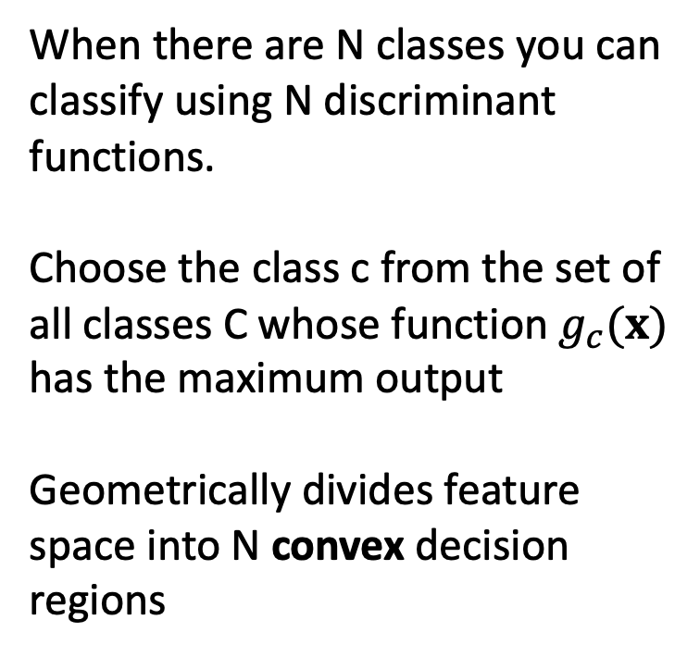
Multi-class Classification
When there are N classes you can classify using N discriminant functions.
Choose the class c from the set of all classes C whose function $g_{c}(x)$ has the maximum output
Geometrically divides feature space into N convex decision regions
a₂
a₁
$$h\left(x\right)=\underset{c∈C}{argmax}{g_{c}(x)}$$

Slide 35
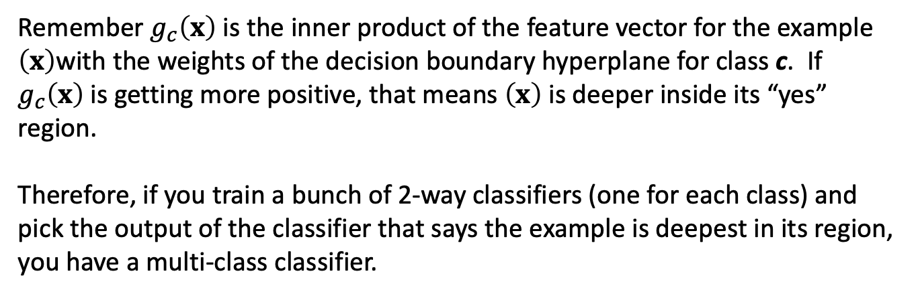
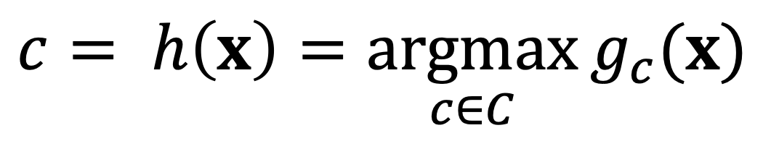
Multi-class Classification
A class label
$$c= h\left(x\right)=\underset{c∈C}{argmax}{g_{c}(x)}$$
Set of all classes
Remember $g_{c}\left(x\right)$is the inner product of the feature vector for the example $\left(x\right)$with the weights of the decision boundary hyperplane for class c. If $g_{c}\left(x\right)$is getting more positive, that means $\left(x\right)$ is deeper inside its “yes” region.
Therefore, if you train a bunch of 2-way classifiers (one for each class) and pick the output of the classifier that says the example is deepest in its region, you have a multi-class classifier.

