Slide 1
REGULARIZATION
Deep Learning: Bryan Pardo, Northwestern University, Fall 2020

Slide 2

Pick data D
The data defines a function to learn: $f\left(x\right)=y$
Typically, this is from $ℝ^{d}$ to $ℝ^{d}$.
This is called regression.
Y
X

Slide 3

Pick data D
The data defines a function to learn: $f\left(x\right)=y$
This can also be from $ℝ^{d}$ to a finite set of labels, e.g. {0,1}.
This is classification.
1
Y
0
X

Slide 4
Pick data D: Is there enough?
Good coverage of the range of possible values?
Just because you got lots of data, doesn’t mean it covers the space.
Y
X

Slide 5
Pick data D: Is there enough?
Enough sample density in the space?
Just because you cover the range, doesn’t mean you captured the function.
Y
X

Slide 6
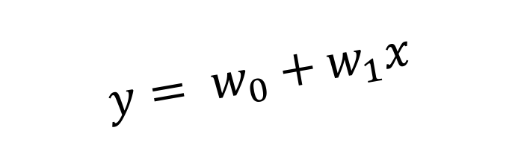
Fitting & Hypothesis space.
If a model’s hypothesis space is too small, the true function is probably not in its vocabulary (underfitting)
Y
$$y= w_{0}+w_{1}x$$
Learnable weights
X

Slide 7

Fitting & Hypothesis space
If a model’s hypothesis space is too big, it can learn a crazy, overly specific function (overfitting)
Y
$$y=\sum_{i=0}^{10}{w_{i}x^{i}}$$
X

Slide 8
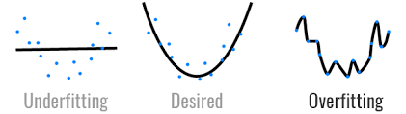
Revisiting Overfitting
Overfitting occurs when your model begins to “memorize” the training data
Can detect overfitting from an increasing gap between training and validation loss.
Performance on the training set improves, but performance on the validation set does not.

Slide 9
Dimensions and data
The more dimensions your data has, the more data you need to cover the space
The more dimensions, the more parameters your model needs (at least 1 per dimension)
The more parameters, the more data you need to prevent overfitting
Conclusion: You probably don’t have enough data. You probably overfit somehow.

Slide 10
Resisting overfitting
Add noise to the training process
Stop before you start overfitting (Early stopping)
Make the model smaller, somehow (regularization)
Make the dataset bigger, somehow (augmentation)

Slide 11
Adding noise
Stochastic Gradient Descent adds noise
Changing or randomizing step sizes add noise
Explicitly adding noise to the
input data
target labels
weights (e.g. Dropout)

Slide 12
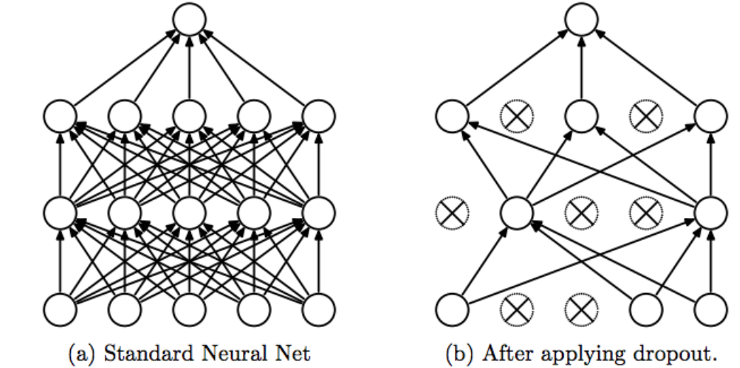
Regularization via noise: Dropout

Slide 13
Validation
Divide data into 3 sets: train, validate, test
Train on the training data
Every so often, evaluate on the validation set (which you don’t train on)
If the loss stops getting better on validation data, stop training
Only then, when you’re done, do you evaluate on the testing data

Slide 14
“traditional” regularization
Big idea (Occam’s Razor) – Given two models with equal performance, prefer the simpler model.
E.g., models with fewer parameters or smaller coefficients
Regularization can be applied to any loss function
The amount of regularization is controlled by the hyperparameter

Slide 15
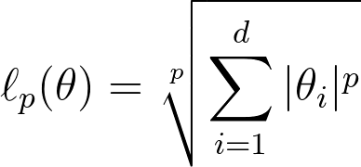
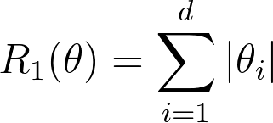
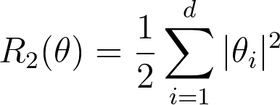

L1- and L2-regularization
Recall the $l_{p}$-norm:
$l_{1}$-regularization penalizes high values of the $l_{1}$-norm of the model parameters:
$l_{2}$-regularization penalizes high values of the $l_{2}$-norm:

Slide 16

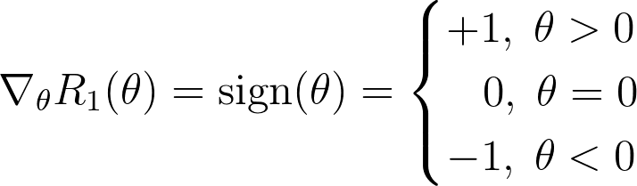

L1-regularization and sparsity
The gradient of the L1-regularizer is bounded (between -1 and +1, inclusive) but not unique at $θ=0$.
Arbitrarily set the gradient at this point to 0.
The resulting function is the sign function
Notes:
Max: Should he add something that leads to the

Slide 17

L1-regularization and sparsity
L1-regularization encourages the model parameters to be sparse
This is a form of feature selection
Only features with non-zero coefficients contribute to the model’s prediction
This is because the gradient of L1-regularization moves model parameters towards 0 at a constant rate
Notes:
Max: Should he add something that leads to the

Slide 18


L2-regularization and big weights
L2-regularization encourages the model parameters to be small
Why would this be?
Notes:
Max: Should he add something that leads to the

Slide 19

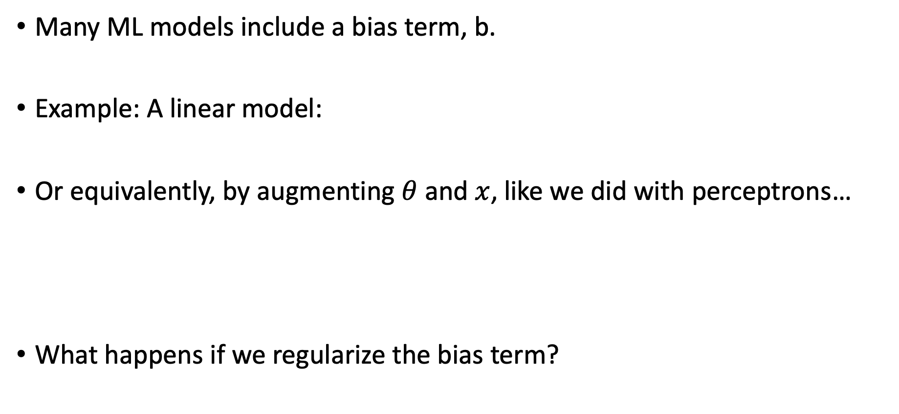
Regularization and offset (aka bias)
Many ML models include a bias term, b.
Example: A linear model:
Or equivalently, by augmenting $θ$ and $x$, like we did with perceptrons…
What happens if we regularize the bias term?
Notes:
A horizontal line at any offset is just as simple of a model. Unless we have a strong prior, we don’t want to preferentially select models with a small offset.
This might need a TOUCH more explanation. Explicitly saying “if we force the bias to be smaller than the needed offset for a horizontal line, it can’t learn a horizontal line.”

Slide 20
Regularization and offset (aka bias)
Recall that “regularizing” a model parameter means encouraging that model parameter to tend towards 0.
How would a linear model represent horizontal line?
How does shrinking the bias affect its ability to do so?
No bias regularization
Bias regularization
Don’t regularize the bias term!
Notes:
A horizontal line at any offset is just as simple of a model. Unless we have a strong prior, we don’t want to preferentially select models with a small offset.
This might need a TOUCH more explanation. Explicitly saying “if we force the bias to be smaller than the needed offset for a horizontal line, it can’t learn a horizontal line.”

Slide 21
Data Augmentation
Make perturbed copies of your data that vary in ways that should not change the value nature of the output function.
This can help prevent spurious correlations between data and output.
Example: Distinguishing clarinet sounds from flute sounds
Vary the pitch of each note by + or – 1%, 2%, 3%, 4%....
Add background noise of different kinds and at different dB
Time-stretch each note a bit
Delay or advance the onset of the note
This can turn 1000 data points into 100,000.

Slide 22
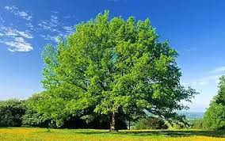
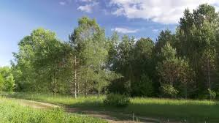

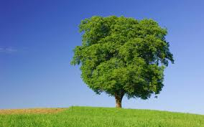
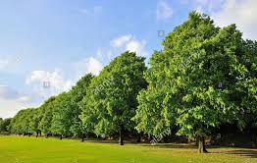
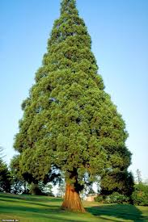
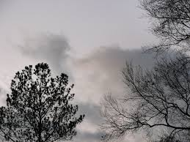
Let’s look at “trees”

Slide 23
One other thing…”normalization”

Slide 24
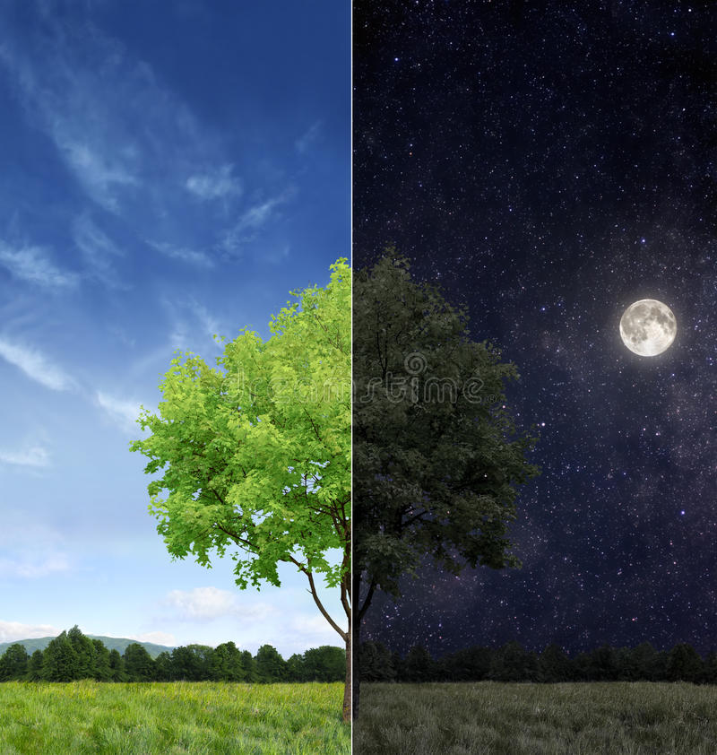
What if….
Your training data
looks like this?
Your testing data
looks like this?
Low dynamic range
Very dark
High dynamic range
Very bright
(image from https://www.dreamstime.com/)

Slide 25
You might want to do this:
Standardize your data:
Make sure that you have unit variance in your batch/dataset.
Give your data the same range overall (e.g. center your values around the same center point)
Decorrelate your variables (can be harder for images, if every pixel is a variable)

Slide 26
“Whitening your data”
name comes from white noise.
Here’s a definition from https://en.wikipedia.org/wiki/Whitening_transformation
A whitening transformation or sphering transformation is a linear transformation that transforms a vector of random variables with a known covariance matrix into a set of new variables whose covariance is the identity matrix, meaning that they are uncorrelated and each have variance 1.^{[1]} The transformation is called "whitening" because it changes the input vector into a white noise vector.

Slide 27
So….when/how to do this?
At the dataset level?
At the batch level?
At the input?
Or further into the network?

Slide 28
What is covariant shift?
Well… we already talked about this potential issue between testing and training
How can a similar issue happen between gradient descent steps for the input, if we’re using minibatches?
How can a similar issue happen to interior nodes even if we run on the same mini batch for two steps in a row?

Slide 29
Batchnorm: centering and scaling
Normalize the data scale input to each node
Subtract the mean value of the data
Do this on a dimension-by-dimension basis
Do this at every training step in gradient descent

Slide 30
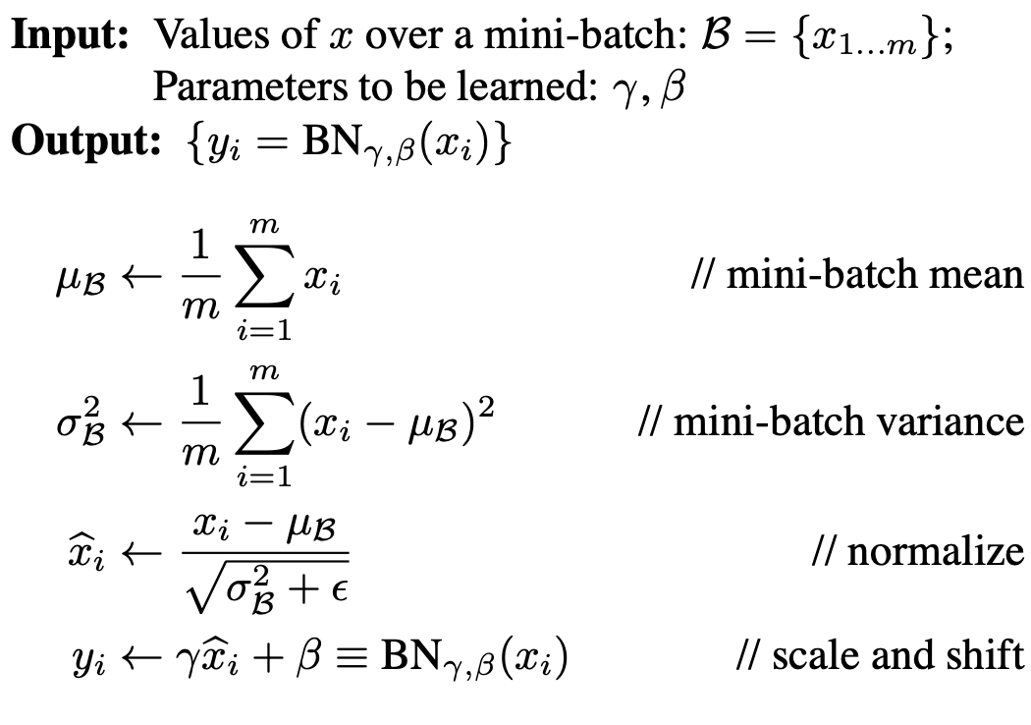

Slide 31
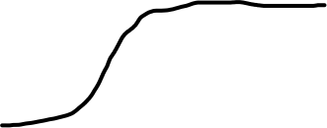


Slide 32

What to do once trained?
Replace batch statistics with the statistics over the entire training set.

