Slide 1
Unsupervised Deep nets
Bryan Pardo
Northwestern University
(updated fall 2020)

Slide 2
Hebbian Learning

Slide 3
Donald Hebb
A cognitive psychologist active mid 20th century
Influential book: The Organization of Behavior (1949)
Hebb’s postulate
"Let us assume that the persistence or repetition of a reverberatory activity (or "trace") tends to induce lasting cellular changes that add to its stability.… When an axon of cell A is near enough to excite a cell B and repeatedly or persistently takes part in firing it, some growth process or metabolic change takes place in one or both cells such that A's efficiency, as one of the cells firing B, is increased.

Slide 4
Pithy version of Hebb’s postulate
Cells that fire together, wire together.

Slide 5
Hopfield networks

Slide 6
Hopfield nets are
“Hebbian” in their learning approach
Old technology. These are proof of concept things from the 80s and earlier.
Fast to train, slow to use
Weights are symmetric
All nodes are input & output nodes
Use binary (1, -1) inputs and output
Used as Associative memory (image cleanup)Classifier
Precursors to Auto Encoders and Restricted Boltzman Machines

Slide 7
Using a Hopfield Net
10 by 10 Training patterns
Query pattern
(to clean or classify)
Output pattern
Fully connected
100 node network
(too complex to draw)

Slide 8
Training a Hopfield Net
Assign connection weights as follows

Slide 9
Using a Hopfield Net
Force output to match an unknown input pattern
Iterate the following function until convergence
Note: this means you have to pick an order for updating nodes. People often update all the nodes in random order

Slide 10
Using a Hopfield Net
Once it has converged…
FOR INPUT CLEANUP: You’re done. Look at the final state of the network.
FOR CLASSIFICATION: Compare the final state of the network to each of your input examples. Classify it as the one it matches best.

Slide 11
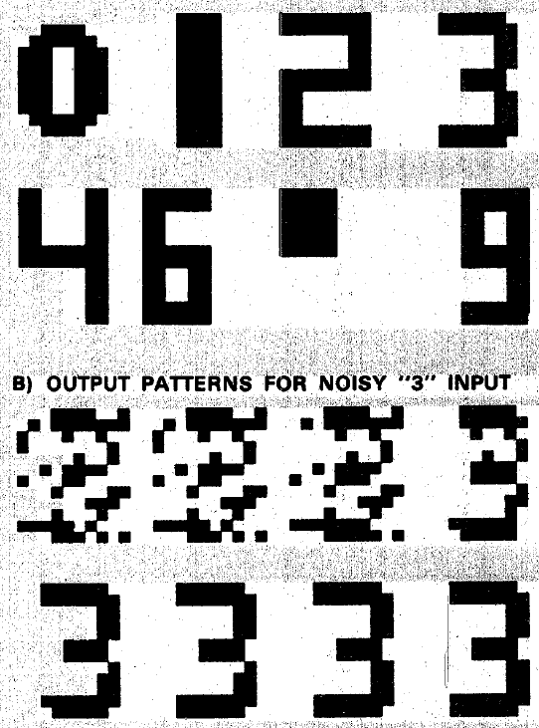
Input Training Examples
Why isn’t 5 in the set of examples?

Slide 12
Output of network over 8 iterations
Input pattern
First iteration
After 3 iterations
After 7 iterations

Slide 13
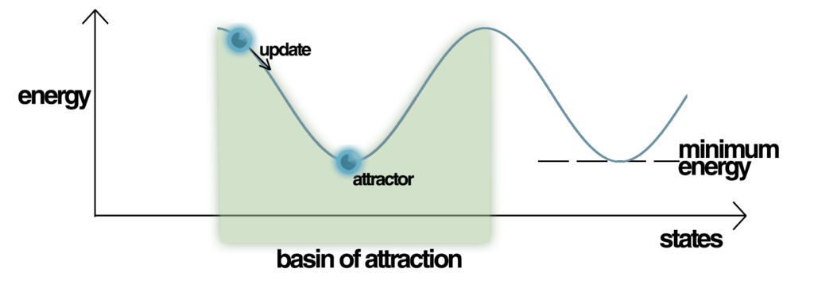
Characterizing “Energy”
As is updated, the state of the system converges on an “attractor”, where
Convergence is measured with this “Energy” function:
Note: people often add a
“bias” term to this function.
I’m assuming we’ve added
an extra “always on”
node to make our “bias”

Slide 14
Limits of Hopfield Networks
Input patterns become confused if they overlap
The number of patterns it can store is about 0.15 times the number of nodes
Retrieval can be slow, if there are a lot of nodes (it can take thousands of updates to converge)

Slide 15
Restricted boltzman machine (RBM)

Slide 16
About RBNs
Related to Hopfield nets
Used extensively in Deep Belief Networks
You can’t understand DBNs without understanding these

Slide 17
About RBNs
Related to Hopfield nets
Used extensively in Deep Belief Networks
You can’t understand DBNs without understanding these

Slide 18

Standard RBM Architecture
Hidden
Units
Weight
Matrix
Input
Units
2 layers (hidden & input) of Boolean nodes
Nodes only connected to the other layer

Slide 19
Standard RBM Architecture
Hidden
Units
Weight
Matrix
Input
Units
Setting the hidden nodes to a vector of values updates the visible nodes…and vice versa

Slide 20
Contrastive Divergence Training
Pick a training example.
Set the input nodes to the values given by the example.
See what activations this gives the hidden nodes.
Set the hidden nodes at the values from step 3.
Set the input node values, given the hidden nodes
Compare the input node values from step 5 to the the input node values from step 2
Update the connection weights to decrease the difference found in step 6.
If that difference falls below some epsilon, quit. Else, go to step 1.

Slide 21
Deep BELIEF Network (DBN)

Slide 22
What is a Deep Belief Network?
A stack of RBNS
Trained bottom to top with Contrastive Divergence
Trained AGAIN with supervised training (similar to backprop in MLPs)
RBN

Slide 23
What is a Deep Belief Network?
A stack of RBNS
Trained bottom to top with Contrastive Divergence
Trained AGAIN with supervised training (similar to backprop in MLPs)
RBN

Slide 24
What is a Deep Belief Network?
A stack of RBNS
Trained bottom to top with Contrastive Divergence
Trained AGAIN with supervised training (similar to backprop in MLPs)
RBN

Slide 25
What is a Deep Belief Network?
A stack of RBNS
Trained bottom to top with Contrastive Divergence
Trained AGAIN with supervised training (similar to backprop in MLPs)
RBN

Slide 26
Why are DBNs important?
Around 2005 they were state-of-the-art systems for doing certain recognition tasks
Handwritten digits
Phonemes
They got the whole “Deep learning” thing going
They have a good marketing campaign “Deep learning” vs “shallow learning”

Slide 27
How does “deep” help?
It may be possible to much more naturally encode problems like the parity problem with deep representations than with shallow ones

Slide 28
Why not use standard MLP training?
Fading signal from backprop
The more complex the network, the more likely there are local minima
Memorization issues
Training set size and time to learn

Slide 29
Benefits
Allowed relatively deep networks (e.g. 10 layers), compared to regular multilayer perceptrons with sigmoid activations
In the mid 2000’s this approach made networks better than anything else out there for some problems (e.g. digit recognition, phoneme recognition)
Today, they’ve been superseded by other approaches

Slide 30
Autoencoders

Slide 31
Variational Autoencoders

