Slide 1
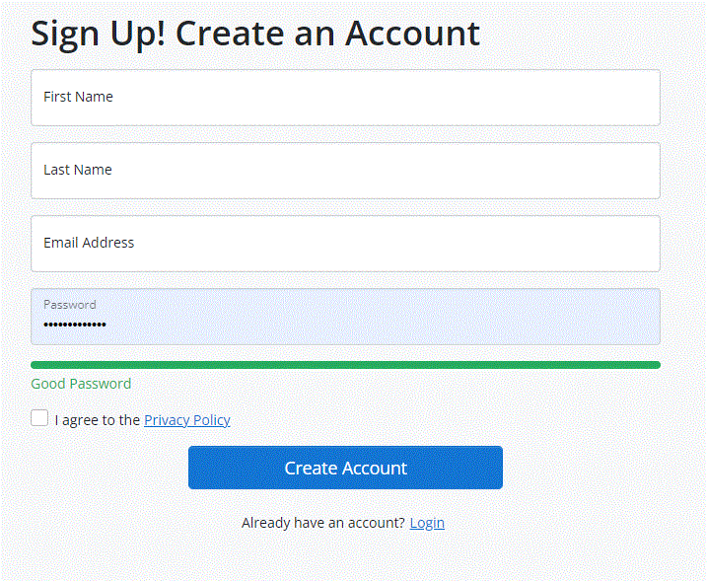
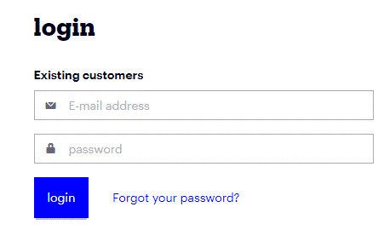
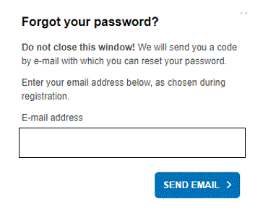
Distributors/Users
Name of the company
Contact number
Current job Designation
Purpose of Registration
To become distributor
To know about products
I am already a distributor
Remarks

Slide 2
When approval is made for an user or for a distributor
And email with authentication link should go to their email
By clicking their link
New password setup
And two factor authentication via SMS or via email need to be set up
Please show the screens of this password setup and two factor authentication pending

Slide 3
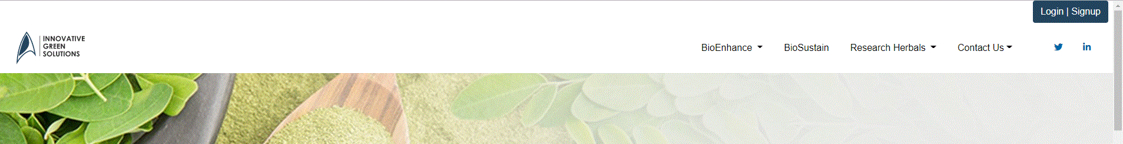
Register/Login
Languages

Slide 4
Documents under the product have same as on home page Register/login
This is with same design with transparent background here the documents of the product with titles can be seen
i.e. only registered user with approved product level access can see
Only registered distributor can see all the documents of each product

Slide 5
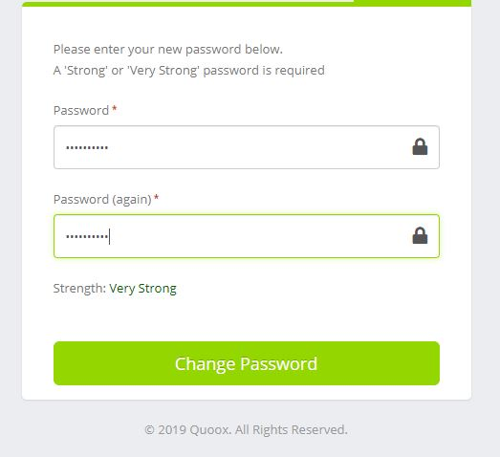
When they click on the link sent to email then they can redirect to a page where they can set their password.
Once log in they are forced to the screen to create two factor SMS authentication to really get account working.

Slide 6

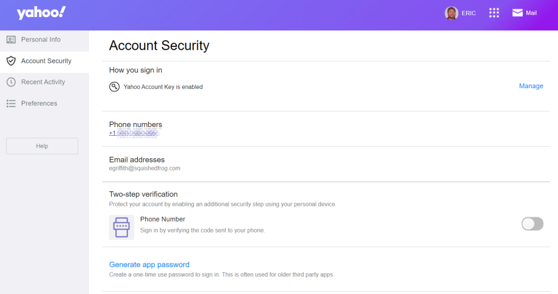

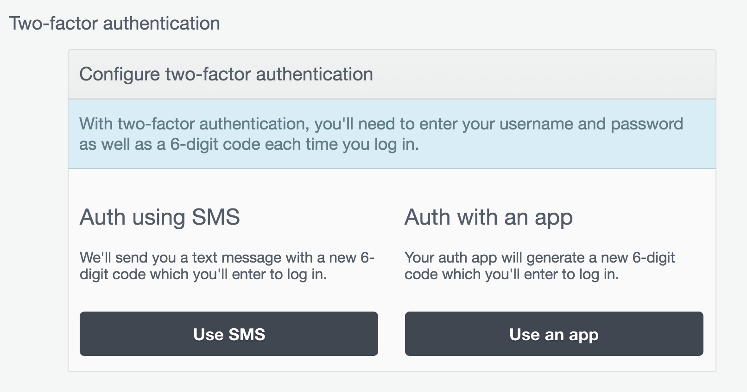
Personal info
Account Security
Alerts ¹
Log out
This two-factor authentication
For all users
Distributors
Data admin
Once any user create authentication then they must make sure to re-log in
A message to appear if the same device is used the log in is still be remembered for next 30 days? With Yes or No

