Slide 1

Medi-Mate
Connected care, anytime, anywhere.

Slide 2

The Problem We’re Solving
70% of Indian elders miss or delay medicines regularly. Care is fragmented: elders forget, caretakers stressed, families anxious. Existing apps fail India → no offline-first, no local language, no SOS.

Slide 3
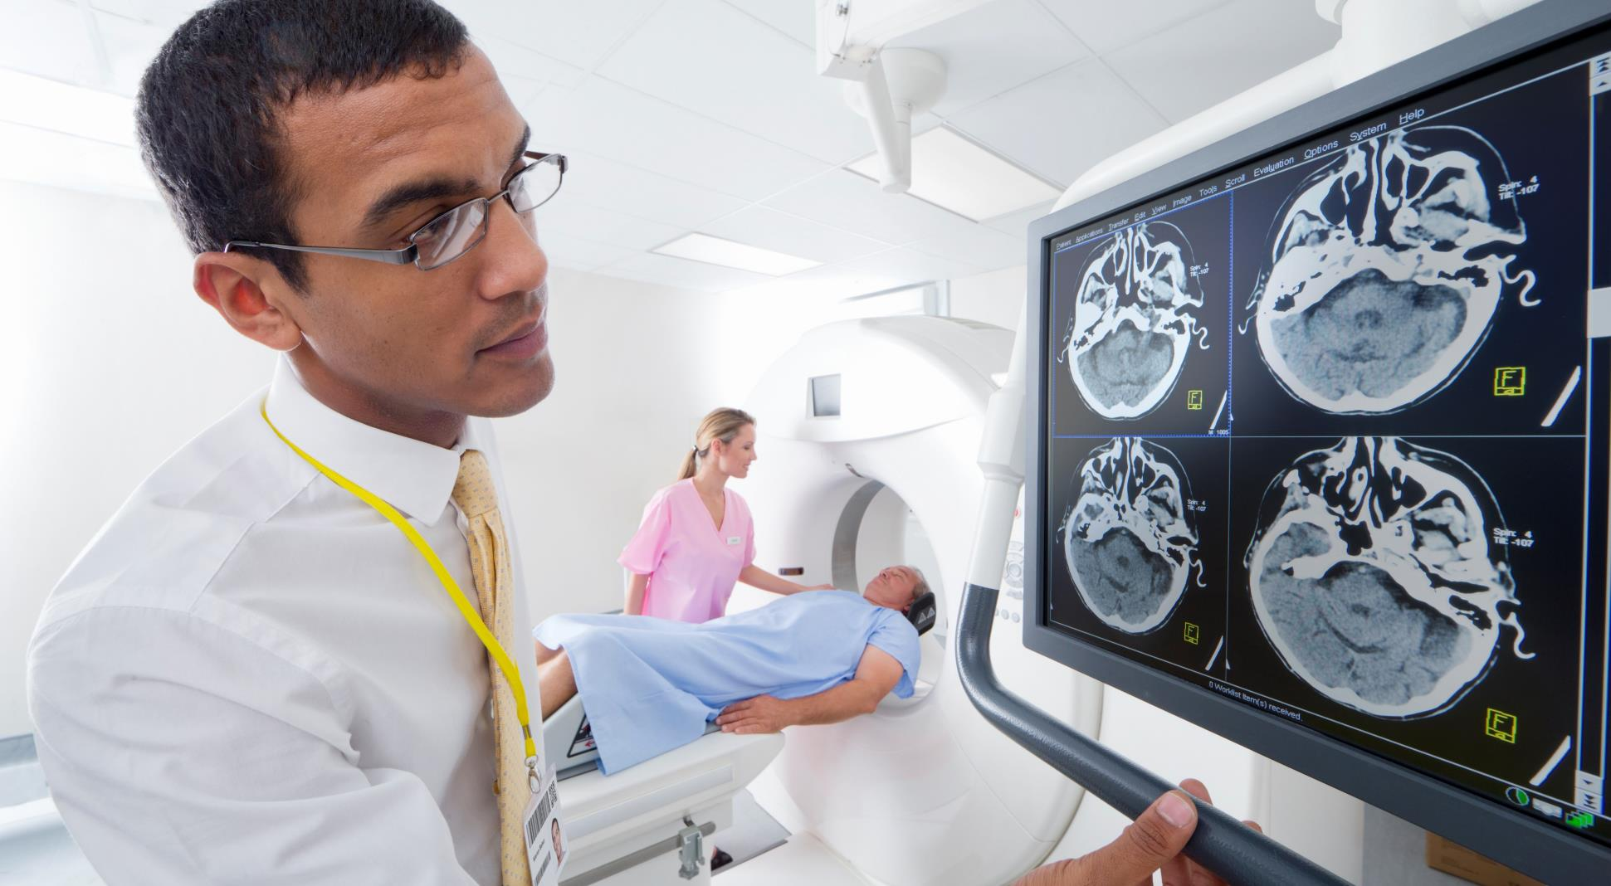




Target Users & Pain Points
70%
60%
65%
30–40%
Elders: Forget meds, fear emergencies, tech struggle.
Caretakers: Overloaded, no structured accountability
Families: Constant worry, no real-time updates.
Doctors: Need clean adherence & vitals data.
“These pain points demand a connected solution.”

Slide 4
Why Now?
India’s Aging Wave & Healthcare Burden
41%
65%
2.5x rise
70%
18%
Elders in India rising fast
Tier-2/3 elders are now mobile-ready.
Elders adopting WhatsApp & voice tech.
Most hospital visits preventable with better care
Healthcare burden will hit unsustainable levels
Year | 2021 | 2025 | 2031 | 2040
Elderly population(M) | 138M | 160M | 194M | 250M+
% of Total Pop. | 10% | 11.5% | 13% | 16%
Preventable Hospital Visits | 65% | 68% | 70% | 72%
Health Spend (₹ Cr) | ₹6.5 lakh crore | ₹8.4 lakh crore | ₹12.3 lakh crore | ₹20+ lakh crore
% of GDP | 12% | 14% | 15% | 17%
Source | Govt Census | NITI/WHO | UN Report | UN/World Bank

Slide 5

Feature Overview
💊 Medication & Health
Elder-Friendly Design
Smart med reminders & low stock alerts Weekly adherence/vitals chart AI health reading & quick assistance
Voice notifications in regional languages Simple UI with large buttons Dark/light mode for comfort
Caretaker & Family
Extra Innovations
Caretaker task lists + confirmations Family chat & real-time notifications SOS alerts & care concern reporting
Auto CSV health reports Smart retry reminders with escalation Geo-tagged caretaker check-ins

Slide 6


How It Works
Smart Reminders
Connected Care
Safety First
Voice + visual alerts in local languages. Simple confirm: “Taken / Missed.” Weekly adherence chart auto-updated.
Caretaker sees instant updates. Family gets real-time notifications.
Auto CSF health reports shared weekly.
One-tap SOS button. Alerts caretaker + family instantly.
Emergency auto-call option to saved contacts.

Slide 7
Demo Storyboard
Emergency Safety Net SOS button → triggers caretaker + family alert immediately.
Doctor/Report Angle Weekly logs can be shared with doctor → reduces errors in future consults.
How Medi-Mate Works in Real Life
Elder Reminder: Elder gets a voice prompt in local language → taps confirm.
Caretaker Dashboard: Task list updates automatically when dose is taken/missed.
Family Notification: Family receives instant alert + weekly health summary.

Slide 8
Impact
Elders Voice-based reminders in their own language. Higher medication adherence → fewer emergencies. Peace of mind knowing someone is “looking out” daily.
Doctors Accurate weekly logs of meds & vitals. Saves time during consultations. Supports better, data-driven treatment decisions.
Caretakers Organized daily task lists. Less chance of missing or double-dosing Clear communication with family → reduced blame/stress.
Families Instant updates if medicine is missed. Weekly reports → better visibility from abroad or away. Reduced anxiety → feel connected to elder’s care..

Slide 9



Roadmap
Our Journey: Launch Fast, Scale Smart, Grow Big
Near Term (0–3 months)
Mid Term (3–9 months)
Future (9+ months)
📌 MVP launch → voice reminders, SOS, family alerts. 📌 Offline-first + multi-language basics.
📌 Expand to 8+ Indian languages. 📌 AI insights for meds & vitals. 📌 Smarter alerts & escalation.
📌 Child nutrition & vaccination module. 📌 IoT pillbox integration. 📌 Doctor/hospital dashboards.

Slide 10
Medi-Mate
Health made simple, care made connected.
Empowering elders with safety & dignity. Supporting caretakers with clarity. Giving families peace of mind. Helping doctors with better data.
“Medi-Mate isn’t just about taking medicines on time — it’s about giving elders dignity, families peace, and India a healthier future.”

Slide 11

Thank you
INTERCEPTORS
SJCET

