Slide 1
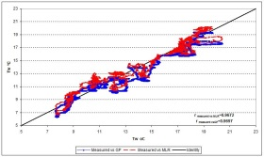
Step 1.
Distributions Generating Validation and Study
Step 2.
Validation Set
Study Set
N
…
Step 3.
Bootstrap Sets
Index | 1 | 2 | 3 | 4
Mean | 31.4 | 39.4 | 52.5 | 57
N
Index | 1 | 2 | 3 | 4
Mean | 32.4 | 40.4 | 52.5 | 60
…
N
…
Step 4.
 | RegCoeff 2.5% | RegCoeff 50% | RegCoeff 97.5% | StdErr
Tr1 | .45 | .49 | .50 | .01
Tr2 | .46 | .50 | .52 | .015
… | … | … | … | …
TrN | .49 | .49 | .51 | .02

