Slide 1
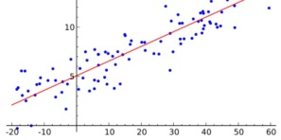
1.
True Base
2.
Validation
Study
N
…
3.
Bootstrap Sets
Index | 1 | 2 | 3 | 4
Mean | 31.4 | 39.4 | 52.5 | 57
N
Index | 1 | 2 | 3 | 4
Mean | 32.4 | 40.4 | 52.5 | 60
…
N
…
4.
 | RegCoeff | StdErr
Tr1 | .45 | .01
Tr2 | .46 | .015
… | … | …
TrN | .49 | .02

