Slide 1
TMEE Console Updates
Reference User Interface changes

Slide 2
Slide Topics
Existing User Interface
User Interface Updates
User Interface Behavior
Discussion/Contact Information

Slide 3
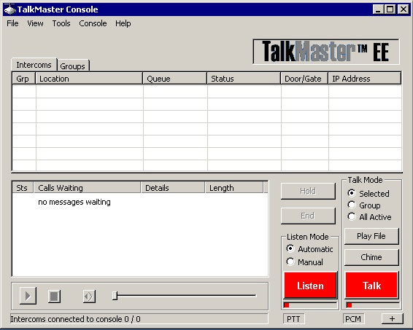
Existing User Interface

Slide 4
Existing User Interface
Note that the current User Interface contains a list of intercoms
The intercoms have a table that displays related information to them

Slide 5
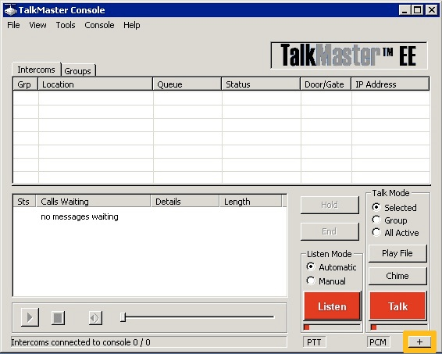
User Interface Updates

Slide 6
User Interface Updates
I’m proposing that we setup a file or some similar mechanism to assign a M-JPEG Camera stream to each intercom
  The user will have the option to expand the window
    the orange box in the previous slide highlights the button that would expand the window

Slide 7
User Interface Behavior
Clicking on the “+” expand button would enlarge the view to show an image that will display the M-JPEG stream of the intercom that is selected in the list
The “+” expand button’s text would change to “-” and would then shrink the view back to it’s original dimensions
  Note the orange box around the button in the next slide

Slide 8
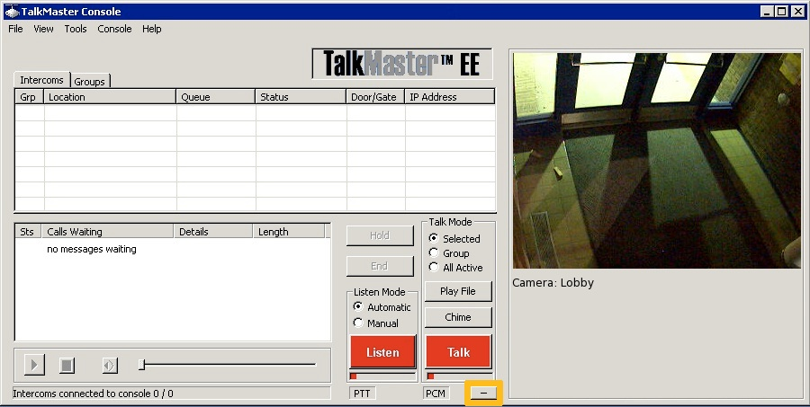
User Interface Behavior

Slide 9
Discussion/Contact Information
I’d like to propose this behavior as the mechanism for linking a camera to an intercom
  I’m still in the process of building this, so I’m open to discussion/debate for the near future
I can be contacted at:
  intere@gmail.com
  (720) 381-2776

